Slide 1

  Standardised Inotrope & Vasopressor Guidelines: Project Background
  December 2018

Slide 2
Learning objectives
To understand why the Critical Care Clinical Network (CCCN) created the Standardised Inotropes & Vasopressor Guidelines
To gain an insight on the current practice variation in centrally administered inotropes and vasopressors in the Victorian ICU/Critical Care setting
To understand how the guidelines got created
To appreciate why the learning package has been included in the state wide bundle

Slide 3
Three phases to project
Phase 1
CCCN identified priorities across the ICU Sector
CCCN scoped the inotrope & vasopressor variation
Phase 2
CCCN created the Inotrope & Vasopressor Guidelines
CCCN identified need for inotropes learning package
Phase 3
Inotrope & Vasopressor Guideline Pilot
State Wide Release (Scaling) of Guidelines
Current phase

Slide 4
Phase 1- CCCN priorities
Inotrope & vasopressor guidelines identified as priority by the sector

Slide 5
Phase 1: Scoping the problem
2014 ANZICS survey of ICU Directors:
80% thought that the standardisation of noradrenaline infusion concentrations was an important patient safety issue
7 different noradrenaline strengths were in use around Australia and New Zealand

Slide 6
Phase 1: Scoping the problem
Variation Found by CCCN (2016):
For 3 vasopressor medications, 11 different infusion concentrations are used
For 6 inotrope medications, 16 different infusion concentrations are used

Slide 7
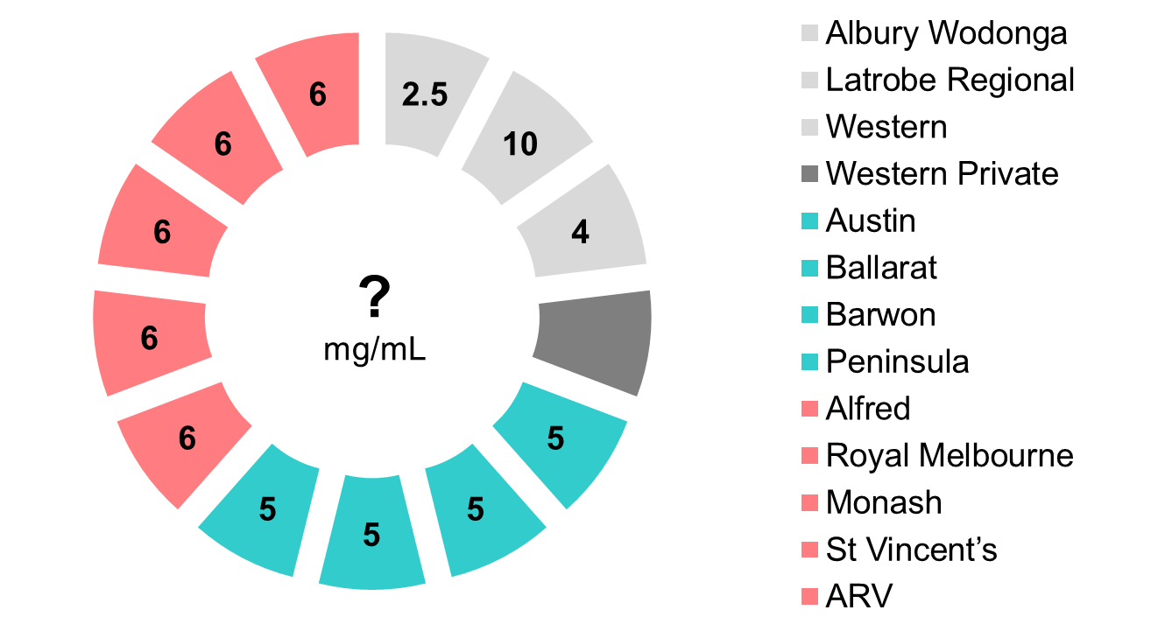
Concentration variation example: Dobutamine

Slide 8
Project Objectives
1. Improve Patient Safety
    Reduce practice variation
    Timely access to protocols
    Up to date guidelines, in accordance with best practice
2. Workforce Benefits
    Support sites without experienced, specialist staff to create guidelines
    Reduce staff training burdens for those who work across multiple sites
    Minimise time and resources required for guideline writing and upkeep
  3. Seamless patient transition

Slide 9
Phase 1: Chosen Medications for Guidelines
Adrenaline
Dobutamine
Milrinone
Noradrenaline
Vasopressin
Metaraminol
Dopamine
Isoprenaline
Levosimendan

Slide 10
Phase 2- Guidelines and learning package
25 member subcommittee of ICU clinicians (lead by Melissa Ankravs- RMH): consisted of medical, nursing and pharmacy
Various working groups within the Phase 2 Subcommittee
Main groups were
    Writing guidelines group: 5 pharmacists from Royal Melbourne Hospital, Alfred Health and Barwon Health
    Inotropes learning package group

Slide 11
Phase 2: Creating the Guidelines
  For each guideline, the pharmacist:
      Completed a literature review
      Consulted standard references
      Reviewed previously submitted guidelines from around the state and Hunter New England Local Health District in NSW
      Used own clinical expertise and consulted with a variety of ICU clinicians

Slide 12
Phase 2: Creating the Guidelines
All guidelines distributed to the
Standardised Guidelines Subcommittee
Subcommittee review
Governance group review
Sign off required from at least 50% of members -
Achieved
Sign off required from at least 75% of members to proceed to Governance Group - Achieved

Slide 13

Phase 2: Inotropes Learning Package
Learning Package Group
Identified there was significant variation in learning packages:
    - Format e.g. lectures, presentations, bed side learning
    - Presence - many health services didn’t have one
  Determined Liverpool NSW ICU Inotropes & Vasopressors Learning package most comprehensive resource available
  CCCN received approval from the package’s author (Ms Sharon Ann Shunker- CNN Liverpool ICU) and the Agency for Clinical Innovation (ACI) to use the resource

Slide 14
Phase 3: Pilot
The guidelines were piloted over a 16 weeks period in 2018 by the following sites:
Adult Retrieval Victoria
Austin Health
Barwon Health
Epworth Eastern
Peninsula Health
South West Healthcare
Werribee Mercy

Slide 15
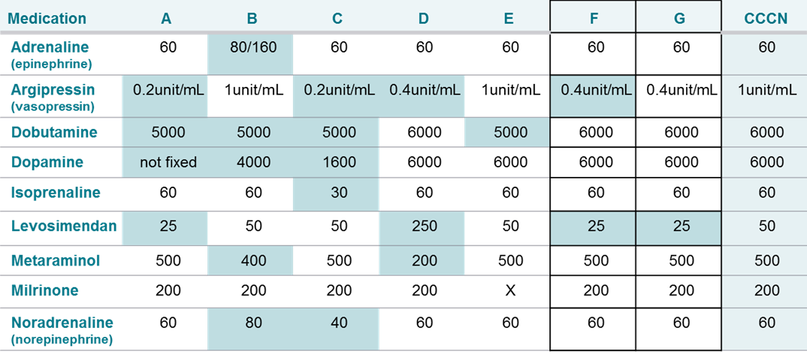
Phase 3: Pilot Pre- Data
Initial pilot site’s infusion concentrations
(microgram/mL unless otherwise specified)

Slide 16
Phase 3: Pilot results summary
7/7 pilot site’s implemented CCCN’s Guidelines into their ICUs/CCUs
    2/7 implemented the guidelines hospital wide
  No adverse events

Slide 17
Phase 3: Learning package update
Feedback received by pilot sites and Phase 3 Subcommittee that the Liverpool NSW ICU Inotropes & Vasopressors Learning package required updates
Subsection of the Phase 3 Subcommittee (Lead by Stephanie Hunter- Eastern Health) updated the learning package based on feedback

Slide 18
Phase 3: State wide release (Scaling)
Due to pilot success, CCCN decided to release the guidelines state wide on December 6 2018
The guidelines were going to be released on the SCV website as part of a bundle. The bundle would include:
The Inotrope & Vasopressor Guidelines
Change Package
Inotropes Learning Package

