Slide 1
Victoria’s mothers, babies and children 2019
Trends and recommendations

Slide 2
About CCOPMM

Slide 3
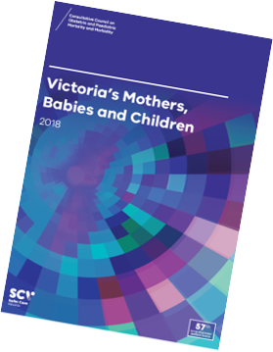
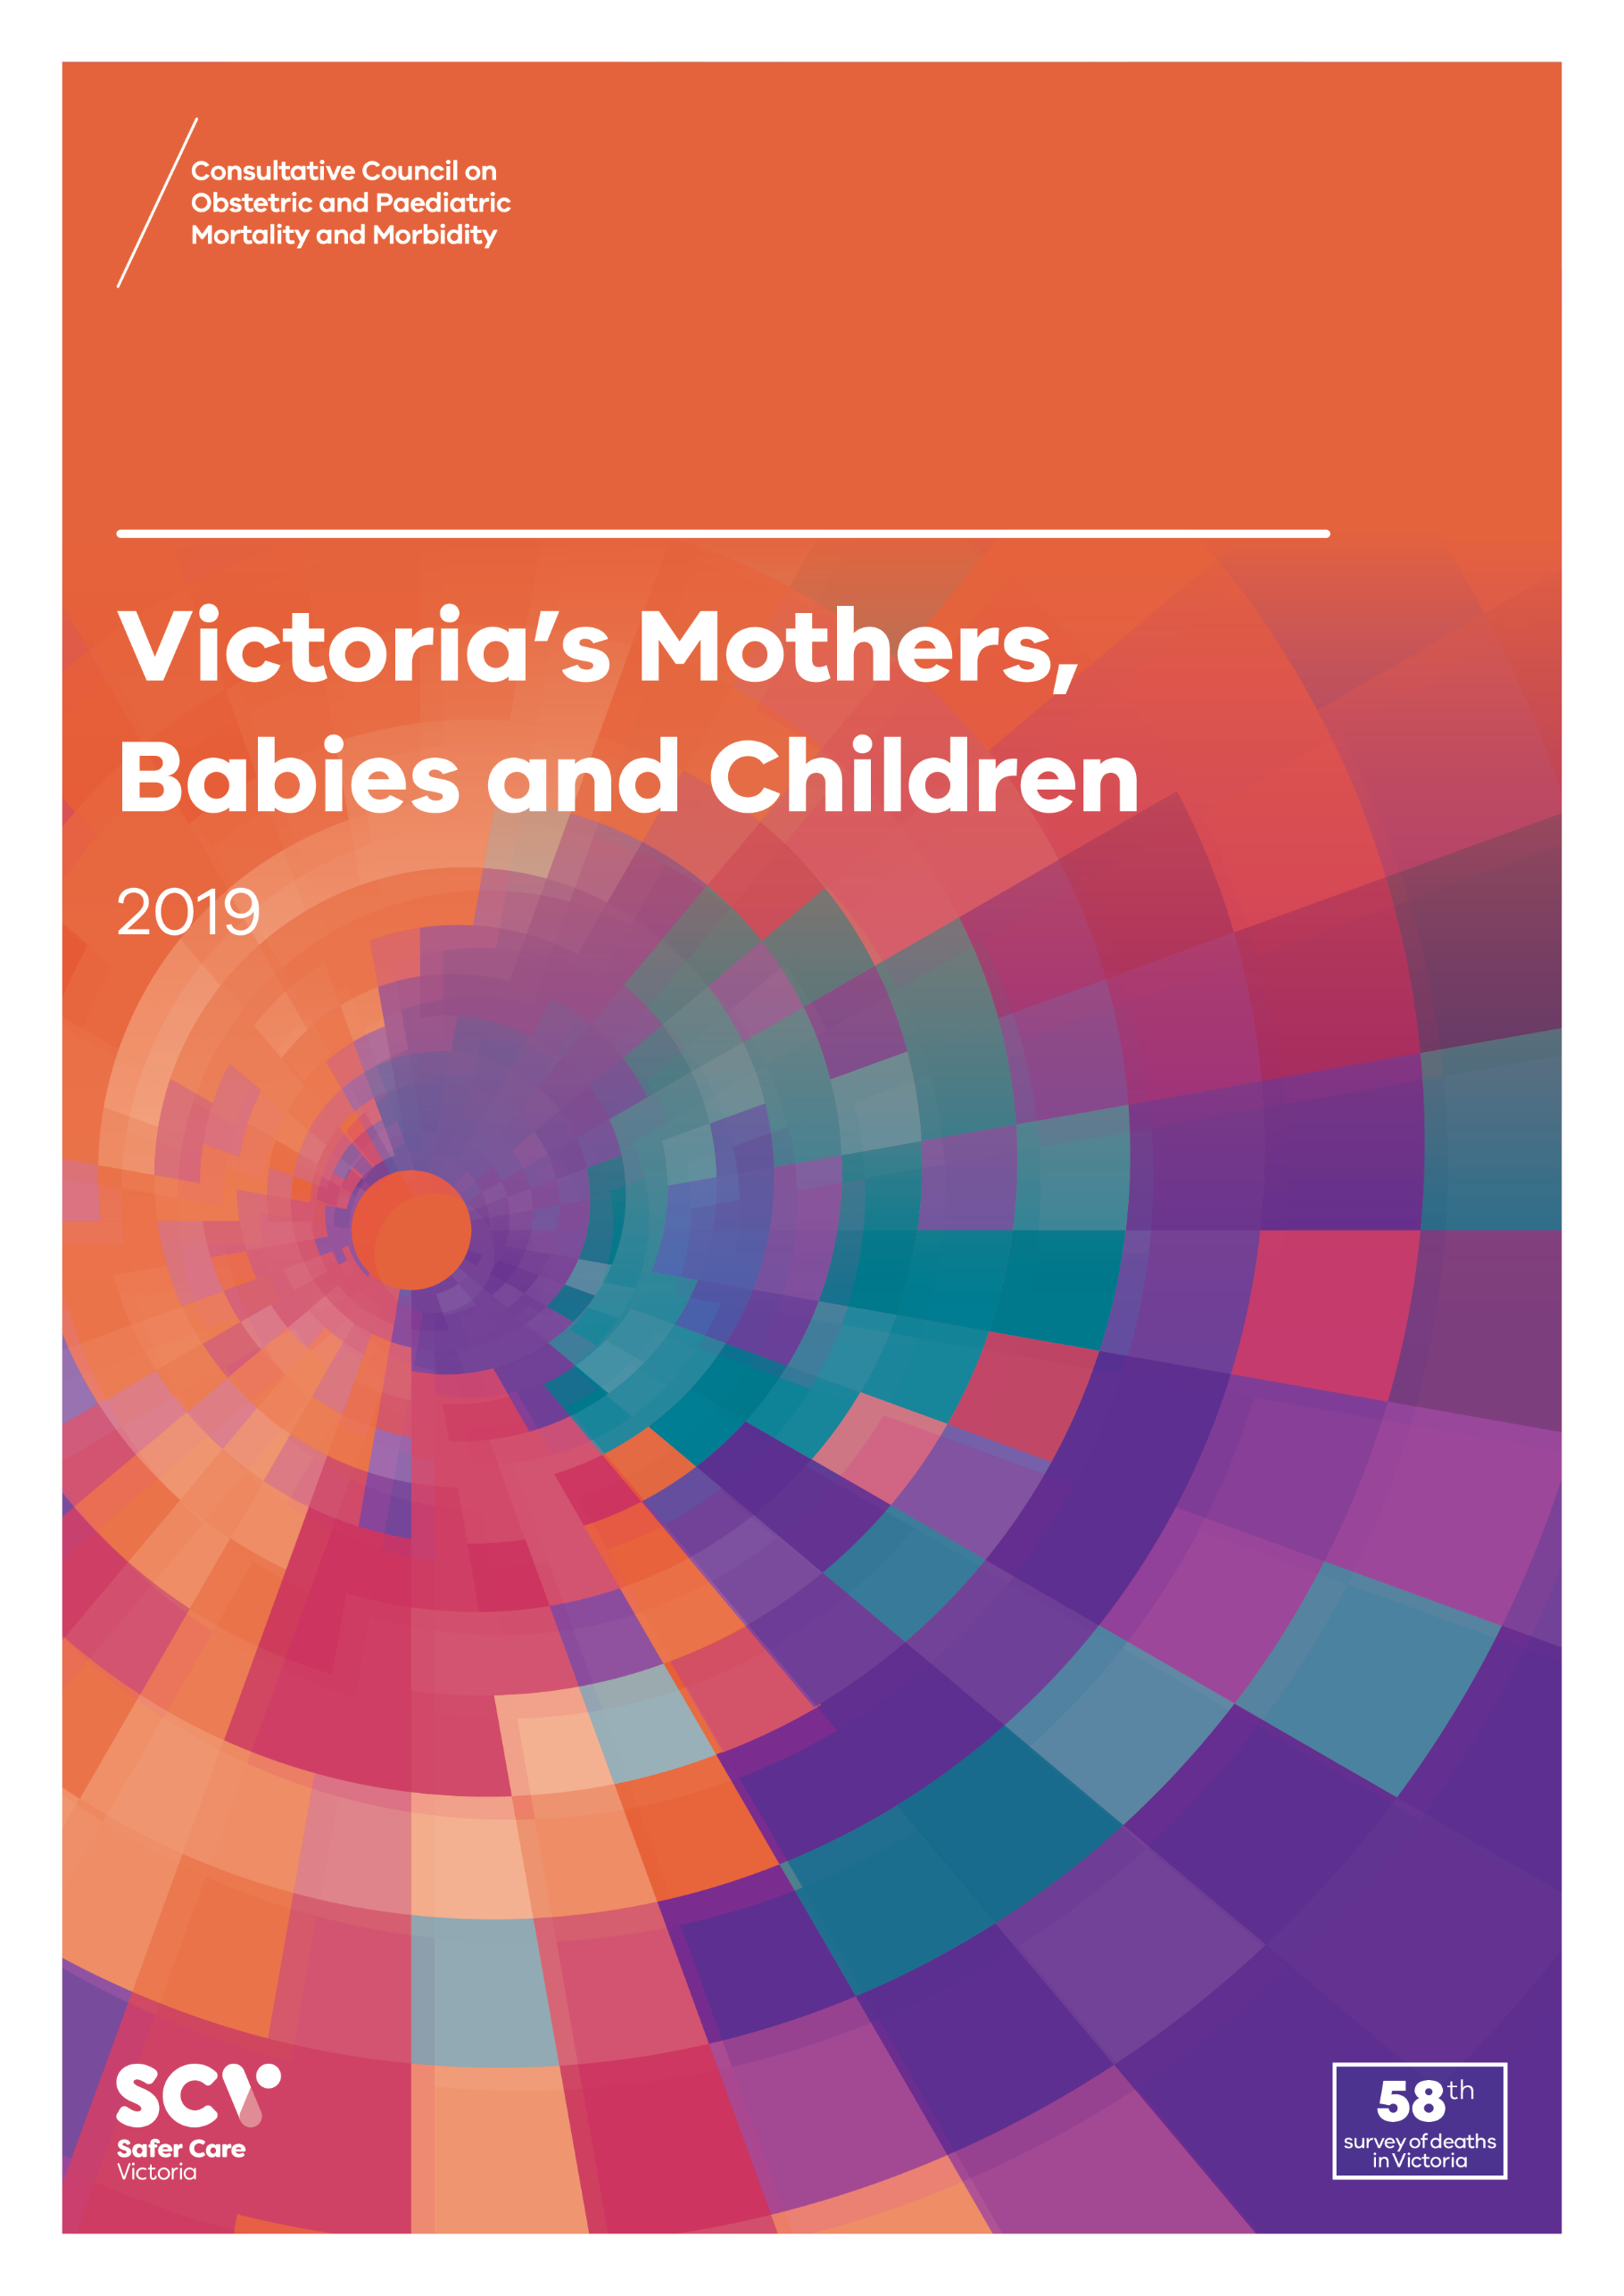
About CCOPMM
The Consultative Council on Obstetric and Paediatric Mortality and Morbidity (CCOPMM) is a statutory authority appointed by the Minister for Health
Chair: Adjunct Professor Tanya Farrell
Operates under the Public Health and Wellbeing Act 2008

Slide 4
About CCOPMM
Legislative responsibility for data collection
Victorian Perinatal Data Collection (VPDC)
Victorian Congenital anomalies register (VCAR)
Legislative responsibility for health surveillance
Mortality collections and review of perinatal, child and adolescent, and maternal mortality
Morbidity collections: severe acute maternal morbidity (SAMM)

Slide 5
Undertaking case reviews
Four subcommittees report to CCOPMM:
Stillbirth – Chair: Professor Susan McDonald
Neonatal Mortality and Morbidity (0-27 days) – Chair: Professor Rod Hunt
Maternal Mortality and Morbidity – Chair: Professor Mark Umstad
Child and Adolescent Mortality and Morbidity (28 days-17 years) – Chair: Professor Paul Monagle

Slide 6
Undertaking research
CCOPMM conducts research itself and also provides data for research purposes
CCOPMM identifies research priorities by:
analysis of our reports, data and through case reviews
collaborating with external research projects

Slide 7
Why do we do what we do?
Independent oversight of all deaths and severe maternal morbidity
Highlight areas that require improvement – hospital and community
Highlight areas for further research
Inform the development of policies and guidelines
Provide advice on areas for prioritisation and investment

Slide 8
Trends and comparisons: 2019

Slide 9
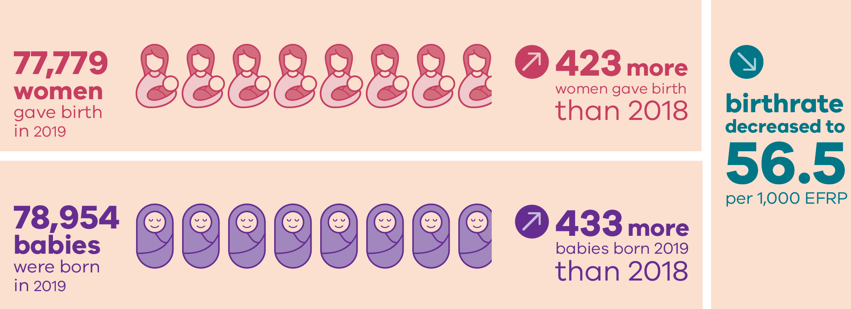
Births in 2019

Slide 10
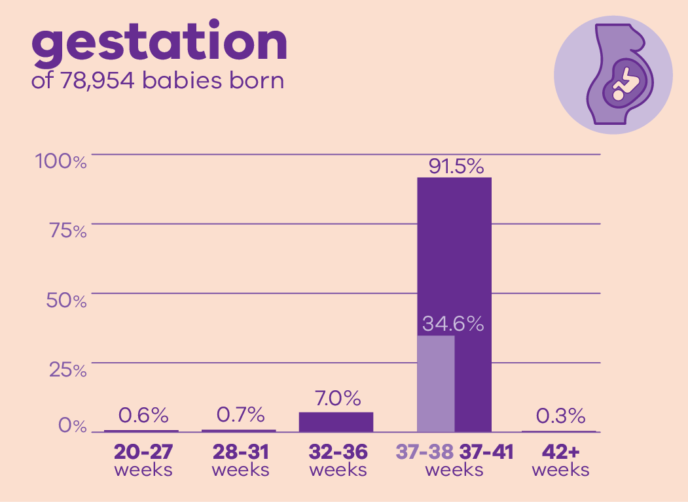
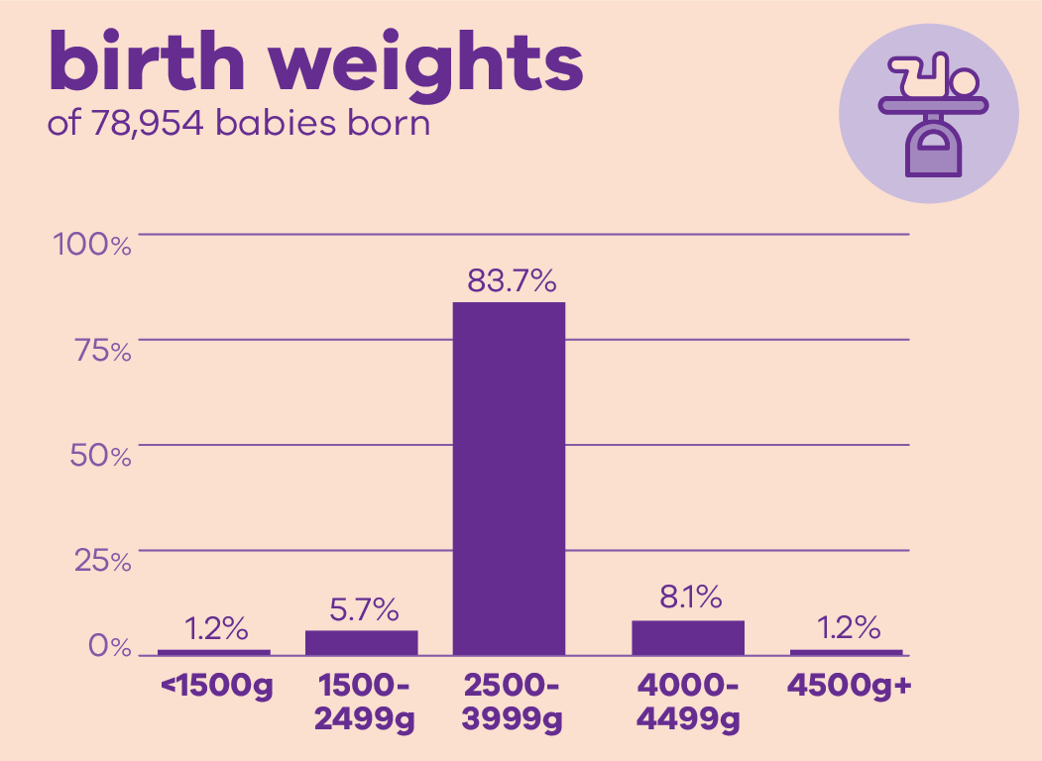
Babies in 2019

Slide 11
Aboriginal mothers and babies in 2019

Slide 12
Trends and comparisons: Perinatal mortality

Slide 13
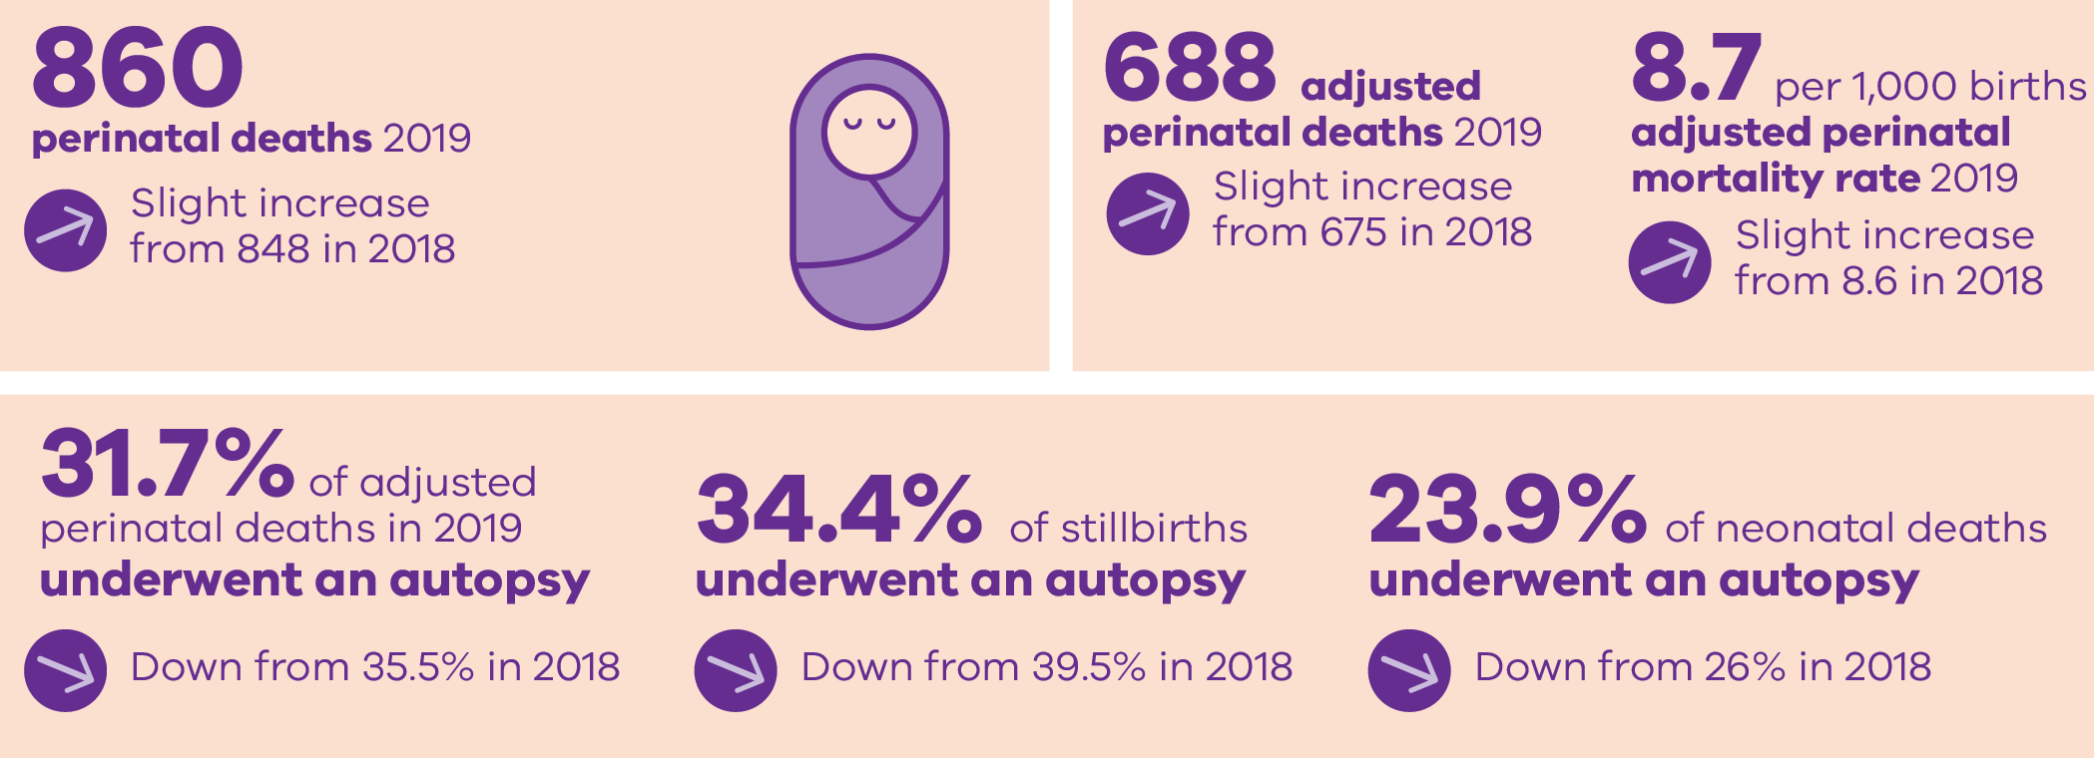
Perinatal deaths in 2019

Slide 14
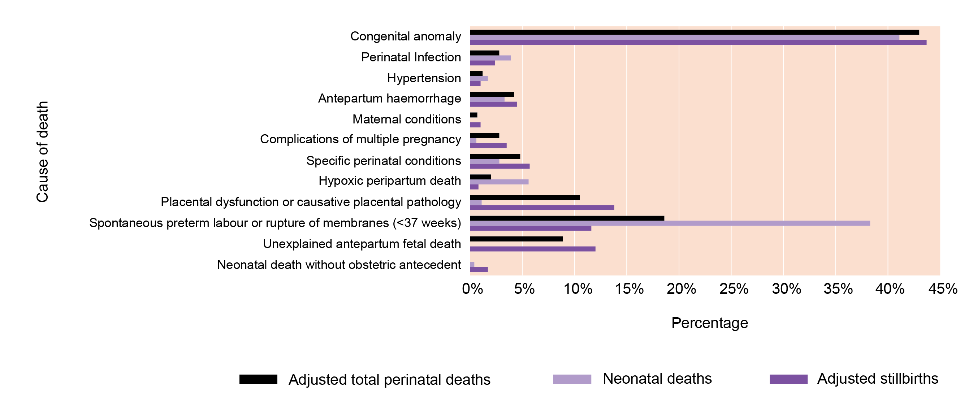
Causes of deaths using PSANZ classifications

Slide 15
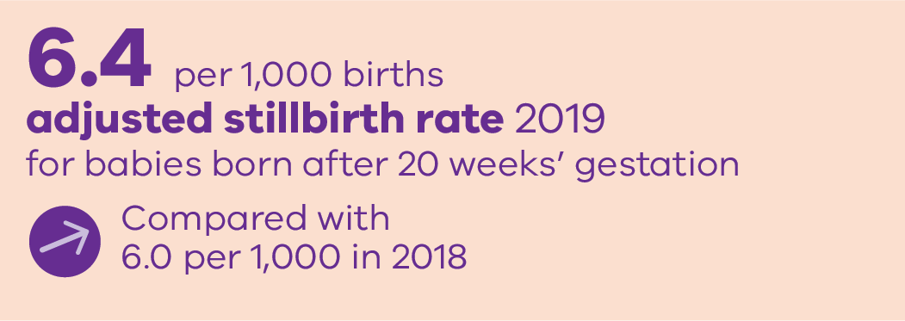
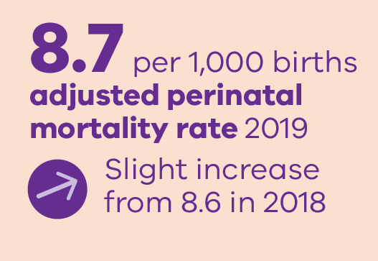
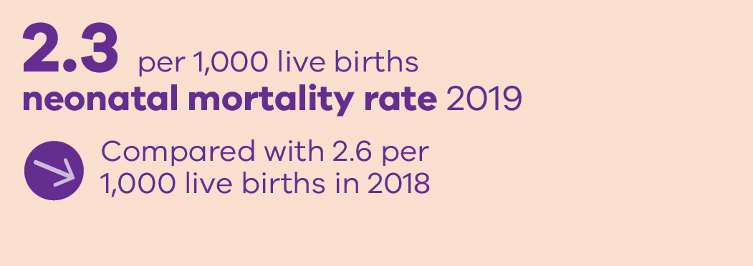
Perinatal mortality rates in 2019

Slide 16
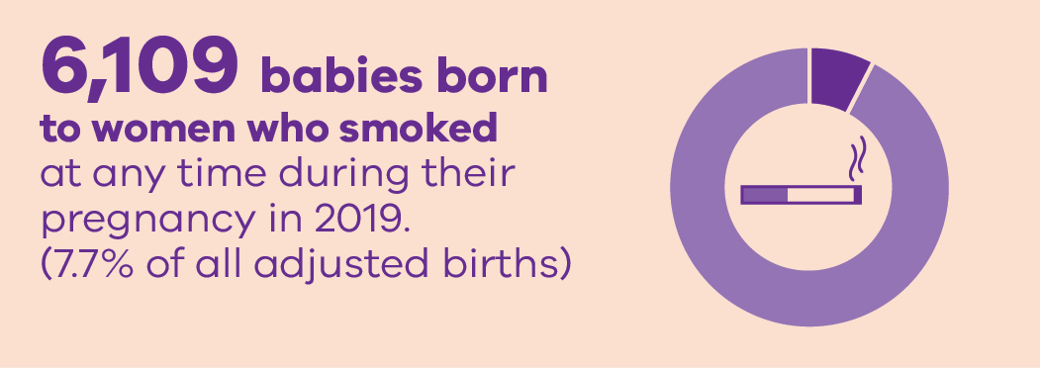
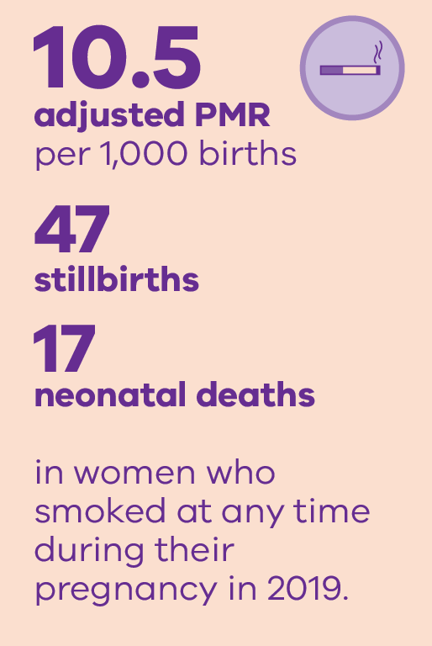
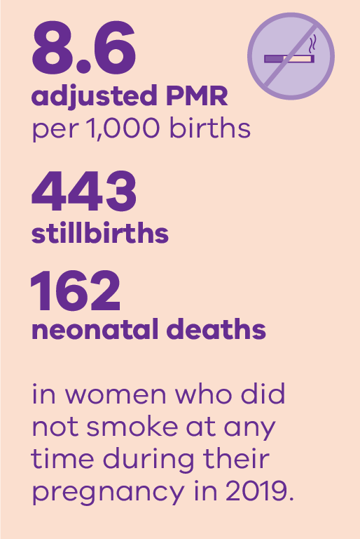
Smoking and outcomes in 2019

Slide 17
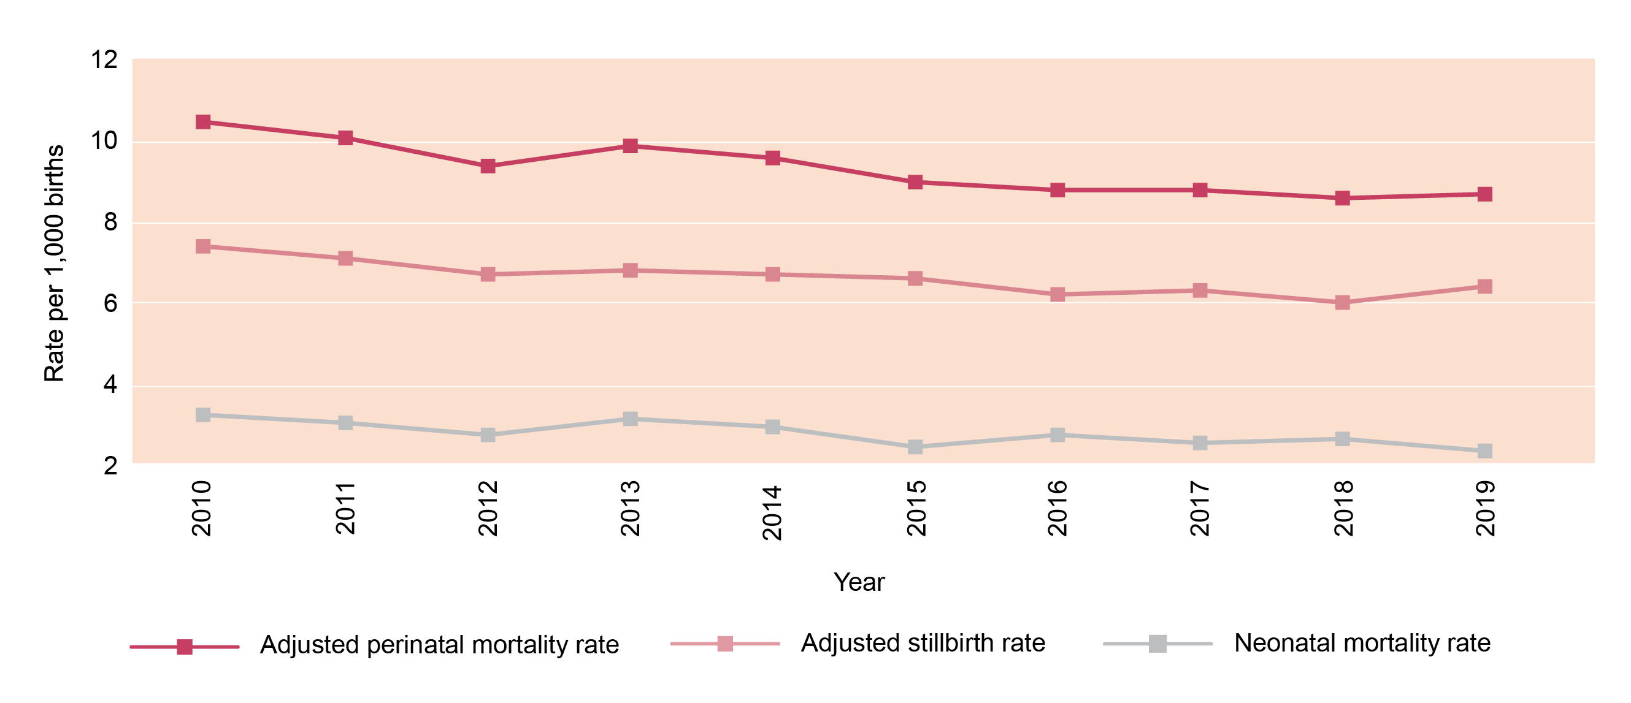
Trends in perinatal mortality rates

Slide 18
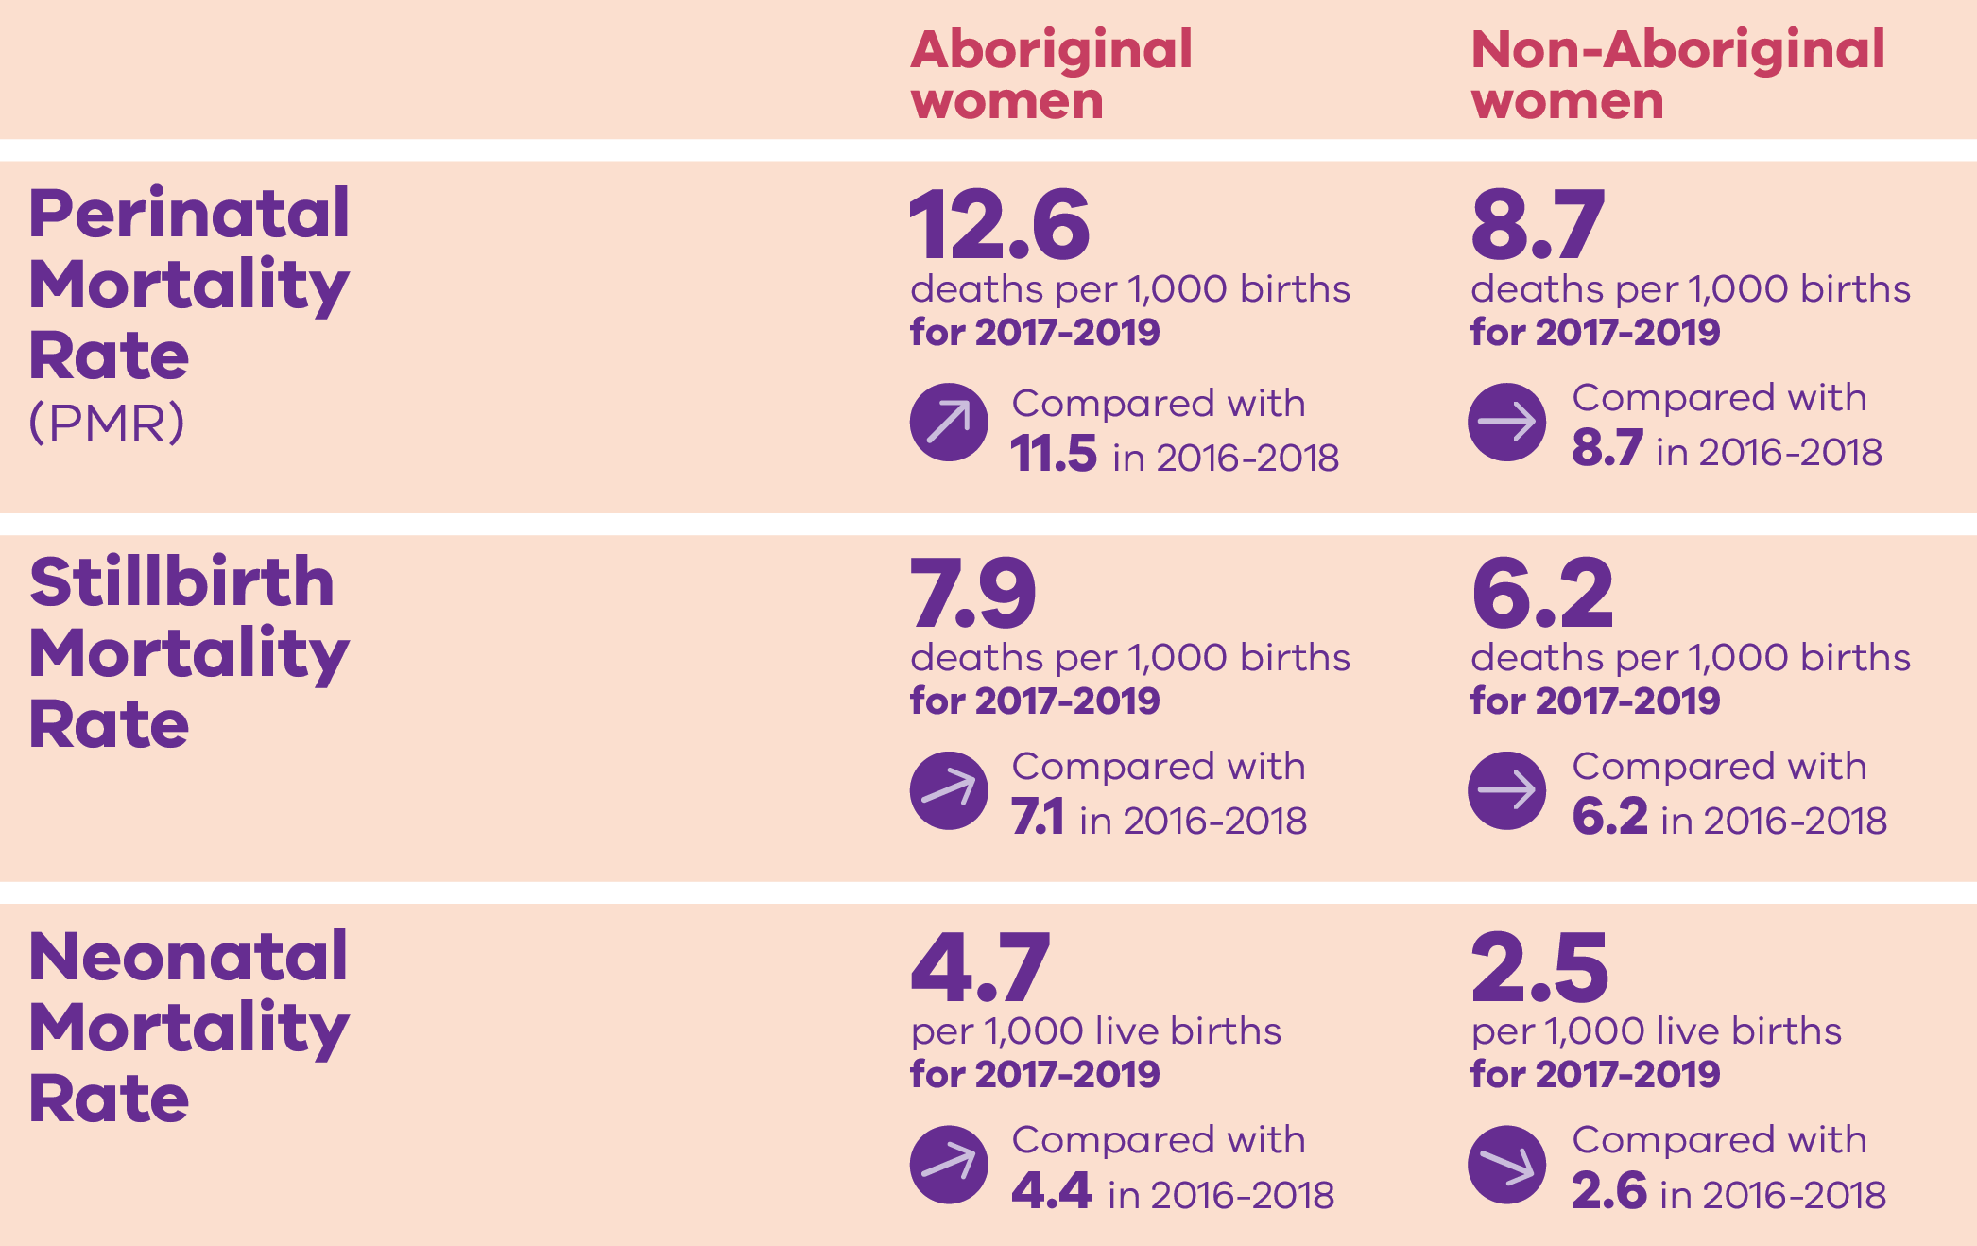
The gap: Aboriginal and Non-Aboriginal women

Slide 19
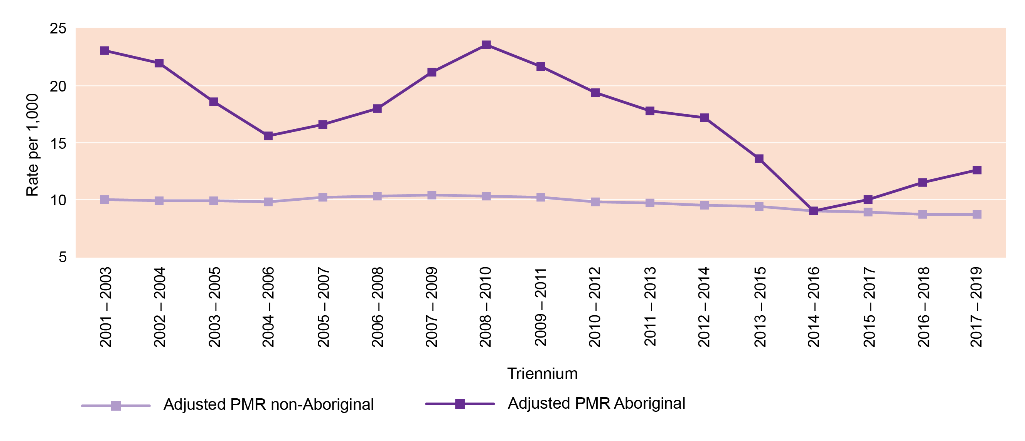
Perinatal mortality rate by Aboriginal status – rolling triennia

Slide 20
Trends and comparisons: Maternal mortality and morbidity

Slide 21
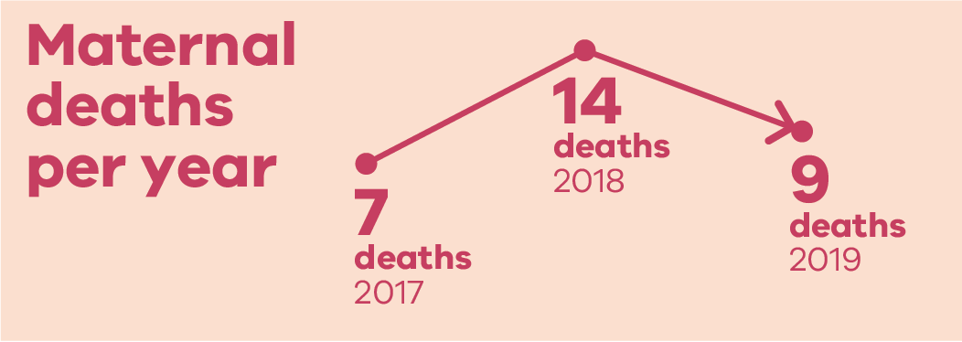
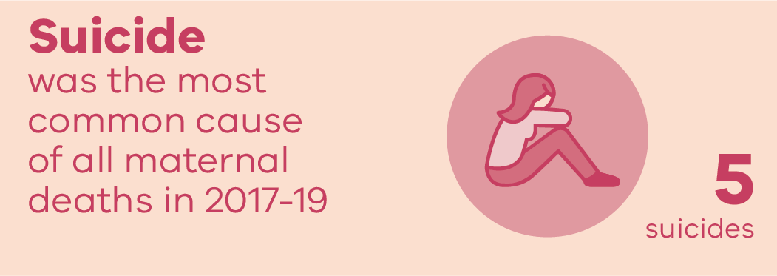
Maternal mortality: 2017 to 2019
Note: this version of the slide was republished in May 2021

Slide 22
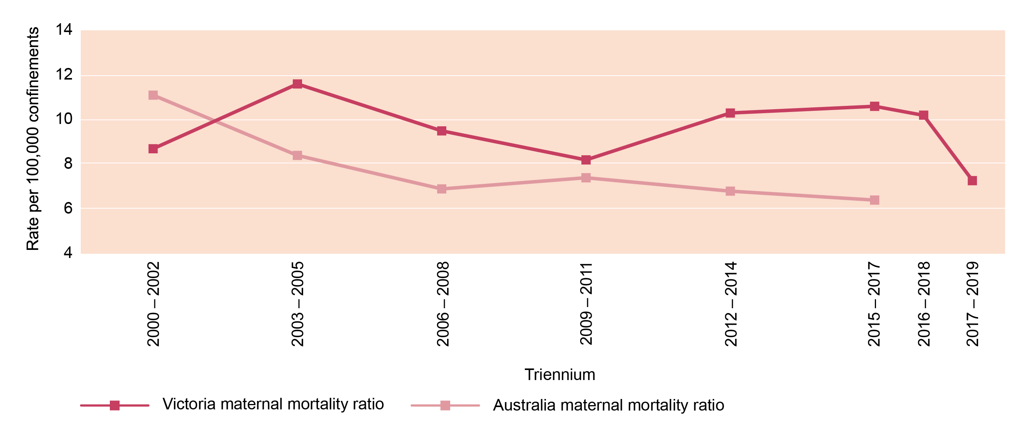
Maternal mortality ratios: Rolling triennia
Note: The methodology for classifications has been updated for the 2017-19 triennium in line with national definitions (AIHW). Comparisons with previous triennia should be made with caution.

Slide 23
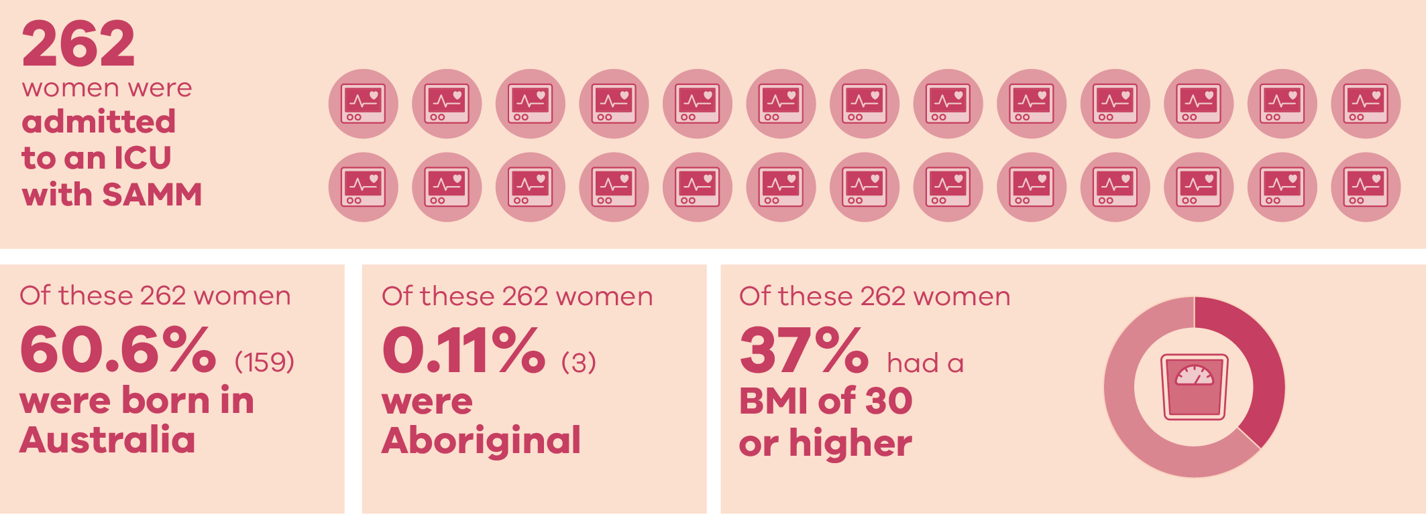
Severe Acute Maternal Morbidity (SAMM)

Slide 24
Trends and comparisons: Child and adolescent mortality

Slide 25
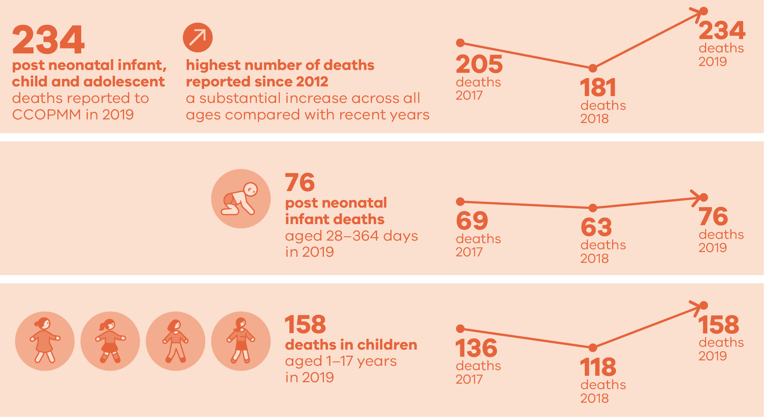
Child and adolescent deaths in 2019

Slide 26
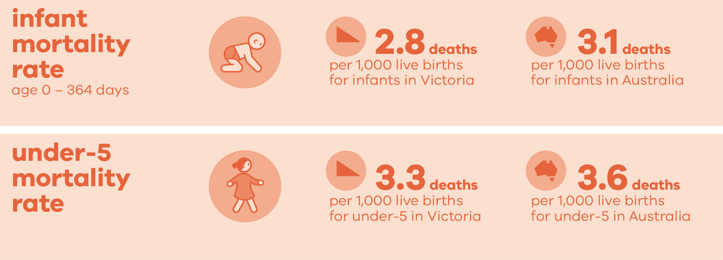
Infant and under 5 mortality

Slide 27
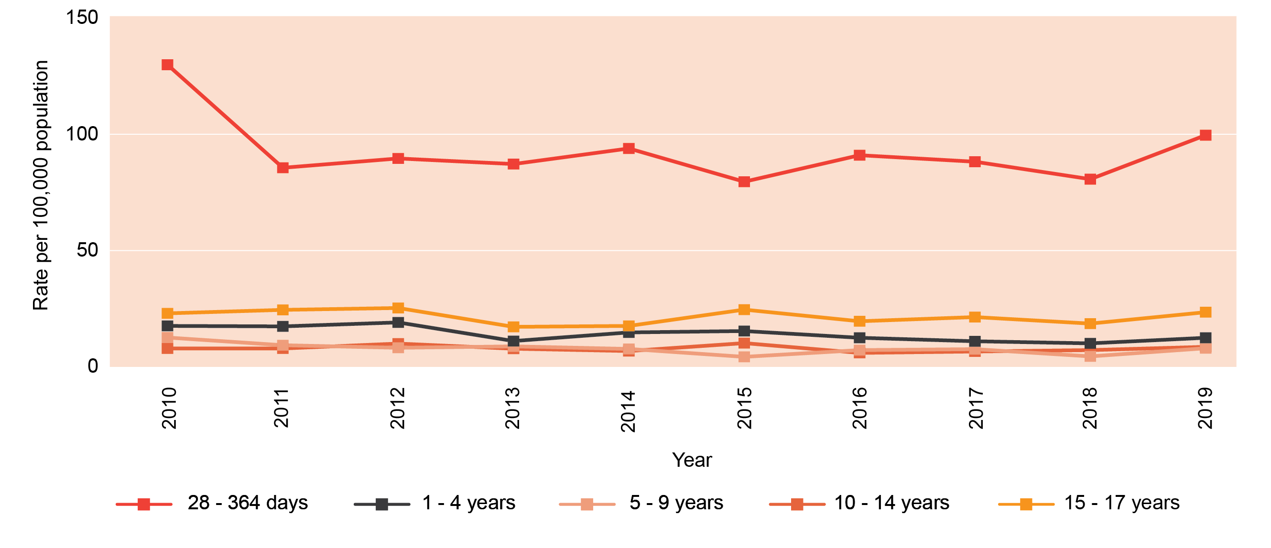
Rates of death by age group

Slide 28
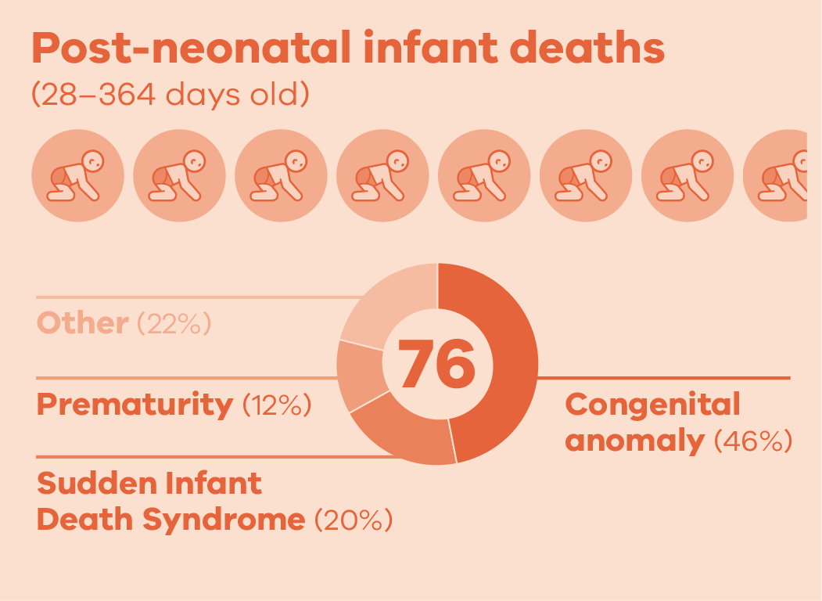
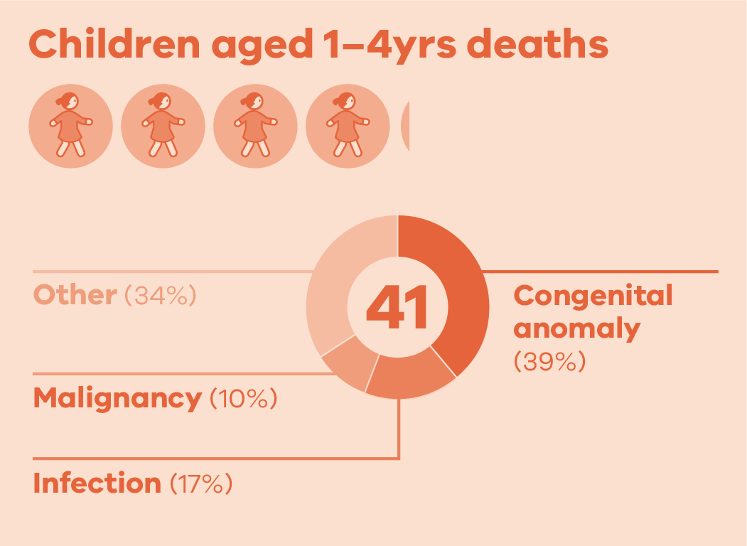
Causes of death in 2019

Slide 29
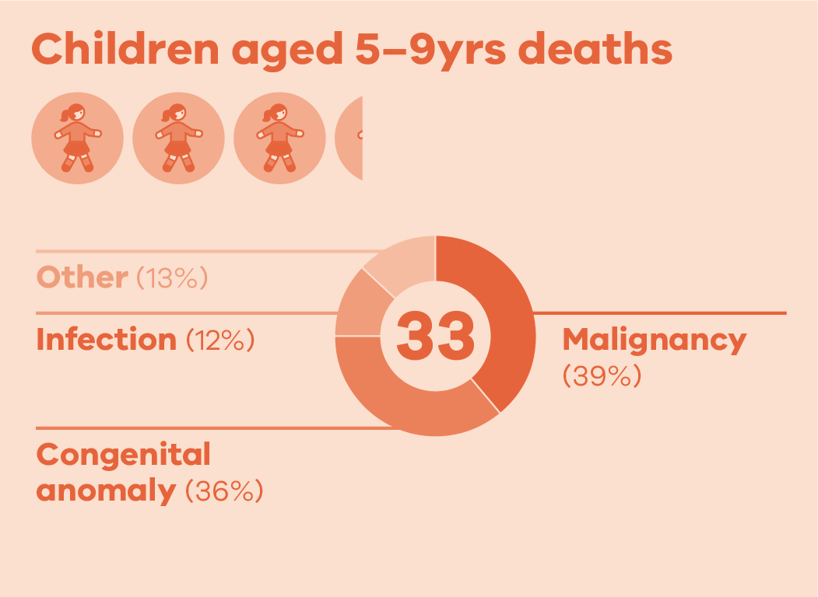
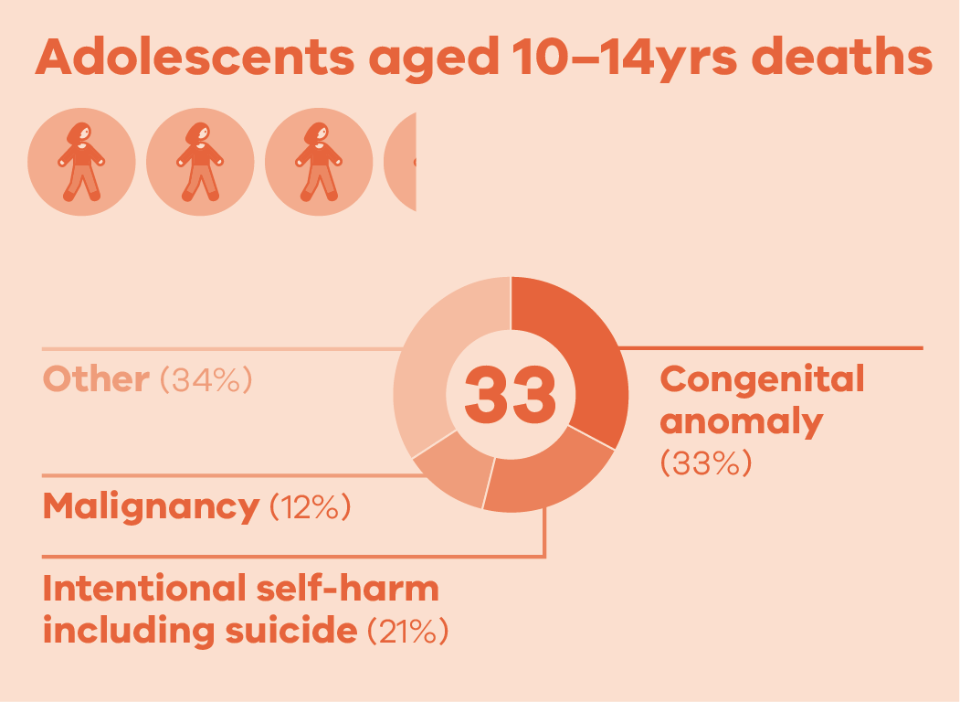
Causes of death in 2019

Slide 30
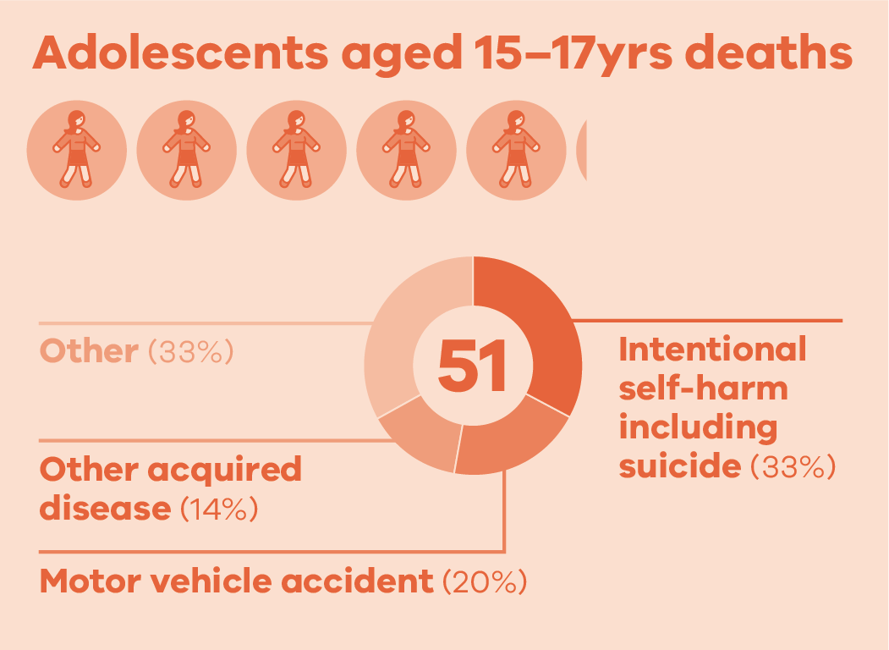
Causes of death in 2019

Slide 31
CCOPMM recommendations: 2019

Slide 32
Recommendation – 1
a) Maternity services must develop and regularly audit a pathway that facilitates rapid access to an emergency operating theatre 24/7 to prevent significant maternal or perinatal morbidity or mortality
b) For all Category 1 caesarean sections, services must record the time in which the decision was made to perform the caesarean section – to enable the accurate recording of the time taken from the ‘decision to deliver’ to the birth of the baby.

Slide 33
Recommendation – 2 & 3
Develop and implement a formal time out process prior to every instrumental birth and emergency caesarean section, whether in a birth room or in the operating theatre, to improve situational awareness and decision making about whether it is the right mode of birth, in the right location, with the right instrument/s, and the right clinical team in attendance
Develop and implement a credentialing process for medical staff practising obstetrics at all levels of training and experience who are undertaking instrumental births and complex caesarean sections

Slide 34
Recommendation – 4
Formalise pathways for women to have timely access to specialist clinical consultations from a named tertiary (level 6) service for secondary and primary maternity services

Slide 35
Recommendation – 5 and 6
Develop and implement a system-wide improvement program to prevent women experiencing postpartum haemorrhage (PPH)
Evaluate the effectiveness of current services in meeting the specific needs of women during pregnancy and in the year following birth. If gaps are identified, implement strategies to improve the health and wellbeing of women and families. The areas of mental health and family violence require specific focused attention

Slide 36
Recommendation – 7
Reform of statewide services is needed to ensure there is a coordinated and timely system response that supports the health and wellbeing of Victorian children in vulnerable situations

Slide 37
Recommendation – 8 and 9
Develop and roll out an annual public health campaign on the importance of influenza vaccination for children using co-design principles with families and their communities
Ensure all children have easy access to free influenza vaccination annually

Slide 38
Recommendation – 10
Develop and implement a public information campaign regarding the dangers for children on farms, using co-design principles with families and their communities, in conjunction with organisations such as WorkSafe Victoria and the Victorian Farmers Federation

Slide 39
For more information
www.bettersafercare.vic.gov.au/publications/victorias-mothers-babies-and-children-2019
Refer to CCOPMM’s other slide packs on:
Mothers and babies
Maternal mortality and morbidity
Perinatal mortality
Child and adolescent mortality

Slide 40
Connect with us
www.bettersafercare.vic.gov.au
tanya.farrell@safercare.vic.gov.au
@safercarevic @TanyaFarrell13
Safer Care Victoria

