Slide 1
Victoria’s mothers, babies and children 2019
Child and adolescent mortality

Slide 2
About CCOPMM

Slide 3
About CCOPMM
The Consultative Council on Obstetric and Paediatric Mortality and Morbidity (CCOPMM) is a statutory authority appointed by the Minister for Health
Chair: Adjunct Professor Tanya Farrell
Operates under the Public Health and Wellbeing Act 2008

Slide 4
About CCOPMM
Legislative responsibility for data collection
Victorian Perinatal Data Collection (VPDC)
Victorian Congenital anomalies register (VCAR)
Legislative responsibility for health surveillance
Mortality collections and review of perinatal, child and adolescent, and maternal mortality
Morbidity collections: severe acute maternal morbidity (SAMM)

Slide 5
Undertaking case reviews
Four subcommittees report to CCOPMM:
Stillbirth – Chair: Professor Susan McDonald
Neonatal Mortality and Morbidity (0-27 days) – Chair: Professor Rod Hunt
Maternal Mortality and Morbidity – Chair: Professor Mark Umstad
Child and Adolescent Mortality and Morbidity (28 days-17 years) – Chair: Professor Paul Monagle

Slide 6
Undertaking research
CCOPMM conducts research itself and also provides data for research purposes
CCOPMM identifies research priorities by:
analysis of our reports, data and through case reviews
collaborating with external research projects

Slide 7
Why do we do what we do?
Independent oversight of all deaths and severe maternal morbidity
Highlight areas that require improvement – hospital and community
Highlight areas for further research
Inform the development of policies and guidelines
Provide advice on areas for prioritisation and investment

Slide 8
Trends and comparisons

Slide 9
Child and adolescent mortality
Includes deaths for post-neonatal infants, children and adolescents.
Post-neonatal infants are aged between 28 and 364 days.
Children and adolescents are aged between one year and up to, but not including, the 18th birthday (one to 17 years).

Slide 10
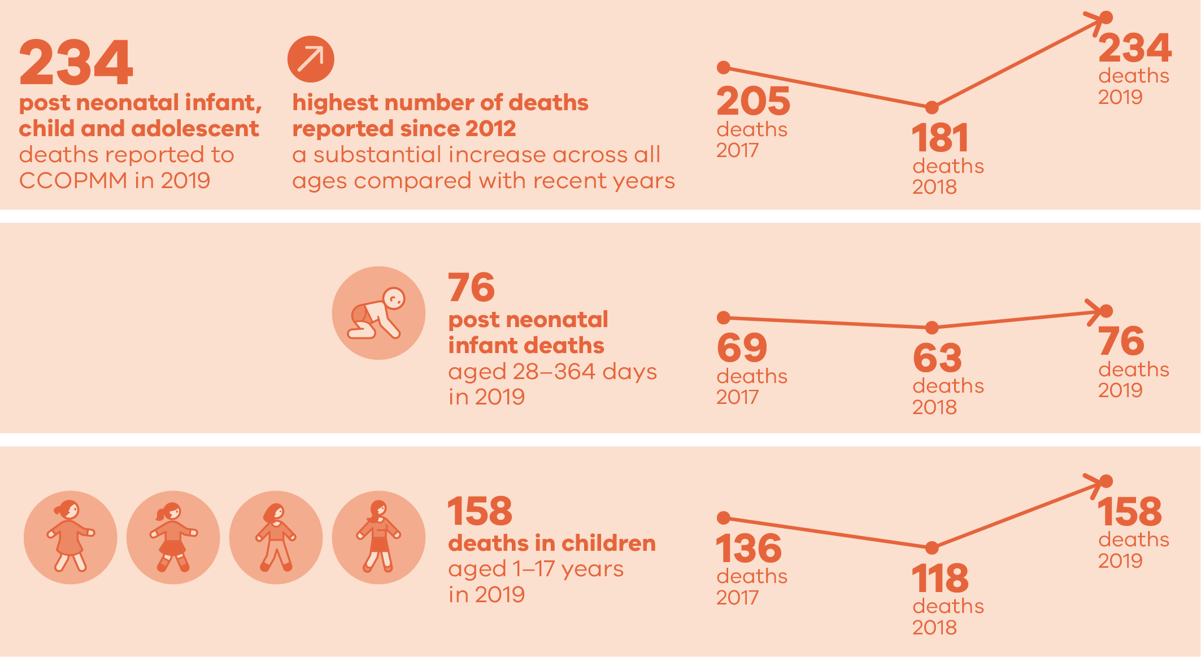
Child and adolescent deaths 2019

Slide 11
Infant and under 5 definitions
Neonatal includes all live born babies from birth to 27 days
Post-neonatal infant includes all live born babies from 28 days to 364 days
Infant includes all live born babies from birth to 364 days
Under 5 includes all babies from birth up to but not including the 5th birthday

Slide 12
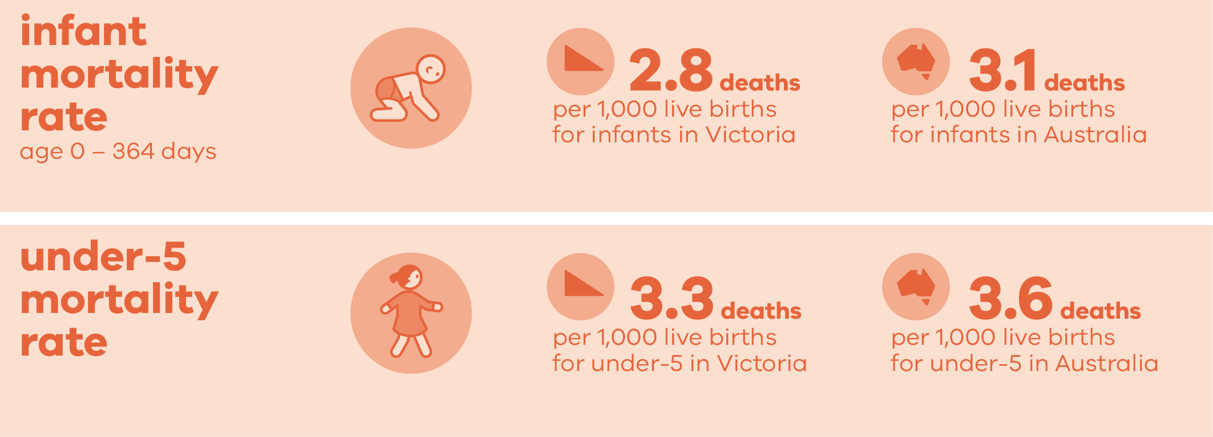
Infant and under 5 mortality

Slide 13
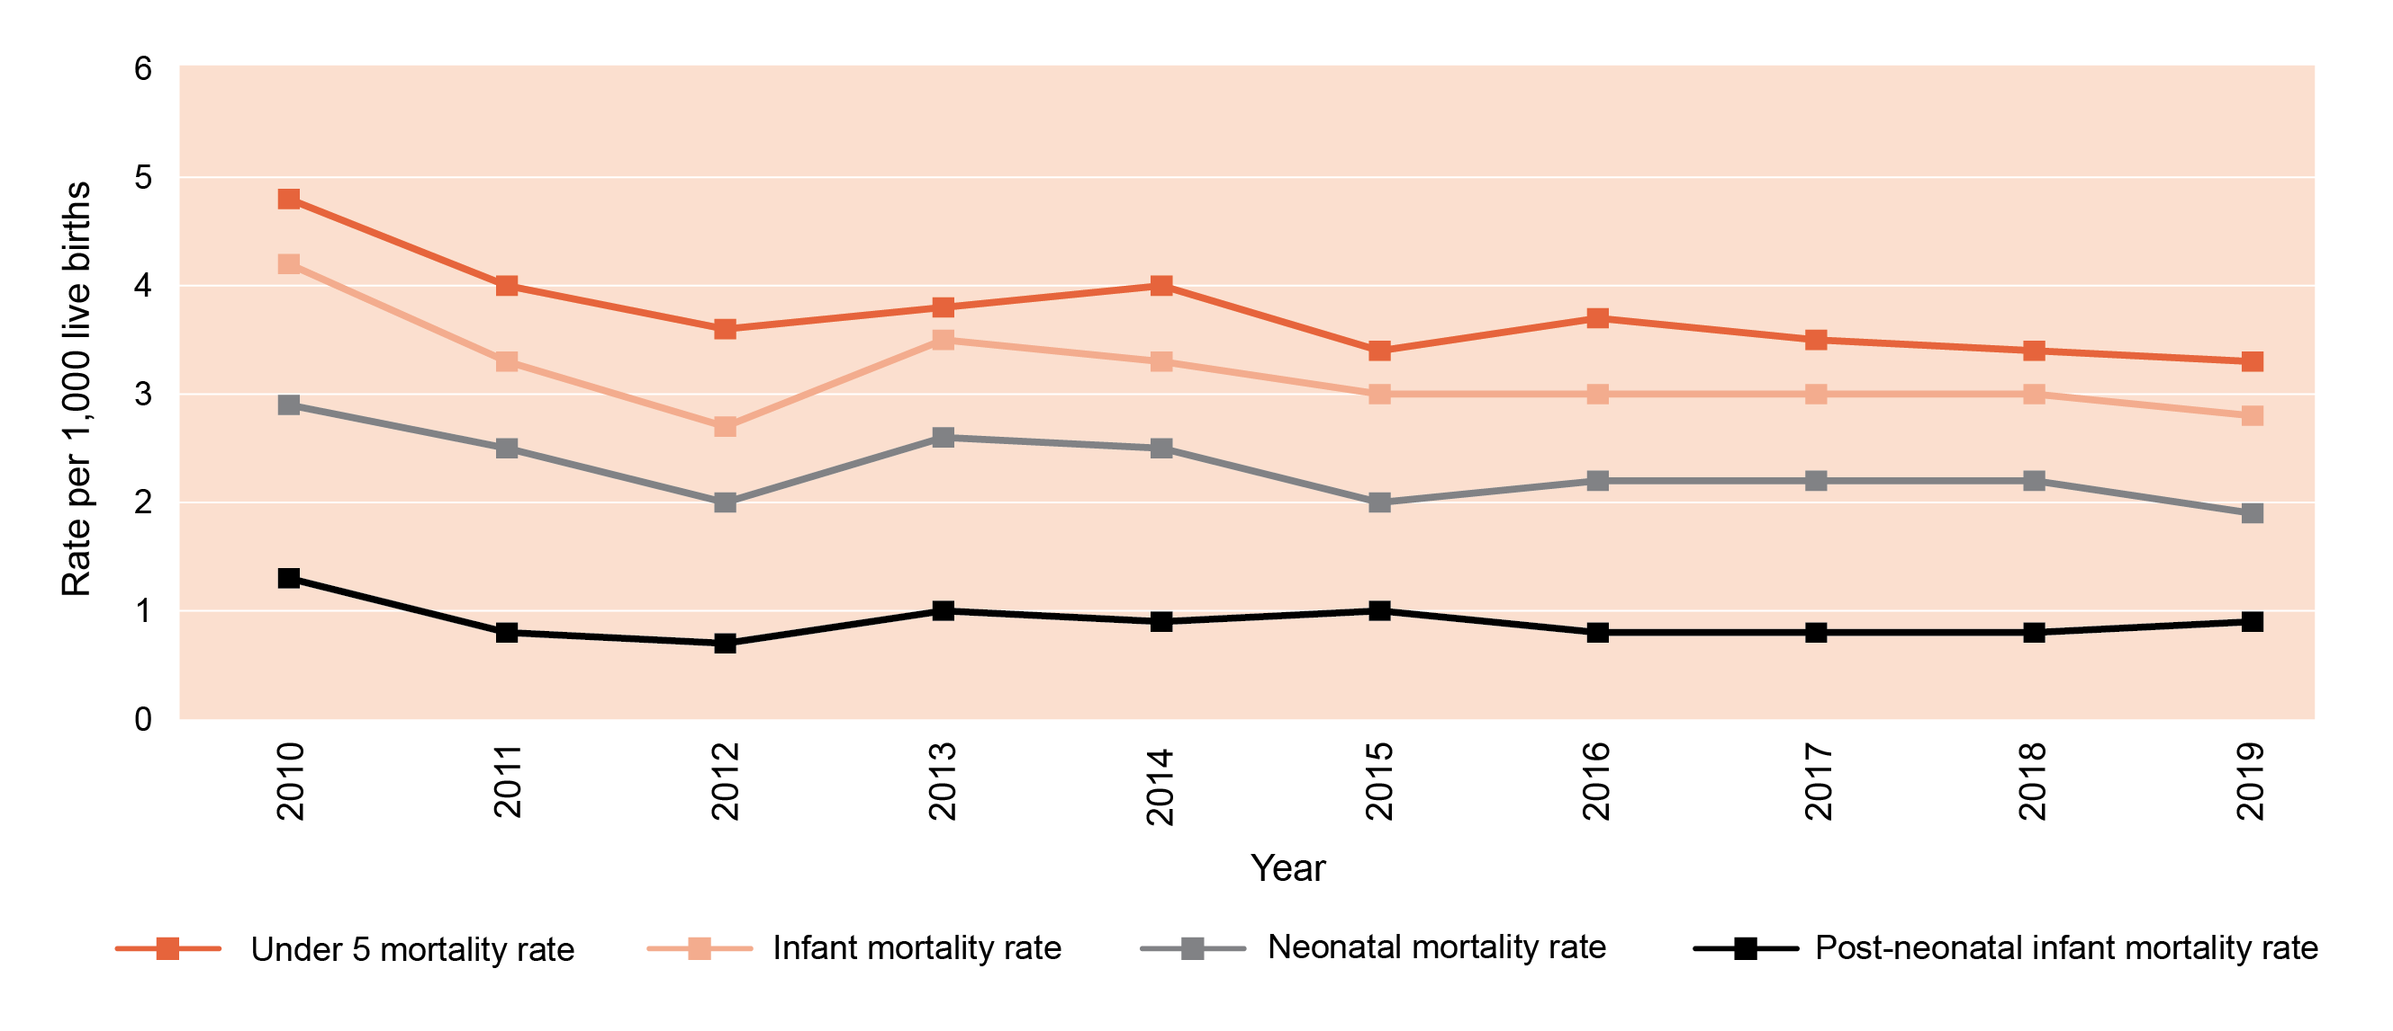
Mortality rates: 0 to 4 years

Slide 14
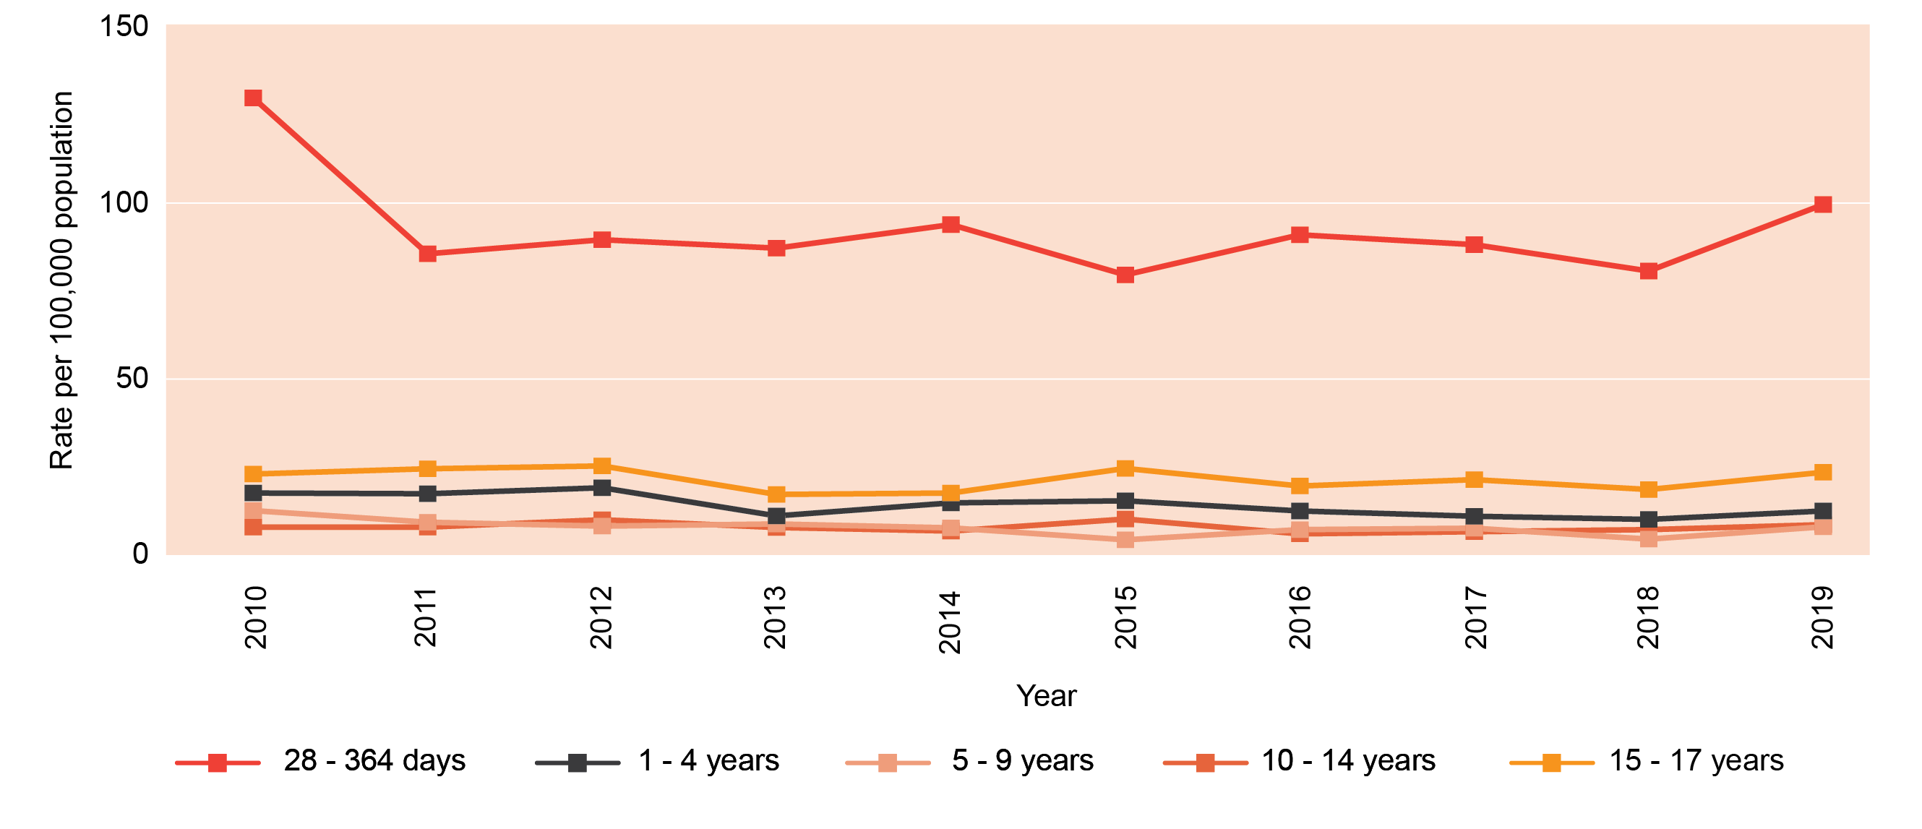
Rates of death by age group

Slide 15
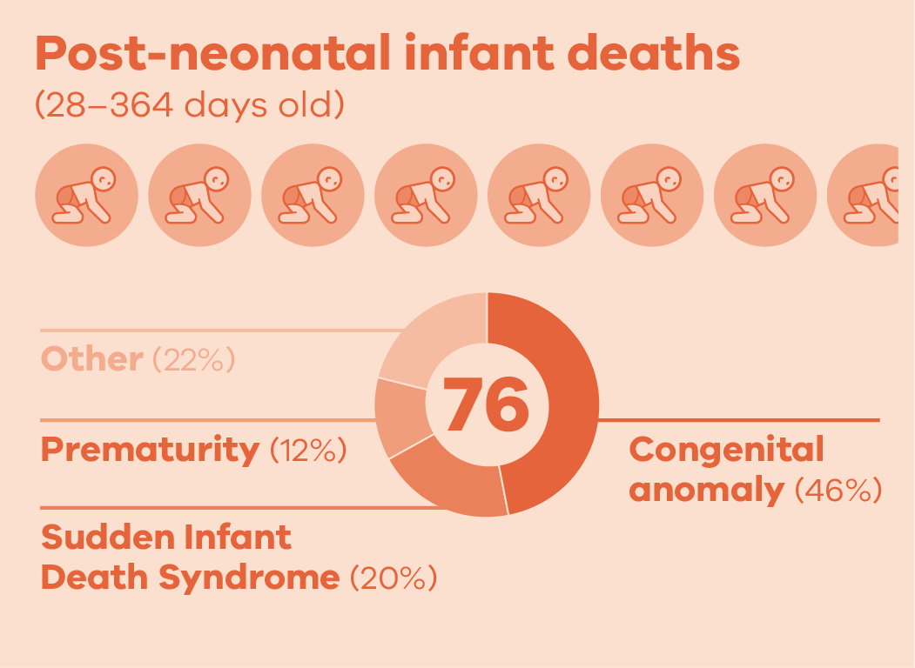
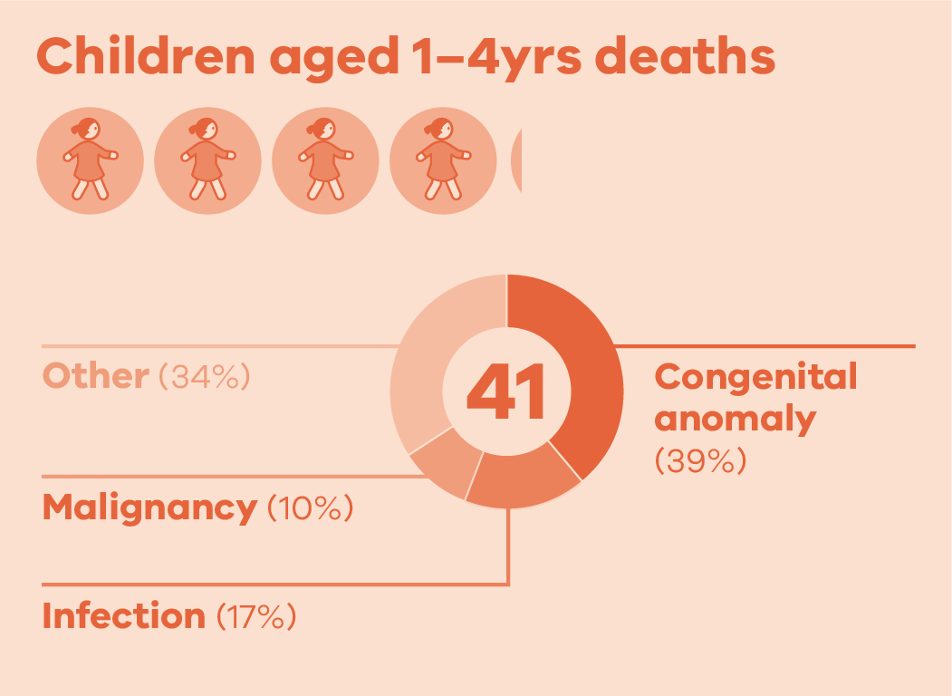
Causes of death in 2019

Slide 16
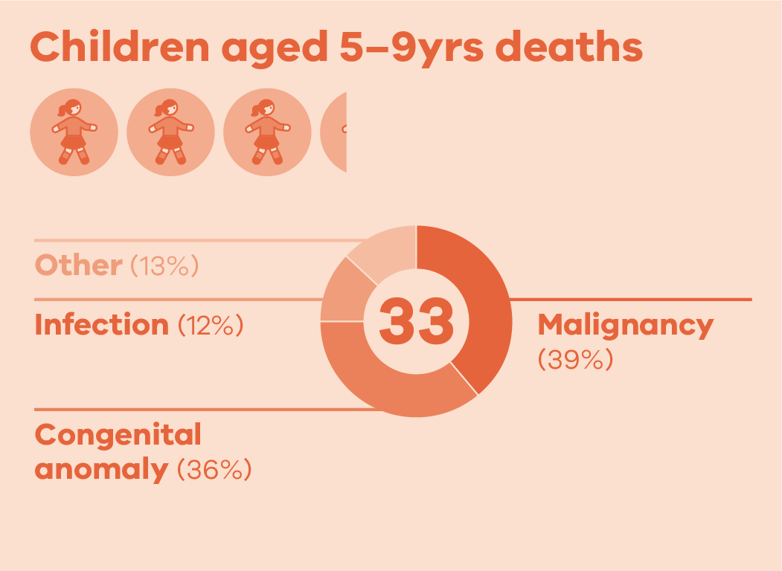
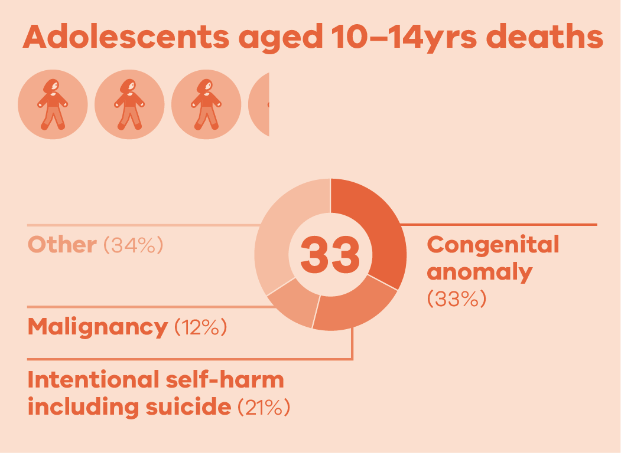
Causes of death in 2019

Slide 17
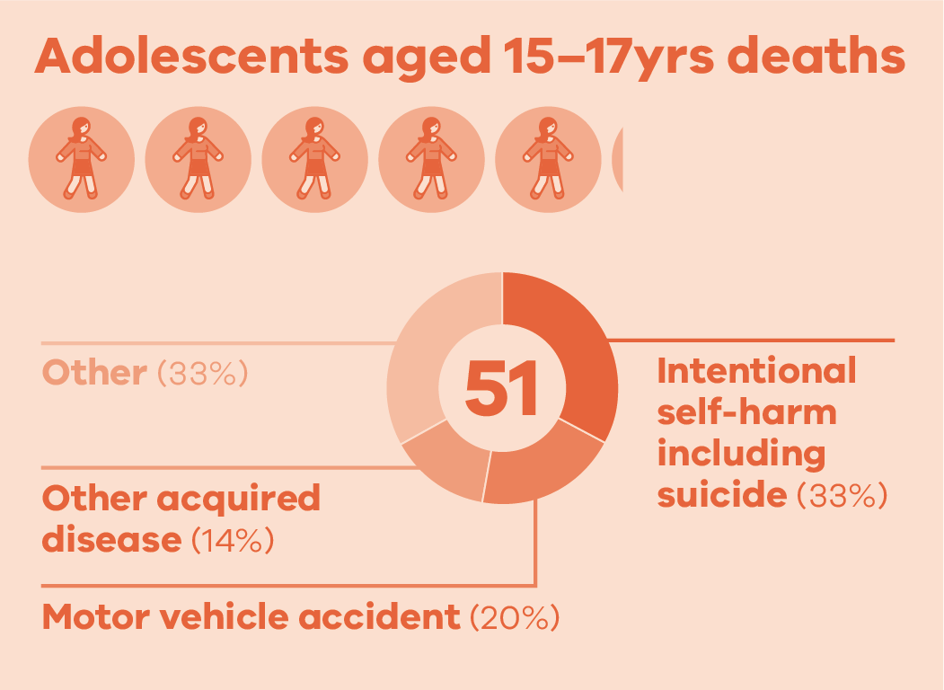
Causes of death in 2019

Slide 18
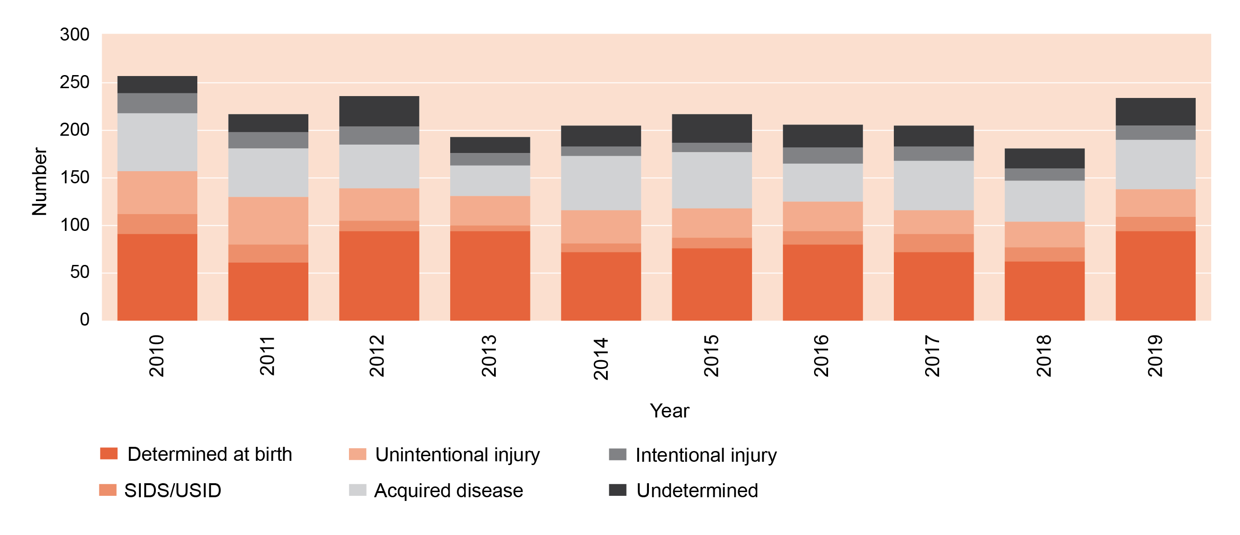
Deaths by major cause: 28 days to 17 years

Slide 19
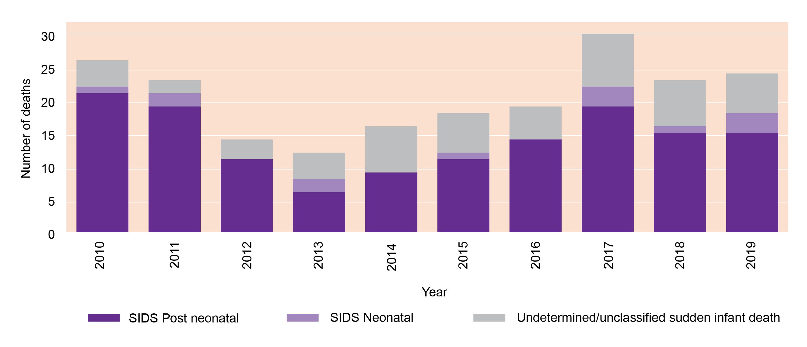
Unexplained sudden unexpected deaths in infants

Slide 20
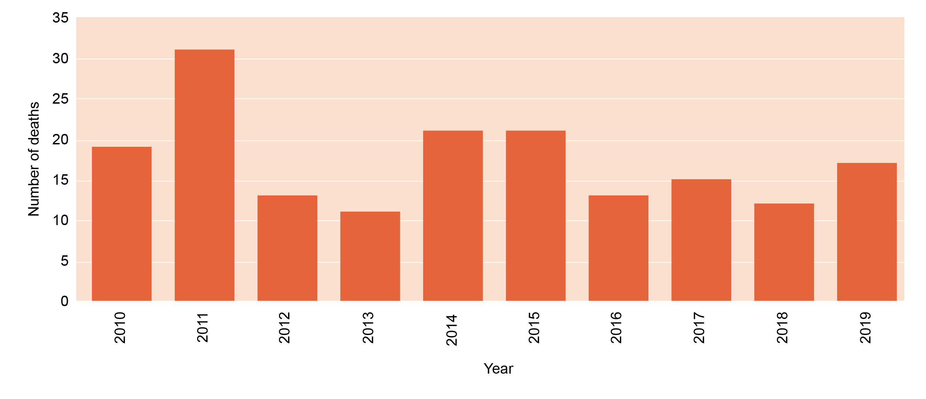
Motor vehicle accident deaths: 28 days to 17 years

Slide 21
CCOPMM recommendations: Child and adolescent

Slide 22
Recommendations
Evaluate the effectiveness of current services in meeting the specific needs of women during pregnancy and in the year following birth. If gaps are identified, implement strategies to improve the health and wellbeing of women and families. The areas of mental health and family violence require specific focused attention
Reform of statewide services is needed to ensure there is a coordinated and timely system response that supports the health and wellbeing of Victorian children in vulnerable situations

Slide 23
Recommendations
Develop and roll out an annual public health campaign on the importance of influenza vaccination for children using co-design principles with families and their communities
Ensure all children have easy access to free influenza vaccination annually

Slide 24
Recommendations
Develop and implement a public information campaign regarding the dangers for children on farms, using co-design principles with families and their communities, in conjunction with organisations such as WorkSafe Victoria and the Victorian Farmers Federation

Slide 25
Good practice points
Good practice points reflect the findings of CCOPMM’s review of all cases of maternal, perinatal and paediatric mortality, and severe acute maternal morbidity in a reporting year
They are designed to guide local improvements in clinical performance and can relate to our clinical care and/or the system or service we work in

Slide 26
Good practice points: systems and/or processes
Follow up of test results
Discharging babies under 2.5kg
Influenza vaccine
Farm safety

Slide 27
Follow up test results – every time, every test
Clinicians who order pathology tests must have clear mechanisms for timely review and follow up
For teams or part-time clinicians: ensure effective plans are in place that outline responsibility for review, follow up and documentation of actions

Slide 28
Discharging babies under 2.5 kilograms
Babies under 2.5kg at discharge should have a comprehensive action plan and follow-up
This plan needs to include a risk assessment of their discharge circumstances

Slide 29
Vaccine-preventable illnesses
Annual influenza immunisation remains important for all children over six months of age
Appropriate vaccines are included in the Australian immunisation schedule for all children and adolescents
Immunisation status should always be assessed and advice provided and documented on appropriate vaccines regardless of external circumstances
Immunisation should not be deferred or withheld because of apparent risk of infection with other agents

Slide 30
Safe farms
Parental supervision and awareness of potential hazards are essential to minimise the deaths from unintentional injury
Parents should not allow the unlicensed or inappropriate use of motorised vehicles by children or adolescents. They do not have the strength, coordination or maturity to use safely
Fence off the area where children play
Supervise young children at all times
Assess competency of older children before they work on the family farm

Slide 31
Good practice points: Clinical
Stridor
Constipation
Growth
Follow up of poor growth
Severe growth failure
Cardiac
Myocarditis
Severe pallor and low cardiac output
Immunosuppression
Lymphopenia
Immunosuppression and infection
High dose long term steroids and risk of infection
Chronic illness in children and adolescents on organised trips
Prescribing SSRIs

Slide 32
Presentations of children with stridor
Not all cases of stridor are caused by viral croup and other causes must be considered
A presentation with stridor must be considered a diagnostic problem until a positive diagnosis is made

Slide 33
Constipation
Organic causes of constipation should be excluded with a thorough history and examination
If constipation persists despite these modifications and laxative therapy, consider investigating for less common organic conditions
Red flag symptoms and signs that require immediate referral for assessment or investigation include any of the following:
Weight loss/poor growth
Abdominal distension with vomiting and constipation
Rectal blood loss
Abdominal mass
Abnormally positioned anus
Infants presenting with constipation under the age of 6 weeks, or
Delayed passage of meconium

Slide 34
Follow up for poor growth
Failure to gain weight – expected for age – occurs for many reasons. E.g. inadequate calorie intake, high-risk social circumstances, and underlying illness
Ongoing assessments are required for decreasing weight
Urgent assessment required if their weight-for-age is less than the 10th percentile and decreasing
Errors are often made when plotting weights on a growth chart. These can be reduced by using the calculator at www.infantchart.com

Slide 35
Severe growth failure and sepsis
Severe growth failure often presents with sepsis without fever
Children with severe growth failure who present acutely unwell should be given antibiotics immediately, by intramuscular injection if they do not have an intravenous cannula
Note: Blood and urine cultures should be taken before giving antibiotics if they can be obtained quickly

Slide 36
Recognising myocarditis
Myocarditis can present with nonspecific symptoms that leads to initial misdiagnoses
Investigate for potential myocarditis at presentation of viral prodrome and cardiac symptoms such as:
Features of heart failure:
Chest pain
Arrhythmias
Seek early consultation with a paediatric cardiologist and/or PIPER
Suspected myocarditis is a ‘Go Now’ criterion for PIPER

Slide 37
Severe pallor and low cardiac output
Extreme pallor but a normal or near normal haemoglobin means low cardiac output until proven otherwise
Urgent treatment is required in cases of extreme pallor, tachycardia and high blood lactate as this indicates low cardiac output

Slide 38
Lymphopenia
Lymphopenia (low blood lymphocytes) is common in children, often secondary to acute infections
Infants or older children presenting with lymphopenia during an acute infection should have a full blood count repeated once they have recovered to ensure the lymphocyte count has normalised
Persistent lymphopenia should trigger further investigation to rule out severe combined immune deficiency (SCID) or other immune deficiency

Slide 39
Lymphopenia: Other good practice points
Investigate further: infant (6 weeks to 6 months) with first lymphocyte count <2.5
Investigate further: child with lymphopenia and signs suspicious of immune deficiency
To exclude SCID include a specific measurement of naïve T cells within the testing of lymphocyte subsets
Lymphocyte subsets without specific measurement of naïve T cells are an inadequate test as may be falsely reassuring

Slide 40
Lymphopenia: Other good practice points
Laboratories reporting FBE should add a comment where lymphocyte count is low
For example, ‘Lymphopenia in children needs follow-up to monitor resolution to exclude potential immunodeficiency. Please refer to immunologist for further investigation if lymphopenia persists or if clinically indicated. In infants below 6 months this maybe a matter of urgency’.

Slide 41
Immunosuppression and infection
Children with immunosuppression may not show the typical features of severe infection or other inflammatory conditions such as appendicitis
For example, they may not develop:
High fever
Localising signs
Elevated white cell count

Slide 42
High-dose long-term steroids and risk of infection
Prednisolone 1mg/kg/day or more for a month or longer, or equivalent steroid
These children should be on cotrimoxazole prophylaxis (three times weekly or single daily dose) to prevent Pneumocystis jirovecii (previously Pneumocystis carinii) pneumonia (PjP)
Cotrimoxazole preventative therapy will also prevent serious infection from Streptococcus pneumoniae, which is a risk with long-term high dose steroid treatment
Other immune suppressive therapies that require PjP prevention with cotrimoxazole include: alemtuzumab and fludarabine, and all children with persistent lymphopenia, SCID and ALL

Slide 43
Prescribing Selective Serotonin Reuptake Inhibitors
SSRIs prescribed for depression can increase suicidal thoughts – particularly on initiation or after dose increases
Advise on common and serious adverse effects and have a clear plan for review as required
Monitor initiation or change of treatment – for adverse effects and assessment of improvement
If there is further deterioration in symptoms (for example, insomnia, agitation or suicidal ideation) or a lack of improvement after four weeks review plans and consider specialist consultation or referral considered

Slide 44
SSRIs: Other good practice points
Evidence-based psychological therapies such as cognitive behavioural therapy (CBT) are recommended for depression in young people
Participation in psychological therapies is vital. It is common that those with suicidal ideation and behaviours do not engage in therapies and follow up
All clinicians have a vital role in ensuring attendance and participation in interventions and can improve outcomes including reducing suicidal ideation and improving school attendance

Slide 45
Be aware: Chronic illnesses on school trips
Prior to travel students with chronic illness should attend their specialist or general practitioner to:
ensure their condition is well managed
decide if any changes in the management are required during the trip
develop an individual healthcare plan which states what care and monitoring they need and which members of staff will help them
All members of staff on the trip should be aware and monitor:
the student’s condition
signs of the student becoming more unwell
what to do in case of an emergency

Slide 46
For more information
www.bettersafercare.vic.gov.au/publications/victorias-mothers-babies-and-children-2019
Refer to CCOPMM’s other slide packs on:
Mothers and babies
Maternal mortality and morbidity
Perinatal mortality
2019 recommendations

Slide 47
Connect with us
www.bettersafercare.vic.gov.au
tanya.farrell@safercare.vic.gov.au
@safercarevic @TanyaFarrell13
Safer Care Victoria

