Slide 1
Victoria’s mothers, babies and children 2019
Maternal mortality and morbidity

Slide 2
About CCOPMM

Slide 3
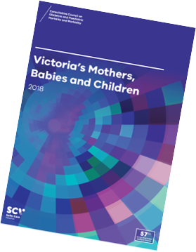
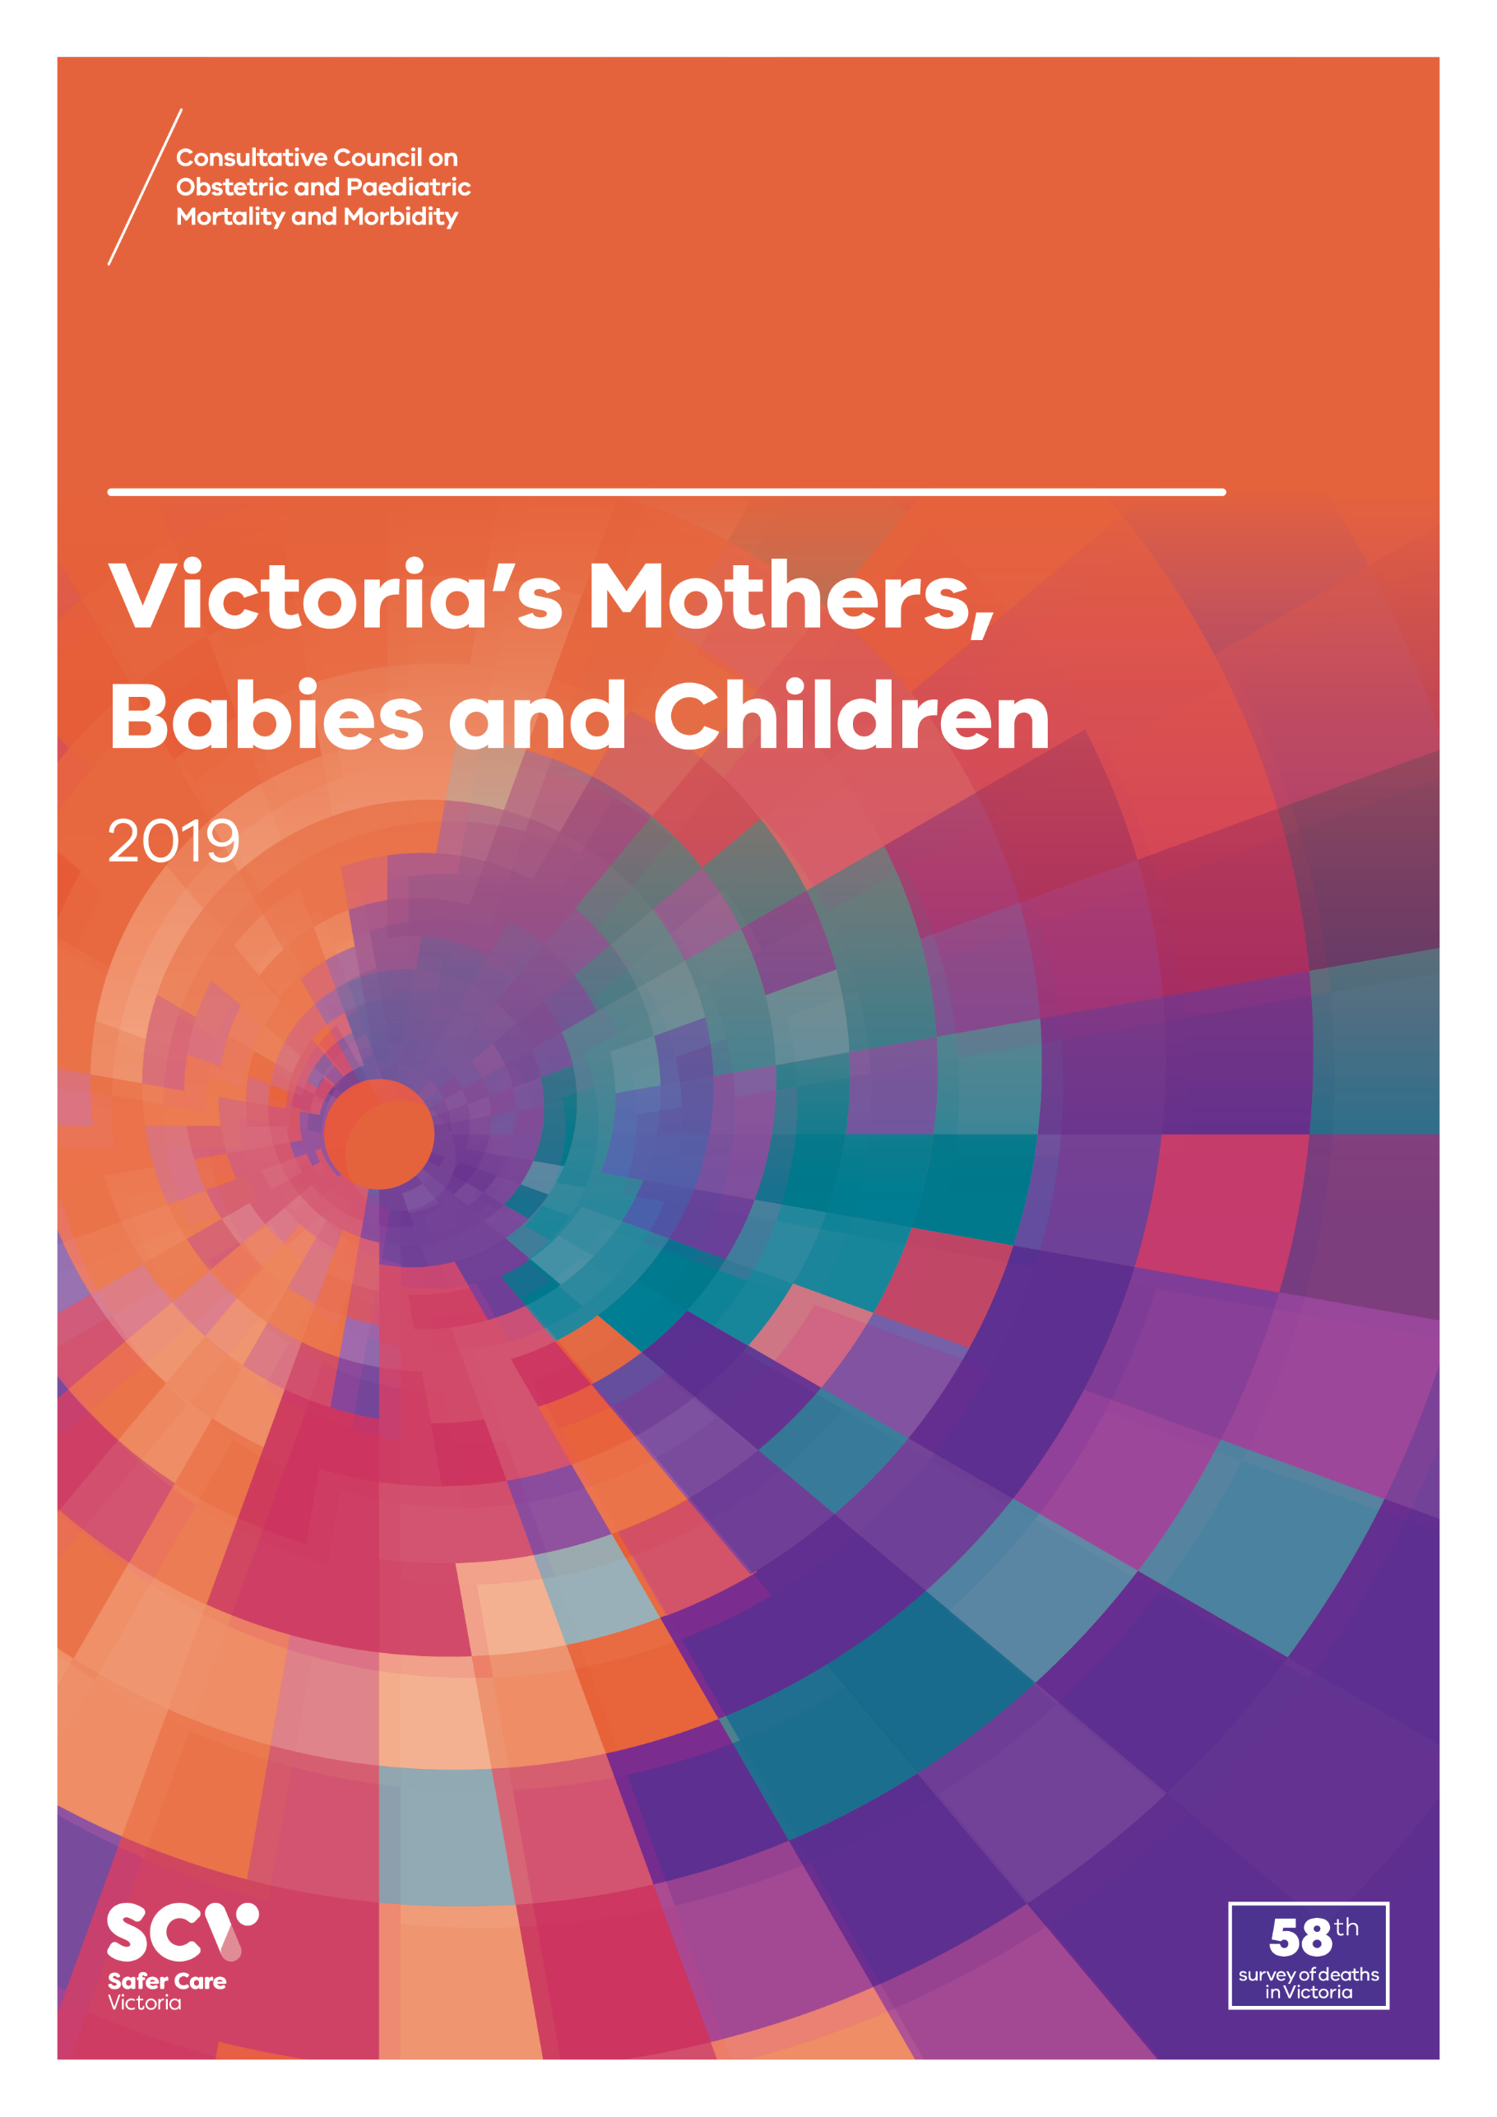
About CCOPMM
The Consultative Council on Obstetric and Paediatric Mortality and Morbidity (CCOPMM) is a statutory authority appointed by the Minister for Health
Chair: Adjunct Professor Tanya Farrell
Operates under the Public Health and Wellbeing Act 2008

Slide 4
About CCOPMM
Legislative responsibility for data collection
Victorian Perinatal Data Collection (VPDC)
Victorian Congenital anomalies register (VCAR)
Legislative responsibility for health surveillance
Mortality collections and review of perinatal, child and adolescent, and maternal mortality
Morbidity collections: severe acute maternal morbidity (SAMM)

Slide 5
Undertaking case reviews
Four subcommittees report to CCOPMM:
Stillbirth – Chair: Professor Susan McDonald
Neonatal Mortality and Morbidity (0-27 days) – Chair: Professor Rod Hunt
Maternal Mortality and Morbidity – Chair: Professor Mark Umstad
Child and Adolescent Mortality and Morbidity (28 days-17 years) – Chair: Professor Paul Monagle

Slide 6
Undertaking research
CCOPMM conducts research itself and also provides data for research purposes
CCOPMM identifies research priorities by:
analysis of our reports, data and through case reviews
collaborating with external research projects

Slide 7
Why do we do what we do?
Independent oversight of all deaths and severe maternal morbidity
Highlight areas that require improvement – hospital and community
Highlight areas for further research
Inform the development of policies and guidelines
Provide advice on areas for prioritisation and investment

Slide 8
Maternal mortality and morbidity

Slide 9
Definition: Maternal mortality and morbidity
Include:
All maternal deaths during pregnancy and within a year of birth
All intensive care unit (ICU) admissions during pregnancy and up to 42 days after birth

Slide 10
Definition: Maternal mortality and morbidity
Maternal deaths occurring during pregnancy or within 42 days of the end of pregnancy are classified as:
Direct – relating to the pregnancy or birth
Indirect – relating to a pre-existing medical condition or newly diagnosed condition
Coincidental – unrelated to the pregnancy or birth
Maternal deaths occurring after 42 days following pregnancy and up to one year post birth are reported as Late

Slide 11
Maternal mortality ratio (MMR)
The incidence of maternal deaths is expressed as the maternal mortality ratio (MMR), which is calculated using direct and indirect deaths combined, and excludes coincidental deaths (AIHW).
This includes direct and indirect deaths that occur during pregnancy or within 42 days of the end of pregnancy.

Slide 12
Definition: SAMM
Severe Acute Maternal Morbidity (SAMM) is measured as an admission to an ICU during pregnancy and up to 42 days after birth
The criteria for ICU admission may vary across hospitals, and not all maternity services in Victoria have direct access to an ICU

Slide 13
Trends and comparisons

Slide 14
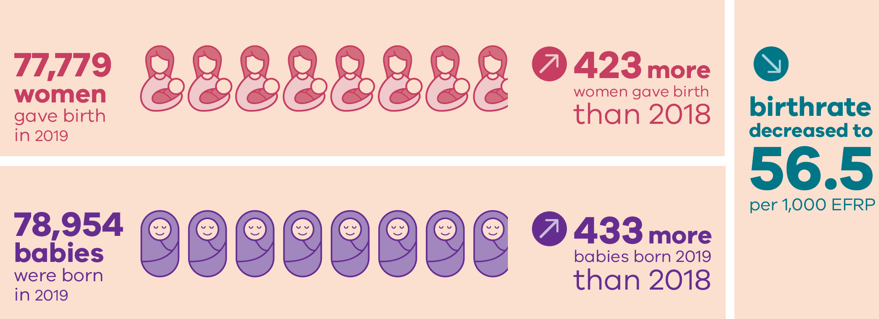
Births 2019

Slide 15
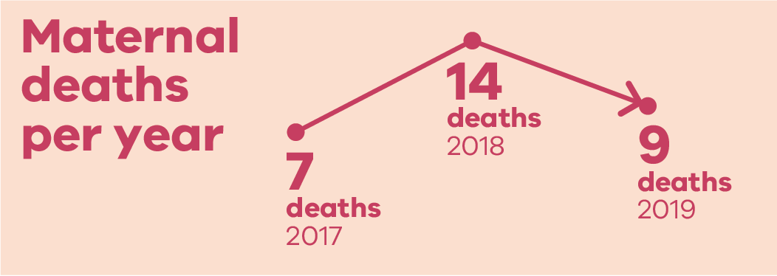
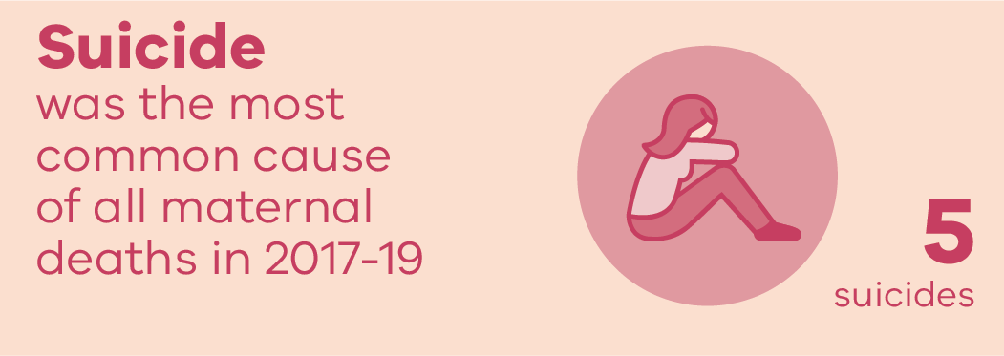
Maternal mortality: 2017 to 2019
Note: this version of the slide was republished in May 2021

Slide 16
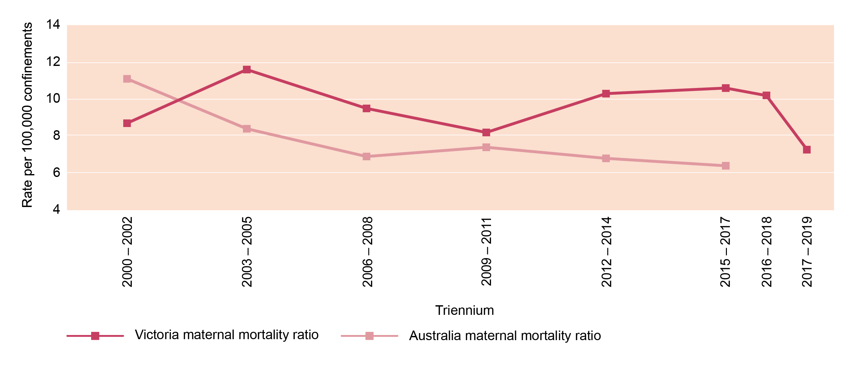
Maternal mortality ratios: Rolling triennia
Note: The methodology for classifications has been updated for the 2017-19 triennium in line with national definitions (AIHW). Comparisons with previous triennia should be made with caution.

Slide 17
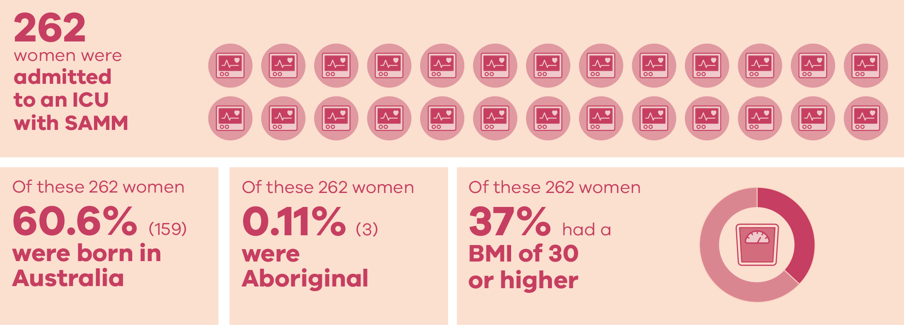
Severe Acute Maternal Morbidity (SAMM) in 2019
Note: There may be small variances in the data over time due to incomplete reporting of SAMM cases. The total number and report information may not reflect a complete SAMM data for Victoria in 2019.

Slide 18
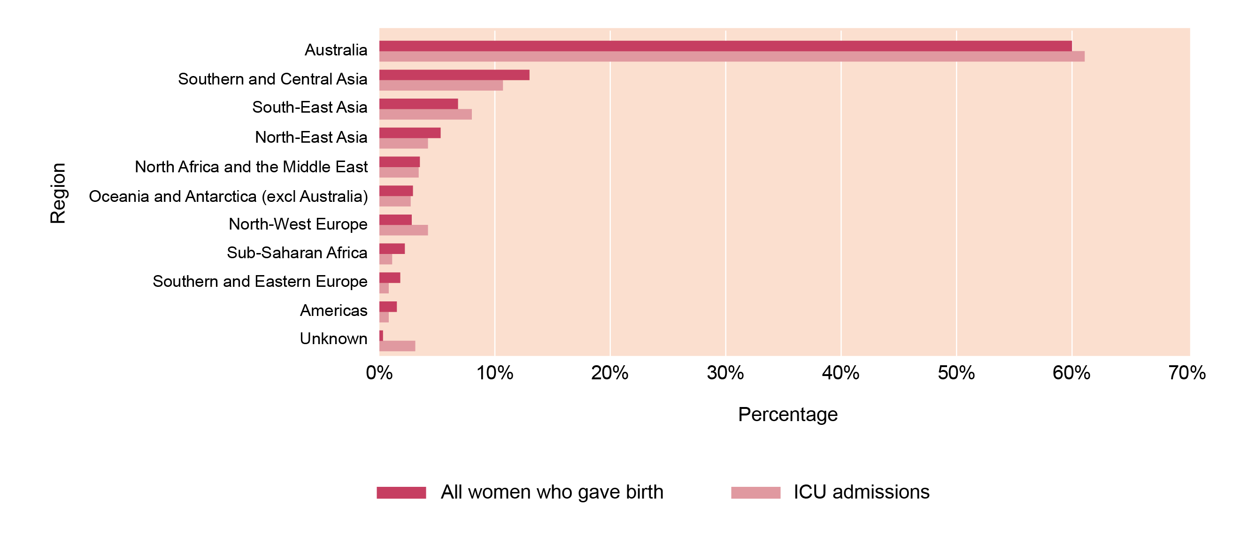
ICU admission by region of birth in 2019
Note: There may be small variances in the data over time due to incomplete reporting of SAMM cases. The total number and report information may not reflect a complete SAMM data for Victoria in 2019.

Slide 19
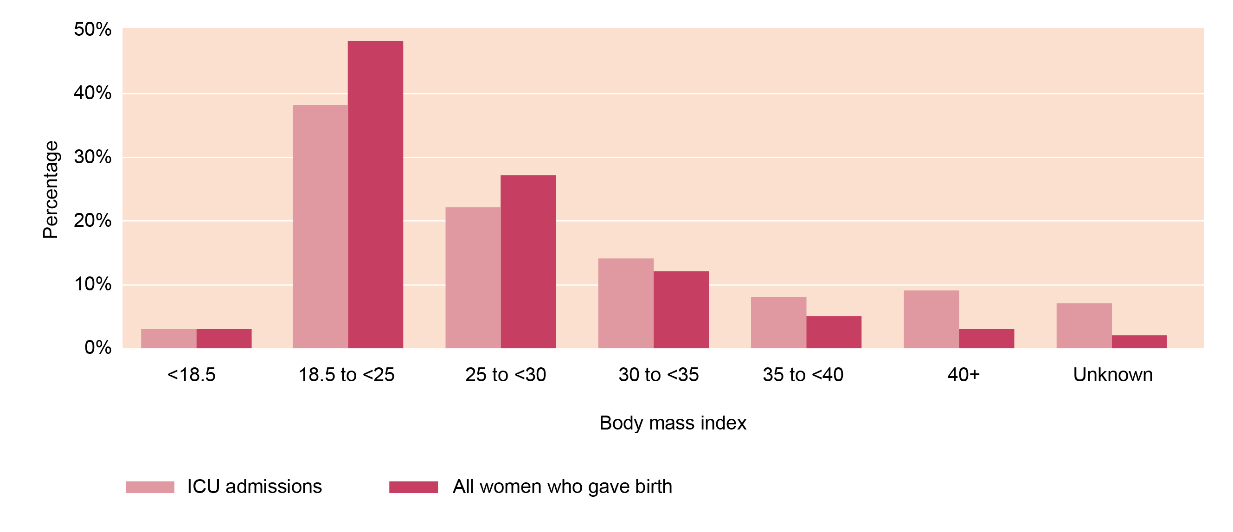
ICU admission by BMI in 2019
Note: There may be small variances in the data over time due to incomplete reporting of SAMM cases. The total number and report information may not reflect a complete SAMM data for Victoria in 2019.

Slide 20
CCOPMM recommendations: Maternal M&M

Slide 21
Recommendations
Develop and implement a system-wide improvement program to prevent women experiencing postpartum haemorrhage (PPH)

Slide 22
Recommendations
Evaluate the effectiveness of current services in meeting the specific needs of women during pregnancy and in the year following birth. If gaps are identified, implement strategies to improve the health and wellbeing of women and families. The areas of mental health and family violence require specific focused attention

Slide 23
Good practice points
Good practice points reflect the findings of CCOPMM’s review of all cases of maternal, perinatal and paediatric mortality, and severe acute maternal morbidity in a reporting year
They are designed to guide local improvements in clinical performance and can relate to our clinical care and/or the system or service we work in

Slide 24
Good practice points
Ensure all staff are upskilled in clinical management through PRactical Obstetric Multi-Professional Training (PROMPT) or alternative program to ensure clinicians are familiar with obstetric emergencies
Use your own clinical scenarios to routinely train staff
Use rare and high-risk emergencies in your training programs

Slide 25
Good practice points
Strengthen your service’s relationships with maternal and child health nurse (MCHN) services - to ensure there is support for women that have complex psychosocial history and/or a history of catastrophic episodes
Ensure effective connection and handover to MCHNs

Slide 26
Good practice point
Given the possibility of damage to the ureter in situations of excessive bleeding at the time of caesarean section, obstetricians should ensure ureteric integrity either at the time of the operation or within a reasonable time post operatively

Slide 27
Good practice point
The judicious, or non-use, of oxytocin infusion for augmentation of a multiparous woman who fails to progress in labour is recommended

Slide 28
Good practice points
To prevent significant maternal or perinatal morbidity or mortality, maternity services must have clear pathways in place that facilitate timely access to an emergency theatre
Rapid access must be available where there is an immediate threat to life of a mother and/or baby – e.g. management of uterine rupture or postpartum haemorrhage
These pathways need to be audited to monitor rapid access in services 24/7

Slide 29
Good practice points
Recommend seeking a second opinion from a senior colleague when returning acutely unwell women to theatre
Consider on first return to theatre and highly recommend on second return

Slide 30
Good practice points
Develop clear guidance around hospital bookings for women planning a homebirth including guidelines for transfer to hospital
Ensure all staff, including private midwives, have regular training and simulation on postpartum haemorrhage (PPH) recognition and management

Slide 31
For more information
www.bettersafercare.vic.gov.au/publications/victorias-mothers-babies-and-children-2019
Refer to CCOPMM’s other slide packs on:
Mothers and babies
Perinatal mortality
Child and adolescent mortality
2019 recommendations

Slide 32
Connect with us
www.bettersafercare.vic.gov.au
tanya.farrell@safercare.vic.gov.au
@safercarevic @TanyaFarrell13
Safer Care Victoria

