Slide 1
Victoria’s mothers, babies and children 2019
Mothers and babies

Slide 2
About CCOPMM

Slide 3
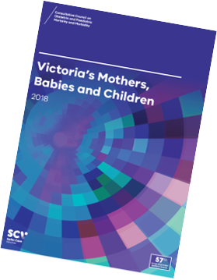
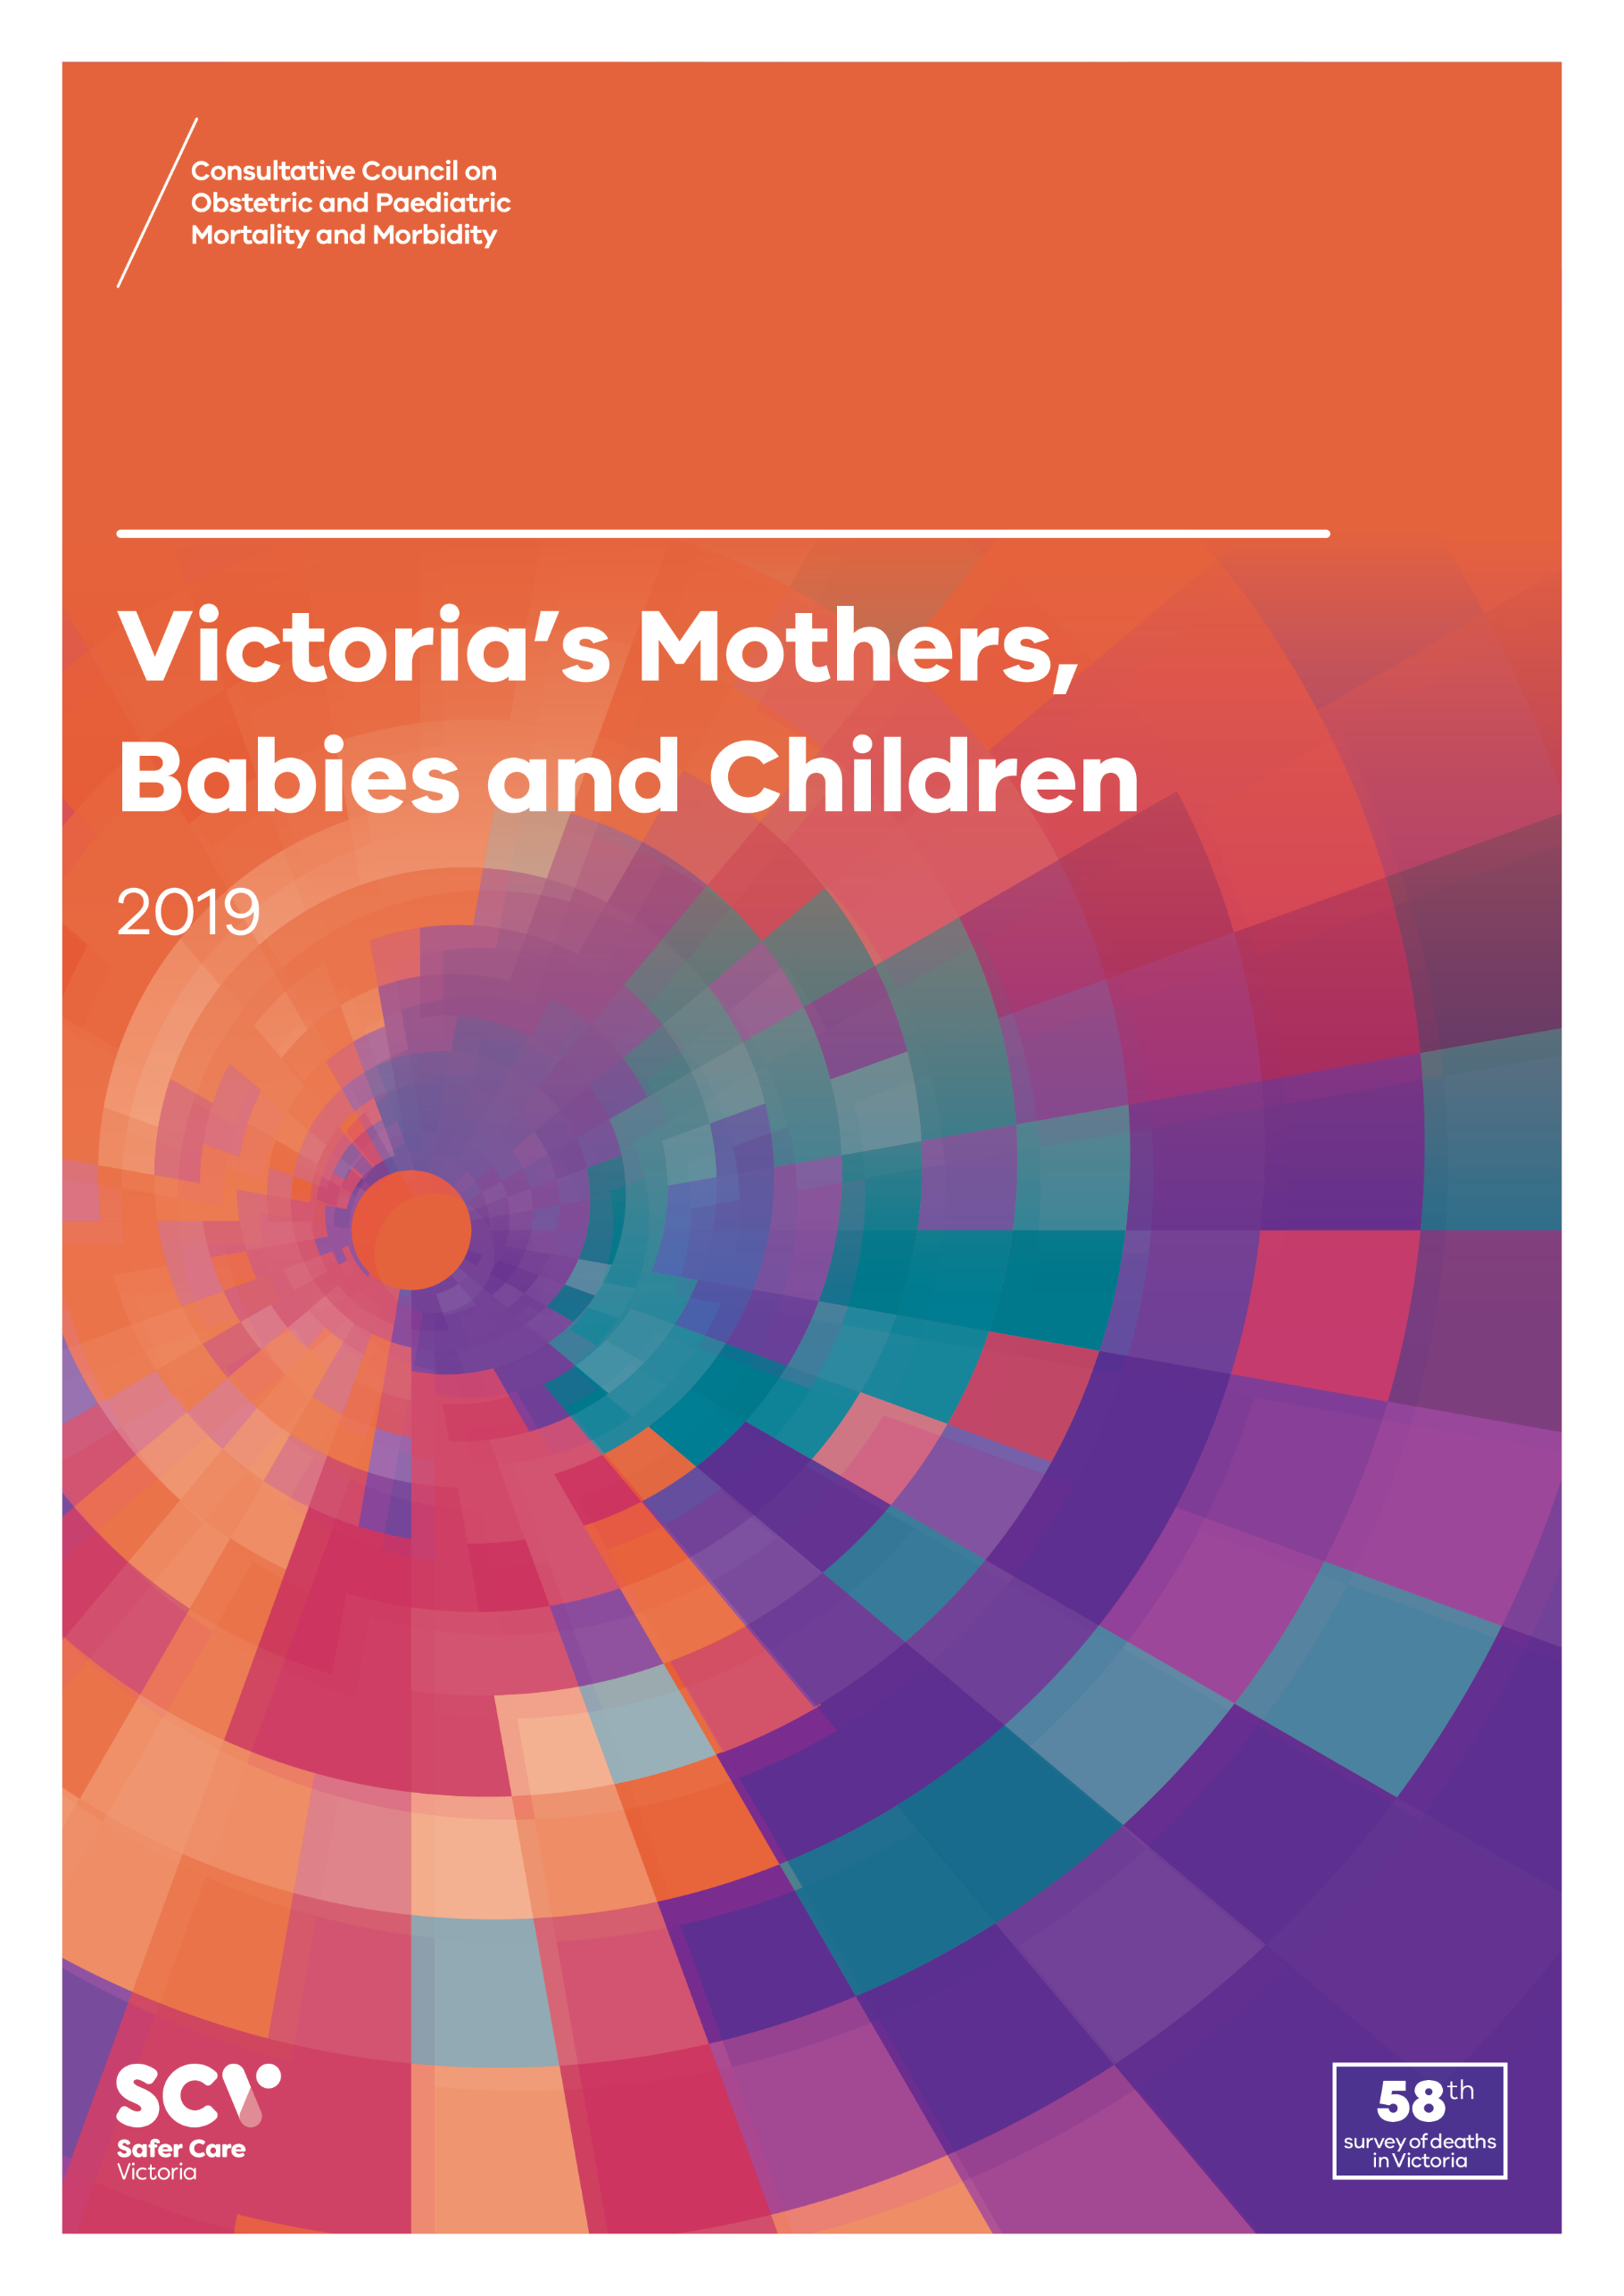
About CCOPMM
The Consultative Council on Obstetric and Paediatric Mortality and Morbidity (CCOPMM) is a statutory authority appointed by the Minister for Health
Chair: Adjunct Professor Tanya Farrell
Operates under the Public Health and Wellbeing Act 2008

Slide 4
About CCOPMM
Legislative responsibility for data collection
Victorian Perinatal Data Collection (VPDC)
Victorian Congenital anomalies register (VCAR)
Legislative responsibility for health surveillance
Mortality collections and review of perinatal, child and adolescent, and maternal mortality
Morbidity collections: severe acute maternal morbidity (SAMM)

Slide 5
Undertaking case reviews
Four subcommittees report to CCOPMM:
Stillbirth – Chair: Professor Susan McDonald
Neonatal Mortality and Morbidity (0-27 days) – Chair: Professor Rod Hunt
Maternal Mortality and Morbidity – Chair: Professor Mark Umstad
Child and Adolescent Mortality and Morbidity (28 days-17 years) – Chair: Professor Paul Monagle

Slide 6
Undertaking research
CCOPMM conducts research itself and also provides data for research purposes
CCOPMM identifies research priorities by:
analysis of our reports, data and through case reviews
collaborating with external research projects

Slide 7
Why do we do what we do?
Independent oversight of all deaths and severe maternal morbidity
Highlight areas that require improvement – hospital and community
Highlight areas for further research
Inform the development of policies and guidelines
Provide advice on areas for prioritisation and investment

Slide 8
Trends and comparisons

Slide 9
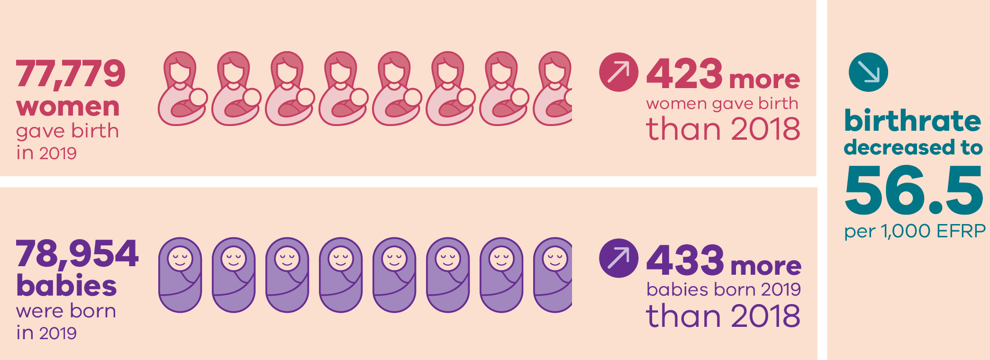
Births in 2019

Slide 10
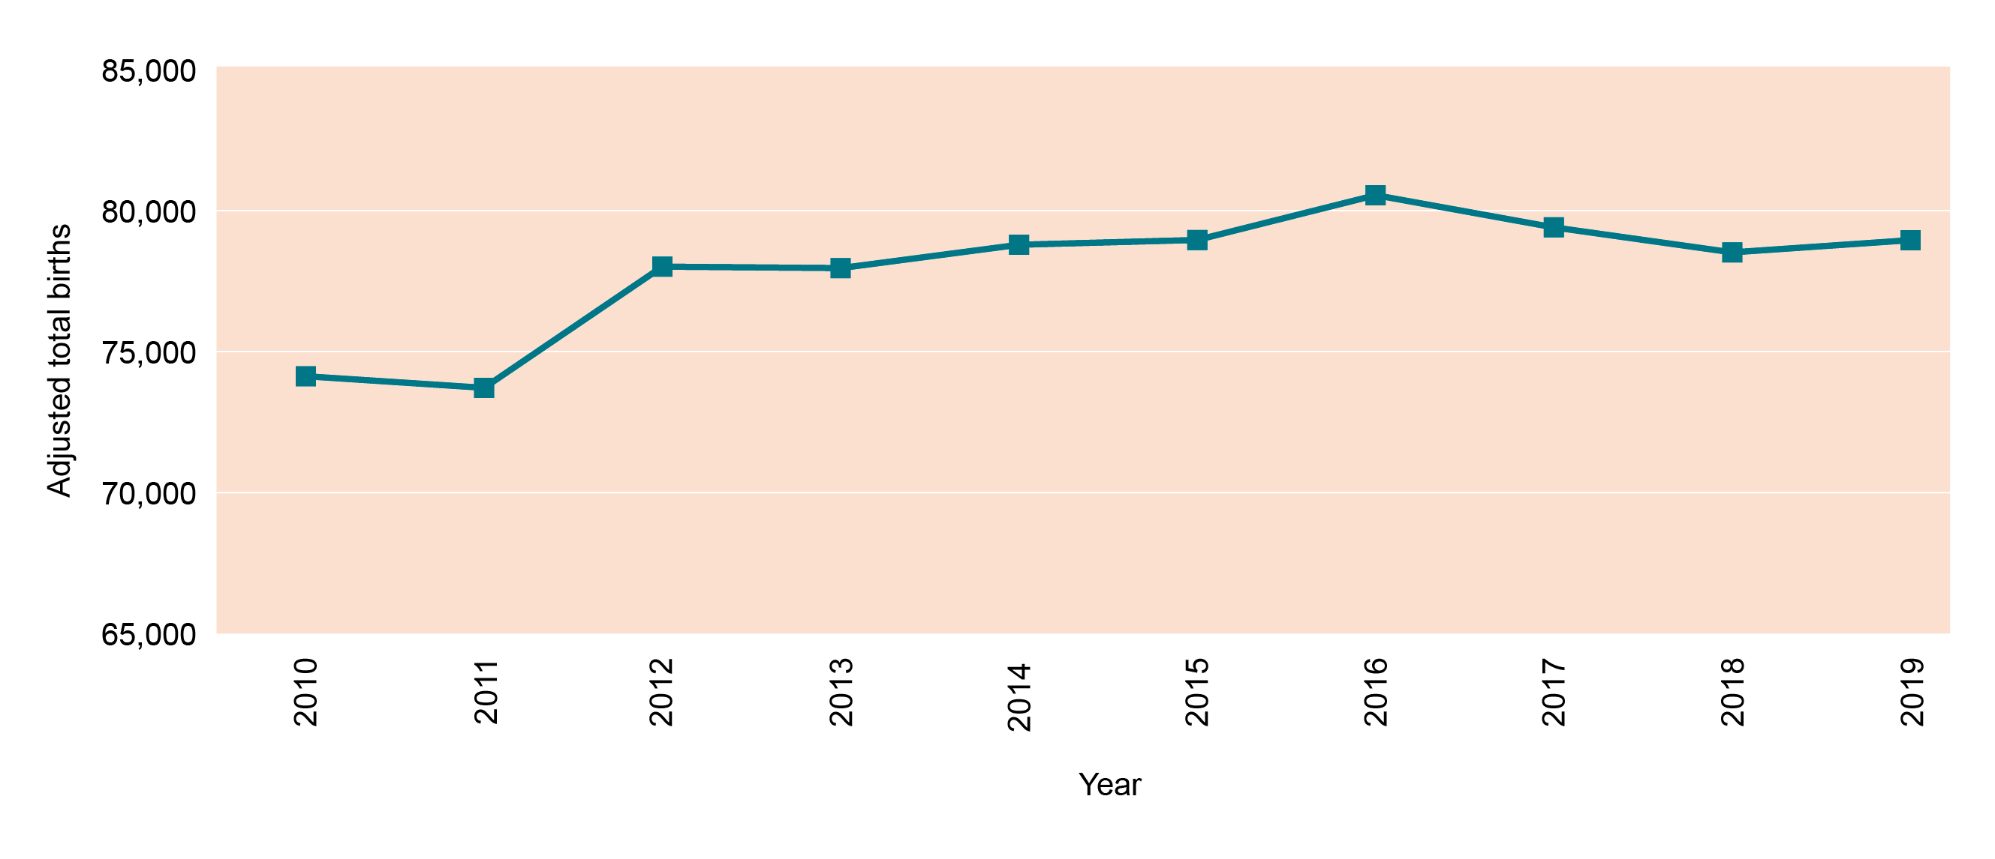
Birth numbers over time

Slide 11
Trends in birthing numbers and gestation (%)
Gestation | 2000 | 2005 | 2010 | 2015 | 2016 | 2017 | 2018 | 2019
 | 61,562 | 65,115 | 72,864 | 77,752 | 79,319 | 78,226 | 77,355 | 78,954
20–27 weeks | 0.7 | 0.6 | 0.6 | 0.5 | 0.6 | 0.5 | 0.6 | 0.6
28–31 weeks | 0.7 | 0.6 | 0.7 | 0.7 | 0.6 | 0.7 | 0.6 | 0.7
32–36 weeks | 5.5 | 5.5 | 5.8 | 6.4 | 6.2 | 6.4 | 6.4 | 7.0
37–41 weeks | 91.8 | 91.9 | 91.6 | 92.0 | 92.2 | 92.1 | 92.1 | 91.5
42+ weeks | 1.3 | 1.3 | 1.2 | 0.5 | 0.4 | 0.3 | 0.2 | 0.3
Not reported | 0.0 | 0.0 | 0.1 | 0.0 | 0.0 | 0.0 | 0.0 | 0.0

Slide 12
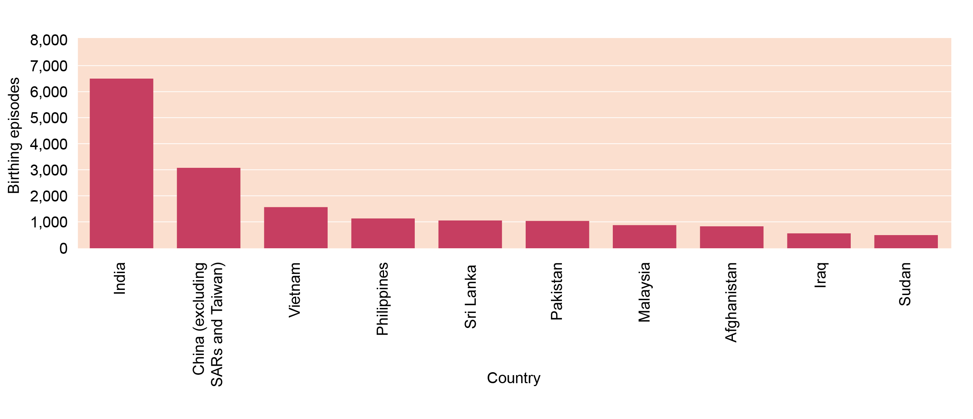
Top 10: mothers born in Non-English speaking countries

Slide 13
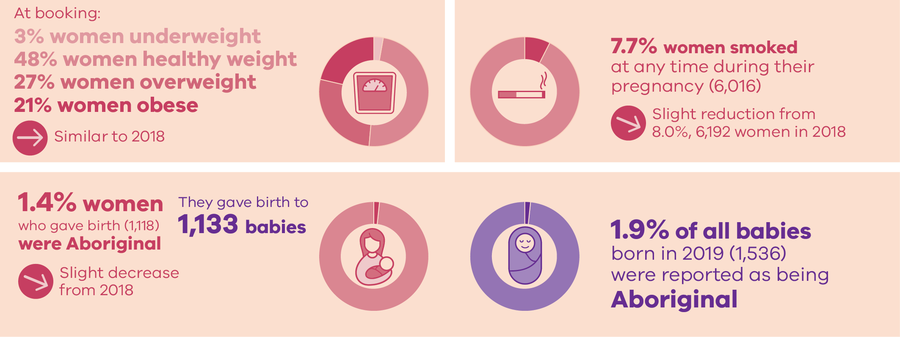
Characteristics of mothers and babies

Slide 14
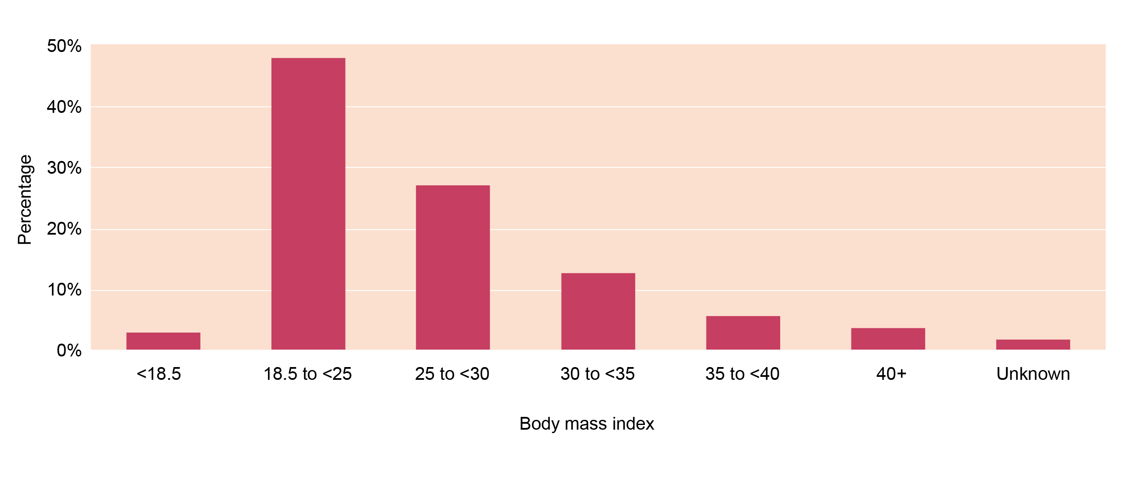
Body mass index at booking

Slide 15
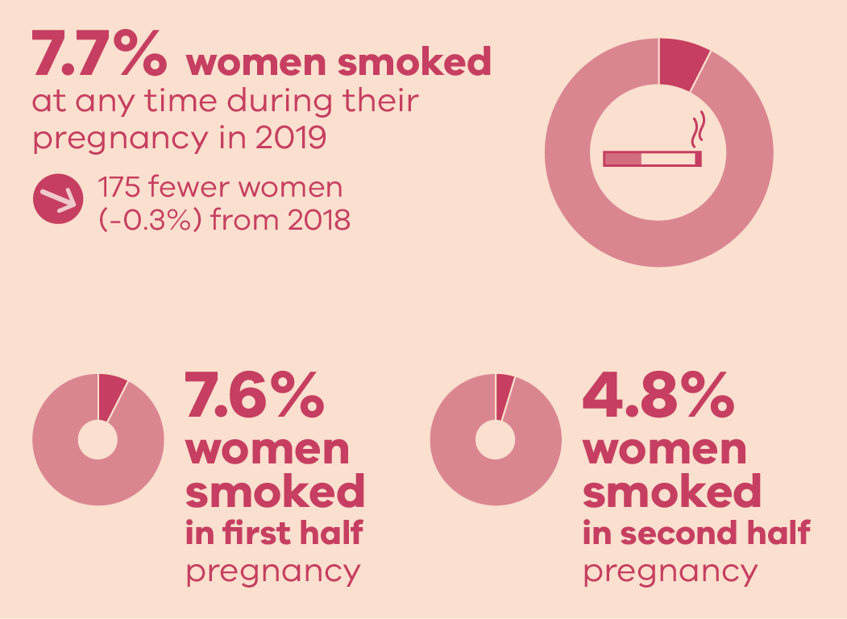
Smoking reported during pregnancy

Slide 16
Smoking reported during pregnancy
First 20 weeks
After 20 weeks

Slide 17
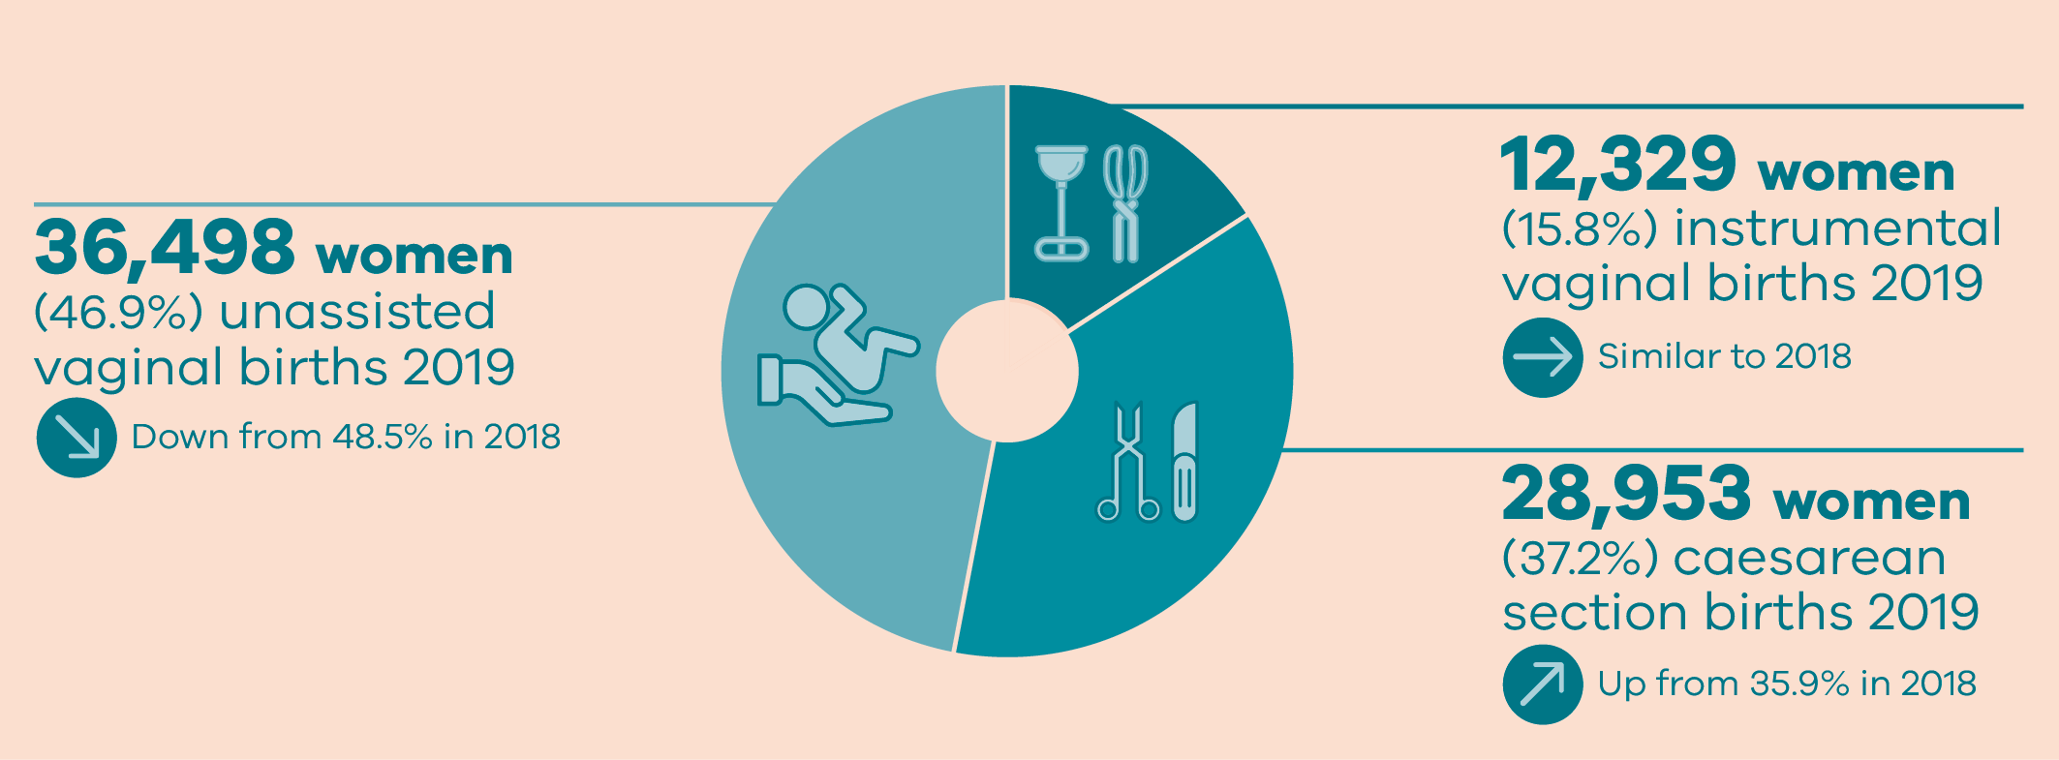
Method of birth

Slide 18
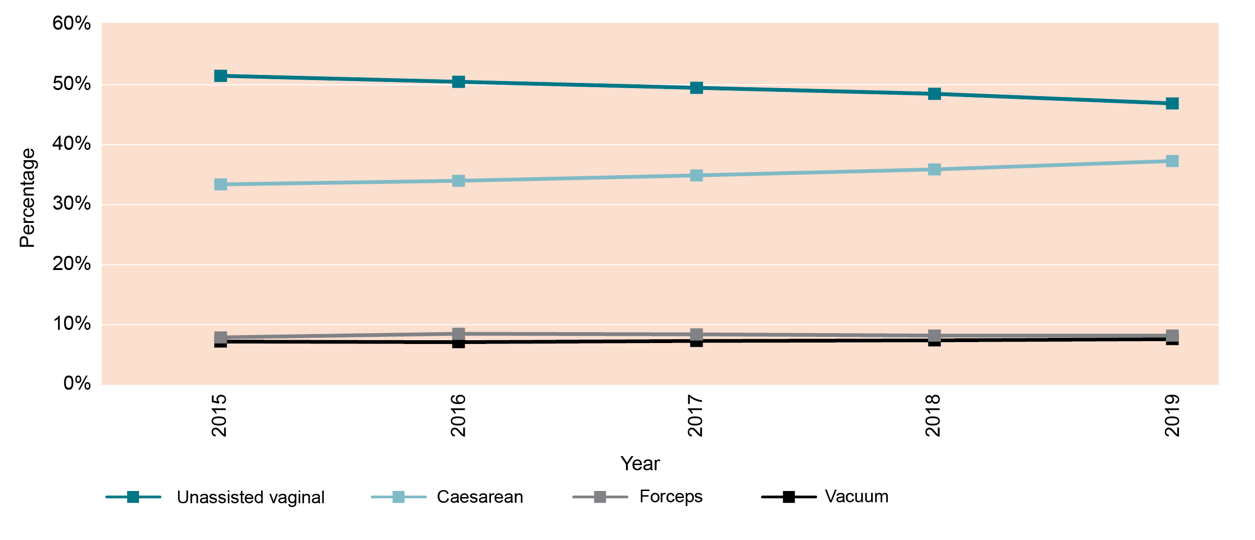
Trends in method of birth

Slide 19
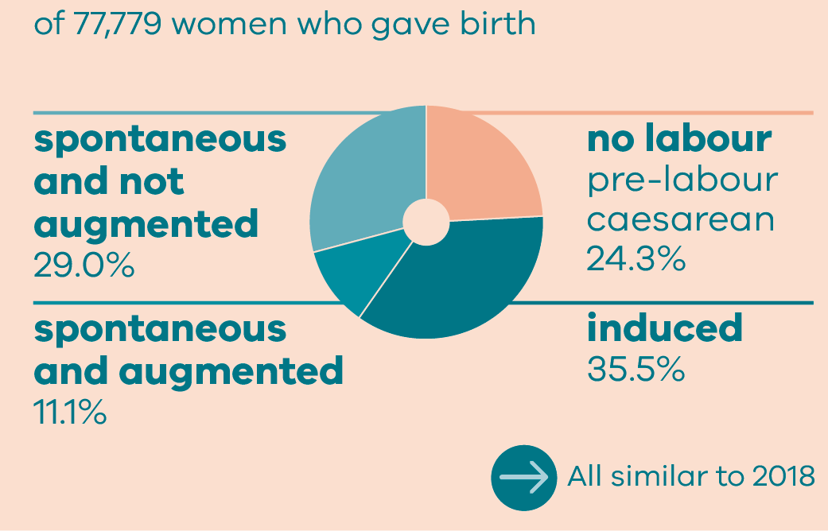
Onset of labour

Slide 20
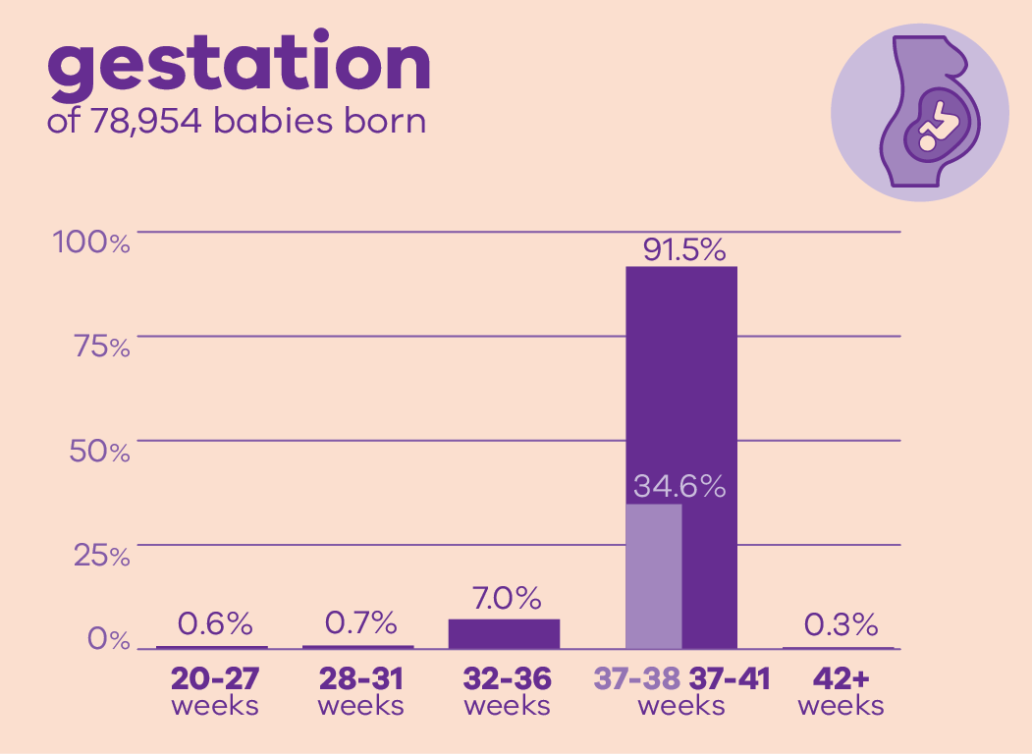
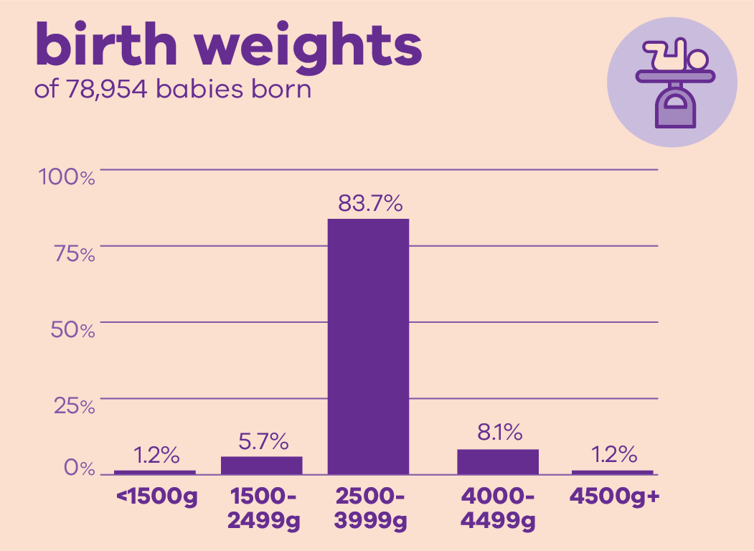
Babies in 2019

Slide 21
Trends and comparisons: Aboriginal mothers and babies

Slide 22
Aboriginal births in 2019

Slide 23
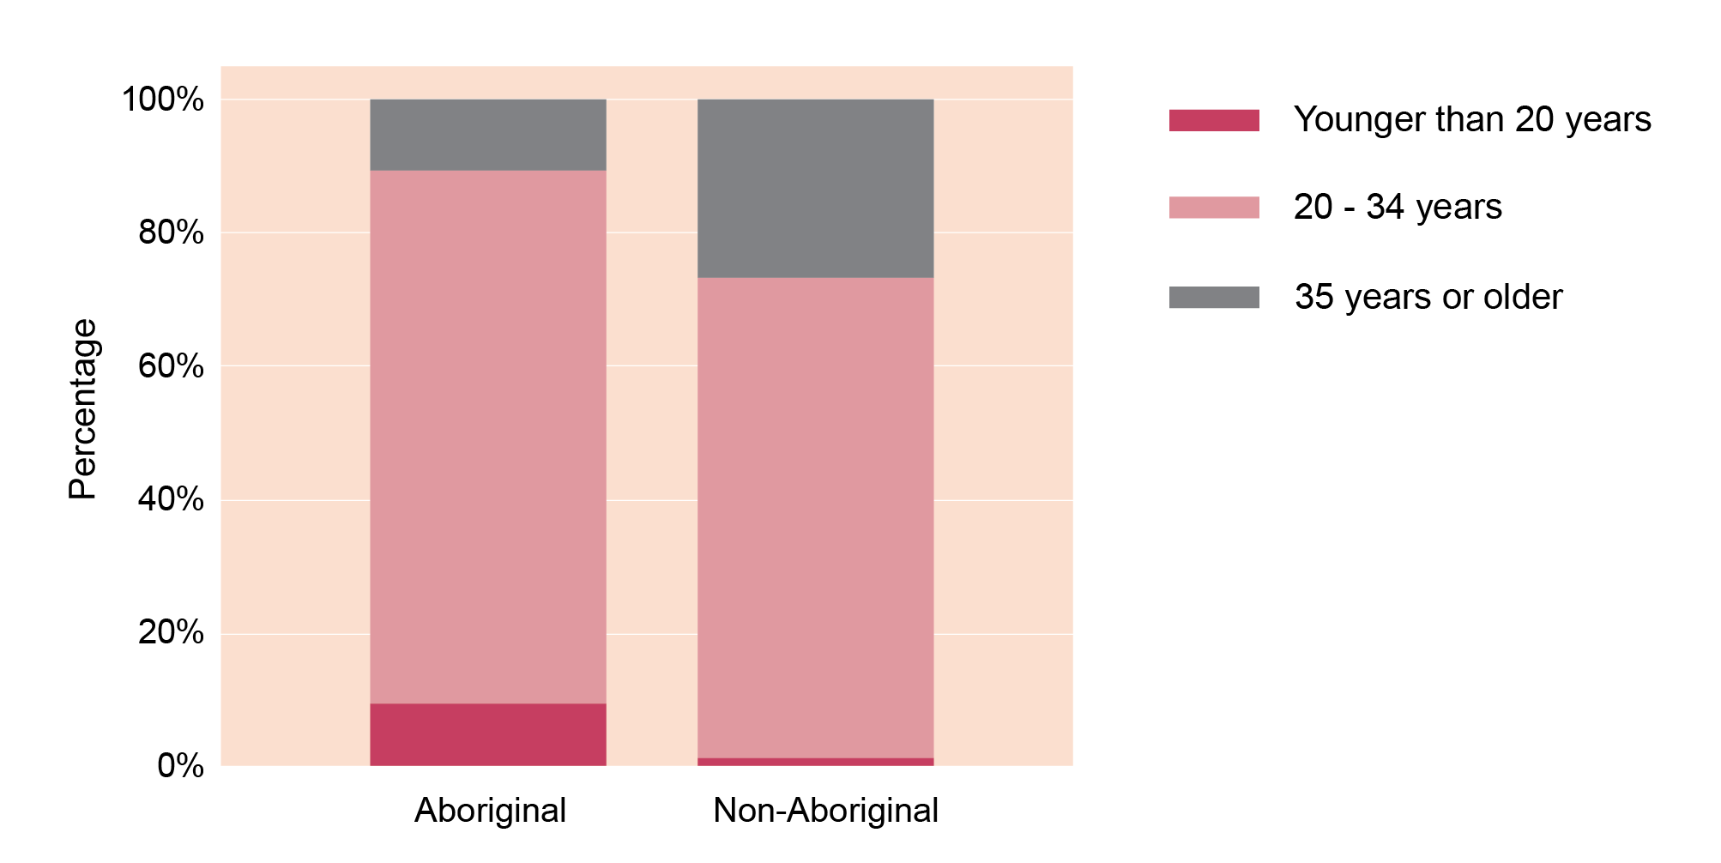
Age comparison: Aboriginal and Non-Aboriginal

Slide 24
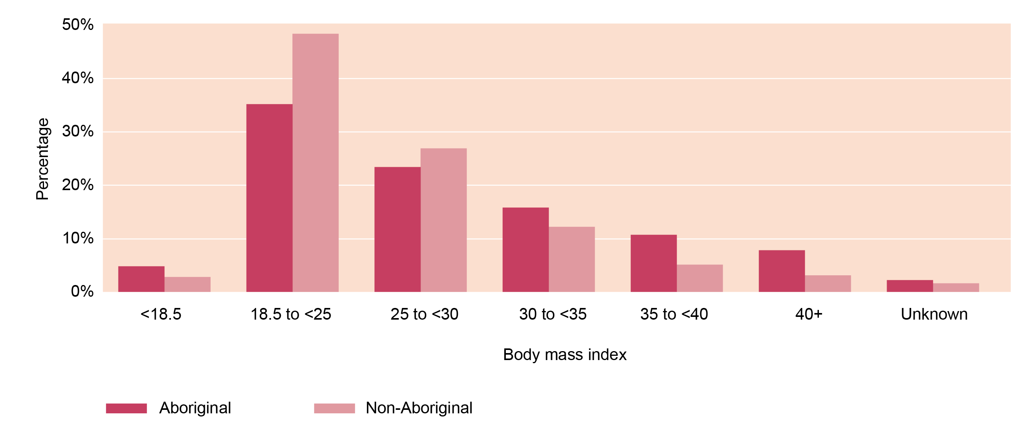
Body mass index at booking by Aboriginal status

Slide 25
Birth outcomes in 2019

Slide 26
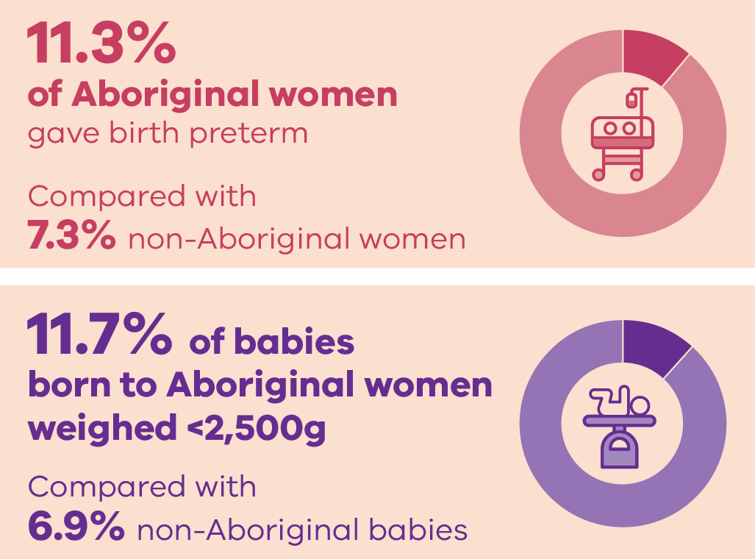
Birth outcomes in 2019

Slide 27
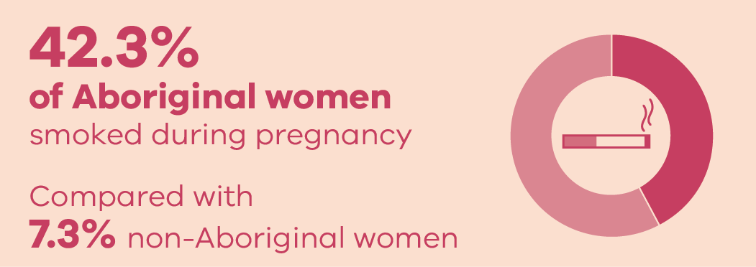
Smoking during pregnancy

Slide 28
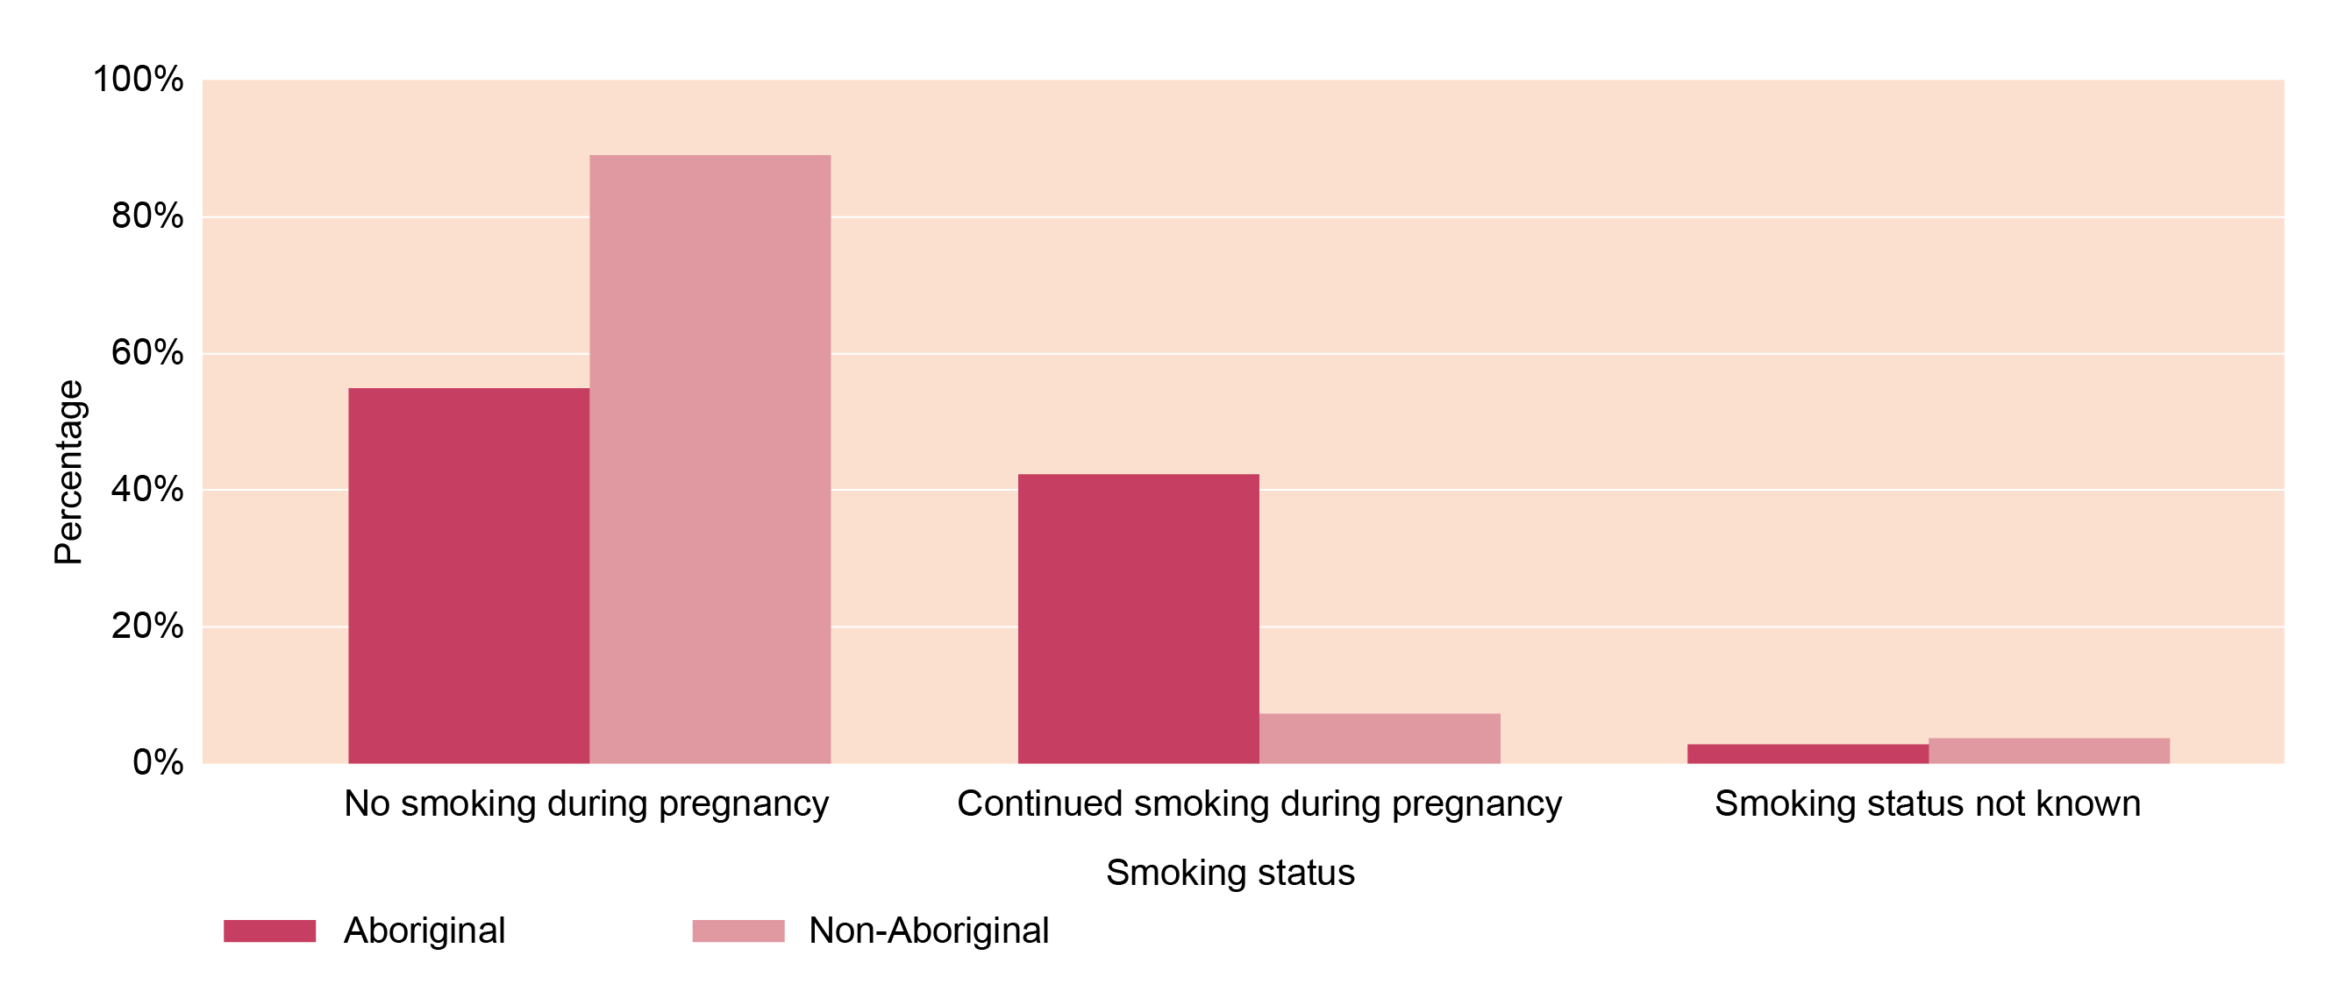
Smoking during pregnancy by Aboriginal status

Slide 29
CCOPMM recommendations: Mothers and babies

Slide 30
Recommendations
1a) Maternity services must develop and regularly audit a pathway that facilitates rapid access to an emergency operating theatre 24/7 to prevent significant maternal or perinatal morbidity or mortality
1b) For all Category 1 caesarean sections, services must record the time in which the decision was made to perform the caesarean section – to enable the accurate recording of the time taken from the ‘decision to deliver’ to the birth of the baby

Slide 31
Recommendations
2. Develop and implement a formal time out process prior to every instrumental birth and emergency caesarean section, whether in a birth room or in the operating theatre, to improve situational awareness and decision making about whether it is the right mode of birth, in the right location, with the right instrument/s, and the right clinical team in attendance

Slide 32
Recommendations
3. Develop and implement a credentialing process for medical staff practising obstetrics at all levels of training and experience who are undertaking instrumental births and complex caesarean sections
4. Formalise pathways for women to have timely access to specialist clinical consultations from a named tertiary (level 6) service for secondary and primary maternity services

Slide 33
Recommendations
5. Develop and implement a system-wide improvement program to prevent women experiencing postpartum haemorrhage (PPH)
6. Evaluate the effectiveness of current services in meeting the specific needs of women during pregnancy and in the year following birth. If gaps are identified, implement strategies to improve the health and wellbeing of women and families. The areas of mental health and family violence require specific focused attention

Slide 34
For more information
Refer to CCOPMM’s other slide packs on:
Maternal mortality and morbidity
Perinatal mortality
Child and adolescent mortality
2019 recommendations

Slide 35
Connect with us
www.bettersafercare.vic.gov.au
tanya.farrell@safercare.vic.gov.au
@safercarevic @TanyaFarrell13
Safer Care Victoria

