Slide 1
Victoria’s mothers, babies and children 2019
Perinatal mortality

Slide 2
About CCOPMM

Slide 3
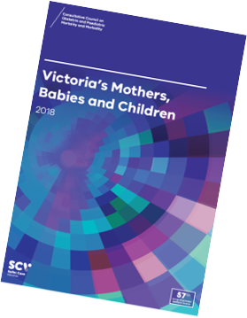
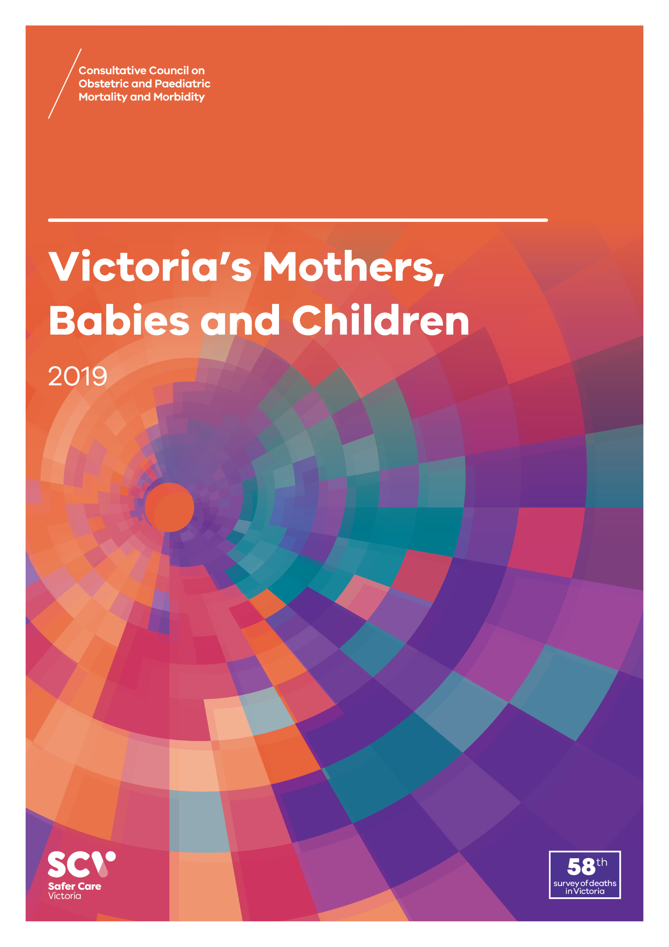
About CCOPMM
The Consultative Council on Obstetric and Paediatric Mortality and Morbidity (CCOPMM) is a statutory authority appointed by the Minister for Health
Chair: Adjunct Professor Tanya Farrell
Operates under the Public Health and Wellbeing Act 2008

Slide 4
About CCOPMM
Legislative responsibility for data collection
Victorian Perinatal Data Collection (VPDC)
Victorian Congenital anomalies register (VCAR)
Legislative responsibility for health surveillance
Mortality collections and review of perinatal, child and adolescent, and maternal mortality
Morbidity collections: severe acute maternal morbidity (SAMM)

Slide 5
Undertaking case reviews
Four subcommittees report to CCOPMM:
Stillbirth – Chair: Professor Susan McDonald
Neonatal Mortality and Morbidity (0-27 days) – Chair: Professor Rod Hunt
Maternal Mortality and Morbidity – Chair: Professor Mark Umstad
Child and Adolescent Mortality and Morbidity (28 days-17 years) – Chair: Professor Paul Monagle

Slide 6
Undertaking research
CCOPMM conducts research itself and also provides data for research purposes
CCOPMM identifies research priorities by:
analysis of our reports, data and through case reviews
collaborating with external research projects

Slide 7
Why do we do what we do?
Independent oversight of all deaths and severe maternal morbidity
Highlight areas that require improvement – hospital and community
Highlight areas for further research
Inform the development of policies and guidelines
Provide advice on areas for prioritisation and investment

Slide 8
Trends and comparisons: Perinatal mortality

Slide 9
Perinatal mortality
Includes fetal deaths (stillbirths) and deaths of live-born babies within the first 28 days after birth (neonatal deaths)
Excludes terminations of pregnancy for psychosocial indications – ‘adjusted’ perinatal mortality:
provides a more accurate assessment of avoidable mortality and assists comparisons with other jurisdictions
Detailed data for perinatal mortality can be found in the online supplementary tables

Slide 10
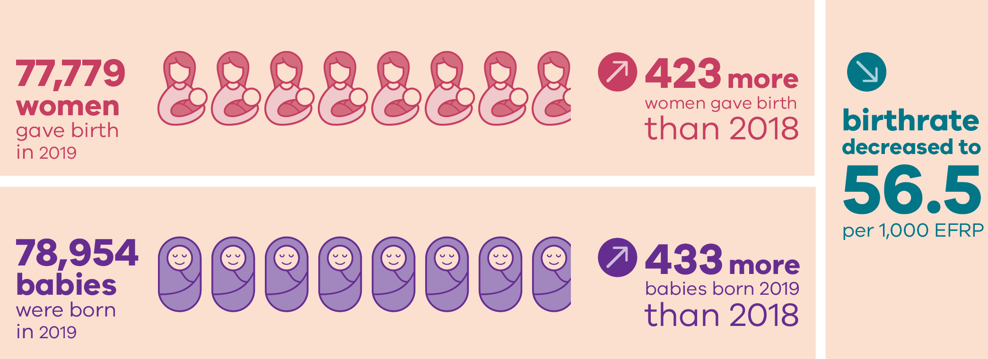
Births in 2019

Slide 11
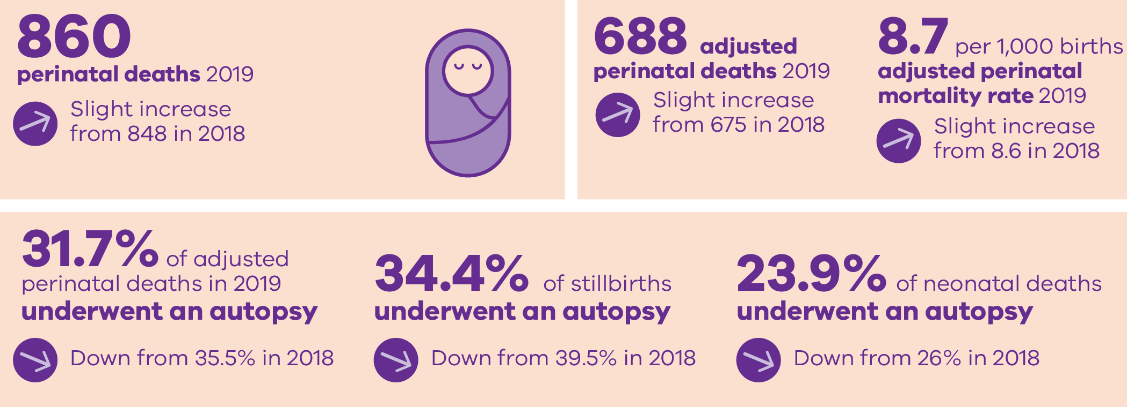
Perinatal deaths in 2019

Slide 12
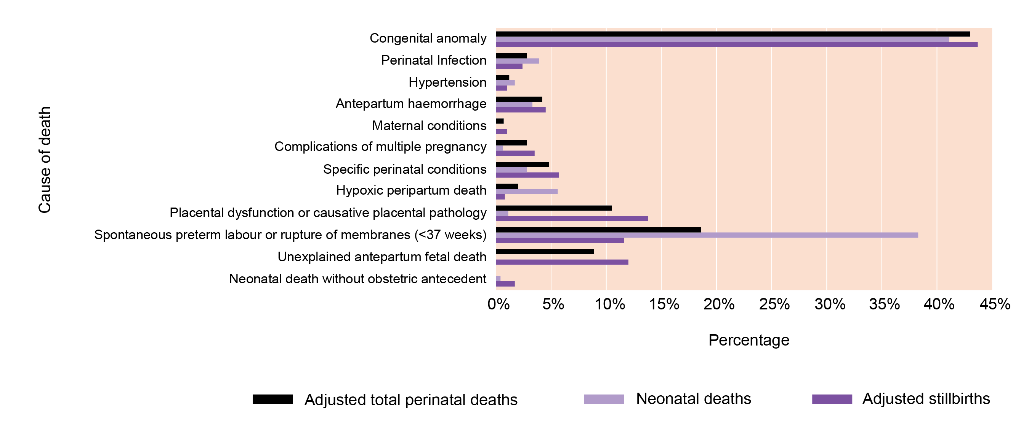
Causes of deaths using PSANZ classifications

Slide 13
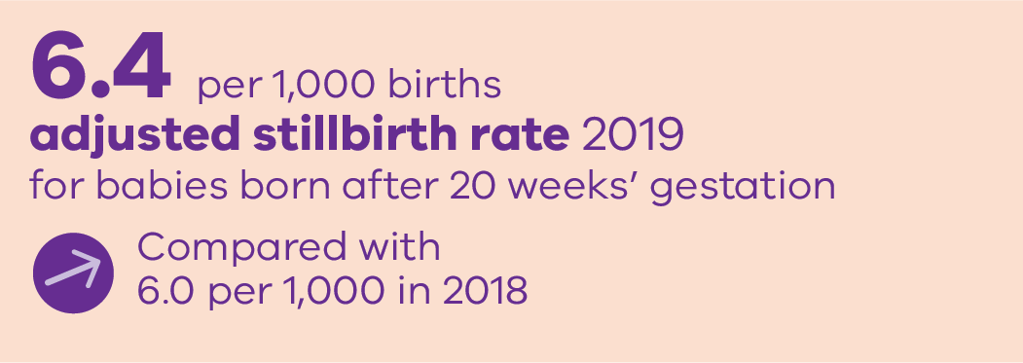
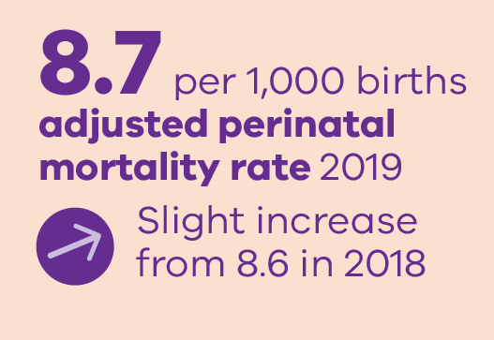
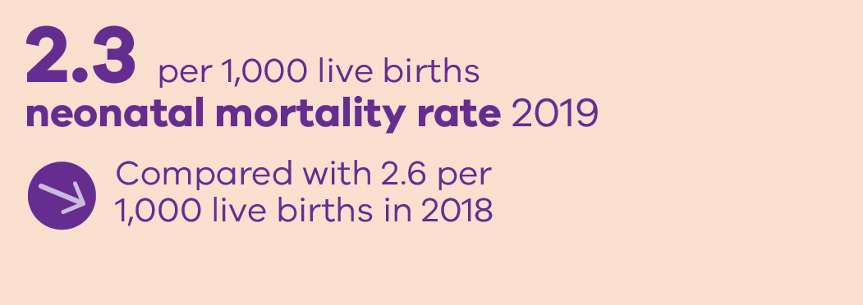
Perinatal mortality rates in 2019

Slide 14
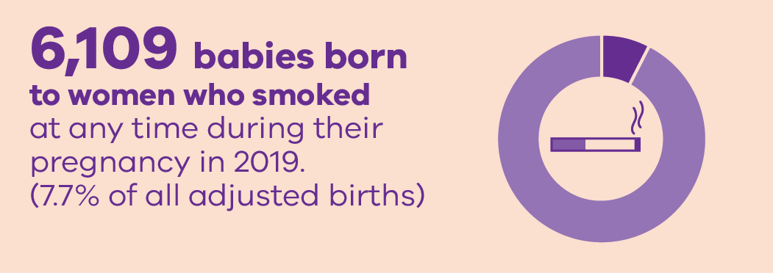
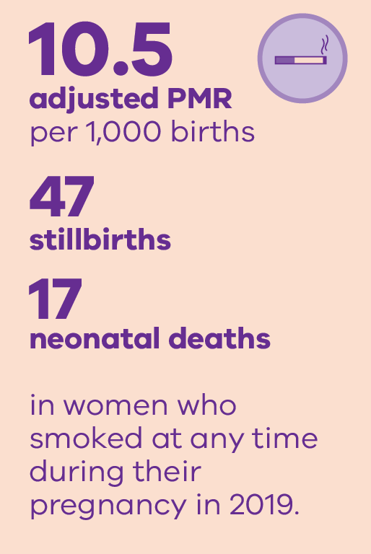
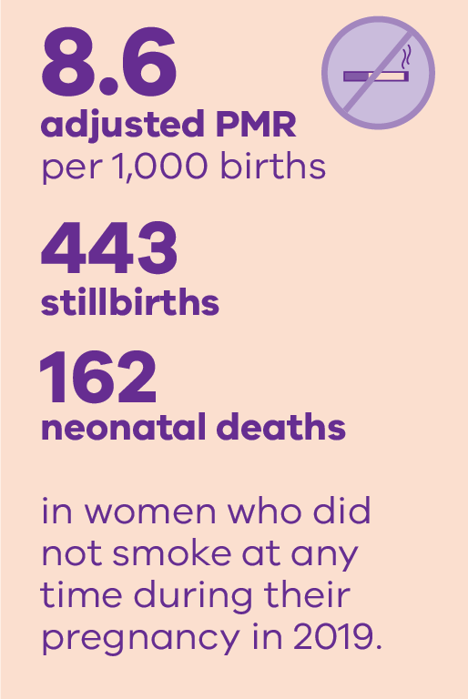
Smoking and outcomes in 2019

Slide 15
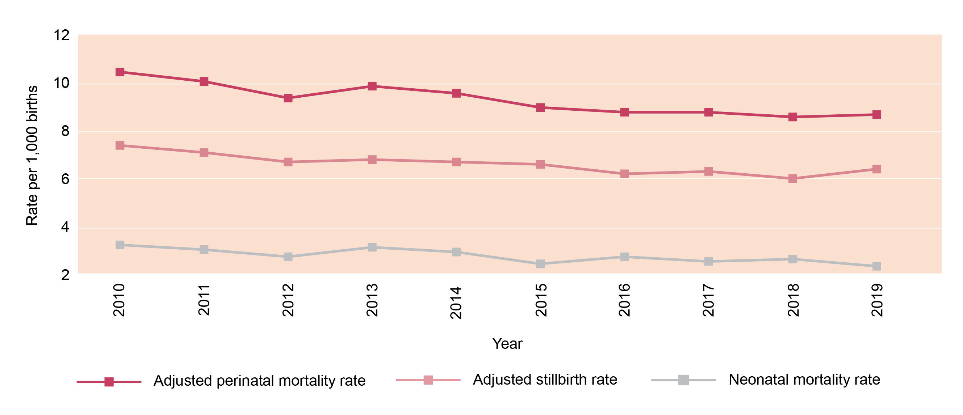
Trends in perinatal mortality rates

Slide 16
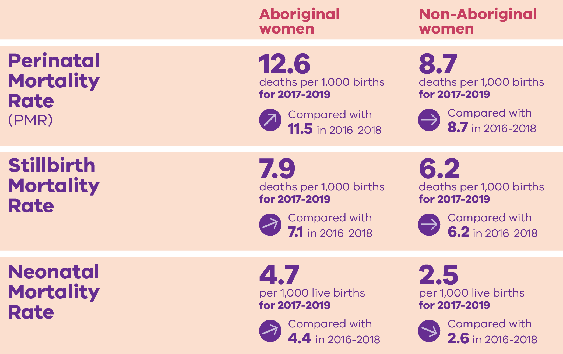
The gap: Aboriginal and Non-Aboriginal women

Slide 17
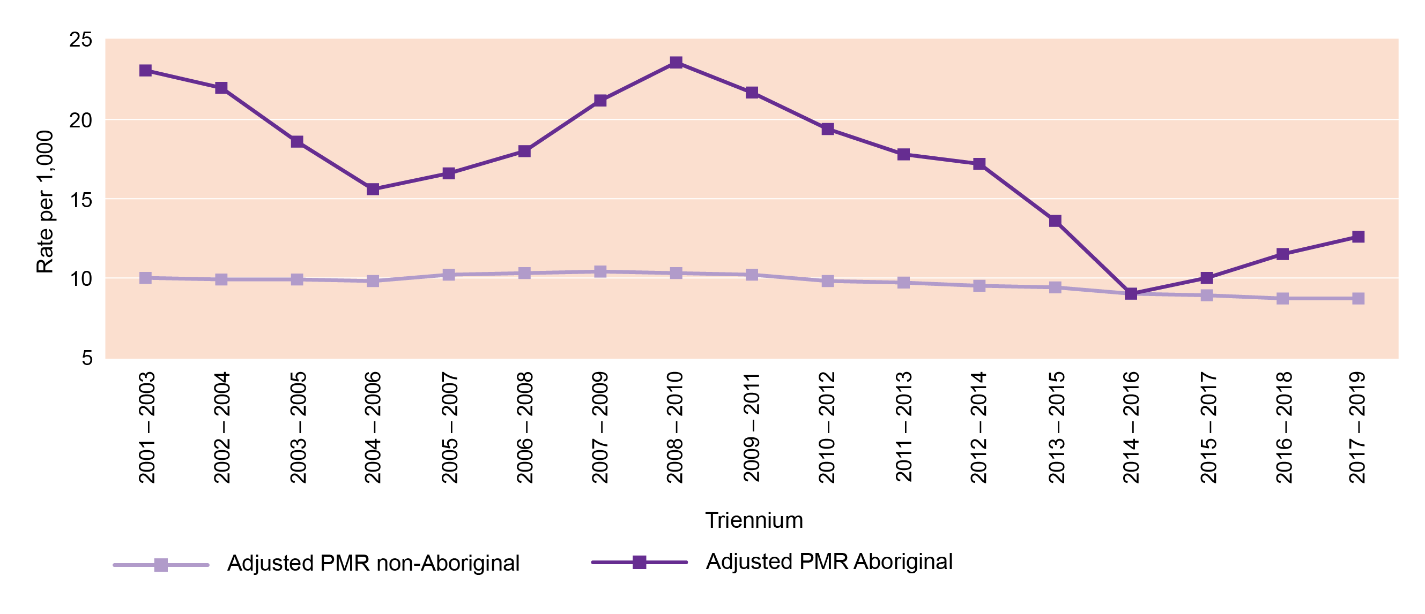
Perinatal mortality rate by Aboriginal status: Rolling triennia

Slide 18
CCOPMM recommendations: Perinatal

Slide 19
Recommendations
Maternity services must develop and regularly audit a pathway that facilitates rapid access to an emergency operating theatre 24/7 to prevent significant maternal or perinatal morbidity or mortality
For all Category 1 caesarean sections, services must record the time in which the decision was made to perform the caesarean section – to enable the accurate recording of the time taken from the ‘decision to deliver’ to the birth of the baby

Slide 20
Recommendations
Develop and implement a formal time out process prior to every instrumental birth and emergency caesarean section, whether in a birth room or in the operating theatre, to improve situational awareness and decision making about whether it is the right mode of birth, in the right location, with the right instrument/s, and the right clinical team in attendance
Develop and implement a credentialing process for medical staff practising obstetrics at all levels of training and experience who are undertaking instrumental births and complex caesarean sections

Slide 21
Recommendations
Formalise pathways for women to have timely access to specialist clinical consultations from a named tertiary (level 6) service for secondary and primary maternity services
Evaluate the effectiveness of current services in meeting the specific needs of women during pregnancy and in the year following birth. If gaps are identified, implement strategies to improve the health and wellbeing of women and families. The areas of mental health and family violence require specific focused attention

Slide 22
Good practice points
Good practice points reflect the findings of CCOPMM’s review of all cases of maternal, perinatal and paediatric mortality, and severe acute maternal morbidity in a reporting year
They are designed to guide local improvements in clinical performance and can relate to our clinical care and/or the system or service we work in

Slide 23
Good practice points
Ensure all staff are upskilled in clinical management through PRactical Obstetric Multi-Professional Training (PROMPT) or alternative program to ensure clinicians are familiar with obstetric emergencies
Use your own clinical scenarios to routinely train staff
Use rare and high-risk emergencies in your training programs

Slide 24
Good practice points
Monitoring - Twin to Twin Transfusion Syndrome - In addition to growth and amniotic fluid assessment every 2 weeks from 16 weeks, include umbilical artery and mid cerebral artery (MCA) Dopplers from 20 weeks’ gestation
If there is growth discordance or amniotic fluid level discordance, include assessment of the ductus venosus (DV) flow
Important component of the staging for twin to twin syndrome

Slide 25
Good practice point
The judicious, or non-use, of oxytocin infusion for augmentation of a multiparous woman who fails to progress in labour is recommended

Slide 26
Good practice points
To prevent significant maternal or perinatal morbidity or mortality, maternity services must have clear pathways in place that facilitate timely access to an emergency theatre
Rapid access must be available where there is an immediate threat to life of a mother and/or baby – e.g. code green/category 1 caesarean section, management of uterine rupture, management of antepartum heamorrhage
These pathways need to be audited to monitor rapid access in services 24/7

Slide 27
Good practice points
Clear handover of care must occur between health services when transferring women during pregnancy
This must be initiated by the service/care provider initiating the transfer
This will remove the onus on women especially when they are vulnerable or at a late gestation in pregnancy

Slide 28
Good practice point
Women choosing to undergo prenatal testing with cell-free DNA testing should be offered an ultrasound at 11 to 13+6 weeks’ gestation to assess early fetal structural development

Slide 29
Good practice points
Strengthen your service’s relationships with maternal and child health nurse (MCHN) services - to ensure there is support for women that have complex psychosocial history and/or a history of catastrophic episodes
Ensure effective connection and handover to MCHNs

Slide 30
For more information
www.bettersafercare.vic.gov.au/publications/victorias-mothers-babies-and-children-2019
Refer to CCOPMM’s other slide packs on:
Mothers and babies
Maternal mortality and morbidity
Child and adolescent mortality
2019 recommendations

Slide 31
Connect with us
www.bettersafercare.vic.gov.au
tanya.farrell@safercare.vic.gov.au
@safercarevic @TanyaFarrell13
Safer Care Victoria

