Slide 1
Tonsillectomy and Adenoidectomy Readmission Collaborative End of project summary – 25 June 2020
A/Prof Gillian Nixon, Clinical Lead, Reducing clinical variation in paediatric adenotonsillectomy project

Slide 2
Why focus on readmission after tonsillectomy?
Adenoidectomy and tonsillectomy (T&A) are very commonly performed in children (around 12,000 per year in Victoria).
These operations are performed in more than 70 hospitals in Victoria alone.
Readmission after T&A is the most common reason for readmission after a surgical procedure in a child Zhou H et al. Austr Health Rev 2019.
Most common cause of post-procedural pain presentation to ED Billings et al. Laryngoscope Investigative Otolaryngology 2019.

Slide 3
What is a collaborative (in a nutshell)?
A collaborative is a short-term learning system that brings together a number of teams from hospitals or clinics to seek improvement in a focused topic area.
The Breakthrough Series 2003
Institute for Healthcare Improvement
See Institute of Healthcare Improvement - www.ihi.org

Slide 4
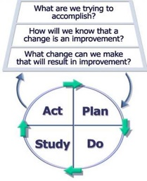
Model for Improvement
A framework to guide improvement work.
Key - using small scale tests of change with PDSA as you introduce something new.
For more information view the Institute for Healthcare Improvement resources
@ www.ihi.org.
Langley et al. the Improvement guide 2009.
Notes:
For further information see the Safer Care Victoria, Reducing readmissions after paediatric tonsillectomy Implementation package.

Slide 5
Paediatric Tonsillectomy Readmission Collaborative
Change ideas developed from literature review and expert advice.
Call for expressions of interest from health services.
5 paediatric teams from different health services- metro, regional, private, public, tertiary and secondary.
July 2019 – March 2020.

Slide 6
Components of the Change Package

Slide 7
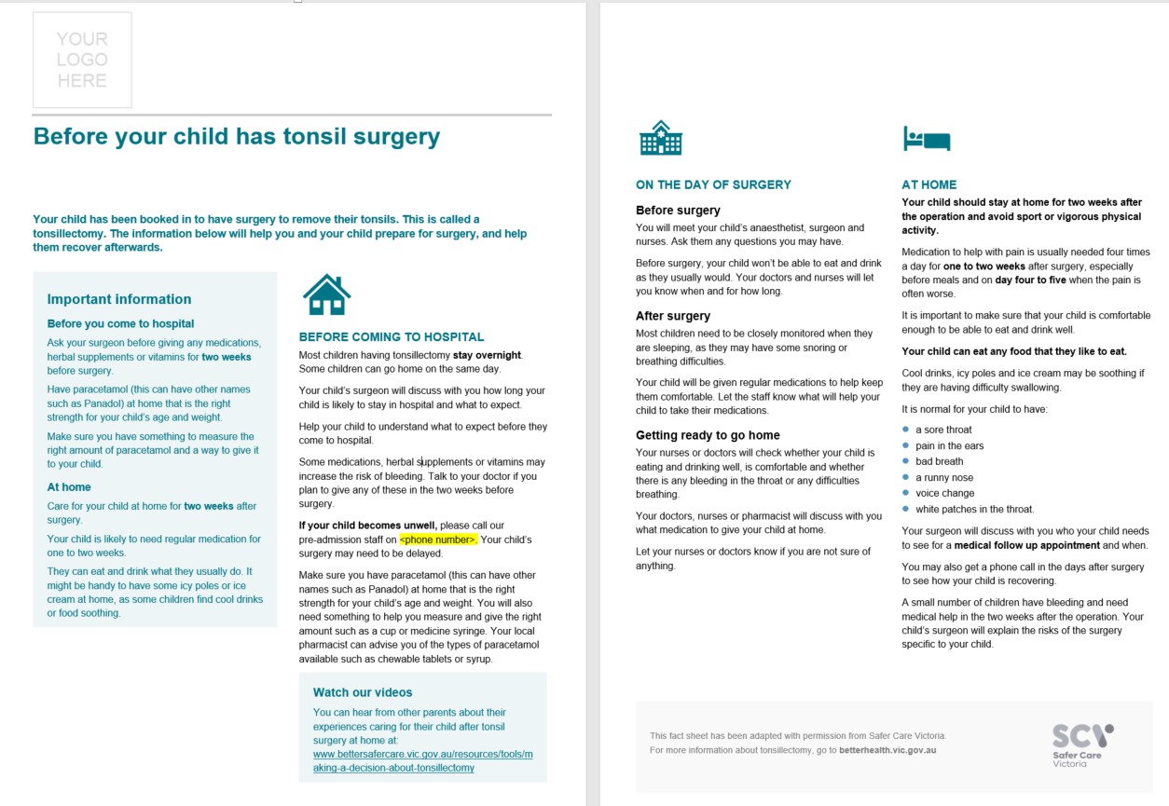
Pre-admission information
Notes:
Adapt this resource to meet local context at your health service.

Slide 8
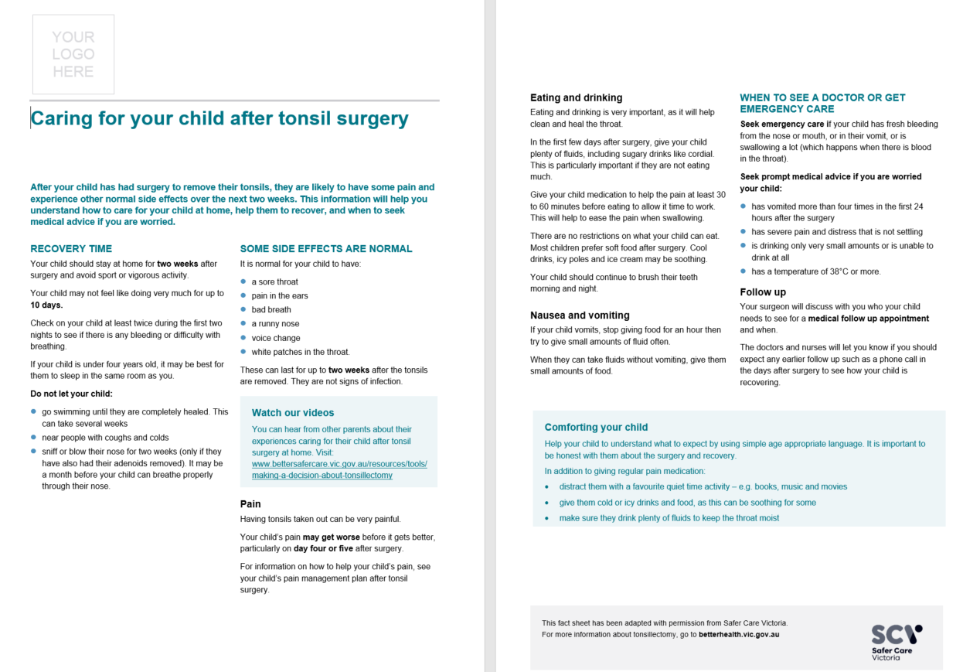
Discharge information
Notes:
Adapt this resource to meet local context at your health service.

Slide 9
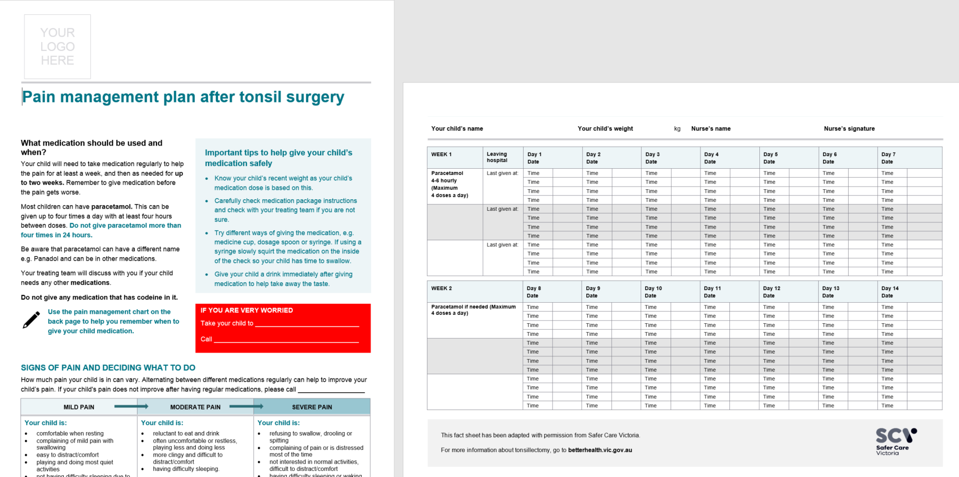
Pain management advice
Notes:
Adapt this resource to meet local context at your health service.

Slide 10
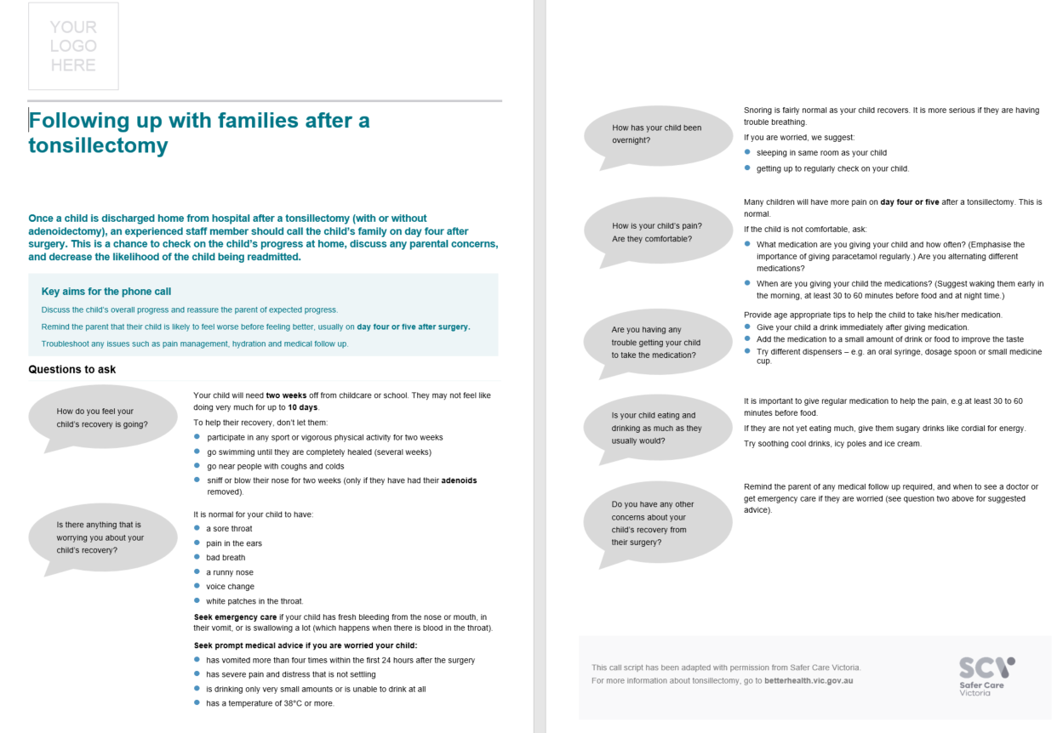
Phone script for post-operative phone calls
Notes:
Adapt this resource to meet local context at your health service.

Slide 11
Results of the Project

Slide 12
Outcomes
Testing change package components by all sites:
By end December 2019, 3 of 5 sites were testing 100% of the change package
The other 2 achieved 75% by February 2020
Improved family satisfaction of support and clinician awareness of the unique needs of children and families before and after tonsil surgery.

Slide 13
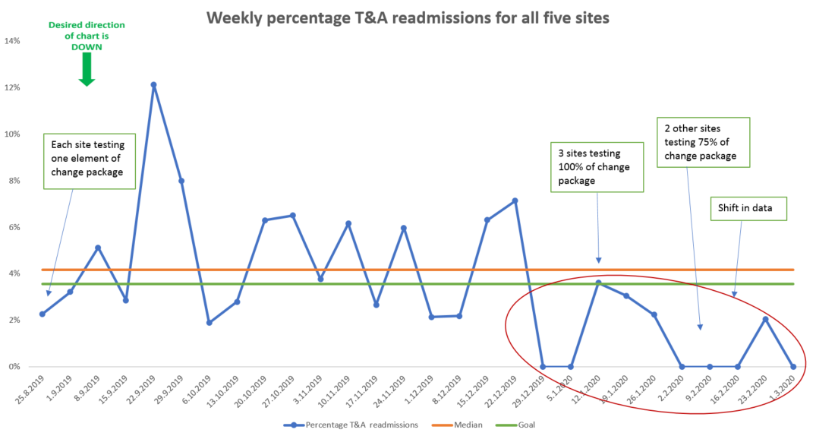
Impact on readmission rates- 5 sites combined
Notes:
The weekly aggregated readmission rate median changed from a baseline of 4.2% to 0% following a shift in the data.

Slide 14
Impact on readmission rates - Local Data
Include local data here if appropriate.

Slide 15
Where to now?

Slide 16
Ongoing monitoring of impact
The Victorian Paediatric Clinical Network will continue to monitor the VAED data for participating sites for six months to capture the effect of the project (VAED data delayed by three months).
Publicity of the final change package across the Victorian health sector.
Dissemination of results through professional networks of participating clinicians.

Slide 17
Resources – Links to consumer, clinician and quality improvement resources
To help your team when considering introducing a quality improvement project to reduce readmissions after paediatric tonsillectomy see resources on the Safer Care Victoria website.
There are consumer, clinician T&A resources and an Implementation package:
Project webpages @
https://www.bettersafercare.vic.gov.au/improvement/projects/mbc/adenotonsillectomy
https://www.bettersafercare.vic.gov.au/clinical-guidance/paediatric/reducing-readmissions-after-paediatric-tonsil-surgery
https://www.bettersafercare.vic.gov.au/clinical-guidance/paediatric/making-a-decision-about-tonsillectomy
Links updated 17 February 2021
Notes:
We encourage you to use the Safer Care Victoria T&A Implementation package to support your team when considering introducing a quality improvement project to reduce readmissions after paediatric tonsillectomy. We can adapt the resources to meet our own local context.

Slide 18
References
Zhou H, Della P, Roberts P, Porter P, Dhaliwal S. A 5-year retrospective cohort study of unplanned readmissions in an Australian tertiary paediatric hospital. Australian health review: a publication of the Australian Hospital Association. 2019;43(6):662-71.
Billings KR, Manworren RCB, Lavin J, et al. Pediatric emergency department visits for uncontrolled pain in postoperative adenotonsillectomy patients. Laryngoscope Investig Otolaryngol. 2018;4(1):165-169.
Langley GL, Moen RD, Nolan TM, Nolan TW, Norman CL, Provost LP. The Improvement Guide: A Practical Approach to Enhancing Organizational Performance. San Francisco: Jossey-Bass Publishers; 2009.
Institute for Health of Healthcare Improvement. Available from: www.ihi.org. Last accessed 16 June 2020.
Notes:
See the Safer Care Victoria Reducing readmissions after paediatric tonsillectomy Implementation package for additional references.

Slide 19
Connect with us
www.bettersafercare.vic.gov.au
info@safercare.vic.gov.au
@safercarevic
Safer Care Victoria
Subscribe to our e-news at www.bettersafercare.vic.gov.au

