Slide 1
Victoria’s mothers, babies and children 2020​
Trends and recommendations​

Slide 2
About CCOPMM

Slide 3
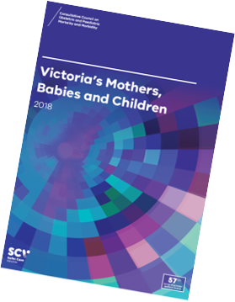
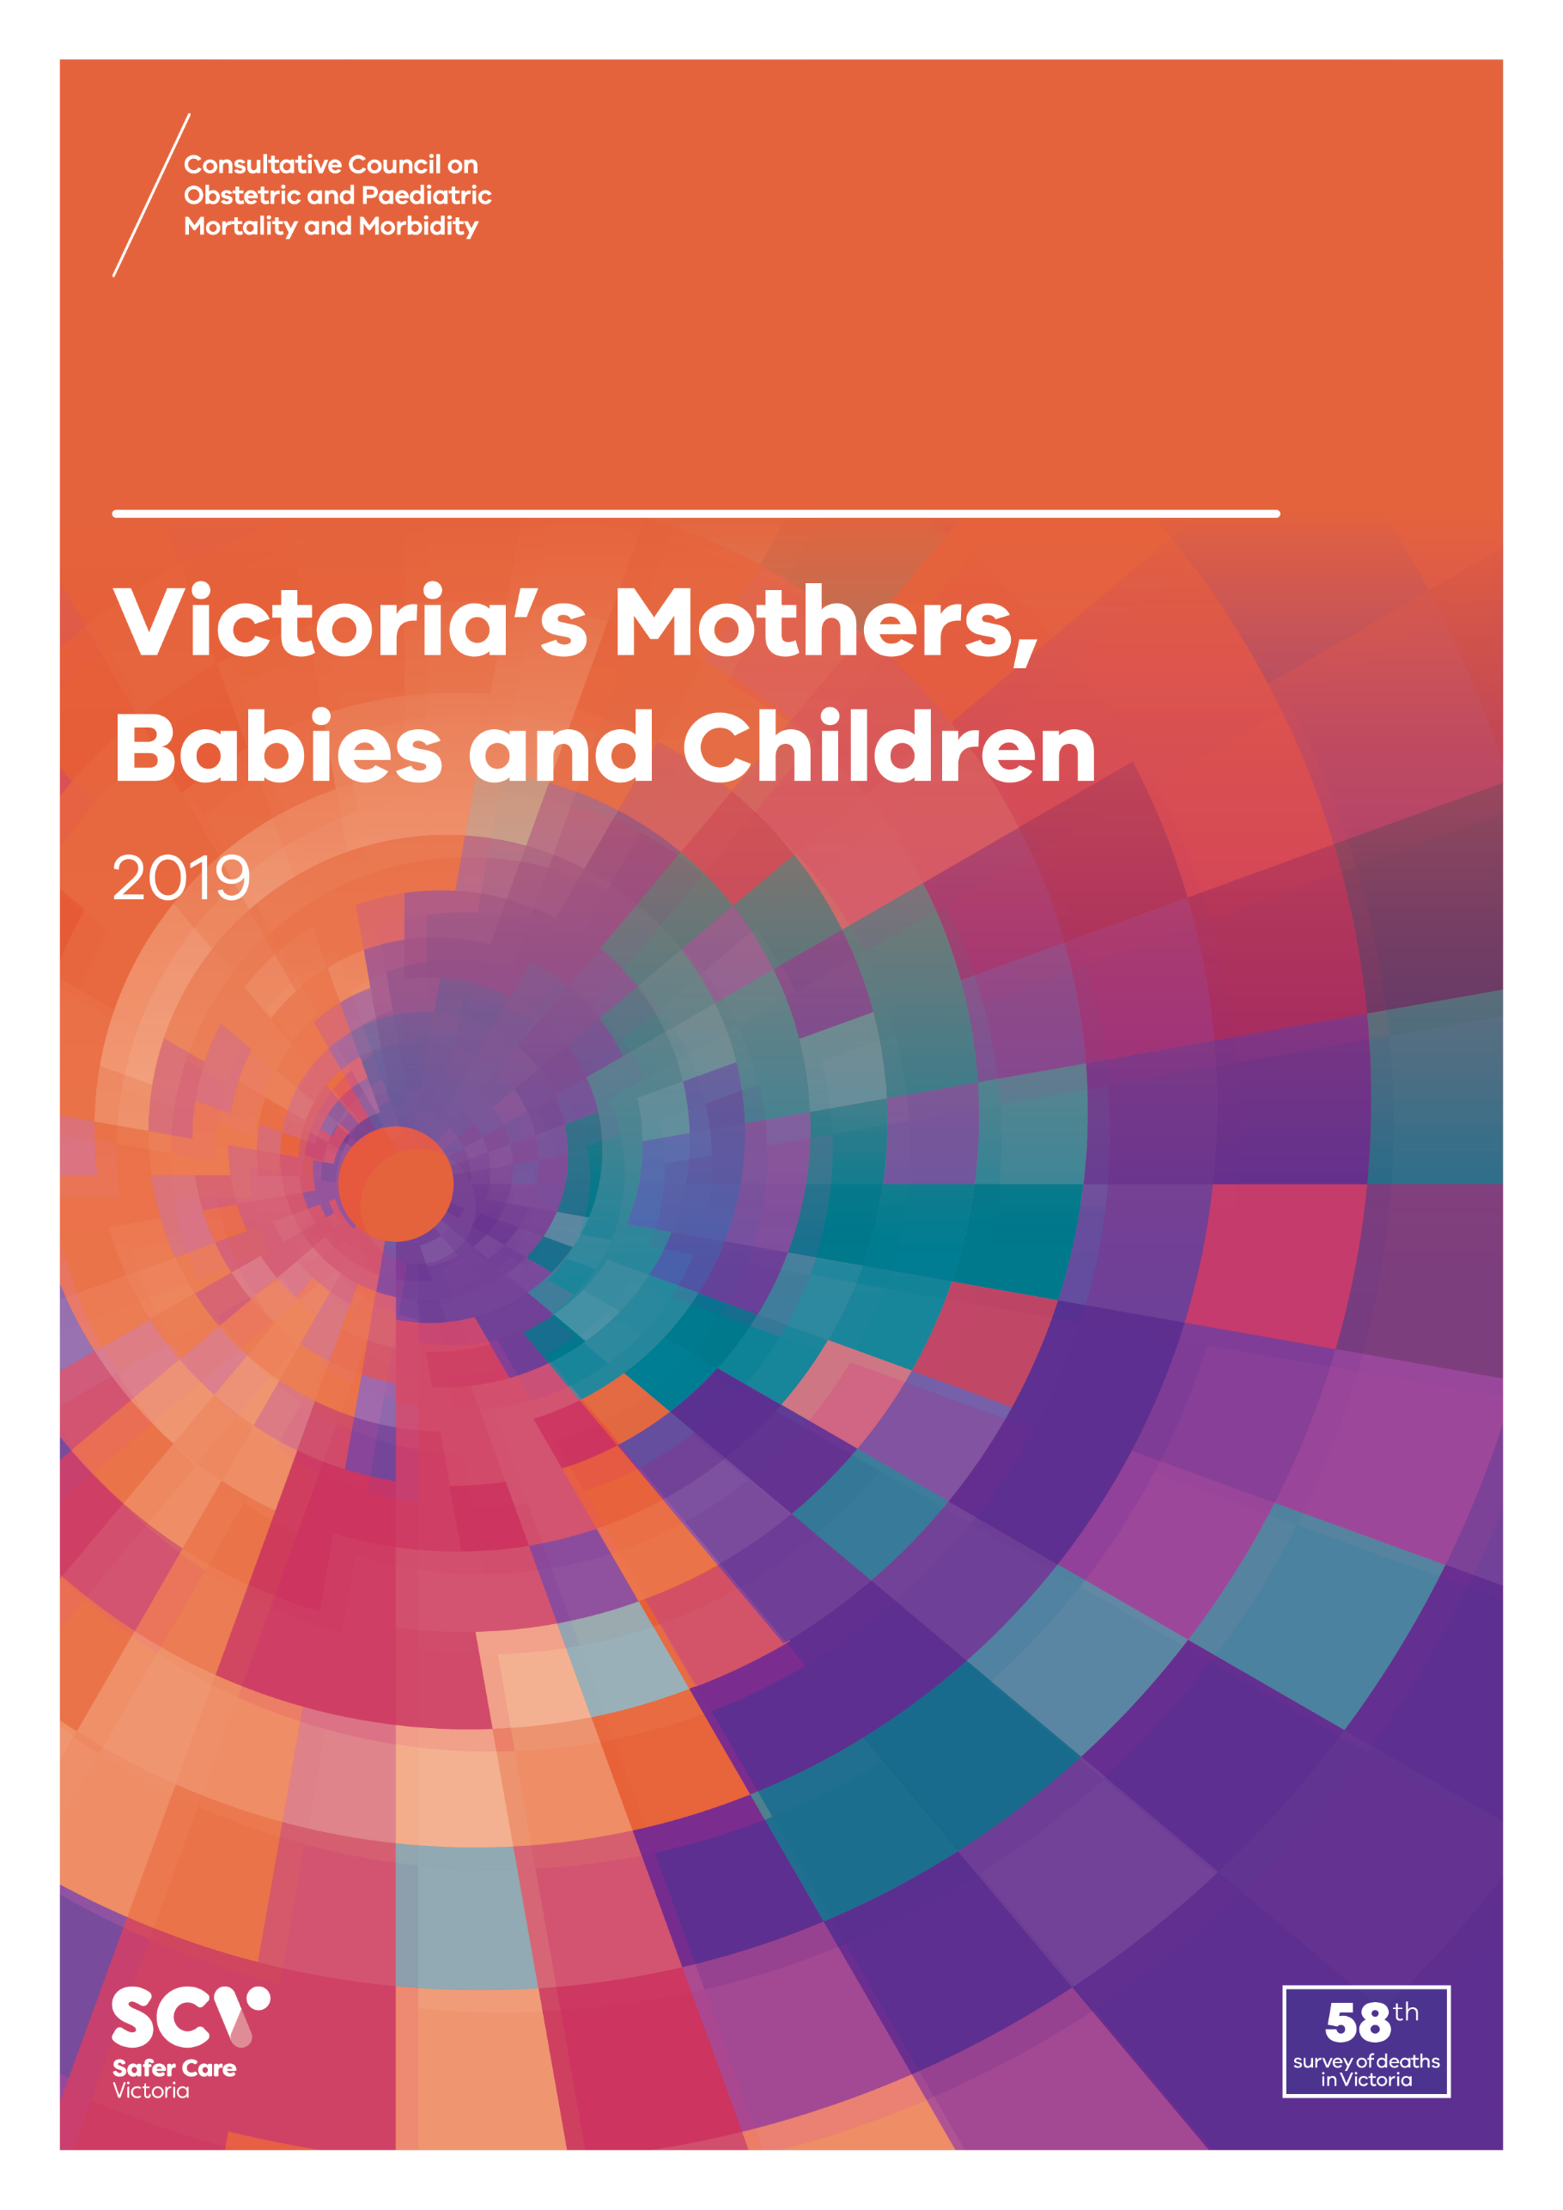
About CCOPMM
The Consultative Council on Obstetric and Paediatric Mortality and Morbidity (CCOPMM) is a statutory authority appointed by the Minister for Health.
Chair: Adjunct Professor Tanya Farrell
Operates under the Public Health and Wellbeing Act 2008

Slide 4
About CCOPMM
Legislative responsibility for data collection:
Victorian Perinatal Data Collection (VPDC)
Victorian Congenital anomalies register (VCAR)
Legislative responsibility for health surveillance:
Mortality collections and review of perinatal, child and adolescent, and maternal mortality
Morbidity collections: severe acute maternal morbidity (SAMM)

Slide 5
Undertaking case reviews
CCOPMM has four subcommittees that undertake case reviews and report to CCOPMM.
Stillbirth – Chair: Professor Susan McDonald
Neonatal Mortality and Morbidity (0-27 days) – Chair: Professor Rod Hunt
Maternal Mortality and Morbidity – Chair: Professor Mark Umstad
Child and Adolescent Mortality and Morbidity (28 days-17 years) – Chair: Adjunct Clinical Associate Professor Rob Roseby

Slide 6
Undertaking research
CCOPMM conducts research itself and provides data for research purposes. The CCOPMM Research and Reporting subcommittee leads this work – Chair: Professor Caroline Homer.
CCOPMM identifies research priorities by:
analysis of our reports, data and through case reviews
collaborating with external research projects

Slide 7
Why we do what we do
Independent oversight of all deaths and severe maternal morbidity
Highlight areas that require improvement – hospital and community
Highlight areas for further research
Inform the development of policies and guidelines
Provide advice on areas for prioritisation and investment

Slide 8
Trends and comparisons: 2020

Slide 9
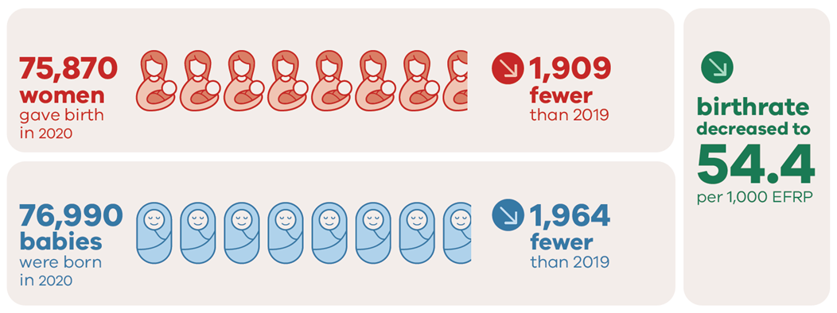
Births in 2020

Slide 10
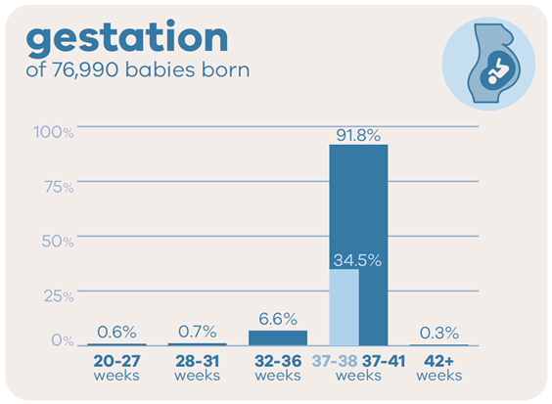
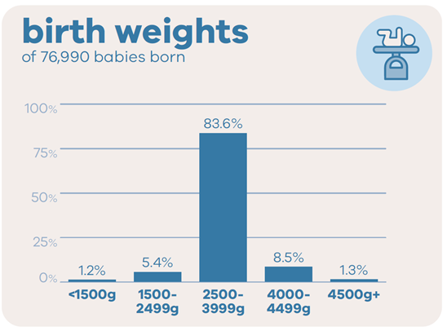
Babies in 2020

Slide 11
Aboriginal mothers and babies in 2020

Slide 12
Trends and comparisons: Perinatal mortality

Slide 13
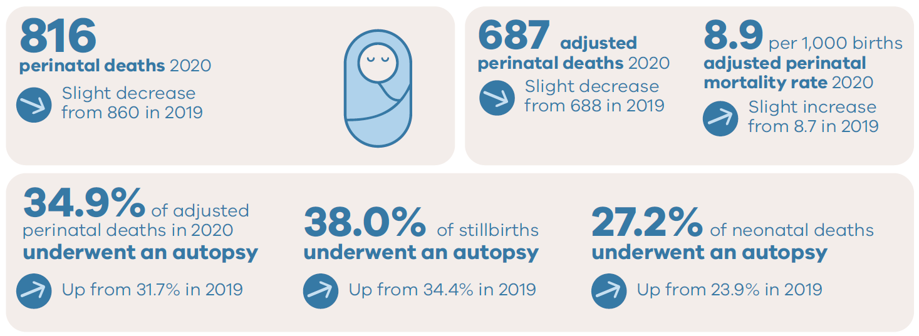
Perinatal deaths in 2020

Slide 14
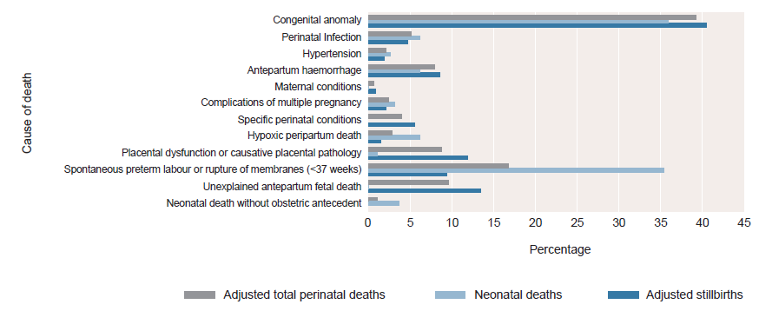
Causes of stillbirths, neonatal and perinatal deaths PSANZ perinatal death classification, 2020

Slide 15
Perinatal mortality rates in 2020

Slide 16
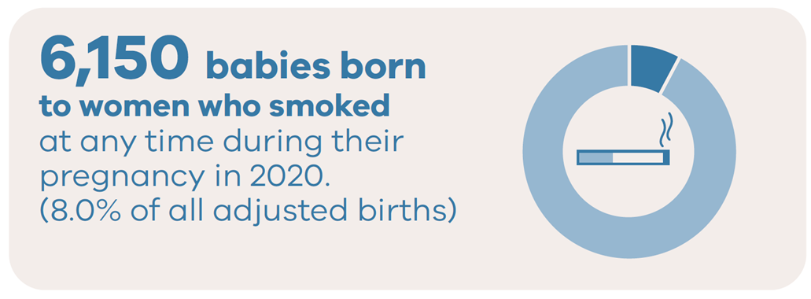
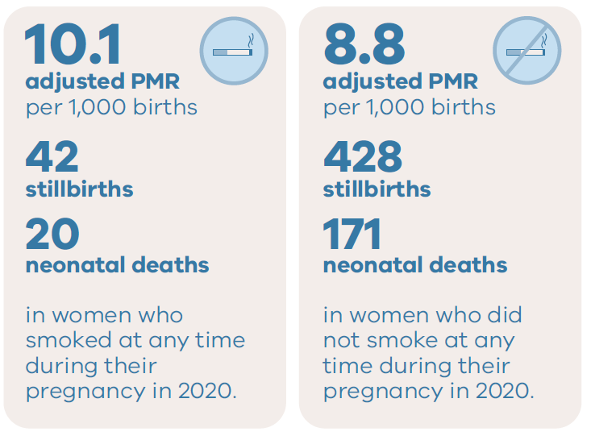
Smoking and outcomes in 2020

Slide 17
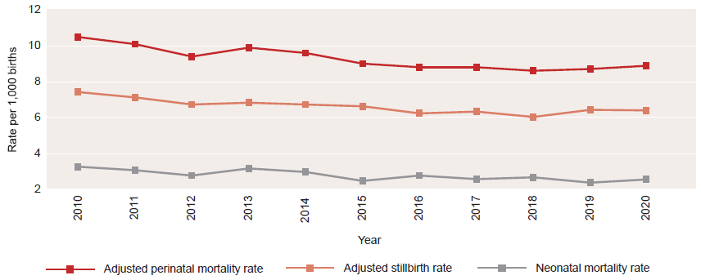
Trends in adjusted perinatal mortality rates, 2010-2020

Slide 18
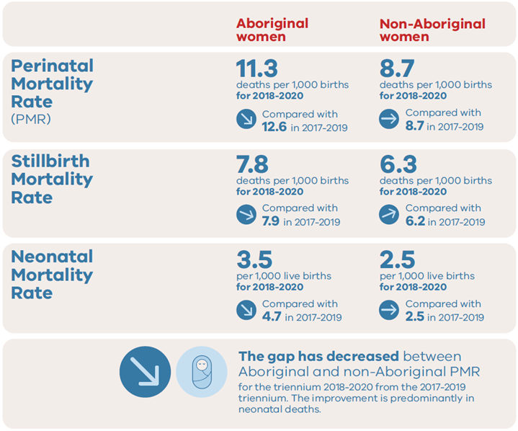
The gap: Aboriginal and Non-Aboriginal women, 2018-2020

Slide 19
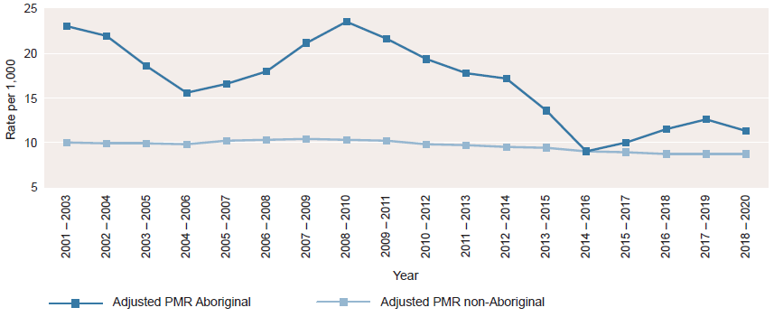
Adjusted perinatal mortality rate by Aboriginal status of mother, by rolling triennia, 2001-2020*

Slide 20
Trends and comparisons: Maternal mortality and morbidity

Slide 21
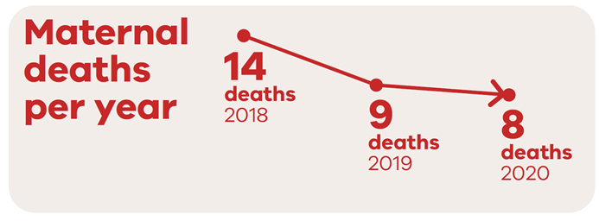
Maternal mortality: 2018 to 2020

Slide 22
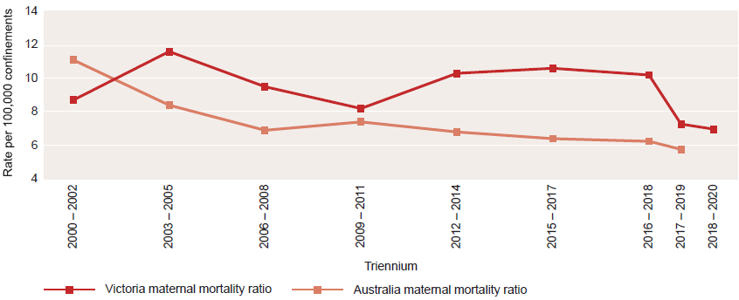
Maternal mortality ratios: Rolling triennia
Please note that the Australian maternal mortality ratio for 2019 does not include data from Western Australia and deaths that are awaiting classification. Data was previously reported as discrete trienniums however CCOPMM has changed reporting to rolling trienniums (i.e. 2016-2018, 2017-2019 and 2018-2020).

Slide 23
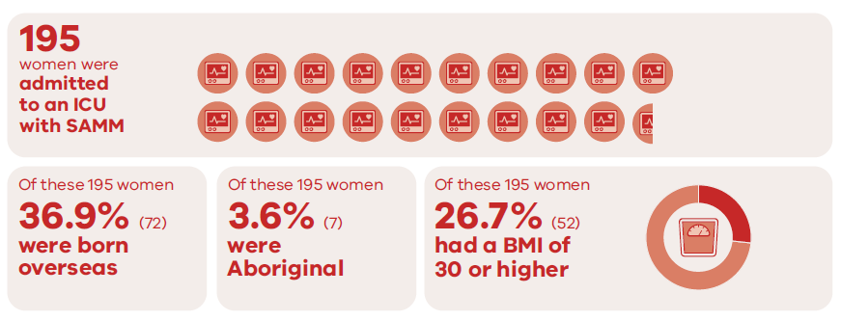
Severe Acute Maternal Morbidity (SAMM), 2020

Slide 24
Trends and comparisons: Child and adolescent mortality

Slide 25
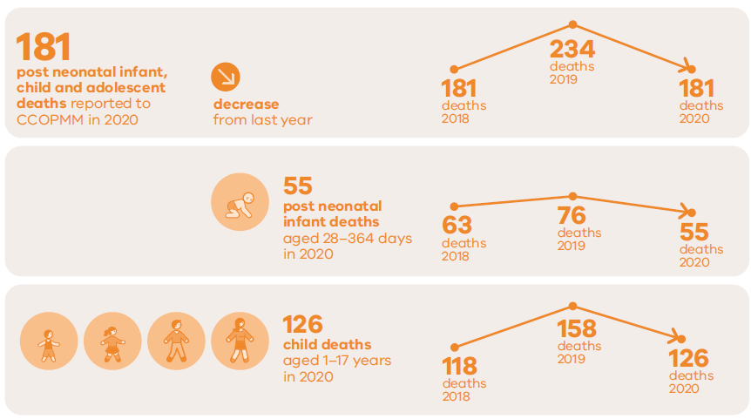
Child and adolescent deaths in 2020

Slide 26
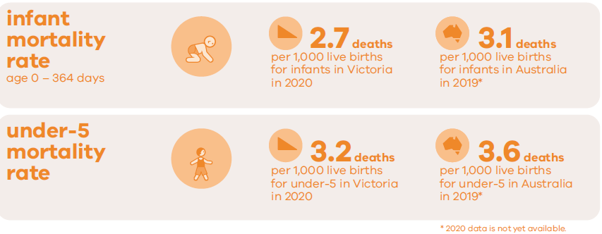
Infant and under 5 mortality

Slide 27
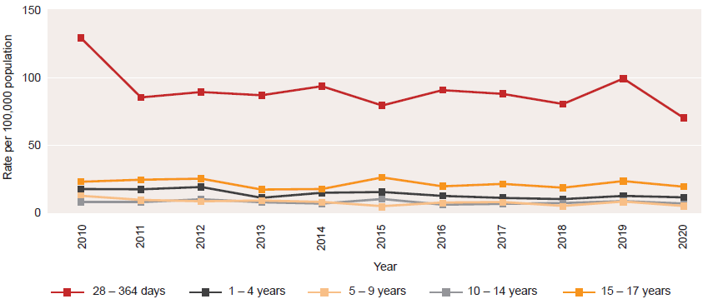
Rates of death by age group, 2010–2020

Slide 28
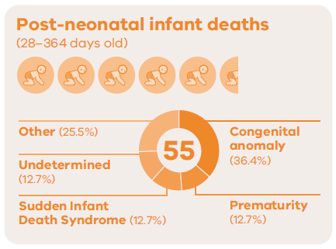
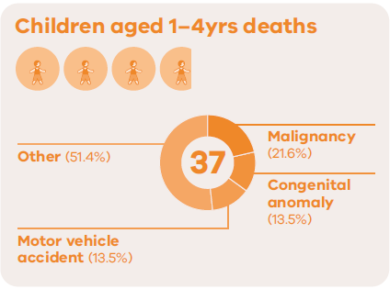
Causes of death in 2020

Slide 29
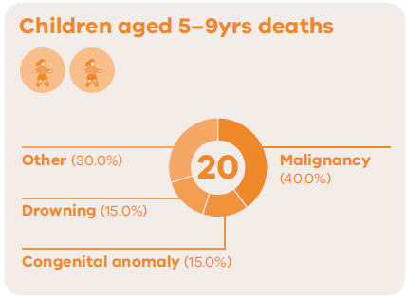
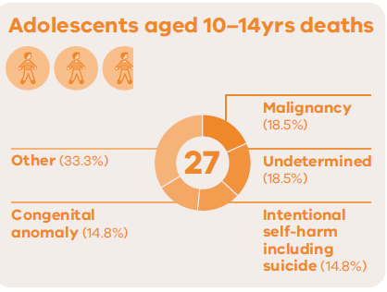
Causes of death in 2020

Slide 30
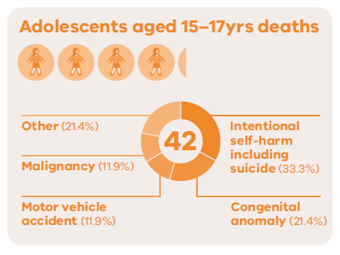
Causes of death in 2020

Slide 31
CCOPMM recommendations: 2020

Slide 32
Recommendation – 1
CCOPMM and SCV collaborate with key partners in continuing to measure and report on the impact of the COVID-19 pandemic on selected outcomes for women, babies and children.

Slide 33
About recommendation – 1
CCOPMM collects data related to the impact of COVID-19.
Preliminary findings on the impact of the pandemic were released by CCOPMM in the CCOPMM COVID-19 communique in 2020.
Statewide data showed no areas of concern requiring immediate interventions.
National data did report significant impacts on women and their partners.
Further research is needed to understand the direct and indirect impacts of COVID-19 to help inform prevention strategies and clinical care.

Slide 34
Recommendation – 2
CCOPMM will actively support the development of a learning system model for Victorian maternity, neonatal and paediatric services to create an environment where consumers, health services and government can work together to learn and improve in an integrated way.

Slide 35
About recommendation – 2
A learning health system is based on rapid learning from data and evidence and applying knowledge to improve care.
CCOPMM will commission specific safety reviews into reoccurring issues starting with neonatal resuscitation and fetal monitoring to identify contributing factors.
AcciMap will be used – a systems focused review methodology.
Mortality and morbidity case review tool to be piloted in selected services to ensure learnings from serious adverse events and systems improvement.

Slide 36
Recommendation – 3
Develop and implement targeted improvement programs for maternity, neonatal and paediatric services to strengthen clinical governance, incident review, reporting processes and quality improvement capability.

Slide 37
About recommendation – 3
Clinical governance was a key area of concern in the Targeting Zero report. To ensure services are safe and high-quality, clinical governance capability must continue to be an area of focus.
SCV clinical governance training – for boards and executives to strengthen leadership, culture and improve clinical outcomes.
SCV clinical governance assessment tool – determine clinical governance capability and performance and areas for improvement.
Other considerations – clinical incident management system, clear escalation policies and clinical governance improvement plans.

Slide 38
Recommendation – 4
Ensure early intervention and preventative care programs focus on improving outcomes for priority maternal and child populations including:
children who are involved with the child protection and out-of-home care system
those who identify with being Aboriginal and Torres Strait Islander
children involved with the youth justice system
those with socioeconomic disadvantage
those who are from diverse communities
those living with mental health challenges
those facing family violence.

Slide 39
About recommendation – 4
CCOPMM continues to see disproportionate mortality and morbidity experienced by priority populations of women, children and their families.
CCOPMM recommends a system- focused approach to understanding inequities with a focus on:
Examining evidence to support system reform and mapping governance structures for increased accountability.
Exploring and evaluating integrated care models such as community-based ‘hospitals’ program and Infant, Child and Family Mental Health and Wellbeing Hubs.
Further investment/expansion of evidence-based models, evaluation of existing initiatives and programs and development of a strategy to measure improvement.

Slide 40
Recommendation – 5
Actively support the research and quality improvement initiatives that are being led by our Aboriginal health partners, to ensure best practice and improve health outcomes and wellbeing.

Slide 41
About recommendation – 5
CCOPMM data shows that Aboriginal mothers and babies experience poorer health outcomes than non-Aboriginal mothers and babies.
We will work with our Aboriginal health and research partners to identify evidence gaps and research priorities.
Increasing access to culturally safe health care.
Build on existing evidence and research underpinned by self-determination, co design and genuine partnership between maternity sector and Aboriginal Community Controlled Health Organisations.
Projects focused on reducing smoking during pregnancy and reducing risk factors for stillbirth.

Slide 42
For more information
www.bettersafercare.vic.gov.au/reports-and-publications/victorias-mothers-babies-and-children-2020-report
Refer to CCOPMM’s other slide packs on:
Mothers and babies
Maternal mortality and morbidity
Perinatal mortality
Child and adolescent mortality

Slide 43
Connect with us
www.bettersafercare.vic.gov.au
tanya.farrell@safercare.vic.gov.au
@safercarevic @TanyaFarrell13
Safer Care Victoria

