Slide 1
Victoria’s mothers, babies and children 2020
Child and adolescent mortality

Slide 2
About CCOPMM

Slide 3
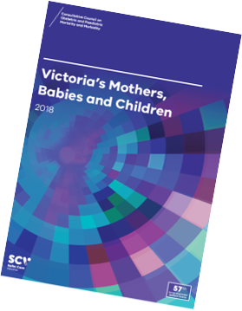
About CCOPMM
The Consultative Council on Obstetric and Paediatric Mortality and Morbidity (CCOPMM) is a statutory authority appointed by the Minister for Health.
Chair: Adjunct Professor Tanya Farrell
Operates under the Public Health and Wellbeing Act 2008

Slide 4
About CCOPMM
Legislative responsibility for data collection:
Victorian Perinatal Data Collection (VPDC)
Victorian Congenital anomalies register (VCAR)
Legislative responsibility for health surveillance:
Mortality collections and review of perinatal, child and adolescent, and maternal mortality
Morbidity collections: severe acute maternal morbidity (SAMM)

Slide 5
Undertaking case reviews
CCOPMM has four subcommittees that undertake case reviews and report to CCOPMM.
Stillbirth – Chair: Professor Susan McDonald
Neonatal Mortality and Morbidity (0-27 days) – Chair: Professor Rod Hunt
Maternal Mortality and Morbidity – Chair: Professor Mark Umstad
Child and Adolescent Mortality and Morbidity (28 days-17 years) – Chair: Adjunct Clinical Associate Professor Rob Roseby

Slide 6
Undertaking research
CCOPMM conducts research itself and provides data for research purposes. The CCOPMM Research and Reporting subcommittee leads this work - Chair: Professor Caroline Homer.
CCOPMM identifies research priorities by:
analysis of our reports, data and through case reviews
collaborating with external research projects

Slide 7
Why we do what we do?
Independent oversight of all deaths and severe maternal morbidity
Highlight areas that require improvement – hospital and community
Highlight areas for further research
Inform the development of policies and guidelines
Provide advice on areas for prioritisation and investment

Slide 8
Trends and comparisons

Slide 9
Child and adolescent mortality
Includes deaths for post-neonatal infants, children and adolescents.
Post-neonatal infants are aged between 28 and 364 days.
Children and adolescents are aged between one year and up to, but not including, the 18th birthday (one to 17 years).

Slide 10
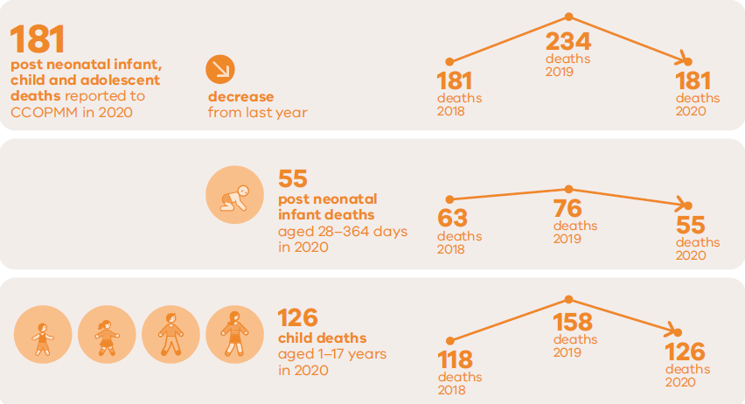
Child and adolescent deaths 2020

Slide 11
Definitions - neonatal, infants and under 5yrs
Neonatal - includes all live born babies from birth to 27 days
Post-neonatal infant - includes all live born babies from 28 days to 364 days
Infant - includes all live born babies from birth to 364 days
Under 5 - includes all babies from birth up to but not including the 5th birthday

Slide 12
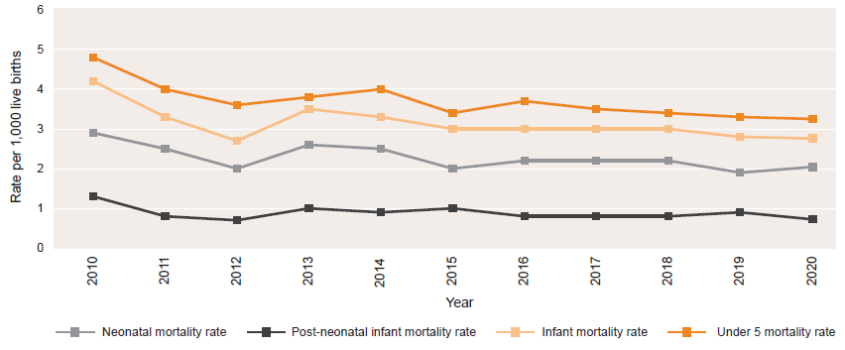
Neonatal, post-neonatal, infant and infant and under 5 mortality rates, 2010-2020

Slide 13
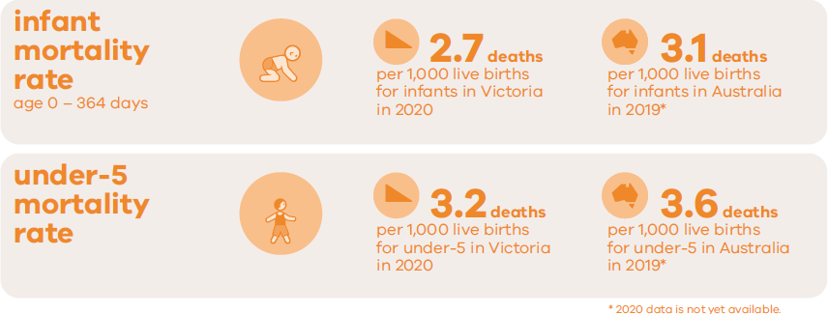
Under- 5 year mortality rate

Slide 14
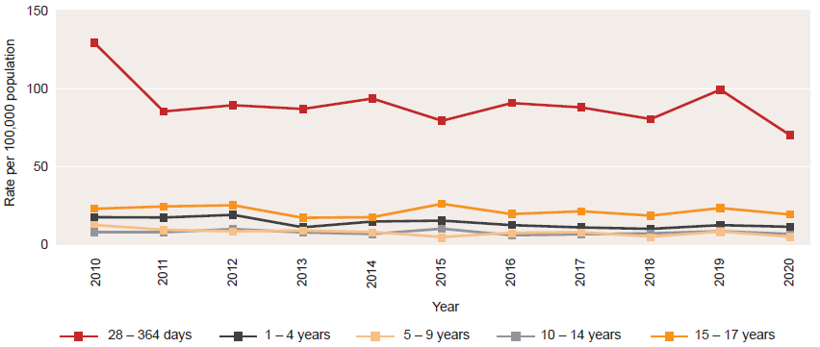
Rates of death by age group, 2010-2020

Slide 15
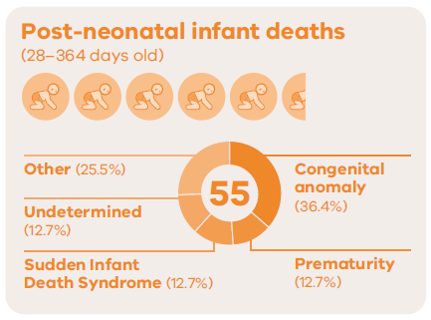
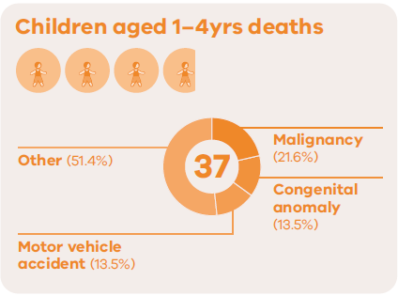
Causes of death in 2020 - Under 5 years

Slide 16
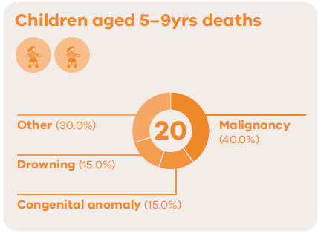
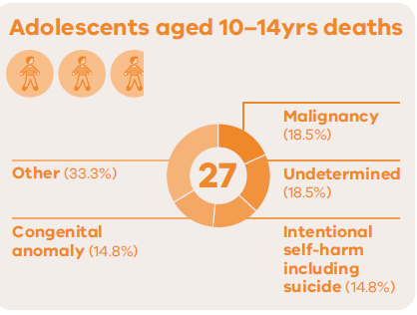
Causes of death in 2020 – 5-14 years

Slide 17
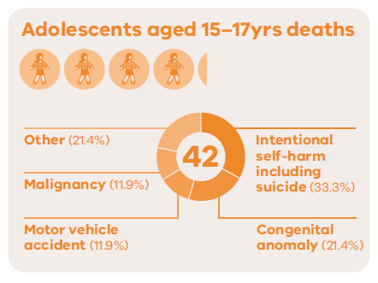
Causes of death in 2020 – 15-17 years

Slide 18
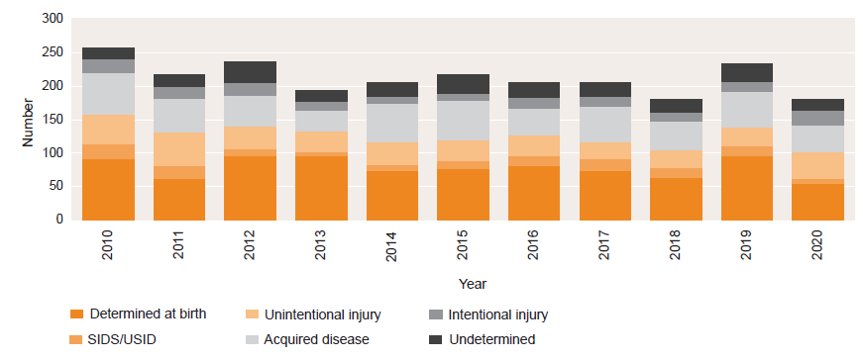
Deaths from major cause, 2010-2020 (28 days to 17 years)

Slide 19
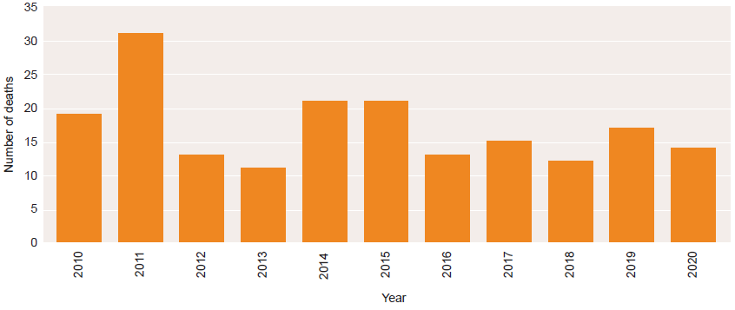
Deaths from motor vehicle accidents 2010-2020 (28 days to 17 years)

Slide 20
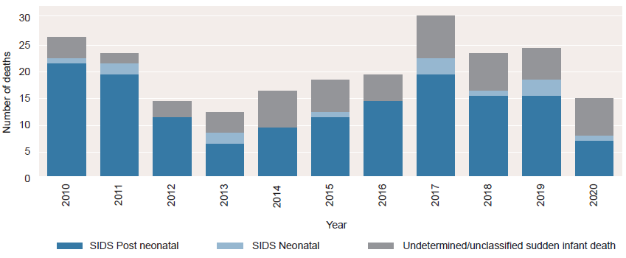
Unexplained sudden unexpected deaths in infants, 2010-2020

Slide 21
CCOPMM recommendations: Child and adolescent

Slide 22
Recommendation
Ensure early intervention and preventative care programs focus on improving outcomes for priority maternal and child populations including:
children who are involved with the child protection and out-of-home care system
those who identify with being Aboriginal and Torres Strait Islander
children involved with the youth justice system
those with socioeconomic disadvantage
those who are from diverse communities
those living with mental health challenges
those facing family violence.

Slide 23
About the recommendation
CCOPMM continues to see disproportionate mortality and morbidity experienced by priority populations of women, children and their families.
CCOPMM recommends a system- focused approach to understanding inequities with a focus on:
Examining evidence to support system reform and mapping governance structures for increased accountability.
Exploring and evaluating integrated care models such as community-based ‘hospitals’ program and Infant, Child and Family Mental Health and Wellbeing Hubs.
Further investment/expansion of evidence-based models, evaluation of existing initiatives and programs and development of a strategy to measure improvement.

Slide 24
Good practice points
Good practice points reflect the findings of CCOPMM’s review of all cases of maternal, perinatal and paediatric mortality, and severe acute maternal morbidity in a reporting year
They are designed to guide local improvements in clinical performance and can relate to our clinical care and/or the system or service we work in.

Slide 25
Good practice points: systems and/or processes
Documentation of care
Deaths of children
Drug administration times

Slide 26
1. Documentation of care needs – every time, every test
All paediatric services ensure children with complex medical needs are discharged with a medical history ‘card’, letter, or electronic summary – that outline current condition, treatment and key information to ensure continuity of care and treatment post discharge.
When a planned reduction in intensity of treatment (e.g. cessation of an antibiotic / reduction in dose of other treatment), have a plan including a clearly outlined post discharge follow up.

Slide 27
2. Deaths of children
All hospitals should review deaths of children with chronic medical conditions who are known to their health service.

Slide 28
3. Drug administration times – sepsis
Delays in antibiotic therapy for severe sepsis are associated with increased mortality, the first antibiotic dose should be given within an hour of presentation.
Clear verbal handover between prescribing and administering clinicians will strengthen the compliance with timing of dose administration and priorities of care planning.
Organisations should implement an auditing program to ensure timely administration of first dose antibiotics.

Slide 29
Good practice points: clinical
Febrile encephalopathy
Asthma

Slide 30
1. Febrile encephalopathy
Any child with a suspected febrile encephalopathy should be assessed by a senior paediatrician or emergency physician.
A child who has a fever and abnormal neurological examination needs immediate treatment including treatment and escalation of care.
Investigations of first afebrile seizures should include a family history or cardiac events and an ECG

Slide 31
2. Asthma
Children with a persistent wheezing should be reviewed by a doctor experienced in the management of children with Asthma
All children with Asthma require a clearly written Asthma plan that includes responses to increasingly severe symptoms

Slide 32
For more information
www.bettersafercare.vic.gov.au/reports-and-publications/victorias-mothers-babies-and-children-2020-report
Refer to CCOPMM’s other slide packs on:
Mothers and babies
Maternal mortality and morbidity
Perinatal mortality
2020 recommendations

Slide 33
Connect with us
www.bettersafercare.vic.gov.au
tanya.farrell@safercare.vic.gov.au
@safercarevic @TanyaFarrell13
Safer Care Victoria

