Slide 1
Victoria’s mothers, babies and children 2020
Maternal mortality and morbidity

Slide 2
About CCOPMM

Slide 3
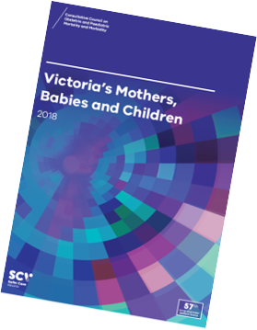
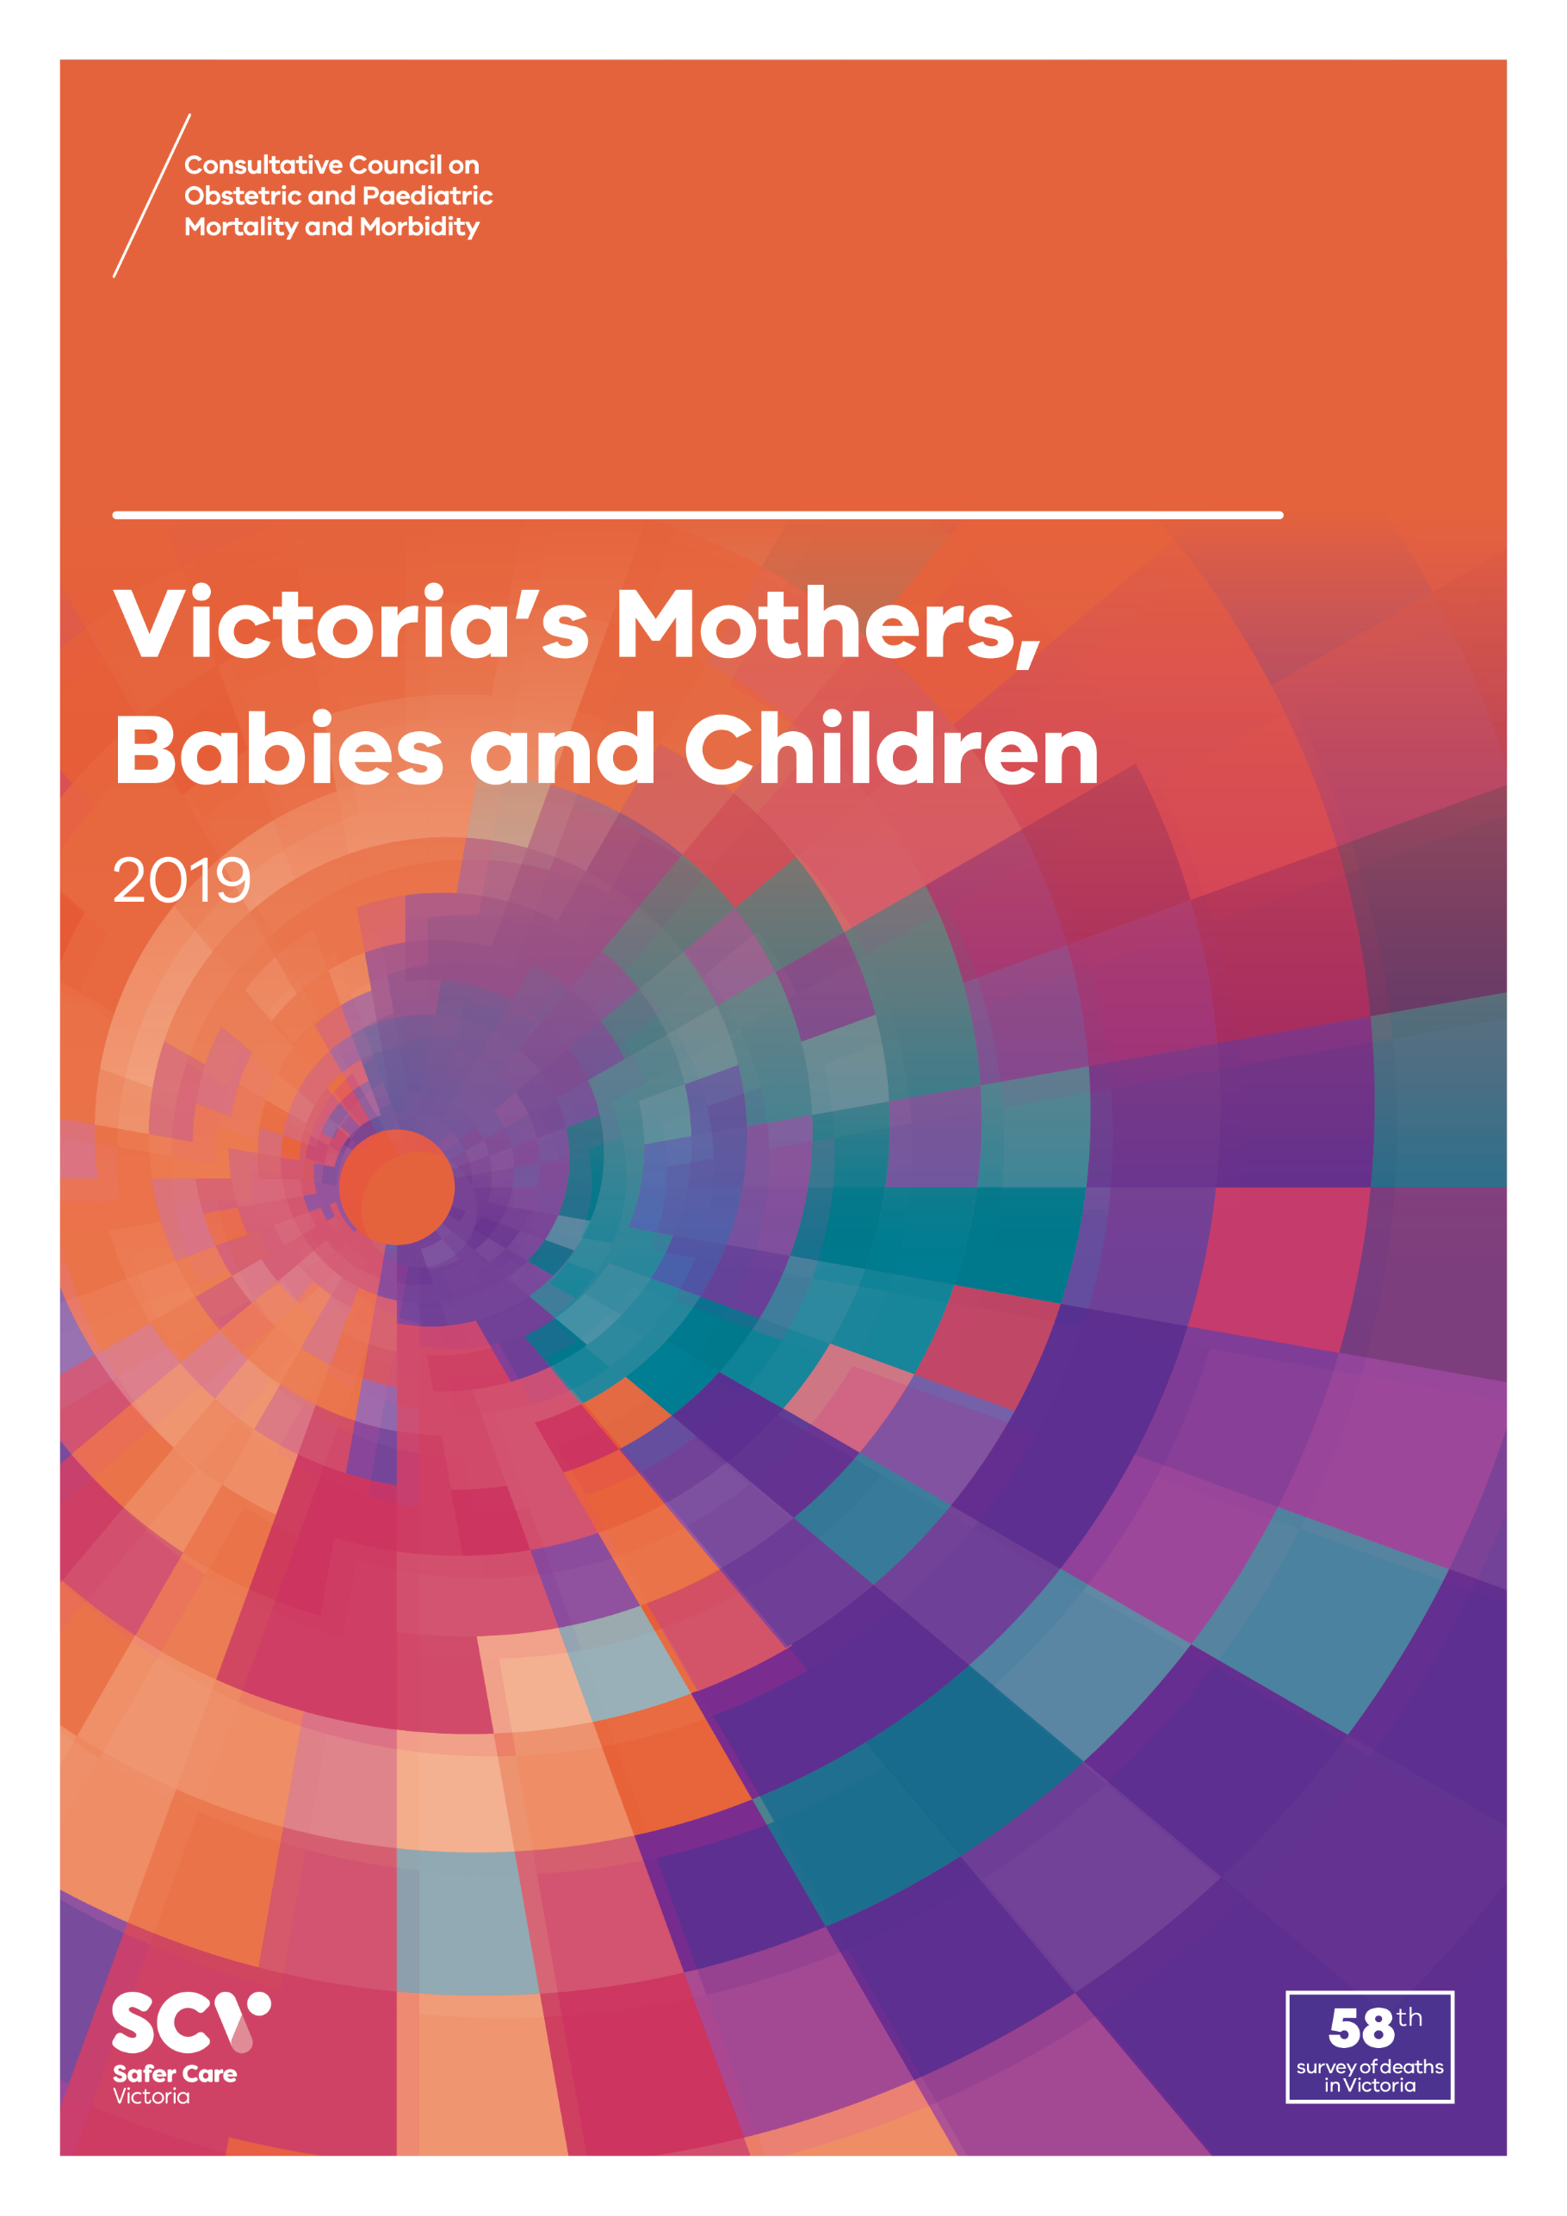
About CCOPMM
The Consultative Council on Obstetric and Paediatric Mortality and Morbidity (CCOPMM) is a statutory authority appointed by the Minister for Health.
Chair: Adjunct Professor Tanya Farrell
Operates under the Public Health and Wellbeing Act 2008

Slide 4
About CCOPMM
Legislative responsibility for data collection:
Victorian Perinatal Data Collection (VPDC)
Victorian Congenital anomalies register (VCAR)
Legislative responsibility for health surveillance:
Mortality collections and review of perinatal, child and adolescent, and maternal mortality
Morbidity collections: severe acute maternal morbidity (SAMM)

Slide 5
Undertaking case reviews
CCOPMM has four subcommittees that undertake case reviews and report to CCOPMM.
Stillbirth – Chair: Professor Susan McDonald
Neonatal Mortality and Morbidity (0-27 days) – Chair: Professor Rod Hunt
Maternal Mortality and Morbidity – Chair: Professor Mark Umstad
Child and Adolescent Mortality and Morbidity (28 days-17 years) – Chair: Adjunct Clinical Associate Professor Rob Roseby

Slide 6
Undertaking research
CCOPMM conducts research itself and provides data for research purposes. The CCOPMM Research and Reporting subcommittee leads this work - Chair: Professor Caroline Homer.
CCOPMM identifies research priorities by:
analysis of our reports, data and through case reviews
collaborating with external research projects

Slide 7
Why we do what we do?
Independent oversight of all deaths and severe maternal morbidity
Highlight areas that require improvement – hospital and community
Highlight areas for further research
Inform the development of policies and guidelines
Provide advice on areas for prioritisation and investment

Slide 8
Maternal mortality and morbidity

Slide 9
Maternal mortality and morbidity
Include:
All maternal deaths during pregnancy and within a year of birth
All intensive care unit (ICU) admissions during pregnancy and up to 42 days after birth

Slide 10
Maternal mortality and morbidity
Maternal deaths occurring during pregnancy or within 42 days of the end of pregnancy are classified as:
Direct – relating to the pregnancy or birth
Indirect – relating to a pre-existing medical condition or newly diagnosed condition
Coincidental – unrelated to the pregnancy or birth
Maternal deaths occurring after 42 days following pregnancy and up to one year post birth are classified as late.

Slide 11
Maternal mortality ratio (MMR)
The incidence of maternal deaths is expressed as the maternal mortality ratio (MMR), which is calculated using direct and indirect deaths combined, and excludes coincidental deaths (AIHW).
This includes direct and indirect deaths that occur during pregnancy or within 42 days of the end of pregnancy.

Slide 12
Severe Acute Maternal Morbidity (SAMM)
SAMM is measured as an admission to an ICU during pregnancy and up to 42 days after birth.
The criteria for ICU admission may vary across hospitals, and not all maternity services in Victoria have direct access to an ICU.

Slide 13
Trends and comparisons

Slide 14
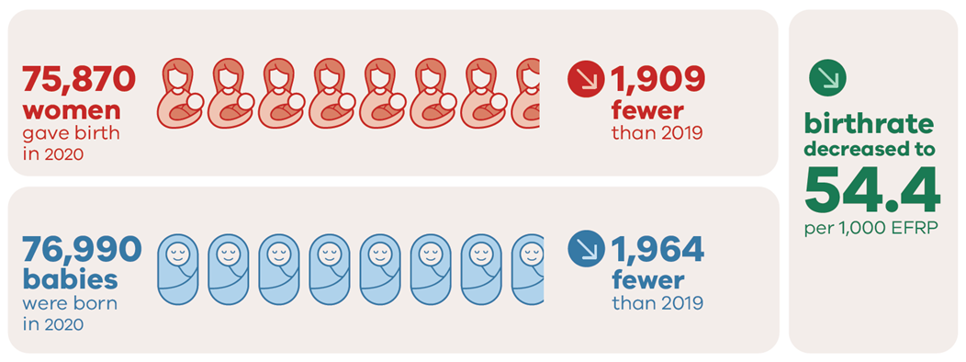
Births in 2020

Slide 15
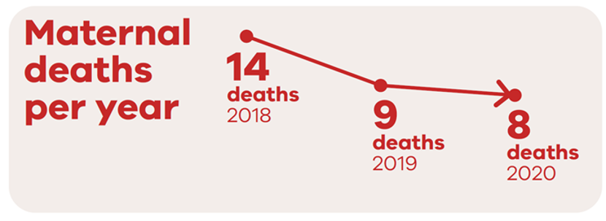
Maternal mortality: 2018 to 2020

Slide 16
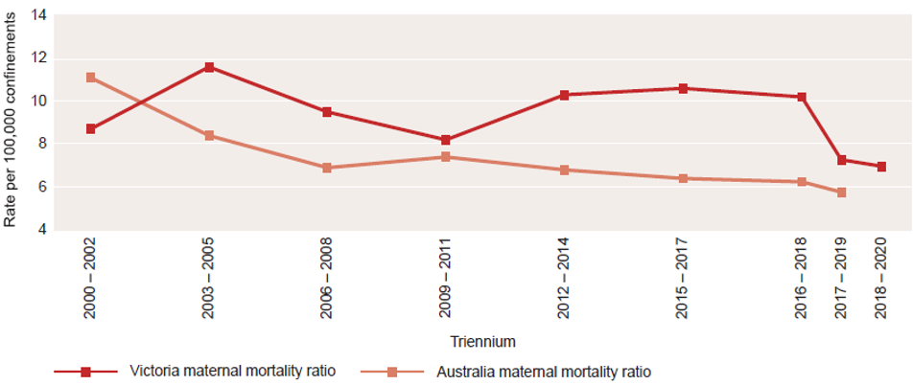
Maternal mortality ratios: Rolling triennia
Please note that the Australian maternal mortality ratio for 2019 does not include data from Western Australia and deaths that are awaiting classification.

Slide 17
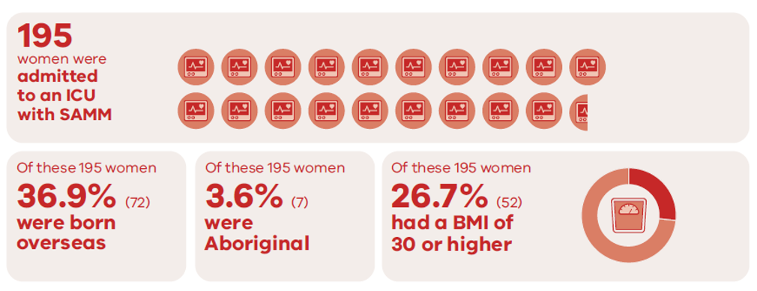
Severe Acute Maternal Morbidity (SAMM), 2020

Slide 18
Proportion of maternal ICU admissions by region of birth compared with all women who gave birth, 2020

Slide 19
Proportion of maternal ICU admissions by BMI categories compared with all women who gave birth, 2020

Slide 20
CCOPMM recommendations: Maternal M&M

Slide 21
Recommendations
CCOPMM and SCV collaborate with key partners in continuing to measure and report on the impact of the COVID-19 pandemic on selected outcomes for women, babies and children.

Slide 22
About the recommendation
CCOPMM collects data related to the impact of COVID -19.
Preliminary findings on the impact of the pandemic were released by CCOPMM in the CCOPMM COVID-19 communique in 2020.
Statewide data showed no areas of concern requiring immediate interventions.
National data did report significant impacts on women and their partners.
Further research is needed to understand the direct and indirect impacts of COVID-19 to help inform prevention strategies and clinical care.

Slide 23
Recommendations
CCOPMM will actively support the development of a learning system model for Victorian maternity, neonatal and paediatric services to create an environment where consumers, health services and government can work together to learn and improve in an integrated way.

Slide 24
About the recommendation
A learning health system is based on rapid learning from data and evidence and applying knowledge to improve care.
CCOPMM will commission specific safety reviews into reoccurring issues starting with neonatal resuscitation and fetal monitoring to identify contributing factors.
AcciMap will be used – a systems focused review methodology.
Mortality and morbidity case review tool to be piloted in selected services to ensure learnings from serious adverse events and systems improvement.

Slide 25
Recommendations
Develop and implement targeted improvement programs for maternity, neonatal and paediatric services to strengthen clinical governance, incident review, reporting processes and quality improvement capability.

Slide 26
About the recommendation
Clinical governance was a key area of concern in the Targeting Zero report. To ensure services are safe and high-quality, clinical governance capability must continue to be an area of focus.
SCV clinical governance training – for boards and executives to strengthen leadership, culture and improve clinical outcomes.
SCV clinical governance assessment tool – determine clinical governance capability and performance and areas for improvement.
Other considerations – clinical incident management system, clear escalation policies and clinical governance improvement plans.

Slide 27
Good practice points
Good practice points reflect the findings of CCOPMM’s review of all cases of maternal, perinatal and paediatric mortality, and severe acute maternal morbidity in a reporting year
They are designed to guide local improvements in clinical performance and can relate to our clinical care and/or the system or service we work in

Slide 28
Good practice point – 1
Clinicians are reminded of the importance of prophylactic anticoagulation for clinical scenarios that place the patient at high risk of thromboembolism.
Balancing the relative risk of haemorrhage and thrombosis can be difficult and clinicians should consider a risk-stratified thromboprophylaxis model¹.
1. Chalal R, Alexander M, Yee K, et al. Impact of a risk-stratified thromboprophylaxis protocol on the incidence of postoperative venous thromboembolism and bleeding. Anaesthesia 2020; 75: 1028-1038.

Slide 29
Good practice point – 2
The use of ergometrine to treat postpartum haemorrhage in hypertensive patients may precipitate a hypertensive crisis.
Administration should be under the guidance of a Consultant Obstetrician and only after both oxytocin and carboprost have proven ineffective.

Slide 30
Good practice point – 3
Second trimester surgical abortion should be undertaken with the aid of intraoperative ultrasound guidance. This likely reduces the risk of perforation and can help ensure that the uterine cavity is completely evacuated.

Slide 31
For more information
www.bettersafercare.vic.gov.au/reports-and-publications/victorias-mothers-babies-and-children-2020-report
Refer to CCOPMM’s other slide packs on:
Mothers and babies
Perinatal mortality
Child and adolescent mortality
2020 recommendations

Slide 32
Connect with us
www.bettersafercare.vic.gov.au
tanya.farrell@safercare.vic.gov.au
@safercarevic @TanyaFarrell13
Safer Care Victoria

