Slide 1
Victoria’s mothers, babies and children 2020​
Mothers and Babies

Slide 2
About CCOPMM

Slide 3
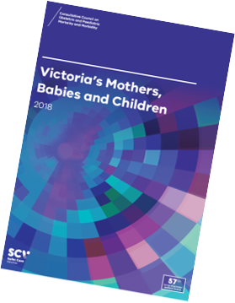
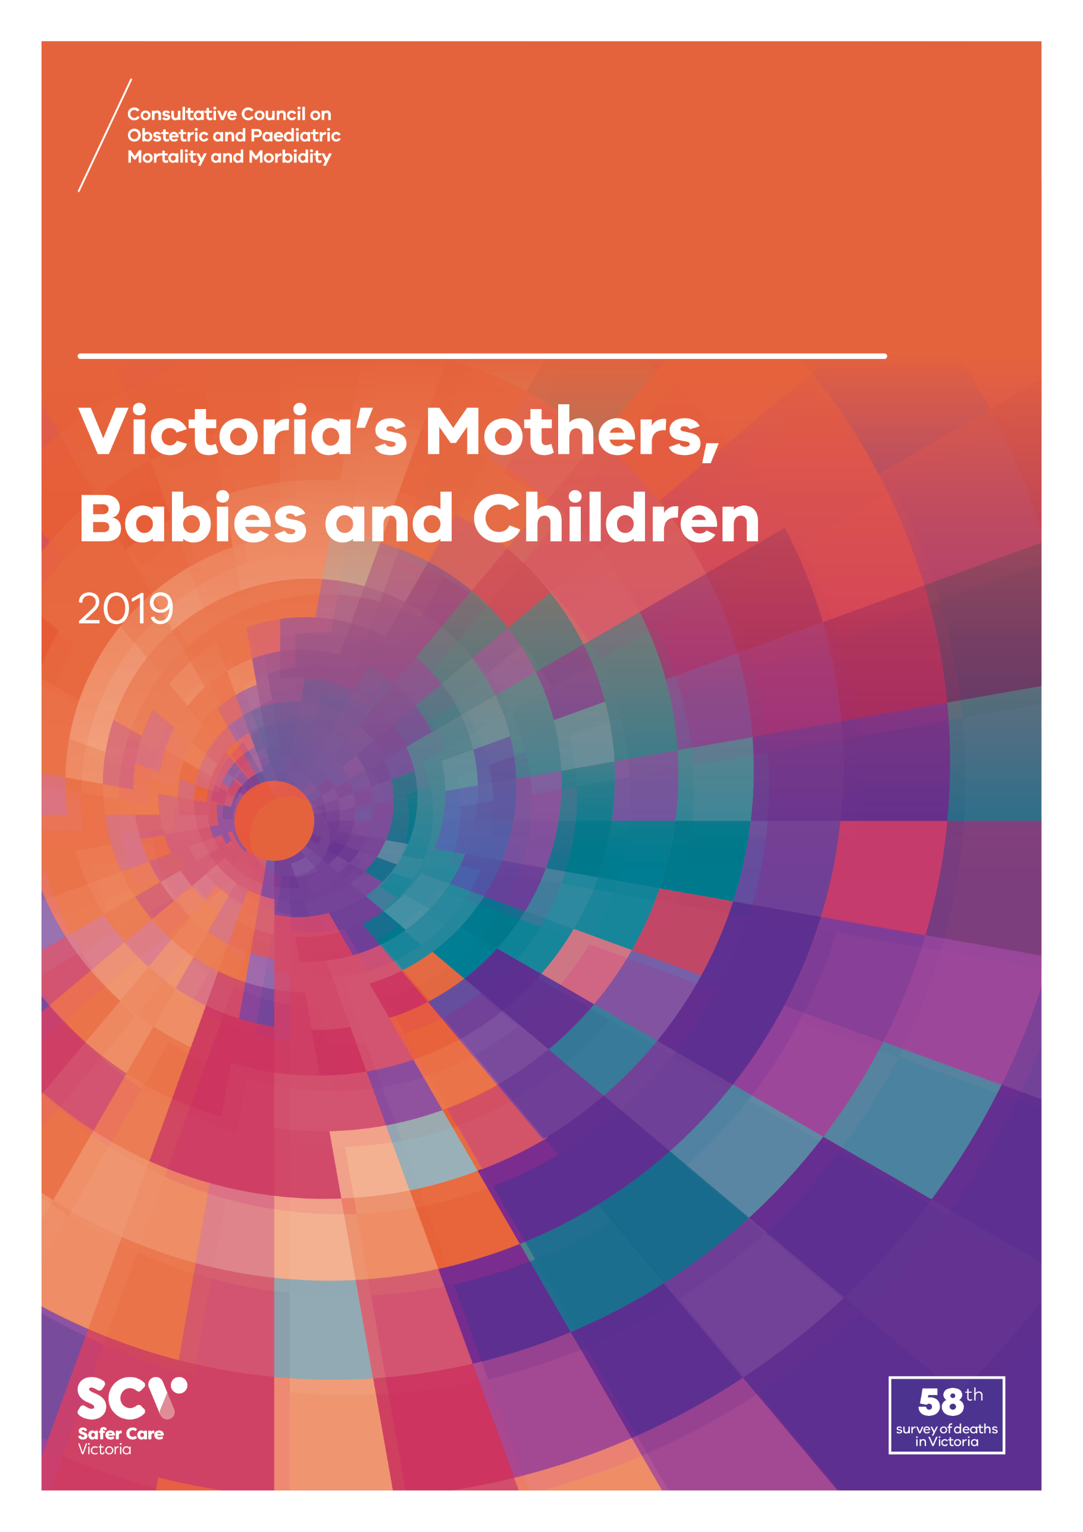
About CCOPMM
The Consultative Council on Obstetric and Paediatric Mortality and Morbidity (CCOPMM) is a statutory authority appointed by the Minister for Health.
Chair: Adjunct Professor Tanya Farrell
Operates under the Public Health and Wellbeing Act 2008

Slide 4
About CCOPMM
Legislative responsibility for data collection:
Victorian Perinatal Data Collection (VPDC)
Victorian Congenital anomalies register (VCAR)
Legislative responsibility for health surveillance:
Mortality collections and review of perinatal, child and adolescent, and maternal mortality
Morbidity collections: severe acute maternal morbidity (SAMM)

Slide 5
Undertaking case reviews
CCOPMM has four subcommittees that undertake case reviews and report to CCOPMM.
Stillbirth – Chair: Professor Susan McDonald
Neonatal Mortality and Morbidity (0-27 days) – Chair: Professor Rod Hunt
Maternal Mortality and Morbidity – Chair: Professor Mark Umstad
Child and Adolescent Mortality and Morbidity (28 days-17 years) – Chair: Adjunct Clinical Associate Professor Rob Roseby

Slide 6
Undertaking research
CCOPMM conducts research itself and provides data for research purposes. The CCOPMM Research and Reporting subcommittee leads this work - Chair: Professor Caroline Homer.
CCOPMM identifies research priorities by:
analysis of our reports, data and through case reviews
collaborating with external research projects

Slide 7
Why we do what we do?
Independent oversight of all deaths and severe maternal morbidity
Highlight areas that require improvement – hospital and community
Highlight areas for further research
Inform the development of policies and guidelines
Provide advice on areas for prioritisation and investment

Slide 8
Trends and comparisons

Slide 9
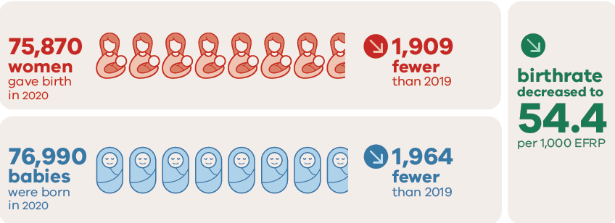
Births in 2020

Slide 10
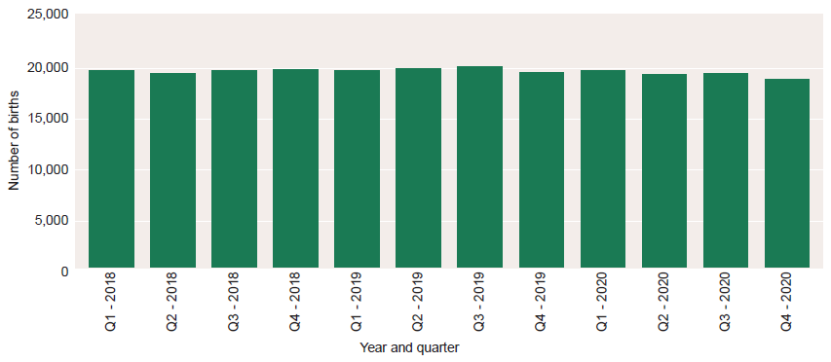
Number of births per quarter, 2018-2020

Slide 11
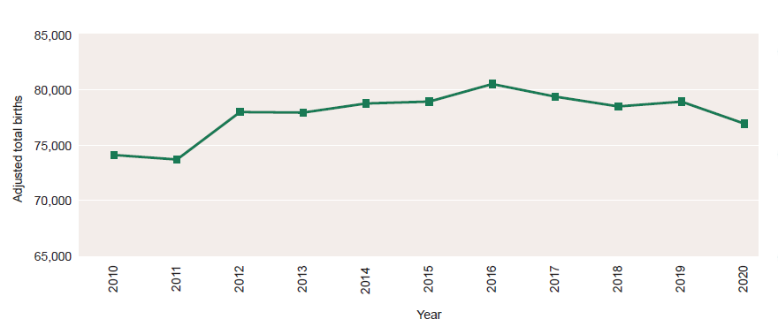
Trend in number of births, Victoria, 2010-2020

Slide 12
Number of women giving birth in 2020 born in non-English-speaking countries – 10 most common countries

Slide 13
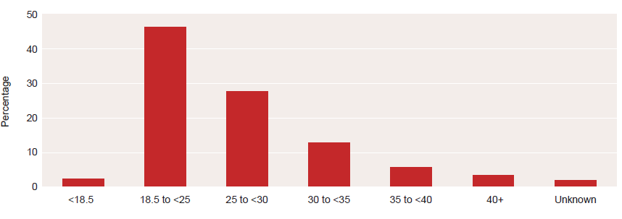
Maternal body mass index at booking, birthing episodes, 2020

Slide 14
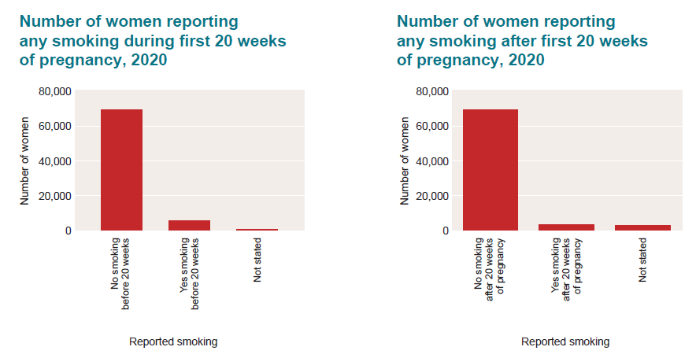
Smoking reported during pregnancy, 2020

Slide 15
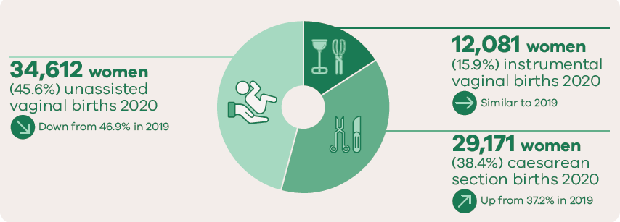
Method of birth

Slide 16
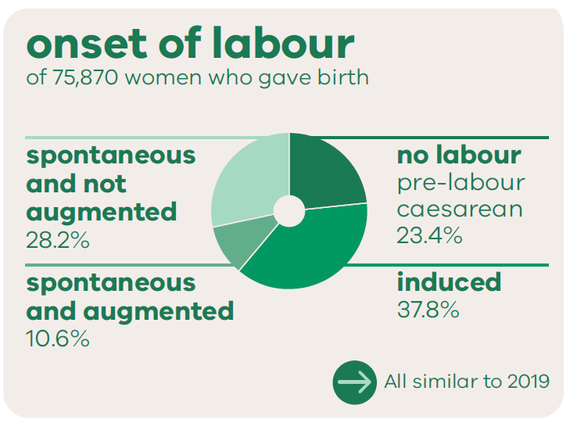
Onset of labour

Slide 17
Trends and comparisons: Aboriginal mothers and babies

Slide 18
Aboriginal births in 2020

Slide 19
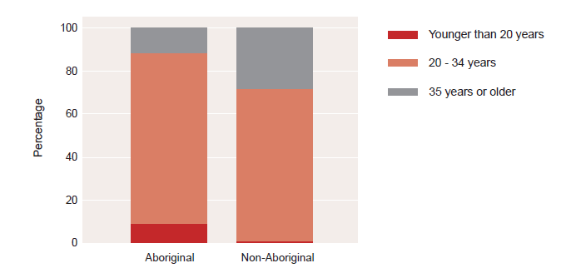
Age comparison: Aboriginal and Non-Aboriginal

Slide 20
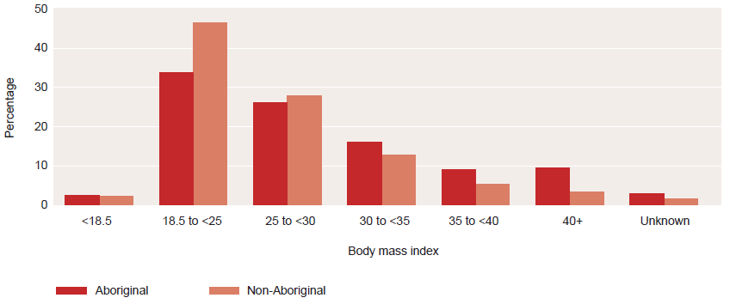
Maternal body mass index by Aboriginal status, birthing episodes, 2020

Slide 21
Birth outcomes in 2020

Slide 22
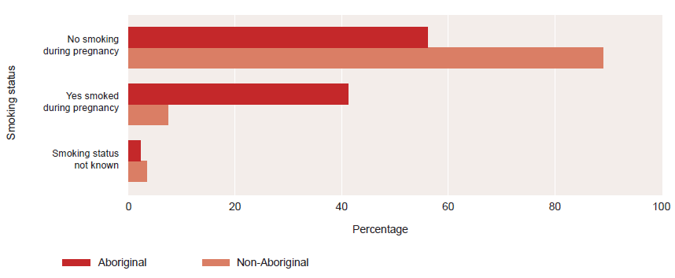
Smoking during pregnancy, 2020

Slide 23
For more information
www.bettersafercare.vic.gov.au/reports-and-publications/victorias-mothers-babies-and-children-2020-report
Refer to CCOPMM’s other slide packs on:
Maternal mortality and morbidity
Perinatal mortality
Child and adolescent mortality
2020 recommendations

Slide 24
Connect with us
www.bettersafercare.vic.gov.au
tanya.farrell@safercare.vic.gov.au
@safercarevic @TanyaFarrell13
Safer Care Victoria

