Slide 1
Victoria’s mothers, babies and children 2020
Perinatal mortality

Slide 2
About CCOPMM

Slide 3
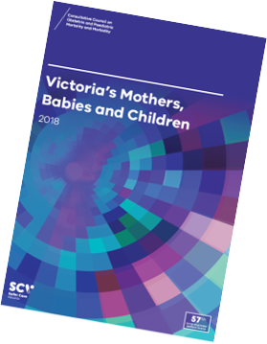
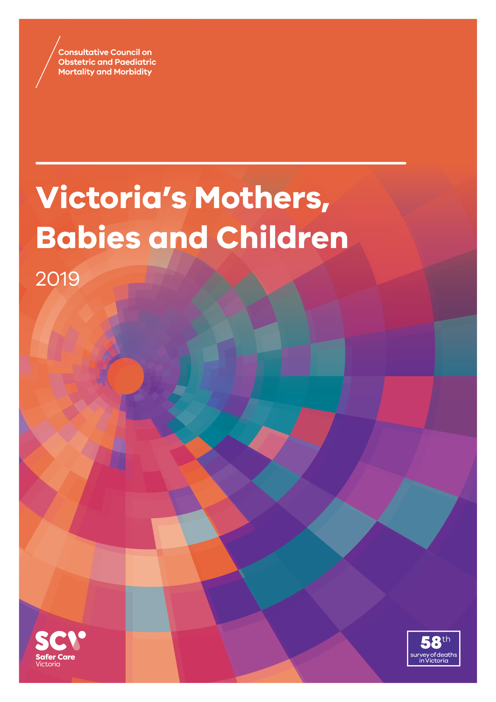
About CCOPMM
The Consultative Council on Obstetric and Paediatric Mortality and Morbidity (CCOPMM) is a statutory authority appointed by the Minister for Health.
Chair: Adjunct Professor Tanya Farrell
Operates under the Public Health and Wellbeing Act 2008

Slide 4
About CCOPMM
Legislative responsibility for data collection:
Victorian Perinatal Data Collection (VPDC)
Victorian Congenital anomalies register (VCAR)
Legislative responsibility for health surveillance:
Mortality collections and review of perinatal, child and adolescent, and maternal mortality
Morbidity collections: severe acute maternal morbidity (SAMM)

Slide 5
Undertaking case reviews
CCOPMM has four subcommittees that undertake case reviews and report to CCOPMM.
Stillbirth – Chair: Professor Susan McDonald
Neonatal Mortality and Morbidity (0-27 days) – Chair: Professor Rod Hunt
Maternal Mortality and Morbidity – Chair: Professor Mark Umstad
Child and Adolescent Mortality and Morbidity (28 days-17 years) – Chair: Adjunct Clinical Associate Professor Rob Roseby

Slide 6
Undertaking research
CCOPMM conducts research itself and provides data for research purposes. The CCOPMM Research and Reporting subcommittee leads this work - Chair: Professor Caroline Homer.
CCOPMM identifies research priorities by:
analysis of our reports, data and through case reviews
collaborating with external research projects

Slide 7
Why we do what we do?
Independent oversight of all deaths and severe maternal morbidity
Highlight areas that require improvement – hospital and community
Highlight areas for further research
Inform the development of policies and guidelines
Provide advice on areas for prioritisation and investment

Slide 8
Trends and comparisons: Perinatal mortality

Slide 9
Perinatal mortality
Includes fetal deaths (stillbirths) and deaths of live-born babies within the first 28 days after birth (neonatal deaths)
Excludes terminations of pregnancy for psychosocial indications - ‘adjusted’ perinatal mortality
‘Adjusted’ perinatal mortality provides a more accurate assessment of avoidable mortality and assists comparisons with other jurisdictions
Detailed data for perinatal mortality can be found in the online supplementary tables

Slide 10
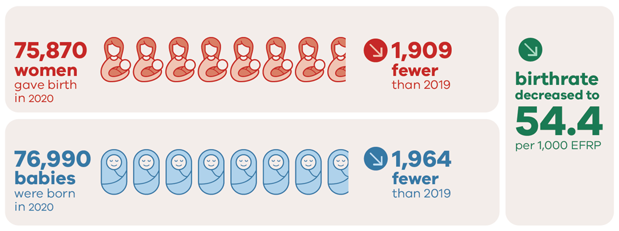
Births in 2020

Slide 11
Perinatal deaths in 2020

Slide 12
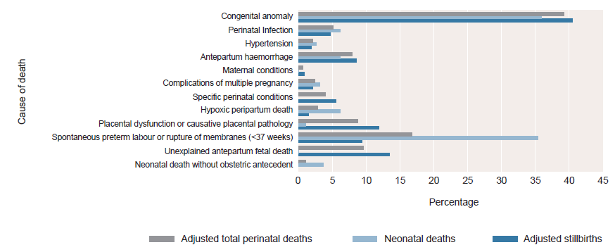
Causes of stillbirths, neonatal and perinatal deaths PSANZ* perinatal death classification, 2020
PSANZ, Perinatal Society of Australia and New Zealand

Slide 13
Perinatal mortality rates in 2020

Slide 14
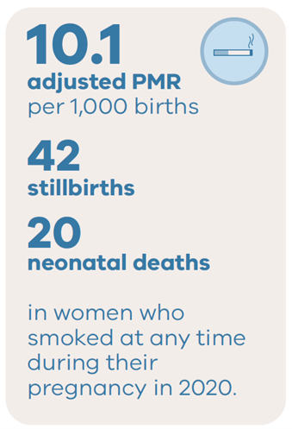
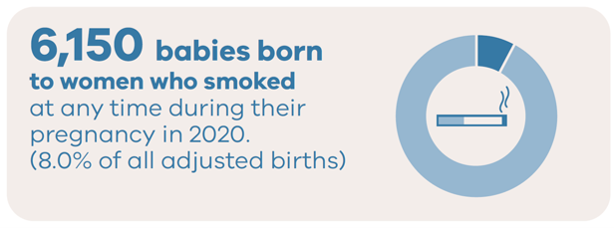
Smoking and outcomes in 2020

Slide 15
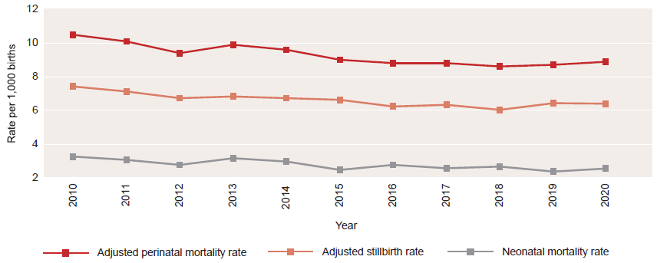
Trends in adjusted perinatal mortality rates, 2010-2020

Slide 16
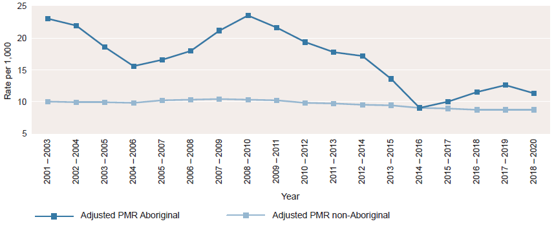
Adjusted perinatal mortality rate by Aboriginal status of mother, by rolling triennia, 2001-2020*

Slide 17
CCOPMM recommendations: Perinatal

Slide 18
Recommendation
CCOPMM and SCV collaborate with key partners in continuing to measure and report on the impact of the COVID-19 pandemic on selected outcomes for women, babies and children.

Slide 19
About the recommendation
CCOPMM collects data related to the impact of COVID -19.
Preliminary findings on the impact of the pandemic were released by CCOPMM in the CCOPMM COVID-19 communique in 2020.
Statewide data showed no areas of concern requiring immediate interventions.
National data did report significant impacts on women and their partners.
Further research is needed to understand the direct and indirect impacts of COVID-19 to help inform prevention strategies and clinical care.

Slide 20
Recommendation
CCOPMM will actively support the development of a learning system model for Victorian maternity, neonatal and paediatric services to create an environment where consumers, health services and government can work together to learn and improve in an integrated way.

Slide 21
About the recommendation
A learning health system is based on rapid learning from data and evidence and applying knowledge to improve care.
CCOPMM will commission specific safety reviews into reoccurring issues starting with neonatal resuscitation and fetal monitoring to identify contributing factors.
AcciMap will be used – a systems focused review methodology.
Mortality and morbidity case review tool to be piloted in selected services to ensure learnings from serious adverse events and systems improvement.

Slide 22
Recommendation
Develop and implement targeted improvement programs for maternity, neonatal and paediatric services to strengthen clinical governance, incident review, reporting processes and quality improvement capability.

Slide 23
About the recommendation
Clinical governance was a key area of concern in the Targeting Zero report. To ensure services are safe and high-quality, clinical governance capability must continue to be an area of focus.
SCV clinical governance training – for boards and executives to strengthen leadership, culture and improve clinical outcomes.
SCV clinical governance assessment tool – determine clinical governance capability and performance and areas for improvement.
Other considerations – clinical incident management system, clear escalation policies and clinical governance improvement plans.

Slide 24
Good practice points
Good practice points reflect the findings of CCOPMM’s review of all cases of maternal, perinatal and paediatric mortality, and severe acute maternal morbidity in a reporting year.
They are designed to guide local improvements in clinical performance and can relate to our clinical care and/or the system or service we work in.

Slide 25
Good practice points – Neonatal Resuscitation and Fetal Surveillance
Services should ensure that annual training and assessments are undertaken for all relevant clinicians.
Services should establish, implement and audit, formalised escalation processes that are consistent 24/7 and include:
Escalation to the most senior team member on duty (whether on site or on-call) where there is any concern by any team member
Escalation to the most senior team member on duty (whether on site or on-call) where there is any concern by any woman/patient/parent
For anticipated or actual neonatal resuscitations, escalation to the most senior team member of the team to ensure they are present and involved.

Slide 26
Strengthening Neonatal Resuscitation (1)
All services should hold regular simulated neonatal emergency response training sessions for all clinicians working in their maternity and neonatal services.
These simulated sessions should include skills training including:
Cardiopulmonary resuscitation (CPR)
Basic and advanced airway management
Prescribing, preparation and delivery of medications
Visual prompts for algorithms should be easily visible near every resuscitative in birthing environments and in operating suites.

Slide 27
Strengthening Neonatal Resuscitation (2)
Ensure that there is a clear process of auditing cases and clinician training. This could involve having a designated clinician, for example a – ‘neonatal resuscitation audit officer’ or ‘champion’.
This dedicated clinician could be accountable for the organisation's neonatal resuscitation program and the regular auditing of case notes, enabling the provision of timely feedback on all aspects of neonatal resuscitation within the service.
Services should ensure that, alongside annual training, there are regular simulated sessions attended by all relevant clinicians.

Slide 28
Strengthening Fetal Surveillance (1)
All clinicians should attend at least two Cardiotocograph (CTG) review sessions per year in addition to annual mandatory training.
These CTG meetings should consist of a variety of CTG abnormalities which are discussed in the context of both the clinical situation, the way the team worked together and the outcome. These sessions must include both antenatal and intrapartum CTGs.
Clear processes are developed from these meetings to ensure any improvements required are actioned in a timely manner.

Slide 29
Strengthening Fetal Surveillance (2)
Ensure that there is a clear process of auditing cases and clinician training. This could involve having a designated clinician, for example a – ‘fetal surveillance audit officer’ or ‘champion’.
This dedicated clinician could be accountable for the organisation's fetal surveillance program and the regular auditing of case notes, enabling the provision of timely feedback on all aspects of fetal surveillance within the service.

Slide 30
Resources – Neonatal Resuscitation and Fetal Surveillance
Victorian Newborn Resuscitation Project
VMIA Incentivising Better Patient Safety Program
Victorian Maternity and Newborn Capability frameworks for maternity and newborn services (2019)
Royal Australian and New Zealand College of Obstetricians and Gynaecologists (RANZCOG) - Intrapartum Fetal Surveillance Clinical Guideline updated
RANZCOG CTG Audit Tool
Australian Commission on Safety and Quality in Health Care (ACSQHC) 2017, ‘National consensus statement: essential elements for recognising and responding to acute physiological deterioration’, 2nd edn. ACSQHC, Sydney
Australian Commission on Safety and Quality in Health Care (ACSQHC) 2017, ‘National safety and quality health service standards, 2nd edn. ACSQHC, Sydney
Safer Care Victoria 2017, ‘Delivering high-quality healthcare: Victorian clinical governance framework’, Victorian Government, Melbourne

Slide 31
Good practice points – Supporting high priority groups
Services must ensure they have clear processes to identify high priority groups – including Aboriginal women.
Individualised care plans need to be formulated early in pregnancy and must be clearly communicated across the multidisciplinary team, including shared care providers.
Ensure ‘face to face appointments’ are prioritised to meet their needs and always include access to a qualified interpreter.

Slide 32
Good practice point–Supporting high priority groups
Services must ensure that adequate postnatal follow-up occurs for high priority groups. This must include appropriate face to face care.
Services providing postnatal home visits should ensure that at least one home visit occurs for all women regardless of nationality, insurance status or Medicare status.
Additional home visits should also be prioritised for high priority groups.

Slide 33
Resources – Supporting high priority groups
Multi-Agency Risk Assessment and Management Framework (MARAM) practice guides and resources
RANZCOG Maternity care in Australia
National Institute for Health and Care Excellence (NICE) guideline CG110: Pregnancy and complex social factors: a model for service provision for pregnant women with complex social factors
The Victorian Department of Health Language services policy and guidelines

Slide 34
Good practice point – management of short cervix
Clinical review of pregnant women who have had a short cervix reported on U/S to occur within one week of diagnosis.
This review is to enable further clinical care that may include the use of progesterone and/or rescue cerclage.

Slide 35
For more information
www.bettersafercare.vic.gov.au/reports-and-publications/victorias-mothers-babies-and-children-2020-report
Refer to CCOPMM’s other slide packs on:
Mothers and babies
Maternal mortality and morbidity
Child and adolescent mortality
2020 recommendations

Slide 36
Connect with us
www.bettersafercare.vic.gov.au
tanya.farrell@safercare.vic.gov.au
@safercarevic @TanyaFarrell13
Safer Care Victoria

