Slide 1
Recognition and management of sepsis in emergency and urgent care centres
September 2022
Modified from BCV/Melbourne Health sepsis project materials

Slide 2
Learning objectives
Recognise that sepsis is a medical emergency
Identify the risk factors, signs and symptoms
Define the initial management actions
Outline the escalation of the septic patient
Discuss the requirements for monitoring the septic patient following initial steps

Slide 3
Which patient has the highest risk of death?
59yo male – large inferior STEMI
27yo male – multi trauma (ISS >15)
65yo female – bleeding gastric ulcer & BP 90/60
74yo female – HR 96, BP 98/50, RR 28, T 35.6oC, mildly confused
32yo female – DKA, pH 6.90, BSL 45, HCO3 9

Slide 4
Which patient has the highest risk of death?
59yo male – large inferior STEMI
27yo male – multi trauma (ISS >15)
65yo female – bleeding gastric ulcer & BP 90/60
74yo female – HR 96, BP 98/50, RR 28, T 35.6oC, mildly confused
32yo female – DKA, pH 6.90, BSL 45, HCO3 9

Slide 5
Mortality
Inferior AMI 5%
Trauma ISS16-24 7%
GI haemorrhage with low BP 11%
Septic shock 25%
Severe DKA < 1%
1) Armstrong PW et al., JAMA, 2007;297:43–51. 2) Clemet N, SJTREM28:18 2010 3) Rockall TA BMJ. 311(6999):222-6, 1995 July 22 4) Mitchell M et al Crit Care Med2010 Vol. 38, No. 2 5) Hamdy O, Sep 2009

Slide 6
Think sepsis!
Sepsis is an emergency
You can make a difference
Time is life

Slide 7
What is sepsis?
Sepsis | Sepsis is the body’s systemic response to an infection and can result in multi-organ failure and death
Suspected sepsis | Two or more of the following: Temp < 36°C or > 38°C RR > 20 HR > 90 WCC < 4 or > 12
Severe sepsis | Sepsis + organ dysfunction, hypoperfusion or hypotension, including lactate > 2 mmol/L, SBP < 100, or altered mental state
Septic shock | Hypotension requiring vasopressors to maintain mean arterial pressure ≥ 65 mmHg and lactate > 2 mmol/L (updated 2016)

Slide 8
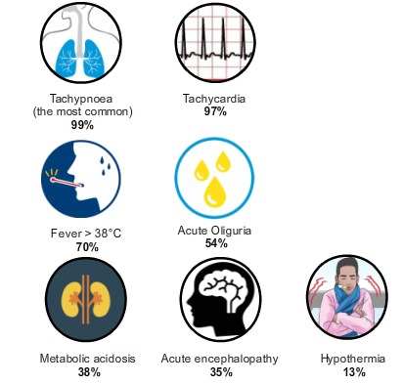
Common signs and symptoms
Tachypnoea is most common
Do not just look for a fever

Slide 9
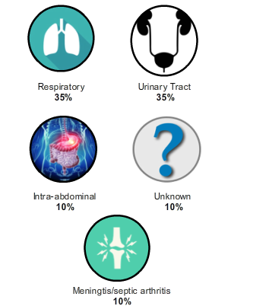
Common sites of infection
Can be community or hospital acquired
The sepsis pathway contains antimicrobial recommendations for site of infection
(Guthrie-Chu, 2009; Hartnett, 1989; Myers; 2007; Shelton, 1999)

Slide 10
Why a clinical pathway?
Sepsis is important
One of the world’s leading causes of death in hospitalised patients
25% mortality associated with septic shock
Intervention saves lives
Delayed recognition and treatment increases mortality
Reduced variation in practice
Standardised care and enhance communication
Empowerment of all team members to activate
All of the team ‘on the same page’

Slide 11
It works!
RMH demonstration project
SCV projects (24 EDs)
50.4% relative reduction in mortality
65.4% reduction in admission to ICU
51.9% reduction in time to antibiotics
42.9% decrease in the length of stay
22% increase in recognition at triage
16% increase in antibiotics within 1 hour
11% increase in IV fluids within 1 hour
25% relative reduction in mortality

Slide 12
Three key elements
Recognise
Risk factors, signs and symptoms of sepsis
Activate pathway
Resuscitate
With oxygen, antibiotics and IV fluids within one hour
Refer
Initiate critical care review if signs and symptoms of severe sepsis not responding to resuscitation
May be ICU in larger hospitals or ARV in smaller ones

Slide 13
Recognise Activate pathway
If the patient has signs or symptoms of infection: suspect sepsis
If the patient has observations in the red or orange boxes on the pathway: suspect sepsis
If the clinician, patient or relatives are concerned about deterioration: suspect sepsis
Suspected Sepsis
2 or more of the following:
Temperature < 36°C or >38°C
Heart rate > 90 beats per minute
Respiratory rate > 20 breaths per minute
WCC <4 or >12 X10⁹/L
Severe Sepsis
2 or more of the following:
SBP <100 mmHg
Altered mental state
Lactate > 2 mmol

Slide 14
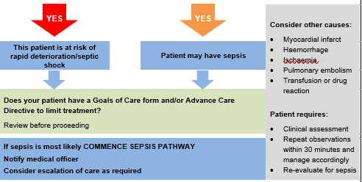
Respond
Nursing staff can initiate the pathway if sepsis is suspected
Time starts when the doctor is notified
Focus on key actions in the first 60 minutes

Slide 15
6 key actions within 60 minutes
Administer oxygen
Take 2 sets of blood cultures
Measure serum lactate (> 2 mmol/L is significant)
Rapid IV fluid resuscitation (500 ml bolus)
IV antibiotics*
Monitor urine output, observations and reassess
*Antibiotics should be administered within 60 minutes if risk of organ dysfunction. Cancer patients currently undergoing systemic chemotherapy require first antibiotic within 30 minutes.

Slide 16
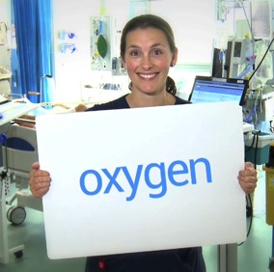
1. Administer oxygen
Improve oxygen delivery to the tissues
Maintain SpO₂ 92–96%
History of COPD maintain SpO₂ 88–92%
Requires regular review
ESCALATE* if patient is unresponsive to oxygen therapy
*Depending on hospital and ED resources, escalation may be MET call, ICU referral and/or consultation with ARV/regional hospital

Slide 17
2. Blood cultures
Take blood cultures BEFORE starting antibiotics
Take two sets of blood cultures – it is more about volume than site
Other cultures: urine, CSF, faeces, wound swabs, sputum, other fluids from within cavities can be done AFTER resuscitation
Consult specialty teams early for source control (if relevant)
Do not delay IV fluids and antibiotics if there is a delay to getting blood cultures

Slide 18
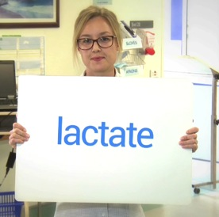
3. Measure serum lactate – if available
Elevated lactate (lactic acid) level is a sign of global tissue hypoxia
Elevated lactate is directly linked to increased mortality
Initial and serial lactate measures are valuable indicators for sepsis management
> 2 mmol/L is an indication of severe sepsis

Slide 19
4. IV fluid resuscitation
Fluids will reduce organ dysfunction and multi-organ failure
Give a rapid IV bolus of 500 mL 0.9% sodium chloride or Hartmann’s
Reassess for effect after each bolus – HR, BP, RR, capillary refill, urine output

Slide 20
4. IV fluid resuscitation
Aim to achieve systolic BP ≥ 100 mmHg
Repeat 500 ml bolus of 0.9% sodium chloride or Hartmann’s if needed
ESCALATE if no improvement in BP after 500 mls fluid
Patients with severe renal or clinical cardiac failure:
Use smaller volumes of fluid
Undertake more frequent assessments
Refer to ICU/ARV for advice and early use of vasopressors

Slide 21
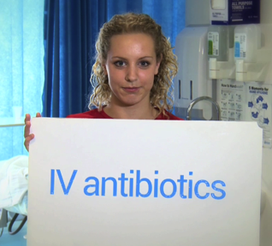
5. Intravenous antibiotics
Start antibiotics within 60 minutes
Early appropriate antibiotic therapy is associated with lower mortality
Take blood cultures before antibiotics but do not delay antibiotics to undertake investigations or await results
Use bolus administration where possible
If delay to IV antibiotics, e.g. access, consider IM antibiotics
PRESCRIBE IT... GET IT... GIVE IT... NOW!

Slide 22
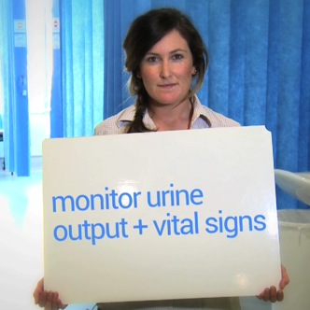
6. Monitor vital signs and urine output
Monitor observations every 30 minutes for 2 hours and then hourly for four hours
Respiratory rate
Heart rate
Blood pressure
Capillary refill
Conscious state
Urine output
If lactate is elevated, re-check in 2 hours

Slide 23
Refer
Refer patients to ICU if they do not respond to initial fluid bolus, i.e. falling BP or increasing lactate level
Early referral ensures specialist advice and timely transfer if required
ESCALATE* if concerned
*Depending on hospital and ED resources, escalation may be MET call, ICU referral and/or consultation with ARV/ regional hospital

Slide 24
Why is the sepsis pathway important?
Evidence suggests that patients treated using a pathway have significantly lower mortality, length of stay, and ICU admissions than those who are not
Early antibiotics and fluids saves lives

Slide 25
Question 1
Which signs and symptoms are most common in adult patients with severe sepsis?
Fever > 38⁰C
Tachycardia
Tachypnoea
Metabolic acidosis
Acute oliguria

Slide 26
Question 1
Which signs and symptoms are most common in adult patients with severe sepsis?
Fever > 38⁰C
Tachycardia
Tachypnoea
Metabolic acidosis
Acute oliguria

Slide 27
Question 2
You are assessing an elderly patient who has presented with confusion. The HR is 100, RR 25, WCC 13 and SBP 100. What do you do?
Proceed with routine assessment and treatment
Recognise that this is sepsis. Start the sepsis pathway, which includes oxygen, bloods and lactate, and call the medical officer to review regarding antimicrobial choice and fluids

Slide 28
Question 2
You are assessing an elderly patient who has presented with confusion. The HR is 100, RR 25, WCC 13 and SBP 100. What do you do?
Proceed with routine assessment and treatment
Recognise that this is sepsis. Start the sepsis pathway which includes oxygen, bloods and lactate, and call the medical officer to review regarding antimicrobial choice and fluids

Slide 29
Case study
George is a 27-year-old man who presented to the ED with cough, shortness of breath, and feeling generally unwell for one week. George was started on oral antibiotics by his GP 2 days ago for suspected pneumonia without much improvement. George has nil known allergies. At triage, you notice George is sweaty and looks tired. George’s observations are as follows:
RR: 24 HR: 101 T: 37.5°C GCS: 15
BP: 110/68 spO2 91% RA
On exam you notice crepitations at his left lung base.

Slide 30
Assessment
Does George meet sepsis criteria?

Slide 31
Assessment
Does George meet sepsis criteria?
YES
RR > 20
HR >90

Slide 32
Assessment
What are your next steps (in order)?
Remember, 6 key actions in 60 minutes!

Slide 33
Assessment
What are your next steps (in order)?
Administer oxygen
Two sets of blood cultures
Venous blood lactate (if available)
Assess need for fluid resuscitation
Antibiotics, if required and based on empiric guidelines
Monitor observations

Slide 34
Think sepsis!
Sepsis is an emergency
You can make a difference
Time is life

Slide 35
To receive this presentation in another format phone 9096 1384 using the National Relay Service 13 36 77 if required or info@safercarevictoria.vic.gov.au.
Authorised and published by the Victorian Government, 1 Treasury Place, Melbourne.
© State of Victoria, Australia, Safer Care Victoria, January 2022.
Available at the www.safercare.vic.gov.au.

