Slide 1
Victoria’s mothers, babies and children 2021
Mothers and Babies

Slide 2
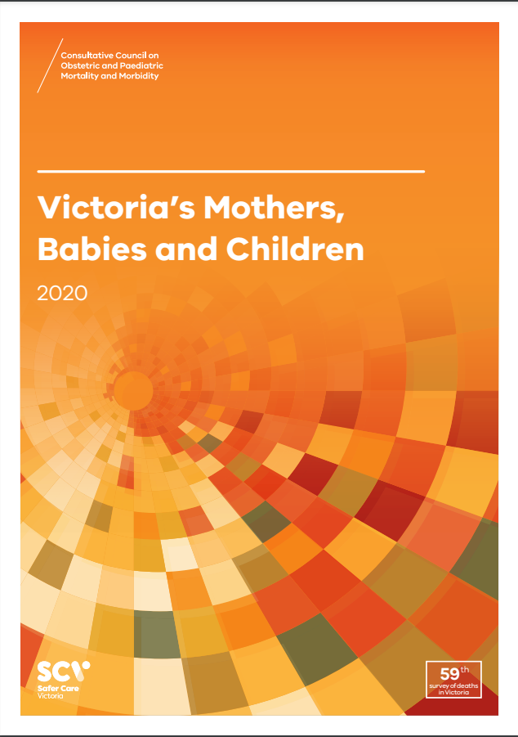
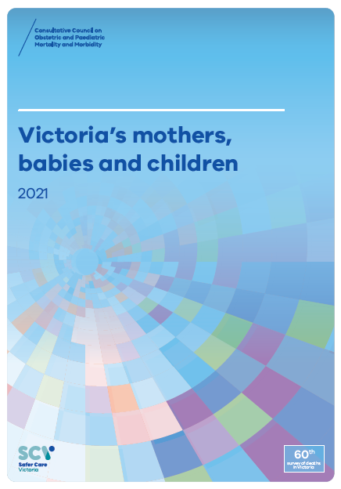
About CCOPMM
The Consultative Council on Obstetric and Paediatric Mortality and Morbidity (CCOPMM) is a statutory authority appointed by the Minister for Health.
Chair: Professor Mark Umstad AM
Operates under the Public Health and Wellbeing Act 2008

Slide 3
About CCOPMM
Legislative responsibility for data collection:
Victorian Perinatal Data Collection (VPDC)
Victorian Congenital anomalies register (VCAR)
Legislative responsibility for health surveillance:
Mortality collections and review of perinatal, child and adolescent, and maternal mortality
Morbidity collections: severe acute maternal morbidity (SAMM)

Slide 4
Undertaking case reviews
CCOPMM has four subcommittees that undertake case reviews and report to CCOPMM.
Stillbirth – Chair: Professor Susan McDonald
Neonatal (0-27 days) – Chair: Professor Rod Hunt
Maternal– Chair: Assoc. Prof. Glyn Teale
Child and Adolescent (28 days-17 years) – Chair: Adjunct Clinical Associate Professor Rob Roseby

Slide 5
Undertaking research
CCOPMM conducts research itself and provides data for research purposes. The CCOPMM Research and Reporting subcommittee leads this work - Chair: Professor Caroline Homer.
CCOPMM identifies research priorities by:
analysis of our reports, data and through case reviews
collaborating with external research projects

Slide 6
Why we do what we do?
Independent oversight of all deaths and severe maternal morbidity
Highlight areas that require improvement – hospital and community
Highlight areas for further research
Inform the development of policies and guidelines
Provide advice on areas for prioritisation and investment

Slide 7
Trends and comparisons

Slide 8
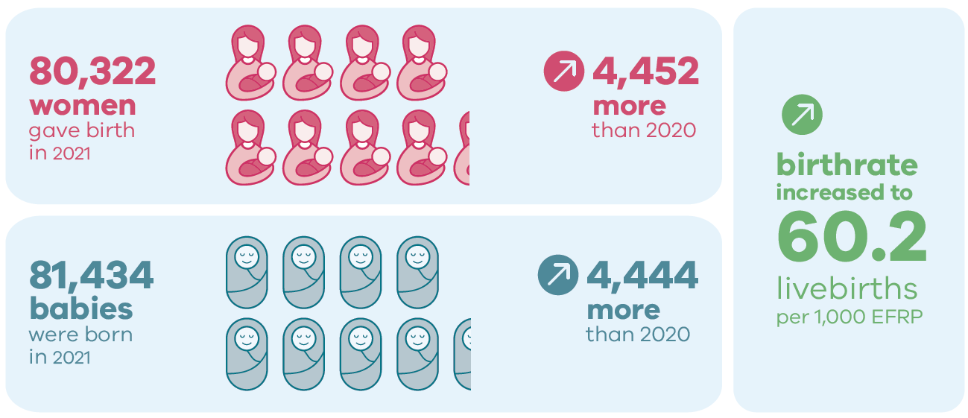
Births in 2021

Slide 9
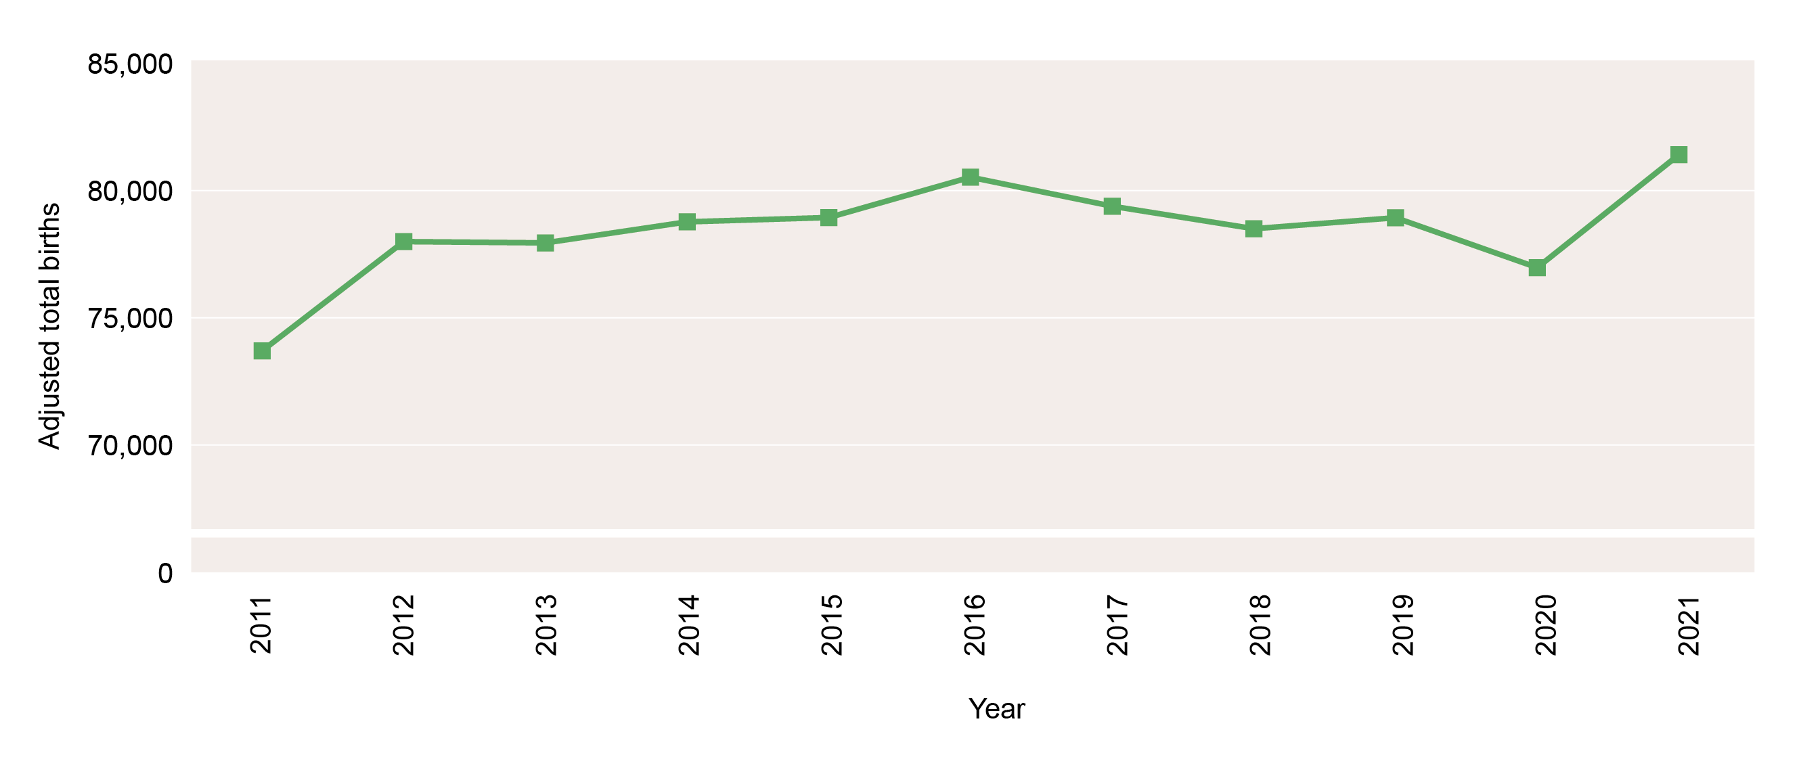
Trend in number of births, Victoria, 2011-2021

Slide 10
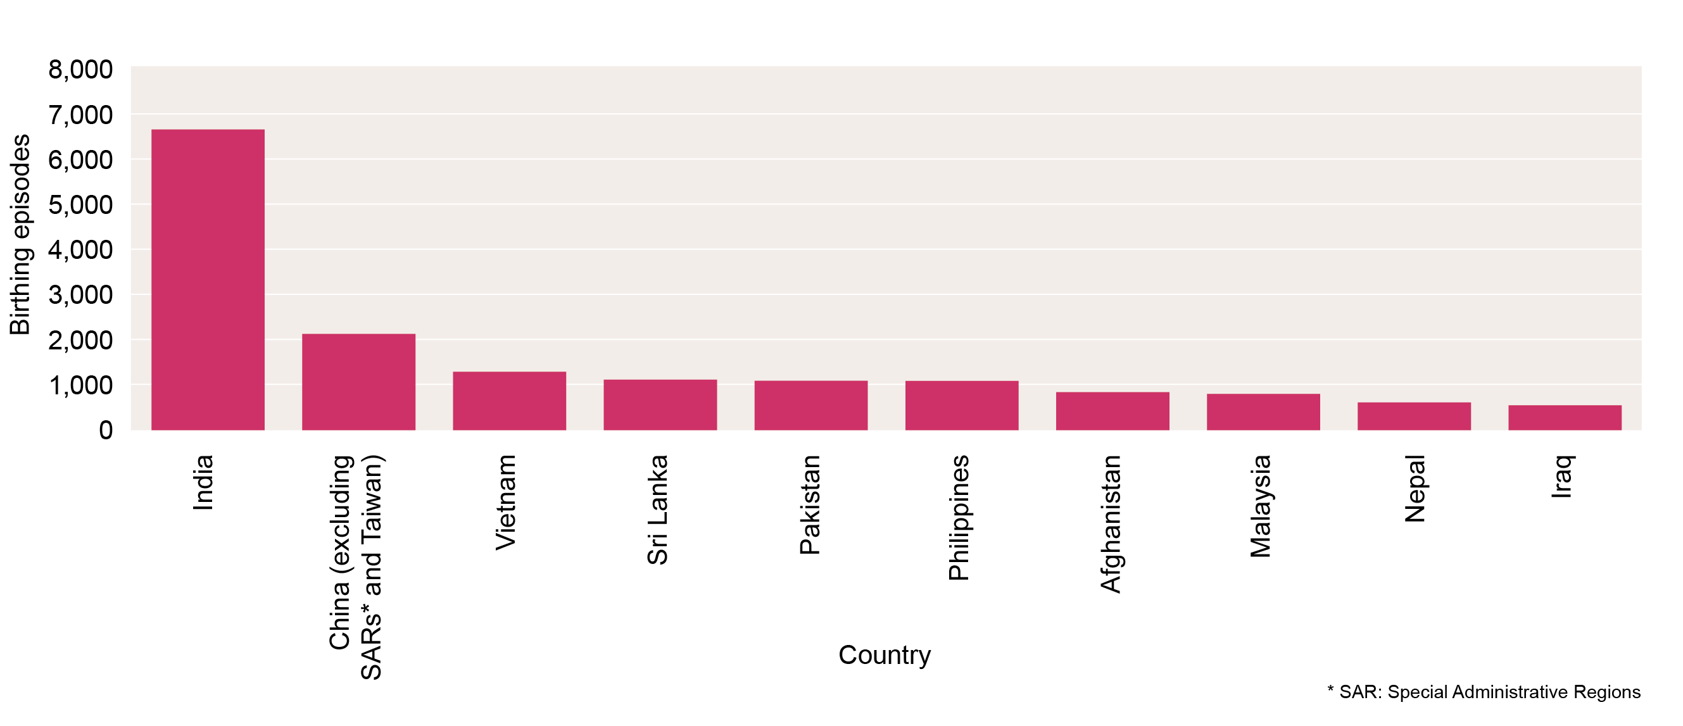
Number of women giving birth in 2021 born in non-English-speaking countries – 10 most common countries

Slide 11
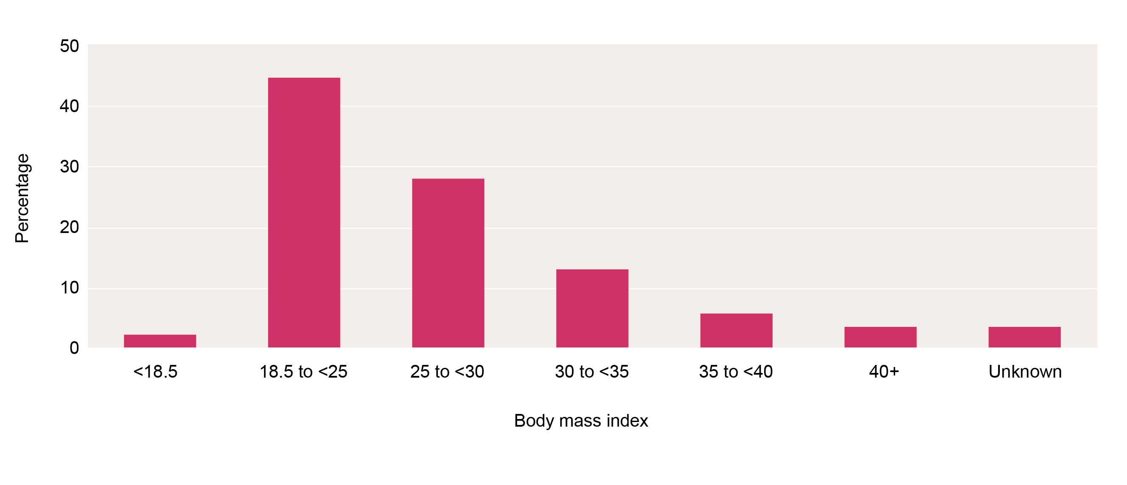
Maternal body mass index at booking, birthing episodes, 2021

Slide 12
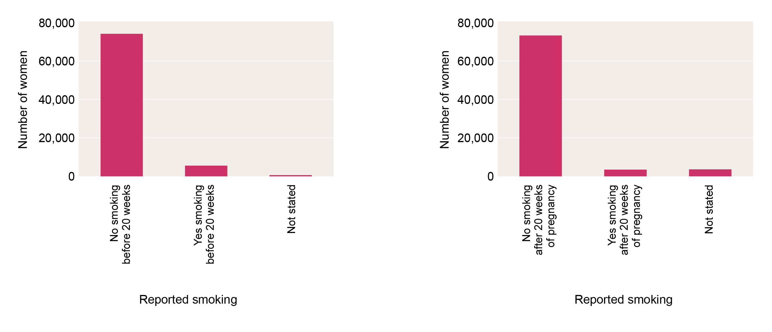
Smoking reported during pregnancy, 2021
No smoking before 20 weeks of pregnancy No smoking after 20 weeks of pregnancy

Slide 13
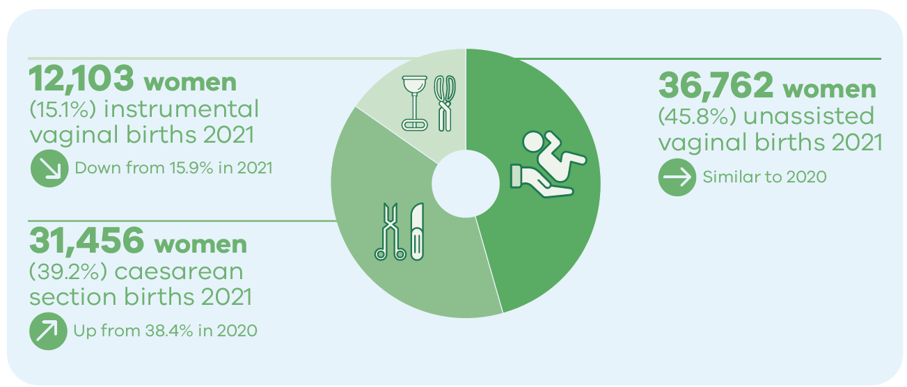
Method of birth

Slide 14
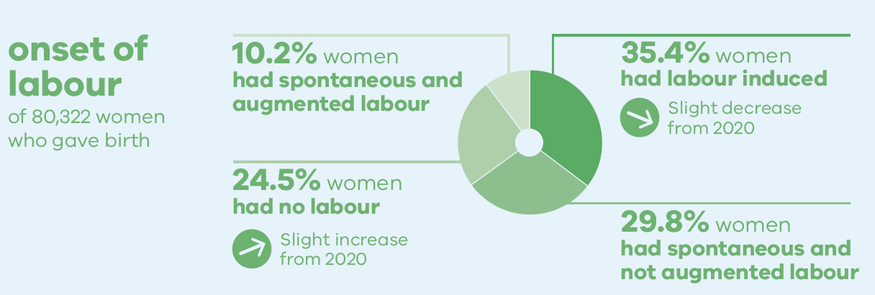
Onset of labour

Slide 15
Trends and comparisons: Aboriginal mothers and babies

Slide 16
Aboriginal births in 2021

Slide 17
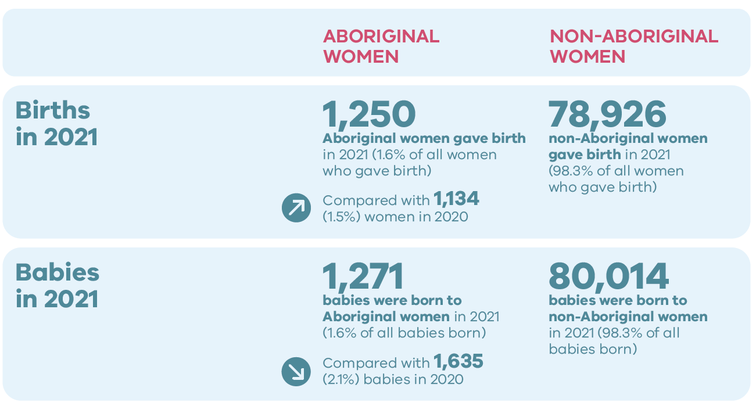
Aboriginal births and babies in 2021

Slide 18
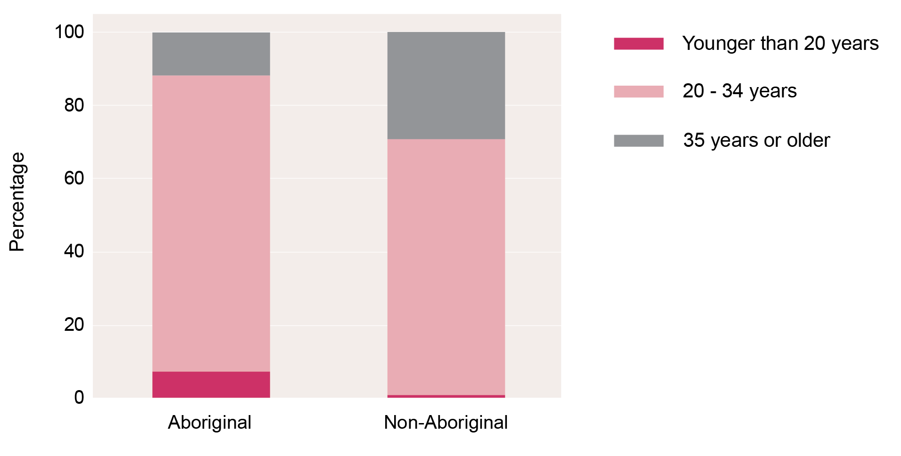
Maternal Age by Aboriginal status, 2021

Slide 19
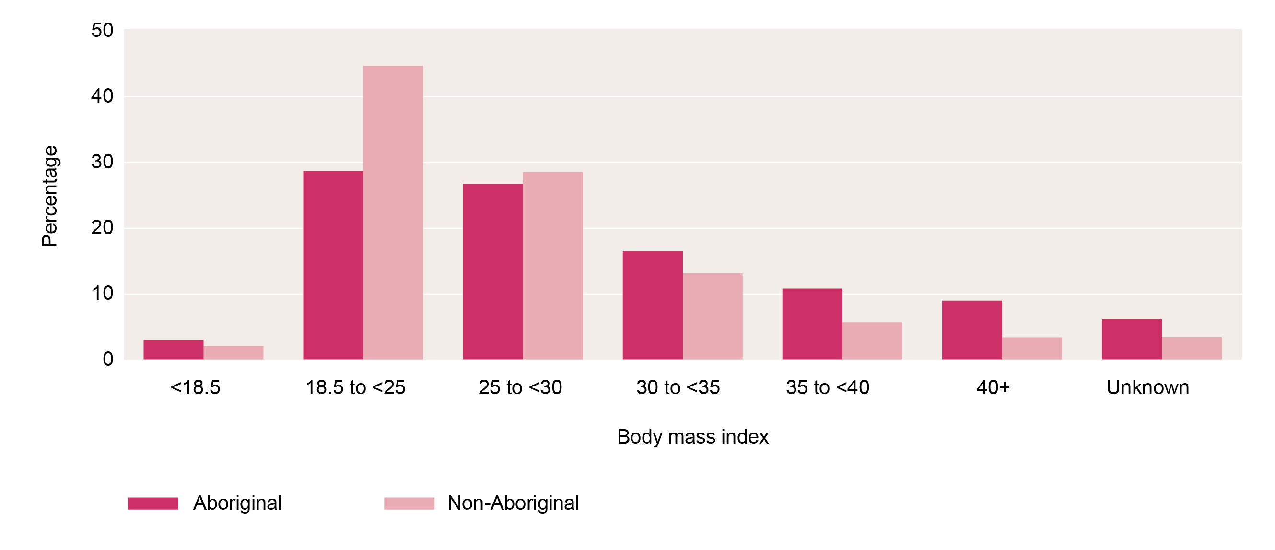
Maternal body mass index by Aboriginal status, birthing episodes, 2021

Slide 20
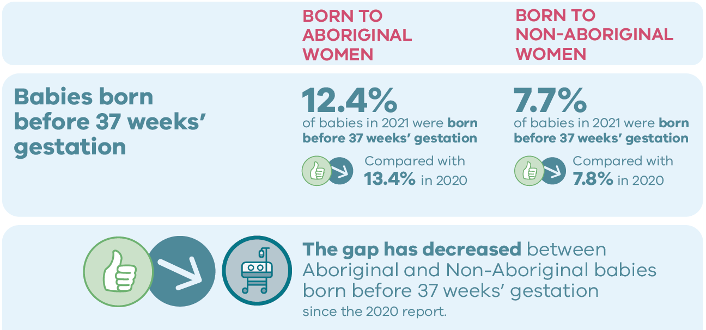
Birth outcomes in 2021

Slide 21
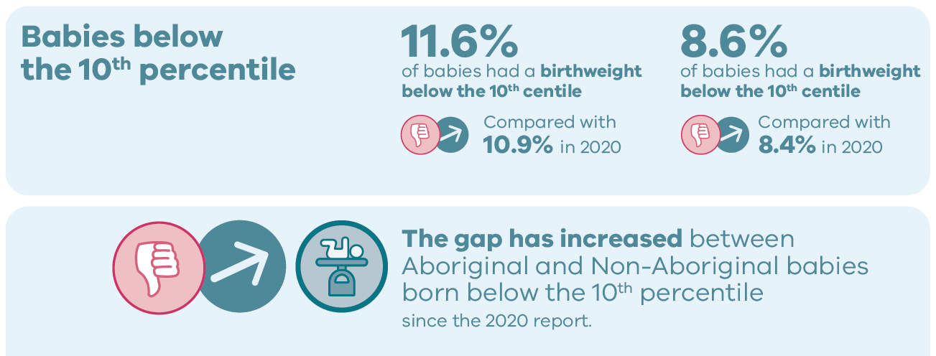
Birth outcomes in 2021

Slide 22
For more information
https://www.safercare.vic.gov.au/reports-and-publications/victorias-mothers-babies-and-children-2021-report-and-presentations
Refer to CCOPMM’s other slide packs on:
Mothers and babies
Maternal mortality and morbidity
Perinatal mortality
2020 recommendations

Slide 23
Connect with us
https://www.safercare.vic.gov.au/about/ccopmm,
ccopmm@safercare.vic.gov.au
@safercarevic
Safer Care Victoria

