Slide 1
Victoria’s mothers, babies and children 2021
Perinatal Mortality

Slide 2
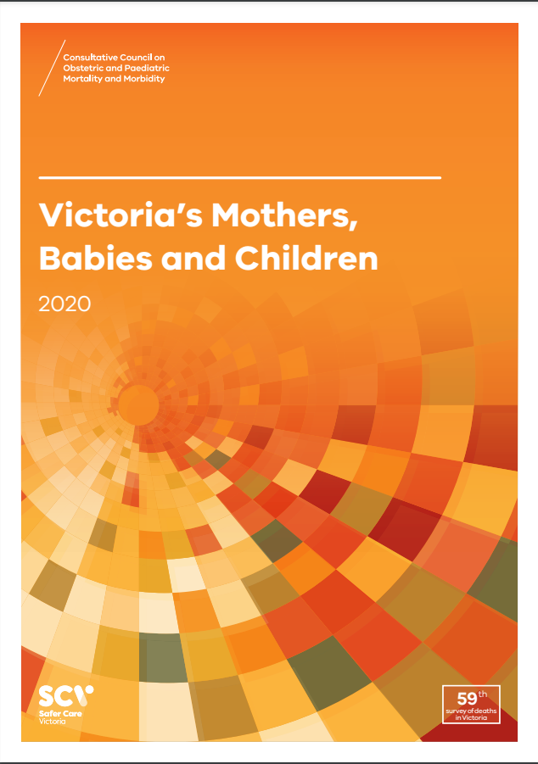
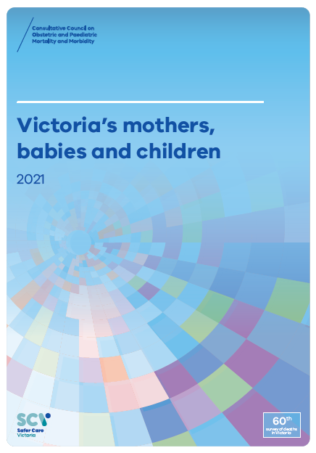
About CCOPMM
The Consultative Council on Obstetric and Paediatric Mortality and Morbidity (CCOPMM) is a statutory authority appointed by the Minister for Health.
Chair: Professor Mark Umstad AM
Operates under the Public Health and Wellbeing Act 2008

Slide 3
About CCOPMM
Legislative responsibility for data collection:
Victorian Perinatal Data Collection (VPDC)
Victorian Congenital anomalies register (VCAR)
Legislative responsibility for health surveillance:
Mortality collections and review of perinatal, child and adolescent, and maternal mortality
Morbidity collections: severe acute maternal morbidity (SAMM)

Slide 4
Undertaking case reviews
CCOPMM has four subcommittees that undertake case reviews and report to CCOPMM.
Stillbirth – Chair: Professor Susan McDonald
Neonatal (0-27 days) – Chair: Professor Rod Hunt
Maternal– Chair: Assoc. Prof. Glyn Teale
Child and Adolescent (28 days-17 years) – Chair: Adjunct Clinical Associate Professor Rob Roseby

Slide 5
Undertaking research
CCOPMM conducts research itself and provides data for research purposes. The CCOPMM Research and Reporting subcommittee leads this work - Chair: Professor Caroline Homer.
CCOPMM identifies research priorities by:
analysis of our reports, data and through case reviews
collaborating with external research projects

Slide 6
Why we do what we do?
Independent oversight of all deaths and severe maternal morbidity
Highlight areas that require improvement – hospital and community
Highlight areas for further research
Inform the development of policies and guidelines
Provide advice on areas for prioritisation and investment

Slide 7
Trends and comparisons: Perinatal Mortality

Slide 8
Perinatal mortality
Includes fetal deaths (stillbirths) and deaths of live-born babies within the first 28 days after birth (neonatal deaths)
Excludes terminations of pregnancy for psychosocial indications - ‘adjusted’ perinatal mortality
‘Adjusted’ perinatal mortality provides a more accurate assessment of avoidable mortality and assists comparisons with other jurisdictions
Detailed data for perinatal mortality can be found in the online supplementary tables

Slide 9
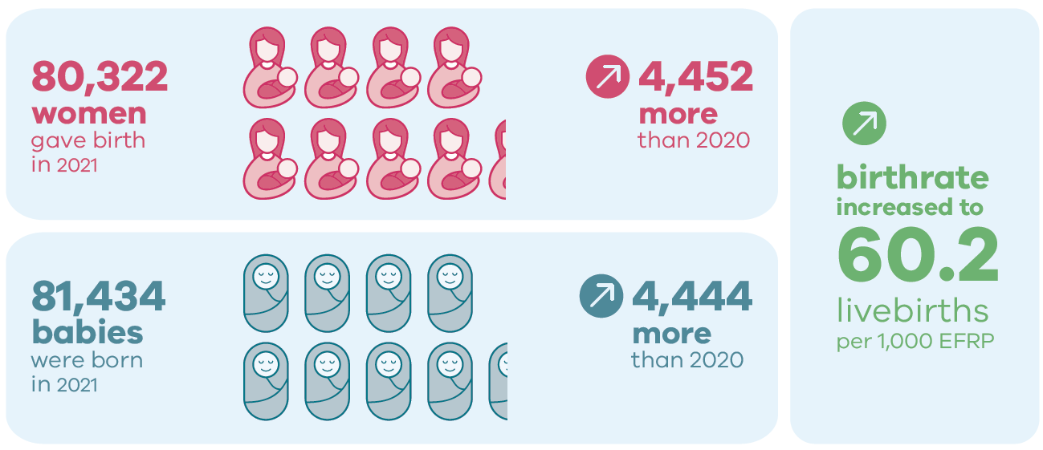
Births in 2021

Slide 10
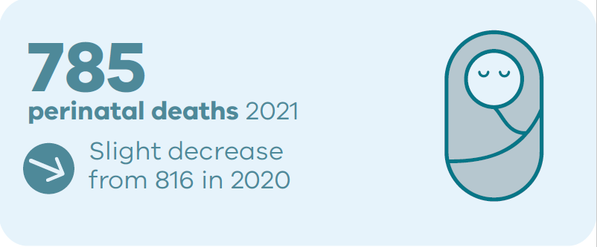
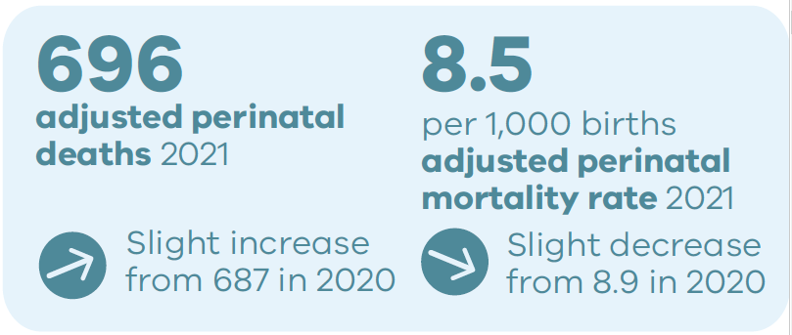
Perinatal deaths in 2021

Slide 11
Adjusted Perinatal Mortality Rates in the 2019-2021 triennium

Slide 12
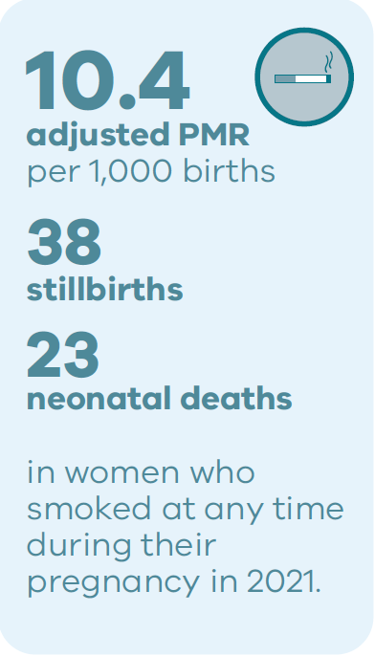
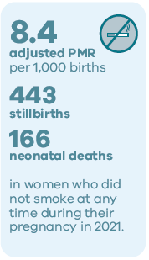
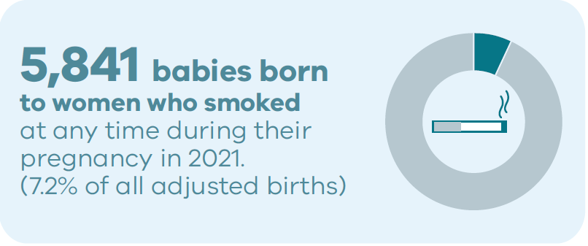
Smoking and outcomes in 2021

Slide 13
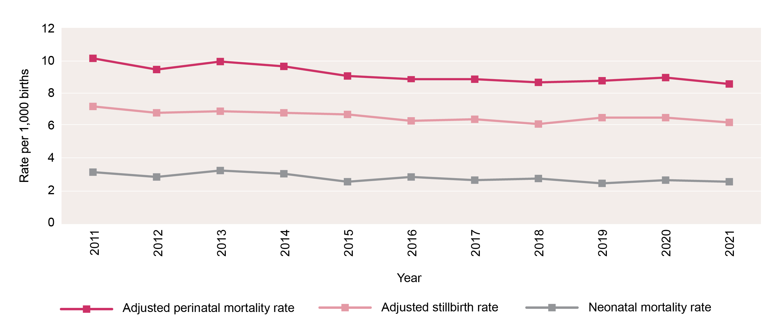
Trends in adjusted perinatal mortality rates, 2011-2021

Slide 14
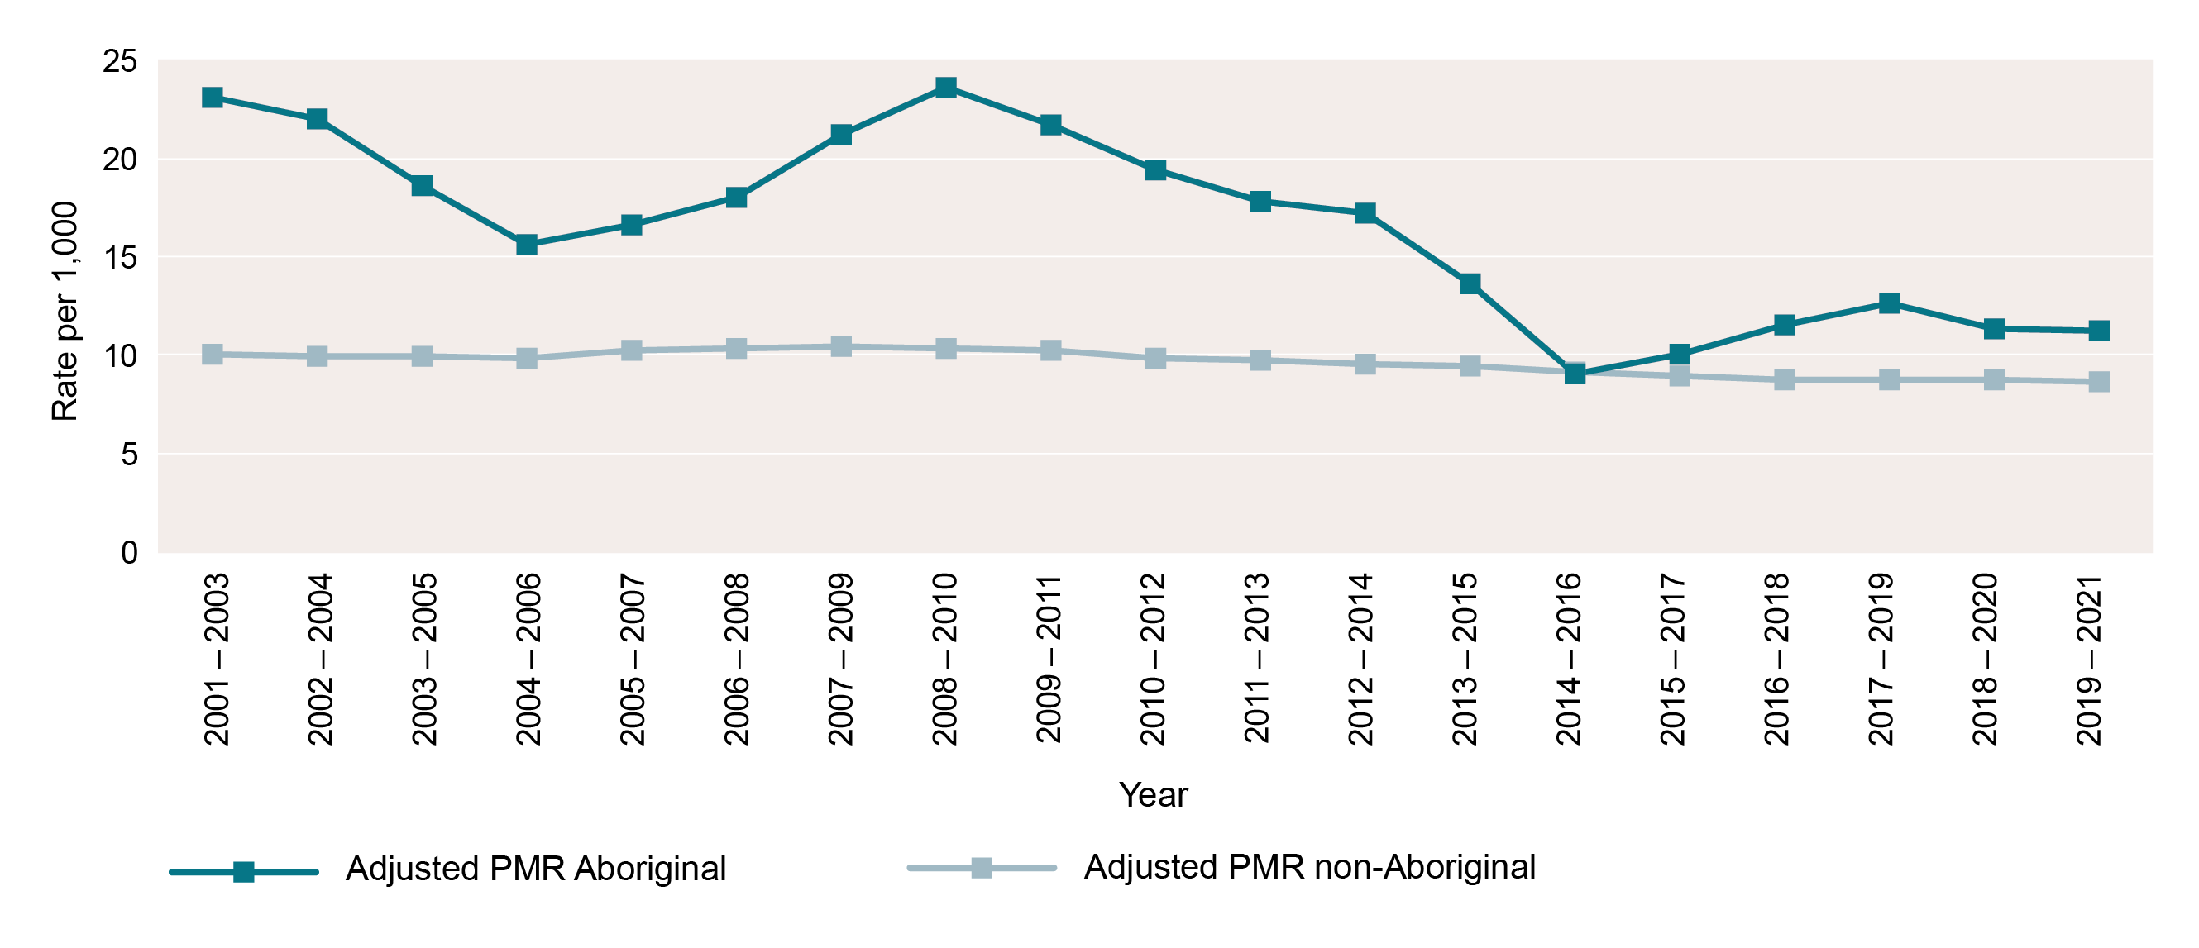
Adjusted perinatal mortality rate by Aboriginal status of mother, by rolling triennia, 2001-2021

Slide 15
CCOPMM Recommendations: Perinatal

Slide 16
Recommendation 1
The Victorian Government funds whole exome sequence testing for families of children who have died from undiagnosed conditions. Whole exome sequencing (WES) can be useful in identifying a cause, however the cost of this can be prohibitive for some families.
Recommendation 2
Support Health Literacy and Shared Decision-Making Capability
Expectant mothers should be provided with the tools required to make informed decisions about their own care. CCOPMM recommendations have previously focused on improving the functioning of the healthcare system. It is essential to recognise the importance of health care literacy on the outcomes of expectant mothers and families.
Notes:
Recommendation 1
The Victorian Government funds whole exome sequence testing for families of children who have died from undiagnosed conditions. Whole exome sequencing (WES) can help identify a cause, but the cost can be prohibitive for some families. The main conditions for WES include:
neuromuscular diseases
syndromic cardiovascular malformations
hypertrophic cardiomyopathy
skeletal malformations and/or dysplasia
neonatal cholestasis and liver failure
cystic renal disease
metabolic disorders with lactic acidosis
immunodeficiency or bone marrow failure
sudden unexpected death in infancy that is not explained by environmental or other conditions
necrotising encephalitis.
Recommendation 2
Support health literacy and shared decision-making capability.
Expectant mothers should be provided with tools to make informed decisions about their own care. CCOPMM recommendations have previously focused on improving the functioning of the healthcare system. It is essential to recognise the importance of healthcare literacy on the outcomes of expectant mothers and families.
Improvements in health literacy is required in:
improving clinician and consumer awareness of the safety and benefits of vaccination in preventing serious perinatal mortality and morbidity
improving women’s awareness, during the childbearing years, of accessing early pregnancy care, including awareness of painful abdominal symptoms or bleeding and the consideration of an ectopic pregnancy
the need for a multimedia program that supports clinicians to communicate effectively and support shared decision making
the need to alert consumers to the increased risk of sudden unexpected death in infants when family are sleeping at different locations while on holidays or visiting family
understanding the choices behind ‘free birthing’ and providing education/support.

Slide 17
Recommendation 3
Malnutrition in children is a high-risk factor for morbidity and mortality. There is an urgent need to strengthen Primary Health care systems, including Maternity, Maternal and Child Health and General Practice services to detect, monitor and treat malnutrition, especially in vulnerable families.
Recommendation 4 – update to 2017 recommendation
Consider admission of an infant, child or adolescent who has presented three times to a hospital
Notes:
Recommendation 3
Malnutrition in children is a high risk factor for morbidity and mortality. There is an urgent need to strengthen primary healthcare systems including maternity, maternal and child health and general practice services to detect, monitor and treat malnutrition, especially in vulnerable families.
CCOPMM has seen several deaths in the 0–4- year age (children) from malnutrition and its complications. These deaths occurred within vulnerable and marginalised families who were either minimally or not at all engaged with maternal and child health nurse services and general practitioners. The limited face-to-face consultations with primary care providers and a lack of recorded weight and growth monitoring resulted in these children suffering unrecognised severe malnutrition.
When nutritional status is borderline, severe acute malnutrition and death can occur within a few weeks if a child is underfed. For children who are living in high-risk social environments where they are vulnerable to neglect, growth monitoring and assessment of risk are essential. The mortality rate of children with severe malnutrition is high. Severe malnutrition may be complicated by sepsis, hypoglycaemia, hypophosphataemia, hypothermia and dehydration.
Areas for improvement include:
in-person appointments – telehealth consultations are a barrier to recognising failure to thrive and/or severe malnutrition because physical observations and growth monitoring cannot be adequately completed
awareness of the complications of syringe-feeding babies – although widespread, it potentially clouds recognition of a baby’s incapacity to suck feed, which needs to be considered when there are growth concerns
diagnosis awareness – in a highly developed country, the diagnosis of malnutrition is less considered than other causes of poor growth
strengthening the transition of care from maternity to maternal and child health services
strengthening the flagging tool for maternal and child health nurses and general practitioners that identifies vulnerable families and prioritises them for appointments and follow-up if they fail to attend booked appointments
referral to Child Protection if families disengage with services and there is a risk of malnutrition that can result in morbidity and mortality.
Community service agencies involved following a Child Protection referral should ensure there is support for families to remain engaged. If they disengage then referral back to Child Protection is necessary. Across all types of deaths and all age groups, CCOPMM continues to observe an overrepresentation of children from vulnerable families. CCOPMM is concerned that the recent increase in economic pressures on families will worsen this problem.
Recommendation 4 – update to 2017 recommendation
Consider admitting to hospital an infant, child or adolescent who has presented three times to a hospital.
Repeat presentation to any health service during the same acute illness is a red flag.
Repeated presentations (that are not planned reviews) may indicate:
The child is deteriorating.
The child is developing complications (for example, secondary bacterial infection with viral illness).
The severity of the illness has not been appreciated by healthcare staff and/or the diagnosis needs to be reviewed.
The parents or caregivers are extremely concerned about their child.
Parents often seek health care from several health services, especially when they are very concerned. It is important to establish how many times a child has presented for the same illness.
A child who presents a second time for the same acute illness should be reviewed by a senior doctor.
If the child presents unexpectedly for a third time during the same illness, there should be serious consideration for hospital admission, even if the child does not look unwell at the time.

Slide 18
Good practice points
Good practice points (GPPs) reflect the findings of CCOPMM’s review of all cases of maternal, perinatal and paediatric mortality, and severe acute maternal morbidity in a reporting year
They are designed to guide local improvements in clinical performance and can relate to our clinical care and/or the system or service we work in.

Slide 19
Good practice points
Contemporaneous documentation of intermittent auscultation
Appropriate syringe feeding at home
Supporting high priority groups
IVF practitioners and double embryo transfer
Syphilis
Please note: Full versions of these GPPs are in the notes below
Notes:
Contemporaneous documentation of intermittent auscultation
Intermittent auscultation has been shown to have equally good outcomes to continuous electronic fetal monitoring (CEFM) in low-risk women when performed according to accepted standards. ​
It is important that intermittent auscultation is performed during and after each contraction in active second stage and documented contemporaneously. ​
Abnormalities in intermittent auscultation must be confirmed with CEFM.
Appropriate syringe feeding at home
The use of a syringe to feed a neonate should be contained to the first few hours of life (if used to provide small volumes of expressed colostrum or breast milk), if used at all. ​
Syringe-feeding bypasses the sucking reflex which is a normal part of newborn feeding. A baby who is not sucking well in order to feed requires further medical assessment to understand why. ​
Abnormalities in suck may be the sole presenting feature of other complex disorders. Prolonged syringe feeding, either in hospital, or at home, should not be encouraged or advised. Where required, further paediatric assessment should be urgently sought.
Supporting high priority groups
Services must ensure they have clear processes to identify high priority groups – including Aboriginal women.
Individualised care plans need to be formulated early in pregnancy and must be clearly communicated across the multidisciplinary team, including shared care providers.
Ensure ‘face to face appointments’ are prioritised to meet their needs and always include access to a qualified interpreter.
Services must ensure that adequate postnatal follow-up occurs for high priority groups. This must include appropriate face to face care.
Services providing postnatal home visits should ensure that at least one home visit occurs for all women regardless of nationality, insurance status or Medicare status.
Additional home visits should also be prioritised for high priority groups.
Resources for supporting high priority groups
Multi-Agency Risk Assessment and Management Framework (MARAM) practice guides and resources
RANZCOG Maternity care in Australia
National Institute for Health and Care Excellence (NICE) guideline CG110: Pregnancy and complex social factors: a model for service provision for pregnant women with complex social factors
The Victorian Department of Health Language services policy and guidelines
In vitro fertilization (IVF) practitioners and double embryo transfer
Infants of women who have undergone IVF are over-represented in perinatal mortality statistics, including women who have undergone double embryo transfer.
It is recommended that IVF practitioners continually review their outcomes, including outcomes related to pregnancy, birth, livebirth & perinatal deaths, to inform their practice & hopefully reduce perinatal mortality related to IVF.
Reporting of perinatal mortality of Assisted Reproductive Technology (ART) births is an essential component of quality ART practice.1 This should include measures that monitor the impact on perinatal mortality of multiple embryo transfer.
A systematic review and meta-analysis of eight studies shows 1.87 times increased risk of perinatal mortality in ART singletons born after IVF/Intracytoplasmic Sperm Injection (ICSI) compared to non-ART singletons.2
Syphilis
All pregnant women should be tested for syphilis as part of routine antenatal screening in the first trimester.
Women at a high risk of congenital syphilis should be re-tested at 28 to 32 weeks, and again at delivery if needed.
Congenital Syphilis can cause miscarriage or stillbirth.
It can also cause other serious health problems in babies including organ, brain, or nerve damage.

Slide 20
For more information
https://www.safercare.vic.gov.au/reports-and-publications/victorias-mothers-babies-and-children-2021-report-and-presentations
Refer to CCOPMM’s other slide packs on:
Mothers and babies
Maternal mortality and morbidity
Perinatal mortality
2020 recommendations

Slide 21
Connect with us
https://www.safercare.vic.gov.au/about/ccopmm,
ccopmm@safercare.vic.gov.au
@safercarevic
Safer Care Victoria

