Slide 1

Bad News Mitigation Refresher
Safewards
Notes:
Explain bad news mitigation (BNM) briefly
It might be helpful to give an example when you have received bad news and how this felt for you (if you feel comfortable)

Slide 2
Patient Community
Patient – patient interaction
Contagion & discord
Patient Modifiers
Anxiety management, Mutual support, Moral commitments, Psychological understanding, Technical mastery
Staff Modifiers
Explanation/information, Role modelling, Patient education, Removal of means, Presence & presence+
Outside Hospital
Patient Characteristics
Stressors
Visitors, Relatives & family tensions, Prospective –ve move
Dependency & institutionalisation, Demands & home
Flashpoints
Assembly/crowding/activity Queuing/waiting/noise Staff/pt turnover/change Bullying/stealing/
prop. damage
Symptoms & demography
Paranoia, PD traits, Irritability/disinhib., Abused, Male, Alc/drugs, Depression, Insight, Delusions, Hall.s, Young
Staff Modifiers
Carer/relative involvement
Family therapy
Active patient support
Staff Modifiers
Pharmacotherapy
Psychotherapy & functional analysis
Nursing support & interventions
Flashpoints
Bad news, Home crisis, Loss of relationship or accommodation, Argument
Flashpoints
Exacerbations;
Independence/identity
Acuity/severity
CONFLICT
&
CONTAINMENT
Flashpoints
Compulsory detention, Admission, Appeal refusal, Complaint denied, Enforced treatment, Exit refused
Flashpoints
Secrecy, Solitude,
Admission shock, Exit blocked
Staff Modifiers
Caringly vigilant & inquisitive, Checking routines, Décor, Maintenance, Clean & Tidy, Alternative choices, Respect
Staff Modifiers
Due process, Justice, Respect for rights,
Hope, Information giving, Support to appeal,
Legitimacy, Compensatory autonomy,
Consistent policy, Flexibility, Respect
Flashpoints
Denial of request,
Staff demand,
Limit setting, Bad news,
Ignoring
Features
Door locked, Quality, Complexity, Seclusion, PICU, ICA, Comfort/sensory rooms, Ligature points
External Structure
Legal framework, National policy, Complaints,
Appeals, Prosecutions, Hospital policy
Physical Environment
Regulatory Framework
Staff Modifiers
Staff anxiety & frustration, Moral commitments, Psychological understanding, Teamwork & consistency, Technical mastery, Positive appreciation
Internal Structure
Rules, Routine, Efficiency, Clean/tidy, Ideology, Custom & practice
Staff Team
Notes:
Provide a quick refresh of the model (see model refresher slides)
Where/how does MHM fit into the model?
What are the flashpoints and why?
What are the staff modifiers?
http://www.safewards.net/model/technical

Slide 3
Background
  People can be affected greatly by unwelcome news, and may want to leave the unit to seek familiar support or escape the cause of the news. Being given no choice to leave the unit when distressed, people may express feelings in an unsafe way.
  Bad news from outside hospital can also cause conflict. Examples can include: death in the family, relationship breakdown, loss of tenancy, burglary, illness in the family, childcare issues, financial issues.
  The resulting distress can cause increased irritability, aggression, violent incidents and absconding
Notes:
http://www.safewards.net/interventions/bad-news-mitigation

Slide 4

Bad news mitigation
Receiving bad news can be common during an inpatient stay. This intervention is about providing support during the delivery of news or afterwards, to mitigate the risk of flashpoints.
Key messages:
Bad news can create confusion and hinder understanding. Be respectful of a person’s views.
Being aware of occasions when people might get upsetting news.
Identify a proactive way to reach out to people before there is a reactive need to.

Slide 5
Bad news mitigation and the Safewards Model
Staff modifier: Mitigate bad news
Staff modifiers
Patient modifiers
Originating domains
Outside hospital
Regulatory framework
Flashpoint: receiving bad news
Originating domains
Flashpoints
Conflict
Containment

Slide 6

Task: Bad news scenarios
  What have you found helpful when working with people who have received bad news?
  What has not been helpful? Why?
Notes:
This task can be done as a large group or smaller groups/pairs. Allow about 5 minutes for this task. Ask for a few examples from the group.

Slide 7

Bad News Mitigation in practice
  Handover
  Before news is delivered
  After news is received
  Ongoing support
Notes:
http://www.safewards.net/interventions/bad-news-mitigation
It is important to highlight that what is considered bad news can vary significantly from person to person therefore it is important to enquire, know the person well and look out for possible signs of distress.
Be aware of occasions and events that might trigger angry or upset reactions.
At handover, discuss as a team and share knowledge to predict who might receive unwelcome news and how support will be offered.
Work with the multidisciplinary team (MDT) to express bad news empathically or intercept after it has happened.
Maintain awareness of what is going on through regular one-on-one contact with the patient.
Know everyone’s general demeanor
Safewards bad news mitigation video helpful here – shows identification of bad news and planning

Slide 8
Bad News Mitigation in practice
  Approach
  Find a quiet place, give the person time to express their feelings.
  Acknowledge their feelings, express empathy.
  Answer any questions honestly, giving time, attention and respect.
  Show you are receptive to concerns - use listening techniques.
  Be responsive and respectful of a person’s views.
  Support the person to understand decisions and acknowledge feelings. This can improve relationships and make aggression, self-harm and absconding less likely.
Notes:
Ask for e.g. open-ended questions
Talking over a cup of tea
http://www.safewards.net/interventions/bad-news-mitigation

Slide 9
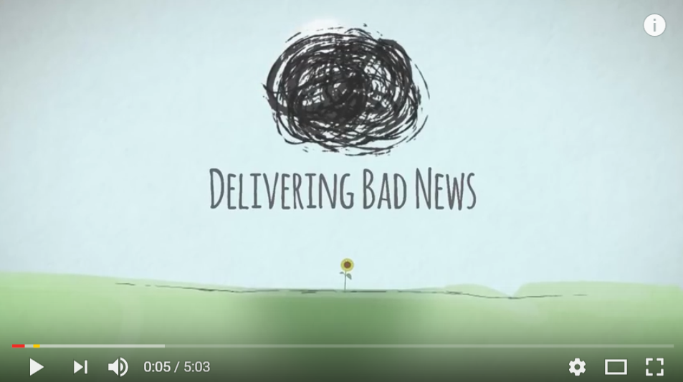
Delivering Bad News Video
https://www.youtube.com/watch?v=juKAMBh9J54
Source: The Irish Hospice Foundation, Youtube

Slide 10
Role of the intervention lead
  Make sure these two questions are considered by the team at handover:
  Has anyone received any bad news over the past shift? If they have, how can we support them?
  Is anyone likely to receive bad news during the coming shift, and if so, how are we going to manage that?
Notes:
http://www.safewards.net/interventions/bad-news-mitigation
You may want to ask the group how they could ensure this process occurs, what measures will they put in place?

Slide 11
Bad news mitigation fidelity
A proactive way to reach out to people before there is a reactive need to
Keeping staff aware and looking for occasions when people might get upsetting news and delivering emotional support quickly
Giving patients enough information so they can determine whether it’s bad news or not
Bad news mitigation
IS
=
  A way of protecting patients from life or threatening them with consequences or assuming how they will feel
  Attaching the phrase ‘I am sorry to let you know’ when we tell patients they cannot have something they desperately want
Bad news mitigation
IS NOT
≠
Notes:
Taken from a PowerPoint from a presentation by Professor Len Bowers

Slide 12
Bad news mitigation adjustments
  CAMHS None, but understanding for meaning and relevance to age group
  Forensic None
  Older people None, but understanding for meaning and relevance to age group
Notes:
Taken from a PowerPoint from a presentation by Professor Len Bowers

