Slide 1
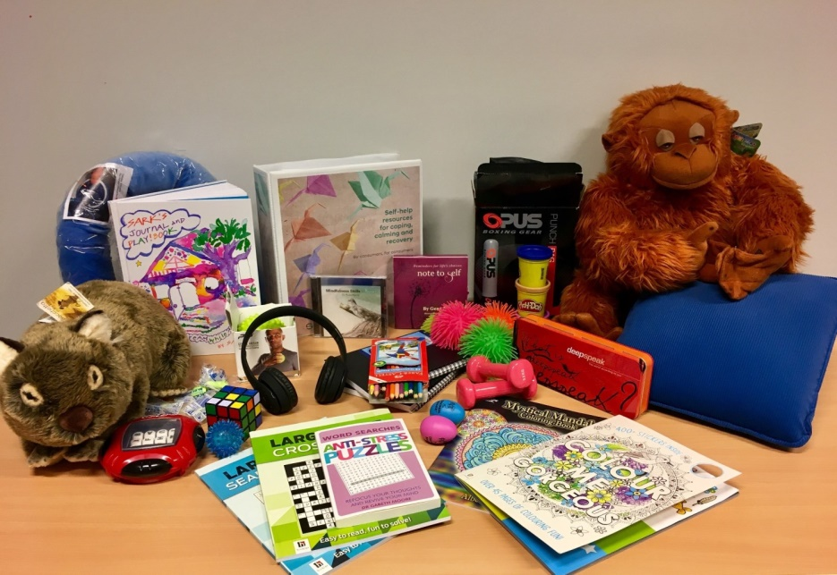
Calm down methods Refresher
Safewards
Notes:
Briefly describe Calm Down Methods

Slide 2
Patient Community
Patient – patient interaction
Contagion & discord
Patient Modifiers
Anxiety management, Mutual support, Moral commitments, Psychological understanding, Technical mastery
Staff Modifiers
Explanation/information, Role modelling, Patient education, Removal of means, Presence & presence+
Outside Hospital
Patient Characteristics
Stressors
Visitors, Relatives & family tensions, Prospective –ve move
Dependency & institutionalisation, Demands & home
Flashpoints
Assembly/crowding/activity Queuing/waiting/noise Staff/pt turnover/change Bullying/stealing/
prop. damage
Symptoms & demography
Paranoia, PD traits, Irritability/disinhib., Abused, Male, Alc/drugs, Depression, Insight, Delusions, Hall.s, Young
Staff Modifiers
Carer/relative involvement
Family therapy
Active patient support
Staff Modifiers
Pharmacotherapy
Psychotherapy & functional analysis
Nursing support & interventions
Flashpoints
Bad news, Home crisis, Loss of relationship or accommodation, Argument
Flashpoints
Exacerbations;
Independence/identity
Acuity/severity
CONFLICT
&
CONTAINMENT
Flashpoints
Compulsory detention, Admission, Appeal refusal, Complaint denied, Enforced treatment, Exit refused
Flashpoints
Secrecy, Solitude,
Admission shock, Exit blocked
Staff Modifiers
Caringly vigilant & inquisitive, Checking routines, Décor, Maintenance, Clean & Tidy, Alternative choices, Respect
Staff Modifiers
Due process, Justice, Respect for rights,
Hope, Information giving, Support to appeal,
Legitimacy, Compensatory autonomy,
Consistent policy, Flexibility, Respect
Flashpoints
Denial of request,
Staff demand,
Limit setting, Bad news,
Ignoring
Features
Door locked, Quality, Complexity, Seclusion, PICU, ICA, Comfort/sensory rooms, Ligature points
External Structure
Legal framework, National policy, Complaints,
Appeals, Prosecutions, Hospital policy
Physical Environment
Regulatory Framework
Staff Modifiers
Staff anxiety & frustration, Moral commitments, Psychological understanding, Teamwork & consistency, Technical mastery, Positive appreciation
Internal Structure
Rules, Routine, Efficiency, Clean/tidy, Ideology, Custom & practice
Staff Team
Notes:
Provide a quick refresh of the model (see model refresher slides)
Where/how does MHM fit into the model?
What are the flashpoints and why?
What are the staff modifiers?
http://www.safewards.net/model/technical

Slide 3
Background and aims
Background
Pro re nata (PRN) medication can been used as an effective strategy to assist people to feel calm, but perhaps we reach for it too easily and too quickly. Where possible and practical, it’s always best to use the patient’s own strengths and coping mechanisms – or support people to develop new strengths and skills – to enable people to self-regulate.
Aims
Early de-escalation
Divert and prevent
Increase people’s sense of empowerment and self-control (these processes contribute to recovery)
Notes:
http://www.safewards.net/interventions/calm-down-methods

Slide 4
Calm Down Methods and the Safewards Model
Staff modifier:
Calm Down Methods
Staff modifiers
Patient modifiers
Originating domain
Patient characteristics
Originating domains
Flashpoints
Conflict
Containment

Slide 5
Benefits
PRN medication is an effective strategy for some people, some of the time, however calm down methods can:
Support people to draw on their own strengths and coping mechanisms
Offer alternatives to medication, that can be sustained well past an admission
Build self-knowledge
Facilitate learning of new strengths and skills
Notes:
http://www.safewards.net/interventions/calm-down-methods

Slide 6
Early signs of distress/agitation
Notice potential changes in:
facial expression
tone of voice
quick response to a normal reminder
restlessness
breathing patterns
body language
eye contact (or lack thereof)
movement around the ward
Notes:
Ask the group what changes they might identify
http://www.safewards.net/interventions/calm-down-methods

Slide 7
Task: Calm down methods handout
Think about what might be helpful for different types of ‘calm down’ needs.
Think about different types of resources and the functions they could serve.
‘It can be easy to say someone is agitated but harder to understand why’
Difficult emotions
Difficult thoughts and urges
Difficult experiences
Sensory & grounding, comfort & soothing, humour, distraction, mindfulness, inspirational, expressive & venting, harm minimisation, problem solving & reflection, movement & activity, drawing on nature or creativity
Notes:
Refer to the handout ‘Calm Down Methods: Resource Ideas’ from the resources pack.
Activity with handout
Split the group into small groups of 3-4 people. Think about a common need you may have seen on the unit and which item might sit with this intervention.
The handout can be used to prompt our thinking about the intervention
It can also be used to consider how you may add to the resources over time

Slide 8
Calm down methods in practice
Assemble a box of ‘calm down resources’ for your unit
Offer/explore calm down methods before considering PRN
Support people to explore the potential uses of calm down methods
Some of the calm down activities can be done together
Record calm down methods use in a log book, and patient files
Notes:
http://www.safewards.net/interventions/calm-down-methods
You could show the Safewards calm down methods video here

Slide 9
Role of the intervention lead
Suggest when calm down methods are appropriate
Ask if/how calm down was used when people mention agitation or PRN at handover
Ask if/how calm down was used if there was a restrictive intervention
Ensure resources are easily available to patients when needed
Check resources regularly to ensure items are returned, clean and in good working order (develop an infection control plan)
Replace missing, depleted or broken items
Expanding Calm Down Methods…
Look at increasing the number and type of resources over time
Make calm down resources available in more spaces
Think about how patients can take resources home after discharge
Notes:
http://www.safewards.net/interventions/calm-down-methods
You might also like to see some of the examples used in Victoria

Slide 10
Calm down methods fidelity
A practical set of equipment and patient resource for self–help when in distress
A store of equipment that can be used to help people who may be feeling agitated/restless, anxious/frightened, angry/irritable, ashamed or depressed/despairing to reach a relaxed state of mind
Calm down methods
IS
=
A box of things that gathers dust in the office or gets dragged to a group
A store of equipment for diversional or recreational activities for patients to do on request
Calm down methods
IS NOT
≠
Notes:
Taken from a PowerPoint from a presentation by Professor Len Bowers

Slide 11
Calm down methods adjustments
CAMHS Safety and supervision review, choice of items different
Forensic Safety and supervision review, choice of items different
Older people Safety and supervision review, choice of items different
Notes:
Taken from a PowerPoint from a presentation by Professor Len Bowers

