Slide 1
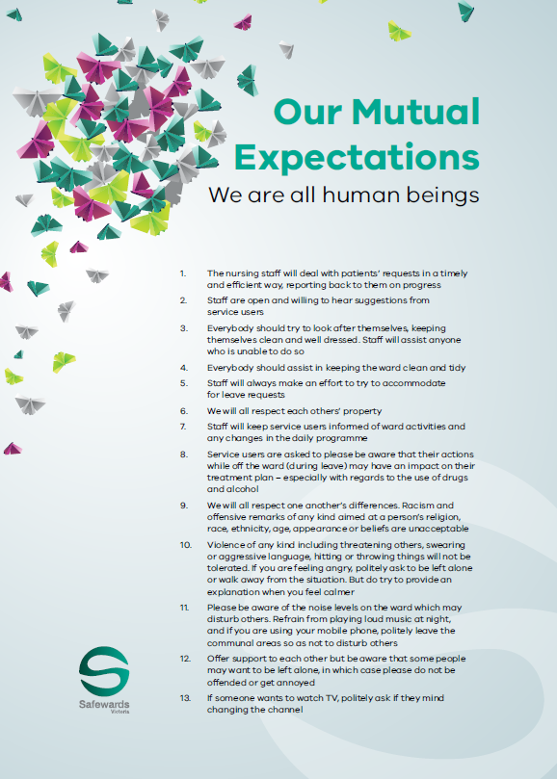
Safewards
Clear mutual expectations Refresher
Notes:
Brief overview of clear mutual expectations (CME)

Slide 2
Patient Community
Patient – patient interaction
Contagion & discord
Patient Modifiers
Anxiety management, Mutual support, Moral commitments, Psychological understanding, Technical mastery
Staff Modifiers
Explanation/information, Role modelling, Patient education, Removal of means, Presence & presence+
Outside Hospital
Patient Characteristics
Stressors
Visitors, Relatives & family tensions, Prospective –ve move
Dependency & institutionalisation, Demands & home
Flashpoints
Assembly/crowding/activity Queuing/waiting/noise Staff/pt turnover/change Bullying/stealing/
prop. damage
Symptoms & demography
Paranoia, PD traits, Irritability/disinhib., Abused, Male, Alc/drugs, Depression, Insight, Delusions, Hall.s, Young
Staff Modifiers
Carer/relative involvement
Family therapy
Active patient support
Staff Modifiers
Pharmacotherapy
Psychotherapy & functional analysis
Nursing support & interventions
Flashpoints
Bad news, Home crisis, Loss of relationship or accommodation, Argument
Flashpoints
Exacerbations;
Independence/identity
Acuity/severity
CONFLICT
&
CONTAINMENT
Flashpoints
Compulsory detention, Admission, Appeal refusal, Complaint denied, Enforced treatment, Exit refused
Flashpoints
Secrecy, Solitude,
Admission shock, Exit blocked
Staff Modifiers
Caringly vigilant & inquisitive, Checking routines, Décor, Maintenance, Clean & Tidy, Alternative choices, Respect
Staff Modifiers
Due process, Justice, Respect for rights,
Hope, Information giving, Support to appeal,
Legitimacy, Compensatory autonomy,
Consistent policy, Flexibility, Respect
Flashpoints
Denial of request,
Staff demand,
Limit setting, Bad news,
Ignoring
Features
Door locked, Quality, Complexity, Seclusion, PICU, ICA, Comfort/sensory rooms, Ligature points
External Structure
Legal framework, National policy, Complaints,
Appeals, Prosecutions, Hospital policy
Physical Environment
Regulatory Framework
Staff Modifiers
Staff anxiety & frustration, Moral commitments, Psychological understanding, Teamwork & consistency, Technical mastery, Positive appreciation
Internal Structure
Rules, Routine, Efficiency, Clean/tidy, Ideology, Custom & practice
Staff Team
Notes:
Provide a quick refresh of the model (see model refresher slides)
Where/how does MHM fit into the model?
What are the flashpoints and why?
What are the staff modifiers?
http://www.safewards.net/model/technical

Slide 3
Background and aims
  Background
  Some flashpoints, and therefore conflict, are due in part to unclear expectations, lack of clarity or inconsistency on the unit.
  Aims
  Create a more egalitarian social unit
  Mutual holding to account
  Set clear standards for both staff and patients
  Build consistency and predictability while allowing flexibility
  Ensure patients and staff understand their obligations to each other
Notes:
See http://www.safewards.net/interventions/clear-mutual-expectations which states that lack of consistency can affect people who may be unwell, distracted, have difficulty interpreting what has been said, experiencing fluctuations in mood, have a history of trauma etc.

Slide 4
Clear mutual expectations and the Safewards model
Staff modifier:
Sharing expectations, finding mutual agreement
Staff modifiers
Patient modifiers: Sharing expectations, finding mutual agreement
Patient modifiers
Originating domains:
Patient Community
Staff Team
Patient Characteristics
Physical environment
Originating domains
Flashpoints
Conflict
Containment

Slide 5

Task: Examples of clear expectations
What are the benefits of having clear expectations?
What expectations can be unclear?
Notes:
Write the examples given from the participants on a whiteboard
Group discussion

Slide 6
Lack of consistency and clarity can cause problems
  Lack of consistency and clarity is annoying for almost everyone. It may particularly affect those who:
  aren't thinking clearly
  are distracted by distressing thoughts or emotions, or are preoccupied
  have difficulty interpreting communication
  experience changes in mood
  have a distorted, or different, view of world and others
  have a history of trauma
Notes:
http://www.safewards.net/interventions/clear-mutual-expectations
Lack of consistency and clarity can be difficult for everyone.

Slide 7
Mutual expectations for consideration
  General expectations
  Staff
  Excluded items
  Property
  Places
Notes:
http://www.safewards.net/interventions/clear-mutual-expectations
These may be helpful topics to start thinking about mutual expectations.

Slide 8
Role of the clear mutual expectations lead
  Ensure clear mutual expectations meetings occur
  Communicate meeting results in a visible manner e.g. posters
  Ensure the clear mutual expectations are discussed:
      If you're the admitting nurse, show the information/poster and explain its contents
      If you are on duty when a person is admitted, remind the admitting nurse to refer to the clear mutual expectations
      At handover, ask whether the poster has been shown and explained to new patients
Notes:
What ideas do you have for design on your unit?
The Safewards Victoria video on clear mutual expectations would be helpful here

Slide 9
Clear mutual expectations fidelity
  Sharing expectations across the community for consistency and high standards of behaviour
  Facilitating public conversation about how different groups sharing one space can respect one another
Clear mutual expectations
IS
=
Clear mutual expectations
IS NOT
  Codifying rules for patients so staff have an easier time telling patients what to do
  A pretty poster or mission statement to point to when things get tricky
≠
Notes:
Taken from a PowerPoint from a presentation by Professor Len Bowers

Slide 10
Clear mutual expectations adjustments
  CAMHS None
  Forensic None
  Older people None, usable by all
Notes:
Taken from a PowerPoint from a presentation by Professor Len Bowers

