Slide 1
Discharge Messages Refresher
Safewards
Notes:
Give a brief overview of Discharge Messages
http://www.safewards.net/interventions/discharge-message

Slide 2
Patient Community
Patient – patient interaction
Contagion & discord
Patient Modifiers
Anxiety management, Mutual support, Moral commitments, Psychological understanding, Technical mastery
Staff Modifiers
Explanation/information, Role modelling, Patient education, Removal of means, Presence & presence+
Outside Hospital
Patient Characteristics
Stressors
Visitors, Relatives & family tensions, Prospective –ve move
Dependency & institutionalisation, Demands & home
Flashpoints
Assembly/crowding/activity Queuing/waiting/noise Staff/pt turnover/change Bullying/stealing/
prop. damage
Symptoms & demography
Paranoia, PD traits, Irritability/disinhib., Abused, Male, Alc/drugs, Depression, Insight, Delusions, Hall.s, Young
Staff Modifiers
Carer/relative involvement
Family therapy
Active patient support
Staff Modifiers
Pharmacotherapy
Psychotherapy & functional analysis
Nursing support & interventions
Flashpoints
Bad news, Home crisis, Loss of relationship or accommodation, Argument
Flashpoints
Exacerbations;
Independence/identity
Acuity/severity
CONFLICT
&
CONTAINMENT
Flashpoints
Compulsory detention, Admission, Appeal refusal, Complaint denied, Enforced treatment, Exit refused
Flashpoints
Secrecy, Solitude,
Admission shock, Exit blocked
Staff Modifiers
Caringly vigilant & inquisitive, Checking routines, Décor, Maintenance, Clean & Tidy, Alternative choices, Respect
Staff Modifiers
Due process, Justice, Respect for rights,
Hope, Information giving, Support to appeal,
Legitimacy, Compensatory autonomy,
Consistent policy, Flexibility, Respect
Flashpoints
Denial of request,
Staff demand,
Limit setting, Bad news,
Ignoring
Features
Door locked, Quality, Complexity, Seclusion, PICU, ICA, Comfort/sensory rooms, Ligature points
External Structure
Legal framework, National policy, Complaints,
Appeals, Prosecutions, Hospital policy
Physical Environment
Regulatory Framework
Staff Modifiers
Staff anxiety & frustration, Moral commitments, Psychological understanding, Teamwork & consistency, Technical mastery, Positive appreciation
Internal Structure
Rules, Routine, Efficiency, Clean/tidy, Ideology, Custom & practice
Staff Team
Notes:
Provide a quick refresh of the model (see model refresher slides)
Where/how does MHM fit into the model?
What are the flashpoints and why?
What are the staff modifiers?
http://www.safewards.net/model/technical

Slide 3
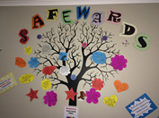
Background
Discharge messages provides a way of helping people connect with hope by:
Demonstrating care and concern
Attending to what people feel and are concerned about
Creating an avenue for patients to inspire and support each other (even anonymously)
Providing hopeful messages from other patients (rather than from staff)
Patient engagement is fundamental to this intervention
Notes:
http://www.safewards.net/interventions/discharge-message

Slide 4
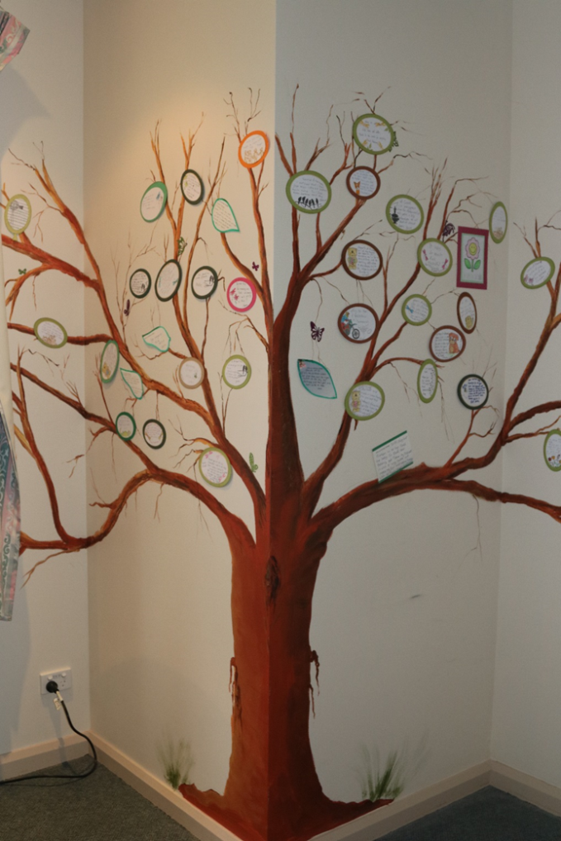
Aims
When a patient is preparing to leave, there is an opportunity for them to provide a discharge message as a form of closure for themselves and to help others on the unit.
Aims:
Provide authentic encouragement and support for new patients
Provide hope and convey messages about the purpose and potential benefits of an admission
Provide a boost to self-esteem / identity on leaving the unit through making a valued contribution to the patient community
Notes:
Ask people to think about integrating this intervention into practice eg-it is not just about someone leaving. It is also about engaging people who are on the unit who may be newly admitted, it is also about positivity and safety planning etc
http://www.safewards.net/interventions/discharge-message

Slide 5
Discharge messages and the Safewards Model
Staff modifier:
Discharge messages
Staff modifiers
Originating domains:
Patient community
Patient characteristics
Physical environment
Patient modifiers:
Hope, mutual help
Patient modifiers
Originating domains
Flashpoints
Conflict
Containment

Slide 6
Role of the intervention lead
Establish the discharge message tree or noticeboard
Check the discharge message tree or noticeboard, keep it tidy and remind staff to encourage writing a message when a patient's discharge is forthcoming
Remind patients the opportunity to complete a discharge message (this could be done during a mutual help meeting). Offer support to write the message if necessary.
Notes:
http://www.safewards.net/interventions/discharge-message
See examples from Victoria which may suit your ward.

Slide 7
Discharge messages fidelity
A way of passing on the messages & advice from leaving patients to arriving patients
Delivering positive messages to provide hope and encouragement to arriving patients
Discharge messages
IS
=
A way of highlighting how good the unit and staff are to visitors
Soliciting compliments from patients leaving the unit to make the staff feel good
Discharge message
IS NOT
≠
Notes:
Taken from a PowerPoint from a presentation by Professor Len Bowers

Slide 8
Discharge messages adjustments
CAMHS None
Forensic Goodbye messages, transfer messages
Older people None in some cases, impossible in others, engaging family
Notes:
Taken from a PowerPoint from a presentation by Professor Len Bowers

