Slide 1
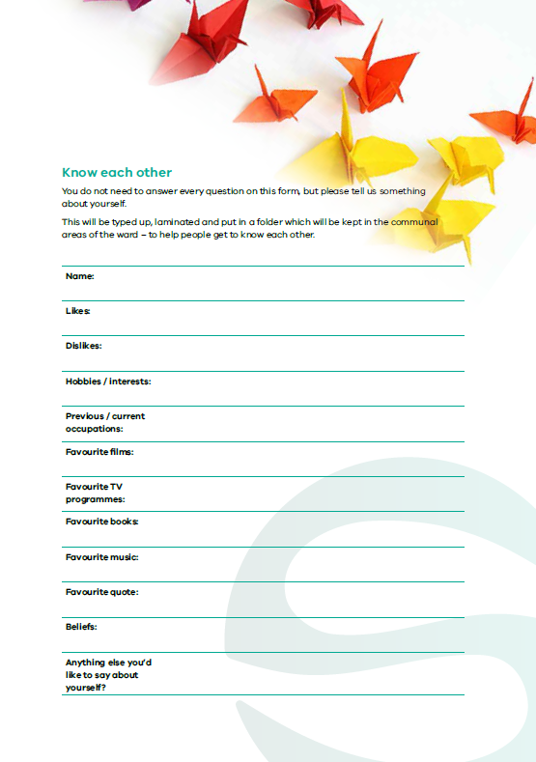
Safewards
Know each other Refresher
Notes:
Briefly explain Know Each Other
http://www.safewards.net/interventions/know-each-other

Slide 2
Patient Community
Patient – patient interaction
Contagion & discord
Patient Modifiers
Anxiety management, Mutual support, Moral commitments, Psychological understanding, Technical mastery
Staff Modifiers
Explanation/information, Role modelling, Patient education, Removal of means, Presence & presence+
Outside Hospital
Patient Characteristics
Stressors
Visitors, Relatives & family tensions, Prospective –ve move
Dependency & institutionalisation, Demands & home
Flashpoints
Assembly/crowding/activity Queuing/waiting/noise Staff/pt turnover/change Bullying/stealing/
prop. damage
Symptoms & demography
Paranoia, PD traits, Irritability/disinhib., Abused, Male, Alc/drugs, Depression, Insight, Delusions, Hall.s, Young
Staff Modifiers
Carer/relative involvement
Family therapy
Active patient support
Staff Modifiers
Pharmacotherapy
Psychotherapy & functional analysis
Nursing support & interventions
Flashpoints
Bad news, Home crisis, Loss of relationship or accommodation, Argument
Flashpoints
Exacerbations;
Independence/identity
Acuity/severity
CONFLICT
&
CONTAINMENT
Flashpoints
Compulsory detention, Admission, Appeal refusal, Complaint denied, Enforced treatment, Exit refused
Flashpoints
Secrecy, Solitude,
Admission shock, Exit blocked
Staff Modifiers
Caringly vigilant & inquisitive, Checking routines, Décor, Maintenance, Clean & Tidy, Alternative choices, Respect
Staff Modifiers
Due process, Justice, Respect for rights,
Hope, Information giving, Support to appeal,
Legitimacy, Compensatory autonomy,
Consistent policy, Flexibility, Respect
Flashpoints
Denial of request,
Staff demand,
Limit setting, Bad news,
Ignoring
Features
Door locked, Quality, Complexity, Seclusion, PICU, ICA, Comfort/sensory rooms, Ligature points
External Structure
Legal framework, National policy, Complaints,
Appeals, Prosecutions, Hospital policy
Physical Environment
Regulatory Framework
Staff Modifiers
Staff anxiety & frustration, Moral commitments, Psychological understanding, Teamwork & consistency, Technical mastery, Positive appreciation
Internal Structure
Rules, Routine, Efficiency, Clean/tidy, Ideology, Custom & practice
Staff Team
Notes:
Provide a quick refresh of the model (see model refresher slides)
Where/how does MHM fit into the model?
What are the flashpoints and why?
What are the staff modifiers?
http://www.safewards.net/model/technical

Slide 3
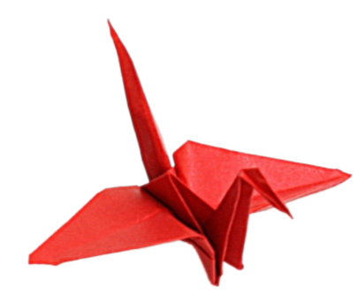
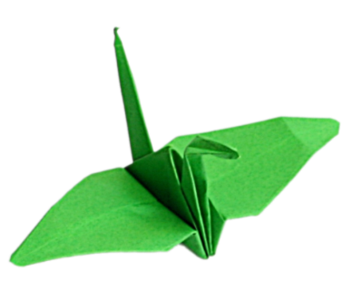
Background
Good therapeutic relationships between staff and patients are the foundation of effective care
If patients and staff have information about each other they can find common areas of interest
Sharing areas of interest makes engagement easier for both patients and staff, especially in tense situations
It’s helpful to have topics for conversation
Notes:
http://www.safewards.net/interventions/know-each-other
This slide covers the reasons for this intervention and the anticipated outcomes

Slide 4
Aims
Build stronger relationships between patients, and between patients and staff
Assist social interaction
Nurture a sense of common humanity while maintaining safety
…making conflict less likely
Notes:
http://www.safewards.net/interventions/know-each-other
This slide covers the aims for this intervention

Slide 5
Know each other and the Safewards model
Staff modifier:
Sharing information
Staff modifiers
Patient modifier: Sharing information
Patient modifiers
Originating domains:
Patient Community
Staff Team
Patient Characteristics
Originating domains
Flashpoints
Conflict
Containment

Slide 6
Task: Getting to know each other
Where did you grow up?
How many children in your family?
What was one of your childhood hobbies?
What was your biggest challenge growing up?
What was your first job?
Notes:
Ask the participants to get into pairs (preferably with someone they do not know so well) and discuss each of these questions.
Allow approximately 10 minutes.
When you bring the group back together ask if they learnt something they didn’t know about each other
You may like to ask for a few examples from the participants

Slide 7
Information collected
What information do we generally collect about patients?
It is usually negative and often focuses on:
past history of psychiatric illness
risks
disabilities
Little of the information collected provides a basis for relationship building
What do patients know about staff?
Notes:
http://www.safewards.net/interventions/know-each-other
Ask the participants what information is usually collected about patients?

Slide 8
Task: What non-controversial information might you wish to share?
Notes:
Ask the participants for examples of what they can share (try to move people away from thinking about what they can share rather than what they cannot share).

Slide 9
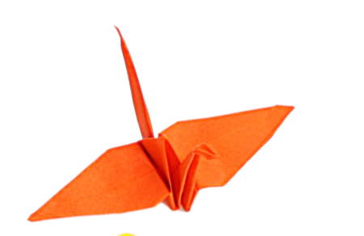
Examples of non-controversial information
Qualifications
Years of experience working in mental health
Hospitals and various locations worked
Previous jobs
Hobbies and interests
Favourite TV program and reasons
Favourite film and why
Favourite book and why
Preferred music genre
What bad advice have you taken?
What bad advice have you given?
What is your top life tip?
Notes:
http://www.safewards.net/interventions/know-each-other

Slide 10
Know each other in practice
On admission, ask the patient (and their carers where appropriate) questions that will help to produce a profile of the patient and include:
key background info
likes and dislikes
favourite things
quotes
beliefs
These can be conversation starters
Add a graphic or picture of the patient’s choice
Notes:
http://www.safewards.net/interventions/know-each-other

Slide 11
Know each other in practice
Produce a know each other folder or display for all staff and patients on the unit
Use the know each other templates or modify and create your own
Appoint a lead to:
prepare the folder or display
draw patients’ attention to the information
make sure the know each other information stays out on the unit
replace any sheets that get lost
Notes:
http://www.safewards.net/interventions/know-each-other
You might like to refer to some of the examples from Victoria here-it does not necessarily have to be in the form of a folder.
On discharge the patient can either take their sheet home or choose to have it destroyed

Slide 12
Notes:
An example

Slide 13
Paste an example of a know each other form filled out from someone in your service here
Notes:
Before the training you may want to ask someone well known to the participants to fill out a Know Each Other Template (this could be anyone from your CEO to your administration, payroll staff etc.) with the persons consent read this out during the training.

Slide 14
Know each other fidelity
Know each other
IS
Patients and staff sharing personal information to facilitate conversations and show mutual respect
A space where staff and patients can show their common humanity.
=
Staff sharing personal information with staff, or giving information to patients to emphasise power differences and unbalanced relationships.
Staff showing who they are to each other in front of patients
Know each other
IS NOT
≠
Notes:
Taken from a PowerPoint from a presentation by Professor Len Bowers

Slide 15
Know each other adjustments
CAMHS None, although staff must provide some age-relevant, interesting content
Forensic More careful vetting and review of contents
Older people None, although relatives may be needed as a source of information for patients, link to life story work again
Notes:
Taken from a PowerPoint from a presentation by Professor Len Bowers

