Slide 1
Mutual Help Meeting Refresher
Safewards
Notes:
Briefly explain the essence of the mutual help meeting (MHM)

Slide 2
Patient Community
Patient – patient interaction
Contagion & discord
Patient Modifiers
Anxiety management, Mutual support, Moral commitments, Psychological understanding, Technical mastery
Staff Modifiers
Explanation/information, Role modelling, Patient education, Removal of means, Presence & presence+
Outside Hospital
Patient Characteristics
Stressors
Visitors, Relatives & family tensions, Prospective –ve move
Dependency & institutionalisation, Demands & home
Flashpoints
Assembly/crowding/activity Queuing/waiting/noise Staff/pt turnover/change Bullying/stealing/
prop. damage
Symptoms & demography
Paranoia, PD traits, Irritability/disinhib., Abused, Male, Alc/drugs, Depression, Insight, Delusions, Hall.s, Young
Staff Modifiers
Carer/relative involvement
Family therapy
Active patient support
Staff Modifiers
Pharmacotherapy
Psychotherapy & functional analysis
Nursing support & interventions
Flashpoints
Bad news, Home crisis, Loss of relationship or accommodation, Argument
Flashpoints
Exacerbations;
Independence/identity
Acuity/severity
CONFLICT
&
CONTAINMENT
Flashpoints
Compulsory detention, Admission, Appeal refusal, Complaint denied, Enforced treatment, Exit refused
Flashpoints
Secrecy, Solitude,
Admission shock, Exit blocked
Staff Modifiers
Caringly vigilant & inquisitive, Checking routines, Décor, Maintenance, Clean & Tidy, Alternative choices, Respect
Staff Modifiers
Due process, Justice, Respect for rights,
Hope, Information giving, Support to appeal,
Legitimacy, Compensatory autonomy,
Consistent policy, Flexibility, Respect
Flashpoints
Denial of request,
Staff demand,
Limit setting, Bad news,
Ignoring
Features
Door locked, Quality, Complexity, Seclusion, PICU, ICA, Comfort/sensory rooms, Ligature points
External Structure
Legal framework, National policy, Complaints,
Appeals, Prosecutions, Hospital policy
Physical Environment
Regulatory Framework
Staff Modifiers
Staff anxiety & frustration, Moral commitments, Psychological understanding, Teamwork & consistency, Technical mastery, Positive appreciation
Internal Structure
Rules, Routine, Efficiency, Clean/tidy, Ideology, Custom & practice
Staff Team
Notes:
Provide a quick refresh of the model (see model refresher slides)
Where/how does MHM fit into the model?
What are the flashpoints and why?
What are the staff modifiers?
http://www.safewards.net/model/technical

Slide 3
Background
The unit is a social community and potentially a powerful engine to help patients, have a positive influence, and progress towards discharge.
The help that patients give each other can be highly valued and effective.
The giving of help and support between patients offers the giver:
a socially valued role
the chance to make a meaningful contribution
the potential to improve their self-esteem
Notes:
http://www.safewards.net/interventions/mutual-help-meeting

Slide 4
Aims
Strengthen an existing mechanism that is highly valued by patients and staff
Create opportunities for patients to find valued roles and public recognition
Build patient self-esteem
Increase mutual support and promote recovery
Establish values, understanding and social connection
Notes:
http://www.safewards.net/interventions/mutual-help-meeting

Slide 5
Mutual Help Meeting and the Safewards Model
Staff modifier: Mutual help meeting
Staff modifiers
Patient modifier
Mutual support
Patient modifiers
Originating domains
Patient community
Patient characteristics
Originating domains
Flashpoints
Conflict
Containment

Slide 6
Task: Invaluable mutual support
Think of an example where patient-to-patient mutual support has been invaluable on your unit…
Notes:
Ask the participants for some examples they have seen in practice
The Safewards mutual help meeting video may be useful hear to provide a consumer perspective

Slide 7
Conflict
Inpatient aggression can arise from many different factors. This intervention focuses on preventing conflict that may arise from patient-to-patient interactions, or from being in a strange and/or frightening environment.
Conflict can be reduced if patients:
Positively appreciate each other
Practice/learn ways regulate their own emotional reactions
Support each other to uphold shared expectations
Feel heard and valued
Have access to mutual support
Notes:
http://www.safewards.net/interventions/mutual-help-meeting

Slide 8
Mutual Help Meeting
A voluntary meeting of all patients and staff on duty
The meeting’s focus is on how people can help each other
Notes:
http://www.safewards.net/interventions/mutual-help-meeting

Slide 9
Agenda
Ensure each agenda item is covered during the meeting
Round of thanks: All patients and staff can individually thank anyone or anything, present or not present, for anything they have done for them since the last meeting. Everyone is free to comment.
Round of news: Staff can inform patients about upcoming events on the unit, or explain recent events on the unit that might be confusing or distressing. Ask everyone to watch over each other, keep each other safe, and call for help if they are worried.
Round of suggestions: Everyone has a chance to offer suggestions.
Round of requests and offers: Patients discuss how others in the unit can help them, and make offers of support to each other.
Notes:
Here are some examples of offers and request you may wish to add (fromhttp://www.safewards.net/images/pdf/Mutual%20Help%20Meeting%20website%20download.pdf)
Share knowledge and experience about care and services
Support each other in practical tasks
Encourage each other to take part in structured activities
Accompany each other on walks or activates
Play games such as cards or table tennis
Discuss current affairs
Spend time with people
Share coping strategies, such as relaxation techniques
Make a drink for someone else
Sit next to someone at meal times
Say good morning
Ask how someone else is feeling
Listen to music or watch TV with someone and talk about it afterwards

Slide 10
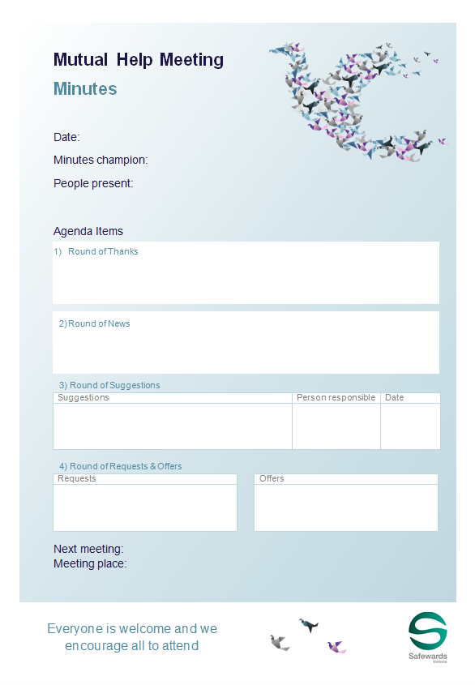
Staff roles
Prepare for the group
Room
Support people
Resources (agenda, flyer, poster, minutes, news)
Ideally first thing in the morning
Preferably every day (at least 3/week)
Protected space/time
Follows a structured agenda
Once all the points are covered the meeting is closed
Chaired by patients or staff
Consider a log book
Notes:
http://www.safewards.net/interventions/mutual-help-meeting
Provide examples of how to prepare for the group
Prepare the room.
Gather patients and staff.
Prepare contributions and offer support in advance.
Acknowledge and support a complaint following your local processes. This isn’t the forum for complaints.

Slide 11
Staff roles
Maintaining the meeting
Encourage good contributions through positive feedback.
Model mutual respect.
Enable everyone to contribute.
Seek information and opinions and provide information.
Clarify and summarise for others.
Suggest compromises and settlements.
Offer advice on expression of mutual respect and positive appreciation
Accurately describe any recent potentially distressing events on the unit (reassurance).
Notes:
http://www.safewards.net/interventions/mutual-help-meeting
Provide examples of how to prepare for the group
Prepare the room.
Gather patients and staff.
Prepare contributions and offer support in advance.
Acknowledge and support a complaint following your local processes. This isn’t the forum for complaints.

Slide 12
What to expect
Attendance will grow if the meeting is held regularly and is talked about.
Even with only a few people the meeting can be productive.
Attendees can consider how they can help others who aren't attending.
Small things can be important to people.
Notes:
http://www.safewards.net/interventions/mutual-help-meeting

Slide 13
Mutual Help Meeting fidelity
Mutual help meeting
IS
Getting patients together to agree on small things they can do to help and support each other, and valuing those activities once completed
In terms of patient care – a chance for staff to take a step back and patients a step forward
=
A forum for complaints and suggestions from patients about what the staff or hospital should do or for staff to give news to patients
Another group in the unit where staff have a debrief while patients go back to bed
Mutual help meeting
IS NOT
≠
Notes:
Taken from a PowerPoint from a presentation by Professor Len Bowers

Slide 14
Mutual help meeting adjustments
CAMHS Constraints and guidance on allowable tasks, new list of suggestions worked out with young people, new patient documentation
Forensic Constraints and guidance, limitations and rules about those, new patient support documentation
Older people May still be creatively feasible
Notes:
Taken from a PowerPoint from a presentation by Professor Len Bowers

