Slide 1
Positive words Refresher
Safewards
Notes:
Provide a brief overview of what positive words is
http://www.safewards.net/interventions/positive-words

Slide 2
Patient Community
Patient – patient interaction
Contagion & discord
Patient Modifiers
Anxiety management, Mutual support, Moral commitments, Psychological understanding, Technical mastery
Staff Modifiers
Explanation/information, Role modelling, Patient education, Removal of means, Presence & presence+
Outside Hospital
Patient Characteristics
Stressors
Visitors, Relatives & family tensions, Prospective –ve move
Dependency & institutionalisation, Demands & home
Flashpoints
Assembly/crowding/activity Queuing/waiting/noise Staff/pt turnover/change Bullying/stealing/
prop. damage
Symptoms & demography
Paranoia, PD traits, Irritability/disinhib., Abused, Male, Alc/drugs, Depression, Insight, Delusions, Hall.s, Young
Staff Modifiers
Carer/relative involvement
Family therapy
Active patient support
Staff Modifiers
Pharmacotherapy
Psychotherapy & functional analysis
Nursing support & interventions
Flashpoints
Bad news, Home crisis, Loss of relationship or accommodation, Argument
Flashpoints
Exacerbations;
Independence/identity
Acuity/severity
CONFLICT
&
CONTAINMENT
Flashpoints
Compulsory detention, Admission, Appeal refusal, Complaint denied, Enforced treatment, Exit refused
Flashpoints
Secrecy, Solitude,
Admission shock, Exit blocked
Staff Modifiers
Caringly vigilant & inquisitive, Checking routines, Décor, Maintenance, Clean & Tidy, Alternative choices, Respect
Staff Modifiers
Due process, Justice, Respect for rights,
Hope, Information giving, Support to appeal,
Legitimacy, Compensatory autonomy,
Consistent policy, Flexibility, Respect
Flashpoints
Denial of request,
Staff demand,
Limit setting, Bad news,
Ignoring
Features
Door locked, Quality, Complexity, Seclusion, PICU, ICA, Comfort/sensory rooms, Ligature points
External Structure
Legal framework, National policy, Complaints,
Appeals, Prosecutions, Hospital policy
Physical Environment
Regulatory Framework
Staff Modifiers
Staff anxiety & frustration, Moral commitments, Psychological understanding, Teamwork & consistency, Technical mastery, Positive appreciation
Internal Structure
Rules, Routine, Efficiency, Clean/tidy, Ideology, Custom & practice
Staff Team
Notes:
Provide a quick refresh of the model (see model refresher slides)
Where/how does MHM fit into the model?
What are the flashpoints and why?
What are the staff modifiers?
http://www.safewards.net/model/technical

Slide 3
Background and aims
Background
At handover the focus is often on describing challenging behaviour or risks to the patient or others. This may promote a negative perception of patients, rather than a balanced view of strengths and ways of working with a person.
Aims
Know peoples’ strengths as well as their challenges
Give the staff something positive and practical to work with
Set an optimistic start to every shift
Try to redress the power differential (remember the person is not in the room!)
Notes:
Outline the background and aims of this intervention
http://www.safewards.net/interventions/positive-words

Slide 4
Positive words and the Safewards model
Staff modifier:
Using positive words & psychological understanding in handover
Staff modifiers
Patient modifiers
Originating domains:
Staff Team
Patient Characteristics
Originating domains
Flashpoints
Conflict
Containment

Slide 5
Handover in practice
Primary role
Only time the team gets together to discuss each patient
The meeting has a critical organisational function – discussion of key risks, new patient admissions
Current approach
Discussions are usually focused on:
Exceptional patient behaviour
Patient behaviour that is viewed as challenging or presents risks to others
Comments that can lead to a negative perception of patients and a negative start to the shift
Notes:
Outline the function of handover and some of the issues that can be associated with handover.
http://www.safewards.net/interventions/positive-words

Slide 6
Safewards approach to handover
Balance the natural tendency to focus on issues and negative aspects of patient behaviour
Positive words focus:
Say something positive about each patient at handover
Promote a positive appreciation of patients to reduce the likelihood of further conflict
When challenging behaviour or situations are described, offer a possible psychological explanation
Provide potentially useful strategies or information for working with the person
Supporting document ‘Understanding patient characteristics and experiences’

Slide 7
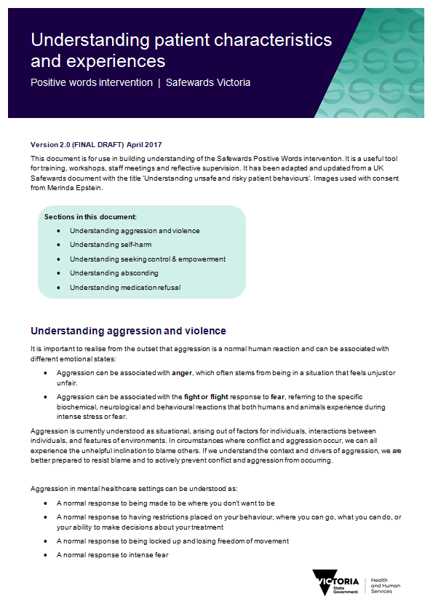
Task: Using psychological explanations
Break into small groups:
Understanding aggression and violence
Understanding self harm
Understanding seeking control and empowerment
Understanding absconding
Understanding medication refusal
Activity:
Read the relevant section in the handout
‘Understanding patient characteristics and
and experiences’
Discuss how the explanations in the handout
could be applied in an actual handover

Slide 8
Task: Examples of negative words and phrases
What are some of the negative words and phrases that are overused in your setting?
What might be some alternatives you could use?

Slide 9
Using positive comments
The handout provides possible psychological explanations.
This slide provides possible positive descriptions of people.
Refer to past achievement, including before admission/illness
Engaging with an activity
Demonstration of coping
Making a contribution or demonstrating patience
Something the patient has enjoyed
Enjoyed a walk or slept well
Interacted more today
Has smiled and made eye contact
Returned to the unit on time after home leave
Looks brighter
Visits and phone calls that went well
Endurance and courage
Coping with things better
Expression of interest in something
Having a good conversation
Notes:
http://www.safewards.net/interventions/positive-words

Slide 10
Role of the intervention leads
In every handover, remind the person doing the handover to ask the following questions:
What is the positive message about this patient?
Why do we think the patient might have behaved in that way?
Give every staff member a copy of the document ‘Understanding patient characteristics and experiences’
Use the document to interpret patient behaviour on the unit for others on the team, and share knowledge or strategies that may be helpful
Notes:
Understanding unsafe and risky patient behaviours can be found on the Safewards website
http://www.safewards.net/interventions/positive-words

Slide 11
Task: Why did you choose to work in mental health?
Notes:
Hand out post it notes
Ask people to write their answer about what made them initially choose to work in mental health
Ask the group to read out their answer - or stick post its on the wall and trainers read out
Whiteboard the key words or themes: common themes are likely to be hope, to help others, to make a difference
Discuss how positive words connects us with what really matters
Reflect that sometimes we can become disconnected from this because of daily pressures, and this can make us forget to look for the positives in the people we work with, or to do the things that make the most positive difference to the people we work with.

Slide 12
Video: The power of words
https://www.youtube.com/watch?v=Hzgzim5m7oU
Notes:
This is a great video to end the positive words training with.
Here is the link for the positive words video https://www.youtube.com/watch?v=Hzgzim5m7oU

Slide 13
Positive words fidelity
Tapping into the reason we came into mental health - that is, a desire to help
Helping staff recognise and share positive views of patients’ strengths and counterbalance negative perceptions
Helping staff use psychological explanations, knowledge and strategies that are helpful
Starting the shift with hope, optimism and respect
Positive words
IS
=
A rhetorical illusion of looking good and seeming to care
Making sarcastic comments or describing patients in mock positive ways, concreting negative perceptions and culture
Positive words
IS NOT
≠
Notes:
Taken from a PowerPoint from a presentation by Professor Len Bowers

Slide 14
Positive words adjustments
CAMHS None
Forensic None
Older people None, links to life story work
Notes:
Taken from a PowerPoint from a presentation by Professor Len Bowers

