Slide 1
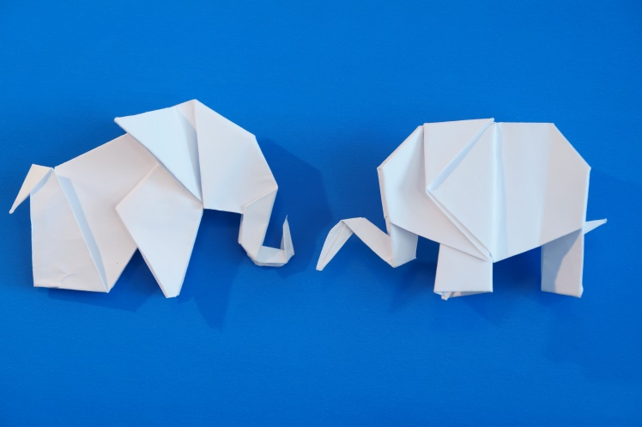
Reassurance Refresher
Safewards
Notes:
Provide a brief overview of Reassurance
http://www.safewards.net/interventions/reassurance

Slide 2
Patient Community
Patient – patient interaction
Contagion & discord
Patient Modifiers
Anxiety management, Mutual support, Moral commitments, Psychological understanding, Technical mastery
Staff Modifiers
Explanation/information, Role modelling, Patient education, Removal of means, Presence & presence+
Outside Hospital
Patient Characteristics
Stressors
Visitors, Relatives & family tensions, Prospective –ve move
Dependency & institutionalisation, Demands & home
Flashpoints
Assembly/crowding/activity Queuing/waiting/noise Staff/pt turnover/change Bullying/stealing/
prop. damage
Symptoms & demography
Paranoia, PD traits, Irritability/disinhib., Abused, Male, Alc/drugs, Depression, Insight, Delusions, Hall.s, Young
Staff Modifiers
Carer/relative involvement
Family therapy
Active patient support
Staff Modifiers
Pharmacotherapy
Psychotherapy & functional analysis
Nursing support & interventions
Flashpoints
Bad news, Home crisis, Loss of relationship or accommodation, Argument
Flashpoints
Exacerbations;
Independence/identity
Acuity/severity
CONFLICT
&
CONTAINMENT
Flashpoints
Compulsory detention, Admission, Appeal refusal, Complaint denied, Enforced treatment, Exit refused
Flashpoints
Secrecy, Solitude,
Admission shock, Exit blocked
Staff Modifiers
Caringly vigilant & inquisitive, Checking routines, Décor, Maintenance, Clean & Tidy, Alternative choices, Respect
Staff Modifiers
Due process, Justice, Respect for rights,
Hope, Information giving, Support to appeal,
Legitimacy, Compensatory autonomy,
Consistent policy, Flexibility, Respect
Flashpoints
Denial of request,
Staff demand,
Limit setting, Bad news,
Ignoring
Features
Door locked, Quality, Complexity, Seclusion, PICU, ICA, Comfort/sensory rooms, Ligature points
External Structure
Legal framework, National policy, Complaints,
Appeals, Prosecutions, Hospital policy
Physical Environment
Regulatory Framework
Staff Modifiers
Staff anxiety & frustration, Moral commitments, Psychological understanding, Teamwork & consistency, Technical mastery, Positive appreciation
Internal Structure
Rules, Routine, Efficiency, Clean/tidy, Ideology, Custom & practice
Staff Team
Notes:
Provide a quick refresh of the model (see model refresher slides)
Where/how does MHM fit into the model?
What are the flashpoints and why?
What are the staff modifiers?
http://www.safewards.net/model/technical

Slide 3
Reassurance background
Already scared & vulnerable
Psychiatric units can be strange and scary places.
Every confrontation has the potential to be a flashpoint for another patient, creating a kind of ripple effect.
Unlike staff, patients are not free to leave the unit or get away to a safe place.
Witness a confrontation
Fight, flight or freeze
Increased, unbearable fear
Patients don’t have to be directly involved in a confrontation for it to have a distressing emotional impact.
Staff can help alleviate fear and other types of distressing emotions.

Slide 4
Reassurance aims
To proactively reassure every patient after every confrontation, incident or conflict on the unit
To reduce the potential ripple effect of conflict on the unit
To prevent or reduce the impact of flashpoints
To ensure patients feel safe and supported
Reassurance for patients is a bit like debriefing for staff

Slide 5
Reassurance and the Safewards model
Staff modifiers
Patient modifiers
Flashpoint: Confrontation on the unit
Originating domains
Flashpoints
Conflict
Containment

Slide 6
Reassurance and the Safewards model
Staff modifier: Provide reassurance
Staff modifiers
Patient modifiers: Know particular triggers for each person
Patient modifiers
Originating domains: Understand how domains increase the emotional impact of conflict
Flashpoint: Confrontation on the unit
Originating domains
Flashpoints
Conflict
Containment

Slide 7
Reassurance and Originating Domains
Which originating domains contribute to psychiatric units feeling like strange and scary places?
Admission to hospital can result in feelings of anxiety/fear, shame, sadness/despair and/or anger. Admission might trigger past memories of trauma.
Many patients are affected by stereotypes, stigma and the media, or expectations of loved ones, or financial, social or work obligations
Staff and the hospital environment may be perceived as strange or frightening. Some patients have been hurt during past admissions.
Losing choice and freedom in a way that has never happened before
A person may be sure that they pose no threat to others - but may not be sure about the threat others may pose to them.
Notes:
Ask learners to identify which domain/s are relevant to each dot point

Slide 8
What other common occurrences on a mental health unit might increase patient fear?

Slide 9
Task: Walk in someone else’s shoes
Step forward…
Would you be approved for a bank loan easily?
Would you be asked to babysit a child?
Would you be asked to be a referee for a friend?
Would you be approved for life or health insurance?
Would you have no difficulty finding rental accommodation?
Would you be shortlisted for a job from your CV?
Would you feel support from friends, family and the community?
Are you well respected by the general public?
Does the media portray you in a positive way?
People wouldn’t consider you to be dangerous or unpredictable?
Would people consider you to be reliable?
Would people consider you to be trustworthy?
Notes:
See Appendix in the Handbook: Activity templates “walking in someone else’s shoes”
Laminate each of the examples (according to the number you have in the workshop) and have them cut to size before the training. Hand out a card to each of the participants (ensuring that at least one person gets a card which states they have a mental illness) and ask people to not reveal to each other what is on their card.
Ask everyone to gather at one end of the room.
Ask participants to take a step forward if they can answer yes to the question.
Read the questions out one by one.

Slide 10
Task: Walk in someone else’s shoes (continued)
For those who have only moved a few steps, consider the following:
How would feel at a dinner party if people identified you as this person?
Would people think that you use drugs or alcohol?
How would you be affected by public opinion and media reporting?
Would people use derogatory terms about you?
Would people think that you might be unpredictable even though they don’t know you?
Do people fear you even though they don’t know you?
Notes:
Continue reading all of the questions one by one. Once you have read all of the questions ask the people who have not moved forward far to reveal what is on their card.
Discuss how they felt, and how the others who moved forward felt. Here you can discuss the impact of stigma/shame/fear/sadness.
Discuss how this activity aimed to reinforce the powerful impact of stigma (an outside hospital originating domain) on how people might react to stressful situations.

Slide 11
Task discussion
This activity was a chance to think more deeply about stigma as an ‘outside hospital’ originating domain.
How could stigma impact patients’ emotions during an admission?
Why do you think we included this activity in the reassurance intervention?

Slide 12
Reassurance in practice Common situations requiring reassurance
Loud shouting/property damage/aggression: May provoke fear that could lead to defensive aggression, absconding, withdrawal and disengagement, suicidality
Self-harm - May provoke similar acts, can be distressing, provoke anger, shame or fear of one’s own internal impulses
Intoxication – May provoke fear about unpredictable behavior and personal safety
Show of staff force – (such as transferring a patient to high dependency area) Can undermine patient confidence in staff, make people feel vulnerable or bullied, provoke anger, fear or other distressing emotions, may trigger re-traumatization / flashbacks, panic, self-harm, suicidality
Notes:
Discuss some of the potentially anxiety provoking events listed here - ask the participants to give some examples from their ward.
http://www.safewards.net/interventions/reassurance

Slide 13
Reassurance in practice Explanation to patient and others
You do not have to be indiscreet or break confidentiality
You can draw upon psychological explanations for patient and staff actions, and use generalities.
For example:
“Sometimes when people are very unwell they may be frightened and confused – this might trigger aggression and we may need to intervene to keep everyone safe. This can look scary, but we are very careful to never hurt someone, and to try and protect people’s dignity”
Notes:
http://www.safewards.net/interventions/reassurance
Important to emphasize here that this intervention can be done without breaking confidentiality.

Slide 14
Reassurance in practice: Empathy is a critical staff skill
Brené Brown on Empathy (Youtube video)
https://youtube/1Evwgu369Jw

Slide 15
Reassurance in practice: Empathy is a critical staff skill
Empathy fuels connection, sympathy drives disconnection.
Key qualities of empathy:
Perspective taking
Staying out of judgement
Recognising emotion in other people
Communicating that
Empathy is feeling ‘with’ people.
Empathy can make us feel vulnerable because it means having to connect with something in yourself that knows that feeling.
Empathy means not trying to make things better.
Responses rarely make something better.
Connection with others can help people feel better
Brené Brown on Empathy (Youtube video)
https://youtube/1Evwgu369Jw

Slide 16
Intervention strategies
Intervention lead
Consider speaking to the nurse in charge of the shift (or as a group, such as at staff meetings) and request a method is identified for ensuring the following two points are identified:
Ensure reassurance action takes place following any incident.
When an incident is mentioned at handover, ask if 'reassurance' took place.
Notes:
The more time you spend with patients in a caring and meaningful way can reduce fear and anxiety

Slide 17
Intervention strategies
Intervention lead
After an event
Following a potential anxiety-provoking incident:
Speak with every patient, alone or in small groups, and ask them:
What is your understanding of what happened?
What affect did it have on you?
Provide an explanation of what happened
Consider how this is documented in relevant patient files

Slide 18
Intervention strategies
Be visible on the unit
Move about a lot and make sure you cover the whole unit
Be watchful (not in an anxious way) in a warm and caring manner
The goal of staff presence, explanation and support is to ensure everyone feels safe and secure
Notes:
The more time you spend with patients in a caring and meaningful way can reduce fear and anxiety

Slide 19
Reassurance fidelity
Heightening staff awareness of events that can make patients feel fear or other distressing emotions, and taking action so that doesn’t happen
A basic standard of consideration for people who have witnessed distressing events
Reassurance
IS
=
Telling patients things will be fine when they come to the office door and express a worry
Gossiping about other patients who may exhibit challenging behaviour
Reassurance
IS NOT
≠
Notes:
Taken from a PowerPoint from a presentation by Professor Len Bowers

Slide 20
Reassurance adjustments
CAMHS Simplify explanations and lower expectations of understanding
Forensic None
Older people None where message can be understood and retained
Notes:
Taken from a PowerPoint from a presentation by Professor Len Bowers

