Slide 1
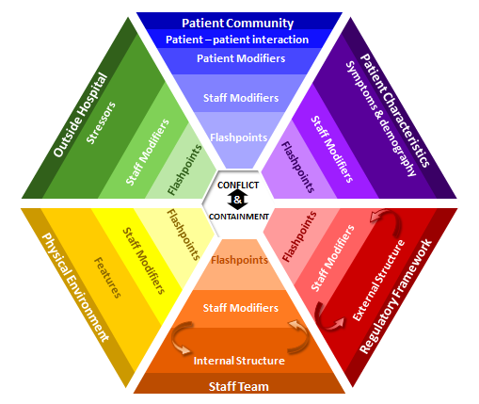
Safewards
Model Refresher

Slide 2


Introduction to Safewards
Origins of Safewards
Key aims of Safewards
The heart of Safewards: conflict and containment
Overview of the model
Notes:
Safewards aims to have a transformational effect on our work…

Slide 3

Origins of the Safewards model
  Safewards origins
  Nursing model
  Developed by Len Bowers, UK
  Research-based
  Focus on conflict and containment (restrictive interventions)
  Evidence (Bowers)
  Cross topic literature review
  Model development
  Cluster randomised controlled trial of model
    31 units, adequate power, significant results
    Conflict 14.6% decrease
    Containment 23.6% decrease
Notes:
Provide a brief overview of how the model was developed. To be able to talk to this slide you need to do some reading about how the model was developed – see Bowers et al. (2015).
Sources: Safewards model is based on
Len’s own research
Cross topic literature review
Reasoned thinking
RCT:
31 units, blind
Conflict 14.6% decrease, containment 23.6% decrease
Strengths: randomised, blind, adequate power, independence of randomisation and analysis
Weaknesses: level of cooperation and implementation, nil results from questionnaires
See Bowers et al. (2014) Safewards: the empirical basis of the model and a critical appraisal
Explain how the model was created, subject to a randomised control trial, and translated into practice (See Bowers et al., 2015).
Mention that Victoria has done its own research to validate the model – this is presented on Day 2.

Slide 4
Key aims of the Safewards model
“Positive and proactive care:
Reducing the need for restrictive interventions”
  1. Explain the relationship between conflict and containment
  2. Identify opportunities where staff can intervene
  3. Generate ideas for change that have the potential to reduce conflict and containment
Notes:
The model can be used to explore the relationship between conflict and containment, identify where we can intervene and to help generate ideas about how we can reduce conflict and containment (See Bowers 2014; Bowers et al., 2014).

Slide 5
Conflict and Containment
Safewards centres around reducing
conflict and containment
Conflict means anything that could lead to harm for the patient, other patients or staff:
Physical aggression
Verbal aggression
Self harm/ suicide
Substance misuse
Property damage
Absconding
Medication refusal
Containment means what staff do to prevent conflict events or minimise harmful outcomes, and may include:
Special observation
Use of security
Physical restraint
Chemical restraint
Seclusion
Mechanical restraint
Environmental restraint
These occurrences may lead to restrictive interventions

Slide 6
Conflict and Containment
Conflict and Containment
Notes:
Conflict and containment are often seen as being one and the same issue.

Slide 7


Conflict and Containment
Conflict
Containment
Notes:
Safewards reminds us that these are two separate issues. Conflict is different to containment, and while it can lead to conflict, there are also other responses.

Slide 8


Task: What is it like on your unit?
  What contributes to conflict and containment on your unit?
  How does conflict and containment influence your unit?
Notes:
For this activity ask the group to consider what contributes to conflict and containment on their ward
Write down people’s responses on a whiteboard or butchers paper (allow approx. 10 minutes).
Try and tease out the issues and keep these in mind for the rest of the day.

Slide 9
Conflict and containment rates
  Rates of conflict and containment vary locally and internationally
  (Bowers et al., 2005a, Nijman et al., 2005)
  Factors that can influence the frequency of conflict and containment:
  social and physical locations of units
  separation from a person’s normal residence
  provision of 24/7 mental health care
  mixed voluntary and legal coercion
Notes:
For this slide refer to:
Bowers, L. (2014). Safewards: a new model of conflict and containment on psychiatric wards. Journal of Psychiatric and Mental Health Nursing, 21, 499-508.
and also see the Safewards Model document which discusses the points in this slide. See http://www.safewards.net/model/technical
Reasons for these differences provide an opportunity to devise ways to reduce the frequency of risky events - keeping people safer
Containment methods used in some countries are not used in others

Slide 10
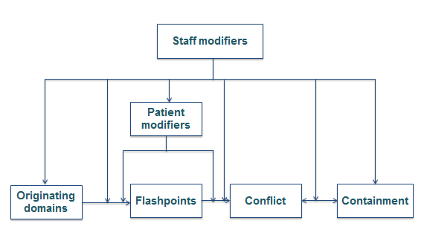
The Safewards model
Simple model
Technical model

Slide 11
Six domains that influence or trigger conflict
Originating Domains
1. The patient community
2. Patient characteristics
Flashpoint
3. Regulatory framework
4. Staff team
Definition:
Social and psychological situations arising out of features of the originating domains, signaling and preceding imminent conflict
5. Physical environment
6. Outside hospital
Notes:
Give a brief summary of each of the domains (you will go into more detail later) and describe how factors in the domains can lead to flashpoints.

Slide 12
  Staff modifiers
  Definition
  Characteristics of staff or teams or the way staff act in working with patients or the environment
  Potential
  The way staff initiate or respond to interactions can influence the frequency of conflict and containment
Notes:
See Bowers (2014)

Slide 13
Staff can influence conflict and containment by:
  Reducing or eradicating the originating conflict factors
  Preventing flashpoints
  Cutting the link between the flashpoint and conflict
  Choosing not to use containment when it would be counterproductive
  Ensuring that containment does not lead to further conflict
Notes:
This slide highlights the various ways that staff can have an influence on conflict and containment rates on their ward.
Go through each of the points highlighting examples that are relevant to your participants.
For dot point 4 - choose not to use containment on occasions when it would be counterproductive - here you could ask the participants if they can talk about a time when they have done this and it has been a positive experience.
You can also facilitate discussion around how to prevent further conflict when using containment methods.

Slide 14
Patient modifiers
  Definition
  How patients respond and behave towards each other can influence the frequency of conflict and containment.
  Patients are susceptible to staff influence.
Notes:
Important to note that patients can also have an influence.

Slide 15
Patients can influence conflict and containment
  Understanding and identifying possible flashpoints
  Seeking assistance or using coping skills to avoid or minimise the impact of flashpoints
  Cutting the link between flashpoint and conflict
  Seeking advocacy to avoid containment

Slide 16
Patient modifiers
When do patients have control over conflict?
When do patients have control over containment?
What influences whether or not patients have control?
Notes:
Whiteboard activity

Slide 17
Simple model
Staff modifiers
Patient modifiers
Originating domains
Flashpoints
Conflict
Containment
Notes:
Explain each of the boxes briefly and how they relate to and influence each other. The YouTube video of Professor Len Bowers describing the model is helpful
https://www.youtube.com/watch?v=C3z7zRRXMFo
The Victorian Safewards Introduction to the model video also provides a helpful explanation
For information relating to the simple form of the model see http://www.safewards.net/images/pdf/Safewards%20model.pdf
http://www.safewards.net/model/easy

Slide 18
Patient Community
Outside Hospital
Patient Characteristics
Physical Environment
Regulatory Framework
Staff Team
Notes:
Show how the originating domains from the previous slide wrap around the outside of the model

Slide 19
Patient Community
Patient – patient interaction
Outside Hospital
Patient Characteristics
Stressors
Symptoms & demography
CONFLICT
&
CONTAINMENT
Features
External Structure
Physical Environment
Regulatory Framework
Internal Structure
Staff Team
Notes:
Explain that the model has detailed descriptions for each domain

Slide 20
Patient Community
Patient – patient interaction
Patient Modifiers
Outside Hospital
Patient Characteristics
Stressors
Symptoms & demography
CONFLICT
&
CONTAINMENT
Features
External Structure
Physical Environment
Regulatory Framework
Internal Structure
Staff Team
Notes:
Explain this is where patient modifiers sit in the model

Slide 21
Patient Community
Patient – patient interaction
Patient Modifiers
Staff Modifiers
Outside Hospital
Patient Characteristics
Stressors
Symptoms & demography
Staff Modifiers
Staff Modifiers
CONFLICT
&
CONTAINMENT
Staff Modifiers
Staff Modifiers
Features
External Structure
Physical Environment
Regulatory Framework
Staff Modifiers
Internal Structure
Staff Team
Notes:
Explain this is where staff modifiers sit in the model

Slide 22
Patient Community
Patient – patient interaction
Patient Modifiers
Staff Modifiers
Outside Hospital
Patient Characteristics
Stressors
Symptoms & demography
Flashpoints
Staff Modifiers
Staff Modifiers
Flashpoints
Flashpoints
Flashpoints
Flashpoints
Staff Modifiers
Flashpoints
Staff Modifiers
Features
External Structure
Physical Environment
Regulatory Framework
Staff Modifiers
Internal Structure
Staff Team
Notes:
This is where flashpoints sit

Slide 23
Patient Community
Patient – patient interaction
Patient Modifiers
Staff Modifiers
Outside Hospital
Patient Characteristics
Stressors
Symptoms & demography
Flashpoints
Staff Modifiers
Staff Modifiers
Flashpoints
Flashpoints
CONFLICT
&
CONTAINMENT
Flashpoints
Flashpoints
Staff Modifiers
Flashpoints
Staff Modifiers
Features
External Structure
Physical Environment
Regulatory Framework
Staff Modifiers
Internal Structure
Staff Team

Slide 24
Patient Community
Patient – patient interaction
Patient Modifiers
Staff Modifiers
Outside Hospital
Patient Characteristics
Stressors
Symptoms & demography
Flashpoints
Staff Modifiers
Staff Modifiers
Flashpoints
Flashpoints
CONFLICT
&
CONTAINMENT
Flashpoints
Flashpoints
Staff Modifiers
Flashpoints
Staff Modifiers
Features
External Structure
Physical Environment
Regulatory Framework
Staff Modifiers
Internal Structure
Staff Team
Notes:
Explain how the whole model wraps around aiming to prevent what’s in the centre: conflict and containment

Slide 25
Patient Community
Patient – patient interaction
Patient Modifiers
Staff Modifiers
Outside Hospital
Patient Characteristics
Stressors
Symptoms & demography
Flashpoints
Staff Modifiers
Staff Modifiers
Flashpoints
Flashpoints
CONFLICT
&
CONTAINMENT
Flashpoints
Flashpoints
Staff Modifiers
Flashpoints
Staff Modifiers
Denial of request
Features
External Structure
Physical Environment
Regulatory Framework
Staff Modifiers
Internal Structure
Staff Team
Notes:
Discuss a denial of a patient request as an example of a flashpoint

Slide 26
Patient Community
Patient – patient interaction
Patient Modifiers
Staff Modifiers
Outside Hospital
Patient Characteristics
Symptoms & demography
Stressors
Bad
news
Flashpoints
Staff Modifiers
Staff Modifiers
Flashpoints
Flashpoints
CONFLICT
&
CONTAINMENT
Flashpoints
Flashpoints
Staff Modifiers
Flashpoints
Staff Modifiers
Features
External Structure
Physical Environment
Regulatory Framework
Staff Modifiers
Internal Structure
Staff Team
Notes:
Discuss bad news as an example of a flashpoint

Slide 27
Patient Community
Patient – patient interaction
Patient Modifiers
Staff Modifiers
Outside Hospital
Patient Characteristics
Stressors
Symptoms & demography
Compulsory detention
Flashpoints
Staff Modifiers
Staff Modifiers
Flashpoints
Flashpoints
CONFLICT
&
CONTAINMENT
Flashpoints
Flashpoints
Staff Modifiers
Flashpoints
Staff Modifiers
Features
External Structure
Physical Environment
Regulatory Framework
Staff Modifiers
Internal Structure
Staff Team
Notes:
Discuss compulsory detention as an example of a flashpoint

Slide 28
Patient Community
Patient – patient interaction
Contagion & discord
Patient Modifiers
Anxiety management, Mutual support, Moral commitments, Psychological understanding, Technical mastery
Staff Modifiers
Explanation/information, Role modelling, Patient education, Removal of means, Presence & presence+
Outside Hospital
Patient Characteristics
Stressors
Visitors, Relatives & family tensions, Prospective –ve move
Dependency & institutionalisation, Demands & home
Flashpoints
Assembly/crowding/activity Queuing/waiting/noise Staff/pt turnover/change Bullying/stealing/
prop. damage
Symptoms & demography
Paranoia, PD traits, Irritability/disinhib., Abused, Male, Alc/drugs, Depression, Insight, Delusions, Hall.s, Young
Staff Modifiers
Carer/relative involvement
Family therapy
Active patient support
Staff Modifiers
Pharmacotherapy
Psychotherapy & functional analysis
Nursing support & interventions
Flashpoints
Bad news, Home crisis, Loss of relationship or accommodation, Argument
Flashpoints
Exacerbations;
Independence/identity
Acuity/severity
CONFLICT
&
CONTAINMENT
Flashpoints
Compulsory detention, Admission, Appeal refusal, Complaint denied, Enforced treatment, Exit refused
Flashpoints
Secrecy, Solitude,
Admission shock, Exit blocked
Staff Modifiers
Caringly vigilant & inquisitive, Checking routines, Décor, Maintenance, Clean & Tidy, Alternative choices, Respect
Staff Modifiers
Due process, Justice, Respect for rights,
Hope, Information giving, Support to appeal,
Legitimacy, Compensatory autonomy,
Consistent policy, Flexibility, Respect
Flashpoints
Denial of request,
Staff demand,
Limit setting, Bad news,
Ignoring
Features
Door locked, Quality, Complexity, Seclusion, PICU, ICA, Comfort/sensory rooms, Ligature points
External Structure
Legal framework, National policy, Complaints,
Appeals, Prosecutions, Hospital policy
Physical Environment
Regulatory Framework
Staff Modifiers
Staff anxiety & frustration, Moral commitments, Psychological understanding, Teamwork & consistency, Technical mastery, Positive appreciation
Internal Structure
Rules, Routine, Efficiency, Clean/tidy, Ideology, Custom & practice
Staff Team
Notes:
This is the technical version of the model.
Time permitting, a good activity at this point is to break up into smaller groups to brainstorm common flashpoints and staff modifiers for each originating domain. Each group can report back to the larger group.

Slide 29
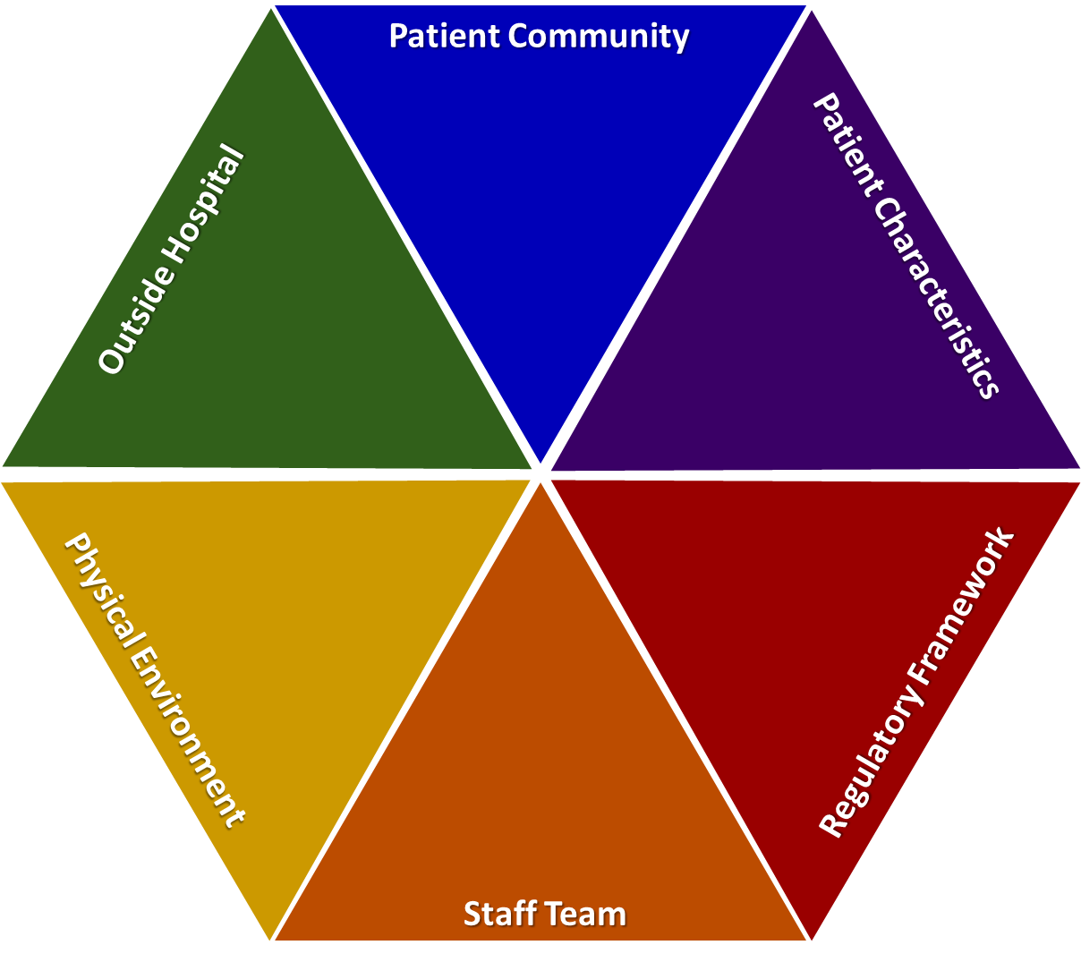
Overview of originating domains

Slide 30
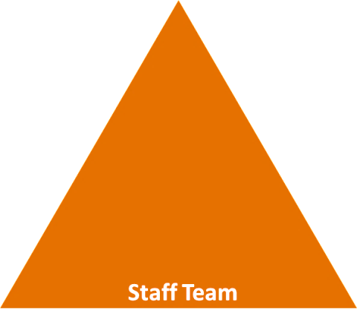
Staff team domain
  Internal structure
  Rules, routines, efficiency, clean/tidy, ideology, custom, practice
  Staff modifiers
  Staff anxiety and frustration, moral commitments (honesty), psychological understanding, teamwork and consistency, technical mastery, positive appreciation, education/training, clinical supervision, model skills, challenge each other, review care provided, focus on flashpoints, finding better ways to manage them (reduce number of rules, pre-empting needs) and set limits
  Flashpoints
  Denial of request, staff demand, limit setting, bad news, ignoring
Notes:
For Staff team domain please see http://www.safewards.net/images/pdf/Safewards%20model.pdf
For each of the following 6 slides you need to be familiar with each of the domains and you need to encourage the participants to start thinking about the factors, modifiers and flashpoints that are specific to their ward. Here you will need to facilitate the discussion and perhaps pose some questions or prompts that are specific to the unit to encourage discussion and reflection. You may need to refer back to the comments you collected from slide 4

Slide 31

Physical environment domain
  Better quality environment versus complexity (observation/supervision)
  Features
  Door locked, quality of environment, speedy repairs, complexity, seclusion rooms available, PICU, ICA, comfort/sensory rooms, ligature points
  Staff modifiers
  Vigilant and inquisitive, checking routines, décor, maintenance, clean and tidy, alternative choices, respect
  Flashpoints
  Secrecy, solitude, admission shock, exit blocked
Notes:
For physical environment domain please see http://www.safewards.net/images/pdf/Safewards%20model.pdf

Slide 32
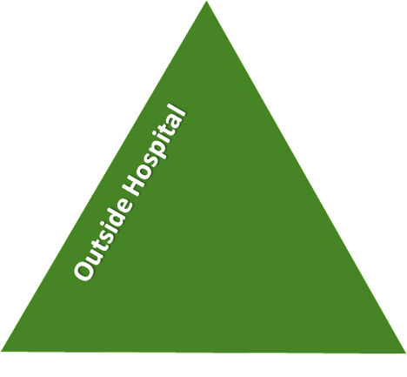
Outside hospital domain
  Stressors
  Visitors, relatives and family tensions and relationships, missing out, dependency and institutionalisation (absconding), demands and home
  Staff modifiers
  Carer/relative involvement, family therapy, active patient support, awareness, important factors from outside that can influence behaviour on the unit (financial circumstances, support to resolve issues with family and friends, accommodation-checked on/leave to visit)
  Flashpoints
  Bad news, home crisis, loss of relationship or accommodation, argument
Notes:
For outside hospital domain please see http://www.safewards.net/images/pdf/Safewards%20model.pdf

Slide 33
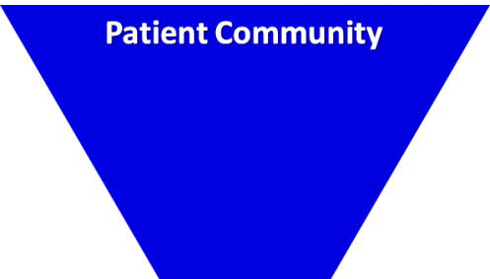
Patient community domain
  Patient-patient interaction
  Ripple effect of conflict (impact of conflict elsewhere on the unit, living with others, meal times and medication times)
  Patient modifiers
  Anxiety management, mutual support, moral commitments, psychological understanding, technical mastery
  Staff modifiers
  Explanation/information, role modelling, patient education, removal of means, presence and presence+ (getting in early), conflict resolution, pre-emptive reassurance, managing level and fluctuation of activity on the unit
  Flashpoints
  Assembly, crowding, activity queuing, waiting, noise, staff/patient turnover or change, bullying, stealing and property damage
Notes:
For patient community domain please see http://www.safewards.net/images/pdf/Safewards%20model.pdf

Slide 34

Patient characteristics domain
  Symptoms and demography
  Symptoms: paranoia-defensive, aggression, specific delusions, depression-suicide attempts/irritability, use of substances, irritability or disinhibition
  Personality traits: features of ASPD, instrumental aggression
  Demographic: particularly being younger and male
  Staff modifiers
  Pharmacotherapy, psychotherapy and functional analysis; nursing support and intervention; enhance choices, freedom and control over circumstances; develop mutually respectful partnership; therapeutic community; authoritarianism-counterproductive; CBT; social skills training; trauma-informed practice responses; choices over how to respond. Only a few people account for the majority of aggressive incidents, therefore:
  change responses after the first event to avoid subsequent events
  target therapeutic interventions
  Flashpoints
  Exacerbations, independence, identity, acuity, severity
Notes:
For Patient characteristics domain please see http://www.safewards.net/images/pdf/Safewards%20model.pdf

Slide 35
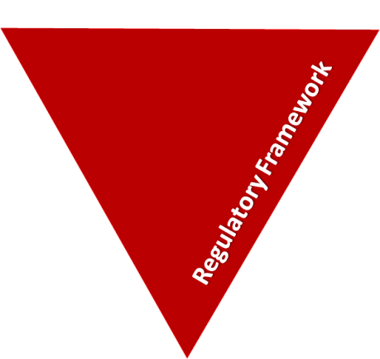
Regulatory framework domain
  External structure
  Legal framework, national policy, complaints, appeals, prosecutions and hospital policy
  Staff modifiers
  With the exception of hospital policy, these modifiers are not under staff control (RRI); however, the way they are carried out can be. This includes:
  Procedural justice, respect for rights, hope, information giving, supported decision making, support to appeal, legitimacy, compensatory autonomy, consistent policy, flexibility, effective complaints process, policy targeted at RRI, choices (such as more activities, meals, snacks), intervene to address hopelessness and self-stigmatisation.
  Flashpoints
  Compulsory detention, admission, appeal refusal, complaint denied, enforced treatment and exit refusal
Notes:
For Regulatory framework domain please see http://www.safewards.net/images /pdf/Safewards%20model.pdf

Slide 36


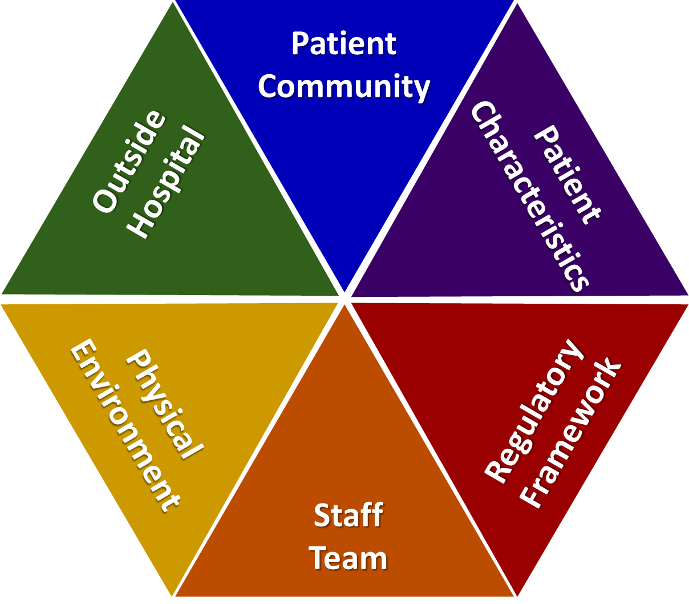








Task: Pin the intervention on the Safewards model
SW
MHM
KEO
R
PW
DM
BNM
TD
CME
CDM
Notes:
Print out the Safewards model as large as you can.
Give participants an intervention and ask them to identify where the interventions best sit in the model.
Facilitate a discussion about how each intervention fits in to the model.

Slide 37
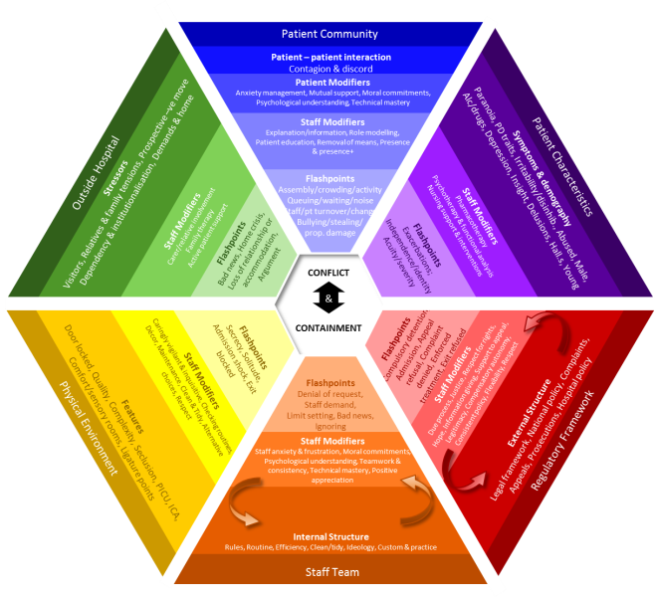
What this model adds to practice
  Includes patient-patient interaction
  Identifies that staff response to patient characteristics can have an impact
  Acknowledges the regulatory framework and that action can be taken at higher policy levels
  Incorporates influences from outside hospital
Notes:
Incorporates:
Systematic influences on the ward
Patient behaviour as a result of outside hospital influences
See https://www.youtube.com/watch?v=C3z7zRRXMFo

