Slide 1
Safewards Victoria 1 day workshop

Slide 2
Introduction to Safewards
Origins of Safewards
Key aims of Safewards
The heart of Safewards: conflict and containment
Overview of the model
Notes:
Safewards aims to have a transformational effect on our work…

Slide 3
Origins of the Safewards model
Safewards origins
Nursing model
Developed by Len Bowers, UK
Research-based
Focus on conflict and containment (restrictive interventions)
Evidence (Bowers)
Cross topic literature review
Model development
Cluster randomised controlled trial of model
31 units, adequate power, significant results
Conflict 14.6% decrease
Containment 23.6% decrease
Notes:
Provide a brief overview of how the model was developed. To be able to talk to this slide you need to do some reading about how the model was developed – see Bowers et al. (2015).
Sources: Safewards model is based on
Len’s own research
Cross topic literature review
Reasoned thinking
RCT:
31 units, blind
Conflict 14.6% decrease, containment 23.6% decrease
Strengths: randomised, blind, adequate power, independence of randomisation and analysis
Weaknesses: level of cooperation and implementation, nil results from questionnaires
See Bowers et al. (2014) Safewards: the empirical basis of the model and a critical appraisal
Explain how the model was created, subject to a randomised control trial, and translated into practice (See Bowers et al., 2015).
Mention that Victoria has done its own research to validate the model – this is presented on Day 2.

Slide 4
Key aims of the Safewards model
“Positive and proactive care:
Reducing the need for restrictive interventions”
1. Explain the relationship between conflict and containment
2. Identify opportunities where staff can intervene
3. Generate ideas for change that have the potential to reduce conflict and containment
Notes:
The model can be used to explore the relationship between conflict and containment, identify where we can intervene and to help generate ideas about how we can reduce conflict and containment (See Bowers 2014; Bowers et al., 2014).

Slide 5
Conflict and Containment
Safewards centres around reducing
conflict and containment
Conflict means anything that could lead to harm for the patient, other patients or staff:
Physical aggression
Verbal aggression
Self harm/ suicide
Substance misuse
Property damage
Absconding
Medication refusal
Containment means what staff do to prevent conflict events or minimise harmful outcomes, and may include:
Special observation
Use of security
Physical restraint
Chemical restraint
Seclusion
Mechanical restraint
Environmental restraint
These occurrences may lead to restrictive interventions

Slide 6
Conflict and Containment
Conflict and Containment
Notes:
Conflict and containment are often seen as being one and the same issue.

Slide 7
Conflict and Containment
Conflict
Containment
Notes:
Safewards reminds us that these are two separate issues. Conflict is different to containment, and while it can lead to conflict, there are also other responses.

Slide 8
Task: What is it like on your unit?
What contributes to conflict and containment on your unit?
How does conflict and containment influence your unit?
Notes:
For this activity ask the group to consider what contributes to conflict and containment on their ward
Write down people’s responses on a whiteboard or butchers paper (allow approx. 10 minutes).
Try and tease out the issues and keep these in mind for the rest of the day.

Slide 9
Conflict and containment rates
Rates of conflict and containment vary locally and internationally
(Bowers et al., 2005a, Nijman et al., 2005)
Factors that can influence the frequency of conflict and containment:
social and physical locations of units
separation from a person’s normal residence
provision of 24/7 mental health care
mixed voluntary and legal coercion
Notes:
For this slide refer to:
Bowers, L. (2014). Safewards: a new model of conflict and containment on psychiatric wards. Journal of Psychiatric and Mental Health Nursing, 21, 499-508.
and also see the Safewards Model document which discusses the points in this slide. See http://www.safewards.net/model/technical
Reasons for these differences provide an opportunity to devise ways to reduce the frequency of risky events - keeping people safer
Containment methods used in some countries are not used in others

Slide 10
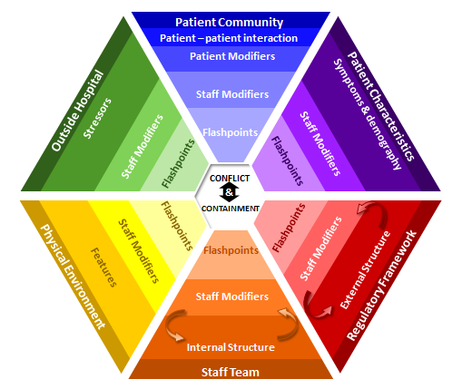
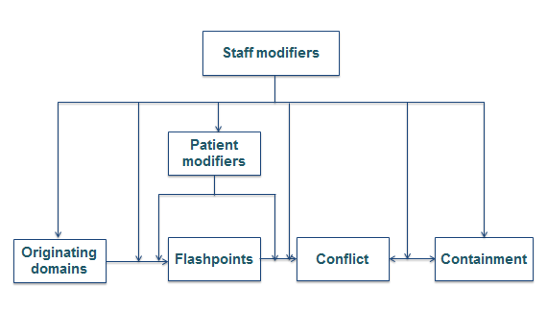
The Safewards model
Simple model
Technical model

Slide 11
Six domains that influence or trigger conflict
Originating Domains
1. The patient community
2. Patient characteristics
Flashpoint
3. Regulatory framework
4. Staff team
Definition:
Social and psychological situations arising out of features of the originating domains, signaling and preceding imminent conflict
5. Physical environment
6. Outside hospital
Notes:
Give a brief summary of each of the domains (you will go into more detail later) and describe how factors in the domains can lead to flashpoints.

Slide 12
Staff modifiers
Definition
Characteristics of staff or teams or the way staff act in working with patients or the environment
Potential
The way staff initiate or respond to interactions can influence the frequency of conflict and containment
Notes:
See Bowers (2014)

Slide 13
Staff can influence conflict and containment by:
Reducing or eradicating the originating conflict factors
Preventing flashpoints
Cutting the link between the flashpoint and conflict
Choosing not to use containment when it would be counterproductive
Ensuring that containment does not lead to further conflict
Notes:
This slide highlights the various ways that staff can have an influence on conflict and containment rates on their ward.
Go through each of the points highlighting examples that are relevant to your participants.
For dot point 4 - choose not to use containment on occasions when it would be counterproductive - here you could ask the participants if they can talk about a time when they have done this and it has been a positive experience.
You can also facilitate discussion around how to prevent further conflict when using containment methods.

Slide 14
Patient modifiers
Definition
How patients respond and behave towards each other can influence the frequency of conflict and containment.
Patients are susceptible to staff influence.
Notes:
Important to note that patients can also have an influence.

Slide 15
Patients can influence conflict and containment
Understanding and identifying possible flashpoints
Seeking assistance or using coping skills to avoid or minimise the impact of flashpoints
Cutting the link between flashpoint and conflict
Seeking advocacy to avoid containment

Slide 16
Patient modifiers
When do patients have control over conflict?
When do patients have control over containment?
What influences whether or not patients have control?
Notes:
Whiteboard activity

Slide 17
Simple model
Staff modifiers
Patient modifiers
Originating domains
Flashpoints
Conflict
Containment
Notes:
Explain each of the boxes briefly and how they relate to and influence each other. The YouTube video of Professor Len Bowers describing the model is helpful
https://www.youtube.com/watch?v=C3z7zRRXMFo
The Victorian Safewards Introduction to the model video also provides a helpful explanation
For information relating to the simple form of the model see http://www.safewards.net/images/pdf/Safewards%20model.pdf
http://www.safewards.net/model/easy

Slide 18
Patient Community
Outside Hospital
Patient Characteristics
Physical Environment
Regulatory Framework
Staff Team
Notes:
Show how the originating domains from the previous slide wrap around the outside of the model

Slide 19
Patient Community
Patient – patient interaction
Outside Hospital
Patient Characteristics
Stressors
Symptoms & demography
CONFLICT
&
CONTAINMENT
Features
External Structure
Physical Environment
Regulatory Framework
Internal Structure
Staff Team
Notes:
Explain that the model has detailed descriptions for each domain

Slide 20
Patient Community
Patient – patient interaction
Patient Modifiers
Outside Hospital
Patient Characteristics
Stressors
Symptoms & demography
CONFLICT
&
CONTAINMENT
Features
External Structure
Physical Environment
Regulatory Framework
Internal Structure
Staff Team
Notes:
Explain this is where patient modifiers sit in the model

Slide 21
Patient Community
Patient – patient interaction
Patient Modifiers
Staff Modifiers
Outside Hospital
Patient Characteristics
Stressors
Symptoms & demography
Staff Modifiers
Staff Modifiers
CONFLICT
&
CONTAINMENT
Staff Modifiers
Staff Modifiers
Features
External Structure
Physical Environment
Regulatory Framework
Staff Modifiers
Internal Structure
Staff Team
Notes:
Explain this is where staff modifiers sit in the model

Slide 22
Patient Community
Patient – patient interaction
Patient Modifiers
Staff Modifiers
Outside Hospital
Patient Characteristics
Stressors
Symptoms & demography
Flashpoints
Staff Modifiers
Staff Modifiers
Flashpoints
Flashpoints
Flashpoints
Flashpoints
Staff Modifiers
Flashpoints
Staff Modifiers
Features
External Structure
Physical Environment
Regulatory Framework
Staff Modifiers
Internal Structure
Staff Team
Notes:
This is where flashpoints sit

Slide 23
Patient Community
Patient – patient interaction
Patient Modifiers
Staff Modifiers
Outside Hospital
Patient Characteristics
Stressors
Symptoms & demography
Flashpoints
Staff Modifiers
Staff Modifiers
Flashpoints
Flashpoints
CONFLICT
&
CONTAINMENT
Flashpoints
Flashpoints
Staff Modifiers
Flashpoints
Staff Modifiers
Features
External Structure
Physical Environment
Regulatory Framework
Staff Modifiers
Internal Structure
Staff Team

Slide 24
Patient Community
Patient – patient interaction
Patient Modifiers
Staff Modifiers
Outside Hospital
Patient Characteristics
Stressors
Symptoms & demography
Flashpoints
Staff Modifiers
Staff Modifiers
Flashpoints
Flashpoints
CONFLICT
&
CONTAINMENT
Flashpoints
Flashpoints
Staff Modifiers
Flashpoints
Staff Modifiers
Features
External Structure
Physical Environment
Regulatory Framework
Staff Modifiers
Internal Structure
Staff Team
Notes:
Explain how the whole model wraps around aiming to prevent what’s in the centre: conflict and containment

Slide 25
Patient Community
Patient – patient interaction
Patient Modifiers
Staff Modifiers
Outside Hospital
Patient Characteristics
Stressors
Symptoms & demography
Flashpoints
Staff Modifiers
Staff Modifiers
Flashpoints
Flashpoints
CONFLICT
&
CONTAINMENT
Flashpoints
Flashpoints
Staff Modifiers
Flashpoints
Staff Modifiers
Denial of request
Features
External Structure
Physical Environment
Regulatory Framework
Staff Modifiers
Internal Structure
Staff Team
Notes:
Discuss a denial of a patient request as an example of a flashpoint

Slide 26
Patient Community
Patient – patient interaction
Patient Modifiers
Staff Modifiers
Outside Hospital
Patient Characteristics
Symptoms & demography
Stressors
Bad
news
Flashpoints
Staff Modifiers
Staff Modifiers
Flashpoints
Flashpoints
CONFLICT
&
CONTAINMENT
Flashpoints
Flashpoints
Staff Modifiers
Flashpoints
Staff Modifiers
Features
External Structure
Physical Environment
Regulatory Framework
Staff Modifiers
Internal Structure
Staff Team
Notes:
Discuss bad news as an example of a flashpoint

Slide 27
Patient Community
Patient – patient interaction
Patient Modifiers
Staff Modifiers
Outside Hospital
Patient Characteristics
Stressors
Symptoms & demography
Compulsory detention
Flashpoints
Staff Modifiers
Staff Modifiers
Flashpoints
Flashpoints
CONFLICT
&
CONTAINMENT
Flashpoints
Flashpoints
Staff Modifiers
Flashpoints
Staff Modifiers
Features
External Structure
Physical Environment
Regulatory Framework
Staff Modifiers
Internal Structure
Staff Team
Notes:
Discuss compulsory detention as an example of a flashpoint

Slide 28
Patient Community
Patient – patient interaction
Contagion & discord
Patient Modifiers
Anxiety management, Mutual support, Moral commitments, Psychological understanding, Technical mastery
Staff Modifiers
Explanation/information, Role modelling, Patient education, Removal of means, Presence & presence+
Outside Hospital
Patient Characteristics
Stressors
Visitors, Relatives & family tensions, Prospective –ve move
Dependency & institutionalisation, Demands & home
Flashpoints
Assembly/crowding/activity Queuing/waiting/noise Staff/pt turnover/change Bullying/stealing/
prop. damage
Symptoms & demography
Paranoia, PD traits, Irritability/disinhib., Abused, Male, Alc/drugs, Depression, Insight, Delusions, Hall.s, Young
Staff Modifiers
Carer/relative involvement
Family therapy
Active patient support
Staff Modifiers
Pharmacotherapy
Psychotherapy & functional analysis
Nursing support & interventions
Flashpoints
Bad news, Home crisis, Loss of relationship or accommodation, Argument
Flashpoints
Exacerbations;
Independence/identity
Acuity/severity
CONFLICT
&
CONTAINMENT
Flashpoints
Compulsory detention, Admission, Appeal refusal, Complaint denied, Enforced treatment, Exit refused
Flashpoints
Secrecy, Solitude,
Admission shock, Exit blocked
Staff Modifiers
Caringly vigilant & inquisitive, Checking routines, Décor, Maintenance, Clean & Tidy, Alternative choices, Respect
Staff Modifiers
Due process, Justice, Respect for rights,
Hope, Information giving, Support to appeal,
Legitimacy, Compensatory autonomy,
Consistent policy, Flexibility, Respect
Flashpoints
Denial of request,
Staff demand,
Limit setting, Bad news,
Ignoring
Features
Door locked, Quality, Complexity, Seclusion, PICU, ICA, Comfort/sensory rooms, Ligature points
External Structure
Legal framework, National policy, Complaints,
Appeals, Prosecutions, Hospital policy
Physical Environment
Regulatory Framework
Staff Modifiers
Staff anxiety & frustration, Moral commitments, Psychological understanding, Teamwork & consistency, Technical mastery, Positive appreciation
Internal Structure
Rules, Routine, Efficiency, Clean/tidy, Ideology, Custom & practice
Staff Team
Notes:
This is the technical version of the model.
Time permitting, a good activity at this point is to break up into smaller groups to brainstorm common flashpoints and staff modifiers for each originating domain. Each group can report back to the larger group.

Slide 29
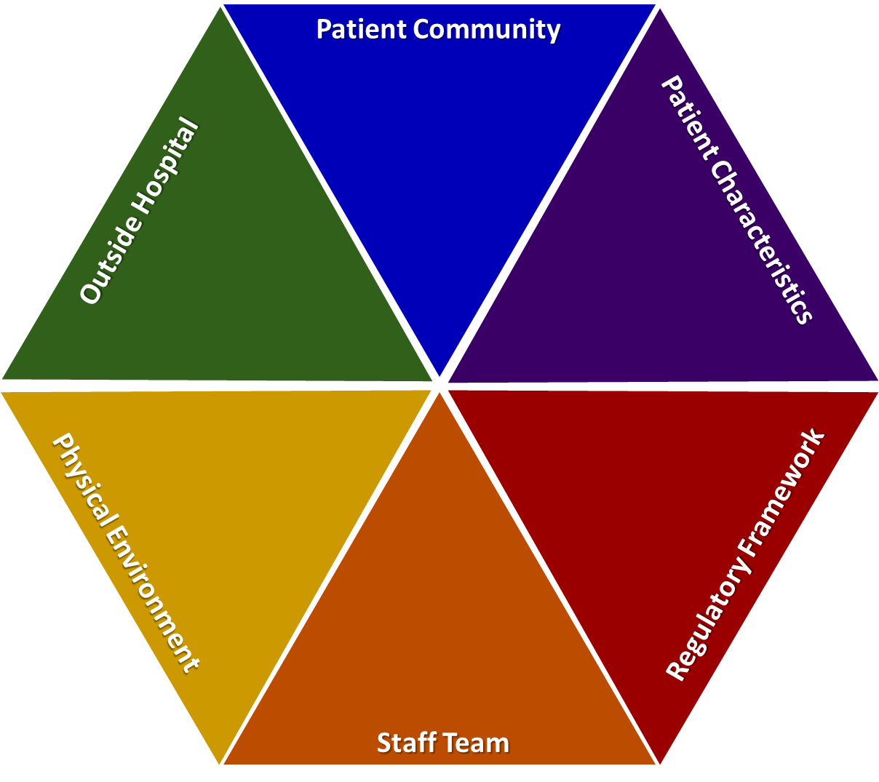
Overview of originating domains

Slide 30
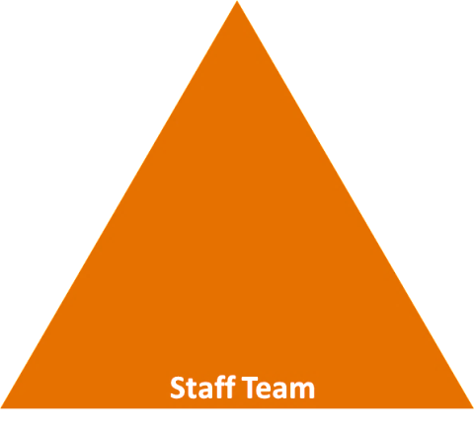
Staff team domain
Internal structure
Rules, routines, efficiency, clean/tidy, ideology, custom, practice
Staff modifiers
Staff anxiety and frustration, moral commitments (honesty), psychological understanding, teamwork and consistency, technical mastery, positive appreciation, education/training, clinical supervision, model skills, challenge each other, review care provided, focus on flashpoints, finding better ways to manage them (reduce number of rules, pre-empting needs) and set limits
Flashpoints
Denial of request, staff demand, limit setting, bad news, ignoring
Notes:
For Staff team domain please see http://www.safewards.net/images/pdf/Safewards%20model.pdf
For each of the following 6 slides you need to be familiar with each of the domains and you need to encourage the participants to start thinking about the factors, modifiers and flashpoints that are specific to their ward. Here you will need to facilitate the discussion and perhaps pose some questions or prompts that are specific to the ward to encourage discussion and reflection. You may need to refer back to the comments you collected from slide 4

Slide 31
Physical environment domain
Better quality environment versus complexity (observation/supervision)
Features
Door locked, quality of environment, speedy repairs, complexity, seclusion rooms available, PICU, ICA, comfort/sensory rooms, ligature points
Staff modifiers
Vigilant and inquisitive, checking routines, décor, maintenance, clean and tidy, alternative choices, respect
Flashpoints
Secrecy, solitude, admission shock, exit blocked
Notes:
For physical environment domain please see http://www.safewards.net/images/pdf/Safewards%20model.pdf

Slide 32
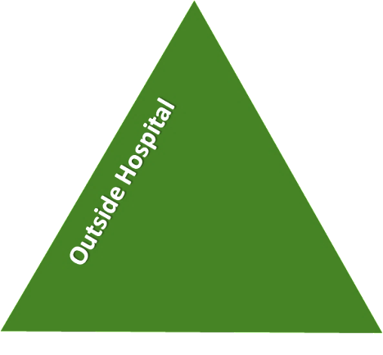
Outside hospital domain
Stressors
Visitors, relatives and family tensions and relationships, missing out, dependency and institutionalisation (absconding), demands and home
Staff modifiers
Carer/relative involvement, family therapy, active patient support, awareness, important factors from outside that can influence behaviour on the unit (financial circumstances, support to resolve issues with family and friends, accommodation-checked on/leave to visit)
Flashpoints
Bad news, home crisis, loss of relationship or accommodation, argument
Notes:
For outside hospital domain please see http://www.safewards.net/images/pdf/Safewards%20model.pdf

Slide 33
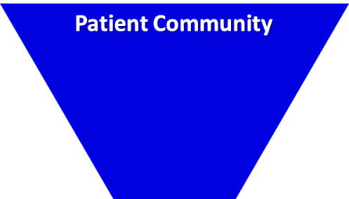
Patient community domain
Patient-patient interaction
Contagion and discord (copying behaviours, impact of others’ behaviour, living with others, meal times and medication times)
Patient modifiers
Anxiety management, mutual support, moral commitments, psychological understanding, technical mastery
Staff modifiers
Explanation/information, role modelling, patient education, removal of means, presence and presence+ (getting in early), conflict resolution, pre-emptive reassurance, managing level and fluctuation of activity on the unit
Flashpoints
Assembly, crowding, activity queuing, waiting, noise, staff/patient turnover or change, bullying, stealing and property damage
Notes:
For patient community domain please see http://www.safewards.net/images/pdf/Safewards%20model.pdf

Slide 34
Patient characteristics domain
Symptoms and demography
Symptoms: paranoia-defensive aggression/absconding, specific delusions, depression-suicide attempts/irritability, use of substances, irritability or disinhibition
Personality traits: features of ASPD, instrumental aggression
Demographic: particularly being younger and male
Staff modifiers
Pharmacotherapy, psychotherapy and functional analysis; nursing support and intervention; enhance choices, freedom and control over circumstances; develop mutually respectful partnership; therapeutic community; authoritarianism-counterproductive; CBT; social skills training; TIC responses; choices over how to respond.
Only a few people account for the majority of aggressive incidents, therefore:
change responses after the first event to avoid subsequent events
target therapeutic interventions
Flashpoints
Exacerbations, independence, identity, acuity, severity
Notes:
For Patient characteristics domain please see http://www.safewards.net/images/pdf/Safewards%20model.pdf

Slide 35
Regulatory framework domain
External structure
Legal framework, national policy, complaints, appeals, prosecutions and hospital policy
Staff modifiers
With the exception of hospital policy, these modifiers are not under staff control (RRI); however, the way they are carried out can be.
Procedural justice, respect for rights, hope, information giving, support to appeal, legitimacy, compensatory autonomy, consistent policy, flexibility, effective complaints process, policy targeted at RRI, choices (such as more activities, meals, snacks), intervene to address hopelessness and self-stigmatisation.
Flashpoints
Compulsory detention, admission, appeal refusal, complaint denied, enforced treatment and exit refusal
Notes:
For Regulatory framework domain please see http://www.safewards.net/images /pdf/Safewards%20model.pdf

Slide 36
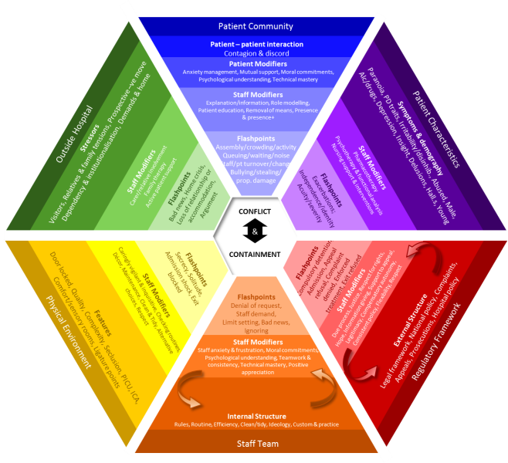
What this model adds to practice
Includes patient-patient interaction
Identifies that staff response to patient characteristics can have an impact
Acknowledges the regulatory framework and that action can be taken at higher policy levels
Incorporates influences from outside hospital
Notes:
Incorporates:
Systematic influences on the ward
Patient behaviour as a result of outside hospital influences
See https://www.youtube.com/watch?v=C3z7zRRXMFo

Slide 37
Safewards interventions
The Safewards interventions are a set of prevention and intervention strategies developed to correspond to diverse flashpoints identified in the model

Slide 38
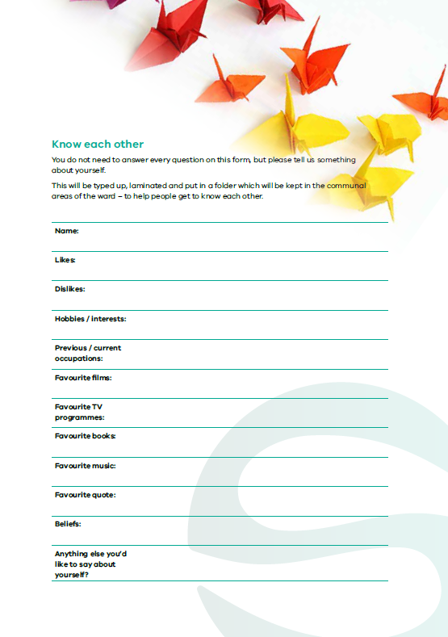
Know each other
Notes:
Briefly explain Know Each Other
http://www.safewards.net/interventions/know-each-other

Slide 39
Background
Good therapeutic relationships between staff and patients are the foundation of effective care.
Gives patients and staff information about each other so they can find common areas of interest
Provides topics for conversation
Shares information within the team to help engage the patient
Notes:
http://www.safewards.net/interventions/know-each-other
This slide covers the reasons for this intervention and the anticipated outcomes

Slide 40
Aims
Build stronger relationships between patients, and between patients and staff
Help patients feel more comfortable and reassured
Assist social interaction
Nurture common humanity while maintaining safety
…making conflict less likely
Notes:
http://www.safewards.net/interventions/know-each-other
This slide covers the aims for this intervention

Slide 41
Know each other and the Safewards model
Staff modifier:
Sharing information
Staff modifiers
Patient modifier: Sharing information
Patient modifiers
Originating domains:
Patient Community
Staff Team
Patient Characteristics
Originating domains
Flashpoints
Conflict
Containment

Slide 42
Task: Getting to know each other
Where did you grow up?
How many children in your family?
What was one of your childhood hobbies?
What was your biggest challenge growing up?
What was your first job?
Notes:
Ask the participants to get into pairs (preferably with someone they do not know so well) and discuss each of these questions.
Allow approximately 10 minutes.
When you bring the group back together ask if they learnt something they didn’t know about each other
You may like to ask for a few examples from the participants

Slide 43
Information collected
What information do we generally collect about patients?
It is usually negative and often focuses on:
past psychiatric history of illness
risks
disabilities
Little of the information collected provides a basis for relationship building
Notes:
http://www.safewards.net/interventions/know-each-other
Ask the participants what information is usually collected about patients?

Slide 44
Task: What non-controversial information might you wish to share?
Notes:
Ask the participants for examples of what they can share (try to move people away from thinking about what they can share rather than what they cannot share).

Slide 45
Examples of non-controversial information
Qualifications
Years of experience working in mental health
Hospitals and various locations worked
Previous jobs
Hobbies and interests
Favourite TV program and reasons
Favourite film and why
Favourite book and why
Preferred music genre
What bad advice have you taken?
What bad advice have you given?
What is your top life tip?
Notes:
http://www.safewards.net/interventions/know-each-other

Slide 46
Know each other in practice
On admission, ask the patient and their carers questions that will help to produce a profile of the patient and include:
key background info
likes and dislikes
favourite things
quotes
beliefs
These can be conversation triggers for staff
Add a graphic or picture of the patient’s choice
Notes:
http://www.safewards.net/interventions/know-each-other

Slide 47
Know each other in practice
Produce a ‘know each other folder’ for all staff and patients on the ward.
Use the know each other templates or modify and create your own.
Appoint a lead to:
prepare the folder
draw patients’ attention to the information
make sure the know each other information stays out on the unit
replace any sheets that get lost.
Notes:
http://www.safewards.net/interventions/know-each-other
You might like to refer to some of the examples from Victoria here-it does not necessarily have to be in the form of a folder.
On discharge the patient can either take their sheet home or choose to have it destroyed

Slide 48
Notes:
An example

Slide 49
Know each other fidelity
Know each other
IS
Patients and staff sharing personal information to facilitate conversations, equality and mutual respect
A space where staff and patients can show their common humanity.
=
Staff sharing personal information with staff, or giving information to patients to emphasise power differences and unbalanced relationships.
Staff showing who they are to each other in front of patients
Know each other
IS NOT
≠
Notes:
Taken from a PowerPoint from a presentation by Professor Len Bowers

Slide 50
Clear mutual expectations
Notes:
Brief overview of clear mutual expectations (CME)

Slide 51
Background and aims
Background
Some flashpoints and therefore conflict are due in part to unclear expectations, lack of clarity or inconsistency on the unit.
Aims
Create a more egalitarian social unit
Mutual holding to account
Set clear standards for staff and patients
Build consistency and predictability while allowing flexibility
Ensure patients and staff understand their obligations to each other
Notes:
See http://www.safewards.net/interventions/clear-mutual-expectations which states that lack of consistency can affect people who may be unwell, distracted, have difficulty interpreting what has been said, experiencing fluctuations in mood, have a history of trauma etc.

Slide 52
Clear mutual expectations and the Safewards model
Staff modifier:
Sharing expectations, finding mutual agreement
Staff modifiers
Patient modifiers: Sharing expectations, finding mutual agreement
Patient modifiers
Originating domains:
Patient Community
Staff Team
Patient Characteristics
Physical environment
Originating domains
Flashpoints
Conflict
Containment

Slide 53
Task: Examples of clear expectations
What are the benefits of having clear expectations?
What expectations can be unclear?
Notes:
Write the examples given from the participants on a whiteboard
Group discussion

Slide 54
Lack of consistency and clarity can cause problems
This can particularly affect those who:
aren't thinking clearly
are distracted by distressing thoughts or emotions, or are preoccupied
have difficulty interpreting communication
experience changes in mood
have a distorted, or different, view of world and others
have a history of trauma
Notes:
http://www.safewards.net/interventions/clear-mutual-expectations
Lack of consistency and clarity can be difficult for everyone.

Slide 55
Mutual expectations for consideration
General expectations
Staff
Excluded items
Property
Places
Notes:
http://www.safewards.net/interventions/clear-mutual-expectations

Slide 56
Role of the clear mutual expectations lead
Ensure clear mutual expectations meetings occur
Communicate meeting results in a visible manner e.g. posters
Ensure the clear mutual expectations are discussed:
If you're the admitting nurse, show the information/poster and explain its contents
If you are on duty when a person is admitted, remind the admitting nurse to refer to the clear mutual expectations
At handover, ask whether the poster has been shown and explained to new patients
Notes:
What ideas do you have for design on your unit?
The Safewards Victoria video on clear mutual expectations would be helpful here

Slide 57
Clear mutual expectations fidelity
Codifying the patients’ expectations of staff and the staff expectations of patients
Sharing expectations across the community for consistency and high standards of behaviour
Facilitating public conversation about how different groups sharing one space can respect one another
Clear mutual expectations
IS
=
Clear mutual expectations
IS NOT
Codifying rules for patients so staff have an easier time telling patients what to do
A pretty poster or mission statement to point to when things get tricky
≠
Notes:
Taken from a PowerPoint from a presentation by Professor Len Bowers

Slide 58
Positive words
Notes:
Provide a brief overview of what positive words is
http://www.safewards.net/interventions/positive-words

Slide 59
Background and aims
Background
At handover the focus is often on describing challenging behaviour or risks to the patient or others. This may promote a negative perception of patients, rather than a balanced view of strengths and ways of working with a person.
Aims
Know peoples’ strengths as well as their challenges
Give the staff something positive and practical to work with
Set an optimistic start to every shift
Try to redress the power differential (remember the person is not in the room!)
Notes:
Outline the background and aims of this intervention
http://www.safewards.net/interventions/positive-words

Slide 60
Positive words and the Safewards model
Staff modifier:
Using positive words & psychological understanding in handover
Staff modifiers
Patient modifiers
Originating domains:
Staff Team
Patient Characteristics
Originating domains
Flashpoints
Conflict
Containment

Slide 61
Handover in practice
Primary role
Only time the team gets together to discuss each patient
The meeting has a critical organisational function – discussion of key risks, new patient admissions
Current approach
Discussions are usually focused on:
Exceptional patient behaviour
Patient behaviour that is viewed as challenging or presents risks to others
Comments that can lead to a negative perception of patients and a negative start to the shift
Notes:
Outline the function of handover and some of the issues that can be associated with handover.
http://www.safewards.net/interventions/positive-words

Slide 62
Safewards approach to handover
Balance the natural tendency to focus on issues and negative aspects of patient behaviour
Positive words focus:
Say something positive about each patient at handover
Promote a positive appreciation of patients to reduce the likelihood of further conflict
When challenging behaviour or situations are described, offer a possible psychological explanation
Provide potentially useful strategies or information for working with the person
Supporting document ‘Understanding patient characteristics and experiences’

Slide 63
Task: Using psychological explanations
Break into small groups:
Understanding aggression and violence
Understanding self harm
Understanding seeking control and empowerment
Understanding absconding
Understanding medication refusal
Activity:
Read through the relevant section in the handout ‘Understanding patient characteristics and experiences’
Discuss how the explanations in the handout could be applied in an actual handover

Slide 64
Using positive comments
The handout provides possible psychological explanations.
This slide provides possible positive descriptions of people.
Refer to past achievement, including before admission/illness
Engaging with an activity
Demonstration of coping
Making a contribution or demonstrating patience
Something the patient has enjoyed
Enjoyed a walk or slept well
Interacted more today
Has smiled and made eye contact
Returned to the ward on time after home leave
Looks brighter
Visits and phone calls that went well
Endurance and courage
Coping with things better
Expression of interest in something
Having a good conversation
Notes:
http://www.safewards.net/interventions/positive-words

Slide 65
Role of the intervention leads
In every handover, remind the person doing the handover to ask the following questions:
What is the positive message about this patient?
Why do we think the patient might have behaved in that way?
Give every staff member a copy of the document ‘Understanding patient characteristics and experiences’
Use the document to interpret patient behaviour on the unit for others on the team, and share knowledge or strategies that may be helpful
Notes:
Understanding unsafe and risky patient behaviours can be found on the Safewards website
http://www.safewards.net/interventions/positive-words

Slide 66
Positive words fidelity
Tapping into the reason we came into nursing - that is, a desire to help
Helping staff recognise and share positive views of patients’ strengths and assets and counterbalance negative perceptions
Starting the shift with hope, optimism and respect
Positive words
IS
=
A rhetorical illusion of looking good and seeming to care
Making sarcastic comments or describing patients’ behaviours in mock positive ways, concreting a negative perception of them
Positive words
IS NOT
≠
Notes:
Taken from a PowerPoint from a presentation by Professor Len Bowers

Slide 67
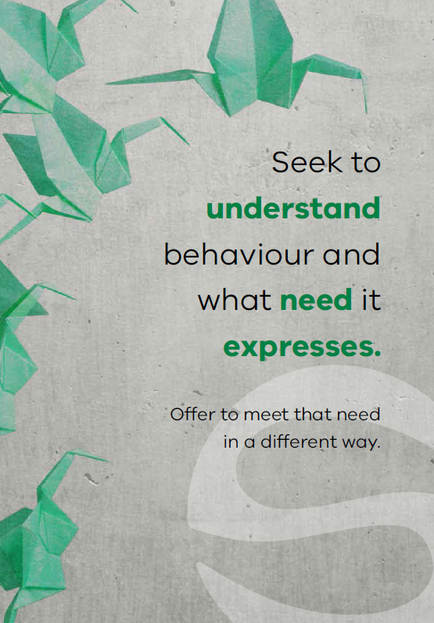
Soft words
Notes:
Briefly describe Soft Words (SW)

Slide 68
“Violence by patients in psychiatric settings is frequently associated with the quality of staff-patient interactions”
(Lancee, Gallop, McCay & Toner, 1995, p.609)
Notes:
Ask the group what they think about this statement and discuss the responses
This quote is taken from the article: Lancee, W. J., Gallop, R., McCay, E., & Toner, B. (1995). The relationship between nurses’ limit-setting styles and anger in psychiatric inpatients. Psychiatric Services, 46(6), 609-613.

Slide 69
Background and aims
Background
A primary flashpoint leading to violent incidents is limit setting. Whenever nurses have to ask patients to do something (or stop them from doing something), this can give rise to understandable frustration.
This intervention provides some ways to avoid confrontations and work more collaboratively with patients.
Aims
Expand the skills and tactical choices of staff in flashpoint situations.
Increase the options applied on the ward
Notes:
http://www.safewards.net/interventions/soft-words

Slide 70
Soft words
Staff modifiers
Staff modifier: Using soft words
Patient modifiers
Flashpoint: Setting limits
Originating domains
Flashpoints
Conflict
Containment

Slide 71
Why do we set limits?
Psychological understanding
Own anxiety & frustration
Perception of risk
Understanding of local policy
Staff
modifiers
Staff modifiers
Patient modifiers
Regulatory environment: Perceived requirements
Flashpoint: Setting limits
Patient characteristics: Perceived needs
Flashpoints
Conflict
Containment
Originating domains

Slide 72
Soft words: Why it matters (example 1)
‘I don’t deserve anything’ (shame)
Staff modifiers
‘You took my choice away’
‘You agree that I don’t deserve anything’
Flashpoint (Increased shame)
Patient modifier: Psychological understanding
Patient modifiers
Patient characteristics
Trauma / abuse
Low self-esteem
Flashpoint: Setting limits
Flashpoints
Conflict
Containment
Originating domains
Conflict:
Self-harm

Slide 73
Soft words: Why it matters (example 2)
‘I’ve never had any choice’ (fear)
Staff modifiers
‘You took my choice away’
‘With less control I now feel even more unsafe’
Flashpoint (Increased fear)
Patient modifier: Psychological understanding
Patient modifiers
Patient characteristics
Trauma / abuse
Disadvantage
Feeling unsafe / anxiety
Conflict: Fight or flee (aggression or abscond)
Flashpoints
Originating domains
Flashpoint: Setting limits
Conflict
Containment

Slide 74
Soft words: Why it matters (example 3)
‘I’ve always had choice’
Staff modifiers
‘You took my choice away’
‘This is not fair!’
Flashpoint (Anger)
Patient modifier: Psychological understanding
Patient modifiers
Patient characteristics
Strong sense of justice & fairness
Confidence
Flashpoints
Flashpoint: Setting limits
Conflict
Containment
Originating domains
Conflict: Aggression

Slide 75
Soft words in practice
Staff modifier: Using soft words
Staff modifiers
Patient modifiers
Flashpoints
Originating domains
Setting limits?
Conflict
Containment

Slide 76
Soft words in practice
What domains do you need to respond to?
Staff modifier: Using soft words
Staff modifiers
Patient modifiers
Physical environment: Privacy & dignity?
Regulatory: Upholding rights?
Flashpoints
Originating domains
Setting limits?
Conflict
Containment
Patient characteristics: Offer support and interventions?

Slide 77
Soft words in practice
What domains do you need to respond to?
Do you really need to set the limit? Try to say ‘yes’ instead.
Staff modifier: Using soft words
Staff modifiers
Patient modifiers
Physical environment: Privacy & dignity?
Regulatory: Upholding rights?
Flashpoints
Originating domains
Setting limits?
Conflict
Containment
Patient characteristics: Offer support and interventions?

Slide 78
Soft words in practice
What domains do you need to respond to?
Do you really need to set the limit? Try to say ‘yes’ instead.
Staff modifier: Using soft words
Can you minimise the limit, offer choices, negotiate?
How can you be as respectful as possible?
Staff modifiers
Patient modifiers
Physical environment: Privacy & dignity?
Regulatory: Upholding rights?
Flashpoints
Originating domains
Setting limits?
Conflict
Containment
Patient characteristics: Offer support and interventions?

Slide 79
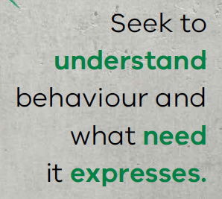
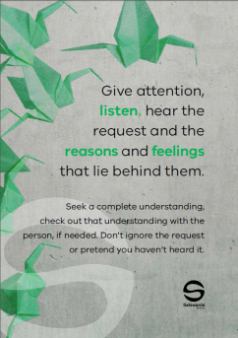
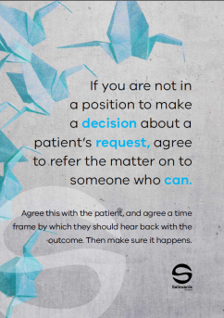
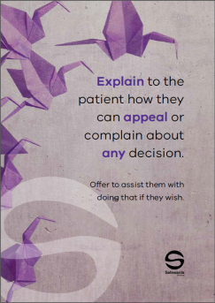
Soft words in practice
This intervention provides some techniques to avoid confrontation and work more collaboratively
with patients.
Soft words are communicated to the
team using a ‘Message of the Day’
poster displaying soft words tips,
placed in the ward office and regularly
changed and discussed.
Notes:
See the Safewards internet for examples http://www.safewards.net/interventions/soft-words
Soft words video may be useful here – shows soft words in practice – turning down a request from a patient

Slide 80
Task: Identifying themes
Read through the poster examples and determine:
How you might use the poster in practice
Which theme/s each of your posters refers to (see below)
Themes
Being respectful and polite
Turning down a request from a patient
Asking a patient to do something
Asking a patient to stop doing something
Notes:
Refer to the soft words ‘messages of the day’ in the resource pack.
Break the participants into 4 groups and provide with the posters from one of the 4 themes listed on the slide.
Each group is assigned a theme, ask them to read through each of the poster examples and identify which theme their posters are and how they would use the resource in practice.
The aim would be to both use them as a training resource with colleagues i.e. talking through the purpose of the poster and also role modeling how to interact with consumers using these principles.

Slide 81
Role of the intervention lead
Change the soft words poster every day
Remind other team members about soft words
Draw attention to the Message of the Day poster
Who might be the most suitable lead?
Notes:
http://www.safewards.net/interventions/soft-words

Slide 82
Soft words fidelity
Increasing staff options and using good interactive skills in flashpoint situations
A means of reminding staff to always use the best style of communication in difficult conversations
Soft words
IS
=
Soft words
IS NOT
Hanging up signs
A soft option as the standard of communication described is high. Expect to be challenged.
≠
Notes:
Taken from a PowerPoint from a presentation by Professor Len Bowers

Slide 83
Reassurance
Notes:
Provide a brief overview of Reassurance
http://www.safewards.net/interventions/reassurance

Slide 84
Reassurance background
Already scared & vulnerable
Psychiatric units can be strange and scary places.
Every confrontation has the potential to be a flashpoint for another patient, creating a kind of ripple effect.
Unlike staff, patients are not free to leave the unit or get away to a safe place.
Witness a confrontation
Fight, flight or freeze
Increased, unbearable fear
Patients don’t have to be directly involved in a confrontation for it to have a distressing emotional impact.
Staff can help alleviate fear and other types of distressing emotions.

Slide 85
Reassurance aims
To proactively reassure every patient after every confrontation, incident or conflict on the unit
To reduce the potential ripple effect of conflict on the unit
To prevent or reduce the impact of flashpoints
To ensure patients feel safe and supported
Reassurance for patients is a bit like debriefing for staff

Slide 86
Reassurance and the Safewards model
Staff modifiers
Patient modifiers
Flashpoint: Confrontation on the unit
Originating domains
Flashpoints
Conflict
Containment

Slide 87
Reassurance and the Safewards model
Staff modifier: Provide reassurance
Staff modifiers
Patient modifiers: Know particular triggers for each person
Patient modifiers
Originating domains: Understand how domains increase the emotional impact of conflict
Flashpoint: Confrontation on the unit
Originating domains
Flashpoints
Conflict
Containment

Slide 88
Reassurance in practice Common situations requiring reassurance
Loud shouting/property damage/aggression: May provoke fear that could lead to defensive aggression, absconding, withdrawal and disengagement, suicidality
Self-harm - May provoke similar acts, can be distressing, provoke anger, shame or fear of one’s own internal impulses
Intoxication – May provoke fear about unpredictable behavior and personal safety
Show of staff force – (such as transferring a patient to high dependency area) Can undermine patient confidence in staff, make people feel vulnerable or bullied, provoke anger, fear or other distressing emotions, may trigger re-traumatization / flashbacks, panic, self-harm, suicidality
Notes:
Discuss some of the potentially anxiety provoking events listed here - ask the participants to give some examples from their ward.
http://www.safewards.net/interventions/reassurance

Slide 89
Reassurance in practice Explanation to patient and others
You do not have to be indiscreet or break confidentiality
You can draw upon psychological explanations for patient and staff actions, and use generalities.
For example:
“Sometimes when people are very unwell they may be frightened and confused – this might trigger aggression and we may need to intervene to keep everyone safe. This can look scary, but we are very careful to never hurt someone, and to try and protect people’s dignity”
Notes:
http://www.safewards.net/interventions/reassurance
Important to emphasize here that this intervention can be done without breaking confidentiality.

Slide 90
Reassurance in practice: Empathy is a critical staff skill
Brené Brown on Empathy (Youtube video)
https://youtube/1Evwgu369Jw

Slide 91
Reassurance in practice: Empathy is a critical staff skill
Empathy fuels connection, sympathy drives disconnection.
Key qualities of empathy:
Perspective taking
Staying out of judgement
Recognising emotion in other people
Communicating that
Empathy is feeling ‘with’ people.
Empathy can make us feel vulnerable because it means having to connect with something in yourself that knows that feeling.
Empathy means not trying to make things better.
Responses rarely make something better.
Connection with others can help people feel better
Brené Brown on Empathy (Youtube video)
https://youtube/1Evwgu369Jw

Slide 92
Intervention strategies
Intervention lead
Consider speaking to the nurse in charge of the shift (or as a group, such as at staff meetings) and request a method is identified for ensuring the following two points are identified:
Ensure reassurance action takes place following any incident.
When an incident is mentioned at handover, ask if 'reassurance' took place.
Notes:
The more time you spend with patients in a caring and meaningful way can reduce fear and anxiety

Slide 93
Intervention strategies
Intervention lead
After an event
Following a potential anxiety-provoking incident:
Speak with every patient, alone or in small groups, and ask them:
What is your understanding of what happened?
What affect did it have on you?
Provide an explanation of what happened
Consider how this is documented in relevant patient files

Slide 94
Intervention strategies
Be visible on the unit
Move about a lot and make sure you cover the whole unit
Be watchful (not in an anxious way) in a warm and caring manner
The goal of staff presence, explanation and support is to ensure everyone feels safe and secure
Notes:
The more time you spend with patients in a caring and meaningful way can reduce fear and anxiety

Slide 95
Reassurance fidelity
Heightening staff awareness of events that can make patients feel fear or other distressing emotions, and taking action so that doesn’t happen
A basic standard of consideration for people who have witnessed distressing events
Reassurance
IS
=
Telling patients things will be fine when they come to the office door and express a worry
Gossiping about other patients who may exhibit challenging behaviour
Reassurance
IS NOT
≠
Notes:
Taken from a PowerPoint from a presentation by Professor Len Bowers

Slide 96
Bad News Mitigation
Notes:
Explain bad news mitigation (BNM) briefly
It might be helpful to give an example when you have received bad news and how this felt for you (if you feel comfortable)

Slide 97
Background
People can be affected greatly by unwelcome news, and may want to leave the unit to seek familiar support or escape the cause of the news. Being given no choice to leave the unit when distressed, people may express feelings in an unsafe way.
Bad news from outside hospital can also cause conflict. Examples can include: death in the family, relationship breakdown, loss of tenancy, burglary, illness in the family, childcare issues, financial issues.
The resulting distress can cause increased irritability, aggression, violent incidents and absconding
Notes:
http://www.safewards.net/interventions/bad-news-mitigation

Slide 98
Bad news mitigation
Receiving bad news can be common during an inpatient stay. This intervention is about providing support during the delivery of news or afterwards, to mitigate the risk of flashpoints.
Key messages:
Bad news can create confusion and hinder understanding. Be respectful of a person’s views.
Being aware of occasions when people might get upsetting news.
Identify a proactive way to reach out to people before there is a reactive need to.

Slide 99
Bad news mitigation and the Safewards Model
Staff modifier: Mitigate bad news
Staff modifiers
Patient modifiers
Originating domains
Outside hospital
Regulatory framework
Flashpoint: receiving bad news
Originating domains
Flashpoints
Conflict
Containment

Slide 100
Task: Bad news scenarios
What have you found helpful when working with people who have received bad news?
What has not been helpful? Why?
Notes:
This task can be done as a large group or smaller groups/pairs. Allow about 5 minutes for this task. Ask for a few examples from the group.

Slide 101
Bad News Mitigation in practice
Handover
Before news is delivered
After news is received
Ongoing support
Notes:
http://www.safewards.net/interventions/bad-news-mitigation
It is important to highlight that what is considered bad news can vary significantly from person to person therefore it is important to enquire, know the person well and look out for possible signs of distress.
Be aware of occasions and events that might trigger angry or upset reactions.
At handover, discuss as a team and share knowledge to predict who might receive unwelcome news and how support will be offered.
Work with the multidisciplinary team (MDT) to express bad news empathically or intercept after it has happened.
Maintain awareness of what is going on through regular one-on-one contact with the patient.
Know everyone’s general demeanor
Safewards bad news mitigation video helpful here – shows identification of bad news and planning

Slide 102
Bad News Mitigation in practice
Approach
Find a quiet place, give the person time to express their feelings.
Acknowledge their feelings, express empathy.
Answer any questions honestly, giving time, attention and respect.
Show you are receptive to concerns - use listening techniques.
Be responsive and respectful of a person’s views.
Support the person to understand decisions and acknowledge feelings. This can improve relationships and make aggression, self-harm and absconding less likely.
Notes:
Ask for e.g. open-ended questions
Talking over a cup of tea
http://www.safewards.net/interventions/bad-news-mitigation

Slide 103
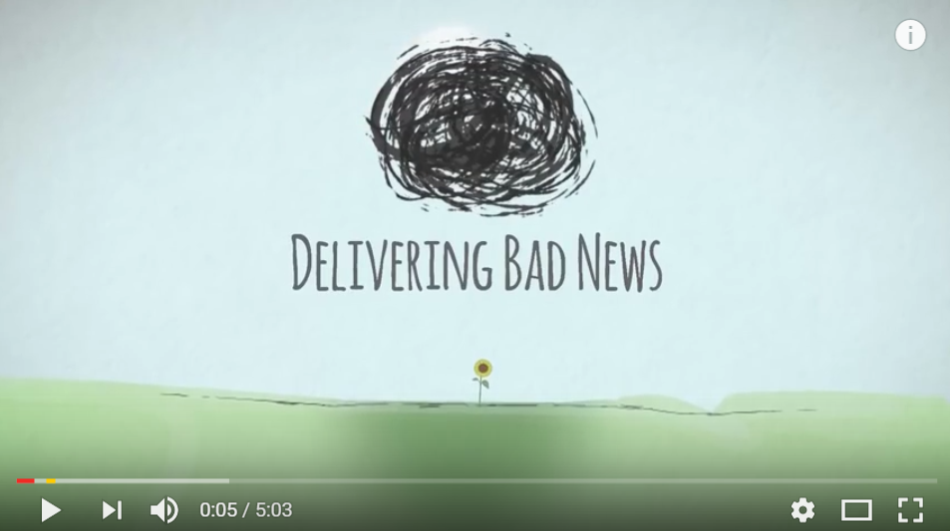
Delivering Bad News Video
https://www.youtube.com/watch?v=juKAMBh9J54
Source: The Irish Hospice Foundation, Youtube

Slide 104
Role of the intervention lead
Make sure these two questions are considered by the team at handover:
Has anyone received any bad news over the past shift? If they have, how can we support them?
Is anyone likely to receive bad news during the coming shift, and if so, how are we going to manage that?
Notes:
http://www.safewards.net/interventions/bad-news-mitigation
You may want to ask the group how they could ensure this process occurs, what measures will they put in place?

Slide 105
Bad news mitigation fidelity
A proactive way to reach out to people before there is a reactive need to
Keeping staff aware and looking for occasions when people might get upsetting news and delivering emotional support quickly
Giving patients enough information so they can determine whether it’s bad news or not
Bad news mitigation
IS
=
A way of protecting patients from life or threatening them with consequences or assuming how they will feel
Attaching the phrase ‘I am sorry to let you know’ when we tell patients they cannot have something they desperately want
Bad news mitigation
IS NOT
≠
Notes:
Taken from a PowerPoint from a presentation by Professor Len Bowers

Slide 106
Mutual Help Meeting
Notes:
Briefly explain the essence of the mutual help meeting (MHM)

Slide 107
Background
The unit is a social community and potentially a powerful engine to help patients, have a positive influence, and progress towards discharge.
The help that patients give each other can be highly valued and effective.
The giving of help and support between patients offers the giver:
a socially valued role
the chance to make a meaningful contribution
the potential to improve their self-esteem
Notes:
http://www.safewards.net/interventions/mutual-help-meeting

Slide 108
Aims
Strengthen an existing mechanism that is highly valued by patients and staff
Create opportunities for patients to find valued roles and public recognition
Build patient self-esteem
Increase mutual support and promote recovery
Establish values, understanding and social connection
Notes:
http://www.safewards.net/interventions/mutual-help-meeting

Slide 109
Mutual Help Meeting and the Safewards Model
Staff modifier: Mutual help meeting
Staff modifiers
Patient modifier
Mutual support
Patient modifiers
Originating domains
Patient community
Patient characteristics
Originating domains
Flashpoints
Conflict
Containment

Slide 110
Conflict
Inpatient aggression can arise from many different factors. This intervention focuses on preventing conflict that may arise from patient-to-patient interactions, or from being in a strange and/or frightening environment.
Conflict can be reduced if patients:
Positively appreciate each other
Practice/learn ways regulate their own emotional reactions
Support each other to uphold shared expectations
Feel heard and valued
Have access to mutual support
Notes:
http://www.safewards.net/interventions/mutual-help-meeting

Slide 111
Mutual Help Meeting
A voluntary meeting of all patients and staff on duty
The meeting’s focus is on how people can help each other
Notes:
http://www.safewards.net/interventions/mutual-help-meeting

Slide 112
Agenda
Ensure each agenda item is covered during the meeting
Round of thanks: All patients and staff can individually thank anyone or anything, present or not present, for anything they have done for them since the last meeting. Everyone is free to comment.
Round of news: Staff can inform patients about upcoming events on the unit, or explain recent events on the unit that might be confusing or distressing. Ask everyone to watch over each other, keep each other safe, and call for help if they are worried.
Round of suggestions: Everyone has a chance to offer suggestions.
Round of requests and offers: Patients discuss how others in the unit can help them, and make offers of support to each other.
Notes:
Here are some examples of offers and request you may wish to add (fromhttp://www.safewards.net/images/pdf/Mutual%20Help%20Meeting%20website%20download.pdf)
Share knowledge and experience about care and services
Support each other in practical tasks
Encourage each other to take part in structured activities
Accompany each other on walks or activates
Play games such as cards or table tennis
Discuss current affairs
Spend time with people
Share coping strategies, such as relaxation techniques
Make a drink for someone else
Sit next to someone at meal times
Say good morning
Ask how someone else is feeling
Listen to music or watch TV with someone and talk about it afterwards

Slide 113
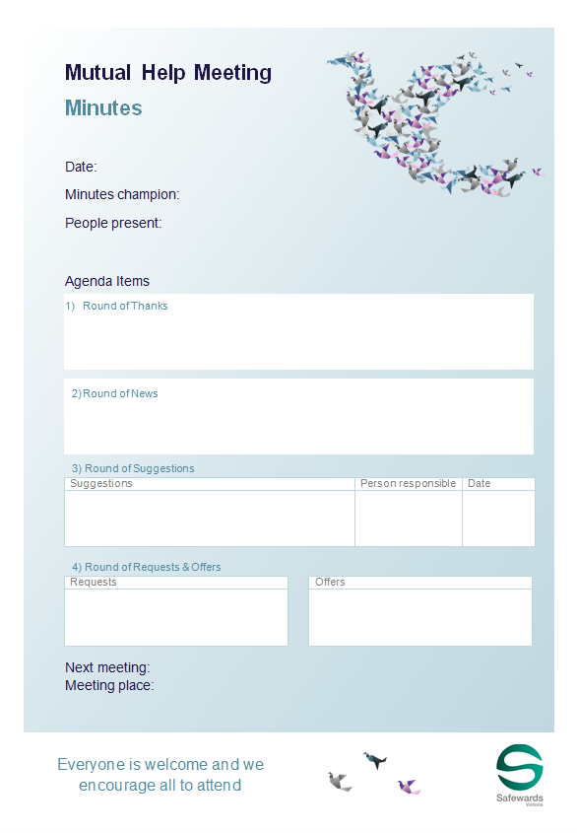
Staff roles
Prepare for the group
Room
Support people
Resources (agenda, flyer, poster, minutes, news)
Ideally first thing in the morning
Preferably every day (at least 3/week)
Protected space/time
Follows a structured agenda
Once all the points are covered the meeting is closed
Chaired by patients or staff
Consider a log book
Notes:
http://www.safewards.net/interventions/mutual-help-meeting
Provide examples of how to prepare for the group
Prepare the room.
Gather patients and staff.
Prepare contributions and offer support in advance.
Acknowledge and support a complaint following your local processes. This isn’t the forum for complaints.

Slide 114
Staff roles
Maintaining the meeting
Encourage good contributions through positive feedback.
Model mutual respect.
Enable everyone to contribute.
Seek information and opinions and provide information.
Clarify and summarise for others.
Suggest compromises and settlements.
Offer advice on expression of mutual respect and positive appreciation
Accurately describe any recent potentially distressing events on the unit (reassurance).
Notes:
http://www.safewards.net/interventions/mutual-help-meeting
Provide examples of how to prepare for the group
Prepare the room.
Gather patients and staff.
Prepare contributions and offer support in advance.
Acknowledge and support a complaint following your local processes. This isn’t the forum for complaints.

Slide 115
What to expect
Attendance will grow if the meeting is held regularly and is talked about.
Even with only a few people the meeting can be productive.
Attendees can consider how they can help others who aren't attending.
Small things can be important to people.
Notes:
http://www.safewards.net/interventions/mutual-help-meeting

Slide 116
Mutual Help Meeting fidelity
Mutual help meeting
IS
Getting patients together to agree on small things they can do to help and support each other, and valuing those activities once completed
In terms of patient care – a chance for staff to take a step back and patients a step forward
=
A forum for complaints and suggestions from patients about what the staff or hospital should do or for staff to give news to patients
Another group in the unit where staff have a debrief while patients go back to bed
Mutual help meeting
IS NOT
≠
Notes:
Taken from a PowerPoint from a presentation by Professor Len Bowers

Slide 117
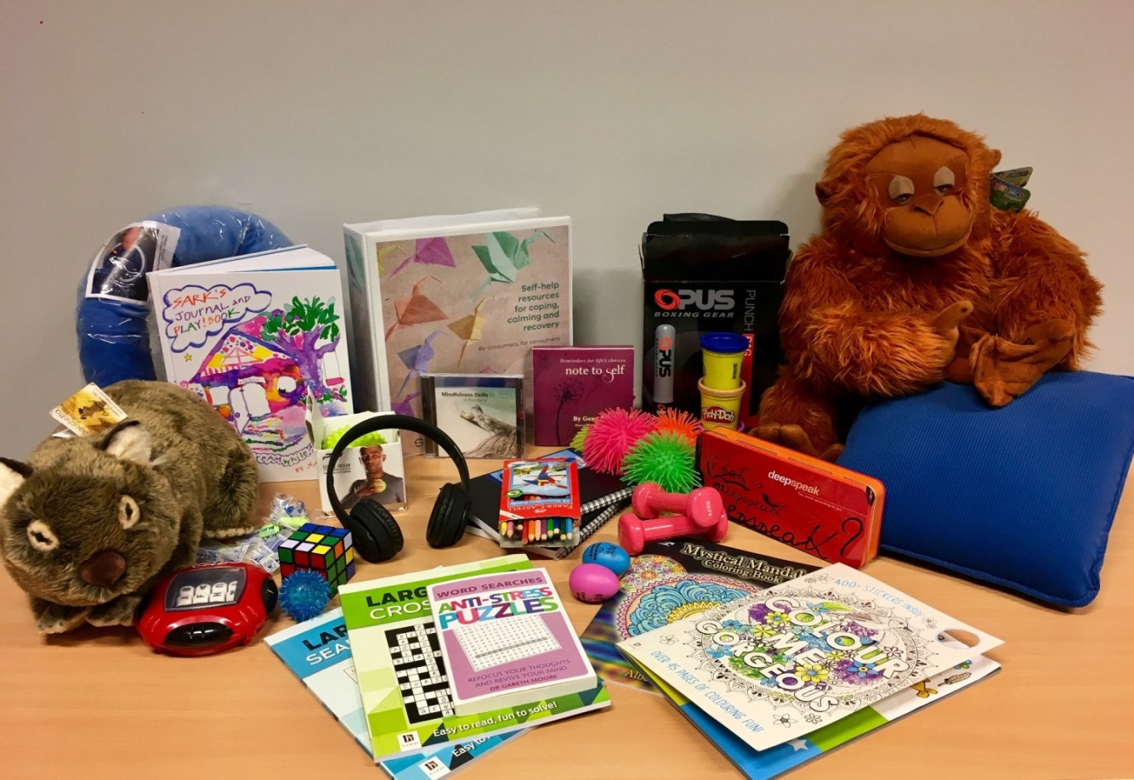
Calm down methods
Notes:
Briefly describe Calm Down Methods

Slide 118
Background and aims
Background
Pro re nata (PRN) medication can been used as an effective strategy to assist people to feel calm, but perhaps we reach for it too easily and too quickly. Where possible and practical, it’s always best to use the patient’s own strengths and coping mechanisms – or support people to develop new strengths and skills – to enable people to self-regulate.
Aims
Early de-escalation
Divert and prevent
Increase people’s sense of empowerment and self-control (these processes contribute to recovery)
Notes:
http://www.safewards.net/interventions/calm-down-methods

Slide 119
Calm Down Methods and the Safewards Model
Staff modifier:
Calm Down Methods
Staff modifiers
Patient modifiers
Originating domain
Patient characteristics
Originating domains
Flashpoints
Conflict
Containment

Slide 120
Benefits
PRN medication is an effective strategy for some people, some of the time, however calm down methods can:
Support people to draw on their own strengths and coping mechanisms
Offer alternatives to medication, that can be sustained well past an admission
Build self-knowledge
Facilitate learning of new strengths and skills
Notes:
http://www.safewards.net/interventions/calm-down-methods

Slide 121
Early signs of distress/agitation
Notice potential changes in:
facial expression
tone of voice
quick response to a normal reminder
restlessness
breathing patterns
body language
eye contact (or lack thereof)
movement around the ward
Notes:
Ask the group what changes they might identify
http://www.safewards.net/interventions/calm-down-methods

Slide 122
Task: Calm down methods handout
Think about what might be helpful for different types of ‘calm down’ needs.
Think about different types of resources and the functions they could serve.
‘It can be easy to say someone is agitated but harder to understand why’
Difficult emotions
Difficult thoughts and urges
Difficult experiences
Sensory & grounding, comfort & soothing, humour, distraction, mindfulness, inspirational, expressive & venting, harm minimisation, problem solving & reflection, movement & activity, drawing on nature or creativity
Notes:
Refer to the handout ‘Calm Down Methods: Resource Ideas’ from the resources pack.
Activity with handout
Split the group into small groups of 3-4 people. Think about a common need you may have seen on the unit and which item might sit with this intervention.
The handout can be used to prompt our thinking about the intervention
It can also be used to consider how you may add to the resources over time

Slide 123
Calm down methods in practice
Assemble a box of ‘calm down resources’ for your unit
Offer/explore calm down methods before considering PRN
Support people to explore the potential uses of calm down methods
Some of the calm down activities can be done together
Record calm down methods use in a log book, and patient files
Notes:
http://www.safewards.net/interventions/calm-down-methods
You could show the Safewards calm down methods video here

Slide 124
Role of the intervention lead
Suggest when calm down methods are appropriate
Ask if/how calm down was used when people mention agitation or PRN at handover
Ask if/how calm down was used if there was a restrictive intervention
Ensure resources are easily available to patients when needed
Check resources regularly to ensure items are returned, clean and in good working order (develop an infection control plan)
Replace missing, depleted or broken items
Expanding Calm Down Methods…
Look at increasing the number and type of resources over time
Make calm down resources available in more spaces
Think about how patients can take resources home after discharge
Notes:
http://www.safewards.net/interventions/calm-down-methods
You might also like to see some of the examples used in Victoria

Slide 125
Calm down methods fidelity
A practical set of equipment and patient resource for self–help when in distress
A store of equipment that can be used to help people who may be feeling agitated/restless, anxious/frightened, angry/irritable, ashamed or depressed/despairing to reach a relaxed state of mind
Calm down methods
IS
=
A box of things that gathers dust in the office or gets dragged to a group
A store of equipment for diversional or recreational activities for patients to do on request
Calm down methods
IS NOT
≠
Notes:
Taken from a PowerPoint from a presentation by Professor Len Bowers

Slide 126
Talk down
Notes:
Briefly explain Talk Down-http://www.safewards.net/interventions/talk-down

Slide 127
Background
When people become agitated, fearful, angry, ashamed, depressed or suicidal, it should be possible to lessen people’s distress by talking to them
Most of us have had instruction in de-escalation in aggression management training but this may be limited
Safewards pulls together ‘Talk Down’ techniques into a meaningful picture
Notes:
http://www.safewards.net/interventions/talk-down

Slide 128
Aims
Build patient’s emotional self-management skills, self-monitoring, self-awareness and psychological understanding
Using crisis as an opportunity for therapeutic learning for everyone
Improve team cohesion, skill sharing, mutual support
Expand staff skill set
Avoid conflict and containment - or minimise the impact in the event of conflict and/or containment
Notes:
http://www.safewards.net/interventions/talk-down

Slide 129
Talk Down and the Safewards Model
Staff modifier:
Talk Down
Staff modifiers
Patient modifiers
Flashpoints
Conflict
Containment
Originating domains
Conflict:
Any type

Slide 130
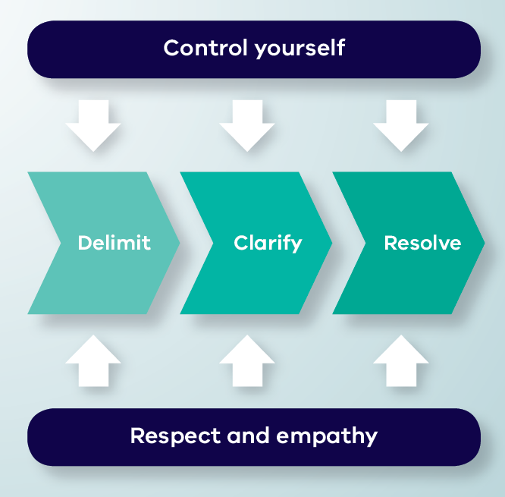
Talk Down Process
Notes:
Give a brief explanation of each of the boxes
You may like to show the talk down video here – this shows talk down in action. You can pause the video before the end description of the model, and ask participants to identify the aspects of the model the staff member has demonstrated.

Slide 131
De-escalation model
Depicts de-escalation as a process:
Starts with delimiting the situation
Moves onto clarification of the problem with the patient
Reaches a resolution
The model indicates that de-escalation is only likely to succeed if, at every stage, the de-escalator:
Controls their own emotions, and
Expresses respect and empathy for the patient
Notes:
Here you might like to split people into groups according to the different processes of Talk Down (delimit, clarify, resolve, control yourself, respect and empathy).
Ask each group to discuss the process they have been assigned
Then feed back to the group (you could do this all at once or use the following slides and ask the group who had the process to describe the process and use the following slides to reinforce the key points).
Allow about 15-20 minutes for this.
http://www.safewards.net/interventions/talk-down

Slide 132
Delimit
• Invite person to move to a quiet place, away from others, audience, people at risk
• Invite person to sit down
• Assess the need for support or backup
• Keep safe, maintain distance if required
Notes:
Go through each of the slides getting the group who focused on the process to feedback first
http://www.safewards.net/interventions/talk-down

Slide 133
Clarify
• Speak clearly, say who you are, use each other’s names, remind of existing relationship, offer your help
• Use open questions to ask what’s happening
• Listen attentively to patient
• Paraphrase what they’ve said to check your understanding
• Answer questions and clarify any misunderstandings
Notes:
http://www.safewards.net/interventions/talk-down

Slide 134
Resolve
• Give patient opportunity to self-regulate, consider using calm down methods
• Be flexible, if possible problem-solve and compromise together
• Offer choices and options
• Give reasons, explain rules, reasoning behind them, be honest, express fallibility (or even agree that it’s unfair)
• Deal with the complaint, apologise, make a change
• Make a personal appeal, remind them of any previously agreed strategy, summarise what’s been said
• Ask if there is anything else you
can do or say that will be
helpful, end positively
Notes:
http://www.safewards.net/interventions/talk-down

Slide 135
Control yourself
Actions
• Act calmly and confidently.
• Don’t corner patients, threaten or make false promises
• Don’t judge, criticise, show irritation, frustration, anger or be retaliative
• Let patient have the last word
Body language
• Have slow and gentle movements
• Relax face, don’t frown, or purse lips
• Relax body, no hands on hips or in pockets, don’t finger wag or prod
• Have lowered, uncrossed arms and open hands
Notes:
http://www.safewards.net/interventions/talk-down

Slide 136
…control yourself
Communication
• No hesitation or uncertainty of speech
• Don’t argue or say they are wrong and you are right
• Don’t defend or justify yourself
• Show no reaction to abuse or insults directed at you, ignore them or partially agree with them
• Prepare responses in advance to typical insults
Emotions
• Breathe deeply and concentrate on situation
• This is not personal and it is not about you

Slide 137
Respect and empathy
Actions
• Be congruent: your actions should match your words
• Listen, hear, acknowledge feelings and needs
• Don’t tell the patient what they should or should not be feeling
• Take time to hear the patient out, be patient and don’t hurry them
Body language
• Make eye contact (exercising care not to be confrontational)
Notes:
http://www.safewards.net/interventions/talk-down

Slide 138
…respect and empathy
Communication
• Extend self and thinking to understand patient viewpoint
• Have a concerned and interested tone of voice
• Don’t yell or shout over people
• Answer all requests for information, however they are phrased
Don’ts
• No advice giving and no orders, no “if I were you I would…”
• Don’t overly smile as this can be condescending

Slide 139
Summary
All the time:
Control yourself (Actions, Body language, Communication, Emotions)
Show respect and empathy (Actions, Body language, Communication)
Three step process:
Delimit: Ensure safety and privacy for all parties
Clarify: Find a shared understanding of the problem
Resolve: Find a solution together

Slide 140
Talk Down in practice
Video by Chris Hart, Youtube
https://youtu.be/Q4T-x1za6lg
Notes:
Watch the video
Ask the group to identify the parts of the model in the video.

Slide 141
Talk down in practice
A poster summarising de-escalation techniques is placed in an area frequented by staff
The unit decides on the ‘talk down’ lead
The lead spends 10-15 minutes with other members of the team explaining the poster and giving examples from their experience
The lead gives each staff member a copy of Talk Down ‘Staying open, friendly and positive handout’
The lead invites staff to read the poster, ask questions and use it to reflect after the process is used
Notes:
There are plenty of resources for this intervention e.g. the poster, the document on staying open friendly and positive, the explanation of the Talk Down poster contents for champions and the guidance for the on how to use the poster, please see the Safewards website

Slide 142
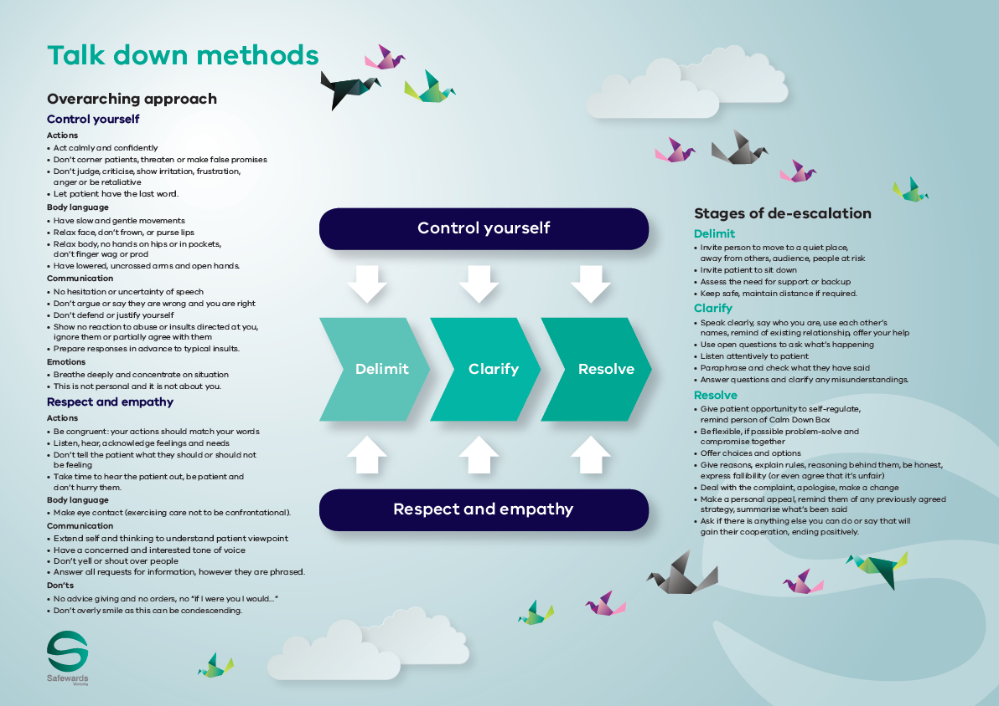
Talk down poster
The poster summarises how the de-escalation process would ideally work
The poster is a guide only. All de-escalation
situations vary
The reality is usually more muddled, nevertheless these principles can be applied to most situations to some degree
Notes:
http://www.safewards.net/interventions/talk-down

Slide 143
Role of the intervention lead – promote talk down
Highlight to the team when talk down methods are used effectively
Mention talk down in handovers or other team meetings
Express respect for use of talk down methods
Acknowledge the growing skill of the team
Consider using the poster when debriefing following an incident - not only recognising the skills that were used but also those that were not and discussing opportunities for improvement

Slide 144
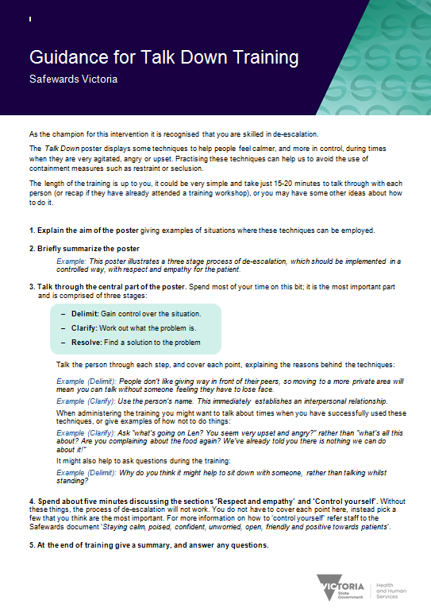
Resources for the intervention lead
Guidance for Talk Down training handout
‘Staying calm…’ handout
Notes:
There are quite a few handouts as previously mentioned to help with this intervention.
http://www.safewards.net/interventions/talk-down

Slide 145
Talk down fidelity
Expanding de-escalation skills and increasing psychological understanding, capitalising on the best of existing team skills and building team cohesion
A crystallisation of de-escalation skills packaged for unit-based teaching and promotion
Talk down
IS
=
Hanging a small poster in the corner of the unit, hoping the staff read it and understand it
Something that ‘happens anyway’ – ‘patient was de-escalated’ is often a myth
Talk down
IS NOT
≠
Notes:
It might help to ensure that the poster is placed in an area where de-escalation is commonly used.
Taken from a PowerPoint from a presentation by Professor Len Bowers

Slide 146
Discharge messages
Notes:
Give a brief overview of Discharge Messages
http://www.safewards.net/interventions/discharge-message

Slide 147
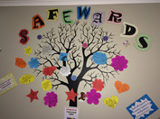
Background
Discharge messages provides a way of helping people connect with hope by:
Demonstrating care and concern
Attending to what people feel and are concerned about
Creating an avenue for patients to inspire and support each other (even anonymously)
Providing hopeful messages from other patients (rather than from staff)
Patient engagement is fundamental to this intervention
Notes:
http://www.safewards.net/interventions/discharge-message

Slide 148
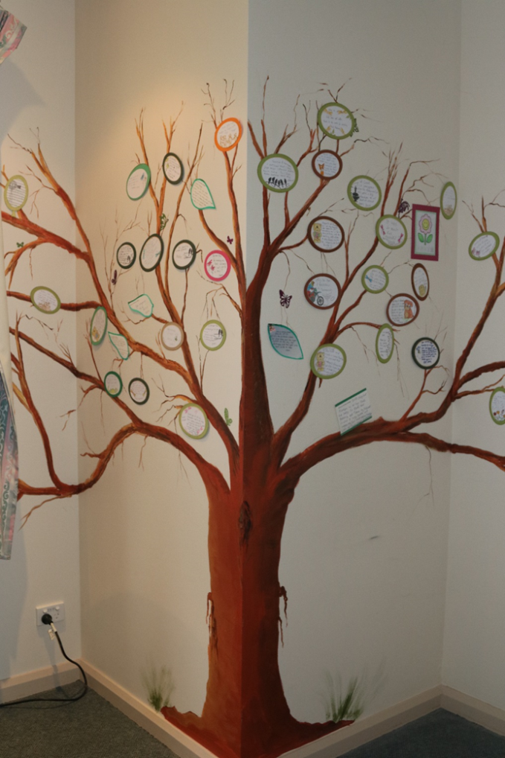
Aims
When a patient is preparing to leave, there is an opportunity for them to provide a discharge message as a form of closure for themselves and to help others on the unit.
Aims:
Provide authentic encouragement and support for new patients
Provide hope and convey messages about the purpose and potential benefits of an admission
Provide a boost to self-esteem / identity on leaving the unit through making a valued contribution to the patient community
Notes:
Ask people to think about integrating this intervention into practice eg-it is not just about someone leaving. It is also about engaging people who are on the unit who may be newly admitted, it is also about positivity and safety planning etc
http://www.safewards.net/interventions/discharge-message

Slide 149
Discharge messages and the Safewards Model
Staff modifier:
Discharge messages
Staff modifiers
Originating domains:
Patient community
Patient characteristics
Physical environment
Patient modifiers:
Hope, mutual help
Patient modifiers
Originating domains
Flashpoints
Conflict
Containment

Slide 150
Role of the intervention lead
Establish the discharge message tree or noticeboard
Check the discharge message tree or noticeboard, keep it tidy and remind staff to encourage writing a message when a patient's discharge is forthcoming
Remind patients the opportunity to complete a discharge message (this could be done during a mutual help meeting). Offer support to write the message if necessary.
Notes:
http://www.safewards.net/interventions/discharge-message
See examples from Victoria which may suit your ward.

Slide 151
Discharge messages fidelity
A way of passing on the messages & advice from leaving patients to arriving patients
Delivering positive messages to provide hope and encouragement to arriving patients
Discharge messages
IS
=
A way of highlighting how good the unit and staff are to visitors
Soliciting compliments from patients leaving the unit to make the staff feel good
Discharge message
IS NOT
≠
Notes:
Taken from a PowerPoint from a presentation by Professor Len Bowers

Slide 152
Wrap up
What will you personally take back to your area and do in relation to Safewards?
How will support the consumers and carers with the Safewards implementation?
How will you support your colleagues with the Safewards implementation?
How will you support the sustainability of Safewards?
Notes:
Ask each participant one of the questions to share and share their response with the group.

Slide 153
Evaluation and questions

