Slide 1
Safewards Train the Trainer Workshop Day 2

Slide 2
Day 1
Introducing the model and interventions
Day 2
Day 3
Theory
Understanding the Safewards model
Theory
Revision of the Safewards model
Theory
Revision of the Safewards Model
Interventions
1. Know each other
2. Clear mutual expectations
3. Positive words
Interventions
4. Soft words
5. Reassurance
6. Bad news mitigation
7. Mutual help meeting
Interventions
8. Calm down methods
9. Talk down
10. Discharge messages

Slide 3
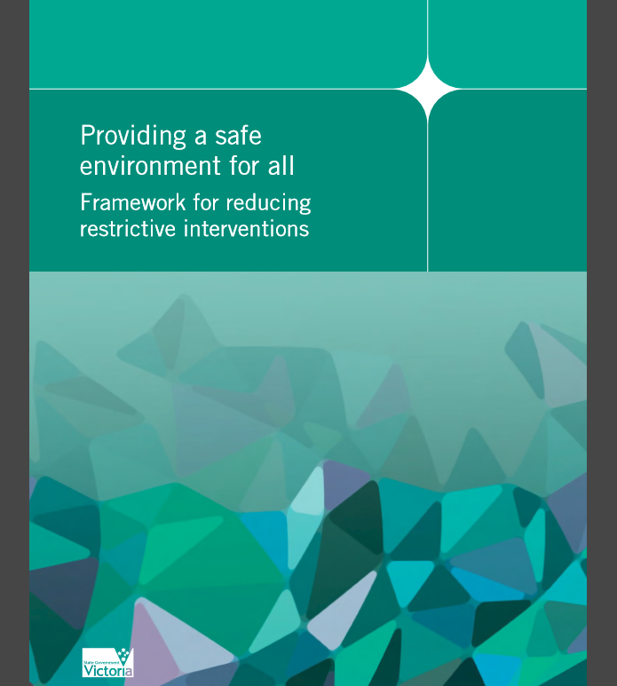
Victorian Safewards trial
Victoria’s new Mental Health Act 2014
Providing a safe environment for all: Framework for reducing restrictive practices (2013)
Initiatives to reduce restrictive practices
Objectives
Trial and evaluate the Safewards model in Victorian mental health services using a partnership approach
Develop recommendations and resources to adapt Safewards to fit the Victorian context and support broader implementation across the state
Notes:
Provide some context for the roll out of Safewards and how it fits in with the MHA and Framework for Reducing Restrictive Interventions.
This link might be helpful https://www2.health.vic.gov.au/mental-health/practice-and-service-quality/safety/reducing-restrictive-interventions

Slide 4
Services from the Victorian trial
Health service | Adult inpatient | Youth acute inpatient | Child & adolescent inpatient | Aged inpatient | Residential aged care | Secure extended care unit
Albury Wodonga Health | 1
Alfred Health | 2
Bendigo Health Care Group | 1 |  |  | 1 |  | 1
Latrobe Regional Hospital | 1 |  |  |  |  | 1
Melbourne Health | 3 | 1
Mercy Health | 1
Monash Health | 1 | 1 | 1 | 1 | 1
Total | 10 | 2 | 1 | 2 | 1 | 2

Slide 5
Task: Reviewing the Safewards model
What does the term conflict mean?
What does containment mean?
What are the six originating domains of the model?
Can you describe what a flashpoint is?
What might a staff modifier be?
What might be a patient modifier be?
Notes:
Ask the group to answer each of these questions
Answers
Conflict: anything that can cause harm to patients, other patients or staff and visitors i.e. verbal aggression, physical aggression, property damage
Containment: actions that staff take to minimise the impact of conflict or stop it from happening i.e. restraint, seclusion, specialling
Domains: Staff team, patient community, patient characteristics, physical environment, outside hospital, regulatory framework
Flashpoint: A trigger that can precede conflict behaviour i.e. bad news, denial of request
Staff modifier: what staff can do to influence the situation i.e. offer psychological support
Patient modifier: what patients can do to prevent a flashpoint or self-regulate when a flashpoint occurs i.e. awareness of triggers

Slide 6
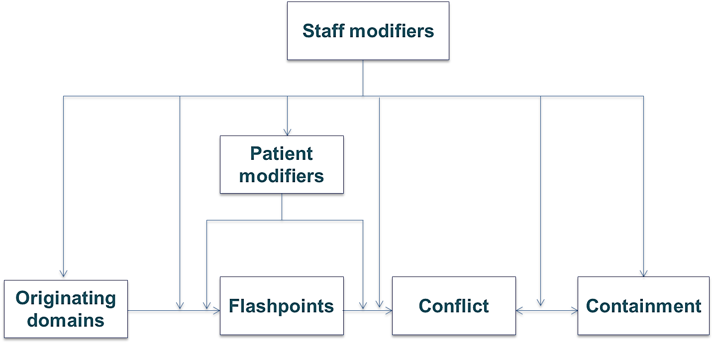
Revision: Summary Slide
Originating Domains
Staff Team
Patient Characteristics
Patient Community
Physical Environment
Outside Hospital
Regulatory Framework
Flashpoints
(triggers or tipping points)
Limit setting
Exacerbation
Noise
Locked doors
Loss of relationship
Denial of leave
Bad news
Conflict
(situations with risk of harm)
Verbal aggression
Suicide
Physical aggression
Property damage
Self Harm
Absconding
Containment
(restrictive interventions)
Seclusion
Physical restraint
Mechanical restraint
Chemical restraint
Use of security
Special observation
High dependency unit

Slide 7
Task: Selling the model and benefits
Prepare a two-minute presentation to sell the value and benefits of Safewards to a person or group.
Different audiences:
Consumer Advisory Group
CEO at your service
Psychiatrists at your service
Colleagues
Notes:
These are just some suggestions. Use people or groups who will be relevant to your participants. You may like to change one of the groups to nurses.
It might help to paste in the photos under the title. Assign each group a key person or group to sell the model to.
Ask people to prepare a presentation-allow around 15 minutes for this in groups. Then each group takes turn to present back selling the Safewards model. The workshop facilitators can act as the key person the group is selling the message to. Allow for around 3 minutes per group to present back to everyone.

Slide 8
Task: Selling the Safewards model
Audiences
1. Consumer Advisory Group
The consumer advisory group at your service have noticed changes on the unit and are wondering what Safewards is all about and how it will affect consumers. You have been chosen to present to the group.
2. CEO
The CEO has heard about Safewards from others outside the service but is interested to know more from an independent source. He is wondering if it has a place in your service. You have been chosen to present to the CEO.
Notes:
Here are some examples that can be used

Slide 9
Task: Selling the Safewards model
Audiences
3. Psychiatrists at your service
It has been bought to the attention of the psychiatrists at your service that a group of nurses are introducing an initiative called Safewards. They know very little about Safewards. You have been chosen to present to the lead psychiatrists.
4. Colleagues
You are a Safewards ‘champion’ and have been approached by a colleague who is expressing negative themes about implementing Safewards. You are a positive role model and would like to discuss the benefits of the model with this person.

Slide 10
Know Each Other - revision
What do you envision will work best for implementing KEO on your unit?
If this intervention has already been implemented, please share what method was most successful?
What challenges need to be overcome for the implementation?
Biggest success?
Notes:
Review of KEO-how has this been working in practice? Ask the participants what has been their biggest success so far.
If you used different interventions in your first workshop-you can choose from the refresher intervention modules.

Slide 11
Clear Mutual Expectations - revision
Explain how you would orientate someone to the CME poster on your unit?
If this intervention has already been implemented, please share what method is used to describe CME to someone on your unit?
What challenges need to be overcome for the implementation?

Slide 12
Positive Words - revision
What do you envision will work best for implementing Positive Words on your unit?
If this intervention has already been implemented, please share how you review the effectiveness of this intervention on your unit?
What challenges need to be overcome for the implementation?
Biggest success?

Slide 13
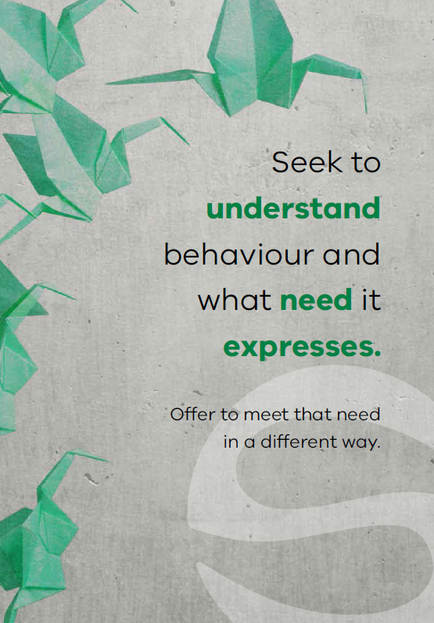
Soft words
Notes:
Briefly describe Soft Words (SW)

Slide 14
“Violence by patients in psychiatric settings is frequently associated with the quality of staff-patient interactions”
(Lancee, Gallop, McCay & Toner, 1995, p.609)
Notes:
Ask the group what they think about this statement and discuss the responses
This quote is taken from the article: Lancee, W. J., Gallop, R., McCay, E., & Toner, B. (1995). The relationship between nurses’ limit-setting styles and anger in psychiatric inpatients. Psychiatric Services, 46(6), 609-613.

Slide 15
Background and aims
Background
A primary flashpoint leading to violent incidents is limit setting. Whenever nurses ask patients to do something (or stop them from doing something), this can give rise to understandable frustration.
This intervention provides some ways to avoid confrontations and work more collaboratively with patients.
Aims
Expand staff skills and choices in relation to limit setting and flashpoint situations
Increase the options available on the unit
Notes:
http://www.safewards.net/interventions/soft-words

Slide 16
Soft words & the Safewards model
Staff modifiers
Staff modifier: Using soft words
Patient modifiers
Flashpoint: Setting limits
Originating domains
Flashpoints
Conflict
Containment

Slide 17
Why do we set limits?
Psychological understanding
Own anxiety & frustration
Perception of risk
Understanding of local policy
Staff
modifiers
Staff modifiers
Patient modifiers
Regulatory framework: Perceived requirements
Flashpoint: Setting limits
Patient characteristics: Perceived needs
Flashpoints
Conflict
Containment
Originating domains

Slide 18
Soft words: Why it matters (example 1)
‘I don’t deserve anything’ (shame)
Staff modifiers
‘You took my choice away’
‘You agree that I don’t deserve anything’
Flashpoint (Increased shame)
Patient modifier: Psychological understanding
Patient modifiers
Patient characteristics
Trauma / abuse
Low self-esteem
Flashpoint: Setting limits
Flashpoints
Conflict
Containment
Originating domains
Conflict:
Self-harm

Slide 19
Soft words: Why it matters (example 2)
‘I’ve never had any choice’ (fear)
Staff modifiers
‘You took my choice away’
‘With less control I now feel even more unsafe’
Flashpoint (Increased fear)
Patient modifier: Psychological understanding
Patient modifiers
Patient characteristics
Trauma / abuse
Disadvantage
Feeling unsafe / anxiety
Conflict: Fight or flee (aggression or abscond)
Flashpoints
Originating domains
Flashpoint: Setting limits
Conflict
Containment

Slide 20
Soft words: Why it matters (example 3)
‘I’ve always had choice’
Staff modifiers
‘You took my choice away’
‘This is not fair!’
Flashpoint (Anger)
Patient modifier: Psychological understanding
Patient modifiers
Patient characteristics
Strong sense of justice & fairness
Confidence
Flashpoints
Flashpoint: Setting limits
Conflict
Containment
Originating domains
Conflict: Aggression

Slide 21
Soft words in practice
Staff modifier: Using soft words
Staff modifiers
Patient modifiers
Flashpoints
Originating domains
Setting limits?
Conflict
Containment

Slide 22
Soft words in practice
What domains do you need to respond to?
Staff modifier: Using soft words
Staff modifiers
Patient modifiers
Physical environment: Privacy & dignity?
Regulatory: Upholding rights?
Flashpoints
Originating domains
Setting limits?
Conflict
Containment
Patient characteristics: Offer support and interventions?

Slide 23
Soft words in practice
What domains do you need to respond to?
Do you really need to set the limit? Try to say ‘yes’ instead.
Staff modifier: Using soft words
Staff modifiers
Patient modifiers
Physical environment: Privacy & dignity?
Regulatory: Upholding rights?
Flashpoints
Originating domains
Setting limits?
Conflict
Containment
Patient characteristics: Offer support and interventions?

Slide 24
Soft words in practice
What domains do you need to respond to?
Do you really need to set the limit? Try to say ‘yes’ instead.
Staff modifier: Using soft words
Can you minimise the limit, offer choices, negotiate?
How can you be as respectful as possible?
Staff modifiers
Patient modifiers
Physical environment: Privacy & dignity?
Regulatory: Upholding rights?
Flashpoints
Originating domains
Setting limits?
Conflict
Containment
Patient characteristics: Offer support and interventions?

Slide 25
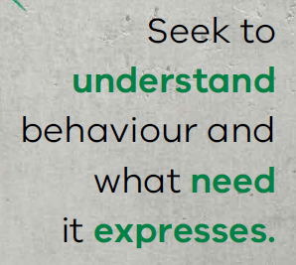
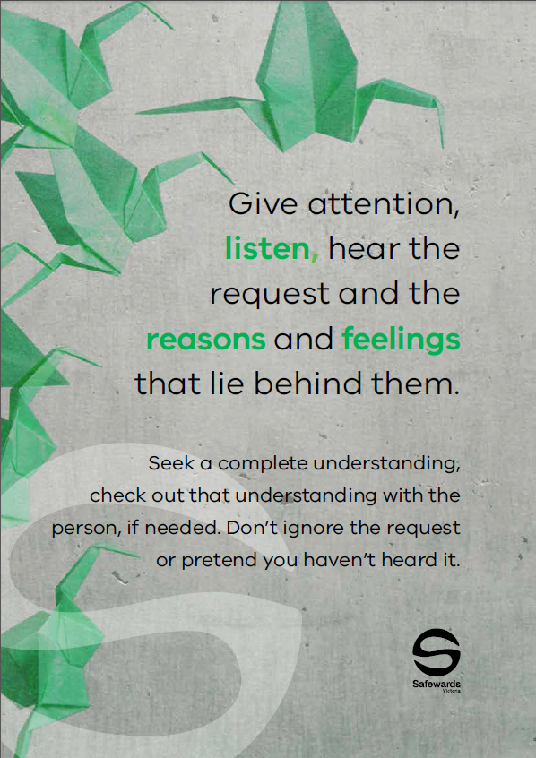
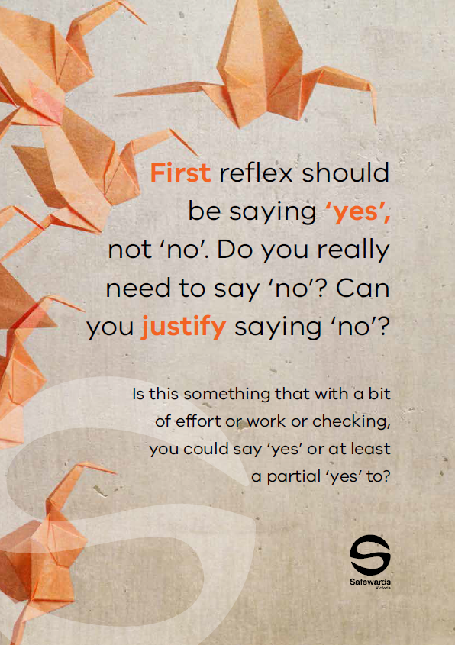
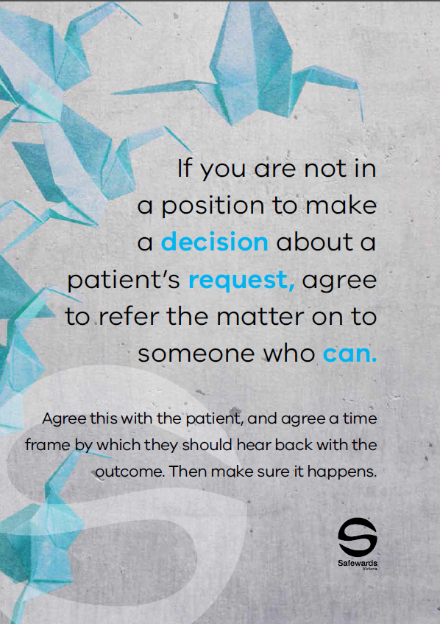
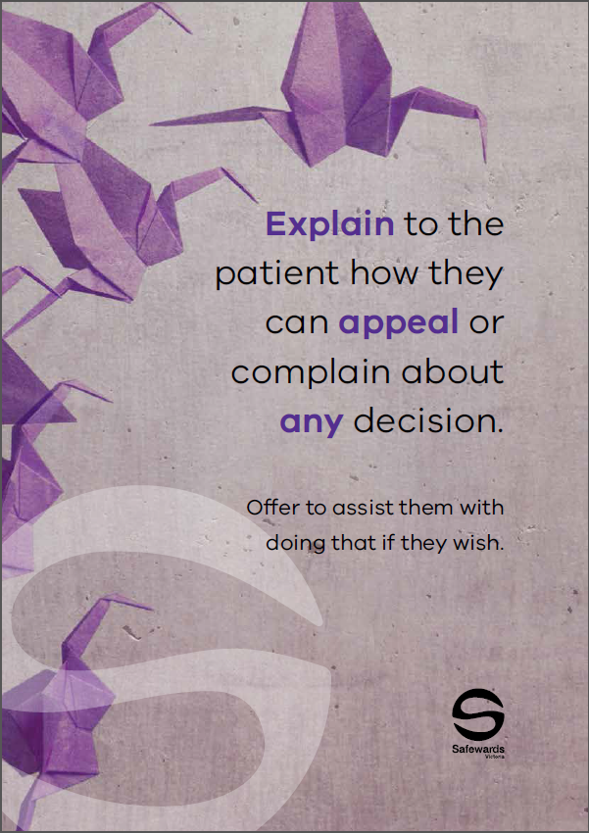
Soft words in practice
This intervention helps to avoid confrontation and improve collaboration with patients – by reducing limit setting, or changing how limits are set.
Soft words are communicated to the
team using a ‘Message of the Day’
poster displaying soft words tips,
placed in the unit office and regularly
changed and discussed.
Notes:
See the Safewards internet for examples http://www.safewards.net/interventions/soft-words
Soft words video may be useful here – shows soft words in practice – turning down a request from a patient

Slide 26
Task: Identifying themes
Read through the poster examples and determine:
How you might use the poster in practice
Which theme/s each of your posters refers to (see below)
Themes
Being respectful and polite
Turning down a request from a patient
Asking a patient to do something
Asking a patient to stop doing something
Notes:
Refer to the soft words ‘messages of the day’ in the resource pack.
Break the participants into 4 groups and provide with the posters from one of the 4 themes listed on the slide.
Each group is assigned a theme, ask them to read through each of the poster examples and identify which theme their posters are and how they would use the resource in practice.
The aim would be to both use them as a training resource with colleagues i.e. talking through the purpose of the poster and also role modeling how to interact with consumers using these principles.

Slide 27
Role of the intervention lead
Remind team about soft words
Change the soft words poster every day
Draw attention to the poster
Encourage others to consider limit setting and Soft Words in different situations
In reflective practice and supervision
During review of policy and procedures
In handover or debriefing following incidents related to limit setting
Who might be the most suitable lead?
Notes:
http://www.safewards.net/interventions/soft-words

Slide 28
Soft words fidelity
Increasing staff options to prevent, or reduce the impact of, flashpoints related to limit-setting
A means of reminding staff to use the best style of communication in difficult conversations
A means of reminding staff to rethink limits and to promote patient choice (recovery-oriented)
Soft words
IS
=
Hanging up signs
A soft option as the standard of communication described is high. Expect to be challenged.
Soft words
IS NOT
≠
Notes:
Taken from a PowerPoint from a presentation by Professor Len Bowers

Slide 29
Soft words methods adjustments
CAMHS none
Forensic none
Older people none, but may want to create expanded version with greater relevancy
Notes:
Taken from a PowerPoint from a presentation by Professor Len Bowers

Slide 30
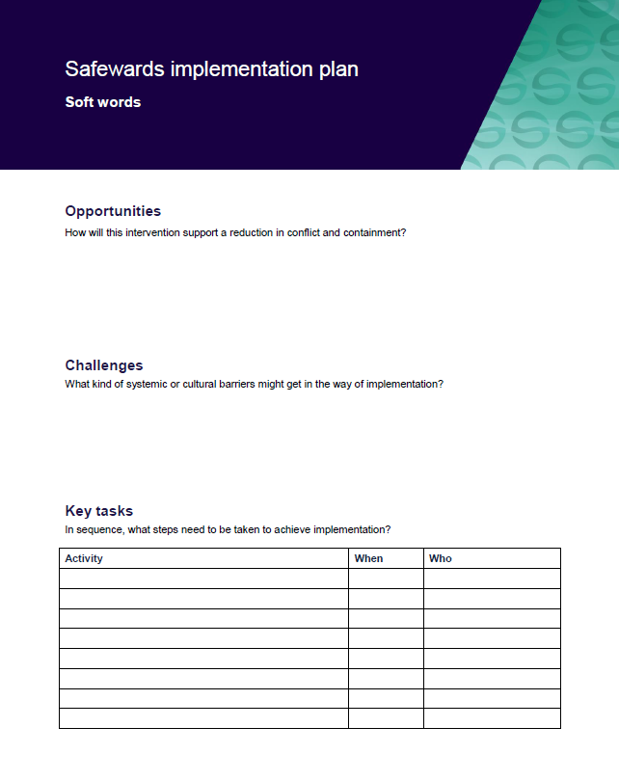
Task: Create your implementation plans
In groups, spend time working on your implementation plans
Notes:
If you have enough participants split them into 10 groups and ask them to spend 15 minutes working on one of the implementation plans.

Slide 31
Reassurance
Notes:
Provide a brief overview of Reassurance
http://www.safewards.net/interventions/reassurance

Slide 32
Reassurance background
Already scared & vulnerable
Psychiatric units can be strange and scary places.
Every confrontation has the potential to be a flashpoint for another patient, creating a kind of ripple effect.
Unlike staff, patients are not free to leave the unit or get away to a safe place.
Witness a confrontation
Fight, flight or freeze
Increased, unbearable fear
Patients don’t have to be directly involved in a confrontation for it to have a distressing emotional impact.
Staff can help alleviate fear and other types of distressing emotions.

Slide 33
Reassurance aims
To proactively reassure every patient after every confrontation, incident or conflict on the unit
To reduce the potential ripple effect of conflict on the unit
To prevent or reduce the impact of flashpoints
To ensure patients feel safe and supported
Reassurance for patients is a bit like debriefing for staff

Slide 34
Reassurance and the Safewards model
Staff modifiers
Patient modifiers
Flashpoint: Confrontation on the unit
Originating domains
Flashpoints
Conflict
Containment

Slide 35
Reassurance and the Safewards model
Staff modifier: Provide reassurance
Staff modifiers
Patient modifiers: Know particular triggers for each person
Patient modifiers
Originating domains: Understand how domains increase the emotional impact of conflict
Flashpoint: Confrontation on the unit
Originating domains
Flashpoints
Conflict
Containment

Slide 36
Reassurance and Originating Domains
Which originating domains contribute to psychiatric units feeling like strange and scary places?
Admission to hospital can result in feelings of anxiety/fear, shame, sadness/despair and/or anger. Admission might trigger past memories of trauma.
Many patients are affected by stereotypes, stigma and the media, or expectations of loved ones, or financial, social or work obligations
Staff and the hospital environment may be perceived as strange or frightening. Some patients have been hurt during past admissions.
Losing choice and freedom in a way that has never happened before
A person may be sure that they pose no threat to others - but may not be sure about the threat others may pose to them.
Notes:
Ask learners to identify which domain/s are relevant to each dot point

Slide 37
What other common occurrences on a mental health unit might increase patient fear?

Slide 38
Task: Walk in someone else’s shoes
Step forward…
Would you be approved for a bank loan easily?
Would you be asked to babysit a child?
Would you be asked to be a referee for a friend?
Would you be approved for life or health insurance?
Would you have no difficulty finding rental accommodation?
Would you be shortlisted for a job from your CV?
Would you feel support from friends, family and the community?
Are you well respected by the general public?
Does the media portray you in a positive way?
People wouldn’t consider you to be dangerous or unpredictable?
Would people consider you to be reliable?
Would people consider you to be trustworthy?
Notes:
See Appendix in the Handbook: Activity templates “walking in someone else’s shoes”
Laminate each of the examples (according to the number you have in the workshop) and have them cut to size before the training. Hand out a card to each of the participants (ensuring that at least one person gets a card which states they have a mental illness) and ask people to not reveal to each other what is on their card.
Ask everyone to gather at one end of the room.
Ask participants to take a step forward if they can answer yes to the question.
Read the questions out one by one.

Slide 39
Task: Walk in someone else’s shoes (continued)
For those who have only moved a few steps, consider the following:
How would feel at a dinner party if people identified you as this person?
Would people think that you use drugs or alcohol?
How would you be affected by public opinion and media reporting?
Would people use derogatory terms about you?
Would people think that you might be unpredictable even though they don’t know you?
Do people fear you even though they don’t know you?
Notes:
Continue reading all of the questions one by one. Once you have read all of the questions ask the people who have not moved forward far to reveal what is on their card.
Discuss how they felt, and how the others who moved forward felt. Here you can discuss the impact of stigma/shame/fear/sadness.
Discuss how this activity aimed to reinforce the powerful impact of stigma (an outside hospital originating domain) on how people might react to stressful situations.

Slide 40
Task discussion
This activity was a chance to think more deeply about stigma as an ‘outside hospital’ originating domain.
How could stigma impact patients’ emotions during an admission?
Why do you think we included this activity in the reassurance intervention?

Slide 41
Reassurance in practice Common situations requiring reassurance
Loud shouting/property damage/aggression: May provoke fear that could lead to defensive aggression, absconding, withdrawal and disengagement, suicidality
Self-harm - May provoke similar acts, can be distressing, provoke anger, shame or fear of one’s own internal impulses
Intoxication – May provoke fear about unpredictable behavior and personal safety
Show of staff force – (such as transferring a patient to high dependency area) Can undermine patient confidence in staff, make people feel vulnerable or bullied, provoke anger, fear or other distressing emotions, may trigger re-traumatization / flashbacks, panic, self-harm, suicidality
Notes:
Discuss some of the potentially anxiety provoking events listed here - ask the participants to give some examples from their ward.
http://www.safewards.net/interventions/reassurance

Slide 42
Reassurance in practice Explanation to patient and others
You do not have to be indiscreet or break confidentiality
You can draw upon psychological explanations for patient and staff actions, and use generalities.
For example:
“Sometimes when people are very unwell they may be frightened and confused – this might trigger aggression and we may need to intervene to keep everyone safe. This can look scary, but we are very careful to never hurt someone, and to try and protect people’s dignity”
Notes:
http://www.safewards.net/interventions/reassurance
Important to emphasize here that this intervention can be done without breaking confidentiality.

Slide 43
Reassurance in practice: Empathy is a critical staff skill
Brené Brown on Empathy (Youtube video)
https://youtube/1Evwgu369Jw

Slide 44
Reassurance in practice: Empathy is a critical staff skill
Empathy fuels connection, sympathy drives disconnection.
Key qualities of empathy:
Perspective taking
Staying out of judgement
Recognising emotion in other people
Communicating that
Empathy is feeling ‘with’ people.
Empathy can make us feel vulnerable because it means having to connect with something in yourself that knows that feeling.
Empathy means not trying to make things better.
Responses rarely make something better.
Connection with others can help people feel better
Brené Brown on Empathy (Youtube video)
https://youtube/1Evwgu369Jw

Slide 45
Intervention strategies
Intervention lead
Consider speaking to the nurse in charge of the shift (or as a group, such as at staff meetings) and request a method is identified for ensuring the following two points are identified:
Ensure reassurance action takes place following any incident.
When an incident is mentioned at handover, ask if 'reassurance' took place.
Notes:
The more time you spend with patients in a caring and meaningful way can reduce fear and anxiety

Slide 46
Intervention strategies
Intervention lead
After an event
Following a potential anxiety-provoking incident:
Speak with every patient, alone or in small groups, and ask them:
What is your understanding of what happened?
What affect did it have on you?
Provide an explanation of what happened
Consider how this is documented in relevant patient files

Slide 47
Intervention strategies
Be visible on the unit
Move about a lot and make sure you cover the whole unit
Be watchful (not in an anxious way) in a warm and caring manner
The goal of staff presence, explanation and support is to ensure everyone feels safe and secure
Notes:
The more time you spend with patients in a caring and meaningful way can reduce fear and anxiety

Slide 48
Reassurance fidelity
Heightening staff awareness of events that can make patients feel fear or other distressing emotions, and taking action so that doesn’t happen
A basic standard of consideration for people who have witnessed distressing events
Reassurance
IS
=
Telling patients things will be fine when they come to the office door and express a worry
Gossiping about other patients who may exhibit challenging behaviour
Reassurance
IS NOT
≠
Notes:
Taken from a PowerPoint from a presentation by Professor Len Bowers

Slide 49
Reassurance adjustments
CAMHS Simplify explanations and lower expectations of understanding
Forensic None
Older people None where message can be understood and retained
Notes:
Taken from a PowerPoint from a presentation by Professor Len Bowers

Slide 50
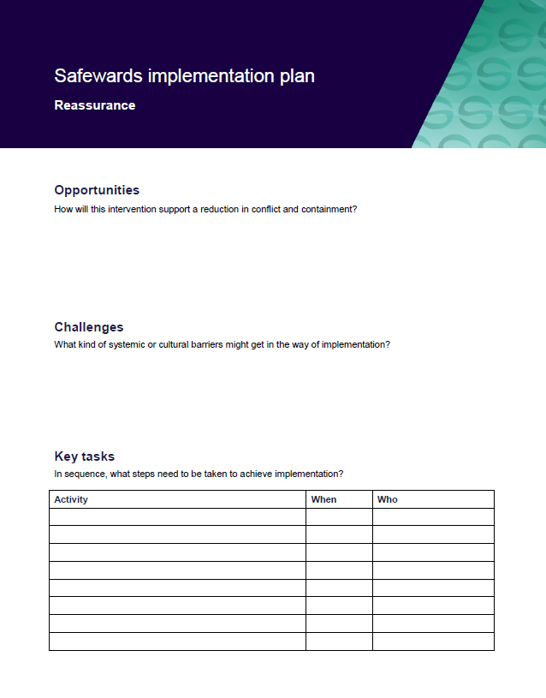
Task: Create your Reassurance implementation plans
In groups, spend time working on your implementation plans

Slide 51
Bad News Mitigation
Notes:
Explain bad news mitigation (BNM) briefly
It might be helpful to give an example when you have received bad news and how this felt for you (if you feel comfortable)

Slide 52
Background
People can be affected greatly by unwelcome news, and may want to leave the unit to seek familiar support or escape the cause of the news. Being given no choice to leave the unit when distressed, people may express feelings in an unsafe way.
Bad news from outside hospital can also cause conflict. Examples can include: death in the family, relationship breakdown, loss of tenancy, burglary, illness in the family, childcare issues, financial issues.
The resulting distress can cause increased irritability, aggression, violent incidents and absconding
Notes:
http://www.safewards.net/interventions/bad-news-mitigation

Slide 53
Bad news mitigation
Receiving bad news can be common during an inpatient stay. This intervention is about providing support during the delivery of news or afterwards, to mitigate the risk of flashpoints.
Key messages:
Bad news can create confusion and hinder understanding. Be respectful of a person’s views.
Being aware of occasions when people might get upsetting news.
Identify a proactive way to reach out to people before there is a reactive need to.

Slide 54
Bad news mitigation and the Safewards Model
Staff modifier: Mitigate bad news
Staff modifiers
Patient modifiers
Originating domains
Outside hospital
Regulatory framework
Flashpoint: receiving bad news
Originating domains
Flashpoints
Conflict
Containment

Slide 55
Task: Bad news scenarios
What have you found helpful when working with people who have received bad news?
What has not been helpful? Why?
Notes:
This task can be done as a large group or smaller groups/pairs. Allow about 5 minutes for this task. Ask for a few examples from the group.

Slide 56
Bad News Mitigation in practice
Handover
Before news is delivered
After news is received
Ongoing support
Notes:
http://www.safewards.net/interventions/bad-news-mitigation
It is important to highlight that what is considered bad news can vary significantly from person to person therefore it is important to enquire, know the person well and look out for possible signs of distress.
Be aware of occasions and events that might trigger angry or upset reactions.
At handover, discuss as a team and share knowledge to predict who might receive unwelcome news and how support will be offered.
Work with the multidisciplinary team (MDT) to express bad news empathically or intercept after it has happened.
Maintain awareness of what is going on through regular one-on-one contact with the patient.
Know everyone’s general demeanor
Safewards bad news mitigation video helpful here – shows identification of bad news and planning

Slide 57
Bad News Mitigation in practice
Approach
Find a quiet place, give the person time to express their feelings.
Acknowledge their feelings, express empathy.
Answer any questions honestly, giving time, attention and respect.
Show you are receptive to concerns - use listening techniques.
Be responsive and respectful of a person’s views.
Support the person to understand decisions and acknowledge feelings. This can improve relationships and make aggression, self-harm and absconding less likely.
Notes:
Ask for e.g. open-ended questions
Talking over a cup of tea
http://www.safewards.net/interventions/bad-news-mitigation

Slide 58
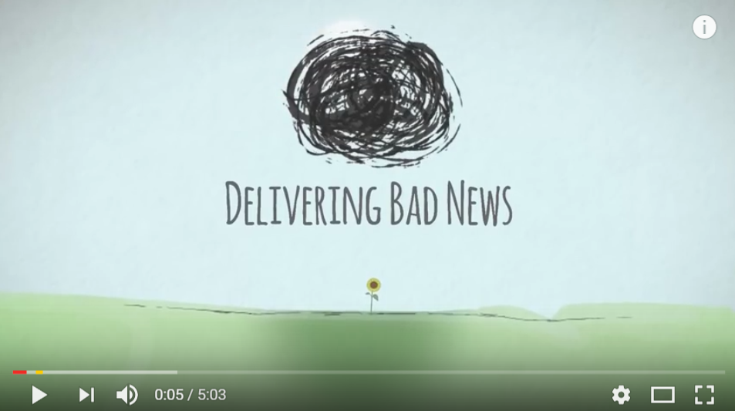
Delivering Bad News Video
https://www.youtube.com/watch?v=juKAMBh9J54
Source: The Irish Hospice Foundation, Youtube

Slide 59
Role of the intervention lead
Make sure these two questions are considered by the team at handover:
Has anyone received any bad news over the past shift? If they have, how can we support them?
Is anyone likely to receive bad news during the coming shift, and if so, how are we going to manage that?
Notes:
http://www.safewards.net/interventions/bad-news-mitigation
You may want to ask the group how they could ensure this process occurs, what measures will they put in place?

Slide 60
Bad news mitigation fidelity
A proactive way to reach out to people before there is a reactive need to
Keeping staff aware and looking for occasions when people might get upsetting news and delivering emotional support quickly
Giving patients enough information so they can determine whether it’s bad news or not
Bad news mitigation
IS
=
A way of protecting patients from life or threatening them with consequences or assuming how they will feel
Attaching the phrase ‘I am sorry to let you know’ when we tell patients they cannot have something they desperately want
Bad news mitigation
IS NOT
≠
Notes:
Taken from a PowerPoint from a presentation by Professor Len Bowers

Slide 61
Bad news mitigation adjustments
CAMHS None, but understanding for meaning and relevance to age group
Forensic None
Older people None, but understanding for meaning and relevance to age group
Notes:
Taken from a PowerPoint from a presentation by Professor Len Bowers

Slide 62
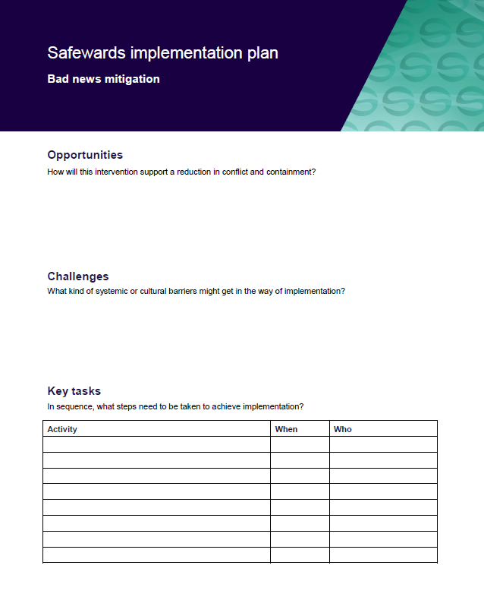
Task: Create your bad news mitigation implementation plan
In groups, spend time working on your implementation plans
Notes:
See appendix for template

Slide 63
Mutual Help Meeting
Notes:
Briefly explain the essence of the mutual help meeting (MHM)

Slide 64
Background
The unit is a social community and potentially a powerful engine to help patients, have a positive influence, and progress towards discharge.
The help that patients give each other can be highly valued and effective.
The giving of help and support between patients offers the giver:
a socially valued role
the chance to make a meaningful contribution
the potential to improve their self-esteem
Notes:
http://www.safewards.net/interventions/mutual-help-meeting

Slide 65
Aims
Strengthen an existing mechanism that is highly valued by patients and staff
Create opportunities for patients to find valued roles and public recognition
Build patient self-esteem
Increase mutual support and promote recovery
Establish values, understanding and social connection
Notes:
http://www.safewards.net/interventions/mutual-help-meeting

Slide 66
Mutual Help Meeting and the Safewards Model
Staff modifier: Mutual help meeting
Staff modifiers
Patient modifier
Mutual support
Patient modifiers
Originating domains
Patient community
Patient characteristics
Originating domains
Flashpoints
Conflict
Containment

Slide 67
Task: Invaluable mutual support
Think of an example where patient-to-patient mutual support has been invaluable on your unit…
Notes:
Ask the participants for some examples they have seen in practice
The Safewards mutual help meeting video may be useful hear to provide a consumer perspective

Slide 68
Conflict
Inpatient aggression can arise from many different factors. This intervention focuses on preventing conflict that may arise from patient-to-patient interactions, or from being in a strange and/or frightening environment.
Conflict can be reduced if patients:
Positively appreciate each other
Practice/learn ways regulate their own emotional reactions
Support each other to uphold shared expectations
Feel heard and valued
Have access to mutual support
Notes:
http://www.safewards.net/interventions/mutual-help-meeting

Slide 69
Mutual Help Meeting
A voluntary meeting of all patients and staff on duty
The meeting’s focus is on how people can help each other
Notes:
http://www.safewards.net/interventions/mutual-help-meeting

Slide 70
Agenda
Ensure each agenda item is covered during the meeting
Round of thanks: All patients and staff can individually thank anyone or anything, present or not present, for anything they have done for them since the last meeting. Everyone is free to comment.
Round of news: Staff can inform patients about upcoming events on the unit, or explain recent events on the unit that might be confusing or distressing. Ask everyone to watch over each other, keep each other safe, and call for help if they are worried.
Round of suggestions: Everyone has a chance to offer suggestions.
Round of requests and offers: Patients discuss how others in the unit can help them, and make offers of support to each other.
Notes:
Here are some examples of offers and request you may wish to add (fromhttp://www.safewards.net/images/pdf/Mutual%20Help%20Meeting%20website%20download.pdf)
Share knowledge and experience about care and services
Support each other in practical tasks
Encourage each other to take part in structured activities
Accompany each other on walks or activates
Play games such as cards or table tennis
Discuss current affairs
Spend time with people
Share coping strategies, such as relaxation techniques
Make a drink for someone else
Sit next to someone at meal times
Say good morning
Ask how someone else is feeling
Listen to music or watch TV with someone and talk about it afterwards

Slide 71
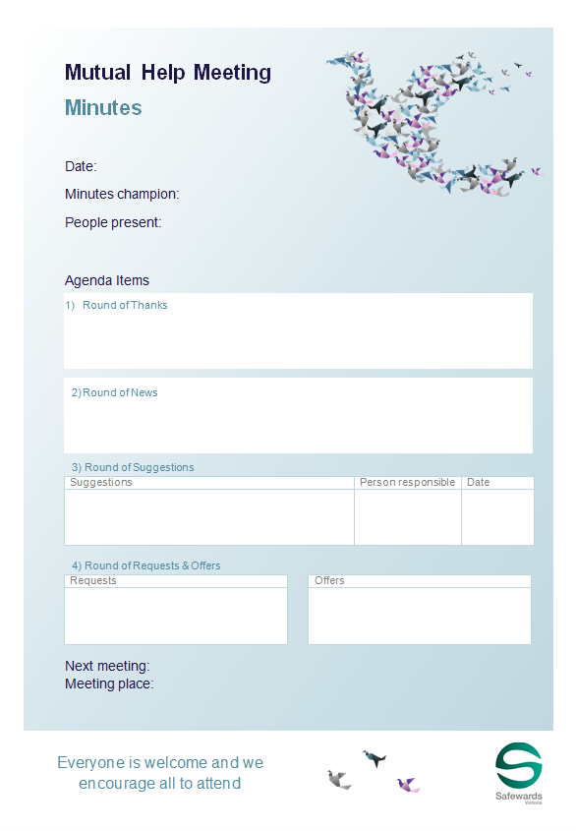
Staff roles
Prepare for the group
Room
Support people
Resources (agenda, flyer, poster, minutes, news)
Ideally first thing in the morning
Preferably every day (at least 3/week)
Protected space/time
Follows a structured agenda
Once all the points are covered the meeting is closed
Chaired by patients or staff
Consider a log book
Notes:
http://www.safewards.net/interventions/mutual-help-meeting
Provide examples of how to prepare for the group
Prepare the room.
Gather patients and staff.
Prepare contributions and offer support in advance.
Acknowledge and support a complaint following your local processes. This isn’t the forum for complaints.

Slide 72
Staff roles
Maintaining the meeting
Encourage good contributions through positive feedback.
Model mutual respect.
Enable everyone to contribute.
Seek information and opinions and provide information.
Clarify and summarise for others.
Suggest compromises and settlements.
Offer advice on expression of mutual respect and positive appreciation
Accurately describe any recent potentially distressing events on the unit (reassurance).
Notes:
http://www.safewards.net/interventions/mutual-help-meeting
Provide examples of how to prepare for the group
Prepare the room.
Gather patients and staff.
Prepare contributions and offer support in advance.
Acknowledge and support a complaint following your local processes. This isn’t the forum for complaints.

Slide 73
What to expect
Attendance will grow if the meeting is held regularly and is talked about.
Even with only a few people the meeting can be productive.
Attendees can consider how they can help others who aren't attending.
Small things can be important to people.
Notes:
http://www.safewards.net/interventions/mutual-help-meeting

Slide 74
Mutual Help Meeting fidelity
Mutual help meeting
IS
Getting patients together to agree on small things they can do to help and support each other, and valuing those activities once completed
In terms of patient care – a chance for staff to take a step back and patients a step forward
=
A forum for complaints and suggestions from patients about what the staff or hospital should do or for staff to give news to patients
Another group in the unit where staff have a debrief while patients go back to bed
Mutual help meeting
IS NOT
≠
Notes:
Taken from a PowerPoint from a presentation by Professor Len Bowers

Slide 75
Mutual help meeting adjustments
CAMHS Constraints and guidance on allowable tasks, new list of suggestions worked out with young people, new patient documentation
Forensic Constraints and guidance, limitations and rules about those, new patient support documentation
Older people May still be creatively feasible
Notes:
Taken from a PowerPoint from a presentation by Professor Len Bowers

Slide 76
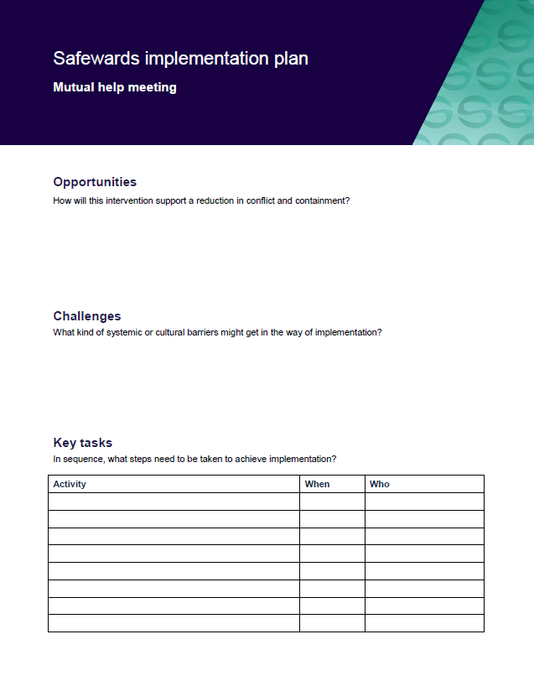
Task: Create your mutual help meeting implementation plan
Notes:
See appendix for implementation plan

Slide 77
Wrap Up
Today we have revised workshop one and covered another four interventions
How can we move forward from today?
The 3rd day of training will include some revision from today’s workshop and cover the remaining three interventions

