Slide 1
Safewards Train the Trainer Workshop Day 3

Slide 2
Day 1
Introducing the model and interventions
Day 2
Day 3
Theory
Understanding the Safewards model
Theory
Revision of the Safewards model
Theory
Revision of the Safewards model
Interventions
1. Know each other
2. Clear mutual expectations
3. Positive words
Interventions
4. Soft words
5. Bad news mitigation
6. Reassurance
7.Mutual help meeting
Interventions
8. Calm down methods
9. Talk down
10. Discharge messages

Slide 3
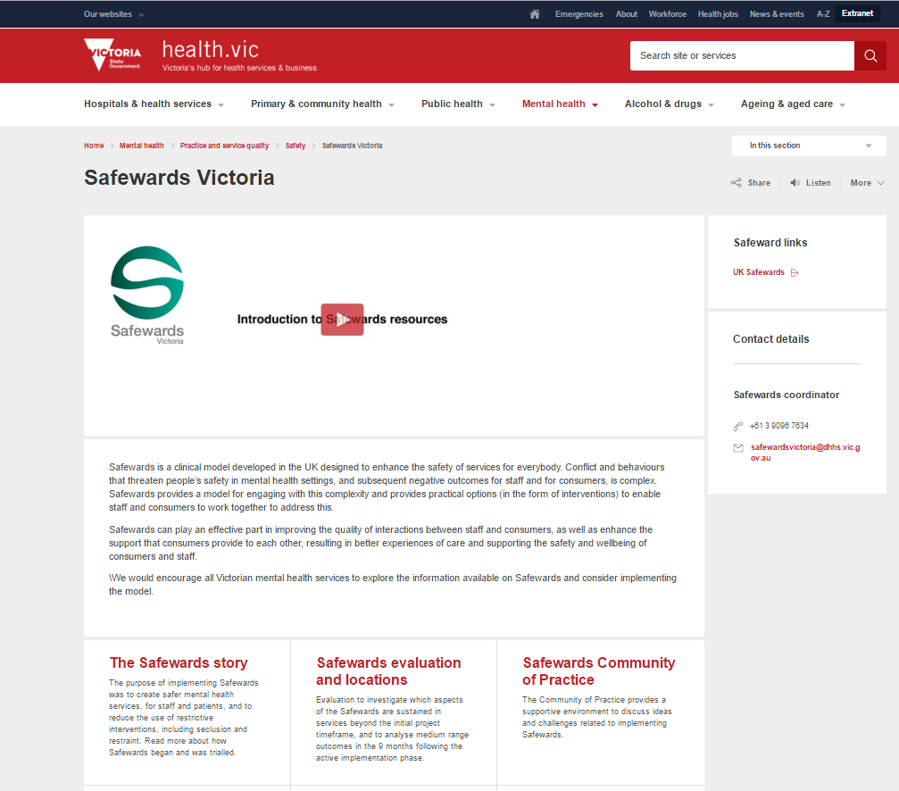
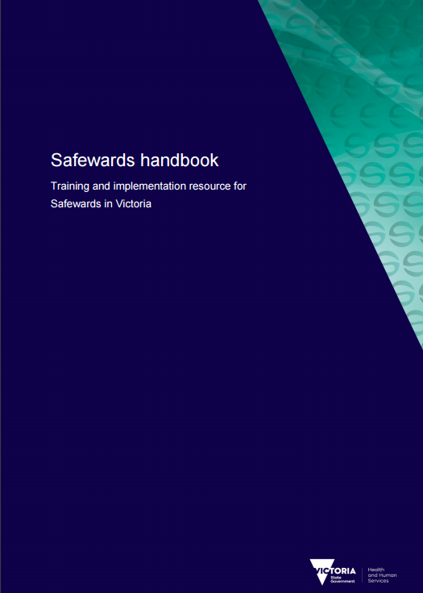
Training Resources
Handouts for all trainees
Presentation slides
Trainer Manual for training lead/s
Handbook
Presentation slides
Session plan
Implementation plan
Supporting documents
Training & implementation resources
Website www.health.vic.gov.au/safewards

Slide 4
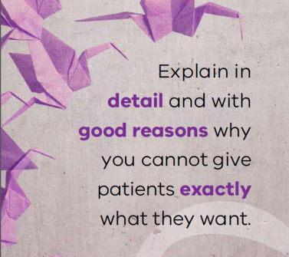
Intervention Refreshers
Notes:
Split the participants into 4 groups:
Reassurance
Mutual help meeting
Bad news mitigation
Soft words
Ask each group to spend 10 minutes discussing and preparing to present on their assigned intervention to a small group of clinicians. Give a time limit of 5 minutes to present to the group.
The purpose of this activity is to check that trainers have understood the background and aim for each intervention from the previous workshop, as well as practice having to train clinician.

Slide 5
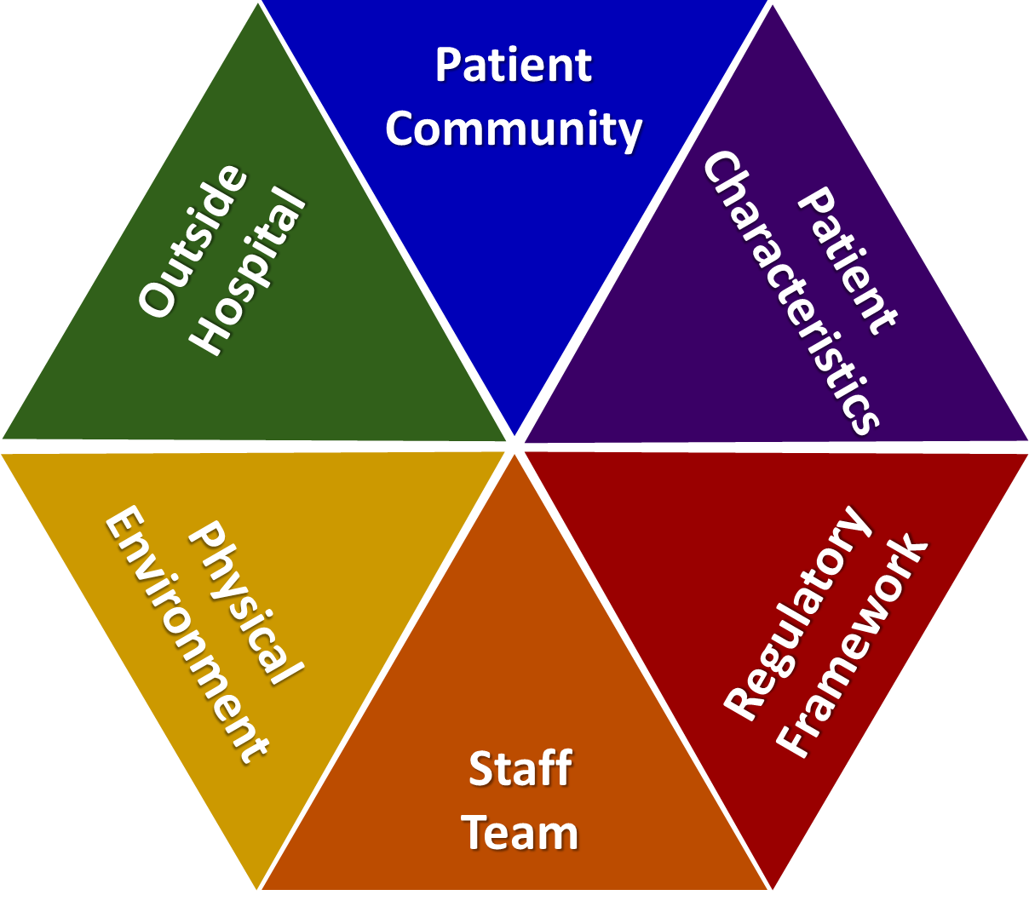
Task: Pin the intervention on the Safewards model
MHM
SW
KEO
BNM
PW
CME
R
Notes:
Print out the Safewards model as large as you can.
Give participants an intervention and ask them to identify where the interventions best sit in the model.
Facilitate a discussion about how each intervention fits in to the model.

Slide 6
Feedback from Consumers and Carers
What mechanisms do you have for collecting feedback?
How will you know what impact Safewards is having?
The Safewards Victoria evaluation will look at how consumers feel about Safewards by inviting them to take part in surveys and focus groups

Slide 7
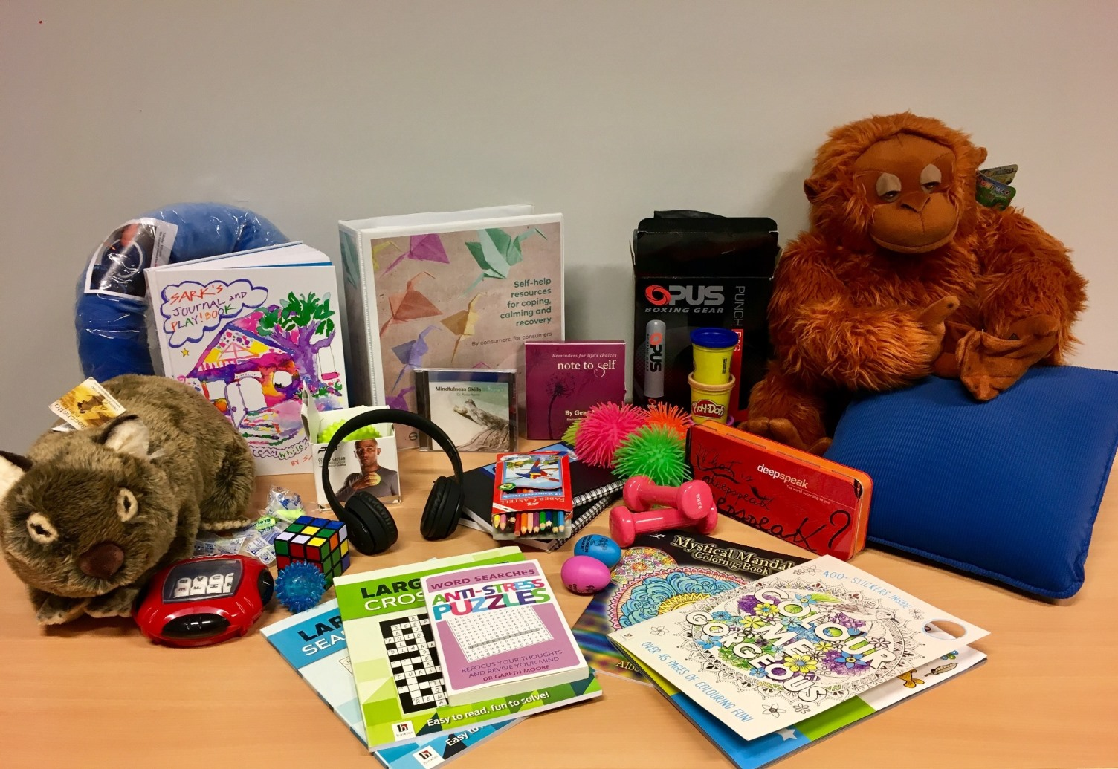
Calm down methods
Notes:
Briefly describe Calm Down Methods

Slide 8
Background and aims
Background
Pro re nata (PRN) medication can been used as an effective strategy to assist people to feel calm, but perhaps we reach for it too easily and too quickly. Where possible and practical, it’s always best to use the patient’s own strengths and coping mechanisms – or support people to develop new strengths and skills – to enable people to self-regulate.
Aims
Early de-escalation
Divert and prevent
Increase people’s sense of empowerment and self-control (these processes contribute to recovery)
Notes:
http://www.safewards.net/interventions/calm-down-methods

Slide 9
Calm Down Methods and the Safewards Model
Staff modifier:
Calm Down Methods
Staff modifiers
Patient modifiers
Originating domain
Patient characteristics
Originating domains
Flashpoints
Conflict
Containment

Slide 10
Benefits
PRN medication is an effective strategy for some people, some of the time, however calm down methods can:
Support people to draw on their own strengths and coping mechanisms
Offer alternatives to medication, that can be sustained well past an admission
Build self-knowledge
Facilitate learning of new strengths and skills
Notes:
http://www.safewards.net/interventions/calm-down-methods

Slide 11
Early signs of distress/agitation
Notice potential changes in:
facial expression
tone of voice
quick response to a normal reminder
restlessness
breathing patterns
body language
eye contact (or lack thereof)
movement around the ward
Notes:
Ask the group what changes they might identify
http://www.safewards.net/interventions/calm-down-methods

Slide 12
Task: Calm down methods handout
Think about what might be helpful for different types of ‘calm down’ needs.
Think about different types of resources and the functions they could serve.
‘It can be easy to say someone is agitated but harder to understand why’
Difficult emotions
Difficult thoughts and urges
Difficult experiences
Sensory & grounding, comfort & soothing, humour, distraction, mindfulness, inspirational, expressive & venting, harm minimisation, problem solving & reflection, movement & activity, drawing on nature or creativity
Notes:
Refer to the handout ‘Calm Down Methods: Resource Ideas’ from the resources pack.
Activity with handout
Split the group into small groups of 3-4 people. Think about a common need you may have seen on the unit and which item might sit with this intervention.
The handout can be used to prompt our thinking about the intervention
It can also be used to consider how you may add to the resources over time

Slide 13
Calm down methods in practice
Assemble a box of ‘calm down resources’ for your unit
Offer/explore calm down methods before considering PRN
Support people to explore the potential uses of calm down methods
Some of the calm down activities can be done together
Record calm down methods use in a log book, and patient files
Notes:
http://www.safewards.net/interventions/calm-down-methods
You could show the Safewards calm down methods video here

Slide 14
Role of the intervention lead
Suggest when calm down methods are appropriate
Ask if/how calm down was used when people mention agitation or PRN at handover
Ask if/how calm down was used if there was a restrictive intervention
Ensure resources are easily available to patients when needed
Check resources regularly to ensure items are returned, clean and in good working order (develop an infection control plan)
Replace missing, depleted or broken items
Expanding Calm Down Methods…
Look at increasing the number and type of resources over time
Make calm down resources available in more spaces
Think about how patients can take resources home after discharge
Notes:
http://www.safewards.net/interventions/calm-down-methods
You might also like to see some of the examples used in Victoria

Slide 15
Calm down methods fidelity
A practical set of equipment and patient resource for self–help when in distress
A store of equipment that can be used to help people who may be feeling agitated/restless, anxious/frightened, angry/irritable, ashamed or depressed/despairing to reach a relaxed state of mind
Calm down methods
IS
=
A box of things that gathers dust in the office or gets dragged to a group
A store of equipment for diversional or recreational activities for patients to do on request
Calm down methods
IS NOT
≠
Notes:
Taken from a PowerPoint from a presentation by Professor Len Bowers

Slide 16
Calm down methods adjustments
CAMHS Safety and supervision review, choice of items different
Forensic Safety and supervision review, choice of items different
Older people Safety and supervision review, choice of items different
Notes:
Taken from a PowerPoint from a presentation by Professor Len Bowers

Slide 17
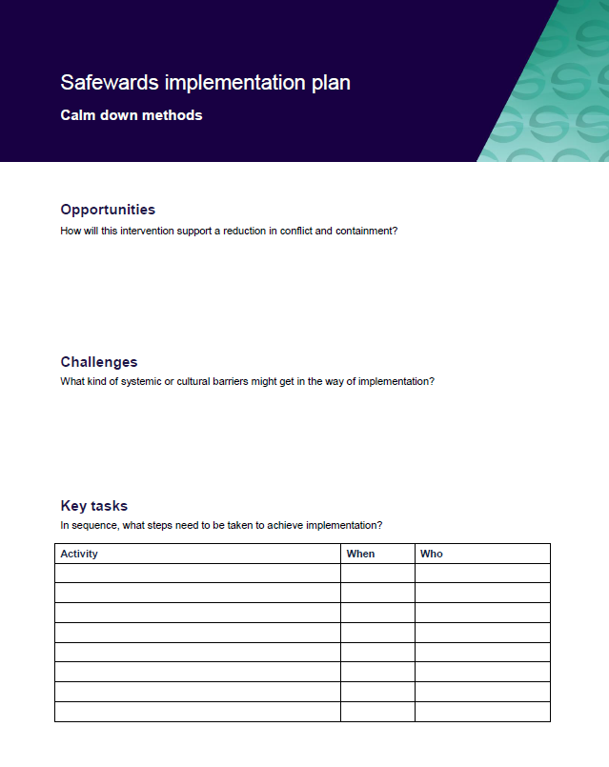
Task: Create your implementation plans
In groups, spend time working on your implementation plans

Slide 18
Talk down
Notes:
Briefly explain Talk Down-http://www.safewards.net/interventions/talk-down

Slide 19
Background
When people become agitated, fearful, angry, ashamed, depressed or suicidal, it should be possible to lessen people’s distress by talking to them
Most of us have had instruction in de-escalation in aggression management training but this may be limited
Safewards pulls together ‘Talk Down’ techniques into a meaningful picture
Notes:
http://www.safewards.net/interventions/talk-down

Slide 20
Aims
Build patient’s emotional self-management skills, self-monitoring, self-awareness and psychological understanding
Using crisis as an opportunity for therapeutic learning for everyone
Improve team cohesion, skill sharing, mutual support
Expand staff skill set
Avoid conflict and containment - or minimise the impact in the event of conflict and/or containment
Notes:
http://www.safewards.net/interventions/talk-down

Slide 21
Talk Down and the Safewards Model
Staff modifier:
Talk Down
Staff modifiers
Patient modifiers
Flashpoints
Conflict
Containment
Originating domains
Conflict:
Any type

Slide 22
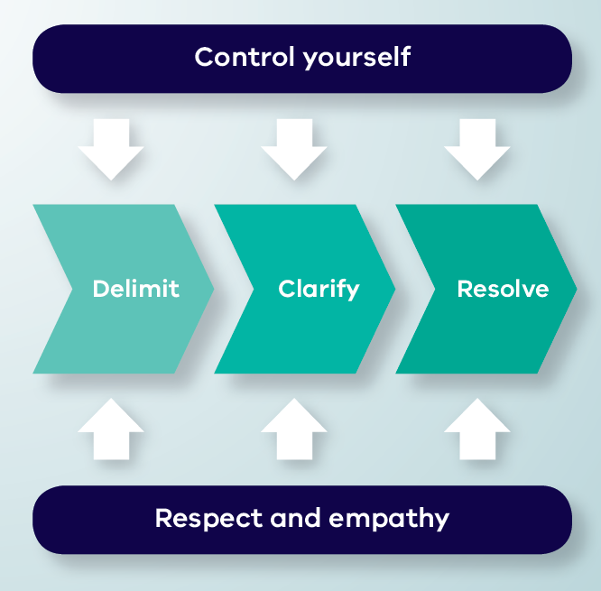
Talk Down Process
Notes:
Give a brief explanation of each of the boxes
You may like to show the talk down video here – this shows talk down in action. You can pause the video before the end description of the model, and ask participants to identify the aspects of the model the staff member has demonstrated.

Slide 23
De-escalation model
Depicts de-escalation as a process:
Starts with delimiting the situation
Moves onto clarification of the problem with the patient
Reaches a resolution
The model indicates that de-escalation is only likely to succeed if, at every stage, the de-escalator:
Controls their own emotions, and
Expresses respect and empathy for the patient
Notes:
Here you might like to split people into groups according to the different processes of Talk Down (delimit, clarify, resolve, control yourself, respect and empathy).
Ask each group to discuss the process they have been assigned
Then feed back to the group (you could do this all at once or use the following slides and ask the group who had the process to describe the process and use the following slides to reinforce the key points).
Allow about 15-20 minutes for this.
http://www.safewards.net/interventions/talk-down

Slide 24
Delimit
• Invite person to move to a quiet place, away from others, audience, people at risk
• Invite person to sit down
• Assess the need for support or backup
• Keep safe, maintain distance if required
Notes:
Go through each of the slides getting the group who focused on the process to feedback first
http://www.safewards.net/interventions/talk-down

Slide 25
Clarify
• Speak clearly, say who you are, use each other’s names, remind of existing relationship, offer your help
• Use open questions to ask what’s happening
• Listen attentively to patient
• Paraphrase what they’ve said to check your understanding
• Answer questions and clarify any misunderstandings
Notes:
http://www.safewards.net/interventions/talk-down

Slide 26
Resolve
• Give patient opportunity to self-regulate, consider using calm down methods
• Be flexible, if possible problem-solve and compromise together
• Offer choices and options
• Give reasons, explain rules, reasoning behind them, be honest, express fallibility (or even agree that it’s unfair)
• Deal with the complaint, apologise, make a change
• Make a personal appeal, remind them of any previously agreed strategy, summarise what’s been said
• Ask if there is anything else you
can do or say that will be
helpful, end positively
Notes:
http://www.safewards.net/interventions/talk-down

Slide 27
Control yourself
Actions
• Act calmly and confidently.
• Don’t corner patients, threaten or make false promises
• Don’t judge, criticise, show irritation, frustration, anger or be retaliative
• Let patient have the last word
Body language
• Have slow and gentle movements
• Relax face, don’t frown, or purse lips
• Relax body, no hands on hips or in pockets, don’t finger wag or prod
• Have lowered, uncrossed arms and open hands
Notes:
http://www.safewards.net/interventions/talk-down

Slide 28
…control yourself
Communication
• No hesitation or uncertainty of speech
• Don’t argue or say they are wrong and you are right
• Don’t defend or justify yourself
• Show no reaction to abuse or insults directed at you, ignore them or partially agree with them
• Prepare responses in advance to typical insults
Emotions
• Breathe deeply and concentrate on situation
• This is not personal and it is not about you

Slide 29
Respect and empathy
Actions
• Be congruent: your actions should match your words
• Listen, hear, acknowledge feelings and needs
• Don’t tell the patient what they should or should not be feeling
• Take time to hear the patient out, be patient and don’t hurry them
Body language
• Make eye contact (exercising care not to be confrontational)
Notes:
http://www.safewards.net/interventions/talk-down

Slide 30
…respect and empathy
Communication
• Extend self and thinking to understand patient viewpoint
• Have a concerned and interested tone of voice
• Don’t yell or shout over people
• Answer all requests for information, however they are phrased
Don’ts
• No advice giving and no orders, no “if I were you I would…”
• Don’t overly smile as this can be condescending

Slide 31
Summary
All the time:
Control yourself (Actions, Body language, Communication, Emotions)
Show respect and empathy (Actions, Body language, Communication)
Three step process:
Delimit: Ensure safety and privacy for all parties
Clarify: Find a shared understanding of the problem
Resolve: Find a solution together

Slide 32
Talk Down in practice
Video by Chris Hart, Youtube
https://youtu.be/Q4T-x1za6lg
Notes:
Watch the video
Ask the group to identify the parts of the model in the video.

Slide 33
Talk down in practice
A poster summarising de-escalation techniques is placed in an area frequented by staff
The unit decides on the ‘talk down’ lead
The lead spends 10-15 minutes with other members of the team explaining the poster and giving examples from their experience
The lead gives each staff member a copy of Talk Down ‘Staying open, friendly and positive handout’
The lead invites staff to read the poster, ask questions and use it to reflect after the process is used
Notes:
There are plenty of resources for this intervention e.g. the poster, the document on staying open friendly and positive, the explanation of the Talk Down poster contents for champions and the guidance for the on how to use the poster, please see the Safewards website

Slide 34
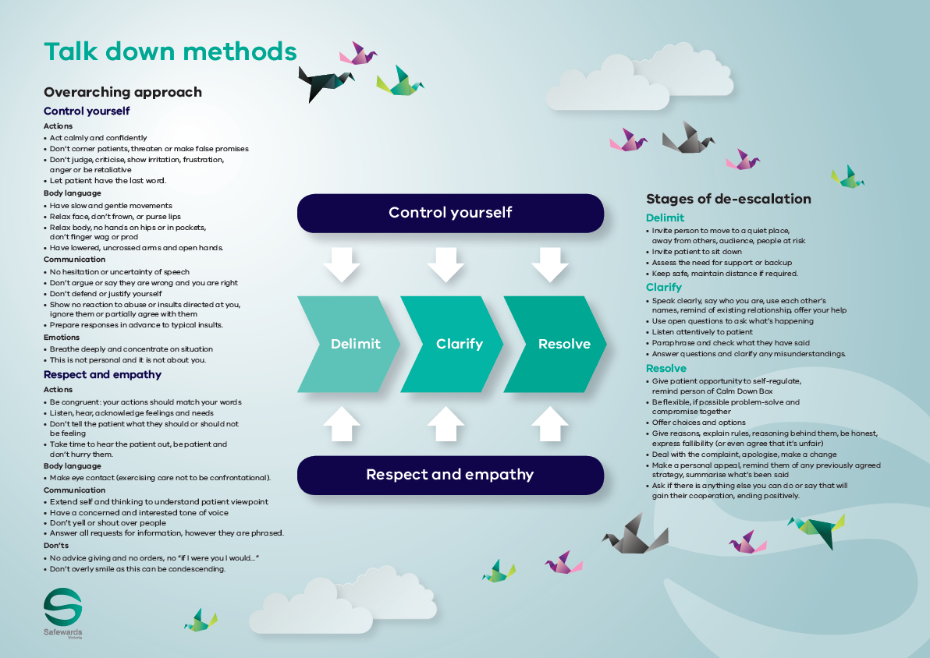
Talk down poster
The poster summarises how the de-escalation process would ideally work
The poster is a guide only. All de-escalation
situations vary
The reality is usually more muddled, nevertheless these principles can be applied to most situations to some degree
Notes:
http://www.safewards.net/interventions/talk-down

Slide 35
Role of the intervention lead – promote talk down
Highlight to the team when talk down methods are used effectively
Mention talk down in handovers or other team meetings
Express respect for use of talk down methods
Acknowledge the growing skill of the team
Consider using the poster when debriefing following an incident - not only recognising the skills that were used but also those that were not and discussing opportunities for improvement

Slide 36
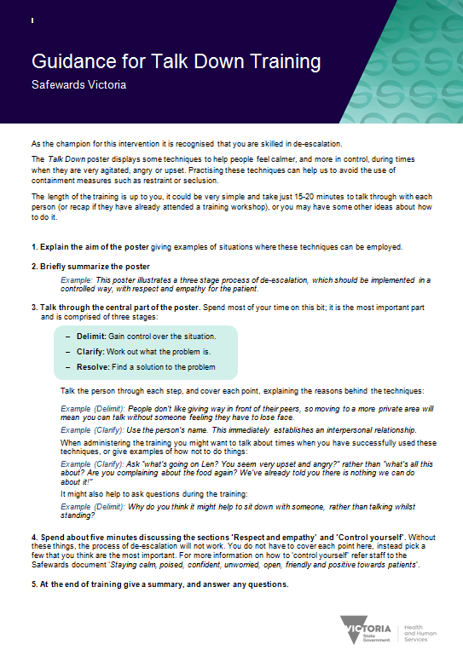
Resources for the intervention lead
Guidance for Talk Down training handout
‘Staying calm…’ handout
Notes:
There are quite a few handouts as previously mentioned to help with this intervention.
http://www.safewards.net/interventions/talk-down

Slide 37
Talk down fidelity
Expanding de-escalation skills and increasing psychological understanding, capitalising on the best of existing team skills and building team cohesion
A crystallisation of de-escalation skills packaged for unit-based teaching and promotion
Talk down
IS
=
Hanging a small poster in the corner of the unit, hoping the staff read it and understand it
Something that ‘happens anyway’ – ‘patient was de-escalated’ is often a myth
Talk down
IS NOT
≠
Notes:
It might help to ensure that the poster is placed in an area where de-escalation is commonly used.
Taken from a PowerPoint from a presentation by Professor Len Bowers

Slide 38
Talk down methods adjustments
CAMHS age-specific techniques
Forensic none
Older people age-specific techniques
What would you need to adjust on your unit?
Notes:
Taken from a PowerPoint from a presentation by Professor Len Bowers

Slide 39
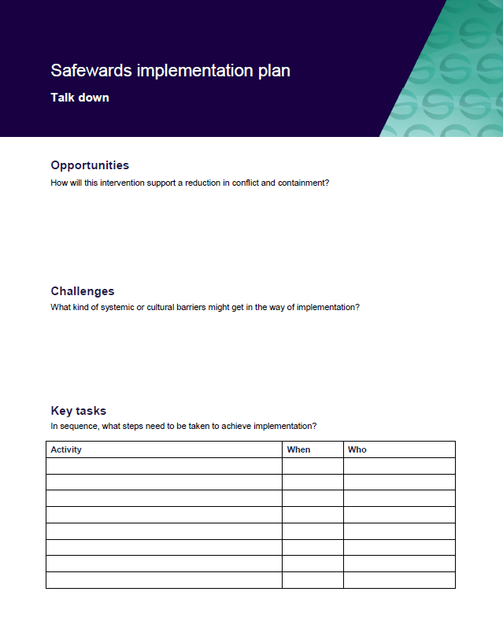
Task: Create your implementation plans
In groups, spend time working on your implementation plans
Notes:
See handbook for templates

Slide 40
Discharge messages
Notes:
Give a brief overview of Discharge Messages
http://www.safewards.net/interventions/discharge-message

Slide 41
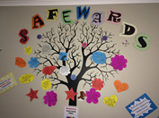
Background
Discharge messages provides a way of helping people connect with hope by:
Demonstrating care and concern
Attending to what people feel and are concerned about
Creating an avenue for patients to inspire and support each other (even anonymously)
Providing hopeful messages from other patients (rather than from staff)
Patient engagement is fundamental to this intervention
Notes:
http://www.safewards.net/interventions/discharge-message

Slide 42
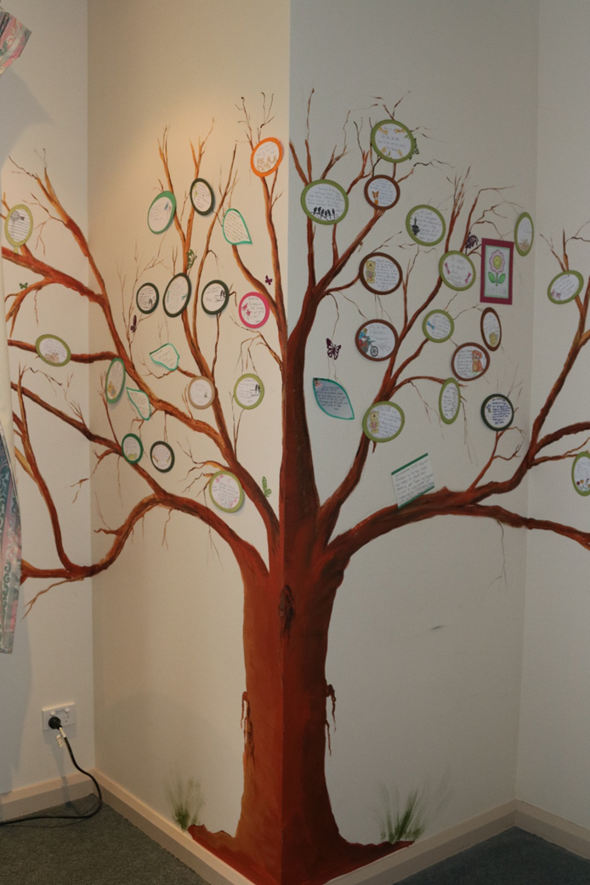
Aims
When a patient is preparing to leave, there is an opportunity for them to provide a discharge message as a form of closure for themselves and to help others on the unit.
Aims:
Provide authentic encouragement and support for new patients
Provide hope and convey messages about the purpose and potential benefits of an admission
Provide a boost to self-esteem / identity on leaving the unit through making a valued contribution to the patient community
Notes:
Ask people to think about integrating this intervention into practice eg-it is not just about someone leaving. It is also about engaging people who are on the unit who may be newly admitted, it is also about positivity and safety planning etc
http://www.safewards.net/interventions/discharge-message

Slide 43
Discharge messages and the Safewards Model
Staff modifier:
Discharge messages
Staff modifiers
Originating domains:
Patient community
Patient characteristics
Physical environment
Patient modifiers:
Hope, mutual help
Patient modifiers
Originating domains
Flashpoints
Conflict
Containment

Slide 44
Role of the intervention lead
Establish the discharge message tree or noticeboard
Check the discharge message tree or noticeboard, keep it tidy and remind staff to encourage writing a message when a patient's discharge is forthcoming
Remind patients the opportunity to complete a discharge message (this could be done during a mutual help meeting). Offer support to write the message if necessary.
Notes:
http://www.safewards.net/interventions/discharge-message
See examples from Victoria which may suit your ward.

Slide 45
Discharge messages fidelity
A way of passing on the messages & advice from leaving patients to arriving patients
Delivering positive messages to provide hope and encouragement to arriving patients
Discharge messages
IS
=
A way of highlighting how good the unit and staff are to visitors
Soliciting compliments from patients leaving the unit to make the staff feel good
Discharge message
IS NOT
≠
Notes:
Taken from a PowerPoint from a presentation by Professor Len Bowers

Slide 46
Discharge messages adjustments
CAMHS None
Forensic Goodbye messages, transfer messages
Older people None in some cases, impossible in others, engaging family
Notes:
Taken from a PowerPoint from a presentation by Professor Len Bowers

Slide 47
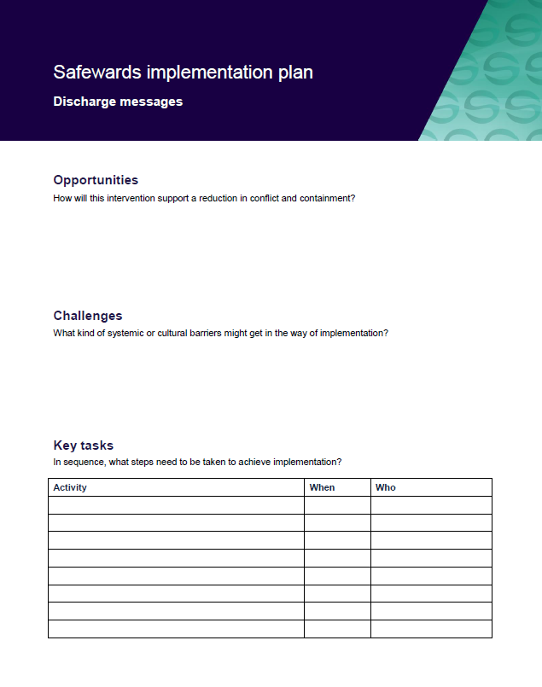
Task: Create your discharge messages implementation plans
In groups, spend time working on your implementation plans
Notes:
See handbook for templates

Slide 48
Interventions: Long-term implementation factors to consider
Notes:
The following slides are designed to refresh participants memories on each of the interventions and also to consider some of the issues that may occur in the medium to long term

Slide 49
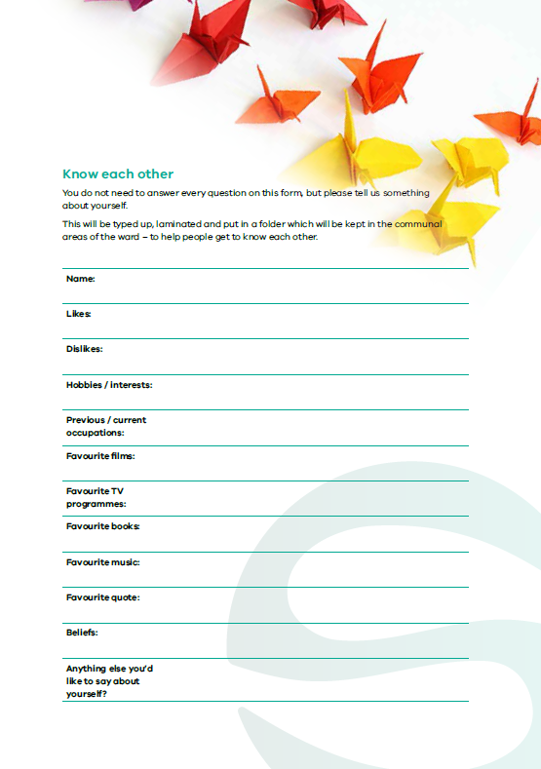
Know each other – long-term implementation
Unproblematic to continue long term if new staff contribute and the folders are maintained
Continuous input of new patients and their information renews this intervention
If this becomes routine for staff, they could be asked to contribute a new information sheet containing facts not previously shared
Notes:
Are there any suggestions for keeping this fresh?
Taken from a PowerPoint from a presentation by Professor Len Bowers

Slide 50
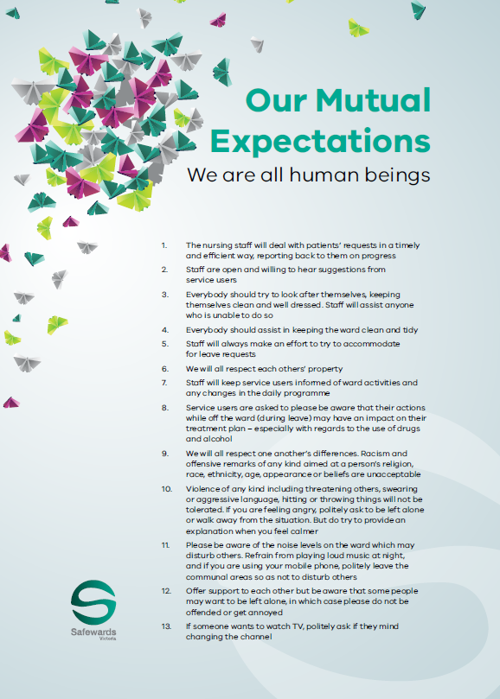
Clear mutual expectations – long-term implementation
Needs to be periodically renegotiated between the staff and patient group
Resources should be renewed, for example, by varying the design schemes and the negotiation process
Notes:
Units will need to decide when the CME need to be reviewed-it may need to be reviewed more frequently on units that have a higher turn over for example.
Adapted from a presentation by Professor Len Bowers

Slide 51
Positive words – long-term implementation
Aim for balanced communication to become part of professional communication
Renew by switching the focus of communication to other professionals (pharmacists, doctors, etc.)
Rotate the focus over longer time periods to reinforce the underlying impetus
Consult with consumer groups or patients on the unit to expand and identify strengths and positive features of patients that staff can use
Discharge reviews with an external facilitator could identify strengths the unit staff missed.
Notes:
Adapted from a PowerPoint presentation by Professor Len Bowers

Slide 52
Discharge messages – long-term implementation
Unproblematic to continue in the long term.
Renew and change the display type to refresh discharge messages.
Consider storage of older messages removed from tree (eg, photo album)
Notes:
Adapted from a PowerPoint presentation by Professor Len Bowers

Slide 53
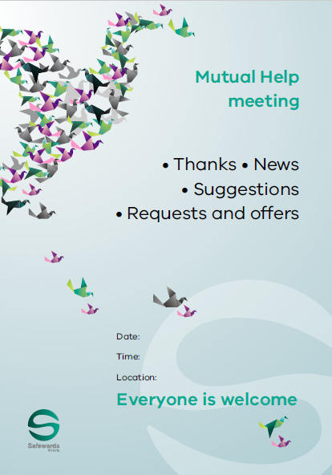
Mutual help meeting – long-term implementation
Meetings should improve as staff become more skilled and experienced in encouraging mutual support
Critical to pass on skills and experience to new staff and students
Networking and sharing successes and failures could assist with this intervention
Notes:
Adapted from a PowerPoint presentation by Professor Len Bowers

Slide 54
Bad news mitigation – long-term implementation
Periodically remind staff to maintain awareness of each patient’s personal life, and likely domains for bad news
Extend to make patients’ family and friends aware of the impact of bad news and share responsibility
Have signs and leaflets on the unit about the intervention and potential for receiving bad news
Include bad news mitigation as an agenda item during handovers
Notes:
Adapted from a PowerPoint presentation by Professor Len Bowers

Slide 55
Reassurance long term implementation
Unproblematic to implement on a permanent basis, but will require strategies to periodically remind staff to maintain awareness and act upon it
Consider including as an agenda item during handover
Consider the inattention that eventually follows a routinised practice - and consider other creative mechanisms

Slide 56
Calm down methods – long-term implementation
Equipment will need permanent care and a robust storage strategy
A budget will be required for replacements, and ideally to expand the types and number of resources over time
Review will be necessary to remove items that may prove to be problematic and to consider and approve replacements and substitutions
Reviews should consider strategies to maximise quick and easy patient access to resources
Notes:
Adapted from a PowerPoint presentation by Professor Len Bowers

Slide 57
Soft words – long-term implementation
Remove soft words statements then re-introduce to regain attention
Reformat or redisplay soft words statements in new ways
Challenge a team to write their own verses or compose their own soft words
Periodically revisit soft words and limit-setting in reflective practice and supervision
Notes:
Adapted from a PowerPoint presentation by Professor Len Bowers

Slide 58
Talk down – long-term implementation
Continually display the poster and change location
Use the poster in post-incident debriefing to identify strengths and weaknesses
Renew training when there is significant staff turnover
Incorporate into local aggression prevention training
Notes:
Adapted from a PowerPoint presentation by Professor Len Bowers

Slide 59
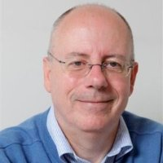
Final comments from Len…
If your intervention doesn’t alter any of the ‘staff modifiers’ identified in the Safewards Model, then it isn’t classified as a Safewards intervention
Although many Safewards interventions can be done creatively, that doesn’t mean anything creative or arty is a Safewards intervention
Notes:
Taken from a PowerPoint from a presentation by Professor Len Bowers

Slide 60
Final comments from Len…
None of the interventions will work if you and your team do not actually do them!
If you present an over-optimistic, exaggeratedly positive, all bad news removed story to your immediate manager, who does the same plus a bit extra to theirs, etc. then the people at the top think everything is wonderful and being put into effect, while in reality nothing much is happening on the wards at all
Notes:
Taken from a PowerPoint from a presentation by Professor Len Bowers

Slide 61
Task: Role play
Notes:
This activity can be used to get the participants to focus on what they have learnt about the Safewards model and the interventions and how Safewards has (or will) have a positive impact on their ward.
Ask the participants to prepare two scenarios the first one will be their unit prior to Safewards. Ask them to act out a common scenario related to conflict and containment on their unit-give them permission to ‘ham it up’ use props etc. Then ask them to deliver the same scenario, but the second time showing how the same scenario could be done using Safewards interventions. See how many of the Safewards interventions they can use!

Slide 62
Wrap up
Today we revised the previous workshop and learnt the last three interventions
How will we move forward with Safewards?
What do you think will be some of the benefits of introducing Safewards?

Slide 63
Evaluation and questions

Slide 64
Congratulations and welcome…
…to the international community of Safewards Champions!
www.health.vic.gov.au/safewards

