Slide 1
Safewards
2 day Workshop
Day 1

Slide 2
Day 1
Introducing the model and interventions
Day 2
Theory
Understanding the Safewards model
Theory
Revision of the Safewards model
Interventions
Know each other
Clear mutual expectations
Positive words
Soft words
Mutual help meeting
Interventions
Reassurance
Bad news mitigation
Calm down methods
Talk down
Discharge messages

Slide 3


Introduction to Safewards
Origins of Safewards
Key aims of Safewards
The heart of Safewards: conflict and containment
Overview of the model
Notes:
Safewards aims to have a transformational effect on our work…

Slide 4
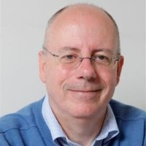
Origins of the Safewards model
  Safewards origins
  Nursing model
  Developed by Len Bowers, UK
  Research-based
  Focus on conflict and containment (restrictive interventions)
  Evidence (Bowers)
  Cross topic literature review
  Model development
  Cluster randomised controlled trial of model
    31 units, adequate power, significant results
    Conflict 14.6% decrease
    Containment 23.6% decrease
Notes:
Provide a brief overview of how the model was developed. To be able to talk to this slide you need to do some reading about how the model was developed – see Bowers et al. (2015).
Sources: Safewards model is based on
Len’s own research
Cross topic literature review
Reasoned thinking
RCT:
31 units, blind
Conflict 14.6% decrease, containment 23.6% decrease
Strengths: randomised, blind, adequate power, independence of randomisation and analysis
Weaknesses: level of cooperation and implementation, nil results from questionnaires
See Bowers et al. (2014) Safewards: the empirical basis of the model and a critical appraisal
Explain how the model was created, subject to a randomised control trial, and translated into practice (See Bowers et al., 2015).
Mention that Victoria has done its own research to validate the model – this is presented on Day 2.

Slide 5
Key aims of the Safewards model
“Positive and proactive care:
Reducing the need for restrictive interventions”
  1. Explain the relationship between conflict and containment
  2. Identify opportunities where staff can intervene
  3. Generate ideas for change that have the potential to reduce conflict and containment
Notes:
The model can be used to explore the relationship between conflict and containment, identify where we can intervene and to help generate ideas about how we can reduce conflict and containment (See Bowers 2014; Bowers et al., 2014).

Slide 6
Conflict and Containment
Safewards centres around reducing
conflict and containment
Conflict means anything that could lead to harm for the patient, other patients or staff:
Physical aggression
Verbal aggression
Self harm/ suicide
Substance misuse
Property damage
Absconding
Medication refusal
Containment means what staff do to prevent conflict events or minimise harmful outcomes, and may include:
Special observation
Use of security
Physical restraint
Chemical restraint
Seclusion
Mechanical restraint
Environmental restraint
These occurrences may lead to restrictive interventions

Slide 7
Conflict and Containment
Conflict and Containment
Notes:
Conflict and containment are often seen as being one and the same issue.

Slide 8
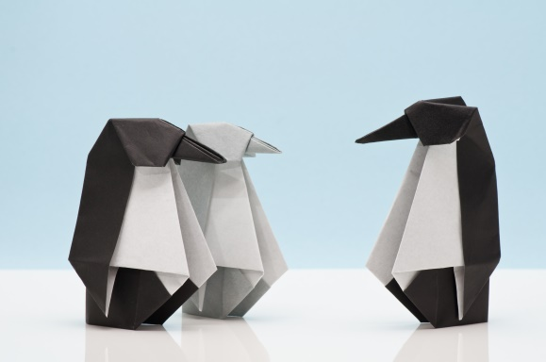

Conflict and Containment
Conflict
Containment
Notes:
Safewards reminds us that these are two separate issues. Conflict is different to containment, and while it can lead to conflict, there are also other responses.

Slide 9


Task: What is it like on your unit?
  What contributes to conflict and containment on your unit?
  How does conflict and containment influence your unit?
Notes:
For this activity ask the group to consider what contributes to conflict and containment on their ward
Write down people’s responses on a whiteboard or butchers paper (allow approx. 10 minutes).
Try and tease out the issues and keep these in mind for the rest of the day.

Slide 10
Conflict and containment rates
  Rates of conflict and containment vary locally and internationally
  (Bowers et al., 2005a, Nijman et al., 2005)
  Factors that can influence the frequency of conflict and containment:
  social and physical locations of units
  separation from a person’s normal residence
  provision of 24/7 mental health care
  mixed voluntary and legal coercion
Notes:
For this slide refer to:
Bowers, L. (2014). Safewards: a new model of conflict and containment on psychiatric wards. Journal of Psychiatric and Mental Health Nursing, 21, 499-508.
and also see the Safewards Model document which discusses the points in this slide. See http://www.safewards.net/model/technical
Reasons for these differences provide an opportunity to devise ways to reduce the frequency of risky events - keeping people safer
Containment methods used in some countries are not used in others

Slide 11
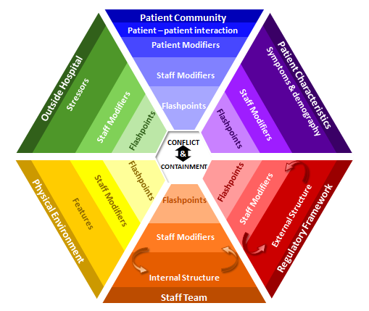
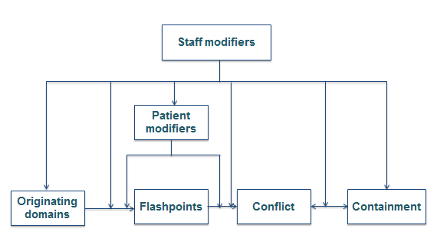
The Safewards model
Simple model
Technical model

Slide 12
Six domains that influence or trigger conflict
Originating Domains
1. The patient community
2. Patient characteristics
Flashpoint
3. Regulatory framework
4. Staff team
Definition:
Social and psychological situations arising out of features of the originating domains, signaling and preceding imminent conflict
5. Physical environment
6. Outside hospital
Notes:
Give a brief summary of each of the domains (you will go into more detail later) and describe how factors in the domains can lead to flashpoints.

Slide 13
  Staff modifiers
  Definition
  Characteristics of staff or teams or the way staff act in working with patients or the environment
  Potential
  The way staff initiate or respond to interactions can influence the frequency of conflict and containment
Notes:
See Bowers (2014)

Slide 14
Staff can influence conflict and containment by:
  Reducing or eradicating the originating conflict factors
  Preventing flashpoints
  Cutting the link between the flashpoint and conflict
  Choosing not to use containment when it would be counterproductive
  Ensuring that containment does not lead to further conflict
Notes:
This slide highlights the various ways that staff can have an influence on conflict and containment rates on their ward.
Go through each of the points highlighting examples that are relevant to your participants.
For dot point 4 - choose not to use containment on occasions when it would be counterproductive - here you could ask the participants if they can talk about a time when they have done this and it has been a positive experience.
You can also facilitate discussion around how to prevent further conflict when using containment methods.

Slide 15
Patient modifiers
  Definition
  How patients respond and behave towards each other can influence the frequency of conflict and containment.
  Patients are susceptible to staff influence.
Notes:
Important to note that patients can also have an influence.

Slide 16
Patients can influence conflict and containment
  Understanding and identifying possible flashpoints
  Seeking assistance or using coping skills to avoid or minimise the impact of flashpoints
  Cutting the link between flashpoint and conflict
  Seeking advocacy to avoid containment

Slide 17
Patient modifiers
When do patients have control over conflict?
When do patients have control over containment?
What influences whether or not patients have control?
Notes:
Whiteboard activity

Slide 18
Simple model
Staff modifiers
Patient modifiers
Originating domains
Flashpoints
Conflict
Containment
Notes:
Explain each of the boxes briefly and how they relate to and influence each other. The YouTube video of Professor Len Bowers describing the model is helpful
https://www.youtube.com/watch?v=C3z7zRRXMFo
The Victorian Safewards Introduction to the model video also provides a helpful explanation
For information relating to the simple form of the model see http://www.safewards.net/images/pdf/Safewards%20model.pdf
http://www.safewards.net/model/easy

Slide 19
Patient Community
Outside Hospital
Patient Characteristics
Physical Environment
Regulatory Framework
Staff Team
Notes:
Show how the originating domains from the previous slide wrap around the outside of the model

Slide 20
Patient Community
Patient – patient interaction
Outside Hospital
Patient Characteristics
Stressors
Symptoms & demography
CONFLICT
&
CONTAINMENT
Features
External Structure
Physical Environment
Regulatory Framework
Internal Structure
Staff Team
Notes:
Explain that the model has detailed descriptions for each domain

Slide 21
Patient Community
Patient – patient interaction
Patient Modifiers
Outside Hospital
Patient Characteristics
Stressors
Symptoms & demography
CONFLICT
&
CONTAINMENT
Features
External Structure
Physical Environment
Regulatory Framework
Internal Structure
Staff Team
Notes:
Explain this is where patient modifiers sit in the model

Slide 22
Patient Community
Patient – patient interaction
Patient Modifiers
Staff Modifiers
Outside Hospital
Patient Characteristics
Stressors
Symptoms & demography
Staff Modifiers
Staff Modifiers
CONFLICT
&
CONTAINMENT
Staff Modifiers
Staff Modifiers
Features
External Structure
Physical Environment
Regulatory Framework
Staff Modifiers
Internal Structure
Staff Team
Notes:
Explain this is where staff modifiers sit in the model

Slide 23
Patient Community
Patient – patient interaction
Patient Modifiers
Staff Modifiers
Outside Hospital
Patient Characteristics
Stressors
Symptoms & demography
Flashpoints
Staff Modifiers
Staff Modifiers
Flashpoints
Flashpoints
Flashpoints
Flashpoints
Staff Modifiers
Flashpoints
Staff Modifiers
Features
External Structure
Physical Environment
Regulatory Framework
Staff Modifiers
Internal Structure
Staff Team
Notes:
This is where flashpoints sit

Slide 24
Patient Community
Patient – patient interaction
Patient Modifiers
Staff Modifiers
Outside Hospital
Patient Characteristics
Stressors
Symptoms & demography
Flashpoints
Staff Modifiers
Staff Modifiers
Flashpoints
Flashpoints
CONFLICT
&
CONTAINMENT
Flashpoints
Flashpoints
Staff Modifiers
Flashpoints
Staff Modifiers
Features
External Structure
Physical Environment
Regulatory Framework
Staff Modifiers
Internal Structure
Staff Team

Slide 25
Patient Community
Patient – patient interaction
Patient Modifiers
Staff Modifiers
Outside Hospital
Patient Characteristics
Stressors
Symptoms & demography
Flashpoints
Staff Modifiers
Staff Modifiers
Flashpoints
Flashpoints
CONFLICT
&
CONTAINMENT
Flashpoints
Flashpoints
Staff Modifiers
Flashpoints
Staff Modifiers
Features
External Structure
Physical Environment
Regulatory Framework
Staff Modifiers
Internal Structure
Staff Team
Notes:
Explain how the whole model wraps around aiming to prevent what’s in the centre: conflict and containment

Slide 26
Patient Community
Patient – patient interaction
Patient Modifiers
Staff Modifiers
Outside Hospital
Patient Characteristics
Stressors
Symptoms & demography
Flashpoints
Staff Modifiers
Staff Modifiers
Flashpoints
Flashpoints
CONFLICT
&
CONTAINMENT
Flashpoints
Flashpoints
Staff Modifiers
Flashpoints
Staff Modifiers
Denial of request
Features
External Structure
Physical Environment
Regulatory Framework
Staff Modifiers
Internal Structure
Staff Team
Notes:
Discuss a denial of a patient request as an example of a flashpoint

Slide 27
Patient Community
Patient – patient interaction
Patient Modifiers
Staff Modifiers
Outside Hospital
Patient Characteristics
Symptoms & demography
Stressors
Bad
news
Flashpoints
Staff Modifiers
Staff Modifiers
Flashpoints
Flashpoints
CONFLICT
&
CONTAINMENT
Flashpoints
Flashpoints
Staff Modifiers
Flashpoints
Staff Modifiers
Features
External Structure
Physical Environment
Regulatory Framework
Staff Modifiers
Internal Structure
Staff Team
Notes:
Discuss bad news as an example of a flashpoint

Slide 28
Patient Community
Patient – patient interaction
Patient Modifiers
Staff Modifiers
Outside Hospital
Patient Characteristics
Stressors
Symptoms & demography
Compulsory detention
Flashpoints
Staff Modifiers
Staff Modifiers
Flashpoints
Flashpoints
CONFLICT
&
CONTAINMENT
Flashpoints
Flashpoints
Staff Modifiers
Flashpoints
Staff Modifiers
Features
External Structure
Physical Environment
Regulatory Framework
Staff Modifiers
Internal Structure
Staff Team
Notes:
Discuss compulsory detention as an example of a flashpoint

Slide 29
Patient Community
Patient – patient interaction
Contagion & discord
Patient Modifiers
Anxiety management, Mutual support, Moral commitments, Psychological understanding, Technical mastery
Staff Modifiers
Explanation/information, Role modelling, Patient education, Removal of means, Presence & presence+
Outside Hospital
Patient Characteristics
Stressors
Visitors, Relatives & family tensions, Prospective –ve move
Dependency & institutionalisation, Demands & home
Flashpoints
Assembly/crowding/activity Queuing/waiting/noise Staff/pt turnover/change Bullying/stealing/
prop. damage
Symptoms & demography
Paranoia, PD traits, Irritability/disinhib., Abused, Male, Alc/drugs, Depression, Insight, Delusions, Hall.s, Young
Staff Modifiers
Carer/relative involvement
Family therapy
Active patient support
Staff Modifiers
Pharmacotherapy
Psychotherapy & functional analysis
Nursing support & interventions
Flashpoints
Bad news, Home crisis, Loss of relationship or accommodation, Argument
Flashpoints
Exacerbations;
Independence/identity
Acuity/severity
CONFLICT
&
CONTAINMENT
Flashpoints
Compulsory detention, Admission, Appeal refusal, Complaint denied, Enforced treatment, Exit refused
Flashpoints
Secrecy, Solitude,
Admission shock, Exit blocked
Staff Modifiers
Caringly vigilant & inquisitive, Checking routines, Décor, Maintenance, Clean & Tidy, Alternative choices, Respect
Staff Modifiers
Due process, Justice, Respect for rights,
Hope, Information giving, Support to appeal,
Legitimacy, Compensatory autonomy,
Consistent policy, Flexibility, Respect
Flashpoints
Denial of request,
Staff demand,
Limit setting, Bad news,
Ignoring
Features
Door locked, Quality, Complexity, Seclusion, PICU, ICA, Comfort/sensory rooms, Ligature points
External Structure
Legal framework, National policy, Complaints,
Appeals, Prosecutions, Hospital policy
Physical Environment
Regulatory Framework
Staff Modifiers
Staff anxiety & frustration, Moral commitments, Psychological understanding, Teamwork & consistency, Technical mastery, Positive appreciation
Internal Structure
Rules, Routine, Efficiency, Clean/tidy, Ideology, Custom & practice
Staff Team
Notes:
This is the technical version of the model.
Time permitting, a good activity at this point is to break up into smaller groups to brainstorm common flashpoints and staff modifiers for each originating domain. Each group can report back to the larger group.

Slide 30
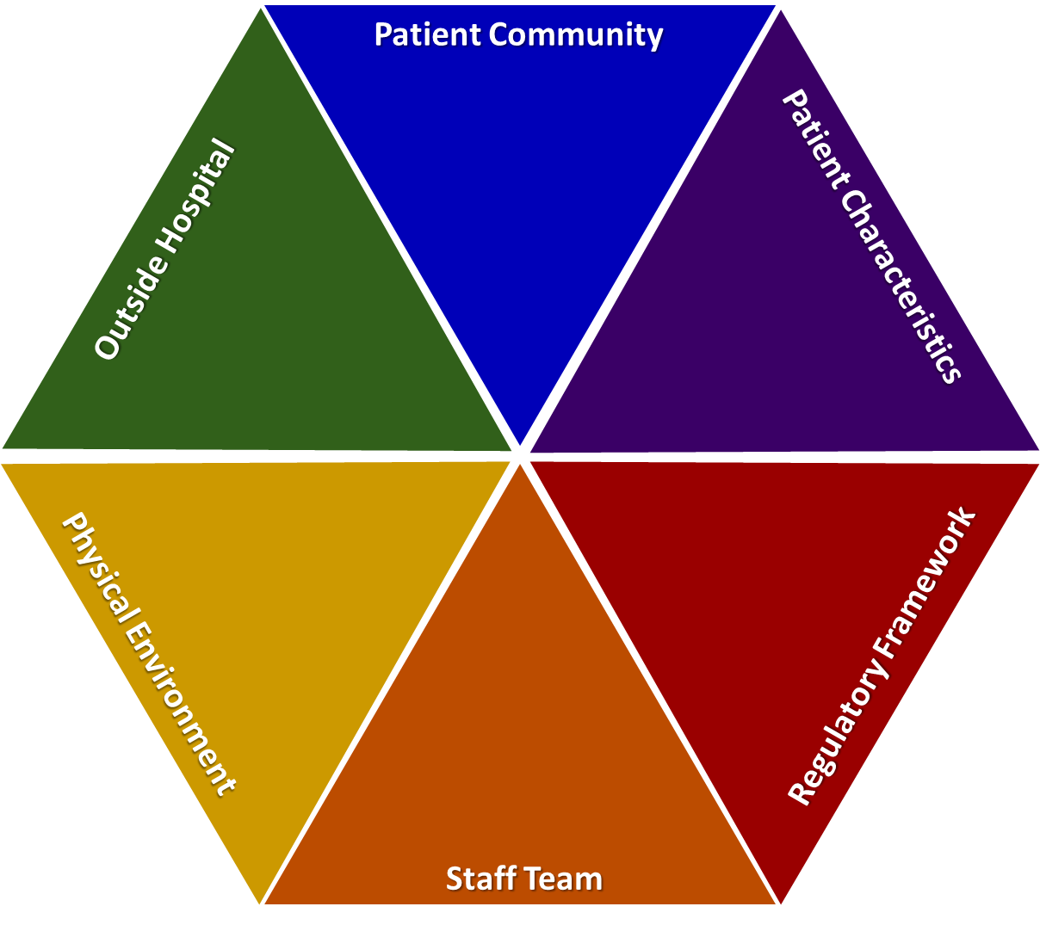
Overview of originating domains

Slide 31
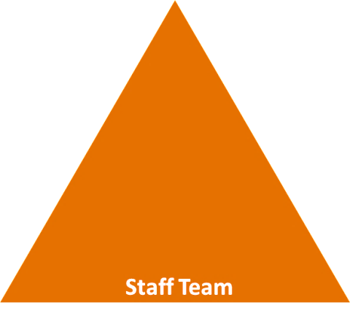
Staff team domain
  Internal structure
  Rules, routines, efficiency, clean/tidy, ideology, custom, practice
  Staff modifiers
  Staff anxiety and frustration, moral commitments (honesty), psychological understanding, teamwork and consistency, technical mastery, positive appreciation, education/training, clinical supervision, model skills, challenge each other, review care provided, focus on flashpoints, finding better ways to manage them (reduce number of rules, pre-empting needs) and set limits
  Flashpoints
  Denial of request, staff demand, limit setting, bad news, ignoring
Notes:
For Staff team domain please see http://www.safewards.net/images/pdf/Safewards%20model.pdf
For each of the following 6 slides you need to be familiar with each of the domains and you need to encourage the participants to start thinking about the factors, modifiers and flashpoints that are specific to their ward. Here you will need to facilitate the discussion and perhaps pose some questions or prompts that are specific to the unit to encourage discussion and reflection. You may need to refer back to the comments you collected from slide 4

Slide 32

Physical environment domain
  Better quality environment versus complexity (observation/supervision)
  Features
  Door locked, quality of environment, speedy repairs, complexity, seclusion rooms available, PICU, ICA, comfort/sensory rooms, ligature points
  Staff modifiers
  Vigilant and inquisitive, checking routines, décor, maintenance, clean and tidy, alternative choices, respect
  Flashpoints
  Secrecy, solitude, admission shock, exit blocked
Notes:
For physical environment domain please see http://www.safewards.net/images/pdf/Safewards%20model.pdf

Slide 33
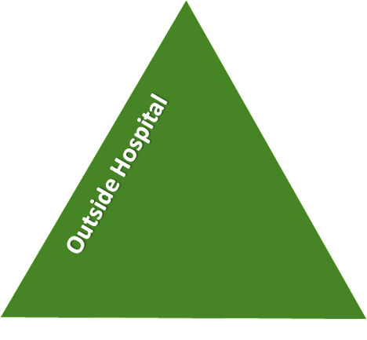
Outside hospital domain
  Stressors
  Visitors, relatives and family tensions and relationships, missing out, dependency and institutionalisation (absconding), demands and home
  Staff modifiers
  Carer/relative involvement, family therapy, active patient support, awareness, important factors from outside that can influence behaviour on the unit (financial circumstances, support to resolve issues with family and friends, accommodation-checked on/leave to visit)
  Flashpoints
  Bad news, home crisis, loss of relationship or accommodation, argument
Notes:
For outside hospital domain please see http://www.safewards.net/images/pdf/Safewards%20model.pdf

Slide 34
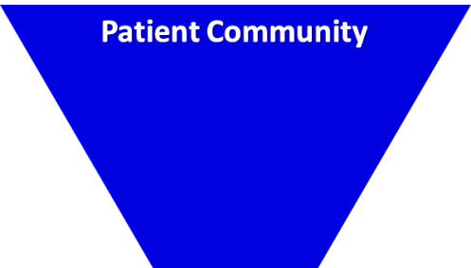
Patient community domain
  Patient-patient interaction
  Ripple effect of conflict (impact of conflict elsewhere on the unit, living with others, meal times and medication times)
  Patient modifiers
  Anxiety management, mutual support, moral commitments, psychological understanding, technical mastery
  Staff modifiers
  Explanation/information, role modelling, patient education, removal of means, presence and presence+ (getting in early), conflict resolution, pre-emptive reassurance, managing level and fluctuation of activity on the unit
  Flashpoints
  Assembly, crowding, activity queuing, waiting, noise, staff/patient turnover or change, bullying, stealing and property damage
Notes:
For patient community domain please see http://www.safewards.net/images/pdf/Safewards%20model.pdf

Slide 35

Patient characteristics domain
  Symptoms and demography
  Symptoms: paranoia-defensive, aggression, specific delusions, depression-suicide attempts/irritability, use of substances, irritability or disinhibition
  Personality traits: features of ASPD, instrumental aggression
  Demographic: particularly being younger and male
  Staff modifiers
  Pharmacotherapy, psychotherapy and functional analysis; nursing support and intervention; enhance choices, freedom and control over circumstances; develop mutually respectful partnership; therapeutic community; authoritarianism-counterproductive; CBT; social skills training; trauma-informed practice responses; choices over how to respond. Only a few people account for the majority of aggressive incidents, therefore:
  change responses after the first event to avoid subsequent events
  target therapeutic interventions
  Flashpoints
  Exacerbations, independence, identity, acuity, severity
Notes:
For Patient characteristics domain please see http://www.safewards.net/images/pdf/Safewards%20model.pdf

Slide 36

Regulatory framework domain
  External structure
  Legal framework, national policy, complaints, appeals, prosecutions and hospital policy
  Staff modifiers
  With the exception of hospital policy, these modifiers are not under staff control (RRI); however, the way they are carried out can be. This includes:
  Procedural justice, respect for rights, hope, information giving, supported decision making, support to appeal, legitimacy, compensatory autonomy, consistent policy, flexibility, effective complaints process, policy targeted at RRI, choices (such as more activities, meals, snacks), intervene to address hopelessness and self-stigmatisation.
  Flashpoints
  Compulsory detention, admission, appeal refusal, complaint denied, enforced treatment and exit refusal
Notes:
For Regulatory framework domain please see http://www.safewards.net/images /pdf/Safewards%20model.pdf

Slide 37
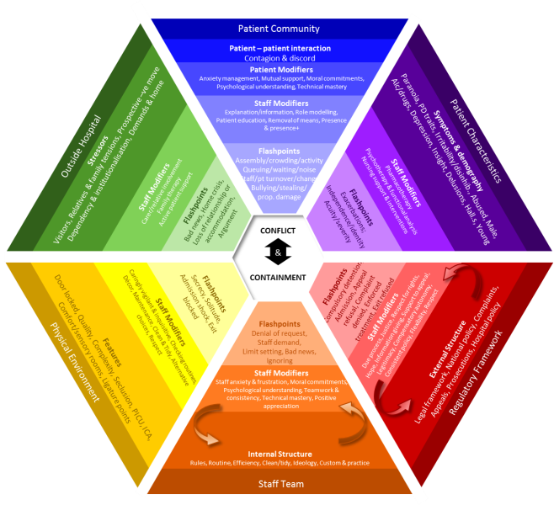
What this model adds to practice
  Includes patient-patient interaction
  Identifies that staff response to patient characteristics can have an impact
  Acknowledges the regulatory framework and that action can be taken at higher policy levels
  Incorporates influences from outside hospital
Notes:
Incorporates:
Systematic influences on the ward
Patient behaviour as a result of outside hospital influences
See https://www.youtube.com/watch?v=C3z7zRRXMFo

Slide 38
Safewards interventions
  The Safewards interventions are a set of prevention and intervention strategies developed to correspond to diverse flashpoints identified in the model

Slide 39
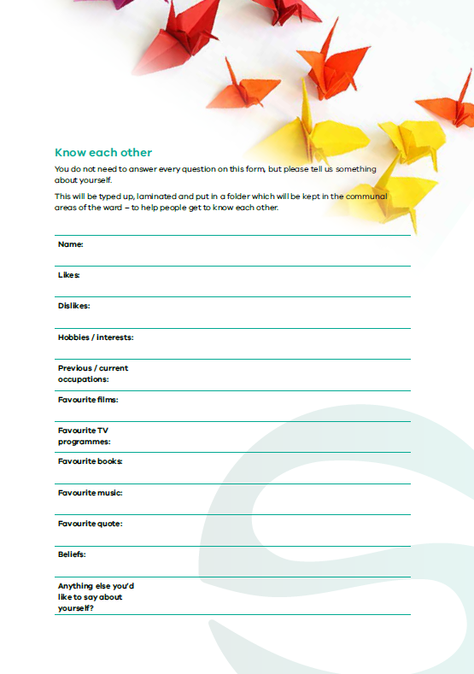
Know each other
Notes:
Briefly explain Know Each Other
http://www.safewards.net/interventions/know-each-other

Slide 40

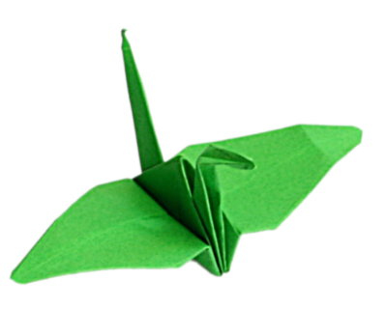
Background
    Good therapeutic relationships between staff and patients are the foundation of effective care
    If patients and staff have information about each other they can find common areas of interest
    Sharing areas of interest makes engagement easier for both patients and staff, especially in tense situations
    It’s helpful to have topics for conversation
Notes:
http://www.safewards.net/interventions/know-each-other
This slide covers the reasons for this intervention and the anticipated outcomes

Slide 41
Aims
    Build stronger relationships between patients, and between patients and staff
    Assist social interaction
    Nurture a sense of common humanity while maintaining safety
    …making conflict less likely
Notes:
http://www.safewards.net/interventions/know-each-other
This slide covers the aims for this intervention

Slide 42
Know each other and the Safewards model
Staff modifier:
Sharing information
Staff modifiers
Patient modifier: Sharing information
Patient modifiers
Originating domains:
Patient Community
Staff Team
Patient Characteristics
Originating domains
Flashpoints
Conflict
Containment

Slide 43

Task: Getting to know each other
  Where did you grow up?
  How many children in your family?
  What was one of your childhood hobbies?
  What was your biggest challenge growing up?
  What was your first job?
Notes:
Ask the participants to get into pairs (preferably with someone they do not know so well) and discuss each of these questions.
Allow approximately 10 minutes.
When you bring the group back together ask if they learnt something they didn’t know about each other
You may like to ask for a few examples from the participants

Slide 44
Information collected
  What information do we generally collect about patients?
  It is usually negative and often focuses on:
      past history of psychiatric illness
      risks
      disabilities
  Little of the information collected provides a basis for relationship building
  What do patients know about staff?
Notes:
http://www.safewards.net/interventions/know-each-other
Ask the participants what information is usually collected about patients?

Slide 45

Task: What non-controversial information might you wish to share?
Notes:
Ask the participants for examples of what they can share (try to move people away from thinking about what they can share rather than what they cannot share).

Slide 46

Examples of non-controversial information
Qualifications
Years of experience working in mental health
Hospitals and various locations worked
Previous jobs
Hobbies and interests
Favourite TV program and reasons
Favourite film and why
Favourite book and why
Preferred music genre
What bad advice have you taken?
What bad advice have you given?
What is your top life tip?
Notes:
http://www.safewards.net/interventions/know-each-other

Slide 47

Know each other in practice
  On admission, ask the patient (and their carers where appropriate) questions that will help to produce a profile of the patient and include:
      key background info
      likes and dislikes
      favourite things
      quotes
      beliefs
  These can be conversation starters
  Add a graphic or picture of the patient’s choice
Notes:
http://www.safewards.net/interventions/know-each-other

Slide 48
Know each other in practice
  Produce a know each other folder or display for all staff and patients on the unit
  Use the know each other templates or modify and create your own
  Appoint a lead to:
  prepare the folder or display
  draw patients’ attention to the information
  make sure the know each other information stays out on the unit
  replace any sheets that get lost
Notes:
http://www.safewards.net/interventions/know-each-other
You might like to refer to some of the examples from Victoria here-it does not necessarily have to be in the form of a folder.
On discharge the patient can either take their sheet home or choose to have it destroyed

Slide 49
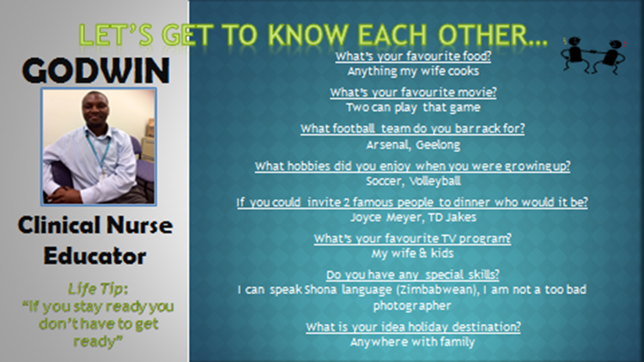
Notes:
An example

Slide 50
Paste an example of a know each other form filled out from someone in your service here
Notes:
Before the training you may want to ask someone well known to the participants to fill out a Know Each Other Template (this could be anyone from your CEO to your administration, payroll staff etc.) with the persons consent read this out during the training.

Slide 51
Know each other fidelity
Know each other
IS
Patients and staff sharing personal information to facilitate conversations and show mutual respect
A space where staff and patients can show their common humanity.
=
  Staff sharing personal information with staff, or giving information to patients to emphasise power differences and unbalanced relationships.
  Staff showing who they are to each other in front of patients
Know each other
IS NOT
≠
Notes:
Taken from a PowerPoint from a presentation by Professor Len Bowers

Slide 52
Know each other adjustments
  CAMHS None, although staff must provide some age-relevant, interesting content
  Forensic More careful vetting and review of contents
  Older people None, although relatives may be needed as a source of information for patients, link to life story work again
Notes:
Taken from a PowerPoint from a presentation by Professor Len Bowers

Slide 53
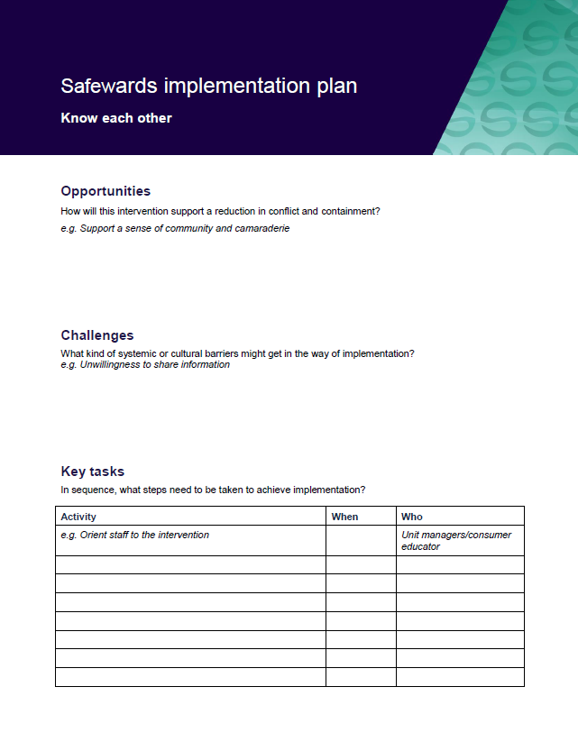
Task: Create your know each other implementation plan
In groups, spend time working on your implementation plan
Notes:
Task: ask participants to form groups and fill out the implementation template for KEO

Slide 54
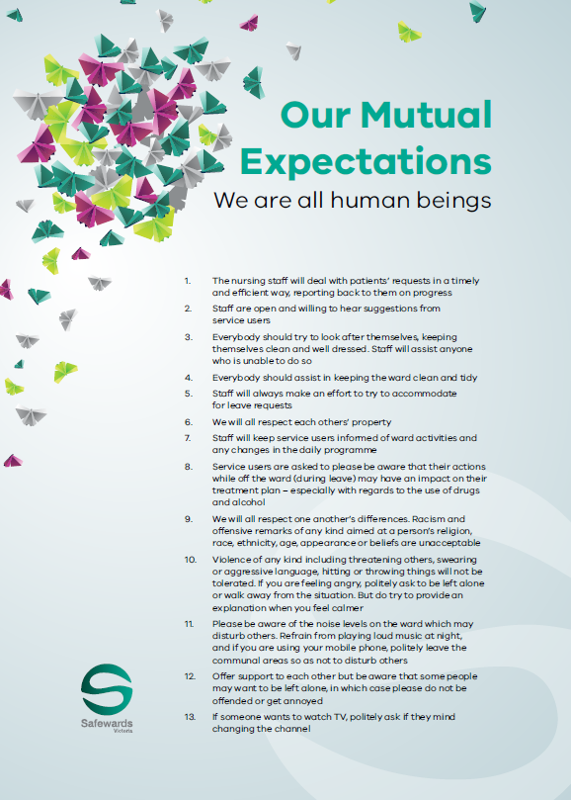
Clear mutual expectations
Notes:
Brief overview of clear mutual expectations (CME)

Slide 55
Background and aims
  Background
  Some flashpoints, and therefore conflict, are due in part to unclear expectations, lack of clarity or inconsistency on the unit.
  Aims
  Create a more egalitarian social unit
  Mutual holding to account
  Set clear standards for both staff and patients
  Build consistency and predictability while allowing flexibility
  Ensure patients and staff understand their obligations to each other
Notes:
See http://www.safewards.net/interventions/clear-mutual-expectations which states that lack of consistency can affect people who may be unwell, distracted, have difficulty interpreting what has been said, experiencing fluctuations in mood, have a history of trauma etc.

Slide 56
Clear mutual expectations and the Safewards model
Staff modifier:
Sharing expectations, finding mutual agreement
Staff modifiers
Patient modifiers: Sharing expectations, finding mutual agreement
Patient modifiers
Originating domains:
Patient Community
Staff Team
Patient Characteristics
Physical environment
Originating domains
Flashpoints
Conflict
Containment

Slide 57
Lack of consistency and clarity can cause problems
  Lack of consistency and clarity is annoying for almost everyone. It may particularly affect those who:
  aren't thinking clearly
  are distracted by distressing thoughts or emotions, or are preoccupied
  have difficulty interpreting communication
  experience changes in mood
  have a distorted, or different, view of world and others
  have a history of trauma
Notes:
http://www.safewards.net/interventions/clear-mutual-expectations
Lack of consistency and clarity can be difficult for everyone.

Slide 58
Mutual expectations for consideration
  General expectations
  Staff
  Excluded items
  Property
  Places
Notes:
http://www.safewards.net/interventions/clear-mutual-expectations
These may be helpful topics to start thinking about mutual expectations.

Slide 59
Role of the clear mutual expectations lead
  Ensure clear mutual expectations meetings occur
  Communicate meeting results in a visible manner e.g. posters
  Ensure the clear mutual expectations are discussed:
      If you're the admitting nurse, show the information/poster and explain its contents
      If you are on duty when a person is admitted, remind the admitting nurse to refer to the clear mutual expectations
      At handover, ask whether the poster has been shown and explained to new patients
Notes:
What ideas do you have for design on your unit?
The Safewards Victoria video on clear mutual expectations would be helpful here

Slide 60
Clear mutual expectations fidelity
  Sharing expectations across the community for consistency and high standards of behaviour
  Facilitating public conversation about how different groups sharing one space can respect one another
Clear mutual expectations
IS
=
Clear mutual expectations
IS NOT
  Codifying rules for patients so staff have an easier time telling patients what to do
  A pretty poster or mission statement to point to when things get tricky
≠
Notes:
Taken from a PowerPoint from a presentation by Professor Len Bowers

Slide 61
Clear mutual expectations adjustments
  CAMHS None
  Forensic None
  Older people None, usable by all
Notes:
Taken from a PowerPoint from a presentation by Professor Len Bowers

Slide 62
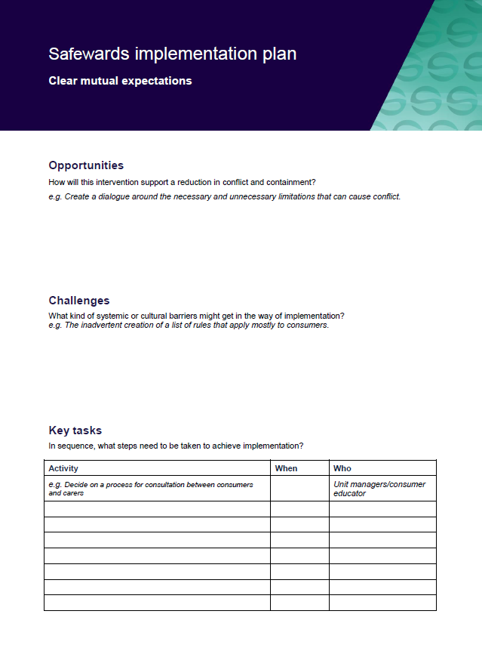
Task: Create your clear mutual expectations implementation plan
In groups, spend time working on your implementation plans

Slide 63


Positive words
Notes:
Provide a brief overview of what positive words is
http://www.safewards.net/interventions/positive-words

Slide 64

Background and aims
  Background
  At handover the focus is often on describing challenging behaviour or risks to the patient or others. This may promote a negative perception of patients, rather than a balanced view of strengths and ways of working with a person.
  Aims
  Know peoples’ strengths as well as their challenges
  Give the staff something positive and practical to work with
  Set an optimistic start to every shift
  Try to redress the power differential (remember the person is not in the room!)
Notes:
Outline the background and aims of this intervention
http://www.safewards.net/interventions/positive-words

Slide 65
Positive words and the Safewards model
Staff modifier:
Using positive words & psychological understanding in handover
Staff modifiers
Patient modifiers
Originating domains:
Staff Team
Patient Characteristics
Originating domains
Flashpoints
Conflict
Containment

Slide 66
Handover in practice
Primary role
  Only time the team gets together to discuss each patient
  The meeting has a critical organisational function – discussion of key risks, new patient admissions
Current approach
Discussions are usually focused on:
Exceptional patient behaviour
Patient behaviour that is viewed as challenging or presents risks to others
Comments that can lead to a negative perception of patients and a negative start to the shift
Notes:
Outline the function of handover and some of the issues that can be associated with handover.
http://www.safewards.net/interventions/positive-words

Slide 67
Safewards approach to handover
Balance the natural tendency to focus on issues and negative aspects of patient behaviour
Positive words focus:
Say something positive about each patient at handover
      Promote a positive appreciation of patients to reduce the likelihood of further conflict
When challenging behaviour or situations are described, offer a possible psychological explanation
Provide potentially useful strategies or information for working with the person
Supporting document ‘Understanding patient characteristics and experiences’

Slide 68
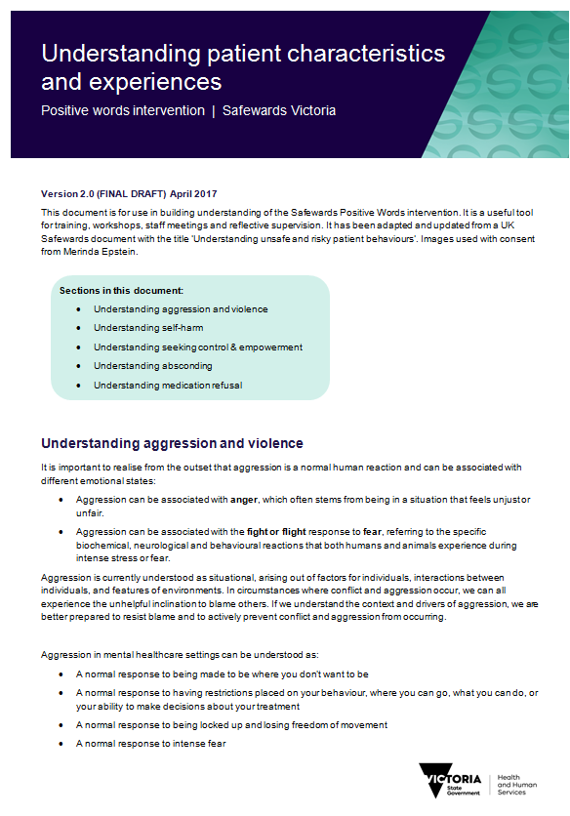
Task: Using psychological explanations
  Break into small groups:
  Understanding aggression and violence
  Understanding self harm
  Understanding seeking control and empowerment
  Understanding absconding
  Understanding medication refusal
  Activity:
  Read the relevant section in the handout
  ‘Understanding patient characteristics and
  and experiences’
  Discuss how the explanations in the handout
  could be applied in an actual handover

Slide 69


Task: Examples of negative words and phrases
  What are some of the negative words and phrases that are overused in your setting?
  What might be some alternatives you could use?

Slide 70
Using positive comments
  The handout provides possible psychological explanations.
  This slide provides possible positive descriptions of people.
  Refer to past achievement, including before admission/illness
  Engaging with an activity
  Demonstration of coping
  Making a contribution or demonstrating patience
  Something the patient has enjoyed
Enjoyed a walk or slept well
Interacted more today
Has smiled and made eye contact
Returned to the unit on time after home leave
Looks brighter
  Visits and phone calls that went well
  Endurance and courage
  Coping with things better
  Expression of interest in something
  Having a good conversation
Notes:
http://www.safewards.net/interventions/positive-words

Slide 71
Role of the intervention leads
  In every handover, remind the person doing the handover to ask the following questions:
      What is the positive message about this patient?
      Why do we think the patient might have behaved in that way?
  Give every staff member a copy of the document ‘Understanding patient characteristics and experiences’
  Use the document to interpret patient behaviour on the unit for others on the team, and share knowledge or strategies that may be helpful
Notes:
Understanding unsafe and risky patient behaviours can be found on the Safewards website
http://www.safewards.net/interventions/positive-words

Slide 72

Task: Why did you choose to work in mental health?
Notes:
Hand out post it notes
Ask people to write their answer about what made them initially choose to work in mental health
Ask the group to read out their answer - or stick post its on the wall and trainers read out
Whiteboard the key words or themes: common themes are likely to be hope, to help others, to make a difference
Discuss how positive words connects us with what really matters
Reflect that sometimes we can become disconnected from this because of daily pressures, and this can make us forget to look for the positives in the people we work with, or to do the things that make the most positive difference to the people we work with.

Slide 73

Video: The power of words
https://www.youtube.com/watch?v=Hzgzim5m7oU
Notes:
This is a great video to end the positive words training with.
Here is the link for the positive words video https://www.youtube.com/watch?v=Hzgzim5m7oU

Slide 74
Positive words fidelity
  Tapping into the reason we came into mental health - that is, a desire to help
  Helping staff recognise and share positive views of patients’ strengths and counterbalance negative perceptions
  Helping staff use psychological explanations, knowledge and strategies that are helpful
  Starting the shift with hope, optimism and respect
Positive words
IS
=
  A rhetorical illusion of looking good and seeming to care
  Making sarcastic comments or describing patients in mock positive ways, concreting negative perceptions and culture
Positive words
IS NOT
≠
Notes:
Taken from a PowerPoint from a presentation by Professor Len Bowers

Slide 75
Positive words adjustments
  CAMHS None
  Forensic None
  Older people None, links to life story work
Notes:
Taken from a PowerPoint from a presentation by Professor Len Bowers

Slide 76
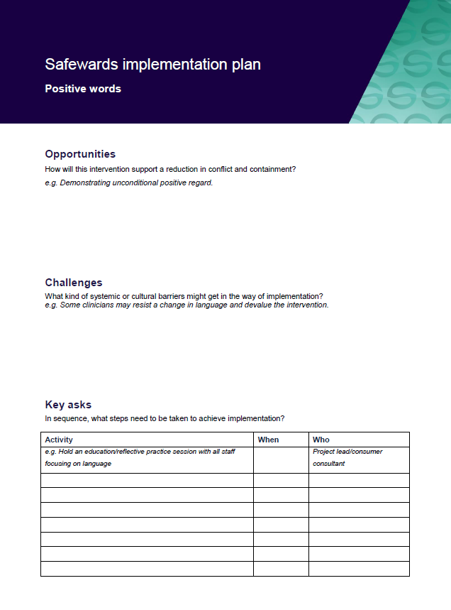
Task: Create your positive words implementation plan
In groups, spend time working on your implementation plans
Notes:
See appendix for template

Slide 77
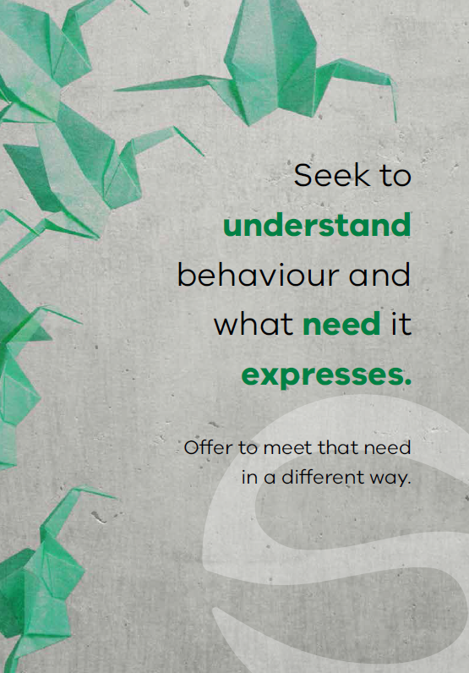

Soft words
Notes:
Briefly describe Soft Words (SW)

Slide 78

  “Violence by patients in psychiatric settings is frequently associated with the quality of staff-patient interactions”
  (Lancee, Gallop, McCay & Toner, 1995, p.609)
Notes:
Ask the group what they think about this statement and discuss the responses
This quote is taken from the article: Lancee, W. J., Gallop, R., McCay, E., & Toner, B. (1995). The relationship between nurses’ limit-setting styles and anger in psychiatric inpatients. Psychiatric Services, 46(6), 609-613.

Slide 79

Background and aims
  Background
  A primary flashpoint leading to violent incidents is limit setting. Whenever nurses ask patients to do something (or stop them from doing something), this can give rise to understandable frustration.
  This intervention provides some ways to avoid confrontations and work more collaboratively with patients.
  Aims
  Expand staff skills and choices in relation to limit setting and flashpoint situations
  Increase the options available on the unit
Notes:
http://www.safewards.net/interventions/soft-words

Slide 80
Soft words & the Safewards model
Staff modifiers
Staff modifier: Using soft words
Patient modifiers
Flashpoint: Setting limits
Originating domains
Flashpoints
Conflict
Containment

Slide 81
Why do we set limits?
Psychological understanding
Own anxiety & frustration
Perception of risk
Understanding of local policy
Staff
modifiers
Staff modifiers
Patient modifiers
Regulatory framework: Perceived requirements
Flashpoint: Setting limits
Patient characteristics: Perceived needs
Flashpoints
Conflict
Containment
Originating domains

Slide 82
Soft words: Why it matters (example 1)
‘I don’t deserve anything’ (shame)
Staff modifiers
‘You took my choice away’
‘You agree that I don’t deserve anything’
Flashpoint (Increased shame)
Patient modifier: Psychological understanding
Patient modifiers
Patient characteristics
Trauma / abuse
Low self-esteem
Flashpoint: Setting limits
Flashpoints
Conflict
Containment
Originating domains
Conflict:
Self-harm

Slide 83
Soft words: Why it matters (example 2)
‘I’ve never had any choice’ (fear)
Staff modifiers
‘You took my choice away’
‘With less control I now feel even more unsafe’
Flashpoint (Increased fear)
Patient modifier: Psychological understanding
Patient modifiers
Patient characteristics
Trauma / abuse
Disadvantage
Feeling unsafe / anxiety
Conflict: Fight or flee (aggression or abscond)
Flashpoints
Originating domains
Flashpoint: Setting limits
Conflict
Containment

Slide 84
Soft words: Why it matters (example 3)
‘I’ve always had choice’
Staff modifiers
‘You took my choice away’
‘This is not fair!’
Flashpoint (Anger)
Patient modifier: Psychological understanding
Patient modifiers
Patient characteristics
Strong sense of justice & fairness
Confidence
Flashpoints
Flashpoint: Setting limits
Conflict
Containment
Originating domains
Conflict: Aggression

Slide 85
Soft words in practice
Staff modifier: Using soft words
Staff modifiers
Patient modifiers
Flashpoints
Originating domains
Setting limits?
Conflict
Containment

Slide 86
Soft words in practice
What domains do you need to respond to?
Staff modifier: Using soft words
Staff modifiers
Patient modifiers
Physical environment: Privacy & dignity?
Regulatory: Upholding rights?
Flashpoints
Originating domains
Setting limits?
Conflict
Containment
Patient characteristics: Offer support and interventions?

Slide 87
Soft words in practice
What domains do you need to respond to?
Do you really need to set the limit? Try to say ‘yes’ instead.
Staff modifier: Using soft words
Staff modifiers
Patient modifiers
Physical environment: Privacy & dignity?
Regulatory: Upholding rights?
Flashpoints
Originating domains
Setting limits?
Conflict
Containment
Patient characteristics: Offer support and interventions?

Slide 88
Soft words in practice
What domains do you need to respond to?
Do you really need to set the limit? Try to say ‘yes’ instead.
Staff modifier: Using soft words
Can you minimise the limit, offer choices, negotiate?
How can you be as respectful as possible?
Staff modifiers
Patient modifiers
Physical environment: Privacy & dignity?
Regulatory: Upholding rights?
Flashpoints
Originating domains
Setting limits?
Conflict
Containment
Patient characteristics: Offer support and interventions?

Slide 89
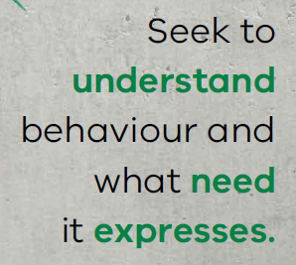

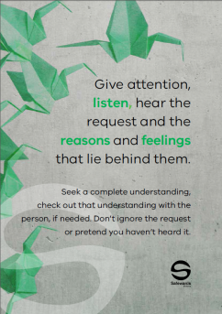
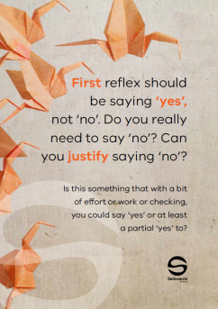




Soft words in practice
  This intervention helps to avoid confrontation and improve collaboration with patients – by reducing limit setting, or changing how limits are set.
  Soft words are communicated to the
  team using a ‘Message of the Day’
  poster displaying soft words tips,
  placed in the unit office and regularly
  changed and discussed.
Notes:
See the Safewards internet for examples http://www.safewards.net/interventions/soft-words
Soft words video may be useful here – shows soft words in practice – turning down a request from a patient

Slide 90
Task: Identifying themes
  Read through the poster examples and determine:
  How you might use the poster in practice
  Which theme/s each of your posters refers to (see below)
  Themes
  Being respectful and polite
  Turning down a request from a patient
  Asking a patient to do something
  Asking a patient to stop doing something
Notes:
Refer to the soft words ‘messages of the day’ in the resource pack.
Break the participants into 4 groups and provide with the posters from one of the 4 themes listed on the slide.
Each group is assigned a theme, ask them to read through each of the poster examples and identify which theme their posters are and how they would use the resource in practice.
The aim would be to both use them as a training resource with colleagues i.e. talking through the purpose of the poster and also role modeling how to interact with consumers using these principles.

Slide 91

Role of the intervention lead
  Remind team about soft words
  Change the soft words poster every day
  Draw attention to the poster
  Encourage others to consider limit setting and Soft Words in different situations
  In reflective practice and supervision
  During review of policy and procedures
  In handover or debriefing following incidents related to limit setting
  Who might be the most suitable lead?
Notes:
http://www.safewards.net/interventions/soft-words

Slide 92
Soft words fidelity
  Increasing staff options to prevent, or reduce the impact of, flashpoints related to limit-setting
  A means of reminding staff to use the best style of communication in difficult conversations
  A means of reminding staff to rethink limits and to promote patient choice (recovery-oriented)
Soft words
IS
=
  Hanging up signs
  A soft option as the standard of communication described is high. Expect to be challenged.
Soft words
IS NOT
≠
Notes:
Taken from a PowerPoint from a presentation by Professor Len Bowers

Slide 93
Soft words methods adjustments
  CAMHS none
  Forensic none
  Older people none, but may want to create expanded version with greater relevancy
Notes:
Taken from a PowerPoint from a presentation by Professor Len Bowers

Slide 94
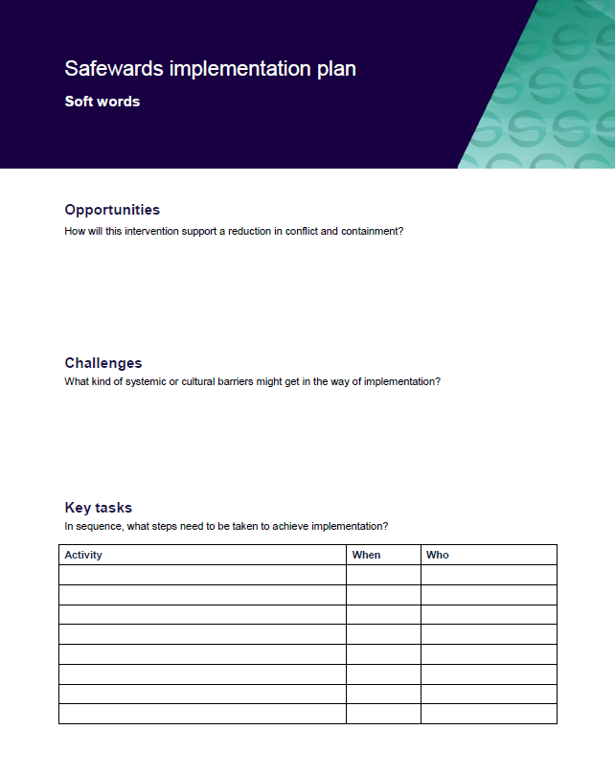
Task: Create your implementation plans
In groups, spend time working on your implementation plans
Notes:
If you have enough participants split them into 10 groups and ask them to spend 15 minutes working on one of the implementation plans.

Slide 95
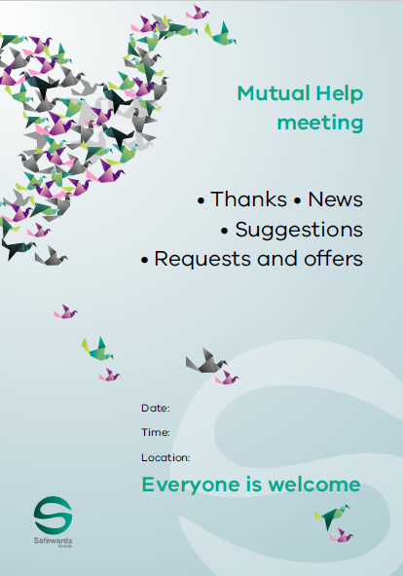
Mutual Help Meeting
Notes:
Briefly explain the essence of the mutual help meeting (MHM)

Slide 96


Background
  The unit is a social community and potentially a powerful engine to help patients, have a positive influence, and progress towards discharge.
  The help that patients give each other can be highly valued and effective.
  The giving of help and support between patients offers the giver:
    a socially valued role
    the chance to make a meaningful contribution
    the potential to improve their self-esteem
Notes:
http://www.safewards.net/interventions/mutual-help-meeting

Slide 97

Aims
  Strengthen an existing mechanism that is highly valued by patients and staff
  Create opportunities for patients to find valued roles and public recognition
  Build patient self-esteem
  Increase mutual support and promote recovery
  Establish values, understanding and social connection
Notes:
http://www.safewards.net/interventions/mutual-help-meeting

Slide 98
Mutual Help Meeting and the Safewards Model
Staff modifier: Mutual help meeting
Staff modifiers
Patient modifier
Mutual support
Patient modifiers
Originating domains
Patient community
Patient characteristics
Originating domains
Flashpoints
Conflict
Containment

Slide 99

Task: Invaluable mutual support
  Think of an example where patient-to-patient mutual support has been invaluable on your unit…
Notes:
Ask the participants for some examples they have seen in practice
The Safewards mutual help meeting video may be useful hear to provide a consumer perspective

Slide 100
Conflict
  Inpatient aggression can arise from many different factors. This intervention focuses on preventing conflict that may arise from patient-to-patient interactions, or from being in a strange and/or frightening environment.
  Conflict can be reduced if patients:
      Positively appreciate each other
      Practice/learn ways regulate their own emotional reactions
      Support each other to uphold shared expectations
      Feel heard and valued
      Have access to mutual support
Notes:
http://www.safewards.net/interventions/mutual-help-meeting

Slide 101
Mutual Help Meeting
  A voluntary meeting of all patients and staff on duty
  The meeting’s focus is on how people can help each other
Notes:
http://www.safewards.net/interventions/mutual-help-meeting

Slide 102
Agenda
  Ensure each agenda item is covered during the meeting
  Round of thanks: All patients and staff can individually thank anyone or anything, present or not present, for anything they have done for them since the last meeting. Everyone is free to comment.
  Round of news: Staff can inform patients about upcoming events on the unit, or explain recent events on the unit that might be confusing or distressing. Ask everyone to watch over each other, keep each other safe, and call for help if they are worried.
  Round of suggestions: Everyone has a chance to offer suggestions.
  Round of requests and offers: Patients discuss how others in the unit can help them, and make offers of support to each other.
Notes:
Here are some examples of offers and request you may wish to add (fromhttp://www.safewards.net/images/pdf/Mutual%20Help%20Meeting%20website%20download.pdf)
Share knowledge and experience about care and services
Support each other in practical tasks
Encourage each other to take part in structured activities
Accompany each other on walks or activates
Play games such as cards or table tennis
Discuss current affairs
Spend time with people
Share coping strategies, such as relaxation techniques
Make a drink for someone else
Sit next to someone at meal times
Say good morning
Ask how someone else is feeling
Listen to music or watch TV with someone and talk about it afterwards

Slide 103
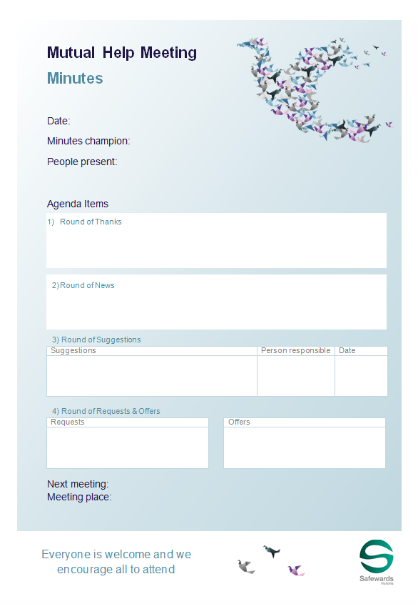
Staff roles
  Prepare for the group
    Room
    Support people
    Resources (agenda, flyer, poster, minutes, news)
    Ideally first thing in the morning
    Preferably every day (at least 3/week)
    Protected space/time
    Follows a structured agenda
    Once all the points are covered the meeting is closed
    Chaired by patients or staff
    Consider a log book
Notes:
http://www.safewards.net/interventions/mutual-help-meeting
Provide examples of how to prepare for the group
Prepare the room.
Gather patients and staff.
Prepare contributions and offer support in advance.
Acknowledge and support a complaint following your local processes. This isn’t the forum for complaints.

Slide 104
Staff roles
  Maintaining the meeting
    Encourage good contributions through positive feedback.
    Model mutual respect.
    Enable everyone to contribute.
    Seek information and opinions and provide information.
    Clarify and summarise for others.
    Suggest compromises and settlements.
    Offer advice on expression of mutual respect and positive appreciation
    Accurately describe any recent potentially distressing events on the unit (reassurance).
Notes:
http://www.safewards.net/interventions/mutual-help-meeting
Provide examples of how to prepare for the group
Prepare the room.
Gather patients and staff.
Prepare contributions and offer support in advance.
Acknowledge and support a complaint following your local processes. This isn’t the forum for complaints.

Slide 105

What to expect
  Attendance will grow if the meeting is held regularly and is talked about.
  Even with only a few people the meeting can be productive.
  Attendees can consider how they can help others who aren't attending.
  Small things can be important to people.
Notes:
http://www.safewards.net/interventions/mutual-help-meeting

Slide 106
Mutual Help Meeting fidelity
Mutual help meeting
IS
Getting patients together to agree on small things they can do to help and support each other, and valuing those activities once completed
In terms of patient care – a chance for staff to take a step back and patients a step forward
=
  A forum for complaints and suggestions from patients about what the staff or hospital should do or for staff to give news to patients
  Another group in the unit where staff have a debrief while patients go back to bed
Mutual help meeting
IS NOT
≠
Notes:
Taken from a PowerPoint from a presentation by Professor Len Bowers

Slide 107
Mutual help meeting adjustments
  CAMHS Constraints and guidance on allowable tasks, new list of suggestions worked out with young people, new patient documentation
  Forensic Constraints and guidance, limitations and rules about those, new patient support documentation
  Older people May still be creatively feasible
Notes:
Taken from a PowerPoint from a presentation by Professor Len Bowers

Slide 108
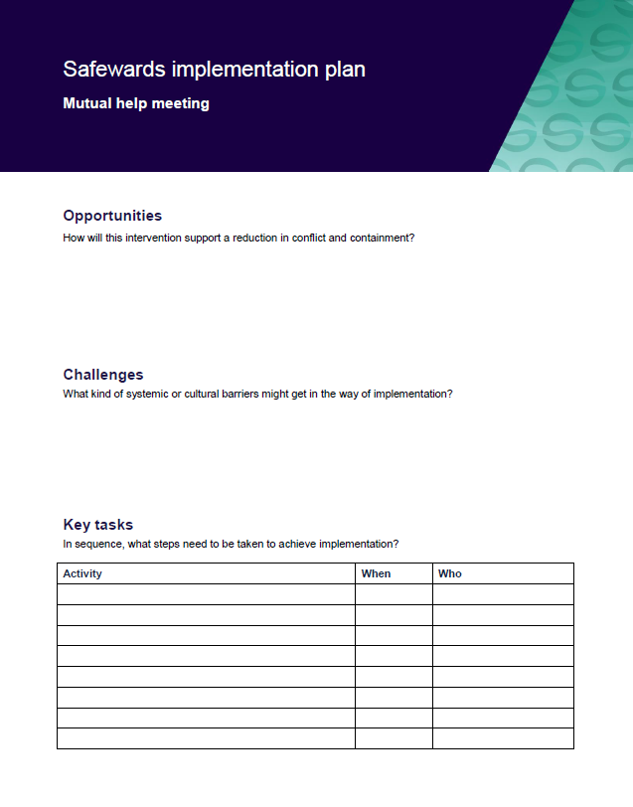
Task: Create your mutual help meeting implementation plan
Notes:
See appendix for implementation plan

Slide 109
Wrap up
  This workshop has covered the Safewards model and 5 interventions:
    Know each other
    Clear mutual expectations
    Positive words
    Soft words
    Mutual help meeting
  Next workshop will include:
    Revision of the model
    Reassurance
    Bad news mitigation
    Calm down methods
    Talk down
    Discharge messages

Slide 110


