Slide 1
Safewards 2 day Workshop Day 2

Slide 2
The model and interventions
Day 2
Theory
Revision of the Safewards model
Interventions
Reassurance
Bad news mitigation
Calm down methods
Talk down
Discharge messages
Notes:
This is what we will cover today. The rest of the 10 interventions from day 1.

Slide 3
Task: Reviewing the Safewards model
What does the term conflict mean?
What does containment mean?
What are the six originating domains of the model?
Can you describe what a flashpoint is?
What might a staff modifier be?
What might be a patient modifier be?
Notes:
Ask the group to answer each of these questions
Answers
Conflict: anything that can cause harm to patients, other patients or staff and visitors i.e. verbal aggression, physical aggression, property damage
Containment: actions that staff take to minimise the impact of conflict or stop it from happening i.e. restraint, seclusion, specialling
Domains: Staff team, patient community, patient characteristics, physical environment, outside hospital, regulatory framework
Flashpoint: A trigger that can precede conflict behaviour i.e. bad news, denial of request
Staff modifier: what staff can do to influence the situation i.e. offer psychological support
Patient modifier: what patients can do to prevent a flashpoint or self-regulate when a flashpoint occurs i.e. awareness of triggers

Slide 4
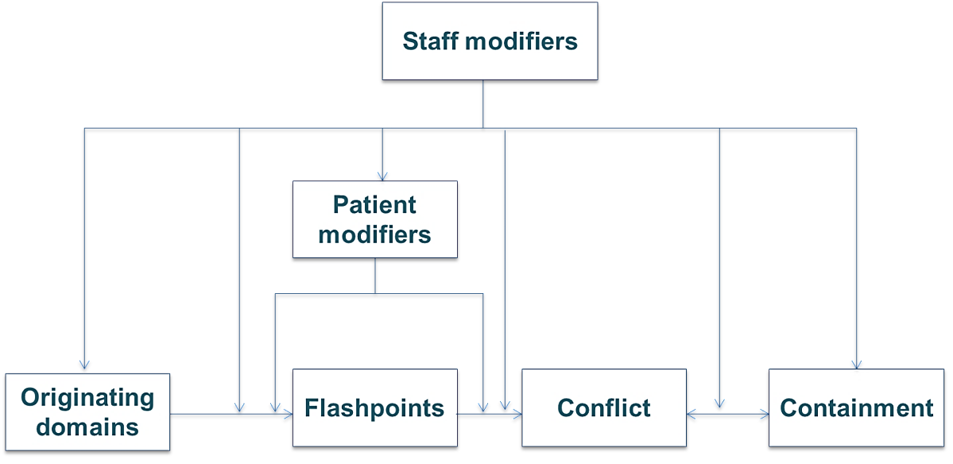
Revision: Summary Slide
Originating Domains
Staff Team
Patient Characteristics
Patient Community
Physical Environment
Outside Hospital
Regulatory Framework
Flashpoints
(triggers or tipping points)
Limit setting
Exacerbation
Noise
Locked doors
Loss of relationship
Denial of leave
Bad news
Conflict
(situations with risk of harm)
Verbal aggression
Suicide
Physical aggression
Property damage
Self Harm
Absconding
Containment
(restrictive interventions)
Seclusion
Physical restraint
Mechanical restraint
Chemical restraint
Use of security
Special observation
High dependency unit

Slide 5
Intervention Refreshers
KEO
SW
PW
CME
MHM
Notes:
Split the participants into 5 groups:
Know each other
Positive words
Clear mutual expectations
Mutual help meeting
Soft words
Ask each group to spend 10 minutes discussing and preparing to present on their assigned intervention to a small group of clinicians. Give a time limit of 5 minutes to present to the group.
The purpose of this activity is to check that trainers have understood the background and aim for each intervention from the previous workshop, as well as practice having to train clinician.

Slide 6
Reassurance
Notes:
Provide a brief overview of Reassurance
http://www.safewards.net/interventions/reassurance

Slide 7
Reassurance background
Already scared & vulnerable
Psychiatric units can be strange and scary places.
Every confrontation has the potential to be a flashpoint for another patient, creating a kind of ripple effect.
Unlike staff, patients are not free to leave the unit or get away to a safe place.
Witness a confrontation
Fight, flight or freeze
Increased, unbearable fear
Patients don’t have to be directly involved in a confrontation for it to have a distressing emotional impact.
Staff can help alleviate fear and other types of distressing emotions.

Slide 8
Reassurance aims
To proactively reassure every patient after every confrontation, incident or conflict on the unit
To reduce the potential ripple effect of conflict on the unit
To prevent or reduce the impact of flashpoints
To ensure patients feel safe and supported
Reassurance for patients is a bit like debriefing for staff

Slide 9
Reassurance and the Safewards model
Staff modifiers
Patient modifiers
Flashpoint: Confrontation on the unit
Originating domains
Flashpoints
Conflict
Containment

Slide 10
Reassurance and the Safewards model
Staff modifier: Provide reassurance
Staff modifiers
Patient modifiers: Know particular triggers for each person
Patient modifiers
Originating domains: Understand how domains increase the emotional impact of conflict
Flashpoint: Confrontation on the unit
Originating domains
Flashpoints
Conflict
Containment

Slide 11
Discussion
What other common occurrences on a mental health unit might increase patient fear?

Slide 12
Task: Walk in someone else’s shoes
Step forward…
Would you be approved for a bank loan easily?
Would you be asked to babysit a child?
Would you be asked to be a referee for a friend?
Would you be approved for life or health insurance?
Would you have no difficulty finding rental accommodation?
Would you be shortlisted for a job from your CV?
Would you feel support from friends, family and the community?
Are you well respected by the general public?
Does the media portray you in a positive way?
People wouldn’t consider you to be dangerous or unpredictable?
Would people consider you to be reliable?
Would people consider you to be trustworthy?
Notes:
See Appendix in the Handbook: Activity templates “walking in someone else’s shoes”
Laminate each of the examples (according to the number you have in the workshop) and have them cut to size before the training. Hand out a card to each of the participants (ensuring that at least one person gets a card which states they have a mental illness) and ask people to not reveal to each other what is on their card.
Ask everyone to gather at one end of the room.
Ask participants to take a step forward if they can answer yes to the question.
Read the questions out one by one.

Slide 13
Task: Walk in someone else’s shoes (continued)
For those who have only moved a few steps, consider the following:
How would feel at a dinner party if people identified you as this person?
Would people think that you use drugs or alcohol?
How would you be affected by public opinion and media reporting?
Would people use derogatory terms about you?
Would people think that you might be unpredictable even though they don’t know you?
Do people fear you even though they don’t know you?
Notes:
Continue reading all of the questions one by one. Once you have read all of the questions ask the people who have not moved forward far to reveal what is on their card.
Discuss how they felt, and how the others who moved forward felt. Here you can discuss the impact of stigma/shame/fear/sadness.
Discuss how this activity aimed to reinforce the powerful impact of stigma (an outside hospital originating domain) on how people might react to stressful situations.

Slide 14
Reassurance in practice Common situations requiring reassurance
Loud shouting/property damage/aggression: May provoke fear that could lead to defensive aggression, absconding, withdrawal and disengagement, suicidality
Self-harm - May provoke similar acts, can be distressing, provoke anger, shame or fear of one’s own internal impulses
Intoxication – May provoke fear about unpredictable behavior and personal safety
Show of staff force – (such as transferring a patient to high dependency area) Can undermine patient confidence in staff, make people feel vulnerable or bullied, provoke anger, fear or other distressing emotions, may trigger re-traumatization / flashbacks, panic, self-harm, suicidality
Notes:
Discuss some of the potentially anxiety provoking events listed here - ask the participants to give some examples from their ward.
http://www.safewards.net/interventions/reassurance

Slide 15
Reassurance in practice Explanation to patient and others
You do not have to be indiscreet or break confidentiality
You can draw upon psychological explanations for patient and staff actions, and use generalities.
For example:
“Sometimes when people are very unwell they may be frightened and confused – this might trigger aggression and we may need to intervene to keep everyone safe. This can look scary, but we are very careful to never hurt someone, and to try and protect people’s dignity”
Notes:
http://www.safewards.net/interventions/reassurance
Important to emphasize here that this intervention can be done without breaking confidentiality.

Slide 16
Reassurance in practice: Empathy is a critical staff skill
Brené Brown on Empathy (Youtube video)
https://youtube/1Evwgu369Jw

Slide 17
Reassurance in practice: Empathy is a critical staff skill
Empathy fuels connection, sympathy drives disconnection.
Key qualities of empathy:
Perspective taking
Staying out of judgement
Recognising emotion in other people
Communicating that
Empathy is feeling ‘with’ people.
Empathy can make us feel vulnerable because it means having to connect with something in yourself that knows that feeling.
Empathy means not trying to make things better.
Responses rarely make something better.
Connection with others can help people feel better
Brené Brown on Empathy (Youtube video)
https://youtube/1Evwgu369Jw

Slide 18
Intervention strategies
Intervention lead
Consider speaking to the nurse in charge of the shift (or as a group, such as at staff meetings) and request a method is identified for ensuring the following two points are identified:
Ensure reassurance action takes place following any incident.
When an incident is mentioned at handover, ask if 'reassurance' took place.
Notes:
The more time you spend with patients in a caring and meaningful way can reduce fear and anxiety

Slide 19
Intervention strategies
Intervention lead
After an event
Following a potential anxiety-provoking incident:
Speak with every patient, alone or in small groups, and ask them:
What is your understanding of what happened?
What affect did it have on you?
Provide an explanation of what happened
Consider how this is documented in relevant patient files

Slide 20
Intervention strategies
Be visible on the unit
Move about a lot and make sure you cover the whole unit
Be watchful (not in an anxious way) in a warm and caring manner
The goal of staff presence, explanation and support is to ensure everyone feels safe and secure
Notes:
The more time you spend with patients in a caring and meaningful way can reduce fear and anxiety

Slide 21
Reassurance fidelity
Heightening staff awareness of events that can make patients feel fear or other distressing emotions, and taking action so that doesn’t happen
A basic standard of consideration for people who have witnessed distressing events
Reassurance
IS
=
Telling patients things will be fine when they come to the office door and express a worry
Gossiping about other patients who may exhibit challenging behaviour
Reassurance
IS NOT
≠
Notes:
Taken from a PowerPoint from a presentation by Professor Len Bowers

Slide 22
Reassurance adjustments
CAMHS Simplify explanations and lower expectations of understanding
Forensic None
Older people None where message can be understood and retained
Notes:
Taken from a PowerPoint from a presentation by Professor Len Bowers

Slide 23
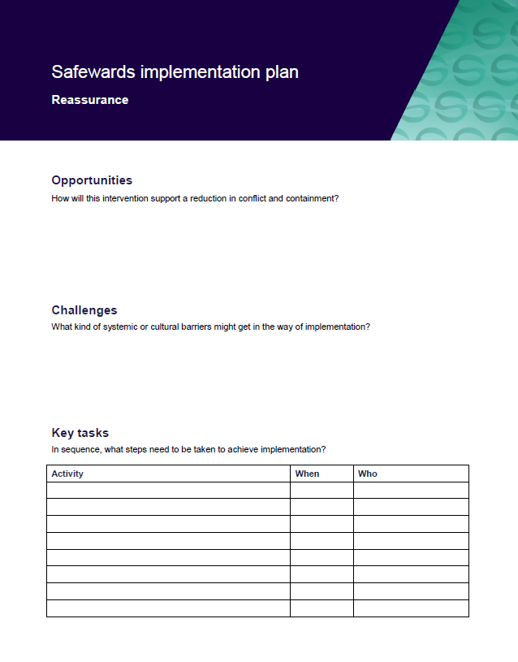
Task: Create your Reassurance implementation plans
In groups, spend time working on your implementation plans

Slide 24
Bad News Mitigation
Notes:
Explain bad news mitigation (BNM) briefly
It might be helpful to give an example when you have received bad news and how this felt for you (if you feel comfortable)

Slide 25
Background
People can be affected greatly by unwelcome news, and may want to leave the unit to seek familiar support or escape the cause of the news. Being given no choice to leave the unit when distressed, people may express feelings in an unsafe way.
Bad news from outside hospital can also cause conflict. Examples can include: death in the family, relationship breakdown, loss of tenancy, burglary, illness in the family, childcare issues, financial issues.
The resulting distress can cause increased irritability, aggression, violent incidents and absconding
Notes:
http://www.safewards.net/interventions/bad-news-mitigation

Slide 26
Bad news mitigation
Receiving bad news can be common during an inpatient stay. This intervention is about providing support during the delivery of news or afterwards, to mitigate the risk of flashpoints.
Key messages:
Bad news can create confusion and hinder understanding. Be respectful of a person’s views.
Being aware of occasions when people might get upsetting news.
Identify a proactive way to reach out to people before there is a reactive need to.

Slide 27
Bad news mitigation and the Safewards Model
Staff modifier: Mitigate bad news
Staff modifiers
Patient modifiers
Originating domains
Outside hospital
Regulatory framework
Flashpoint: receiving bad news
Originating domains
Flashpoints
Conflict
Containment

Slide 28
Bad News Mitigation in practice
Handover
Before news is delivered
After news is received
Ongoing support
Notes:
http://www.safewards.net/interventions/bad-news-mitigation
It is important to highlight that what is considered bad news can vary significantly from person to person therefore it is important to enquire, know the person well and look out for possible signs of distress.
Be aware of occasions and events that might trigger angry or upset reactions.
At handover, discuss as a team and share knowledge to predict who might receive unwelcome news and how support will be offered.
Work with the multidisciplinary team (MDT) to express bad news empathically or intercept after it has happened.
Maintain awareness of what is going on through regular one-on-one contact with the patient.
Know everyone’s general demeanor
Safewards bad news mitigation video helpful here – shows identification of bad news and planning

Slide 29
Bad News Mitigation in practice
Approach
Find a quiet place, give the person time to express their feelings.
Acknowledge their feelings, express empathy.
Answer any questions honestly, giving time, attention and respect.
Show you are receptive to concerns - use listening techniques.
Be responsive and respectful of a person’s views.
Support the person to understand decisions and acknowledge feelings. This can improve relationships and make aggression, self-harm and absconding less likely.
Notes:
Ask for e.g. open-ended questions
Talking over a cup of tea
http://www.safewards.net/interventions/bad-news-mitigation

Slide 30
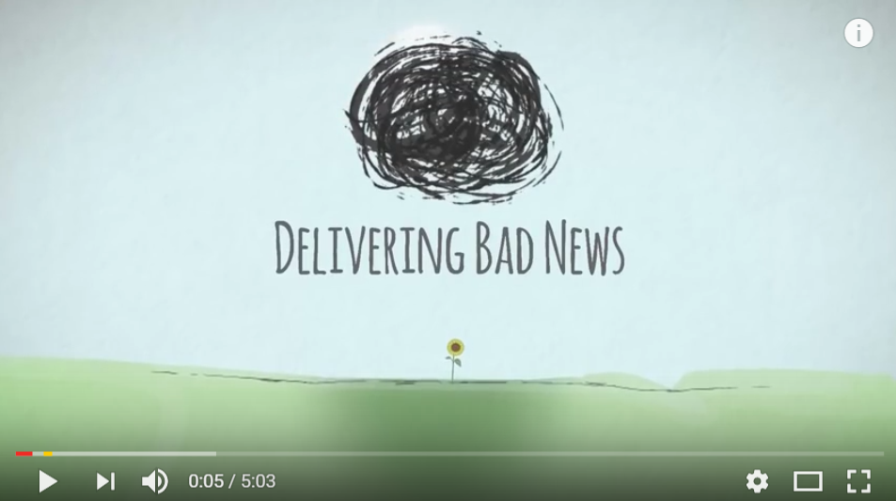
Delivering Bad News Video
https://www.youtube.com/watch?v=juKAMBh9J54
Source: The Irish Hospice Foundation, Youtube

Slide 31
Role of the intervention lead
Make sure these two questions are considered by the team at handover:
Has anyone received any bad news over the past shift? If they have, how can we support them?
Is anyone likely to receive bad news during the coming shift, and if so, how are we going to manage that?
Notes:
http://www.safewards.net/interventions/bad-news-mitigation
You may want to ask the group how they could ensure this process occurs, what measures will they put in place?

Slide 32
Bad news mitigation fidelity
A proactive way to reach out to people before there is a reactive need to
Keeping staff aware and looking for occasions when people might get upsetting news and delivering emotional support quickly
Giving patients enough information so they can determine whether it’s bad news or not
Bad news mitigation
IS
=
A way of protecting patients from life or threatening them with consequences or assuming how they will feel
Attaching the phrase ‘I am sorry to let you know’ when we tell patients they cannot have something they desperately want
Bad news mitigation
IS NOT
≠
Notes:
Taken from a PowerPoint from a presentation by Professor Len Bowers

Slide 33
Bad news mitigation adjustments
CAMHS None, but understanding for meaning and relevance to age group
Forensic None
Older people None, but understanding for meaning and relevance to age group
Notes:
Taken from a PowerPoint from a presentation by Professor Len Bowers

Slide 34
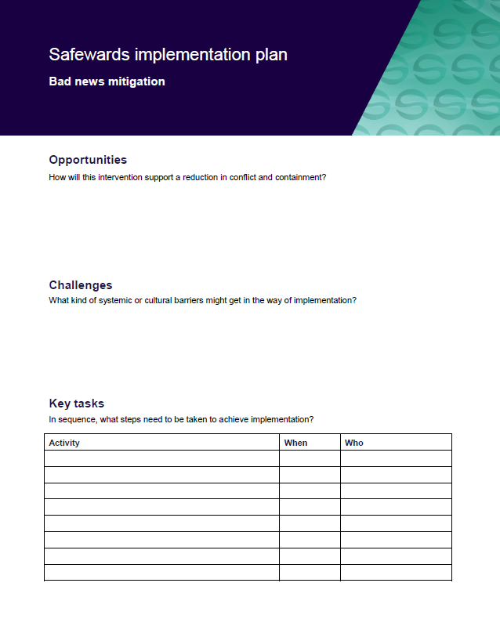
Task: Create your bad news mitigation implementation plan
In groups, spend time working on your implementation plans
Notes:
See appendix for template

Slide 35
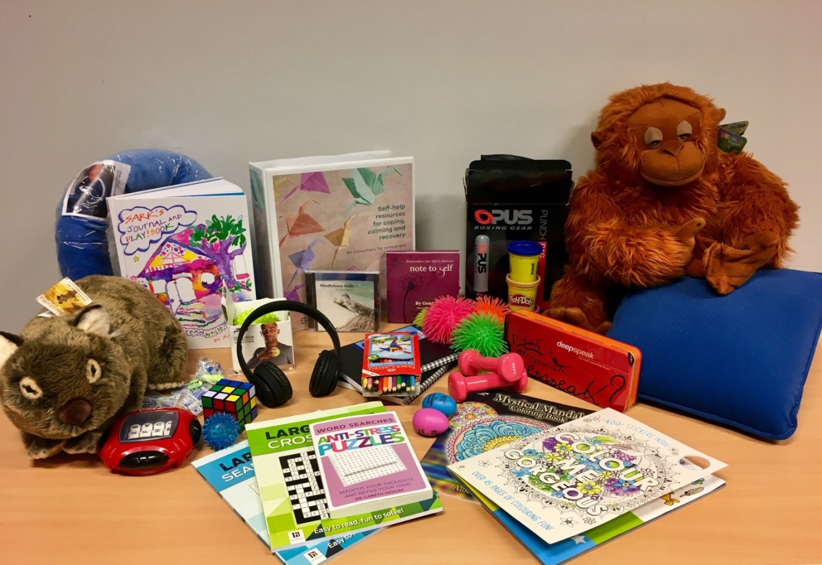
Calm down methods
Notes:
Briefly describe Calm Down Methods

Slide 36
Background and aims
Background
Pro re nata (PRN) medication can been used as an effective strategy to assist people to feel calm, but perhaps we reach for it too easily and too quickly. Where possible and practical, it’s always best to use the patient’s own strengths and coping mechanisms – or support people to develop new strengths and skills – to enable people to self-regulate.
Aims
Early de-escalation
Divert and prevent
Increase people’s sense of empowerment and self-control (these processes contribute to recovery)
Notes:
http://www.safewards.net/interventions/calm-down-methods

Slide 37
Calm Down Methods and the Safewards Model
Staff modifier:
Calm Down Methods
Staff modifiers
Patient modifiers
Originating domain
Patient characteristics
Originating domains
Flashpoints
Conflict
Containment

Slide 38
Benefits
PRN medication is an effective strategy for some people, some of the time, however calm down methods can:
Support people to draw on their own strengths and coping mechanisms
Offer alternatives to medication, that can be sustained well past an admission
Build self-knowledge
Facilitate learning of new strengths and skills
Notes:
http://www.safewards.net/interventions/calm-down-methods

Slide 39
Early signs of distress/agitation
Notice potential changes in:
facial expression
tone of voice
quick response to a normal reminder
restlessness
breathing patterns
body language
eye contact (or lack thereof)
movement around the ward
Notes:
Ask the group what changes they might identify
http://www.safewards.net/interventions/calm-down-methods

Slide 40
Task: Calm down methods handout
Think about what might be helpful for different types of ‘calm down’ needs.
Think about different types of resources and the functions they could serve.
‘It can be easy to say someone is agitated but harder to understand why’
Difficult emotions
Difficult thoughts and urges
Difficult experiences
Sensory & grounding, comfort & soothing, humour, distraction, mindfulness, inspirational, expressive & venting, harm minimisation, problem solving & reflection, movement & activity, drawing on nature or creativity
Notes:
Refer to the handout ‘Calm Down Methods: Resource Ideas’ from the resources pack.
Activity with handout
Split the group into small groups of 3-4 people. Think about a common need you may have seen on the unit and which item might sit with this intervention.
The handout can be used to prompt our thinking about the intervention
It can also be used to consider how you may add to the resources over time

Slide 41
Calm down methods in practice
Assemble a box of ‘calm down resources’ for your unit
Offer/explore calm down methods before considering PRN
Support people to explore the potential uses of calm down methods
Some of the calm down activities can be done together
Record calm down methods use in a log book, and patient files
Notes:
http://www.safewards.net/interventions/calm-down-methods
You could show the Safewards calm down methods video here

Slide 42
Role of the intervention lead
Suggest when calm down methods are appropriate
Ask if/how calm down was used when people mention agitation or PRN at handover
Ask if/how calm down was used if there was a restrictive intervention
Ensure resources are easily available to patients when needed
Check resources regularly to ensure items are returned, clean and in good working order (develop an infection control plan)
Replace missing, depleted or broken items
Expanding Calm Down Methods…
Look at increasing the number and type of resources over time
Make calm down resources available in more spaces
Think about how patients can take resources home after discharge
Notes:
http://www.safewards.net/interventions/calm-down-methods
You might also like to see some of the examples used in Victoria

Slide 43
Calm down methods fidelity
A practical set of equipment and patient resource for self–help when in distress
A store of equipment that can be used to help people who may be feeling agitated/restless, anxious/frightened, angry/irritable, ashamed or depressed/despairing to reach a relaxed state of mind
Calm down methods
IS
=
A box of things that gathers dust in the office or gets dragged to a group
A store of equipment for diversional or recreational activities for patients to do on request
Calm down methods
IS NOT
≠
Notes:
Taken from a PowerPoint from a presentation by Professor Len Bowers

Slide 44
Calm down methods adjustments
CAMHS Safety and supervision review, choice of items different
Forensic Safety and supervision review, choice of items different
Older people Safety and supervision review, choice of items different
Notes:
Taken from a PowerPoint from a presentation by Professor Len Bowers

Slide 45
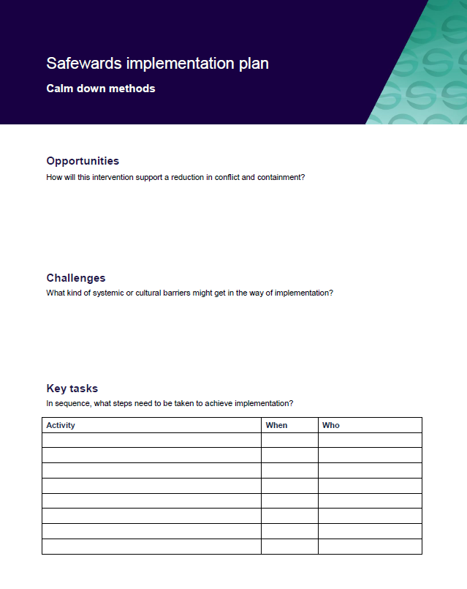
Task: Create your implementation plans
In groups, spend time working on your implementation plans

Slide 46
Talk down
Notes:
Briefly explain Talk Down-http://www.safewards.net/interventions/talk-down

Slide 47
Background
When people become agitated, fearful, angry, ashamed, depressed or suicidal, it should be possible to lessen people’s distress by talking to them
Most of us have had instruction in de-escalation in aggression management training but this may be limited
Safewards pulls together ‘Talk Down’ techniques into a meaningful picture
Notes:
http://www.safewards.net/interventions/talk-down

Slide 48
Aims
Build patient’s emotional self-management skills, self-monitoring, self-awareness and psychological understanding
Using crisis as an opportunity for therapeutic learning for everyone
Improve team cohesion, skill sharing, mutual support
Expand staff skill set
Avoid conflict and containment - or minimise the impact in the event of conflict and/or containment
Notes:
http://www.safewards.net/interventions/talk-down

Slide 49
Talk Down and the Safewards Model
Staff modifier:
Talk Down
Staff modifiers
Patient modifiers
Flashpoints
Conflict
Containment
Originating domains
Conflict:
Any type

Slide 50
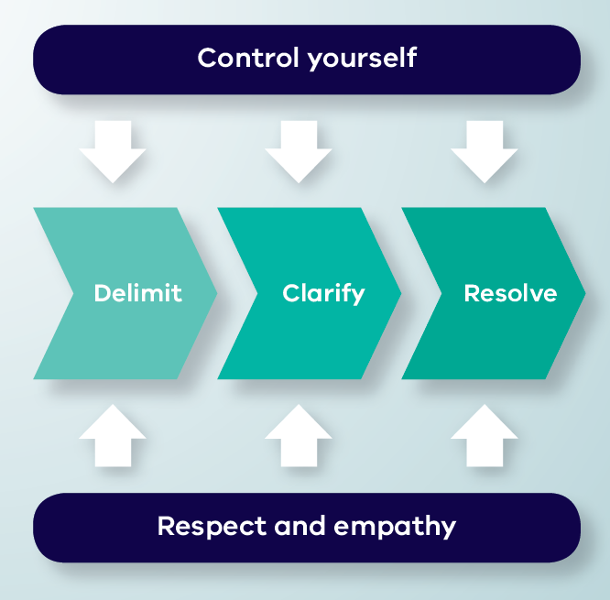
Talk Down Process
Notes:
Give a brief explanation of each of the boxes
You may like to show the talk down video here – this shows talk down in action. You can pause the video before the end description of the model, and ask participants to identify the aspects of the model the staff member has demonstrated.

Slide 51
De-escalation model
Depicts de-escalation as a process:
Starts with delimiting the situation
Moves onto clarification of the problem with the patient
Reaches a resolution
The model indicates that de-escalation is only likely to succeed if, at every stage, the de-escalator:
Controls their own emotions, and
Expresses respect and empathy for the patient
Notes:
Here you might like to split people into groups according to the different processes of Talk Down (delimit, clarify, resolve, control yourself, respect and empathy).
Ask each group to discuss the process they have been assigned
Then feed back to the group (you could do this all at once or use the following slides and ask the group who had the process to describe the process and use the following slides to reinforce the key points).
Allow about 15-20 minutes for this.
http://www.safewards.net/interventions/talk-down

Slide 52
Delimit
• Invite person to move to a quiet place, away from others, audience, people at risk
• Invite person to sit down
• Assess the need for support or backup
• Keep safe, maintain distance if required
Notes:
Go through each of the slides getting the group who focused on the process to feedback first
http://www.safewards.net/interventions/talk-down

Slide 53
Clarify
• Speak clearly, say who you are, use each other’s names, remind of existing relationship, offer your help
• Use open questions to ask what’s happening
• Listen attentively to patient
• Paraphrase what they’ve said to check your understanding
• Answer questions and clarify any misunderstandings
Notes:
http://www.safewards.net/interventions/talk-down

Slide 54
Resolve
• Give patient opportunity to self-regulate, consider using calm down methods
• Be flexible, if possible problem-solve and compromise together
• Offer choices and options
• Give reasons, explain rules, reasoning behind them, be honest, express fallibility (or even agree that it’s unfair)
• Deal with the complaint, apologise, make a change
• Make a personal appeal, remind them of any previously agreed strategy, summarise what’s been said
• Ask if there is anything else you
can do or say that will be
helpful, end positively
Notes:
http://www.safewards.net/interventions/talk-down

Slide 55
Control yourself
Actions
• Act calmly and confidently.
• Don’t corner patients, threaten or make false promises
• Don’t judge, criticise, show irritation, frustration, anger or be retaliative
• Let patient have the last word
Body language
• Have slow and gentle movements
• Relax face, don’t frown, or purse lips
• Relax body, no hands on hips or in pockets, don’t finger wag or prod
• Have lowered, uncrossed arms and open hands
Notes:
http://www.safewards.net/interventions/talk-down

Slide 56
…control yourself
Communication
• No hesitation or uncertainty of speech
• Don’t argue or say they are wrong and you are right
• Don’t defend or justify yourself
• Show no reaction to abuse or insults directed at you, ignore them or partially agree with them
• Prepare responses in advance to typical insults
Emotions
• Breathe deeply and concentrate on situation
• This is not personal and it is not about you

Slide 57
Respect and empathy
Actions
• Be congruent: your actions should match your words
• Listen, hear, acknowledge feelings and needs
• Don’t tell the patient what they should or should not be feeling
• Take time to hear the patient out, be patient and don’t hurry them
Body language
• Make eye contact (exercising care not to be confrontational)
Notes:
http://www.safewards.net/interventions/talk-down

Slide 58
…respect and empathy
Communication
• Extend self and thinking to understand patient viewpoint
• Have a concerned and interested tone of voice
• Don’t yell or shout over people
• Answer all requests for information, however they are phrased
Don’ts
• No advice giving and no orders, no “if I were you I would…”
• Don’t overly smile as this can be condescending

Slide 59
Summary
All the time:
Control yourself (Actions, Body language, Communication, Emotions)
Show respect and empathy (Actions, Body language, Communication)
Three step process:
Delimit: Ensure safety and privacy for all parties
Clarify: Find a shared understanding of the problem
Resolve: Find a solution together

Slide 60
Talk Down in practice
Video by Chris Hart, Youtube
https://youtu.be/Q4T-x1za6lg
Notes:
Watch the video
Ask the group to identify the parts of the model in the video.

Slide 61
Talk down in practice
A poster summarising de-escalation techniques is placed in an area frequented by staff
The unit decides on the ‘talk down’ lead
The lead spends 10-15 minutes with other members of the team explaining the poster and giving examples from their experience
The lead gives each staff member a copy of Talk Down ‘Staying open, friendly and positive handout’
The lead invites staff to read the poster, ask questions and use it to reflect after the process is used
Notes:
There are plenty of resources for this intervention e.g. the poster, the document on staying open friendly and positive, the explanation of the Talk Down poster contents for champions and the guidance for the on how to use the poster, please see the Safewards website

Slide 62
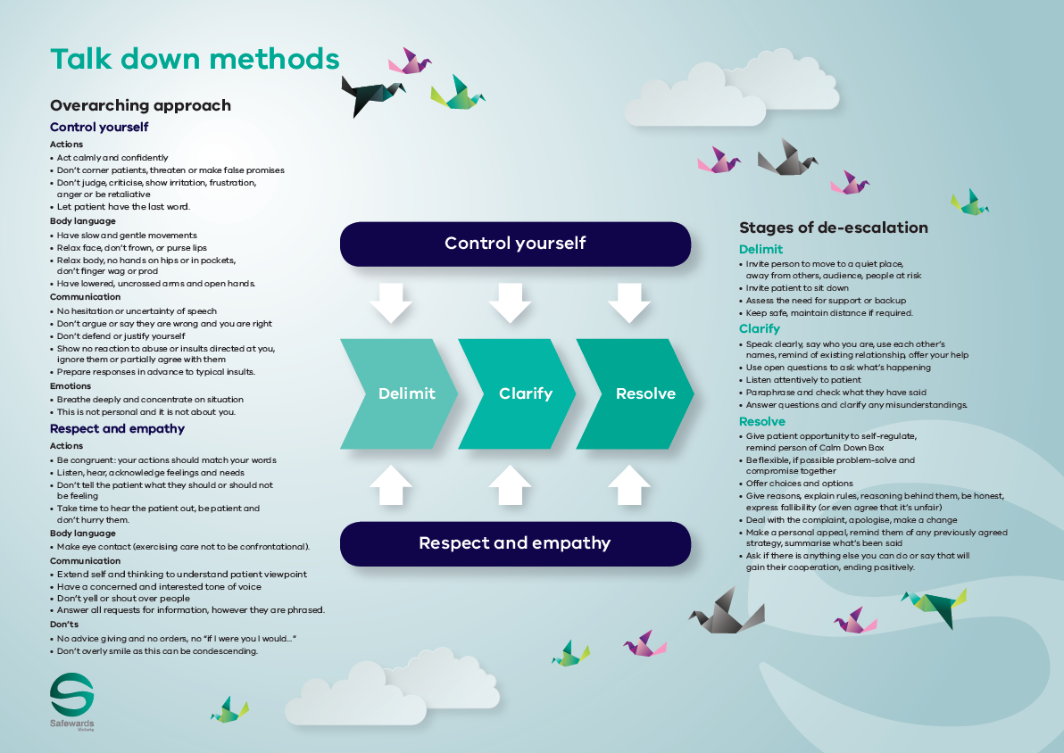
Talk down poster
The poster summarises how the de-escalation process would ideally work
The poster is a guide only. All de-escalation
situations vary
The reality is usually more muddled, nevertheless these principles can be applied to most situations to some degree
Notes:
http://www.safewards.net/interventions/talk-down

Slide 63
Role of the intervention lead – promote talk down
Highlight to the team when talk down methods are used effectively
Mention talk down in handovers or other team meetings
Express respect for use of talk down methods
Acknowledge the growing skill of the team
Consider using the poster when debriefing following an incident - not only recognising the skills that were used but also those that were not and discussing opportunities for improvement

Slide 64
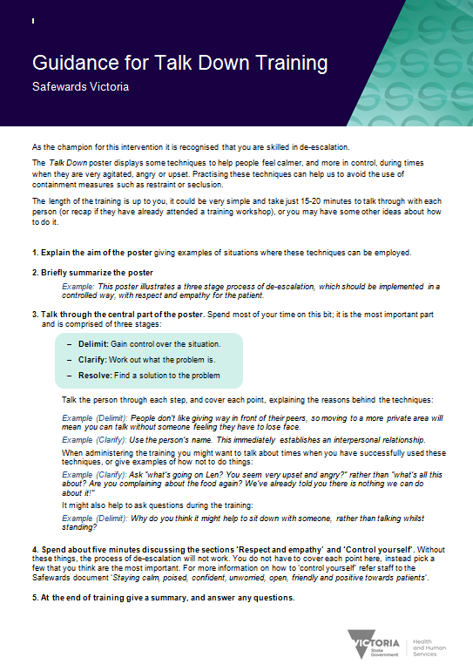
Resources for the intervention lead
Guidance for Talk Down training handout
‘Staying calm…’ handout
Notes:
There are quite a few handouts as previously mentioned to help with this intervention.
http://www.safewards.net/interventions/talk-down

Slide 65
Talk down fidelity
Expanding de-escalation skills and increasing psychological understanding, capitalising on the best of existing team skills and building team cohesion
A crystallisation of de-escalation skills packaged for unit-based teaching and promotion
Talk down
IS
=
Hanging a small poster in the corner of the unit, hoping the staff read it and understand it
Something that ‘happens anyway’ – ‘patient was de-escalated’ is often a myth
Talk down
IS NOT
≠
Notes:
It might help to ensure that the poster is placed in an area where de-escalation is commonly used.
Taken from a PowerPoint from a presentation by Professor Len Bowers

Slide 66
Talk down methods adjustments
CAMHS age-specific techniques
Forensic none
Older people age-specific techniques
What would you need to adjust on your unit?
Notes:
Taken from a PowerPoint from a presentation by Professor Len Bowers

Slide 67
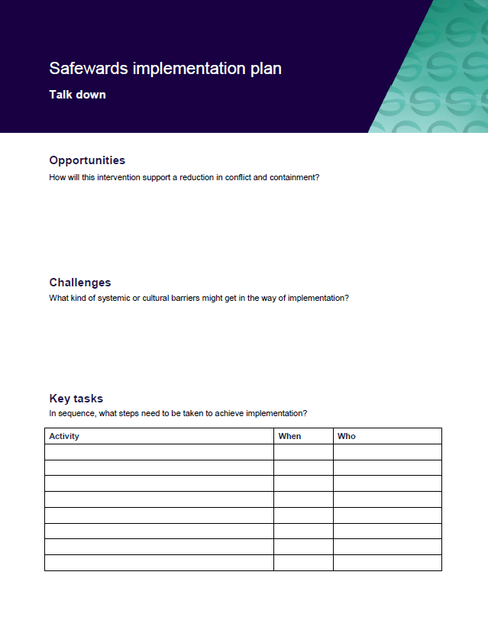
Task: Create your implementation plans
In groups, spend time working on your implementation plans
Notes:
See handbook for templates

Slide 68
Discharge messages
Notes:
Give a brief overview of Discharge Messages
http://www.safewards.net/interventions/discharge-message

Slide 69
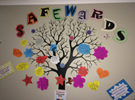
Background
Discharge messages provides a way of helping people connect with hope by:
Demonstrating care and concern
Attending to what people feel and are concerned about
Creating an avenue for patients to inspire and support each other (even anonymously)
Providing hopeful messages from other patients (rather than from staff)
Patient engagement is fundamental to this intervention
Notes:
http://www.safewards.net/interventions/discharge-message

Slide 70
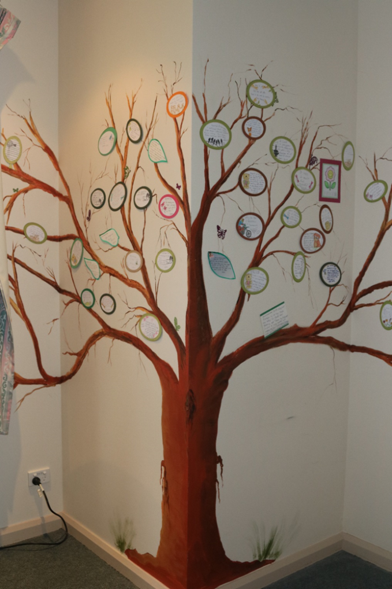
Aims
When a patient is preparing to leave, there is an opportunity for them to provide a discharge message as a form of closure for themselves and to help others on the unit.
Aims:
Provide authentic encouragement and support for new patients
Provide hope and convey messages about the purpose and potential benefits of an admission
Provide a boost to self-esteem / identity on leaving the unit through making a valued contribution to the patient community
Notes:
Ask people to think about integrating this intervention into practice eg-it is not just about someone leaving. It is also about engaging people who are on the unit who may be newly admitted, it is also about positivity and safety planning etc
http://www.safewards.net/interventions/discharge-message

Slide 71
Discharge messages and the Safewards Model
Staff modifier:
Discharge messages
Staff modifiers
Originating domains:
Patient community
Patient characteristics
Physical environment
Patient modifiers:
Hope, mutual help
Patient modifiers
Originating domains
Flashpoints
Conflict
Containment

Slide 72
Role of the intervention lead
Establish the discharge message tree or noticeboard
Check the discharge message tree or noticeboard, keep it tidy and remind staff to encourage writing a message when a patient's discharge is forthcoming
Remind patients the opportunity to complete a discharge message (this could be done during a mutual help meeting). Offer support to write the message if necessary.
Notes:
http://www.safewards.net/interventions/discharge-message
See examples from Victoria which may suit your ward.

Slide 73
Discharge messages fidelity
A way of passing on the messages & advice from leaving patients to arriving patients
Delivering positive messages to provide hope and encouragement to arriving patients
Discharge messages
IS
=
A way of highlighting how good the unit and staff are to visitors
Soliciting compliments from patients leaving the unit to make the staff feel good
Discharge message
IS NOT
≠
Notes:
Taken from a PowerPoint from a presentation by Professor Len Bowers

Slide 74
Discharge messages adjustments
CAMHS None
Forensic Goodbye messages, transfer messages
Older people None in some cases, impossible in others, engaging family
Notes:
Taken from a PowerPoint from a presentation by Professor Len Bowers

Slide 75
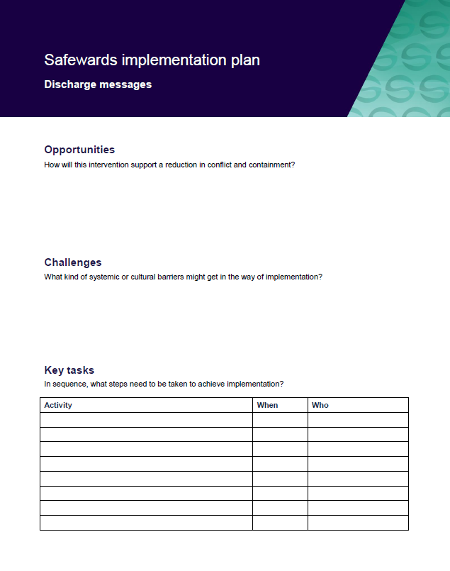
Task: Create your discharge messages implementation plans
In groups, spend time working on your implementation plans
Notes:
See handbook for templates

Slide 76
Interventions: Long-term implementation factors to consider
Notes:
The following slides are designed to refresh participants memories on each of the interventions and also to consider some of the issues that may occur in the medium to long term

Slide 77
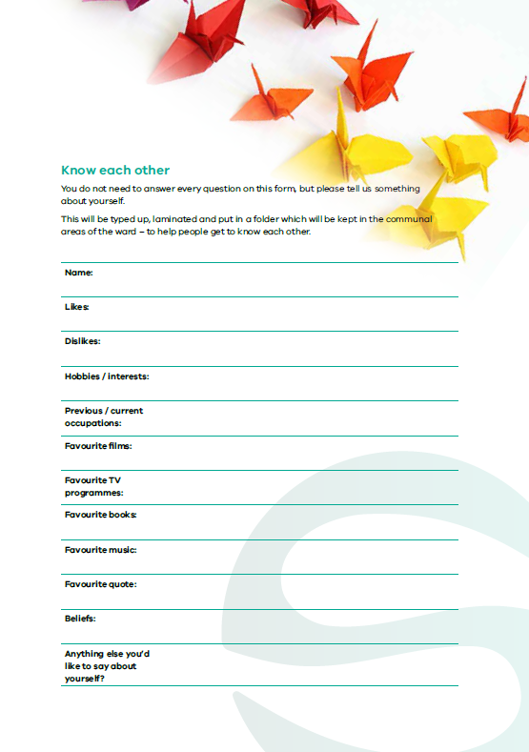
Know each other – long-term implementation
Unproblematic to continue long term if new staff contribute and the folders are maintained
Continuous input of new patients and their information renews this intervention
If this becomes routine for staff, they could be asked to contribute a new information sheet containing facts not previously shared
Notes:
Are there any suggestions for keeping this fresh?
Taken from a PowerPoint from a presentation by Professor Len Bowers

Slide 78
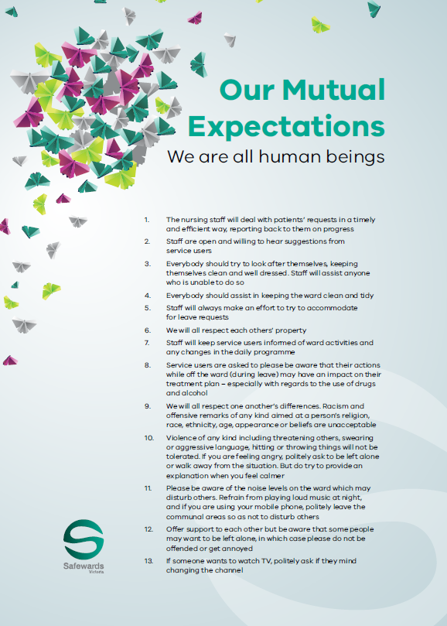
Clear mutual expectations – long-term implementation
Needs to be periodically renegotiated between the staff and patient group
Resources should be renewed, for example, by varying the design schemes and the negotiation process
Notes:
Units will need to decide when the CME need to be reviewed-it may need to be reviewed more frequently on units that have a higher turn over for example.
Adapted from a presentation by Professor Len Bowers

Slide 79
Positive words – long-term implementation
Aim for balanced communication to become part of professional communication
Renew by switching the focus of communication to other professionals (pharmacists, doctors, etc.)
Rotate the focus over longer time periods to reinforce the underlying impetus
Consult with consumer groups or patients on the unit to expand and identify strengths and positive features of patients that staff can use
Discharge reviews with an external facilitator could identify strengths the unit staff missed.
Notes:
Adapted from a PowerPoint presentation by Professor Len Bowers

Slide 80
Discharge messages – long-term implementation
Unproblematic to continue in the long term.
Renew and change the display type to refresh discharge messages.
Consider storage of older messages removed from tree (eg, photo album)
Notes:
Adapted from a PowerPoint presentation by Professor Len Bowers

Slide 81
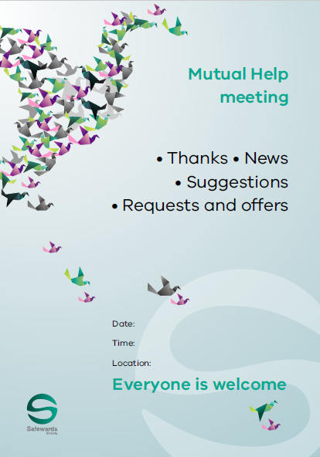
Mutual help meeting – long-term implementation
Meetings should improve as staff become more skilled and experienced in encouraging mutual support
Critical to pass on skills and experience to new staff and students
Networking and sharing successes and failures could assist with this intervention
Notes:
Adapted from a PowerPoint presentation by Professor Len Bowers

Slide 82
Bad news mitigation – long-term implementation
Periodically remind staff to maintain awareness of each patient’s personal life, and likely domains for bad news
Extend to make patients’ family and friends aware of the impact of bad news and share responsibility
Have signs and leaflets on the unit about the intervention and potential for receiving bad news
Include bad news mitigation as an agenda item during handovers
Notes:
Adapted from a PowerPoint presentation by Professor Len Bowers

Slide 83
Reassurance long term implementation
Unproblematic to implement on a permanent basis, but will require strategies to periodically remind staff to maintain awareness and act upon it
Consider including as an agenda item during handover
Consider the inattention that eventually follows a routinised practice - and consider other creative mechanisms

Slide 84
Calm down methods – long-term implementation
Equipment will need permanent care and a robust storage strategy
A budget will be required for replacements, and ideally to expand the types and number of resources over time
Review will be necessary to remove items that may prove to be problematic and to consider and approve replacements and substitutions
Reviews should consider strategies to maximise quick and easy patient access to resources
Notes:
Adapted from a PowerPoint presentation by Professor Len Bowers

Slide 85
Soft words – long-term implementation
Remove soft words statements then re-introduce to regain attention
Reformat or redisplay soft words statements in new ways
Challenge a team to write their own verses or compose their own soft words
Periodically revisit soft words and limit-setting in reflective practice and supervision
Notes:
Adapted from a PowerPoint presentation by Professor Len Bowers

Slide 86
Talk down – long-term implementation
Continually display the poster and change location
Use the poster in post-incident debriefing to identify strengths and weaknesses
Renew training when there is significant staff turnover
Incorporate into local aggression prevention training
Notes:
Adapted from a PowerPoint presentation by Professor Len Bowers

Slide 87
Final comments from Len…
If your intervention doesn’t alter any of the ‘staff modifiers’ identified in the Safewards Model, then it isn’t classified as a Safewards intervention
Although many Safewards interventions can be done creatively, that doesn’t mean anything creative or arty is a Safewards intervention
Notes:
Taken from a PowerPoint from a presentation by Professor Len Bowers

Slide 88
Final comments from Len…
None of the interventions will work if you and your team do not actually do them!
If you present an over-optimistic, exaggeratedly positive, all bad news removed story to your immediate manager, who does the same plus a bit extra to theirs, etc. then the people at the top think everything is wonderful and being put into effect, while in reality nothing much is happening on the wards at all
Notes:
Taken from a PowerPoint from a presentation by Professor Len Bowers

Slide 89
Feedback from Consumers and Carers
What mechanisms do you have for collecting feedback?
How will you know what impact Safewards is having?
The Safewards Victoria evaluation will look at how consumers feel about Safewards by inviting them to take part in surveys and focus groups

Slide 90
Wrap up
How will we move forward with Safewards?
What do you think will be some of the benefits of introducing Safewards?

Slide 91
Evaluation and questions

