Slide 1
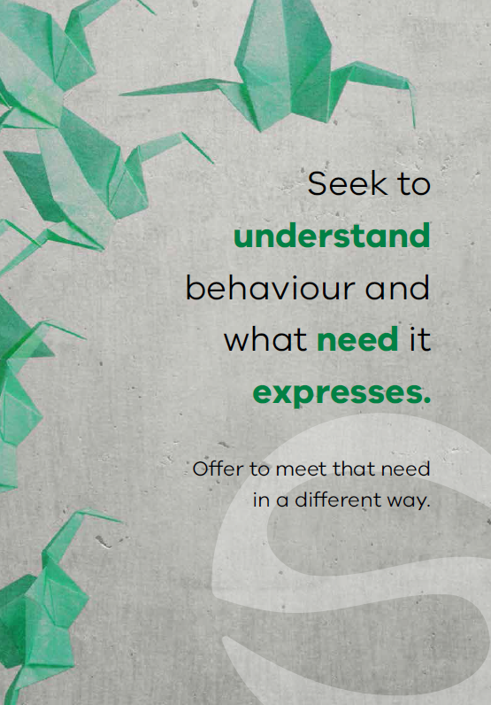
Soft words Refresher
Safewards
Notes:
Briefly describe Soft Words (SW)

Slide 2
Patient Community
Patient – patient interaction
Contagion & discord
Patient Modifiers
Anxiety management, Mutual support, Moral commitments, Psychological understanding, Technical mastery
Staff Modifiers
Explanation/information, Role modelling, Patient education, Removal of means, Presence & presence+
Outside Hospital
Patient Characteristics
Stressors
Visitors, Relatives & family tensions, Prospective –ve move
Dependency & institutionalisation, Demands & home
Flashpoints
Assembly/crowding/activity Queuing/waiting/noise Staff/pt turnover/change Bullying/stealing/
prop. damage
Symptoms & demography
Paranoia, PD traits, Irritability/disinhib., Abused, Male, Alc/drugs, Depression, Insight, Delusions, Hall.s, Young
Staff Modifiers
Carer/relative involvement
Family therapy
Active patient support
Staff Modifiers
Pharmacotherapy
Psychotherapy & functional analysis
Nursing support & interventions
Flashpoints
Bad news, Home crisis, Loss of relationship or accommodation, Argument
Flashpoints
Exacerbations;
Independence/identity
Acuity/severity
CONFLICT
&
CONTAINMENT
Flashpoints
Compulsory detention, Admission, Appeal refusal, Complaint denied, Enforced treatment, Exit refused
Flashpoints
Secrecy, Solitude,
Admission shock, Exit blocked
Staff Modifiers
Caringly vigilant & inquisitive, Checking routines, Décor, Maintenance, Clean & Tidy, Alternative choices, Respect
Staff Modifiers
Due process, Justice, Respect for rights,
Hope, Information giving, Support to appeal,
Legitimacy, Compensatory autonomy,
Consistent policy, Flexibility, Respect
Flashpoints
Denial of request,
Staff demand,
Limit setting, Bad news,
Ignoring
Features
Door locked, Quality, Complexity, Seclusion, PICU, ICA, Comfort/sensory rooms, Ligature points
External Structure
Legal framework, National policy, Complaints,
Appeals, Prosecutions, Hospital policy
Physical Environment
Regulatory Framework
Staff Modifiers
Staff anxiety & frustration, Moral commitments, Psychological understanding, Teamwork & consistency, Technical mastery, Positive appreciation
Internal Structure
Rules, Routine, Efficiency, Clean/tidy, Ideology, Custom & practice
Staff Team
Notes:
Provide a quick refresh of the model (see model refresher slides)
Where/how does MHM fit into the model?
What are the flashpoints and why?
What are the staff modifiers?
http://www.safewards.net/model/technical

Slide 3

  “Violence by patients in psychiatric settings is frequently associated with the quality of staff-patient interactions”
  (Lancee, Gallop, McCay & Toner, 1995, p.609)
Notes:
Ask the group what they think about this statement and discuss the responses
This quote is taken from the article: Lancee, W. J., Gallop, R., McCay, E., & Toner, B. (1995). The relationship between nurses’ limit-setting styles and anger in psychiatric inpatients. Psychiatric Services, 46(6), 609-613.

Slide 4

Background and aims
  Background
  A primary flashpoint leading to violent incidents is limit setting. Whenever nurses ask patients to do something (or stop them from doing something), this can give rise to understandable frustration.
  This intervention provides some ways to avoid confrontations and work more collaboratively with patients.
  Aims
  Expand staff skills and choices in relation to limit setting and flashpoint situations
  Increase the options available on the unit
Notes:
http://www.safewards.net/interventions/soft-words

Slide 5
Soft words & the Safewards model
Staff modifiers
Staff modifier: Using soft words
Patient modifiers
Flashpoint: Setting limits
Originating domains
Flashpoints
Conflict
Containment

Slide 6
Why do we set limits?
Psychological understanding
Own anxiety & frustration
Perception of risk
Understanding of local policy
Staff
modifiers
Staff modifiers
Patient modifiers
Regulatory framework: Perceived requirements
Flashpoint: Setting limits
Patient characteristics: Perceived needs
Flashpoints
Conflict
Containment
Originating domains

Slide 7
Soft words: Why it matters (example 1)
‘I don’t deserve anything’ (shame)
Staff modifiers
‘You took my choice away’
‘You agree that I don’t deserve anything’
Flashpoint (Increased shame)
Patient modifier: Psychological understanding
Patient modifiers
Patient characteristics
Trauma / abuse
Low self-esteem
Flashpoint: Setting limits
Flashpoints
Conflict
Containment
Originating domains
Conflict:
Self-harm

Slide 8
Soft words: Why it matters (example 2)
‘I’ve never had any choice’ (fear)
Staff modifiers
‘You took my choice away’
‘With less control I now feel even more unsafe’
Flashpoint (Increased fear)
Patient modifier: Psychological understanding
Patient modifiers
Patient characteristics
Trauma / abuse
Disadvantage
Feeling unsafe / anxiety
Conflict: Fight or flee (aggression or abscond)
Flashpoints
Originating domains
Flashpoint: Setting limits
Conflict
Containment

Slide 9
Soft words: Why it matters (example 3)
‘I’ve always had choice’
Staff modifiers
‘You took my choice away’
‘This is not fair!’
Flashpoint (Anger)
Patient modifier: Psychological understanding
Patient modifiers
Patient characteristics
Strong sense of justice & fairness
Confidence
Flashpoints
Flashpoint: Setting limits
Conflict
Containment
Originating domains
Conflict: Aggression

Slide 10
Soft words in practice
Staff modifier: Using soft words
Staff modifiers
Patient modifiers
Flashpoints
Originating domains
Setting limits?
Conflict
Containment

Slide 11
Soft words in practice
What domains do you need to respond to?
Staff modifier: Using soft words
Staff modifiers
Patient modifiers
Physical environment: Privacy & dignity?
Regulatory: Upholding rights?
Flashpoints
Originating domains
Setting limits?
Conflict
Containment
Patient characteristics: Offer support and interventions?

Slide 12
Soft words in practice
What domains do you need to respond to?
Do you really need to set the limit? Try to say ‘yes’ instead.
Staff modifier: Using soft words
Staff modifiers
Patient modifiers
Physical environment: Privacy & dignity?
Regulatory: Upholding rights?
Flashpoints
Originating domains
Setting limits?
Conflict
Containment
Patient characteristics: Offer support and interventions?

Slide 13
Soft words in practice
What domains do you need to respond to?
Do you really need to set the limit? Try to say ‘yes’ instead.
Staff modifier: Using soft words
Can you minimise the limit, offer choices, negotiate?
How can you be as respectful as possible?
Staff modifiers
Patient modifiers
Physical environment: Privacy & dignity?
Regulatory: Upholding rights?
Flashpoints
Originating domains
Setting limits?
Conflict
Containment
Patient characteristics: Offer support and interventions?

Slide 14
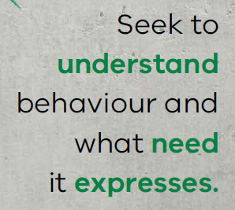
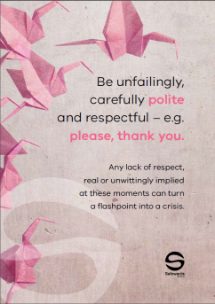
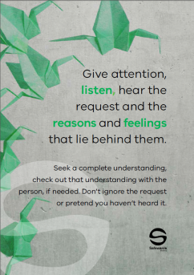
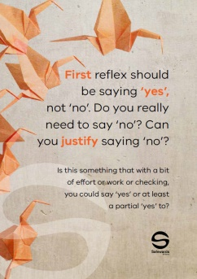
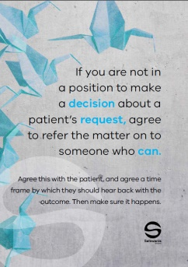

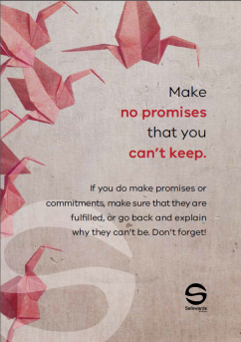
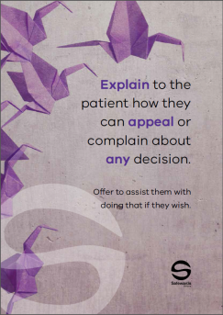
Soft words in practice
  This intervention helps to avoid confrontation and improve collaboration with patients – by reducing limit setting, or changing how limits are set.
  Soft words are communicated to the
  team using a ‘Message of the Day’
  poster displaying soft words tips,
  placed in the unit office and regularly
  changed and discussed.
Notes:
See the Safewards internet for examples http://www.safewards.net/interventions/soft-words
Soft words video may be useful here – shows soft words in practice – turning down a request from a patient

Slide 15
Task: Identifying themes
  Read through the poster examples and determine:
  How you might use the poster in practice
  Which theme/s each of your posters refers to (see below)
  Themes
  Being respectful and polite
  Turning down a request from a patient
  Asking a patient to do something
  Asking a patient to stop doing something
Notes:
Refer to the soft words ‘messages of the day’ in the resource pack.
Break the participants into 4 groups and provide with the posters from one of the 4 themes listed on the slide.
Each group is assigned a theme, ask them to read through each of the poster examples and identify which theme their posters are and how they would use the resource in practice.
The aim would be to both use them as a training resource with colleagues i.e. talking through the purpose of the poster and also role modeling how to interact with consumers using these principles.

Slide 16

Role of the intervention lead
  Remind team about soft words
  Change the soft words poster every day
  Draw attention to the poster
  Encourage others to consider limit setting and Soft Words in different situations
  In reflective practice and supervision
  During review of policy and procedures
  In handover or debriefing following incidents related to limit setting
  Who might be the most suitable lead?
Notes:
http://www.safewards.net/interventions/soft-words

Slide 17
Soft words fidelity
  Increasing staff options to prevent, or reduce the impact of, flashpoints related to limit-setting
  A means of reminding staff to use the best style of communication in difficult conversations
  A means of reminding staff to rethink limits and to promote patient choice (recovery-oriented)
Soft words
IS
=
  Hanging up signs
  A soft option as the standard of communication described is high. Expect to be challenged.
Soft words
IS NOT
≠
Notes:
Taken from a PowerPoint from a presentation by Professor Len Bowers

Slide 18
Soft words methods adjustments
  CAMHS none
  Forensic none
  Older people none, but may want to create expanded version with greater relevancy
Notes:
Taken from a PowerPoint from a presentation by Professor Len Bowers

