Slide 1

Safewards
Talk Down Refresher
Notes:
Briefly explain Talk Down-http://www.safewards.net/interventions/talk-down

Slide 2
Patient Community
Patient – patient interaction
Contagion & discord
Patient Modifiers
Anxiety management, Mutual support, Moral commitments, Psychological understanding, Technical mastery
Staff Modifiers
Explanation/information, Role modelling, Patient education, Removal of means, Presence & presence+
Outside Hospital
Patient Characteristics
Stressors
Visitors, Relatives & family tensions, Prospective –ve move
Dependency & institutionalisation, Demands & home
Flashpoints
Assembly/crowding/activity Queuing/waiting/noise Staff/pt turnover/change Bullying/stealing/
prop. damage
Symptoms & demography
Paranoia, PD traits, Irritability/disinhib., Abused, Male, Alc/drugs, Depression, Insight, Delusions, Hall.s, Young
Staff Modifiers
Carer/relative involvement
Family therapy
Active patient support
Staff Modifiers
Pharmacotherapy
Psychotherapy & functional analysis
Nursing support & interventions
Flashpoints
Bad news, Home crisis, Loss of relationship or accommodation, Argument
Flashpoints
Exacerbations;
Independence/identity
Acuity/severity
CONFLICT
&
CONTAINMENT
Flashpoints
Compulsory detention, Admission, Appeal refusal, Complaint denied, Enforced treatment, Exit refused
Flashpoints
Secrecy, Solitude,
Admission shock, Exit blocked
Staff Modifiers
Caringly vigilant & inquisitive, Checking routines, Décor, Maintenance, Clean & Tidy, Alternative choices, Respect
Staff Modifiers
Due process, Justice, Respect for rights,
Hope, Information giving, Support to appeal,
Legitimacy, Compensatory autonomy,
Consistent policy, Flexibility, Respect
Flashpoints
Denial of request,
Staff demand,
Limit setting, Bad news,
Ignoring
Features
Door locked, Quality, Complexity, Seclusion, PICU, ICA, Comfort/sensory rooms, Ligature points
External Structure
Legal framework, National policy, Complaints,
Appeals, Prosecutions, Hospital policy
Physical Environment
Regulatory Framework
Staff Modifiers
Staff anxiety & frustration, Moral commitments, Psychological understanding, Teamwork & consistency, Technical mastery, Positive appreciation
Internal Structure
Rules, Routine, Efficiency, Clean/tidy, Ideology, Custom & practice
Staff Team
Notes:
Provide a quick refresh of the model (see model refresher slides)
Where/how does MHM fit into the model?
What are the flashpoints and why?
What are the staff modifiers?
http://www.safewards.net/model/technical

Slide 3

Background
  When people become agitated, fearful, angry, ashamed, depressed or suicidal, it should be possible to lessen people’s distress by talking to them
  Most of us have had instruction in de-escalation in aggression management training but this may be limited
  Safewards pulls together ‘Talk Down’ techniques into a meaningful picture
Notes:
http://www.safewards.net/interventions/talk-down

Slide 4
Aims
  Build patient’s emotional self-management skills, self-monitoring, self-awareness and psychological understanding
  Using crisis as an opportunity for therapeutic learning for everyone
  Improve team cohesion, skill sharing, mutual support
  Expand staff skill set
  Avoid conflict and containment - or minimise the impact in the event of conflict and/or containment
Notes:
http://www.safewards.net/interventions/talk-down

Slide 5
Talk Down and the Safewards Model
Staff modifier:
Talk Down
Staff modifiers
Patient modifiers
Flashpoints
Conflict
Containment
Originating domains
Conflict:
Any type

Slide 6

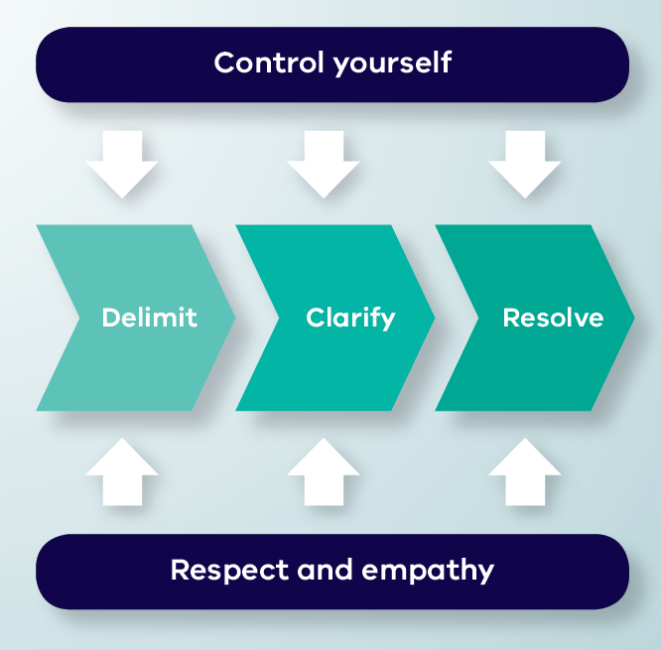


Talk Down Process
Notes:
Give a brief explanation of each of the boxes
You may like to show the talk down video here – this shows talk down in action. You can pause the video before the end description of the model, and ask participants to identify the aspects of the model the staff member has demonstrated.

Slide 7
De-escalation model
  Depicts de-escalation as a process:
  Starts with delimiting the situation
  Moves onto clarification of the problem with the patient
  Reaches a resolution
  The model indicates that de-escalation is only likely to succeed if, at every stage, the de-escalator:
  Controls their own emotions, and
  Expresses respect and empathy for the patient
Notes:
Here you might like to split people into groups according to the different processes of Talk Down (delimit, clarify, resolve, control yourself, respect and empathy).
Ask each group to discuss the process they have been assigned
Then feed back to the group (you could do this all at once or use the following slides and ask the group who had the process to describe the process and use the following slides to reinforce the key points).
Allow about 15-20 minutes for this.
http://www.safewards.net/interventions/talk-down

Slide 8

Delimit
• Invite person to move to a quiet place, away from others, audience, people at risk
• Invite person to sit down
• Assess the need for support or backup
• Keep safe, maintain distance if required
Notes:
Go through each of the slides getting the group who focused on the process to feedback first
http://www.safewards.net/interventions/talk-down

Slide 9
Clarify
  • Speak clearly, say who you are, use each other’s names, remind of existing relationship, offer your help
  • Use open questions to ask what’s happening
  • Listen attentively to patient
  • Paraphrase what they’ve said to check your understanding
  • Answer questions and clarify any misunderstandings
Notes:
http://www.safewards.net/interventions/talk-down

Slide 10
Resolve
  • Give patient opportunity to self-regulate, consider using calm down methods
  • Be flexible, if possible problem-solve and compromise together
  • Offer choices and options
  • Give reasons, explain rules, reasoning behind them, be honest, express fallibility (or even agree that it’s unfair)
  • Deal with the complaint, apologise, make a change
  • Make a personal appeal, remind them of any previously agreed strategy, summarise what’s been said
  • Ask if there is anything else you
  can do or say that will be
  helpful, end positively
Notes:
http://www.safewards.net/interventions/talk-down

Slide 11


Control yourself
  Actions
  • Act calmly and confidently.
  • Don’t corner patients, threaten or make false promises
  • Don’t judge, criticise, show irritation, frustration, anger or be retaliative
  • Let patient have the last word
  Body language
  • Have slow and gentle movements
  • Relax face, don’t frown, or purse lips
  • Relax body, no hands on hips or in pockets, don’t finger wag or prod
  • Have lowered, uncrossed arms and open hands
Notes:
http://www.safewards.net/interventions/talk-down

Slide 12


…control yourself
  Communication
  • No hesitation or uncertainty of speech
  • Don’t argue or say they are wrong and you are right
  • Don’t defend or justify yourself
  • Show no reaction to abuse or insults directed at you, ignore them or partially agree with them
  • Prepare responses in advance to typical insults
  Emotions
  • Breathe deeply and concentrate on situation
  • This is not personal and it is not about you

Slide 13
Respect and empathy
Actions
• Be congruent: your actions should match your words
• Listen, hear, acknowledge feelings and needs
• Don’t tell the patient what they should or should not be feeling
• Take time to hear the patient out, be patient and don’t hurry them
Body language
• Make eye contact (exercising care not to be confrontational)
Notes:
http://www.safewards.net/interventions/talk-down

Slide 14
…respect and empathy
Communication
• Extend self and thinking to understand patient viewpoint
• Have a concerned and interested tone of voice
• Don’t yell or shout over people
• Answer all requests for information, however they are phrased
Don’ts
• No advice giving and no orders, no “if I were you I would…”
• Don’t overly smile as this can be condescending

Slide 15
Summary
All the time:
Control yourself (Actions, Body language, Communication, Emotions)
Show respect and empathy (Actions, Body language, Communication)
Three step process:
Delimit: Ensure safety and privacy for all parties
Clarify: Find a shared understanding of the problem
Resolve: Find a solution together

Slide 16
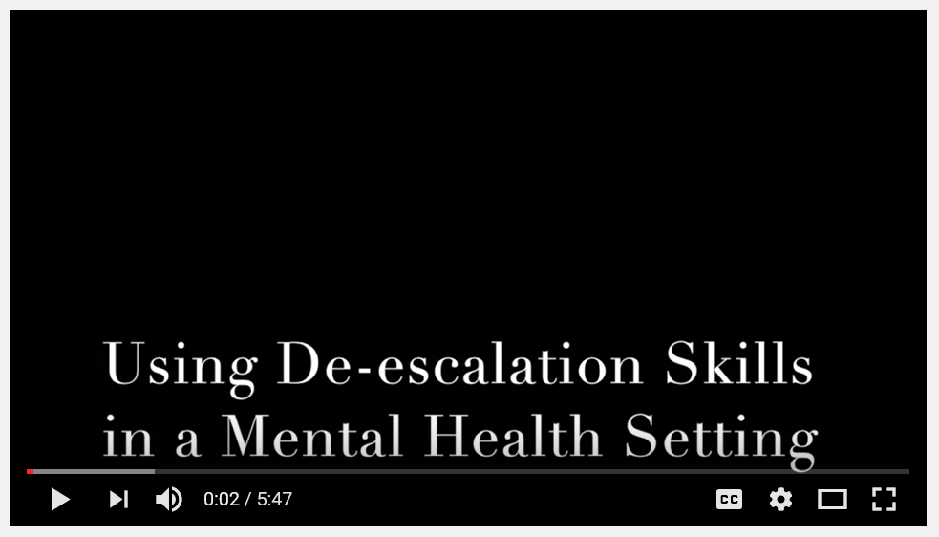
Talk Down in practice
Video by Chris Hart, Youtube
https://youtu.be/Q4T-x1za6lg
Notes:
Watch the video
Ask the group to identify the parts of the model in the video.

Slide 17

Talk down in practice
  A poster summarising de-escalation techniques is placed in an area frequented by staff
  The unit decides on the ‘talk down’ lead
  The lead spends 10-15 minutes with other members of the team explaining the poster and giving examples from their experience
  The lead gives each staff member a copy of Talk Down ‘Staying open, friendly and positive handout’
  The lead invites staff to read the poster, ask questions and use it to reflect after the process is used
Notes:
There are plenty of resources for this intervention e.g. the poster, the document on staying open friendly and positive, the explanation of the Talk Down poster contents for champions and the guidance for the on how to use the poster, please see the Safewards website

Slide 18
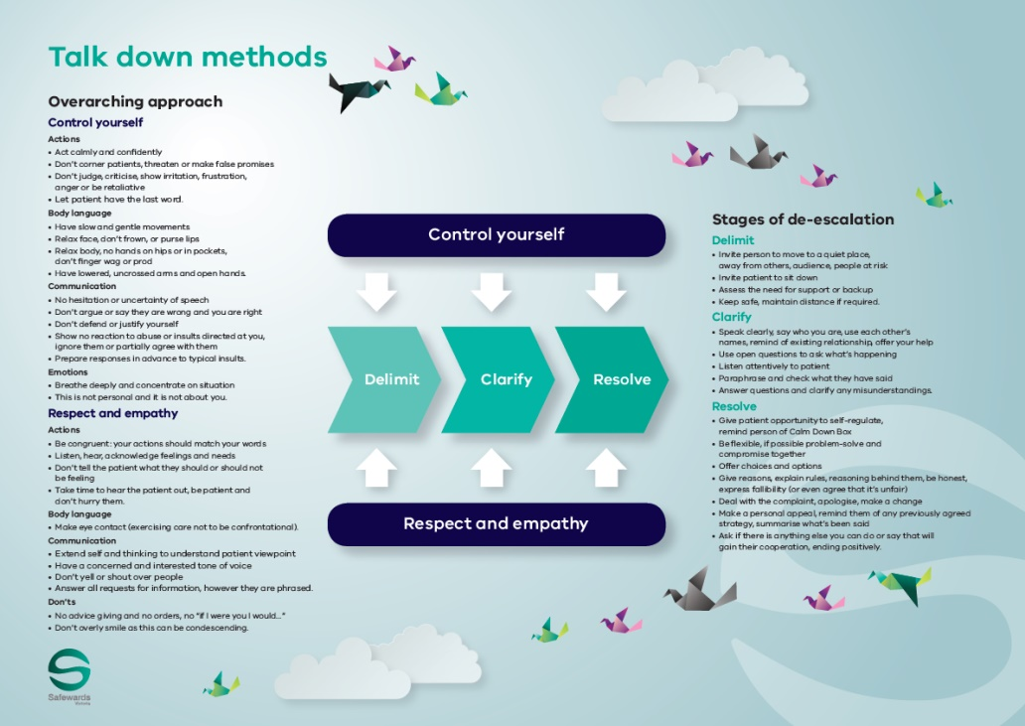

Talk down poster
  The poster summarises how the de-escalation process would ideally work
  The poster is a guide only. All de-escalation
  situations vary
  The reality is usually more muddled, nevertheless these principles can be applied to most situations to some degree
Notes:
http://www.safewards.net/interventions/talk-down

Slide 19
Role of the intervention lead – promote talk down
  Highlight to the team when talk down methods are used effectively
  Mention talk down in handovers or other team meetings
  Express respect for use of talk down methods
  Acknowledge the growing skill of the team
  Consider using the poster when debriefing following an incident - not only recognising the skills that were used but also those that were not and discussing opportunities for improvement

Slide 20
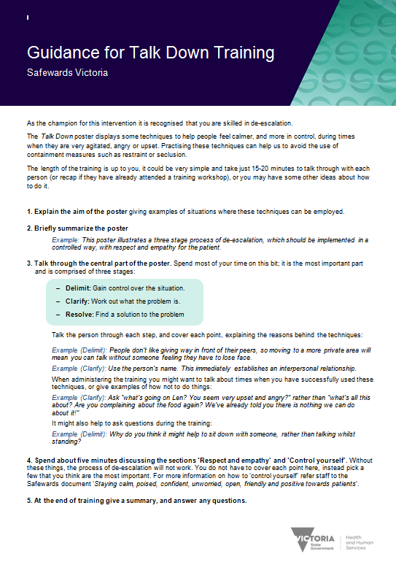
Resources for the intervention lead
  Guidance for Talk Down training handout
  ‘Staying calm…’ handout
Notes:
There are quite a few handouts as previously mentioned to help with this intervention.
http://www.safewards.net/interventions/talk-down

Slide 21
Talk down fidelity
  Expanding de-escalation skills and increasing psychological understanding, capitalising on the best of existing team skills and building team cohesion
  A crystallisation of de-escalation skills packaged for unit-based teaching and promotion
Talk down
IS
=
  Hanging a small poster in the corner of the unit, hoping the staff read it and understand it
  Something that ‘happens anyway’ – ‘patient was de-escalated’ is often a myth
Talk down
IS NOT
≠
Notes:
It might help to ensure that the poster is placed in an area where de-escalation is commonly used.
Taken from a PowerPoint from a presentation by Professor Len Bowers

Slide 22
Talk down methods adjustments
  CAMHS age-specific techniques
  Forensic none
  Older people age-specific techniques
  What would you need to adjust on your unit?
Notes:
Taken from a PowerPoint from a presentation by Professor Len Bowers

