Slide 1
Sample Education Presentation Management of acute pain & optimal use of analgesics in surgical patients
USER INFORMATION:
Slides included in this sample presentation relevant to medical, nursing and pharmacy
Individualize slides to your target audience
DATE
Acknowledgements: Thuy Bui, Analgesic Stewardship Pharmacist at Alfred Health
OFFICIAL

Slide 2
Learning Objectives
Understand how to assess and manage acute pain
Understand the importance of appropriate selection and use of different analgesics
Understand how to appropriately de-escalate analgesics and prescribe appropriate quantities/duration for discharge, particularly opioid analgesics

Slide 3
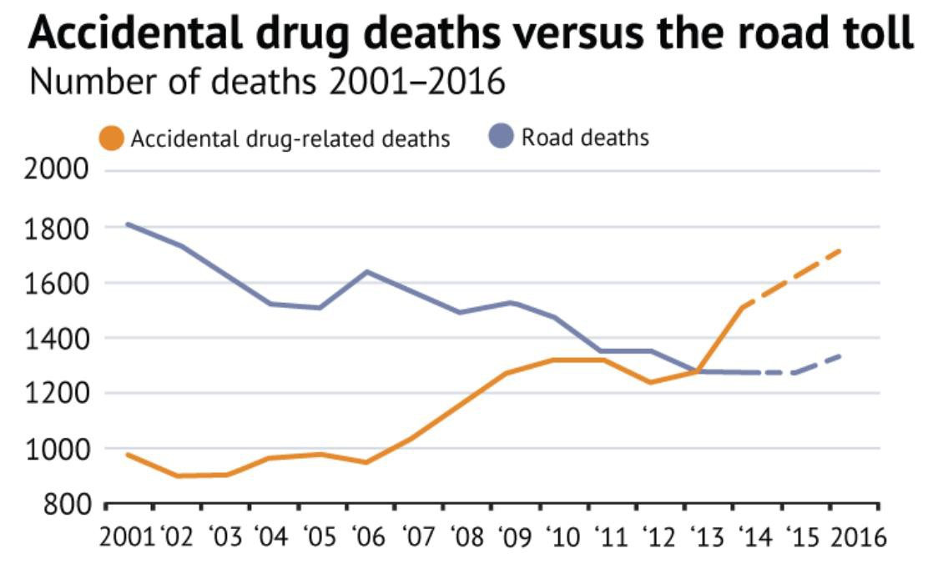
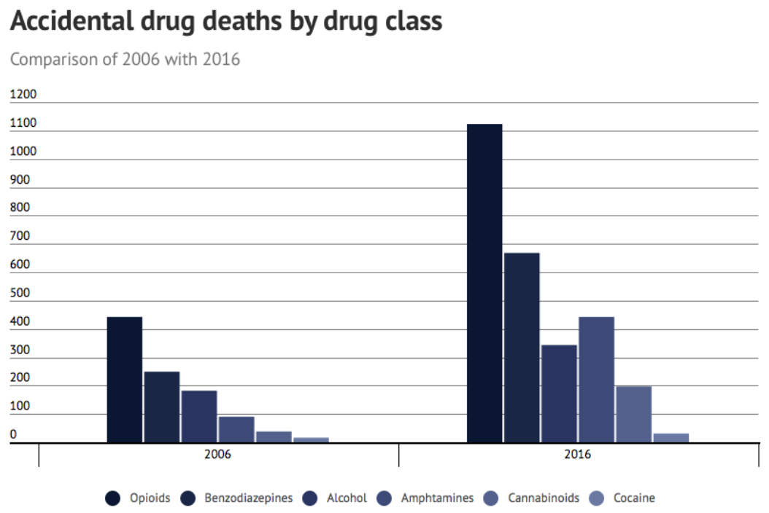
Background
Effective treatment of acute post-operative pain reduces the incidence of postoperative morbidity, chronic pain, and facilitates earlier discharge¹
Concern around analgesics, particularly opioids²
http://www.anzca.edu.au/documents/ps41-2013-guidelines-on-acute-pain-management.pdf
https://rehabreviews.com.au/australian-drug-deaths-hit-record-high/

Slide 4
Background
Opioids are effective for acute pain, not chronic pain
Opioid use after surgery is associated with future chronic use¹
Prescribing 6 days of opioids on discharge compared to 3 days doubles the risk of long term opioid use²
1. Brummett et al. JAMA Surg 2017;152(6)
2. Shah A, et al. MMWR 2017;66: 265-269

Slide 5
Management of acute pain

Slide 6
Management of acute pain
Set realistic expectations around pain after surgery
Expect some pain
Use of pre-emptive pain medication
Goal is to improve function​
Management should include:
Non-pharmacological
Physical therapy (splinting, dressings)
Psychological approaches (relaxation, education)
Physiotherapy +/- Occupational Therapy
Pharmacological
Multimodal analgesic regimen

Slide 7
Assessment tools
USER INFORMATION:
Refer to relevant assessment tools recommended by your health service
Regularly assess pain both at rest & on movement
Observational
Functional Activity Score (FAS)
Self-report
Pain scores (e.g. NRS)

Slide 8
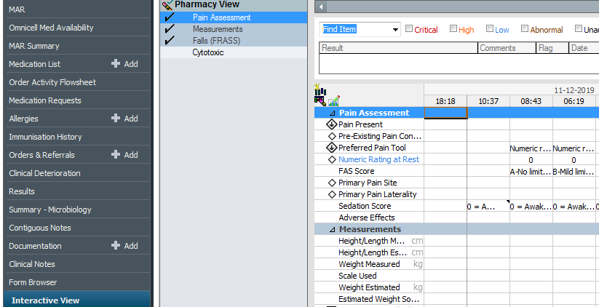
Assessment tools
USER INFORMATION:
Refer to relevant assessment tools recommended by your health service (E.g. EMR or paper chart)

Slide 9
Optimal use of analgesics

Slide 10
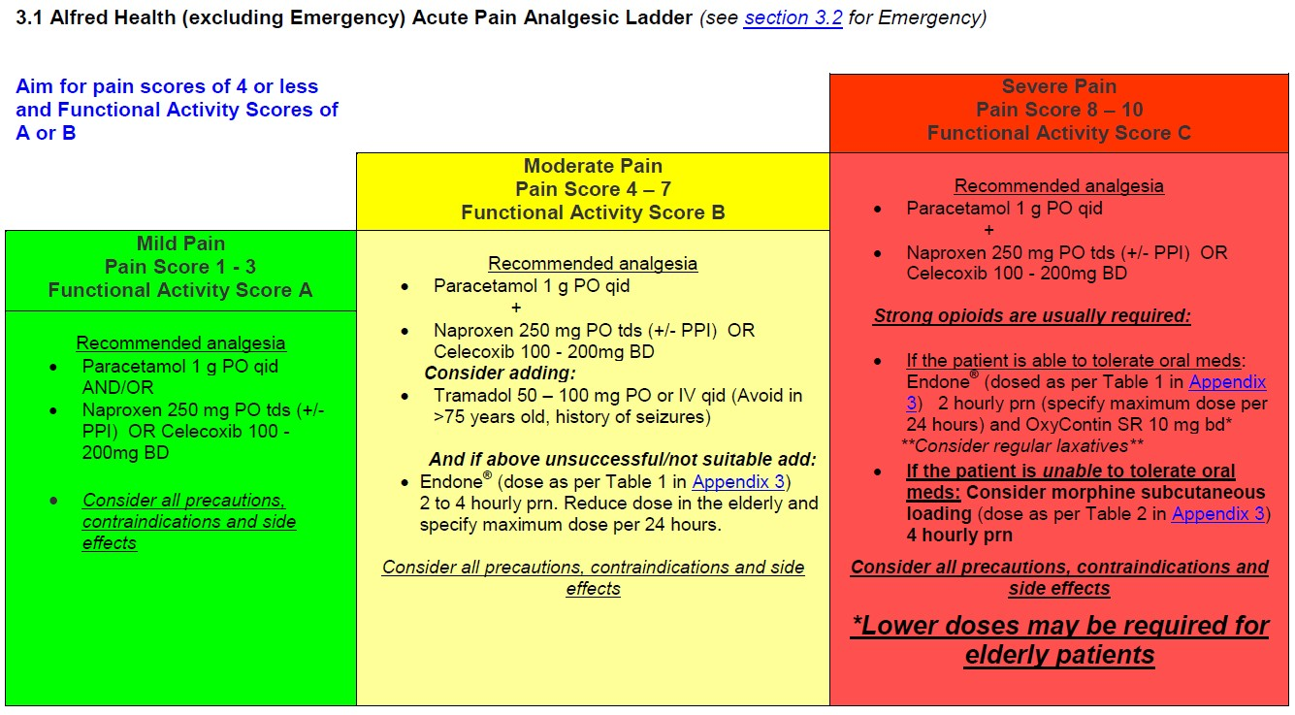
Analgesic ladder
USER INFORMATION:
Refer to relevant analgesic ladders to your health service

Slide 11
Simple Analgesics
USER INFORMATION:
Refer to relevant analgesic guidelines to your health service (IV Paracetamol guideline) or add in relevant considerations for NSAID’s for your health service (e.g. specific surgical unit information)
Paracetamol
Backbone of analgesic regimens
Reduce daily dose if underweight, malnourished, frail, elderly, or severe liver disease
NSAID’s
Add on where possible
Naproxen preferred (or ibuprofen); celecoxib if high risk of bleeding/GI effects IV options: parecoxib / ketorolac
Care in the older patient, renal impairment, high cardiovascular or thrombosis risk (naproxen least risk), bleeding risk
Short duration of use (up to 2 weeks)
Consider PPI in patients at high risk of GI adverse effects

Slide 12
Opioid Analgesics
USER INFORMATION:
Refer to relevant analgesic guidelines to your health service (e.g. opioid-related constipation guideline)
General principles
Effective in acute pain; not in chronic non-cancer pain
Age, rather than weight, to guide dose
One strong opioid at a time
Prescribe regular laxatives
Limit use of slow-release opioids to prolonged painful situations such as major surgery or multi-trauma patients²
1. Dowell et al. MMWR Recomm Rep 2016;65
2. http://www.anzca.edu.au/resources/endorsed-guidelines/position-statement-on-the-use-of-slow-release-opio

Slide 13
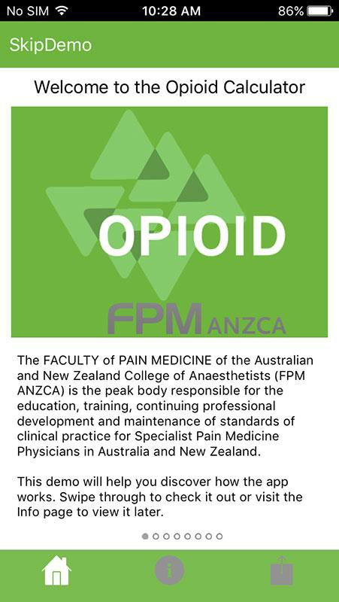
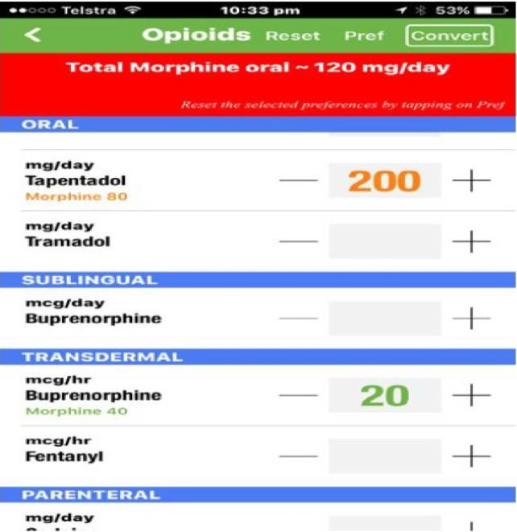
Opioid Analgesics
Be familiar with oral Morphine Equivalent Daily Dose (oMEDD)
FPM Opioid calculator app
Minimise high doses
Switching between opioids or routes of admin - 50% equivalent dose

Slide 14
Less µ potent opioids with dual activity
USER INFORMATION:
Refer to relevant analgesic guidelines to your health service (e.g. Tapentadol Guideline or Neurosurgery Unit specific guidelines)
Opioid | Common preparations | Considerations
Tramadol | Oral immediate release (tab/liquid) slow release (tab) IV IV = oral dose | Inhibits noradrenaline & serotonin re- uptake May be used in combo with more potent opioids Avoid in major head injury, risk of seizure, serotonin syndrome Reduce dose in older patients & renal impairment CYP2D6 drug interactions
Tapentadol | Oral immediate release (tab) slow release (tab) | Inhibits noradrenaline re-uptake Less CNS and GI side effects than other opioids More potent opioid than tramadol Reduce dose in moderate to severe liver impairment

Slide 15
More µ potent opioids
Opioid | Common preparations | Considerations
Morphine | Oral immediate release (tab/liquid) slow release (tab/sachet) IV/SC IV = oral dose x 1/3 | Accumulates in renal impairment especially M6G metabolite, prolonging CNS side effects Commonly causes itch (histamine release), nausea & vomiting Delayed sedation due to delayed crossing of blood brain barrier
Oxycodone | Oral immediate release (tab/liquid) slow release (tab) IV/SC IV dose = oral dose x 1/2 | Better tolerated, quicker onset, more potent than morphine (1:1.5) Reduce dose in moderate to severe renal impairment Targin® (oxycodone/ naloxone) may reduce constipation CYP3A4 drug interactions
Fentanyl | Patch IV/SC | Suitable in renal impairment Very short-acting CYP3A4 interactions

Slide 16
Restricted to specialist pain services use
USER INFORMATION:
Refer to relevant analgesic restrictions to your health service (e.g. Buprenorphine for management of acute pain)
Opioid | Common preparations | Considerations
Buprenorphine | Sublingual tab/wafer Patch IV | Partial opioid agonist with ceiling effect on respiratory depression Less CNS, GI and dependence effects Caution in mod-severe hepatic or severe renal impairment
Methadone | Oral tablet/liquid IV/SC | Also an NMDA receptor antagonist (anti- neuropathic activity) Complex pharmacokinetics Potential for CYP450 interactions; QT prolongation
Hydromorphone | Oral immediate (tab) slow release (tab) IV/SC | 5 x more potent than morphine Reduce dose in mod renal/liver impairment Infrequently used Frequent dosing errors

Slide 17
Adjunct analgesics
In opioid tolerant, opioid resistant pain and neuropathic pain
Clonidine
Alpha-2 adrenoreceptor antagonist with sedative, anxiolytic, analgesic and haemodynamic-stabilising effects
Monitor SBP
IV = PO
Anti-neuropathics
Pregabalin +/- Tricyclic/(S)NRI antidepressants
Reduce dose in elderly and frail, renal impairment (pregabalin), concomitant CNS depressants
Continue for 6-12 weeks, except to opioid spare post-op max 7 days

Slide 18
Specialist Services
USER INFORMATION:
Refer to relevant specialist services to your health service, contact details and referral pathways
Acute Pain Service (APS), Registrar #1234
Severe pain not controlled on usual analgesics
Acute pain & opioid tolerant
Neuropathic pain
Moderate or high risk on the Opioid Risk Tool
Requiring specialised analgesia e.g. PCA, epidural, paravertebral
Alcohol and Other Drugs (AOD), Registrar #4567
AOD Clinical Nurse #7286
After-hours DACAS* 1800 812 804
Palliative Care, Registrar #8910
Chronic Pain Service
*DACAS - the Victorian Drug and Alcohol Clinical Advisory Service

Slide 19
De-escalation of analgesics
USER INFORMATION:
Refer to relevant guidelines for de-escalation of analgesics to your health service
General principles
De-escalate one (at most two) analgesics at a time
In acute-on-chronic pain, aim to de-escalate to baseline
Rate of de-escalation often based on
New steady state (4-5 half lives of the agent)
Type of pain, response, side-effects and risk of adverse effects (e.g. withdrawal syndrome)
If de-escalation cannot be completed in hospital, provide a clear medication management plan to GP & patient

Slide 20
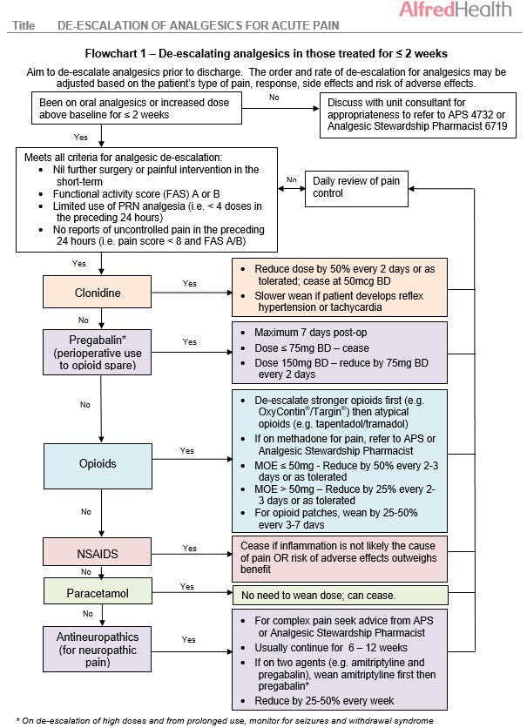
USER INFORMATION:
Refer to relevant guidelines for de-escalation of analgesics to your health service

Slide 21
Considerations for discharge
USER INFORMATION:
Refer to relevant guideline for discharge of patients with opioid analgesics and provide specific guidance on quantity of immediate release opioids at discharge
Short-stay surgical patients don’t need slow-release or strong opioids
Prescribe necessary quantities, not full packs
Assess number of PRN doses in last 24-48 hours and supply 3-5 days
Provide a specific analgesic medication management plan to the patient and their GP in the medical discharge summary including
Indication, duration, weaning/cessation plan, quantity

Slide 22
Considerations for discharge
USER INFORMATION:
Refer to examples relevant to your discharge processes
Provide a specific analgesic medication management plan to the patient and their GP in the medical discharge summary including

Slide 23
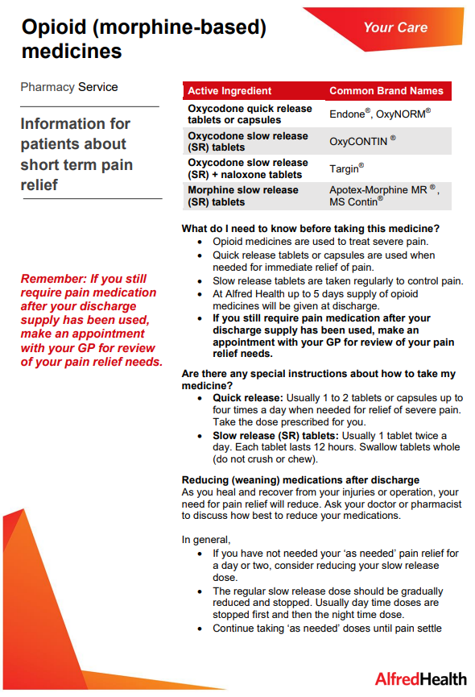
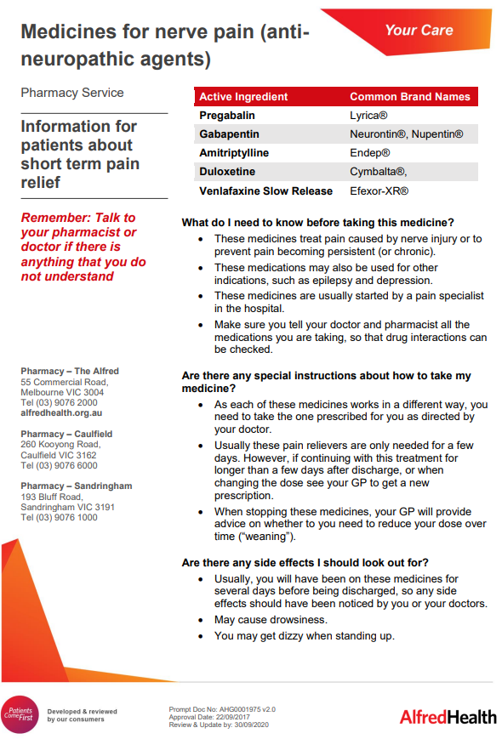
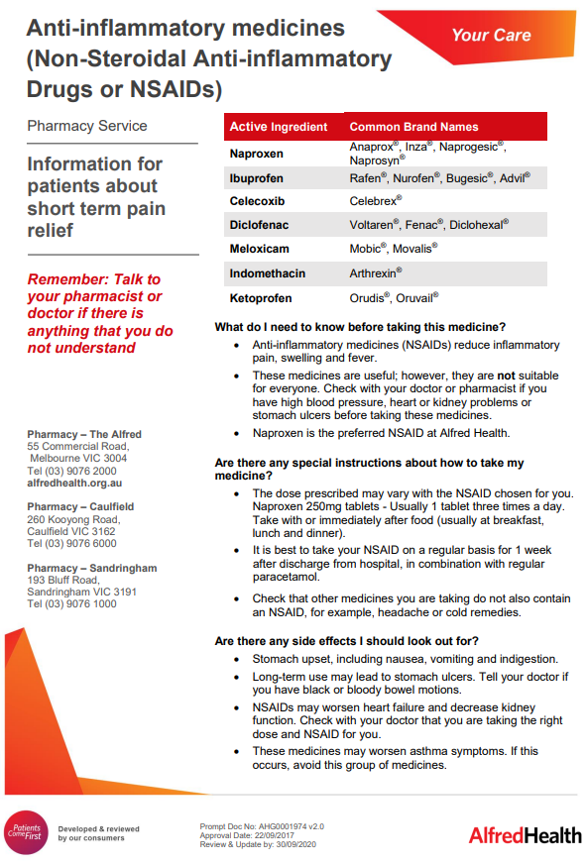
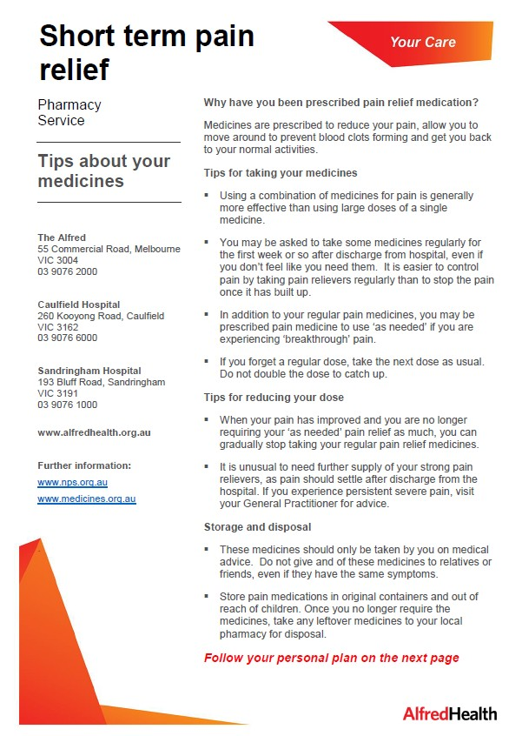
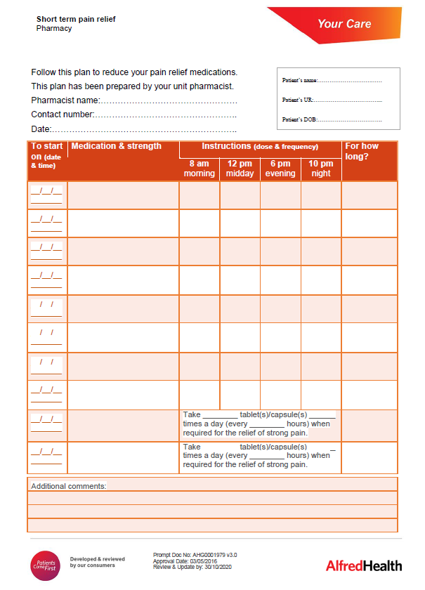
Analgesic leaflets for patients
USER INFORMATION:
Refer to examples relevant to your discharge processes or resources and how clinicians can find them
Available in various languages; paper copies in Pharmacy/wards
Electronic copies available on Intranet

Slide 24
Summary
Undertake regular pain assessment
Utilise non-pharmacological and pharmacological management
Multimodal analgesic regimen consisting of
paracetamol +/- NSAID +/- (weaker) opioid
Provide short-term pain management plan including de- escalation after surgery
Monitor closely for risk of opioid harms/misuse

Slide 25
Relevant guidelines
USER INFORMATION:
Refer to relevant guidelines

