Slide 1
Quality Improvement in Action
Introductory training for quality improvement in health care
2025
Notes:
Faculty name:
Session 1 Slides: 1-6
Time: 10mins
Slide: 1
Welcome to Quality Improvement (QI) in Action.
This is an introductory learning program on the mindsets, methods, and tools you can use in your everyday work to do quality improvement.
Introduce the faculty and support team for the day.

Slide 2


Acknowledgement of Country
SCV acknowledges the strength, power, and resilience of Aboriginal people as members of the world’s oldest living culture. We recognise Aboriginal people as Australia’s First People and honour the richness and diversity of all Traditional Owners across Victoria.
We respect the lore, customs, and languages practiced by Aboriginal people in Victoria, and their deep spiritual and cultural connections to land and water. We are committed to a future based on equality, truth, and justice, and recognise the ongoing systemic injustices faced by Aboriginal people. Victoria’s treaty and truth-telling processes offer a chance to address these wrongs, empowering Aboriginal people to make decisions for their communities.
We pay our deepest respects to ancestors, Elders, and leaders, past and present, whose strength and fortitude have paved the way for future generations.
Kevyn Morris | Basket weaving
Notes:
Session 1 Slide: 2
Photographs provided by Kevyn Morris who has given a consumer perspective to many SCV projects. Kevyn is Aboriginal, his ancestral lands are not in Victoria, but he has a deep connection to the land which is apparent in his beautiful photographs.
Acknowledge the traditional owners of the land we are on today.
Note: This is Safer Care Victoria’s Acknowledgement of Country slide template. Please replace this with your own individual or organisation acknowledgement. Faculty can adapt this to their own acknowledgement.
Source: Kevyn Morris

Slide 3




Being different together
In this space, we’re not the same and that’s our greatest strength.
We draw on our differences in:
who we are
what we’ve experienced
how we think
Notes:
Session 1 Slide: 3
Our diversity is one of our biggest assets.
We work together to allow people from different cultures, genders, abilities, sexualities, spiritualities, ages and backgrounds to contribute.
One of the biggest strengths of the model for improvement is that it emphasises including the diverse voices of those who use and benefit from the system – and that we need to work together to achieve better, safer, more person-centered care. Listen to difference in expertise, experience and needs – learn from difference and create a more holistic and deeper understanding of how we can all help ensure safe, quality and person-centered care together.
For today, it is important to acknowledge that everyone here will have different experiences of our healthcare system as consumers, carers, clinicians and this diversity of experience, ideas and perspectives will be a great strength to draw on in our shared learning.
Source: Safer Care Victoria

Slide 4




A spot of housekeeping
Phones on silent or
aeroplane mode
Restrooms
Consent for photos to be taken
Exit
Notes:
Session 1 Slide: 4
Before we get into it we have some housekeeping:
Please ensure phones are switched to silent or off completely.
Bathrooms – describe where they are.
Consent for pics to be taken – Note: Ensure you have a way for participants to opt in or out of photos e.g. provide a coloured sticky dot if they do not wish to be in photos.
Emergency exits are marked and give details if venue has emergency procedure instructions.

Slide 5
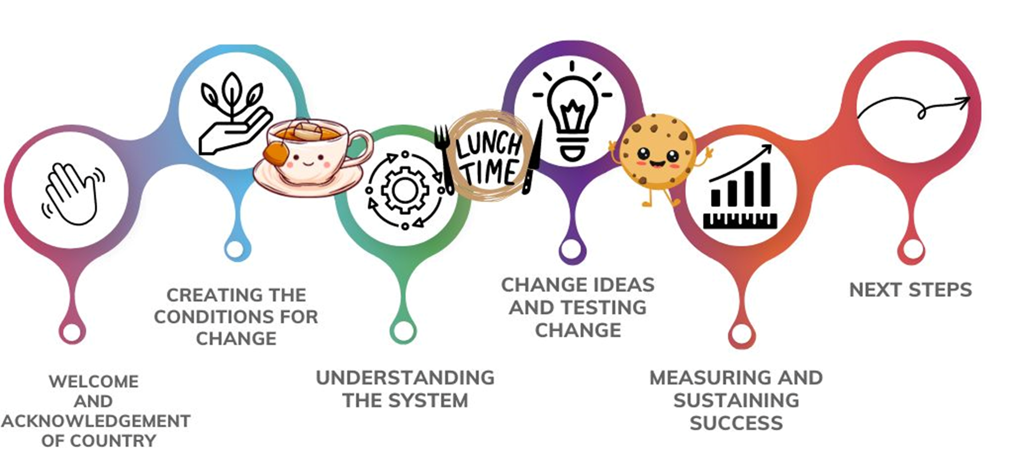
Disclaimer and Acknowledgement
Agenda
SCV acknowledges the information included in this presentation draws upon content developed by the Institute for Healthcare Improvement.
As such, the material may not be reproduced for commercial or for-profit use.
Notes:
Session 1 Slide: 5
NOTE: Animations in slide
The QI in Action program will we cover the following topics:
Creating the conditions for change and the role the organisation, we as individuals and our workplace culture has in supporting improvement work.
Understanding our system and the variation that commonly occurs to identify if you have a problem and how to set a goal/aim for your improvement.
The third session will cover change ideas and how to test them through PDSA cycles.
At the end of the day, we will discuss how to know if your change has led to an improvement through measurement and what affects the sustainability of the project.
[Click]
Safer Care Victoria acknowledges the information included in this presentation draws upon content developed by the Institute for Healthcare Improvement. As such, the material may not be reproduced for commercial or for-profit use.

Slide 6
Learning objectives
By the end of the day, you will be able to:
Start creating conditions of change to enable quality improvement
Understand how your system assesses itself to identify where and when change can occur
Use the Model for Improvement as a framework for improvement
Use quality improvement tools and methods to understand the problem, set a goal, design and implement the solution, evaluate the outcome and sustain improvement
Notes:
Slide: 6
By the end of the day, you will be able to:
Create conditions of change to enable quality improvement.
Understand how your system works to help identify where and when change can occur.
Use the Model for Improvement as a framework for improvement projects.
Use quality improvement tools and methods to understand the problem, set a goal, design, and implement the solution, evaluate the outcome, and sustain improvement.

Slide 7
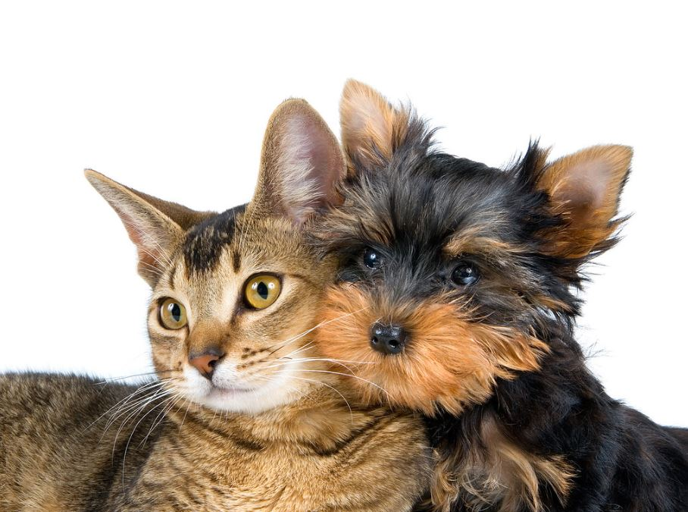
Icebreaker
Source: Cats and Dogs 23 by Douglas Sprott license under: https://creativecommons.org/licenses/by-nc/2.0/
Notes:
Faculty name:
Session 1 Slide: 7
Time: 10+min
The goal of an icebreaker is to do just that – help get the participants comfortable leaning in and engaging. This is also a good opportunity for you to get to know who you have in the room and for your participants to get to know one another...
Activity instructions:
Pose the statement - ‘cats are better pets than dogs’.
Designate opposite sides of room to represent the different ends of the continuum (i.e. one side are committed cat fans and the other side are committed dog fans).
Ask people to choose a side of the room. There may be some people who choose to stand in the middle. There will often be a spread of people across the continuum.
Invite participates to explain their reasons for choosing their “side” and to try and to convince ‘fence-sitters’ to join their side of the room.
Faculty to share reflections:
We can look at the numbers of how many people like cats, dogs or something in between but what does that tell us really?
Everyone shared different experiences and reasons behind their opinions (e.g. personality types, allergies, past experiences with animals, environmental reasons, some don’t like cats or dogs). This would not have been captured if we just reflect on how many people placed themselves on the cat, dog side of the room.
This activity is about fun and getting to know each other, but also:
Is a way to demonstrate how different perspectives exist and the many reasons someone my like/dislike something.
Needs and experience are very personal, our understanding of what a problem may be and what would be an improvement will also be unique to our own unique experience.
Being curious about the different ideas, experiences and perspectives strengthens QI work by really understanding the story behind the data to get to the truth of what a problem and its solution might be. We need to ask, explore and be curious in our QI work to consider diverse experience and perspectives to help create and sustain improvement.
Return to seats for the next slide
Source: Cats and Dogs 23 by Douglas Sprott license under: https://creativecommons.org/licenses/by-nc/2.0/

Slide 8

How do we put ‘being different together’ into practice?
Source: Uptownknitmob blanket by Lindsey license under: https://creativecommons.org/licenses/by-nc/2.0/
Notes:
Faculty name:
Session 1 Slides: 8-11
Time: 15mins (5mins per question)
A few slides ago, we mentioned how being different, together is one of the greatest strengths. But what does this mean when we all come together?
In any QI process – it’s critical to establish relationships and create an environment and a positive culture for your work.
One tool we can use to do this is a shared agreement.
A shared agreement is an important part of bringing any group of people to work together.
It’s about what the group decides is needed and important to work together.
A shared agreement and understanding of HOW we’ll work together helps us to have some joint and shared expectations about BEHAVIOURS and ATTITUDES that support us to learn, engage and participate.
Faculty discussion prompt: Show of hands who has used a shared agreement before?
We are now going to do a very quick shared agreement to firstly set up some rules for how we are going to work today but also to give you your first tool that you can take away and use in your work.
Source: Uptownknitmob blanket by Lindsey license under: https://creativecommons.org/licenses/by-nc/2.0/

Slide 9

Crafting a shared agreement
Question 1
What type of space do we need to collaborate well?
Notes:
Session 1 Slide: 9
So – the first question to start us off with creating our shared agreement is:
Question 1: "What type of space do we need to collaborate or work together well?
Faculty discussion prompts:
Perhaps think about times where you have felt comfortable and confident to participate.
What it was from that experience that we should work towards building with each other today?
Ask participants to write down 3 things they would need to feel comfortable and confident to collaborate and learn from each other today?
Write each idea on one post-it note.
Ask participants to place them up on the wall – grouping them with similar ideas as they go.
Facilitator summarises what the main ideas, principles or values identified for creating a safe, confident space to collaborate are for the group.
If running the program virtually you might consider using these options:
Virtual activity option 1: Mentimeter word cloud
Faculty to create the activity in Mentimeter and add QR code to the slide.
Ask participants to respond to the question.
Share the Word Cloud presentation screen to show the group the live responses to the question. Take a screen shot or download the Word Cloud image and share with the group in the chat.
Virtual activity option 2: Chat waterfall
Ask participants to respond to the question and write down on paper their three responses.
Tell them to then write them in to the chat function but don’t press send. Count down the participants 3,2,1 Send. And all the responses should appear at once.
Ask a team member to help identify themes in the responses so that you end up with a list of no more than 5 principles and values needed to create a safe, confident space to collaborate.
Source: Coworkers working together by Pexel under licenese: https://creativecommons.org/public-domain/

Slide 10

Crafting a shared agreement
Question 2
How do we create these spaces together?
Notes:
Session 1 Slide: 10
Group Discussion
Question 2: How do we create these spaces together?
Now that we have identified our top principles we want to hold ourselves accountable to today, the next question is ‘how do we create this space’?
What actions and behaviours will help us demonstrate these principles. Being specific about what we need to do helps us all to be accountable to our principles for a positive shared collaborative space and really understand what it takes to create the space we need.
Source: A smiling young woman presenting in a business meeting by rawpixel license under: https://creativecommons.org/publicdomain/zero/1.0/

Slide 11

Crafting a shared agreement
Question 3
How will we deal with difference?
Notes:
Session 1 Slide: 11
Group discussion
Question 3: How will we deal with difference?
How do we achieve healthy and curious and respectful debate when we have different ideas, experiences and opinions?
How do we create this environment where everyone feels free to bring their valuable opinions and perspectives?
So that’s a shared agreement in 5 minutes or less. It can be as easy and quick as that.
Source: Ocean Wave by vnhelen license under: https://creativecommons.org/licenses/by-nc-nd/2.0/

Slide 12
Session 1
Creating conditions for change
Notes:
Faculty name:
Session 1 Slides: 12-32
Time: 1hour 15minutes
In this session we will be discussing what conditions are needed for change and how we engage people in the quality improvement journey.

Slide 13
But first: What is quality improvement?
Seeking to understand the big picture
Seeing patterns and trends in systems
Recognising how a system’s structure causes its behaviour
Identifying cause-and-effect relationships
Identifying and testing assumptions
Finding where unintended consequences might arise
Finding leverage points to change a system
Resisting the urge to jump to conclusions
Notes:
Session 1 Slides: 13-14
Time: 5mins
NOTE: Animations in slide
But first, what are do we mean by quality improvement?
When we are using quality improvement methods and mindsets we seek to:
Understand the big picture by assessing the system as a whole not just its individual parts and by doing this start to see patterns and trends.
Recognise how a system’s structure influences the outcomes it achieves by testing cause and effect relationships.
Identify and test assumptions and resist the urge to jump to conclusions about what the problem or solution may be.
Find leverage points where we can make changes that improve outcomes.
Faculty note: Consider including an image in the slide to enhance understanding of the concept.

Slide 14

All improvement requires change…
… but not all change is an improvement!
Notes:
Session 1 Slide 14:
All improvement requires change but not all change is an improvement.
Faculty discussion:
Let’s have a little fun, would you consider the addition of a knitted woollen toilet seat an improvement?
Some people may consider this an improvement. Some may not?
When we are thinking about the changes we want to make, we must constantly ask ‘does this change lead to an improvement?’
Source: Image generated using Google Gemini from the prompt toilet with a colourful knitted seat cover 2024

Slide 15


Activity 1: What does quality improvement mean to you?
Get as creative as you want to be and draw, write, doodle on the person outline anything that represents your thoughts and feelings about Quality Improvement.
Use these prompts to help think about what to draw.
Why is quality improvement important to you?
What do you think learning about quality improvement and partnering will do to your work?
What does it mean for the patients, families, and carers you care for?
Why is quality improvement important to patients, families, and carers?
Pages 4-5 of workbook​
10 mins
Notes:
Faculty name:
Session 1 Slide: 15
Time: 10+min + 5min discussion/feedback
Now that you know a little bit about quality improvement, let’s have a think about why we do quality improvement.
Activity instructions:
In your workbook you will find a template of a person. This person can represent you, your patients, or your community.
Get as creative as you want to be and draw, write, doodle on the person outline anything that represents your thoughts and feelings about Quality Improvement. Use these prompts to help think about what to draw:
Why is quality improvement important to you?
What do you think learning about quality improvement and partnering will do to your work?
What does it mean for the patients, families, and carers you care for?
Why is quality improvement important to patients, families, and carers?
Faculty to share reflections:
Ask participants to volunteer to share their ‘why’.
Summarise key points brought up in the discussion.
Link back to health being a service industry and most people are in it to help and provide quality, safe care to consumers while constantly evolving and improving our services.

Slide 16
Conditions for quality improvement
Notes:
Faculty name:
Session 1 Slides: 16-19
Time: 10mins
Quality Improvement means change – it’s right there in the term ‘improvement’. Taking something from what it is currently to something better!
But for change to happen, there needs to be the right conditions.
I’m sure we’ve all been in situations, either professionally or personally, we’ve seen some great change ideas, but they haven’t worked no matter how great they might be because the conditions weren’t right.
Before we get into the details of how we do quality improvement, we’re going to discuss the mindsets and conditions you need for change.

Slide 17



Creating the conditions for change
Organisational Level
Individual Level
CULTURE
Notes:
Session 1 Slide 17:
NOTE: Animation in slide
In your QI work, it is important to consider what the environment you are doing your work in looks like and what challenges and opportunities exist? This will have a significant impact on how successful you will be and how you plan your work.
We can look at conditions from three perspectives:
Organisation level: does the organisation have the policies, procedures, resources (people and tools), framework and desire to change?
Individual level (capacity and capability): are there individuals trained in QI to support initiatives and are they given time and resources to undertake the work?
Cultural level: Culture is the enabling force for change to happen. Do you have psychological safety to try and fail and bring up issues?
So what do you do if you answer no to these questions? In most cases, rather than just saying these are too hard, it is worth considering how to expand your circle of control and influence.
Faculty note: Insert information about local policy/frameworks to support creating the conditions at each level.

Slide 18

Understanding control and influence
Circle of Concern
Circle of Influence
Circle of Control
Source: Safer Care Victoria 2024
Notes:
Session 1 Slide 18:
NOTE: Click to play video
Transcript of video: video 1min in length
Have you ever felt like your efforts are not making a difference?
Let's talk about circles of control and how you can create a culture of continuous improvement.
Circles of control are the things we can influence or change.
We can partner with others who have influence to expand our circles.
Creating conditions is another way to expand your circle of influence.
By setting the right conditions, you can encourage others to take action and create change.
Together, we can make a difference. Let's have a look at an example.
Jane is looking at making a change to the electronic medical record system (EMR) in her ward. Jane has already been working with her team and exec sponsor on the project aims and measures, however, to make any changes to the EMR, Jane needs to partner with Toby from the EMR analyst team to help with her change. By partnering with Toby and the EMR team Jane and her team are able to ensure the changes are achievable, have correct oversight and governance and optimise sustainability. If the change affects more than one area, Jane needs to engage with the Informatics Manager Noah and other speciality teams as this change may affect their workflow. By engaging with the those most affected by the change ensure all perspectives are seen when decisions need to be made.
Faculty discussion prompt:
Ask yourself:
Who is most affected by this change?
And how might I connect with them?
Source: Safer Care Victoria 2024

Slide 19
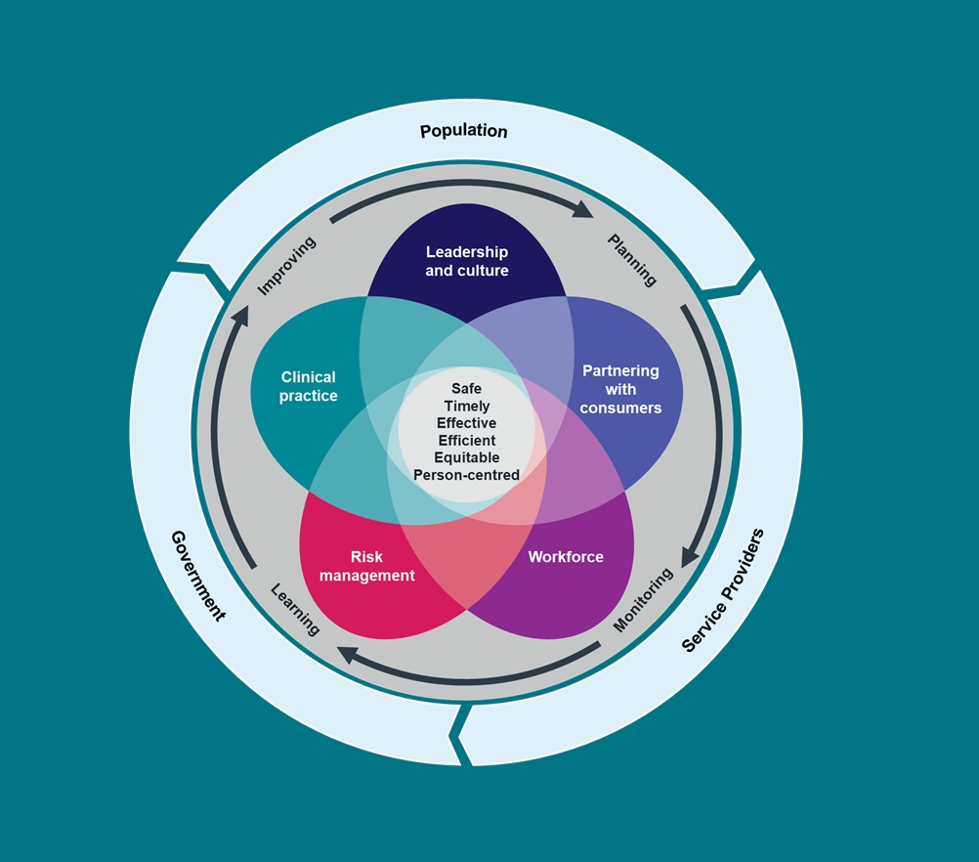
Clinical Governance and Quality Improvement
Notes:
Session 1 Slide 19:
A framework that can be useful for thinking about the conditions for change and improvement is the Victorian Clinical Governance Framework.
Clinical governance provides a framework to ensure services have systems in place and are accountable for their service and as the Victorian Clinical Governance Framework makes clear - it rests on a foundation of continuous improvement.
Building on the circles of control, everyone has a role to play to ensure effective clinical governance from the frontline to the Board. It is the role of everyone in the health system to ensure the provision of safe, effective person-centred care.
Understanding our role, how our role interacts with others, and how working together we can more effectively design, implement and measure change for improvement is key.
Faculty discussion prompt: What role do you see a role for yourself in clinical governance?
Faculty note: Insert information slide about your local clinical governance and improvement policy/frameworks.
Source: Safer Care Victoria. Victorian Clinical Governance Framework 2024

Slide 20
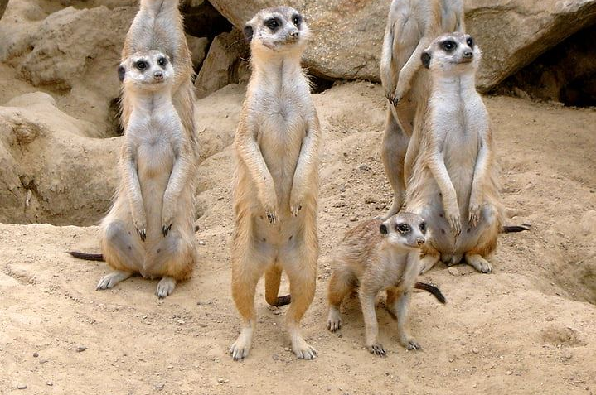


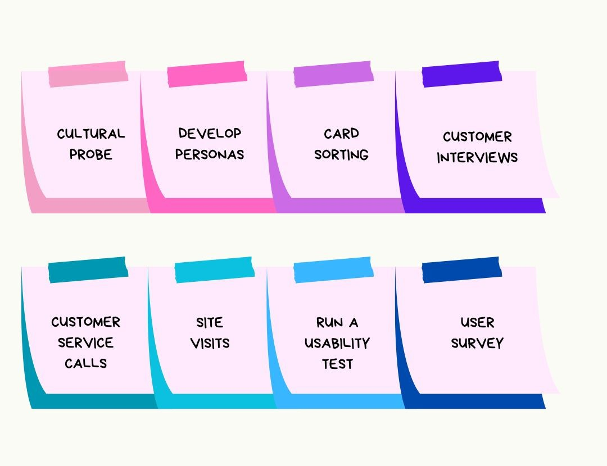


Quality improvement and partnering mindsets
Get curious
Value many perspectives
Elevate the voice and contribution of lived experience
Source: Meerkat zoo animal sand desert attention by pickpik under license: https://creativecommons.org/publicdomain/zero/1.0/
Source: Photo 19638 by Pxhere under license: https://creativecommons.org/publicdomain/
Source: Mood by Grimarika under license: https://creativecommons.org/licenses/by-nc/4.0/
Sit in the grey – uncertainty is okay
Start small
Continuous improvement
Source: Image created using Canva Pro 2024 / Reference: KA McKercher. Beyond Sticky Notes: Co-design for Real: Mindsets, methods and movements. Thorpe-Bowker Identifier Services Australia 2020.
Source: Dense cloud formation in a grey sky by Free Nature Stock under license: https://creativecommons.org/publicdomain/zero/1.0/
Source: Photo - 71744 by PxHere under license: https://creativecommons.org/publicdomain/
Notes:
Faculty name:
Session 1 Slide: 20
Time: 5mins
One of the most important things that we need for quality improvement to occur is the right mindset.
These are our 6 mindsets which are adapted from the book by KA McKercher – Beyond Sticky Notes. We use these across partnering and QI.
1. Get curious - And stay curious for as long as possible. Use empathy when working with others. Get inspired the stories they share. Question your own assumptions. Why am I disagreeing? What part and why?
2. Value many perspectives – Diversity is not a nice to have it’s key! Understanding diverse views helps uncover the systemic causes of issues and overlooked resources as well as individual and community needs. Your QI and Partnering with consumers work will value hugely from having many perspectives.
3. Elevate the voice and contribution of lived experience - Elevate means to raise or lift something to a higher position. It requires more than just telling or sharing a story. It requires having a seat at the table, so voices can be heard and elevated and they can be used to make a positive impact not only for the health service but also for stakeholders.
4. Continuous Improvement – This really speaks to the notion that even if we are happy with the way our system is performing, we are continuously reviewing how we are doing things, what our systems outcomes are and looking for ways to perform even better. In other words – how we are continuously learning and how we are using that learning to inform the changes we need to make.
5. Sit in the grey – Uncertainty is okay - We need to grow our willingness to be uncomfortable, unclear and confused while learning and opportunities emerge.
6. Start small – The improvement methodology that we teach and advocate for is the model for improvement. There are other models out there, but one thing many have in common is that they advocate for small scale testing of change ideas in the real world BEFORE any changes are implemented.
Reference: KA McKercher. Beyond Sticky Notes: Co-design for Real: Mindsets, methods and movements. Thorpe-Bowker Identifier Services Australia 2020
Source: Meerkat zoo animal sand desert attention by pickpik under license: https://creativecommons.org/publicdomain/zero/1.0/
Source: Photo 19638 by Pxhere under license: https://creativecommons.org/publicdomain/
Source: Mood by Grimarika under license: https://creativecommons.org/licenses/by-nc/4.0/
Source: Image created using Canva Pro 2024
Source: Dense cloud formation in a grey sky by Free Nature Stock under license: https://creativecommons.org/publicdomain/zero/1.0/
Source: Photo - 71744 by PxHere under license: https://creativecommons.org/publicdomain

Slide 21

The human side of change
People are born with intrinsic motivation, self-esteem, dignity, curiosity to learn, joy in learning
W. Edwards Deming
Source: Active construction of your own future by Dibs School under license: https://creativecommons.org/publicdomain/zero/1.0/
Notes:
Faculty name:
Session 1 Slides: 21-25
Time: 10mins
What we are talking about with mindsets is an important part of the human side of change.
How do we get people to see that the work they are doing is actually something they want to be doing?
We identify, embrace and harness their intrinsic motivations. For some people the motivation to achieve better outcomes for patients is a strong intrinsic motivation for others it may be the opportunity to work collaboratively with others, or for others the joy they find in getting curious about finding solutions to problems. Finding what people’s intrinsic motivation to get involved in improvement work might be provides you with a quality improvement superpower.
The doll activity we do in this program, is one tool we use to connect you to your motivations for QI.
The next step is to ask, what is it that keeps us motivated to do things? Sometimes we get caught up in busyness of tasks at hand, or the obstacles we face and we can lose sight of this.
Learning how to harness intrinsic motivations is a very powerful tool for getting people involved in, excited by and prepared for the changes involved in improvement work.
Reference: Peter M. Senge, The Fifth Discipline: The Art & Practice of The Learning Organization, New York: Doubleday Business,1990.
Source: Active construction of your own future by Dibs School under licence: https://creativecommons.org/publicdomain/zero/1.0/

Slide 22

The human side of change
Resistance is inevitable – embrace it!
Source: Resistance by the blue diamond under licenese: https://creativecommons.org/licenses/by-sa/3.0/
Notes:
Session 1 Slide 22:
When talking about change, there is a topic we need to address head on. Resistance to change.
As you seek to test, implement, spread & scale-up changes …. expect resistance.
Faculty discussion prompt: Ask audience when they have resisted change and when did they embrace it?
So why do people resist change?
Faculty discussion prompt: Why do you think people resist change? Does anyone have an example of this? When have you embraced change and what enabled this? (Can be done in small groups or as a large plenary group)
Discuss and reflect on some of the responses from the participants. Share an example or ask faculty to if they have an example of when they have faced resistance to change.
The system we are in is run by humans, for humans and centered around care. When things change, everyone is affected in a different way. Harnessing and knowing how humans respond to change is instrumental in our ability to roll out change.
Source: Resistance by the blue diamond under licenese: https://creativecommons.org/licenses/by-sa/3.0/

Slide 23
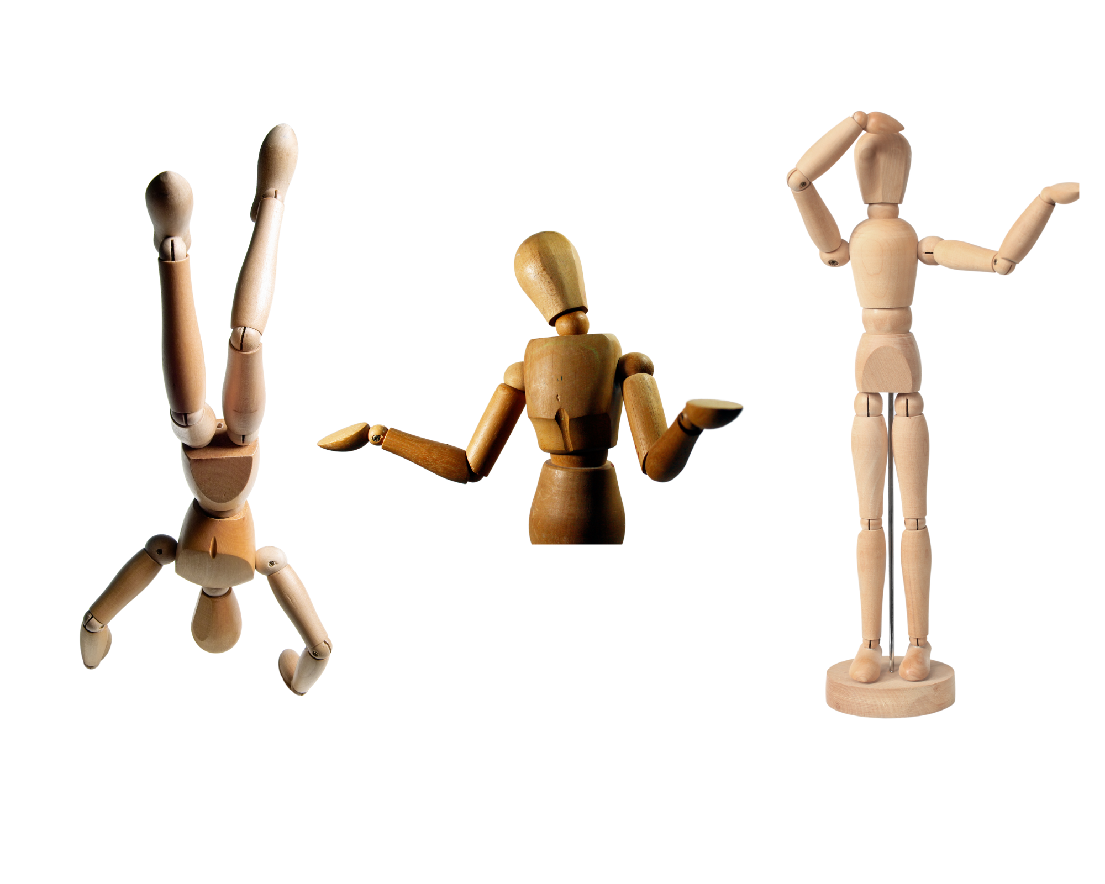
Ten reasons people resist change
Loss of control
Excess uncertainty
Surprise, surprise
Everything seems different
Loss of face
Concerns about competence
More work
Ripple effects
Past resentments
Sometimes the threat is real
Reference: Rosabeth Moss Kanter Ten Reasons People Resist Change. Havard Business Review 2012.
Source: Hand Stand by J Horrocks, Getty Images Signature, Canva Pro 2024 Source: Muñeco articulado duda by Ant Sanz, Getty Images, Canva Pro 2024 Source: Untitled by Wezeli, Getty Images, Pro Canva 2024
Notes:
Session 1 Slide 23:
Here are some of the reasons that people resist change. These come from an article written by Rosabeth Moss Kanter reflecting on her work as the co-founder of the Harvard University-wide Advanced Leadership Initiative and as previous leader in IHI
Faculty discussion prompt: How do these compare with the reasons we came up with? Can you see how what we discussed can fit within these 10 reasons?
If we think about all these factors about resistance to change and the reasons people resist, one thing is clear, no matter what we do to initiate and implement change. We should always expect there to be resistance.
Reference: Rosabeth Moss Kanter Ten Reasons People Resist Change. Havard Business Review 2012.
Source: Hand Stand by J Horrocks, Getty Images Signature, Canva Pro 2024
Source: Muñeco articulado duda by Ant Sanz, Getty Images, Canva Pro 2024
Source: Untitled by Wezeli, Getty Images, Pro Canva 2024

Slide 24

Resistance is good
Resistance = engagement
Resistance indicates a dilemma
Can initially present as emotion
Work through emotion to engagement
Source: Wooden Mannequin Dummy by Stock Images_AT, Getty Images Signature, Canva Pro 2024 Source: Wooden dummy looking up by Yalcinadali, Getty Images, Canva Pro 2024 Source: Wooden pose puppet by Kuppa_rock, Getty Images, Canva Pro 2024
Notes:
Session 1 Slide 24:
Resistance = good
Resistance can be seen as an opportunity. It means there is a level of engagement, and the resistor has considered your suggested improvement idea. This opens the door for discussion on the idea and the reason why they are resisting. You can understand where their motivations are coming from.
Source: Wooden Mannequin Dummy by Stock Images_AT, Getty Images Signature, Canva Pro 2024
Source: Wooden dummy looking up by Yalcinadali, Getty Images, Canva Pro 2024
Source: Wooden pose puppet by Kuppa_rock, Getty Images, Canva Pro 2024

Slide 25
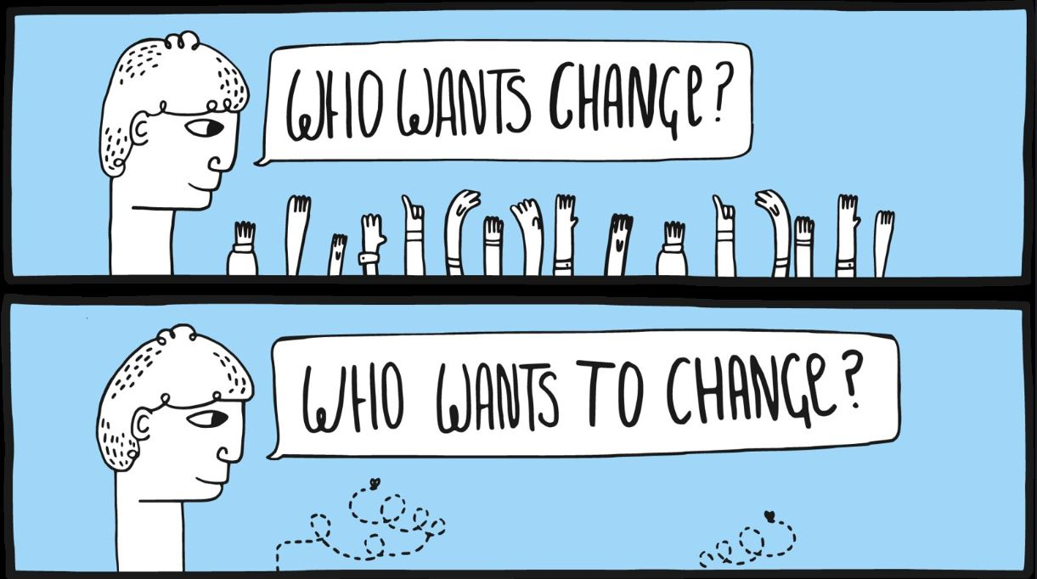
Reframing the question
From: How can I get all these people to do what I want them to do?
To: How can I get all these people to do what they want to do?
Let’s activate their agency – the ability to act with purpose!
Source: Who-wants-change-crowd-change-management-blue by Alan O'Rouke under license: https://creativecommons.org/licenses/by/2.0/
Notes:
Session 1 Slide 25:
If you ask, many people will say they want to see things done differently – they want change, the question we really need to tackle is not who wants change but "who wants TO change?".
Ultimately, what we want to do is to go from:
Getting people from simply agreeing that want to see change – to
Activating their agency to be part of making the change happen.
Finding what motivates people to engage in change themselves is key to activating this agency and engagement in the process of change.
Source: Who-wants-change-crowd-change-management-blue by Alan O'Rouke under license: https://creativecommons.org/licenses/by/2.0/

Slide 26
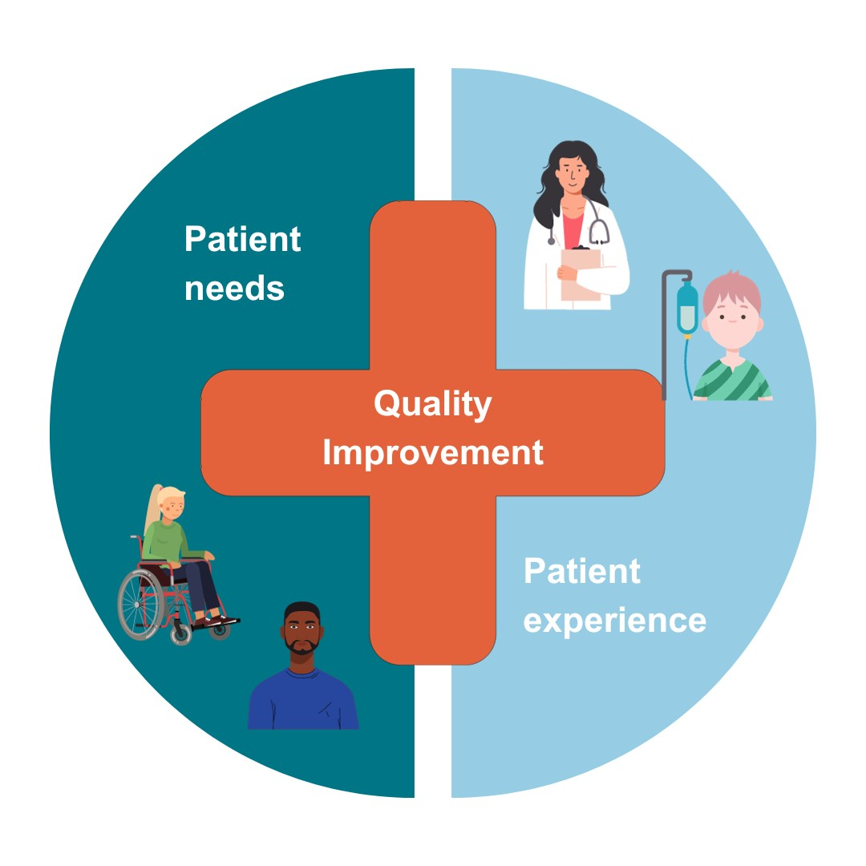
Why quality improvement and partnering?
Source: Image adapted from: https://www.hqip.org.uk/resource/introduction-to-quality-improvement-for-patients-and-public/
Notes:
Faculty name:
Session 1 Slides: 26-31
Time: 15mins
We’ve been talking about organisations, individuals and the culture that you need for your QI change work. The other side of the ‘human side of change’ are the patients. This might be the people that you drew in our first activity – ‘what is your why?’
Quality improvement and partnering are intrinsically linked.
Partnering isn’t just about partnering with consumers, though this is integral to your improvement work.
You should also be partnering with all those most affected by the changes that will occur in this improvement work.
Faculty note: Insert information slide about local policy/frameworks. How does your organisation partner with consumers?
Source: Image adapted from: https://www.hqip.org.uk/resource/introduction-to-quality-improvement-for-patients-and-public

Slide 27

Who are we partnering with?
Those who are most affected by our improvement work.
Our colleagues
Our workforce
Our organisation
Source: Who-wants-change-crowd-change-management-blue by Alan O'Rouke under license: https://creativecommons.org/licenses/by/2.0/
Notes:
Session 1 Slide 27:
Now we are going to speak more about who and how you need to partner in your QI work.
Firstly, you're going to need to partner with EACH OTHER. This includes your colleagues, your wider workforce and perhaps on an organisational level.
Source: Who-wants-change-crowd-change-management-blue by Alan O'Rouke under license: https://creativecommons.org/licenses/by/2.0/

Slide 28

Who are we partnering with?
Our patients
Our carers
Our communities
Source: Who-wants-change-crowd-change-management-blue by Alan O'Rouke under license: https://creativecommons.org/licenses/by/2.0/
Notes:
Session 1 Slide 28:
Secondly, you are going to need to partner with consumers – people with lived or living experience who could be patients, carers, family members of those who participate in the service you are looking to improve.
Faculty discussion prompt: Who has heard of this quote ‘Nothing about us, without us’? It is pretty commonly used throughout health and human services by advocates and activists.
Partnering authentically represents all the interactions you have including your team, wider stakeholder engagement and with the consumer network. Understanding who is affected by the change and how they will be impacted.
Consider the different experiences and expertise that would be important to consider from anyone involved in how a service is delivered (for example, reception, IT, different clinicians, health information, education, communications, custodian, decision makers etc.) and those who engage with or receive the service (patients, carers and family/support networks).
Source: Image created using Canva Pro 2024

Slide 29

Partnering in quality improvement isn’t just about a ‘vibe’. It’s an approach that’s underpinned by key policy and legislation. If you’re working in this space, it’s a bare minimum to be informed about the Australian Charter of Healthcare Rights, the National Accreditation Standards (Partnering with Consumers) and Victoria’s own Partnering in Healthcare framework.
Belinda MacLeod-Smith
Partnering Lead, Safer Care Victoria (2024)
Notes:
Session 1 Slide 29:
We are now going to listen to a quote from Safer Care Victoria’s Partnering and co-design capability lead, Belinda MacLeod-Smith (2024).
PROMPT: Click on image to play audio

Slide 30




Benefits of partnering with consumers
Better patient and
community experience
Improved patient satisfaction
Improved patient engagement
Improved community perceptions of health organisations
Better workforce experience and improved wellbeing
Improved patient satisfaction
Improved patient engagement
Improved community perceptions of health organisations
Better clinical outcomes, safety and quality
Lower mortality
Reduced admissions
Reduced length of stay
Reduced healthcare-acquired infections
Improved treatment adherence
Better value care through lower costs of care
Shorter length of stay
Lower costs per case
Better utilisation of low-cost and high-cost workforce members
Less workforce turnover
Source: Who-wants-change-crowd-change-management-blue by Alan O'Rouke under license: https://creativecommons.org/licenses/by/2.0/
Notes:
Session 1 Slide 30:
As Belinda said in the previous slide, partnering with consumers is not just a nice to have, it underpins our work in a very real way through policy and legislation.
There is also good evidence that working in partnership with consumers, and fostering person-centred approaches to care can help improve the safety and quality of care.
This slide outlines some of those benefits:
Better patient and community experience
Better workforce experience and improved wellbeing
Better clinical outcomes, safety and quality
Better value care through lower costs of care
Source: Australian Commission on Safety and Quality in Health Care. Review of the key attributes of high-performing person-centred healthcare organisations. Sydney: ACSQHC; 2018.

Slide 31
Consumer
owned
Gradient of partnering
Co-design &
Co-production
Consumer led
Engaging
Consulting
Co-creation
Informing
Partnering ‘zone’
Educating
Coercing
Human-centered design
No power
‘Doing to’
Degrees of tokenism
‘Doing for’
Degrees of citizen power
‘Doing with’
Reference: IAP2 Spectrum Source: Based on Arnstein 1969 + IAP2 Spectrum
Notes:
Session 1 Slide 31:
When thinking about partnering, it can be helpful to visualise a spectrum of engagement. This ‘gradient of partnering’ picture outlines the different ways you can partner with those most affected by the change, particularly patients and consumers.
We use the gradient of partnering as a way for our teams to figure out where they sit on the spectrum of participation and plan their engagement.
Even though this may feel like a hierarchy, it’s really not. What we are asking you to consider when thinking about how you will partner is what is the balance of power among and between partners at each level, what this means for decision making in the work, how we set expectations about the style of partnership we are using. It's about doing whatever you do, well and transparently.
For example, in co-design, there is equal power in decision making – is this possible in your work?. A lot of the work done previously in this space has been at the informing or consulting level with consumers - which is usually associated with doing things to or for other people.
Reference: IAP2 Spectrum
Source: Based on Arnstein 1969 + IAP2 Spectrum

Slide 32
Activity 2: Who is affected?
Page 9 of workbook
Using the case study allocated to your table, discuss the following questions.
Note: you will be using this case study for the rest of the day
10 Mins
Who is affected by the problem?
Are there different levels of engagement for different groups?
How might you want to engage those who are affected by the improvement process?
Notes:
Faculty name:
Session 1 Slide 32:
Time: 10+min + 5min discussion/feedback
Now that you know a little bit about partnering, let’s think about the ‘who’ of our quality improvement work.
Activity instructions:
Work through your assigned case studies. Identify who is affected by the proposed improvement project.
Consider:
Who is affected by the problem?
Are there different levels of engagement for different groups?
How do you want to engage those who are affected in the improvement process?
Faculty to share reflections:
Ask for a volunteer from each table to share their ‘who’
Was this activity useful? Could participants see how this could help their QI work?
This activity may help with other QI tools including process maps.
Faculty note: Ensure participants are considering not only consumers and cares that may be affected, but anyone in their system e.g. ward clerk, doctor, nurse, admin, IT.

Slide 33
Where to next?
Notes:
Session 1 Slide 33
Thank you for participating in QI in Action Session 1: Creating conditions for change. We have covered a lot of content including:
How to set the conditions for change and support our improvement effort.
How to identify who is needed to make the improvement work and to ensure we have a wide range of perspectives and views, including from consumers, at each step of our improvement process.
QI in Action Session 2: Understanding the system will focus on:
Learning about our system and how to look at data to find common and special cause variation and how to display data to tell a story.
Break time
Faculty note: Schedule a 15 minute break

