Slide 1
Quality Improvement in Action
An introductory training for quality improvement in health care
2025
Notes:
Faculty name:
Session 2 Slide 1
Welcome to Quality Improvement (QI) in Action – Session 2: Understanding the system

Slide 2
Session 2
Understanding the system
Notes:
Faculty name:
Session 2 Slides: 2-47
Time: 2 hours
In this session we will be discussing what a system is, how to identify if there is a problem in the system through interpreting data, applying QI tools and finally constructing an aim statement for your project.

Slide 3
What is a system?
An interdependent group of items, people or processes working together towards a common goal.
Source: Image generated using DeepAI from the prompt Create two images, one of an old fashioned bike and another image of an identical bike except the parts are all disassembled 2025
Notes:
Session 2 Slides: 3-7
Time: 10mins
What is a system?
A system is an interdependent group of items, people or processes working together to a common goal.
A system can be as small as a team/ward and as large as an organisation or the entire health system.
Changes made to systems can result in delayed effects, minimal or magnified effects and unintended consequences.
Here you can see a depiction of what a system is and isn’t.
On the left we have a heap of equipment. When one piece is taken away or added, nothing changes to this heap.
On the right we have a system. All the equipment is connected to one another. If you add or take away part of this system, a change is made.
Reference: Institute of Play – systems thinking design curriculum pack (instituteofplay.org.)
Source: Image generated using DeepAI from the prompt Create two images, one of an old fashioned bike and another image of an identical bike except the parts are all disassembled 2025

Slide 4


System theory
Put a good person in a bad system and the bad system wins, no contest.
W.Edwards Deming
“EVERY SYSTEM IS PREFECTLY DESIGNED TO THE GET THE RESULTS IT GETS”
PAUL BATALDEN
Source: Green leaves in close up by Pexel under license: https://creativecommons.org/public-domain/
Source: Photo 1492095 by Pxhere under license: https://creativecommons.org/publicdomain/
Notes:
Session 2 Slide 4:
Let’s start talking about our system.
Pictured are 2 quotes from pioneers of quality improvement Paul Batalden and W Edward Deming.
Applying systems thinking means exploring the characteristics of components within a system and how they interconnect to improve our understanding of how outcome emerge. If there is harm or undesired outcomes, the system should be examined, rather than the individuals within the system.
We can make improvements to the system rather than the individuals within the system.
Faculty discussion prompt: How often do we hear the blame game when it comes to things not going to plan, mistakes being made or poor performance results?
Reference: Dr Paul Batalden, the Dartmouth Institute, USA
Reference: W. Edwards Deming, Deming Four day seminar, Phoenix, Arizona, 1993
Source: Green leaves in close up by Pexel under license: https://creativecommons.org/public-domain/
Source: Photo 1492095 by Pxhere under license: https://creativecommons.org/publicdomain/

Slide 5
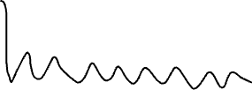
Quality improvement
Quality improvement is about making conscious and deliberate change that results in a new level of performance.
Deliberate change is made
Current performance
A new level of performance!
Notes:
Session 2 Slide 5:
While both are needed, what we often find in quality improvement is that we find ourselves focusing on quality control – or taking actions that maintain a current level of performance.
Quality improvement is not about maintaining performance, but about making deliberate changes to a system, thinking it will lead to a new level of performance entirely.
To get to a new level of performance we need to be asking ourselves – what changes to do we need to make that will change our level of performance for the better....

Slide 6
Reactive vs. fundamental change
Reactive change (first order change) | Fundamental change (second order change)
Often routine
Solves problems or reacts to special circumstances
Keeps the system running or returns it to its prior condition
Immediate but short-term impact
Creates a new system (process, product or service)
Alters how work gets done (process) and what people do (behaviour)
Necessary for improvement beyond problems
Changes the system in a visible, measurable way
Creates sustained long-term impact
This often means more training, resources, rules, audits, flyers, etc.
Reference:: The Improvement Guide, chapter 6, p.111–116
Notes:
Session 2 Slide 6:
NOTE: Animations in slide
Reacting to change:
It is important to distinguish between the types of change action we can take.
Reactive change is often an immediate action that has a short-term or surface level impact. This kind of change isn't transformative change – it is more about what can we do to return the system to its prior condition or maintain it at a current level of performance (i.e quality control). Some examples that often appear as reactive change include more training, more rules, another audit, standalone information brochures or flyers.
Fundamental change is transformative change. It is the changes we make to a system or service to change the level of performance and have a sustained impact.
Faculty discussion prompt: What changes have you seen in the quality improvement projects you have been involved in? Which category do they fall in?
Reference: The Improvement Guide, chapter 6, p.111–116.

Slide 7
Where do you get feedback from your system?
Feedback
Incidents
System data
(e.g. electronic records)
Shadow or observe the system
Tools: process maps, stakeholder analysis, Cause-and-effect diagrams
Notes:
Session 2 Slide 7:
How does your system receive feedback?
There are many sources of feedback in a system on how it is performing.
Some measures are quantitative, think audits, wait times and mortality rates.
Other feedback is qualitative: data staff and patient feedback, observations.
Both sets of data are important to provide the whole picture and tell the story of improvement.
There are also a number of tools that can help you assess your system and how it is performing and identify areas for improvement.

Slide 8
How do you know you have a problem?
Notes:
Faculty name:
Session 2 Slides: 8-16
Time: 10mins
So we have all this feedback from our system.
But:
How do we know we have a problem?
Where can we identify areas for improvement?

Slide 9

Using data to tell a story
“The greatest value of a picture is when it forces us to notice what we never expected to see.”
– John W. Tukey
Source: Whimsical world of books by flickr under license: https://creativecommons.org/licenses/by/2.0/
Notes:
Session 2 Slide 9:
Using data to tell a story
This is what we are trying to achieve through the use of data in Quality Improvement.
Data visualisation lets us translate information (data) into a visual context, making things easier for the human brain to understand.
Reference: John W Tukey. Exploratory Data Analysis. Reading, Massachusetts: Addison-Wesley Pub Company,1977.
Source: Whimsical world of books by flickr under license: https://creativecommons.org/licenses/by/2.0/

Slide 10
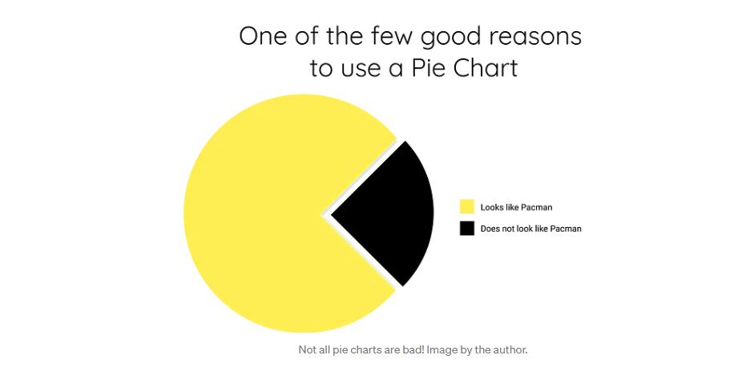
Pie charts
Reference: IHI Professional Improvement Coach Program (2023)
Notes:
Session 2 Slide 10:
NOTE: Animations in slide
Not all visual displays help us tell the story of improvement.
Faculty discussion prompt: What types of charts have you seen to display improvement work or quality data? Who would use a Pie Chart to illustrate their improvement efforts?
Let’s look at some of the differences the way we visualise our data can help or hinder our understanding of what is happening.
Reference: IHI Professional Improvement Coach Program (2023)

Slide 11
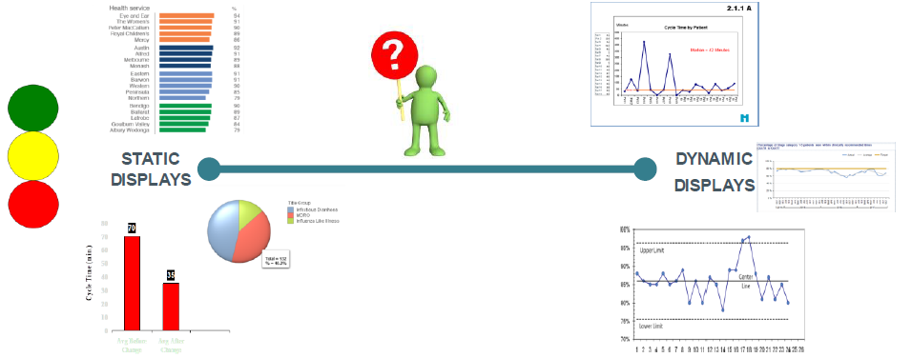
Static vs. dynamic content
Reference: Peter Bohlin, Robin Cooper, Elisabet Engdahl, Staffan Larsson. (1999). Information states and dialogue move engines. Department of linguistics Göteborg University, Sweden.
Notes:
Session 2 Slide 11:
Within data visualisation there are two main types of visuals: dynamic and static.
Static displays include bar charts, pie charts and gauges. Static data can hide variation.
People are used to before and after comparisons (bar charts, traffic light scorecards)
Dynamic is data over time (e.g. run charts) and can help us to shine a light on any variation in our systems and performance.
Reference: Peter Bohlin, Robin Cooper, Elisabet Engdahl, Staffan Larsson. (1999). Information states and dialogue move engines. Department of linguistics
Göteborg University, Sweden. Link, https://www.google.com.au/url?sa=t&rct=j&q=&esrc=s&source=web&cd=&ved=2ahUKEwjM-qS_277yAhWe_XMBHWN5DTUQFnoECAMQAw&url=https%3A%2F%2Fwww.dfki.de%2Fetai%2FSpecialIssues%2FDia99%2Fbohlin%2Fisdme_html%2Fnode3.html&usg=AOvVaw12lH9RVVGHR79APQpzanlj
Source: Institute of Healthcare Improvement

Slide 12
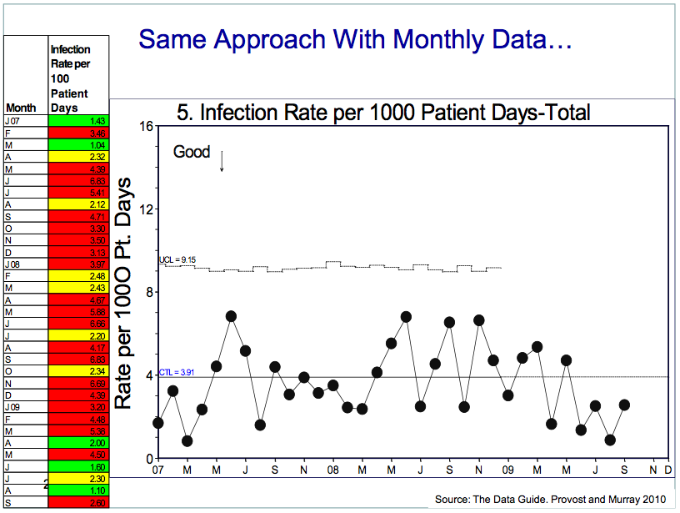
Traffic light system
Reference: IHI Professional Improvement Coach Program (2023)
Notes:
Session 2 Slide 12:
NOTE: Animation in slide
Faculty discussion prompt:
Who has used a traffic light system before?
Does red mean bad in this system? What story does this tell you?
What if the data is displayed over time (click)?
Faculty discussion prompt: What can you see now with this same data but presented over time?
Presenting the data over time provides more information can help us analyze our systems better.
Source: The Data Guide. Provost and Murray 2010.
Reference: IHI Professional Improvement Coach Program (2023)

Slide 13
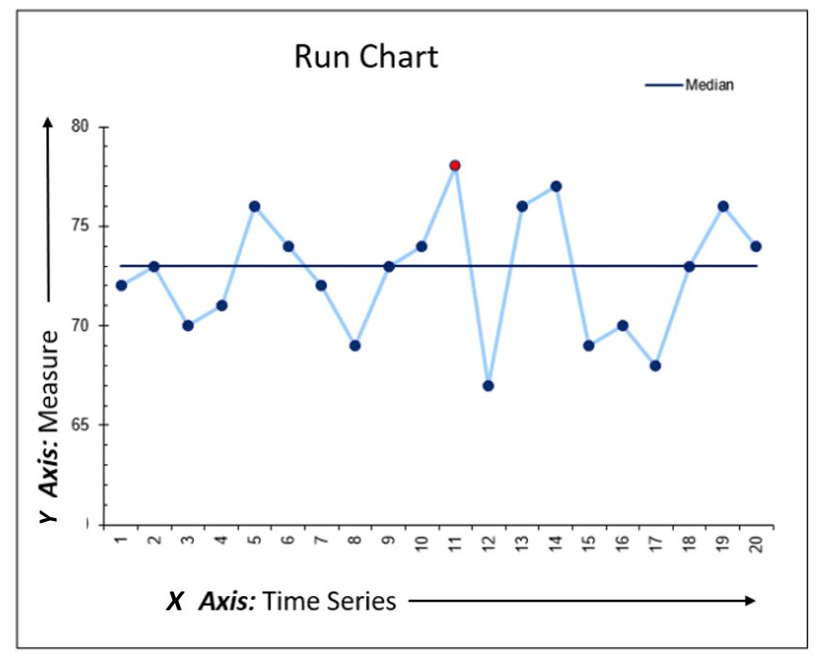
Anatomy of a run chart
Notes:
Session 2 Slide 13:
There are many different types of charts that will display your data over time these include ranging from the basic to highly complex charts.
As this is a foundations program designed to be an introduction to the basic methods, mindsets and tools used in quality improvement, we focus on the most basic way to display data over time and that is a run chart.
Anatomy of a run chart
X axis is a time variable e.g. weeks, months, or patient 1, 2, 3.
Y axis is our variable we are wanting to measure e.g. admission, time waiting, falls, no of infections etc.
Some other information you may find on a run chart are; median lines, goals line and annotations of when changes may have occurred.
Why use a run chart
Can be for any type of performance data.​
No calculations are required. ​
Can easily make by hand.​
They show performance behavior at a glance. ​
They are readily understood by all.
Can detect signals of change.
Can start building with 1 data point.
You don’t need any fancy tools, equipment or software to build one!
Can simply start with pen and paper or even on a whiteboard!
Use run charts when
You want to visualise the overall performance of a process over time.
You are looking for trends, patterns, or shifts in the data.
You need a simple, easy-to-understand visualisation of process data.
Interpreting a run chart
Using run charts, we can better understand our data and thus prompt us to ask the questions when we see data that appears out of place.
Run charts can begin to distinguish between common and special cause variation.
There are a set of rules for interpreting a run chart that defines what a signal is based on rules of probability which are out of scope of the QI in Action program but you can find more information at through the SCV Quality Improvement Toolkit | Safer Care Victoria.
(but if you need to determine if a process is ‘stable’ you will need a more advanced type of chart to identify the presence of special cause and common cause variation (Shewhart - Statistical Process Control Chart with control limits)

Slide 14
83% of our patients are satisfied with their care.
Percent of patients are satisfied with their care by month
Notes:
Session 2 Slide 14:
NOTE: Animations in slide
In this example we are given a statement of 83% of our patients are satisfied with their care by month……but what does that mean???
Same data plotted over time [click]
See the values month to month for 10 month period
Different message
Median 10 months = 83%
Faculty discussion prompt:
Does the median mean we are happy with what this actually is over time?
Does the display of data over time tell a different story than the overall percentage?

Slide 15
Outpatient median wait time per week is 90 minutes.
Average outpatient wait times per week
Notes:
Session 2 Slide 15:
NOTE: Animations in slide
This example we are given a statement of median wait time per week is 90mins.
What does this look like over time though?
Weekly values for the 10 week period
Median count cross 10 days is 90 mins
Faculty discussion prompt: What happened in Week 3? And week 6

Slide 16
The median monthly number of telehealth appointments is 290.
Number of telehealth appointments by month
Notes:
Session 2 Slide 16:
NOTE: Animations in slide
All 3 when variation is visible there is useful information there.
Median monthly number of telehealth appointments.
A single figure is not enough to understand the patterns, performance of our system – making variation visible through data over time tells a clearer story...helps us understand if our change ideas are working or if there is a problem to explore.

Slide 17
Variation
Notes:
Faculty name:
Session 2 Slides: 17-27
Time: 20mins
In this section we will be covering what variation is and whether it is common or special cause variation and what you can do.

Slide 18
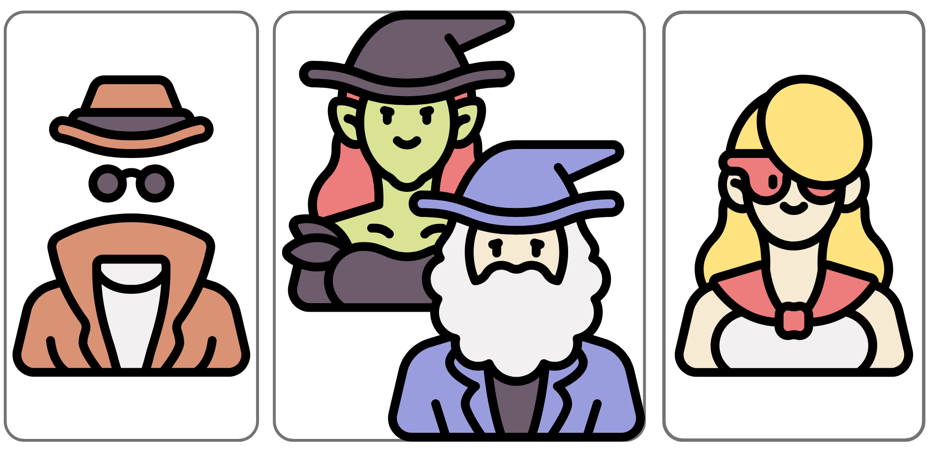
Variation
Interpret and respond
(think and do)
Making variation visible
2 types of variation
Notes:
Session 2 Slide 18:
When looking at data from our system, we need to understand what is variation and its different types.
We need to know how to make variation visible for all to see. We need to be able to interpret which type of variation is occurring and respond accordingly.
We also need to understand what it means in the context of our quality improvement project/s.
Source: Image created using Canva Pro 2024

Slide 19
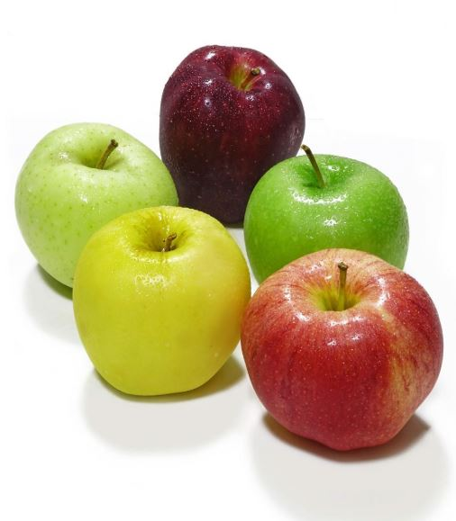
Variation
Variation refers to the measurable differences, fluctuations, or changes observed in a set of data or a process.
In healthcare, it encompasses the inherent diversity in patient characteristics, care delivery processes, and patient outcomes.
Source: Four apples arranged neatly by Freerangestock under license: https://creativecommons.org/publicdomain/zero/1.0/
Notes:
Session 2 Slide 19:
Variation refers to the measurable differences, fluctuations, or changes observed in a set of data or a process.
In a nutshell Variation is all about difference, and we expect difference.
No two apples from an apple tree are exactly the same.
There is variation in things, such as colour, size, shape, flavours.
If we choose to, we can measure and collect data for each of our apples based on these characteristics…. this data can then be organised to understand the nature of variation of this particularly characteristic.
In health care variation may occur in many things including:
Patient characteristics
Care delivery processes (e.g. how people are using EMR, wait-times)
Patient outcomes
Let's have a look at the way we can use data over time to start understanding what different types of variation might look like.
Source: Four apples arranged neatly by Freerangestock under licence: https://creativecommons.org/publicdomain/zero/1.0/

Slide 20
My commute to work (minutes)
Graph reference: IHI Professional Improvement Coach Program (2023)
Notes:
Session 2 Slide 20:
Graph 1: Measuring commute to work overtime.
Faculty discussion prompt: Is this an accurate representative of real life? Where commute time is exactly the same each day?
Faculty note: Faculty to consider adding an image to the slide to enhance interest.
Graph reference slide 20-22: IHI Professional Improvement Coach Program (2023)

Slide 21
First type of variation
Variation = Common cause
Median
Notes:
Session 2 Slide 21:
Graph 2: Variation type 1: common cause variation
Faculty discussion prompt: Is this more indicative of a normal commute time?
There is randomly distributed variation with points above and below the median line.
This type of variation is called: Common cause – normal variation that is inherent in the system.

Slide 22
Second type of variation
Variation = Special cause
Median
Notes:
Session 2 Slide 22:
Graph 3: Variation type 2: Special cause variation
Faculty discussion prompt: Can you see any changes to the data now? What looks different in this graph?
What we have here is an indication of Special Cause variation - We have an action that has led to something unexpected e.g. I now walk to the train station rather than drive. This has created a ‘signal’ that something has changed within the system.
(In the QI in Action program, remember we talked about quality improvement needing conscious and deliberate action to change the level of performance).

Slide 23
Types of variation
Special cause variation – a ‘signal’
Due to irregular or unnatural causes that are not inherent in the design of the process
Due to something not inherent in the process​
Affect some (but not all) outputs
Statistically different from other data points
Results in an ‘unstable’ process that is not predictable
Also referred to as non-random variation
Common cause variation – ‘noise’
Due to regular, natural or ordinary causes that are inherent in the design of the process
Always present, inherent to the process​
Affects all outputs
Statistically similar to other data points
Results in a ‘stable’ process that is predictable
Also referred to as random variation
Notes:
Session 2 Slide 23:
This slide provides more of an explanation about what we mean by Special and Common cause variation. Let’s go through these quickly:
Special cause variation – a signal
Due to irregular or unnatural causes that are not inherent in the design of the process
Due to something NOT inherent in the process​
Affect some (but not all) outputs
Statistically different from other data points
Results in an ‘unstable’ process that is not predictable
Also referred to as non-random variation
Common cause variation – ‘noise’
Due to regular, natural or ordinary causes that are inherent in the design of the process
Always present, inherent to the process​
Affects all outputs
Statistically similar to other data points
Results in a ‘stable’ process that is predictable
Also referred to as random variation
All things vary naturally – this is a fact of life
We need tools to identify true changes in data versus variation that is inherent in a system and we want to identify true changes as soon as is possible
Run and control charts are tools that help us begin to interpret special cause and common cause variation (which we will define)

Slide 24
Where does special cause variation come from?
Intended Variation
Unintended Variation
Deliberate changes or adjustments made to processes or systems to achieve specific goals or outcomes
Changes introduced into a healthcare process that are not purposeful, planned or guided. Usually, these changes arise from factors such as equipment, supplies, environmental or human factors.
E.g. changes implemented as part of improvement project
e.g. medication errors due to outdated syringe pump program
Notes:
Session 2 Slide 24:
Special cause variation, also known as non-random variation, originates from specific factors or events that are not part of the regular, inherent variability of a system.
Unlike common cause variation, which is a natural and expected part of any process, special cause variation is often linked to identifiable, external influences.
Intended Variation is an important part of effective patient-centred healthcare. It is desirable to have variation with the intent to best match the care being provided to patient preferences. Quality improvement initiatives also be another source of intended variation within a system.
Unintended Variation creates inefficiencies, waste, re-work, ineffective care, errors, and harm in our healthcare system.
Focussing on reducing unintended variation that is occurring within a process/system usually results in improved outcomes and reduced costs.
Faculty discussion prompt: Can you think of any examples of both intended and unintended variation?
How did you or your organisation respond to any unintended variation?
Understanding and identifying the sources of special cause variation are crucial for effective quality improvement efforts.
By addressing these specific causes, you can work to minimise variability and improve the stability and predictability of their systems.

Slide 25

When to take action
If you have common cause variation:
Random variation is natural to the system. Reacting to random variation by adjusting a stable process can lead to increased variation and inefficiencies. This is called tampering.
If you are not satisfied with your current level of performance, you can develop theories and test changes that might result in a new level of performance.
If you have special cause variation:
Undesirable outcome (worsening performance): investigate to find the cause and take steps to eliminate the opportunity for this to reoccur.
Desirable outcome (improving performance): investigate to find the cause and take steps to ensure this becomes part of standard practice.
Be cautious not to overreact to every fluctuation in data!
Source: Sprinter at starting blocks in a race by Freerange under license: https://creativecommons.org/publicdomain/zero/1.0/
Reference: IHI Professional Improvement Coach Program (2023)
Notes:
Session 2 Slide 25:
NOTE: Animations in slide
Understanding variation will help ensure you will act appropriately.
Common cause Variation
You don’t want to react to fluctuations in data that is actually common cause variation – this is called tampering and may result in a more unstable system.
If your current level of performance is not satisfactory (e.g. Benchmarking Hospital vs Hospital or Ward vs Ward), you want to develop and test theories that might result in improvements to the system.
This is the principal of continuous quality improvement
Special cause Variation
- If undesirable (worsening performance) – Investigate & Eliminate from system
- If desirable (improving performance) – investigate and propagate or spread across system
If you don't recognise special cause variation occurring it can be seen as a missed opportunity to learn there is something unstable in the system.
As mentioned in previous slide “instability in the process” is a cause of special cause variation.
Source: Sprinter at starting blocks in a race by Freerange under license: https://creativecommons.org/publicdomain/zero/1.0/
Reference: IHI Professional Improvement Coach Program (2023)

Slide 26

When we get it wrong, we…
see patterns in our data where there are none.
blame and give credit to people for things over which they have no control.
spend a lot of wasted time trying to explain natural variation as special events.
Source: Photo 1450419 by Pxhere under license: https://creativecommons.org/publicdomain/
Notes:
Session 2 Slide 26:
If we don’t correctly identify variation, we are more likely to take the wrong action.
See trends where there are no trends. Shifts where there are no shifts.
Blame and give credit to people for things over which they have no control.
Spend a lot of wasted time trying to explain normal variation as special events.
E.g. red data point = everything is terrible/repercussions.
Source: Photo 1450419 by Pxhere under license: https://creativecommons.org/publicdomain/

Slide 27

When we get it right, we…
Ask the right questions to generate learning
Avoid blaming (or giving credit) to people and teams for results that are part of random variation
Understand whether the changes we are making are resulting in improvement
Engage the people doing the work (and the changes) to understand what is happening in their system
Source: Photo 1640023 by Pxhere under license: https://creativecommons.org/publicdomain/
Notes:
Session 2 Slide 27:
Variation is an expected in our measurement.
When you are more comfortable navigating variation and able to distinguish between common and special cause variation (the variation that is expected in your system and the variation that isn’t) your learning is enhanced and the actions you take are more appropriate.
Remember when you put a good person in a bad system the system always wins.
Source: Photo 1640023 by Pxhere under licence: https://creativecommons.org/publicdomain/
Slide informed by: Institute for Healthcare Improvement (IHI) Professional Improvement Coach Program (2023).

Slide 28
Activity 3: Variation
At your tables…
Look at the three graphs you have been given in handouts
Discuss and answer the following questions for each graph
    Are there patterns or changes in the data that may indicate special cause variation?
    Would you take action?
    Has a new level of performance been reached?
Pages 12-13 of workbook
10 Mins
Activity Graph references: IHI Professional Improvement Coach Program (2023)
Notes:
Faculty name:
Session 2 Slides 28-32
Time: 10+min + 5min discussion/feedback
Now that we have learnt about variation, let’s have a look at some examples.
Activity instructions
Participants to review the 3 graphs in their workbook
Discuss and answer the following questions:
Are there patterns or changes in the data that may indicate special cause variation?
Would you take action?
Has a new level of improvement been reached?
Faculty to facilitate discussion when group comes back
Graph 1: indicates common cause variation – no action required.
Graph 2: indicates an astronomical point – participants might look into the astronomical point but not take action.
Graph 3: indicates a deliberate change and new level of performance. More data would tell us if the new level is sustained but shows early signs of a change.
Activity Graph references: IHI Professional Improvement Coach Program (2023)

Slide 29

Example 1
Treat as part of the system?
Panic! Inform GP!
Notes:
Session 2 Slide 29:
NOTE: Animations in slide
Graph 1: Common cause variation
Are we seeing any patterns, trends or changes in the data that may indicate something worth investigating?
Do we treat it as part of the system?
Do we panic and inform the GP?

Slide 30
Example 2
Investigate what happened on day 7?
Standardise approach to commuting?
Notes:
Session 2 Slide 30:
NOTE: Animations in slide
Graph 2: Astronomical point
Are we seeing any patterns, trends or changes in the data that may indicate something worth investigating?
Should we:
Investigate the astronomical point (#7)?
Standardise the approach to commuting?

Slide 31
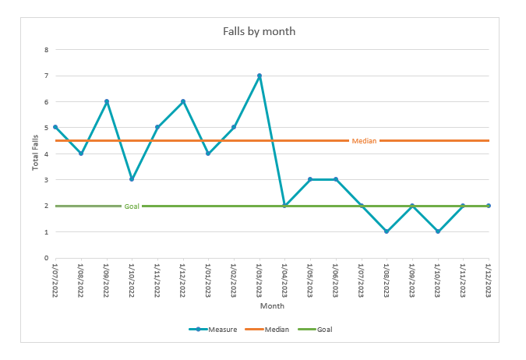

Example 3
Was the improvement activity successful?
Was a new level of performance achieved?
Notes:
Session 2 Slide 31:
NOTE: Animations in slide
Graph 3: Special cause variation
Was the improvement activity successful?
Has a new level of performance been reached? It looks positive but more data is needed to determine this.
Is the change sustainable/being sustained? More data is needed to determine this.

Slide 32
Summary
In improvement we are trying to introduce favorable special cause variation (signals) through testing changes and then hold these gains over time so they become part of the system (random variation that is sustained).
Notes:
Session 2 Slide 32:
In improvement we are trying to introduce favourable special cause variation (signals) through testing changes and then hold these gains over time so they become part of the system (random variation that is sustained).

Slide 33
Understanding the problem
Notes:
Faculty name:
Session 2 Slides: 33-37
Time: 5mins
Now that we can assess our system and identify common and special cause variation. We can use other QI tools to interrogate whether there is a problem there or opportunity for improvement.

Slide 34
Tools for understanding the problem
5 Whys
Cause-and-Effect (fishbone) Diagram
Process Mapping
Pareto Chart
Notes:
Session 2 Slide 34:
NOTE: Animations in slide
There are many QI tools we can use to understand the problem and each tool has its place in understanding the problem. It is good to keep in mind that often it can be good to use more than one tool to unpack the root causes of the problem. Today we are going to teach you about the 5 Whys.

Slide 35

The 5 Whys
Important to identify the root cause of a problem and not the symptoms.
Ask ‘why’ five times to get to the root cause – a very simple tool!
  Write down the specific problem
  Ask why the problem happens
  If the answer is not the root cause of the problem in Step 1, ask ‘why’ again
  Repeat Step 3 until you agree that you have identified the root cause
By identifying and removing the root cause of a problem, we move from short-term problem solving to long-term problem prevention
Tip: Use all five Whys – resist the urge to skip!
Source: Question1 by Flickr under license: https://creativecommons.org/licenses/by-nc/2.0/
Notes:
Session 2 Slide 35:
NOTE: Animations in slide
5 Whys is the practice of asking why repeatedly whenever a problem is encountered in order to get beyond the obvious symptoms to discover the root cause.
This can be applied in conjunction with other QI tools like a cause and effect diagram to help interrogate your understanding of the root cause of your problem and therefore bring more focus to your improvement efforts.
Reference: Olivier D Serrat. The Five Whys Technique. Knowledge Solutions 2009. https://www.adb.org/publications/five-whys-technique Accessed January 2025.
Source: Question1 by Flickr under license: https://creativecommons.org/licenses/by-nc/2.0/

Slide 36

The 5 Whys
Safer Care Victoria (2025) The 5 Whys Tool https://vimeo.com/safercarevic/5whys?ts=0&share=copy
Notes:
Session 2 Slide 36:
NOTE: Click to play video
This 3 min video demonstrates how the 5 Whys can be applied to interrogate the root cause of a problem.
Source: Safer Care Victoria (2025) The 5 Whys Tool https://vimeo.com/safercarevic/5whys?ts=0&share=copy
The 5 Whys Tool – video transcript
Often when we try to solve a problem, we jump to the first solution that comes to mind without investigating the underlying cause.
The 5 Whys Tool is a simple way to peel back the layers of a problem and identify the root cause. Let's have a look at how the 5 Whys technique helped Barry.
Barry is a cafe owner and is dismayed at the sharp increase in his café’s cleaning bills during the summer months due to frequent cleaning of bird droppings.
Determined to find the root cause, Barry starts asking why and conducts a 5 Whys analysis.
He starts with identifying the problem. The cafe's high cleaning bill in summer.
Why is the cleaning bill so high in summer? Because of frequent cleaning of bird droppings.
Why are there so many bird droppings? Because the cafe attracts a lot of birds.
Why are there so many birds around the cafe?
At first, Barry blames the birds that come to eat the crumbs left by customers.
The workers sweep up more frequently and notice that while the birds have stopped coming during business hours, the
cafe continues to be plagued by bird droppings.
Barry and the workers notice that things seem to be messy when they open the cafe in the morning.
Barry tries a different approach and visits the cafe after hours.
He finds some birds eating insects that are flying around the building.
Why are there so many insects around the cafe?
It turns out that the insects are drawn to the lights that are kept on at night.
Why are the lights left on at night?
Barry had installed night lights outside the cafe as a security measure and as the weather turned warmer, more insects appeared.
He replaces the night lights with motion censored lights to reduce the time the lights are kept on while retaining its security features.
The motion sensor lights kept the insects away, which in turn stopped the birds from visiting the cafe and making a mess.
Barry now has a lower cleaning bill and as a bonus, his electricity costs have reduced, too. A win for the 5 Whys and for Barry.
Can you see how asking why over and over again helped Barry uncover the root cause of his high cleaning bill?
If he had only asked one why, the insects would have remained, the birds would have kept coming and his cleaning bill would have stayed sky high.
How might you use the 5 Whys Tool to help understand the problem you're trying to solve?
You may need to ask why more than five times and explore different approaches to understand the various factors that can contribute to something going wrong.

Slide 37
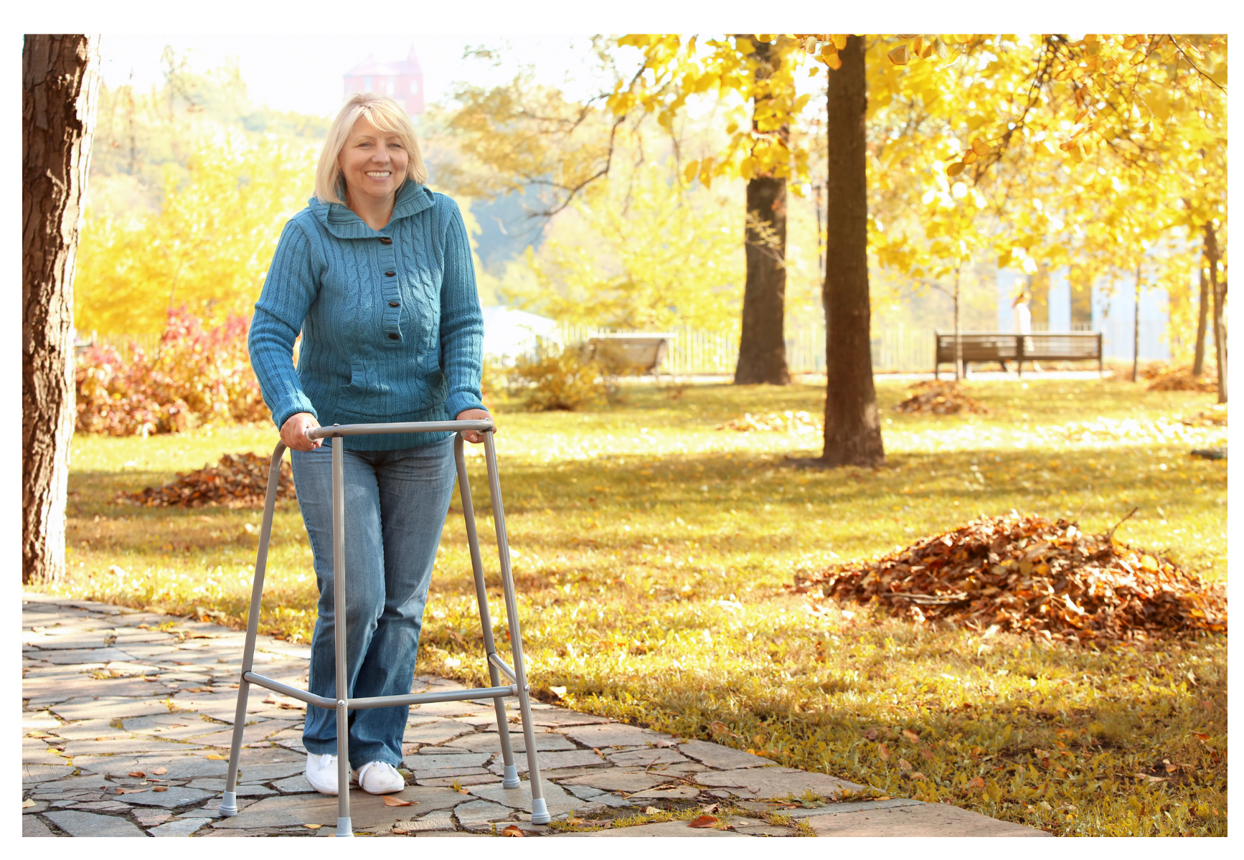
Resident falls and worn-out walker pads
Why do tennis balls used as walker pads stop working?
  Because the ends of the walker break through the tennis balls.
Why are they breaking through?
  Because the material of the tennis ball is breaking down.
Why is the material breaking down?
  Because the tennis balls have a life-span and they are being used for too long.
Why are they being used for too long?
  Don’t know they have broken down until there is a fall or other adverse event.
Why are they waiting for a fall to happen to initiate a change of pads?
  Because there is no standard policy for checking on tennis ball wear.
Change idea to test: Standard process for regularly evaluating and replacing tennis balls.
Source: Senior Woman with Walking, Pixelshot, Canva Pro 2024
Notes:
Session 2 Slide 37:
Let’s look at applying the 5 Whys in a health example:
In this example you can see the problem is resident falls and warn out walker pads.
But using the 5 Whys Tools, you can identify the root cause and therefore potential change ideas to test.
Faculty discussion prompt: read through examples on slide (you may wish to replace this example with one of your own)
In this example, the use of tennis balls was a solution because getting access to the rubber stoppers that are usually on the bottom of walkers was a challenge. The team have solved one problem but created another.
Reference: IHI Professional Improvement Coach Program (2023)
Source: Senior Woman with Walking, Pixelshot, Canva Pro 2024

Slide 38
Activity 4: 5 Whys
Using the Cause-and-Effect diagram for your case scenario, interrogate the circled ‘cause’ using the 5 Whys.
  What is the problem?
  Where is there opportunity for improvement?
Identifying this now will help you to develop an aim statement later in the session.
Pages 14-15 of workbook
10 Mins
Notes:
Faculty name:
Session 2 Slide 38:
Time: 10+min + 5min discussion/feedback
We will now apply the 5 Whys to a case study/scenario to see if we can drill down to the root cause.
Activity instructions
Use the same case scenario your group has used for previous activities in QI in Action.
Each group will have a cause and effect diagram with a circled cause. You can use this “Cause” or select another from the cause and effect diagram example for your scenario.
Using the 5 Whys template
Identify what the problem is?
Where the opportunity for improvement might be?
This activity will help you develop your aim statement in a later activity.
Faculty to facilitate discussion when group comes back
Participants can choose to do 1 (or more cause if they wish) applying the 5 Whys.
Ensure participants are truly questioning why and getting to a root cause rather than superficial statements.

Slide 39
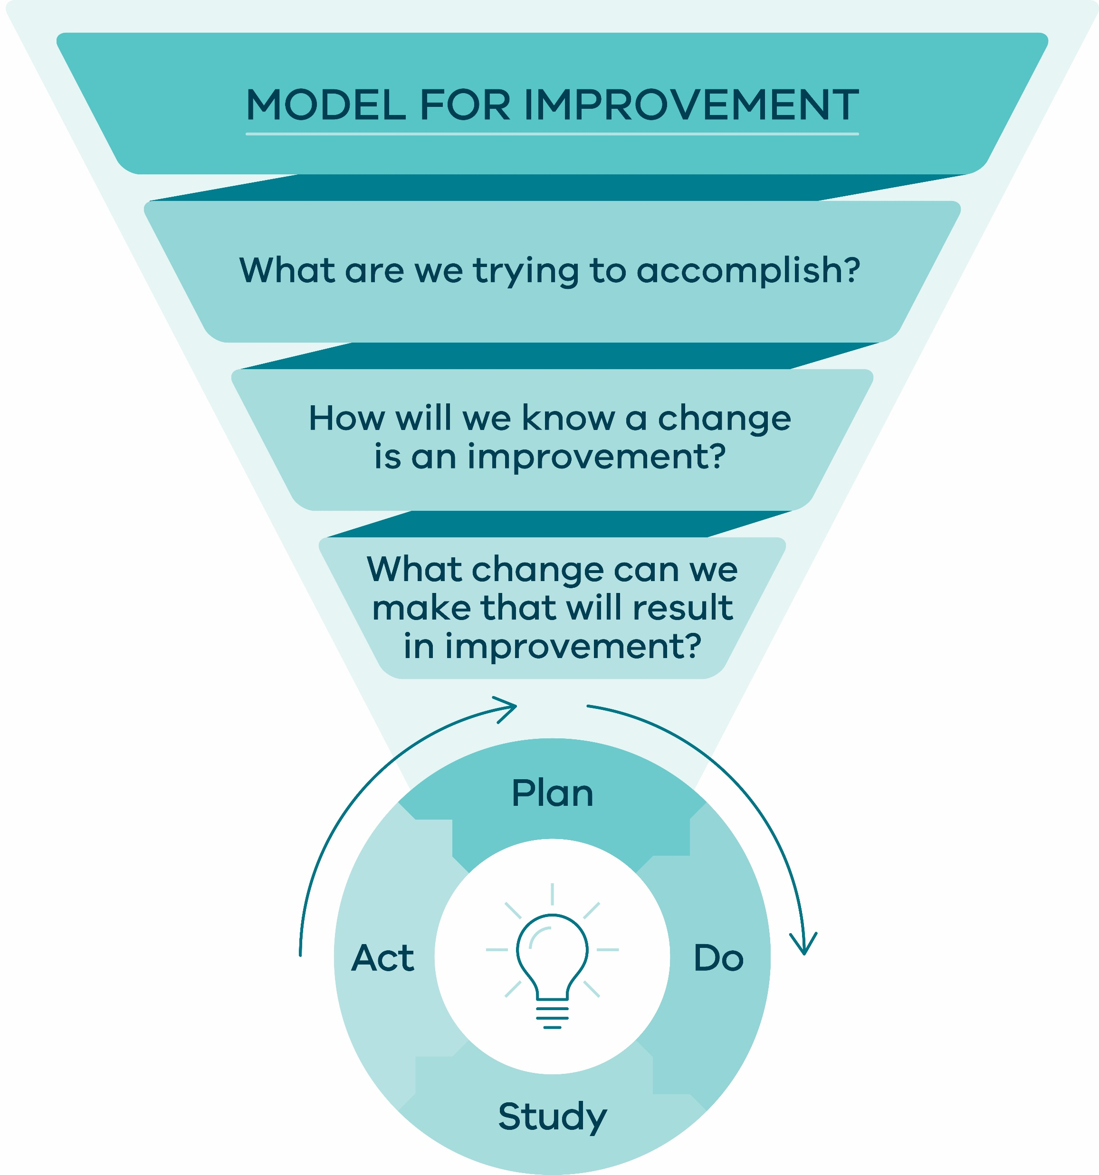
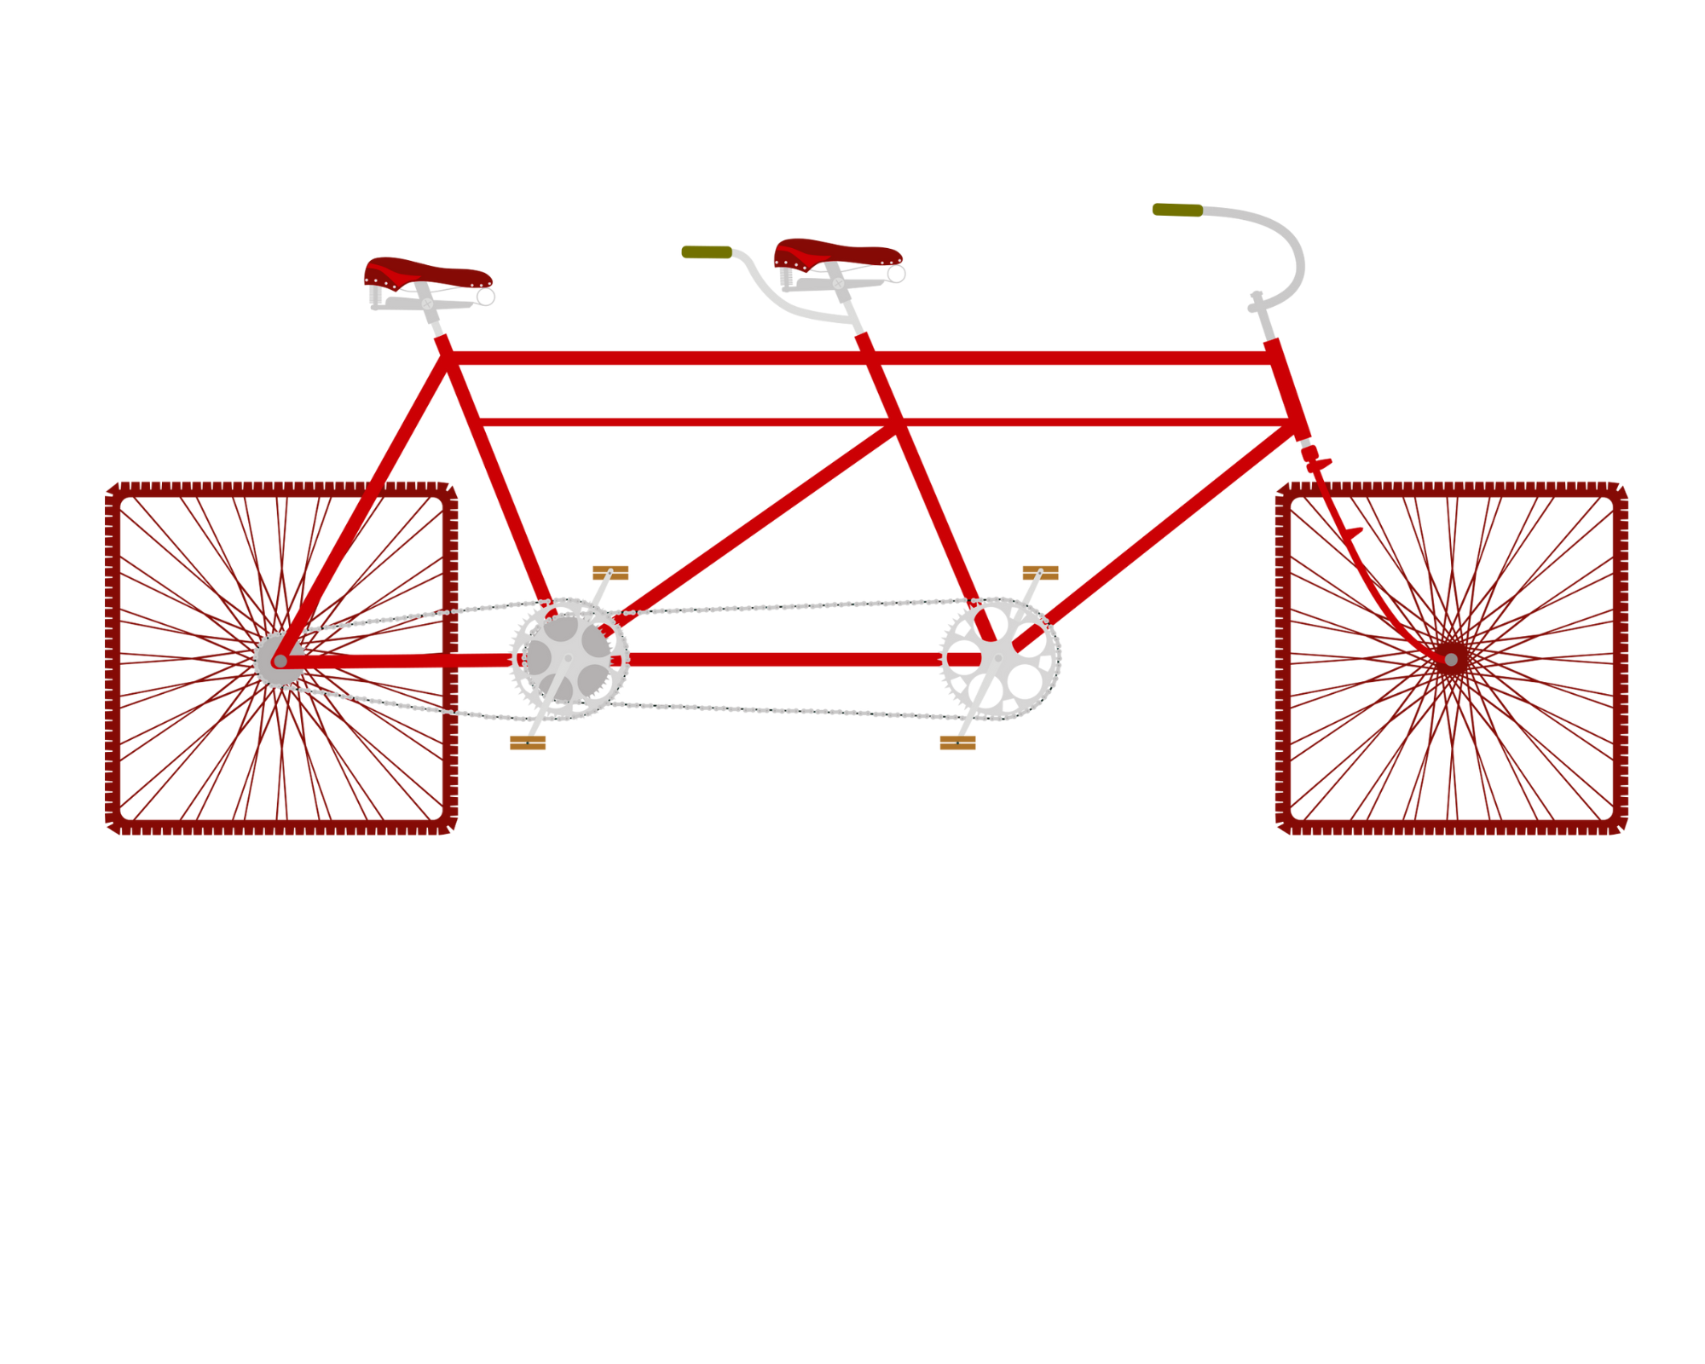
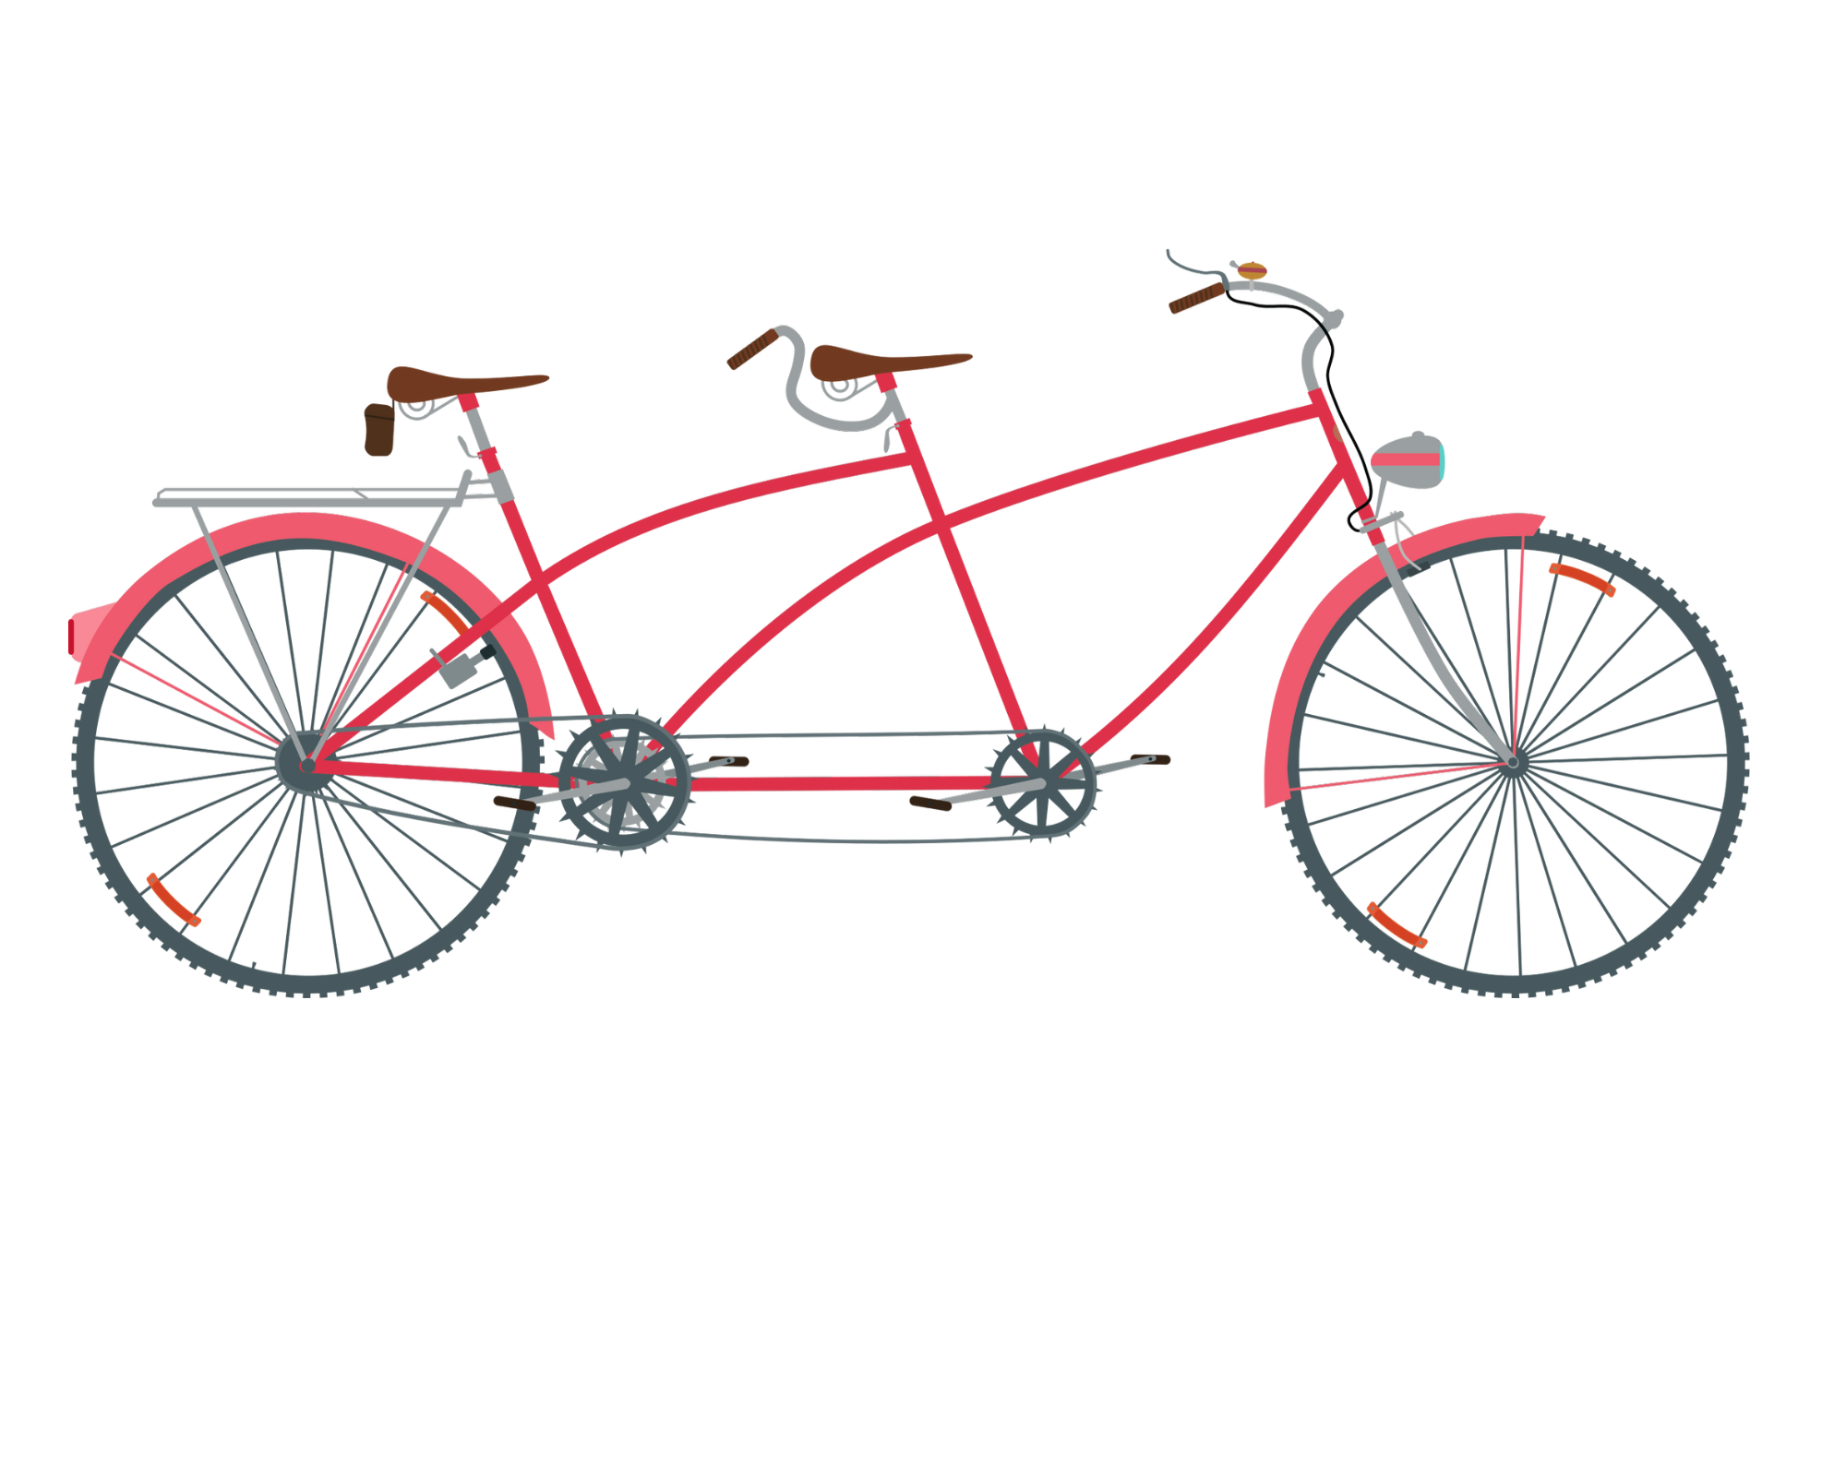
The model for improvement
Change
Setting aims
Test
Test again!
Establishing
measures
Selecting changes
Ideas are tested in real life, with people who will be impacted by the change, to determine if the idea was:
Acceptable
Effective
Efficient
Source: Square Wheels Tandem by Norbertsobolewski, Canva Pro 2024 Source: Retro Tandem by Norbertsobolewski, Canva Pro 2024
Source: Safer Care Victoria (2024) SCV Quality Improvement Tool
Notes:
Faculty name:
Session 2 Slides: 39-40
Time: 5mins
NOTE: Animation in slide
Introducing the model for improvement.
The IHI model for improvement is a framework and method to undertake your improvement work. It asks as series of questions followed by small scale testing to gain insights and learnings from the system you are trying to change.
The model helps to identify, define, and diagnose a problem, create a theory of change and to test 'change ideas' to determine if they will result in system performance improvement.
Reference: Safer Care Victoria (2024) SCV Quality Improvement Tool
Source: Square Wheels Tandem by Norbertsobolewski, Canva Pro 2024
Source: Retro Tandem by Norbertsobolewski, Canva Pro 2024
Source: Safer Care Victoria (2024) SCV Quality Improvement Tool

Slide 40


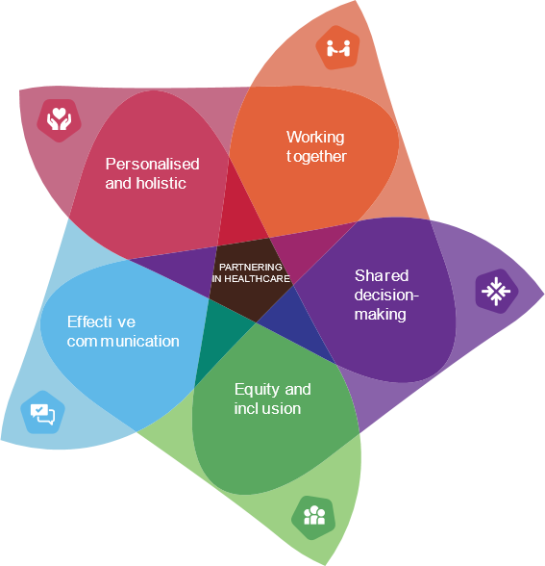
The model for improvement
Partnering in Healthcare Framework
Source: Safer Care Victoria (2019) Partnering in healthcare: a framework for better care and outcomes
Source: Safer Care Victoria (2024) SCV Quality Improvement Tool
Notes:
Session 2 Slide 40:
NOTE: Animation in slide
Quality improvement cannot be done alone.
To understand our system, understand the problem we are trying to solve, the improvement we want to see and to identify changes we want to test…..we need to work together with the people most affected by the system we want to improve…..form service delivery to consumers/carers…..
Collaboration and co-development and partnering is the foundation of QI work…as you can see in the MFI questions that highlight “We” not “I” as the basis for who is working through the three key questions.
Source: Safer Care Victoria (2019) Partnering in healthcare: a framework for better care and outcomes
Source: Safer Care Victoria (2024) SCV Quality Improvement Tool
Source: Image created using Canva Pro 2024

Slide 41
Developing an aim
Notes:
Faculty name:
Session 2 Slides: 41-45
Time: 5mins
Faculty discussion prompt: What is the purpose of an aim statement?
Aim statements are our communication piece. In this section we will find out the key components of an effective aim statement and how to craft one.

Slide 42
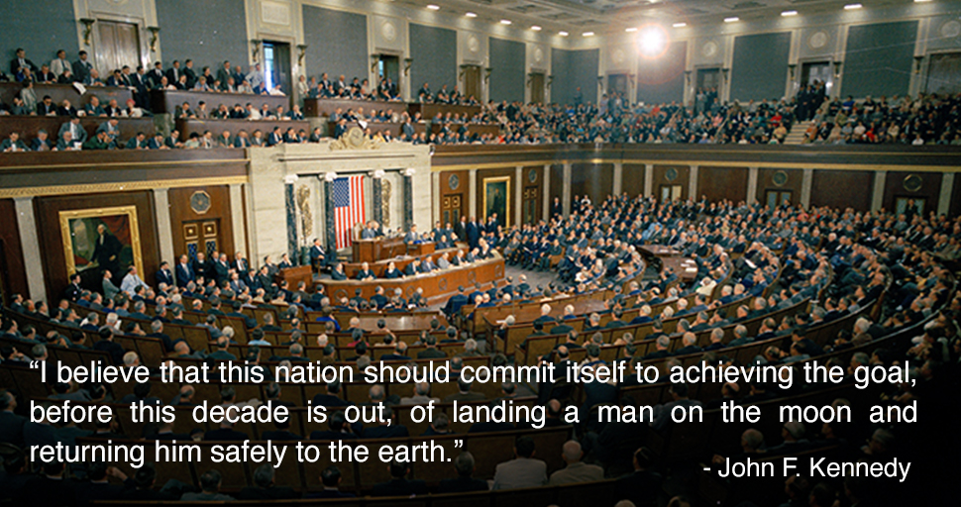

Aim statement components
Reference: JFK's 'Landing a man on the moon' speech by NASA/Langley Research Center (NASA-LaRC), Internet Archive, 1987 https://archive.org/details/NIX-LV-1998-00007 accessed 12/12/2024
Source: President John F. Kennedy’s Special Address to a Joint Session of Congress, May 25, 1961. (JFK Library Digital Identifier JFKWHP-ST-M19-1-61)
Notes:
Session 2 Slide 42:
NOTE: Audio quote from JFK moon speech to congress . Click image to play audio.
Consider the aim statement heard by JFK and think about how this motivated the world into action. [PLAY AUDIO]
Crafting an aim statement requires translating the purpose that brought the team together into operational terms that can be used to drive the work forward.
An aim statement must represent an accomplishment that is compelling and be collectively owned by the team. An effective aim statement will be motivating to the team and all those interested in the desired improvement.
Reference: JFK's 'Landing a man on the moon' speech by NASA/Langley Research Center (NASA-LaRC), Internet Archive, 1987 https://archive.org/details/NIX-LV-1998-00007 accessed 12/12/2024
Source: President John F. Kennedy’s Special Address to a Joint Session of Congress, May 25, 1961. (JFK Library Digital Identifier JFKWHP-ST-M19-1-61)

Slide 43
Setting an aim statement
Reference: Institute for Healthcare Improvement (IHI). (2021). How to Improve. Link Accessed 13 August 2021, http://www.ihi.org/resources/Pages/HowtoImprove/default.aspx
Reference: Institute for Healthcare Improvement (IHI). (2021). Science of Improvement: Testing Changes. Link Accessed 13 August 2021, http://www.ihi.org/resources/Pages/HowtoImprove/ScienceofImprovementTestingChanges.aspx
Source: Safer Care Victoria (2024) SCV Quality Improvement Tool
Notes:
Session 2 Slide 43:
NOTE: Animations in slide
Setting an aim answers the first question in the model for improvement: “What are we trying to accomplish?“
Using the model for improvement, we can break each component down to provide a framework for our improvement efforts. Each question requires us to think deeply and collaboratively to answer.
Reference: Institute for Healthcare Improvement (IHI). (2021). How to Improve. Link Accessed 13 August 2021, http://www.ihi.org/resources/Pages/HowtoImprove/default.aspx
Reference: Institute for Healthcare Improvement (IHI). (2021). Science of Improvement: Testing Changes. Link Accessed 13 August 2021, http://www.ihi.org/resources/Pages/HowtoImprove/ScienceofImprovementTestingChanges.aspx
Source: Safer Care Victoria (2024) SCV Quality Improvement Tool

Slide 44
Constructing an aim statement
For whom?
Who will benefit from this improvement?
Be specific e.g. location, patient group, system.
How good?
What is the numerical value of your goal? We can’t measure ‘reduce wait times’ but ‘reduce wait time by 15%’ gives us a target.
This should be measurable and show we reached our aim
By when?
What is the date by which you will make your improvement
This needs to be time-bound and realistic.
Where?
What are the boundaries of the process or system you are trying to improve?
Why?
What is the heart of what you are trying to achieve?
Why does this improvement need to happen, what would happen if it didn’t go ahead?
Institute for Healthcare Improvement (IHI). (2021). How to Improve. Link Accessed 13 August 2021, http://www.ihi.org/resources/Pages/HowtoImprove/default.aspx
Reference: Institute for Healthcare Improvement (IHI). (2021). Science of Improvement: Testing Changes. Link Accessed 13 August 2021, http://www.ihi.org/resources/Pages/HowtoImprove/ScienceofImprovementTestingChanges.aspx
Notes:
Session 2 Slide 44:
NOTE: Animations in slide
Overall key points
The key elements of a strong aim statement: for whom, what, when, how good, why.
A strong aim statement operationalises the identified problem.
Notes for going through each element:
(CLICK) FOR WHOM or WHAT
Be Specific – e.g. location, patient population, service, system etc.
Make sure that the aim statement describes the system to be improved, and the population. Some aim statements also contain information about key strategies and other guidance for the improvement project. But the aim should be succinct and not contain extraneous background information or side issues. It should be easy to understand exactly where we’re going and what we expect to accomplish.
(CLICK) HOW GOOD
Measurable – we need to be able to tell when we’ve reached the aim.
Setting numerical goals clarifies the aim, helps to create tension for change, directs measurement, and focuses initial changes. For example, the aim “reduce wait times for walk-in services by 60%” is clearer than “reduce wait times”. Including a numerical goal not only clarifies the aim but also helps team members begin to think about what their measures of improvement will be, what initial changes they might make, and what level of support they will need.
(CLICK) BY WHEN
Actionable – we need to be focusing on something we really can influence and make changes to.
Realistic – we should be ambitious (who wants to buy into a goal of exercising 5 minutes more) but also possible (e.g. exercising 24/7 is not realistic).
Time based - How good by when?
A “stretch” goal is one to reach for within a certain time. Setting stretch goals such as “Reduce wait times for walk-in services by 60% within 12 months” communicates immediately and clearly that maintaining the status quo is not an option. Effective leaders make it clear that the goal cannot be met by tweaking the existing system. Once this is clear, people begin to look for ways to overcome barriers and achieve the stretch goals.
(CLICK) WHERE: where is this improvement taking place e.g. Victoria or ward Y.
(CLICK) WHY
It is very easy when we start to achieve precision in our aim statements that our focus becomes cold and definitively numerical.
BUT a solid aim statement is almost defunct if the system and people can’t see the narrative or align to the purpose (HEART) for the improvement.
Reference: Institute for Healthcare Improvement (IHI). (2021). How to Improve. Link Accessed 13 August 2021, http://www.ihi.org/resources/Pages/HowtoImprove/default.aspx
Reference: Institute for Healthcare Improvement (IHI). (2021). Science of Improvement: Testing Changes. Link Accessed 13 August 2021, http://www.ihi.org/resources/Pages/HowtoImprove/ScienceofImprovementTestingChanges.aspx

Slide 45
What difference will it make to your QI project
We will reduce the rate of severe perineal trauma by 50 per cent by June 2021
We aim to reduce the harm Victorian women experience during childbirth by reducing the rate of third- and fourth-degree perineal tears by 50 per cent in participating services by June 2021
or
Notes:
Session 2 Slide 45:
Here are two aim statements for the same project.
Aim statement 1: has a goal of reducing perineal trauma by 50%, has an end date, by June 2021.
This aim statement, however, does not include the who or why or where for the improvement project. There is also no definition of what ‘severe’ means.
Faculty discussion prompt: Let’s have a show of hands:
who likes the first aim statement?
who thinks it requires work?
Aim statement 2: provides us with more clarity of the ‘who’, ‘why’ and the ‘harm’. It provides more of a story and pulls are the heart strings of why this improvement project needs to go ahead.
Faculty discussion prompt: Which of these aim statements would make you take part in the improvement work?

Slide 46
Activity 5: Writing an aim statement
1. In your workbook read your assigned case scenario.
Scenarios have been assigned based on table number
(for example, table 1 is doing scenario 1).
2. Collaborate with your group to review and refine the aim statement provided.
Consider these questions:
What improvements can you make?
For whom or what?
How good?
By when?
Why?
Pages 18-19 of workbook
15 Mins
Notes:
Faculty name:
Session 2 Slide 46
Time: 15min + 15min discussion/feedback
Activity instructions:
Working through your assigned case studies, re-work the provided aim statement to ensure it includes all elements.
Consider these questions:
What improvements can you make?
For whom or what?
How good?
By when?
Why?
Faculty to facilitate discussion when group comes back
Ensure all groups write their aim statement on flip chart paper to present back to the group.
Each group should provide their new aim statement.
Provide feedback to ensure critical reflection and where adjustments are needed.
The example aim statements for scenarios are in the participant workbooks and a summary is provided in the faculty guide.

Slide 47
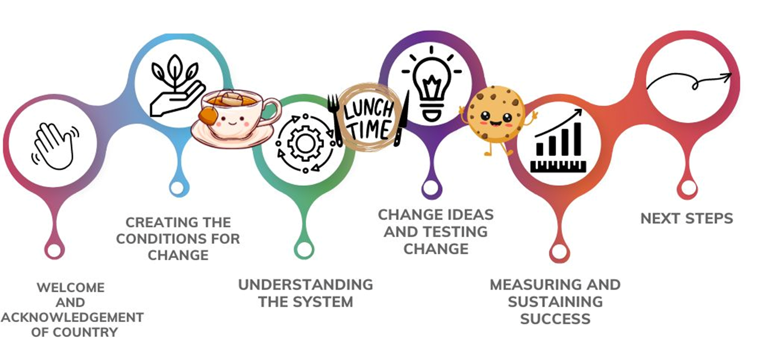
Where to next?
Notes:
Session 2 Slide 47:
Thank you for participating in QI in Action Session 2: Understanding the system. We have covered a lot of content including:
Learning about our system and how to look at data to find common and special cause variation and how to display data to tell a story.
QI in Action Session 3: Change ideas and testing changes will now focus on:
Working through the Model for Improvement to learn how to set an aim, come up with change ideas, and document and undertake PDSA cycles to test our ideas in the real world, under a variety of conditions.
Break time
Faculty note: Schedule a 15 minute break

