Slide 1
Quality Improvement in Action
An introductory training for quality improvement in health care
2025
Notes:
Faculty name:
Slide:
Welcome to Quality Improvement (QI) in Action – Session 3: Change ideas and testing changes

Slide 2
Session 3
Change ideas and testing changes
Notes:
Faculty name:
Session 3 Slides: 2-30
Time: 1hour 35mins
In this section we will cover:
How to generate change ideas.
How to depict your Theory of Change.
How to ensure your change ideas link back to your aim
How to ensure rigor and robustness in your testing changes ideas through PDSA cycles.

Slide 3
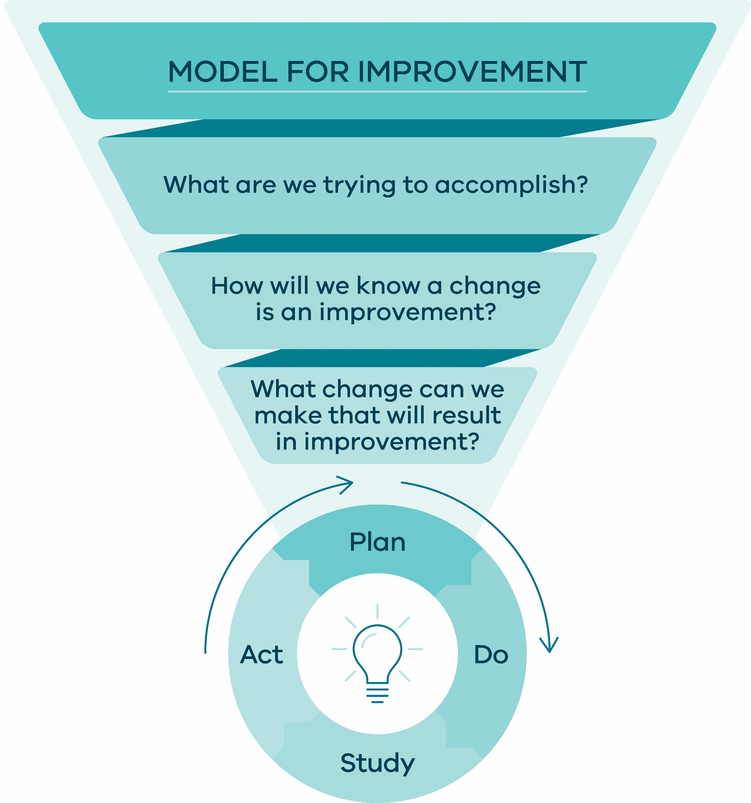
What change can we make that will result in improvement?
Selecting changes
or
Developing a Theory of Change
Source: Safer Care Victoria (2024) SCV Quality Improvement Tool
Notes:
Faculty name:
Session 3 Slides: 3
Time: 5mins
NOTE: Animations in slide
After developing an aim statement and goal, we need to work out what changes are required to get there.
We are now looking at question 3 in the model, ‘what changes can we make that will result in improvement?’
It is all about articulating our Theory of Change – by this we mean articulating the assumptions, enablers, and evidence (as we understand it today) that surround the work and making explicit the activities we believe will lead to the outcome we’re trying to achieve.
Source: Safer Care Victoria (2024) SCV Quality Improvement Tool

Slide 4


Why do we need a theory of change?
Change ideas
Aims
Source: Image generated using Deep AI from the prompt picture of a canyon in the distance with a bridge 2025
Notes:
Session 3 Slide 4:
NOTE: Animations in slide
Ask Audience
How often do we in healthcare jump straight to our change ideas without thinking about when/where/why/how of our problem/system?
Key messages / talking points
A theory of change bridges the canyon between what we want to achieve (our aims) and our change ideas.
Establishing a theory of change helps you to step back consider your aim and change ideas and to consider the system in which you work in to bridge between these 2 key items.
Describing the connections between aims and change ideas will help drive the success/failure of your improvement activity.
Source: Image generated using Deep AI from the prompt picture of a canyon in the distance with a bridge 2025

Slide 5

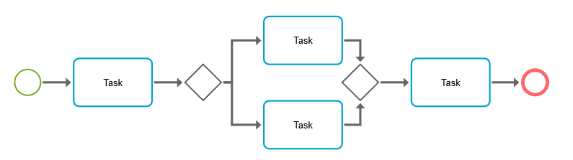


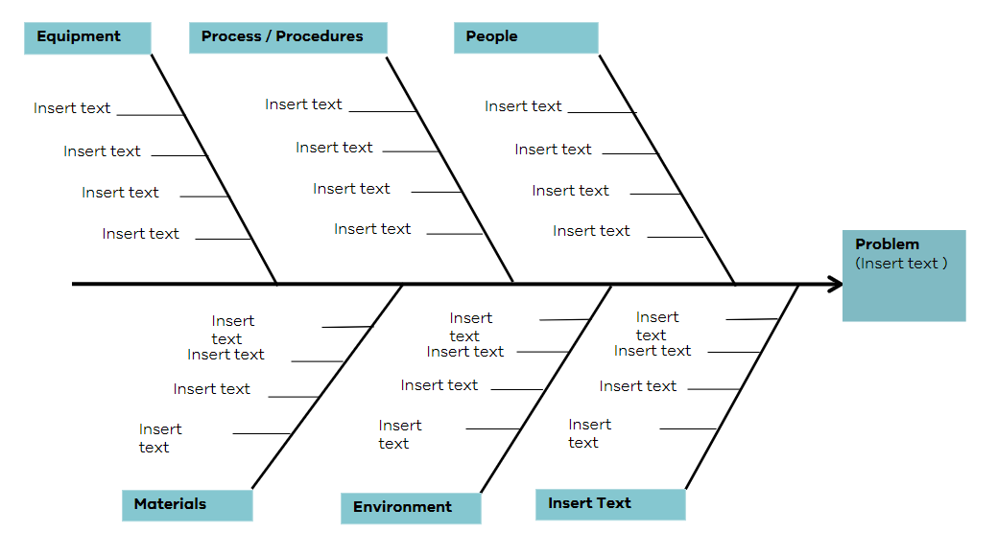
Generating change ideas
Source: Photo 1370218 by Pxhere under licenese: https://creativecommons.org/publicdomain/
Source: UI of charts and graphs by Freerange under licenese: https://creativecommons.org/publicdomain/zero/1.0/
Source: Colourful cogs turning in a circle by theskorys under license: https://creativecommons.org/licenses/by-nd/4.0/deed.en
Source: Lightbulb with brain form by mqpaloma under license: https://creativecommons.org/licenses/by-nd/4.0/deed.en
Notes:
Session 3 Slide 5:
NOTE: Animations in slide
Health professionals are good at coming up with change ideas, that is what we/health professionals are trained to do. We are problem solvers. Quality improvement asks you to step back, understand your system and work with others before jumping to solutions.
We can do this by using:
The SCV QI toolkit: for example cause and effect diagrams or process maps to identify possible areas of change. [Share link: Quality Improvement Toolkit | Safer Care Victoria]
Creative thinking exercises.
Group brainstorming activities.
And most importantly, ask the people using the system! People who use the system often are most likely the people with ideas for how to improve it.
Remember, what is important in Quality Improvement is ensuring your change ideas should link back to the aim/goal of your project. We do this by creating our theories of change.
Source: Photo 1370218 by Pxhere under licenese: https://creativecommons.org/publicdomain/
Source: UI of charts and graphs by Freerange under licenese: https://creativecommons.org/publicdomain/zero/1.0/
Source: Colourful cogs turning in a circle by theskorys under license: https://creativecommons.org/licenses/by-nd/4.0/deed.en
Source: Lightbulb with brain form by mqpaloma under license: https://creativecommons.org/licenses/by-nd/4.0/deed.en

Slide 6
Building a theory of change
In order to achieve this aim…
we need to ensure that….
which requires….
Our idea to make this happen is…
Aim
Knowing when and where change is needed
Specific change ideas to test
What themes will drive change?
Beware! Change idea vs change concept
Notes:
Faculty name:
Session 3 Slides: 6-10
Time: 10mins
NOTE: Animation in slide
Building a theory of change
A Theory of Change states that:
In order to achieve this aim... Clearly define the ultimate goal or desired change that you want to achieve.
We need to ensure…Consider the high-level factors or themes that you need to influence that will help you achieve the improvement aim.
Which requires…Determine when and where your efforts will have the most significant impact. Consider the specific contexts and settings where change is most crucial.
Ideas to make this happen... Identify the key areas where change is needed to address the problem. Identify potential ‘change concepts’ and ‘change ideas’ that you can test to understand their influence.
When thinking about change ideas there are many ways to identify them.
It is always important to remember to interrogate your ideas to make sure that they are Change ideas and not Change concepts.... As many of you will be going forward to test change ideas – it is important to explore this difference a little more.
A theory of change takes us through the linkages from aim to change idea and back again.
Firstly, what is the aim of the improvement work?
Secondly, what are the high level themes (process, norms and structures) that will help us drive the change.
Thirdly, when and where can we test our changes to see if they make an improvement.
Fourth, what change ideas can we come up with to work towards our aim. We don’t want to be making changes on something that won’t have any impact on the aim of the project.

Slide 7
Theory of change example: Reducing ED wait times
In order to achieve this aim
We need to ensure that there are models of care (MOC) that support patient flow
Which requires patients to be assessed in a timely manner on presentation to Emergency
Our idea to make this happen is to develop and test a screening tool to identify patients suitable for nursing fast track MOC
Notes:
Session 3 Slide 7:
NOTE: Animations in slide
Here is a one-line example of a theory of change from the example.
You can see here how a Theory of Change can be used to link a change idea (screening tool) logically and specifically to a place (ED presentation), to a need (MOC) right back to our aim.
Consider using a real life example to aid understanding of the concept

Slide 8
Change concepts vs. change ideas
Change concept | Change idea
Change concepts are general notions or approaches to change that are useful in developing specific ideas for changes that lead to improvement | Change ideas are specific, actionable ideas for changing a process. The things you can specifically test to see if they make a difference
‘Improve communication in the team’ is a concept
‘Introduction of a weekly huddle’ is a change idea
Notes:
Session 3 Slide 8:
NOTE: Animations in slide
When coming up with changes, it’s important to understand the different between a Change concept and a Change idea.
Change concepts can be used to help you come up with your change ideas.
Change ideas should be actionable and able to be tested. Starting a change idea with a verb is a good way to ensure the idea can be followed through and actioned.
For example: If you are trying to improve sleep, a change idea would be ‘charge phone in kitchen overnight’ as opposed to a broad change concept like ‘reduce technology use at night’.

Slide 9
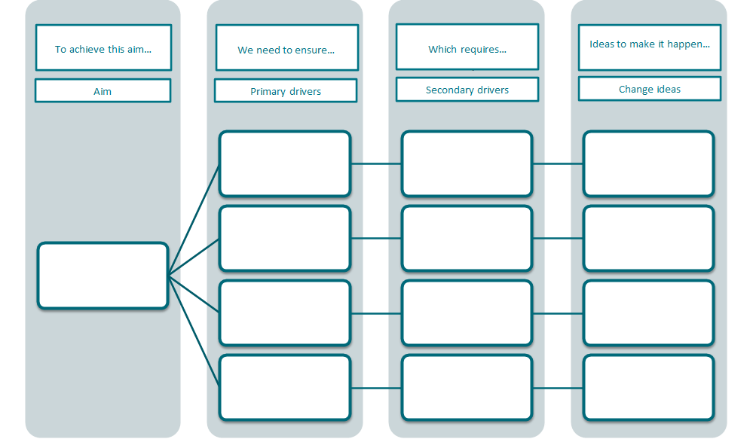
Visualising your theories of change
Where and when
Small, specific, actionable, ideas…
Structures
What are we trying to achieve?
Where and when
Which can be tested and measured…
Processes
Aim
Norms
Where and when
To understand their influence
Will live on in your system if successful
Where and when
Notes:
Session 3 Slide 9:
Faculty discussion prompt:
Hands up if you've heard of a Driver Diagram?
Keep hands up if you've used a Driver Diagram?
Keep your hands up if you felt you completely understood DD and how to use them the first time you heard about them?
Did you instinctively read the DD from right to left (or vice versa)? Essentially it doesn’t matter….
Key Teaching Points
The driver diagram is a way of displaying visually what you believe will influence your aim.
It is very rare for an improvement aim to be achieved by only 1 change idea. A driver diagram is a tool to show the display and organise the theories you have about how your change ideas will influence improvement fit together.
Each pathway through your driver diagram is a different theory of change.
As long as you start with the aim, any order is ok to create a driver diagram (left to right vs right to left).
Should be created with a team including those who use or are affected by the system you wish to change.
Don’t get too excited with numerous primary drivers. If you have more than 3 or 4 it is likely you may need to look at the scale of the improvement you are trying to accomplish in your aim.
Primary drivers this can be a good way to start thinking about primary drivers, although not all primary drivers will fit neatly into these boxes. Essentially these are the major overarching themes that influence the aim.
Structures = physical design of the space or product or even policy/governance structures (e.g. buildings, Computer software, equipment etc).
Processes = workflow, how things are accomplished, what steps are taken in what order.
Norms = written and unwritten rules that govern the behaviour of the people in the system "the way we do things around here".
It can sometimes be useful to cluster your change ideas to help identify some of the key overarching themes or primary drivers.
Secondary Drivers – The where, when, and who
In other words, what are our ideas for change, when and where will these need to occur and what major themes/factors do they support toward achieving our aim.
The thing to remember about driver diagrams is that they are living theories – the whole purpose is to map your initial theory, test ideas and update it if needed. They don't have to remain ‘set in stone’ if evidence emerges for new change ideas. NOT CHANGING TOO OFTEN

Slide 10

Example of a completed driver program
To achieve this aim...
we need to ensure that…
which requires…
Our ideas to make this happen…
Primary drivers
Secondary drivers
Change ideas
Reduce the number of patients waiting 2 hours or more in the Emergency Department by 40% by Dec 2025 to improve patient care and flow
Hospital occupancy
Volume of ED presentations
Admission
Models of care
Before Presentation
Discharge
Presentation
Discharge education materials available for patients in key languages
Develop and test a screening tool to identify patients suitable for nursing fast track MOC
Allocate all appropriate patients to discharge lounge
Test nurse practitioner model of care for specific patient groups
Provide virtual model of care options for patients
Test GP Fasttrack in ED for low-risk patients
Source: Safer Care Victoria (Canto) 2024
Notes:
Session 3 Slide 10:
NOTE: Animations in slide
Ok let’s look at an example of how to display a theory of change.
Driver Diagram Example: Reducing Emergency Department Wait Times
Discuss primary & secondary drivers & change ideas in context of this example
Primary Drivers: ED wait times are influenced by level of hospital occupancy, how many people are presenting to ED & the models of care being used
Secondary Drivers: The where and when / the timepoints of the system that we can act at / target our change ideas
They decided on Discharge, Admission, presentation and before presentation
Change Ideas: Can link to multiple primary and secondary drivers, as a team,
They came up with some change ideas they could test including referral to network hospitals, changes to models of care, cares plans to fast track diagnostics and virtual appointments.
Discussion Points
A driver diagram communicates multiple theories of change.
Each pathway through the driver diagram from aim to change idea represents an individual theory of change.
This is highlighted by the animated circling the example theory of change from earlier in presentation.
Source: Safer Care Victoria (Canto) 2024

Slide 11
Activity 6: Theory of change
(Continue with your assigned scenario)
You will be provided with a prompt sheet for your
Theory of Change. Using the post-it notes and pens provided,
build your group’s Theory of Change.
  Start with the aim statement you created earlier.
  What are your change ideas? Get creative, and make
  sure they are change ideas – not change concepts.
  Group your change ideas into themes.
  We have provided you with some prompts for
  themes. Please change, remove and add themes
  of your own!
Don’t forget to interrogate how your change ideas
will influence the success of your aim.
Pages 23-24 of workbook
15 Mins
Notes:
Faculty name:
Session 3 Slide 11
Time: 15min + 5min discussion/feedback
Working through your assigned case studies. Construct a theory of change using the driver diagram template.
Activity instructions:
Continue on with your case scenarios
Start with the aim statement you created earlier.
What are your change ideas? Get creative and make sure they are change ideas – not change concepts.
Group your change ideas into themes. We have provided you with some prompts for themes – please change, remove, and add themes of your own!
Faculty to facilitate discussion when group comes back
Prompt groups/tables to consider ideas from perspective of different ‘hats’. For example, consider consumer/patient: ‘what ideas do you think you might have as a patient’.
Interrogate whether change concepts or change ideas have been added.
Emphasise the importance of engaging with different expertise and experience as well as working together.

Slide 12
Testing changes
Notes:
Faculty name:
Session 3 Slides: 12-25
Time: 15mins
Now that we have our change ideas, we need to test them in our real-world environment to collect information on whether we should adopt, adapt, or abandon our idea.

Slide 13

How can we achieve improvement?
Improvement
Ideas
Will
Ideas
Execution
Execution
Source: Safer Care Victoria (2024) SCV Quality Improvement Tool
Reference stool image: IHI Professional Improvement Coach Program (2023)
Notes:
Session 3 Slide 13:
Even if we answer all three questions in the Model for Improvement there is an important element that is needed. The doing. We might have Will for change, Ideas of what needs to change, but without any doing or action we will never see any results!
When we consider where the “Plan Do Study Act (PDSA)” cycle fits in out broader improvement work, it’s about execution – the doing. The PDSA cycle is the machine of our improvement work.
The stool is another way of looking at three important considerations for when we are doing improvement work: What this image of the stool is saying is….
Will – Is there a ‘will’ for the improvement and is there enough? Does this topic matter to people?
Ideas – What new things will you test and try. What are the things you are trying to create?
Execution – How will things get done? What needs to happen for action and how do you make your change ideas a reliable part of your system and ensure they do result in improvement?
Source: Safer Care Victoria (2024) SCV Quality Improvement Tool
Reference stool image: IHI Professional Improvement Coach Program (2023)

Slide 14
Typical approach
Design
Approve
Implement
Notes:
Session 3 Slide 14:
A traditional approach to improvement often involves people who may be distant from the problem, coming up with a solution or designing a change, and then implementing the change.
I wonder if this sounds familiar to any of you?
Faculty discussion prompt: Think of a time in your organisation when change has occurred. How many of those doing the work or who benefit from the work were part of the design process? What were the outcomes?

Slide 15
Quality improvement approach
Plan – Theory of change
Implement
Test and modify
Test and modify
Scale testing and modify
Sustain change
Spread
Notes:
Session 3 Slide 15:
In QI, we know that if we don’t test – we don’t learn!
Using a QI mindset, we want to start with small scale tests in the real world to learn about and get feedback from the system we are trying to change.
PDSA cycles are our vehicle for testing and modifying the change in the real world before investing in widespread implementation. These cycles provoke the system and generate learning and data about what is the best approach in a particular context.
By testing in your system, you can understand what conditions influence if your change idea works or doesn’t work and so you can learn how to adapt them.
Testing helps to build your degree of belief that the change idea will work and what needs to be considered for it to work before starting to scale and spread.

Slide 16
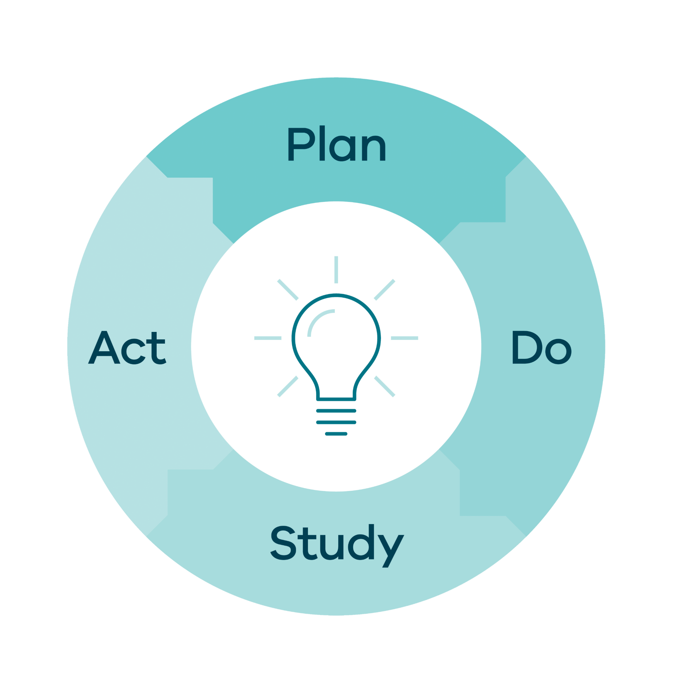
Plan / Do / Study / Act
Plan
Questions: What do we want to know?
Predictions: What do we think will happen?
Plan for test: Who, what, when, where?
What are we going to do to make our test happen?
Plan for data collection: What will you measure?
Do
Go out and do what you planned!
Describe what happened: Was it carried out as planned?
What data did you collect?
What observations did you make?
Any observations that
weren’t part of the plan?
Act
Will you adapt, adopt or abandon?
What will your next cycle look like?
Study
Summarise and reflect on what you learned.
How did the results of this cycle compare to your predictions?
What knowledge was gained from this cycle
Notes:
Session 3 Slide 16:
NOTE: Animations in slide
Key points:
A PDSA cycle is a process that gives structure to testing your change ideas and can be used as a decision aid to determine your next steps: Based on what you have learned in your test, will you adopt, adapt, or abandon your change idea?
PDSA cycles have 4 steps.
[CLICK] Planning phase: we want to test our change idea. In this step we want to make a prediction as to what will happen during the ‘do’ phase. What do we think will happen if we introduce this change? We want to plan for when and where the test will occur and who with and most importantly what data or information are we going to collect during the test. In a PDSA you are wanting to measure the effectiveness of a single change idea so makes sure to identify what measures you will use to do this. (PDSA measures are different from your overarching program measures (or Family of Measures) – as these measure the progress and outcomes of multiple change ideas).
[CLICK] Do phase: carry out the testing and describe what happened during the test and what your observations were. Did it go to plan? Were your predictions correct? What data did you collect?
[CLICK] Study phase: during the study phase we want to summarise and reflect on what we learnt. What knowledge did you gain from this cycle to help you inform the next? What can you tell from the test about how this change idea might help influence how you can achieve your aim?
[CLICK] Act phase: PDSA cycles must result in a decision about next steps. Once we have our data from our test, we need to make a decision. Will you adapt the change, adopt the change or abandon it altogether? If you are adapting, what change will you make during the next test?

Slide 17

Robust testing under a variety of conditions
Source: Um, perfect by Flickr under licenese: https://creativecommons.org/licenses/by/2.0/
Notes:
Session 3 Slide 17:
We do PDSA cycles to give our testing more rigor and ensure we have robust learning from the tests.
Robust testing includes running tests in a variety of conditions over time and generating new knowledge that is built sequentially over time. Looking at the tree in the image here, as it grows it is tested under the conditions of each season, and adapts how it grows and thrives over time.
As the learning is coming in, teams decide if it makes sense to increase the complexity of their tests over different areas, or with new conditions including looping in different staff, providers, testing at different times of day/days of the week etc.
Source: Um, perfect by Flickr under licenese: https://creativecommons.org/licenses/by/2.0/

Slide 18



Small-scale testing
People
Time
Location
Source: A group of people by Al Emojis under license: https://creativecommons.org/licenses/by-nd/4.0/deed.en
Source: Clock by Al Emojis under license: https://creativecommons.org/licenses/by-nd/4.0/deed.en
Source: Map with a pin by Al Emojis under license: https://creativecommons.org/licenses/by-nd/4.0/deed.en
Notes:
Session 3 Slide 18:
Key points:
When we start testing, we want to go small, small scales means we can test in the real world and gain knowledge that we can apply in real time to the next test.
The main building blocks of our systems are people, time, location.
So, when you are trying to scale back, you are often scaling back one of these components.
It is important to keep asking yourself when planning your PDSA cycles: How small can we go?
Example: Change idea might involve wanting to include assessment tool during admissions. Instead of investing all your time to develop the full tool, write the questions/assessment tasks down on a piece of paper and ask 1 willing person to give it a go. Get some feedback about the wording, usefulness, experience, and adapt it for your next test.
As a general rule your first PDSA cycles should be as small as:
One person
One shift
One ward
Then build in complexity to the conditions you are testing under as you learn more and build your degree of belief in the change idea and how it works.
Source: A group of people by Al Emojis under license: https://creativecommons.org/licenses/by-nd/4.0/deed.en
Source: Clock by Al Emojis under license: https://creativecommons.org/licenses/by-nd/4.0/deed.en
Source: Map with a pin by Al Emojis under license: https://creativecommons.org/licenses/by-nd/4.0/deed.en

Slide 19

Are your change ideas working?
  Utilise measures for each PDSA cycle so you can:
  assess the impact of a specific change or intervention
  help teams understand whether the planned change resulted in the desired improvements
  inform further adjustments in subsequent cycles
Source: Question mark by Flickr under license: https://creativecommons.org/licenses/by-nc-nd/2.0/
Notes:
Session 3 Slide 19:
PDSA measures are small-scale measures designed to assess the impact of a specific change for an individual PDSA cycle.
These measures will help guide your decision-making about your future PDSA cycles.
Will you adopt, adapt or abandon your change idea?
Source: Question mark by Flickr under license: https://creativecommons.org/licenses/by-nc-nd/2.0/

Slide 20
Example of a completed driver program
To achieve this aim...
we need to ensure that…
which requires…
Our ideas to make this happen…
Primary drivers
Secondary drivers
Change ideas
Reduce the number of patients waiting 2 hours or more in the Emergency Department by 40% by Dec 2025 to improve patient care and flow
Hospital occupancy
Volume of ED presentations
Admission
Models of care
Before Presentation
Discharge
Presentation
Discharge education materials available for patients in key languages
Develop and test a screening tool to identify patients suitable for nursing fast track MOC
Allocate all appropriate patients to discharge lounge
Test nurse practitioner model of care for specific patient groups
Provide virtual model of care options for patients
Test GP Fasttrack in ED for low-risk patients
Notes:
Session 3 Slide 20:
NOTE: Animations in slide
In this example: the team have decided to test a new model of care with a nurse practitioner (NP) for specific patients.
Note: Faculty can insert an image to the slide to enhance learning.
Source: Safer Care Victoria (Canto), 2024

Slide 21
Documenting your PDSA cycle
1. Plan: What do you want to learn and what do you need to do? Question: Will allowing low-risk patients to access a Nurse practitioner (NP) model of care in Emergency improve flow? Prediction: Having nurse practitioner model of care in fast track will allow for appropriate patients to be allocated to NP care, reducing wait times for those presenting to Emergency. Data (PDSA measures): How many pts seen with NP? Time waiting for NP to see pt from triage Outcome of presentation Interview with NP +/- pt feedback Appropriateness of referrals | 2. Do: Who, what, by when? Day 1: On Tuesday morning shift, 1 NP commenced in fast track in Emergency. Data: 3 pts seen by NP Pt 1: pt appropriate for NP, treated and given review appt, wait time 25mins Pt 2: pt appropriate for NP, given referral to community service, wait time 20mins Pt 3: pt appropriate for NP, treated and discharged, wait time 17mins Pt 4: referred but needed escalation
4. Act: Adapt, adopt, abandon? Adapt Test having NP clinic in fast track after hours. | 3. Study: What actually happened? What did you learn? Triage staff found it helpful to be able to allocate appropriate patients to the NP. 4 pts seen by NP but 1 pt referred but needed escalation to a doctor as out of scope for NP NP able to be easily allocated on a morning shift to fast track Need to more pts to see if total wait time reduced NP observation Pt observation
Notes:
Session 3 Slide 21:
Documentation of a PDSA cycle can be as simple as this four-box table, or as complex as a multi-page form – whatever is most meaningful to your team.
Ensure you complete each section, including the prediction of what you think will occur during the test.
Completing each section is helpful for telling your story but also, if for some reason you move on or need to go back and review why certain changes did or didn’t work, you will have evidence and documentation. It leaves a paper trail for others to follow.
PLAN: In this example the team are testing the NP model of care with low risk patients with 1 nurse on a Tuesday morning shift. They have identified the data they want to collect and their prediction of what will happen.
DO: The team then document what happened on the day, what data they observed and collected e.g pts, time to be seen, outcome.
STUDY: What was learnt from this test was then documented in the study section.
ACT: This is where your decision for the next test will occur. Using the data and learnings, will you adopt, adapt or abandon this idea? This team saw the test as a success and have decided to adapt and change the time of the clinic to after hours.

Slide 22
Goals of PDSA measures
PDSA Measures
Measures that are employed during each iteration of the PDSA cycle
Assess the impact of a specific change or intervention
Help teams understand whether the planned change resulted in the desired improvements and inform further adjustments in subsequent cycles
Notes:
Session 3 Slide 22:
When we are measuring our PDSA cycles, our measures are specific to the continuous improvement process and are focused on assessing the effectiveness and impact of individual changes or interventions within that process and test. They have a much smaller and specific scope than project measures.
In PDSA cycles, measurement is taken immediately after an idea or change has been tested, or in real-time.
Remember, your PDSA cycles are helping you build your degree of belief in a change idea and to understand the conditions in which it is most effective.
We will discuss project measures in another section of QI in Action to help you to understand the effectiveness and impact of multiple change ideas and how their implementation is helping to achieve your aim.

Slide 23
Documenting your PDSA measure
Pts – patients
NP – nurse practitioner
Notes:
Session 3 Slide 23:
Along with documenting your cycles in the PDSA template, it can also be a good idea to monitor your PDSA results in a run chart.
Monitor for changes/patterns/signals of change in your data to see the impact of your change ideas.
In this example the team measured both, number of patients seen by the NP and what wait time looked like at the corresponding times the NP model of care was operational.
These 2 measures would form part of this project’s family of measures – however this is not always the case. You will have measures that will be specific to a PDSA cycle or ramp that may not relate to the family of measures e.g. testing the questions during the development of a new form.
For example, a PDSA measure would be how you test/understand the effectiveness of questions used on a new admissions form. Your project measures would likely measure the implementation progress and outcomes once the form is implemented.

Slide 24
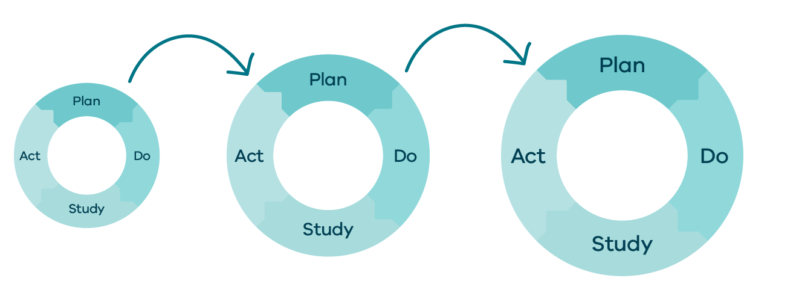
Plan-do-study-act
Source: Safer Care Victoria (2024) SCV Quality Improvement Tool
Notes:
Session 3 Slide 24:
NOTE: Animations in slide
PDSA cycles are the engine of the Model for Improvement.
Where the work and learning is done.
Is this about developing (designing) a change/testing a change/or implementing/spreading a change?
The diagram shows one cycle, but in reality, we undertake many, many cycles for improvement work [CLICK]
We may start with information gathering to help us work out what we could change. For instance, we, might go and watch the process or get some simple data. Next, we carry out a very small-scale test, and then we gradually build and test in different conditions until we are ready to implement.
Source: Safer Care Victoria (2024) SCV Quality Improvement Tool

Slide 25
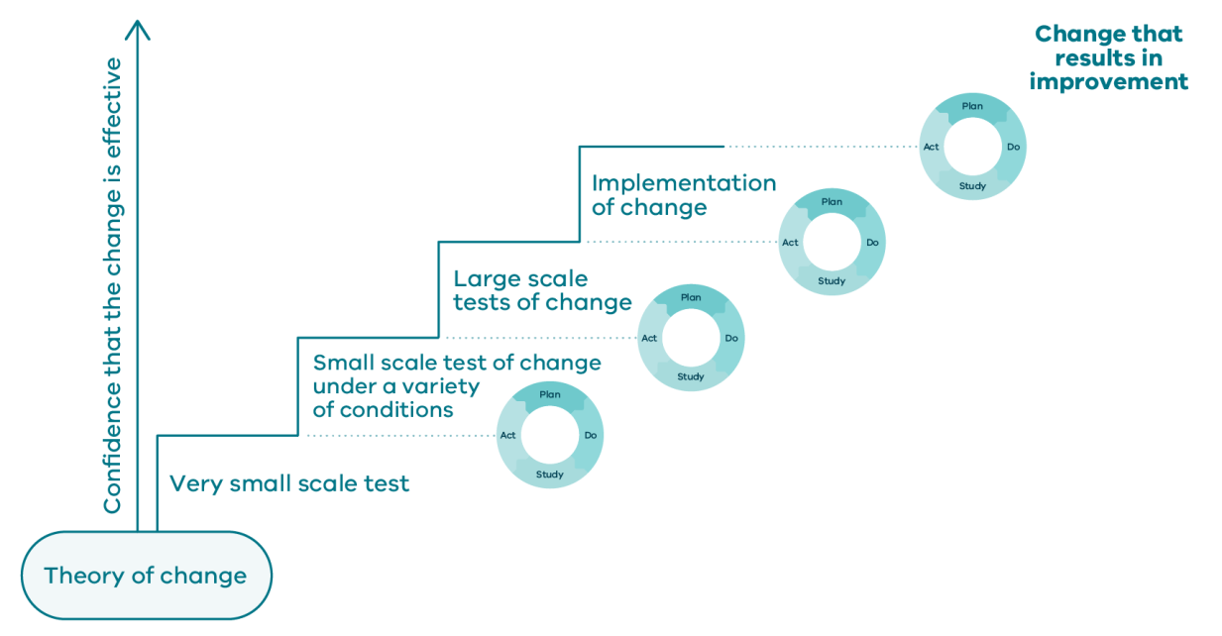
Improvement sequence
Source: Safer Care Victoria (2024) SCV Quality Improvement Tool
Notes:
Session 3 Slide 25:
As we collect information about our system, our confidence in this change idea grows and we can continue to learn and test under different conditions and increase in complexity and scale as part of the process.
This is PDSA ramping.
The idea of a ramping is to take us from ideas we think might work and build our degree of belief that they will work, by doing a series of tests.
We may start with information gathering to help us work out what we could change. For instance, we, might go and watch the process or get some simple data. Next, we carry out a very small-scale test, and then we gradually build and test in different conditions until we are ready to implement.
The SCV QI toolkit has a section and template for PDSA ramping you may wish to refer to after this program.
Source: Safer Care Victoria (2024) SCV Quality Improvement Tool

Slide 26
Activity 7: Coin spinning
Improvement goal: To achieve a coin spin that lasts no less than 10 seconds
Group change ideas:
What ideas might you want to test that will impact the length of the spin?
Page 26 of workbook
Notes:
Faculty name:
Session 3 Slide 26-27
Time: 15min + 10min discussion/feedback
Practicing documenting PDSA cycles with coin spin.
Our improvement goal for this activity is: To achieve a coin spin that lasts no less than 10 seconds.
Faculty discussion prompt: If we are to achieve this, what ideas might you want to test that could impact the length of the spin?
Faculty activity note: explain the activity before they start spinning coins.
Each table should have:
1 bag of coins,
1 A3 run chart and
2 PDSA templates.
Example documentation can be found in the participant workbook.
Faculty note: Insert an image to the slide to enhance understanding of the activity.

Slide 27
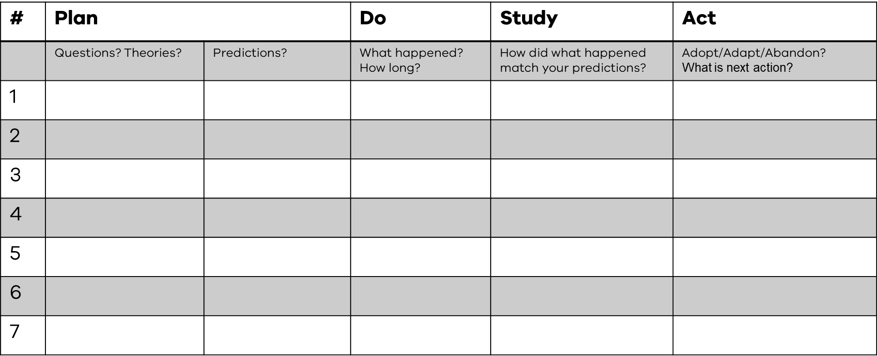
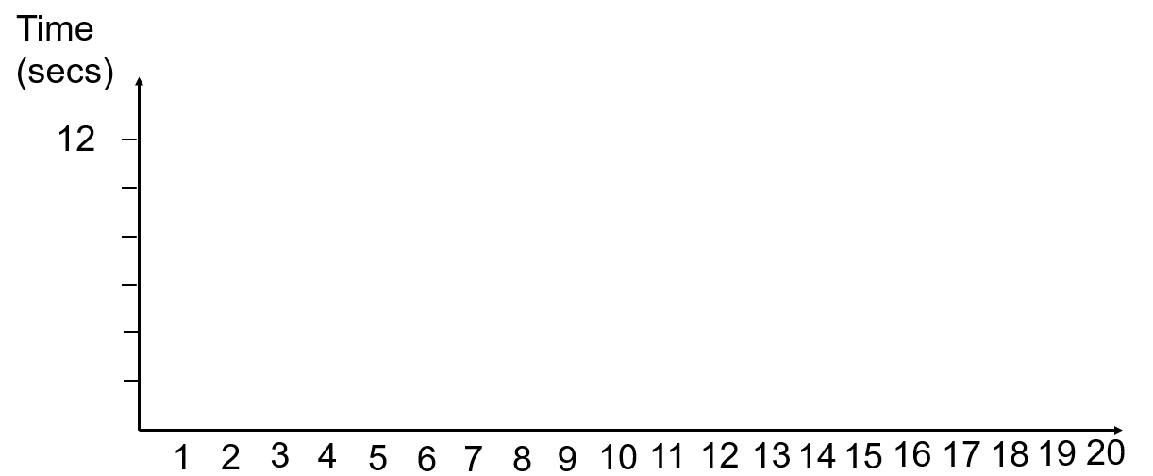
Activity 7: Coin spinning
Pages 27-29 of workbook
15 Mins
How to play:
Assign roles (Person/Timekeeper/Data collector)
Decide on coin, spinning technique, person and surface
Start spinning and get your baseline data
Document your PDSA cycles on your PDSA and run chart templates. Don’t forget to make a prediction for each test!
Make sure you document your PDSAs on your PDSA Template and spin times on your run chart
PDSA Cycles
Cycle 1: Baseline 10 spins
Cycle 2: Change first variable Change one variable (coin/technique/person/surface) Make your prediction Test for five spins Decide if you want to adapt, adopt or abandon your change?
Cycle 3: Make second change Change one of coin/technique/person/surface Make your prediction Test for five spins Decide if you want to adapt, adopt or abandon your change?
Notes:
Session 3 Slide 27:
Activity instructions:
Document your PDSA cycles on your PDSA and run chart templates.
Assign roles (Who is the Person/Timekeeper/Data collector).
Decide on specifics of what they are testing (which coin, spinning technique, person/spinner and surface etc).
Start spinning and generate your baseline understanding of your spin length. Do 10 spins to get your baseline.
Then start making changes! Decide the change you will test, make a prediction of what it will achieve and test that change for 5 spins.
PDSA Cycles:
Cycle 1: Create a baseline of 10 spins – document on run chart graph and in table.
Cycle 2: Change one variable (coin/technique/person/surface).
Predict what the outcome of your change will be.
Test for five spins.
Decide if you want to adapt, adopt or abandon your change?
Cycle 3: Make second change.
Predict what the outcome of your change will be.
Change one of coin/technique/person/surface.
Test for five spins.
Decide if you want to adapt, adopt or abandon your change?
Faculty call out timing to keep on track:
First 5 min – baseline data
Second 5 min – change 1
Third 5 min – change 2.
Faculty to facilitate discussion when group comes back

Slide 28

Time to reflect
What did you learn?
Did you stick to your plan?
Did you measure the way you intended to?
How did you respond to your data?
Were you testing to prove yourself right?
Did you reach a new level of performance?
Were your results sustainable?
Source: Photo 1403206 by Pxhere under license: https://creativecommons.org/publicdomain/
Notes:
Session 3 Slide 29:
NOTE: Animations in slide
Participants to reflect on the process using the questions on the slide as a guide for discussion.
Faculty discussion prompts: a sample of questions to prompt reflection:
What was that like?
Did it accelerate learning?
Did you want to disregard any tests?
How did you decide when to start and stop the coin spin?
Did everyone do it the same way? (importance of operational definitions)
Source: Photo 1403206 by Pxhere under license: https://creativecommons.org/publicdomain/

Slide 29
Activity 8: PDSA scenario
Continue with your scenario.
You have been given a change idea and an associated PDSA cycle.
As a group discuss your PDSA cycle scenario and how you will make decisions about your next testing steps.
Will you adopt, adapt or abandon
What will your next test look like?
Pages 31-37 of workbook
15 Mins
Notes:
Faculty name:
Session 3 Slide 29-30
Time: 15min + 10min discussion/feedback
Activity instructions:
Use the pre-filled out PDSA examples from your scenarios. [NOTE You can use the provided scenarios in the faculty guide or create your own scenarios using the PDSA form in the SCV QI Toolkit for this activity]
Each team have a change idea to document.
Based on the information, would you recommend they adopt, adapt, or abandon the cycle?
What would your plans be for the next cycle?
Faculty note:
Ensure each group has the opportunity to provide feedback
Summarise change they tested and key info that helped them to decide whether they adopted, adapted or abandon the next test.
Summary of each PDSA Scenario is in the faculty guide.

Slide 30
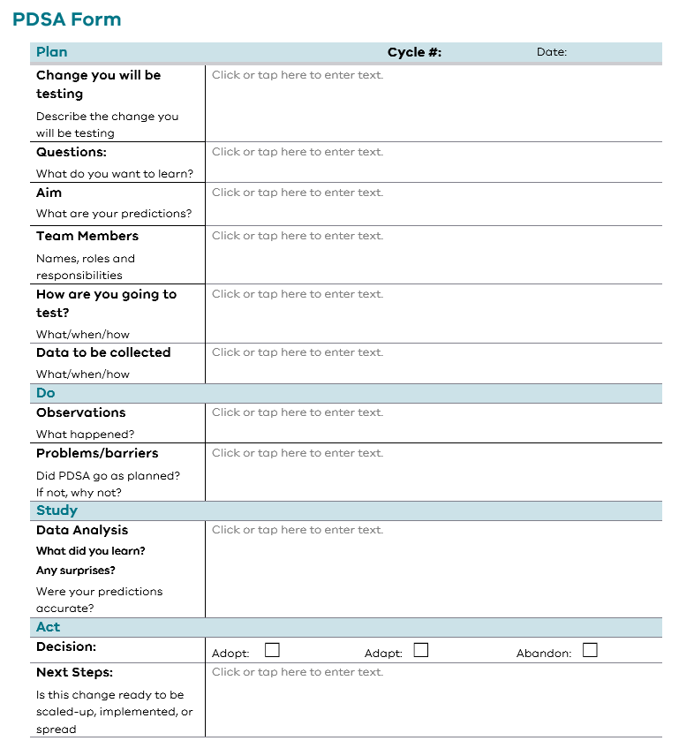
PDSA form
Notes:
Session 3 Slide 30:
This is what the example looks like in the workbooks for this activity.
You have now used several different ways to document your PDSA cycles from the simple quadrants, the form, and run charts.

Slide 31
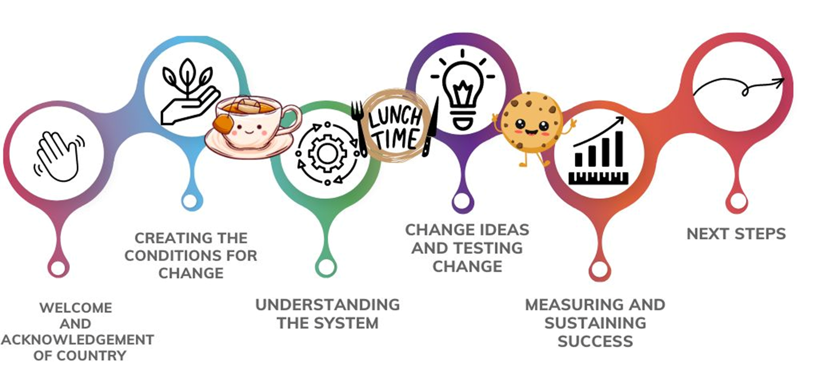
Where to next?
Notes:
Session 3 Slide 31:
Thank you for participating in QI in Action Session 3: Change ideas and testing changes. We have covered a lot of content including:
Working through the Model for Improvement to learn how to set an aim, come up with change ideas, and document and undertake PDSA cycles to test our ideas in the real world, under a variety of conditions.
QI in Action Session 4: Change ideas and testing changes will now focus on:
Learning about an improvement project’s family of measures that help measure the impact our theory of change is having in the system.
And finally, we will touch on how to sustain our change.
Break time
Faculty note: Schedule a 15 minute break

