Slide 1
Quality Improvement in Action
An introductory training for quality improvement in health care
2025
Notes:
Faculty name:
Slide: 1
Welcome to Quality Improvement (QI) in Action – Session 4: Measuring and sustaining success

Slide 2
Session 4
Measuring and sustaining success
Notes:
Faculty name:
Slide 2-19
Time: 40mins
Our final session is on how do we know the changes we are making are making a difference and what things to consider when we need change to be sustained.

Slide 3
Measurement
Notes:
Faculty name:
Slide 3
Time: 15mins
Once we have defined what we are going to improve and then set our aim, we need to establish measures to know if the changes we make lead to an improvement. Measures are indicators of change. To answer this key question (“How will we know that a change is an improvement?”), several measures usually are required. These measures also can be used to monitor a system’s performance over time.

Slide 4
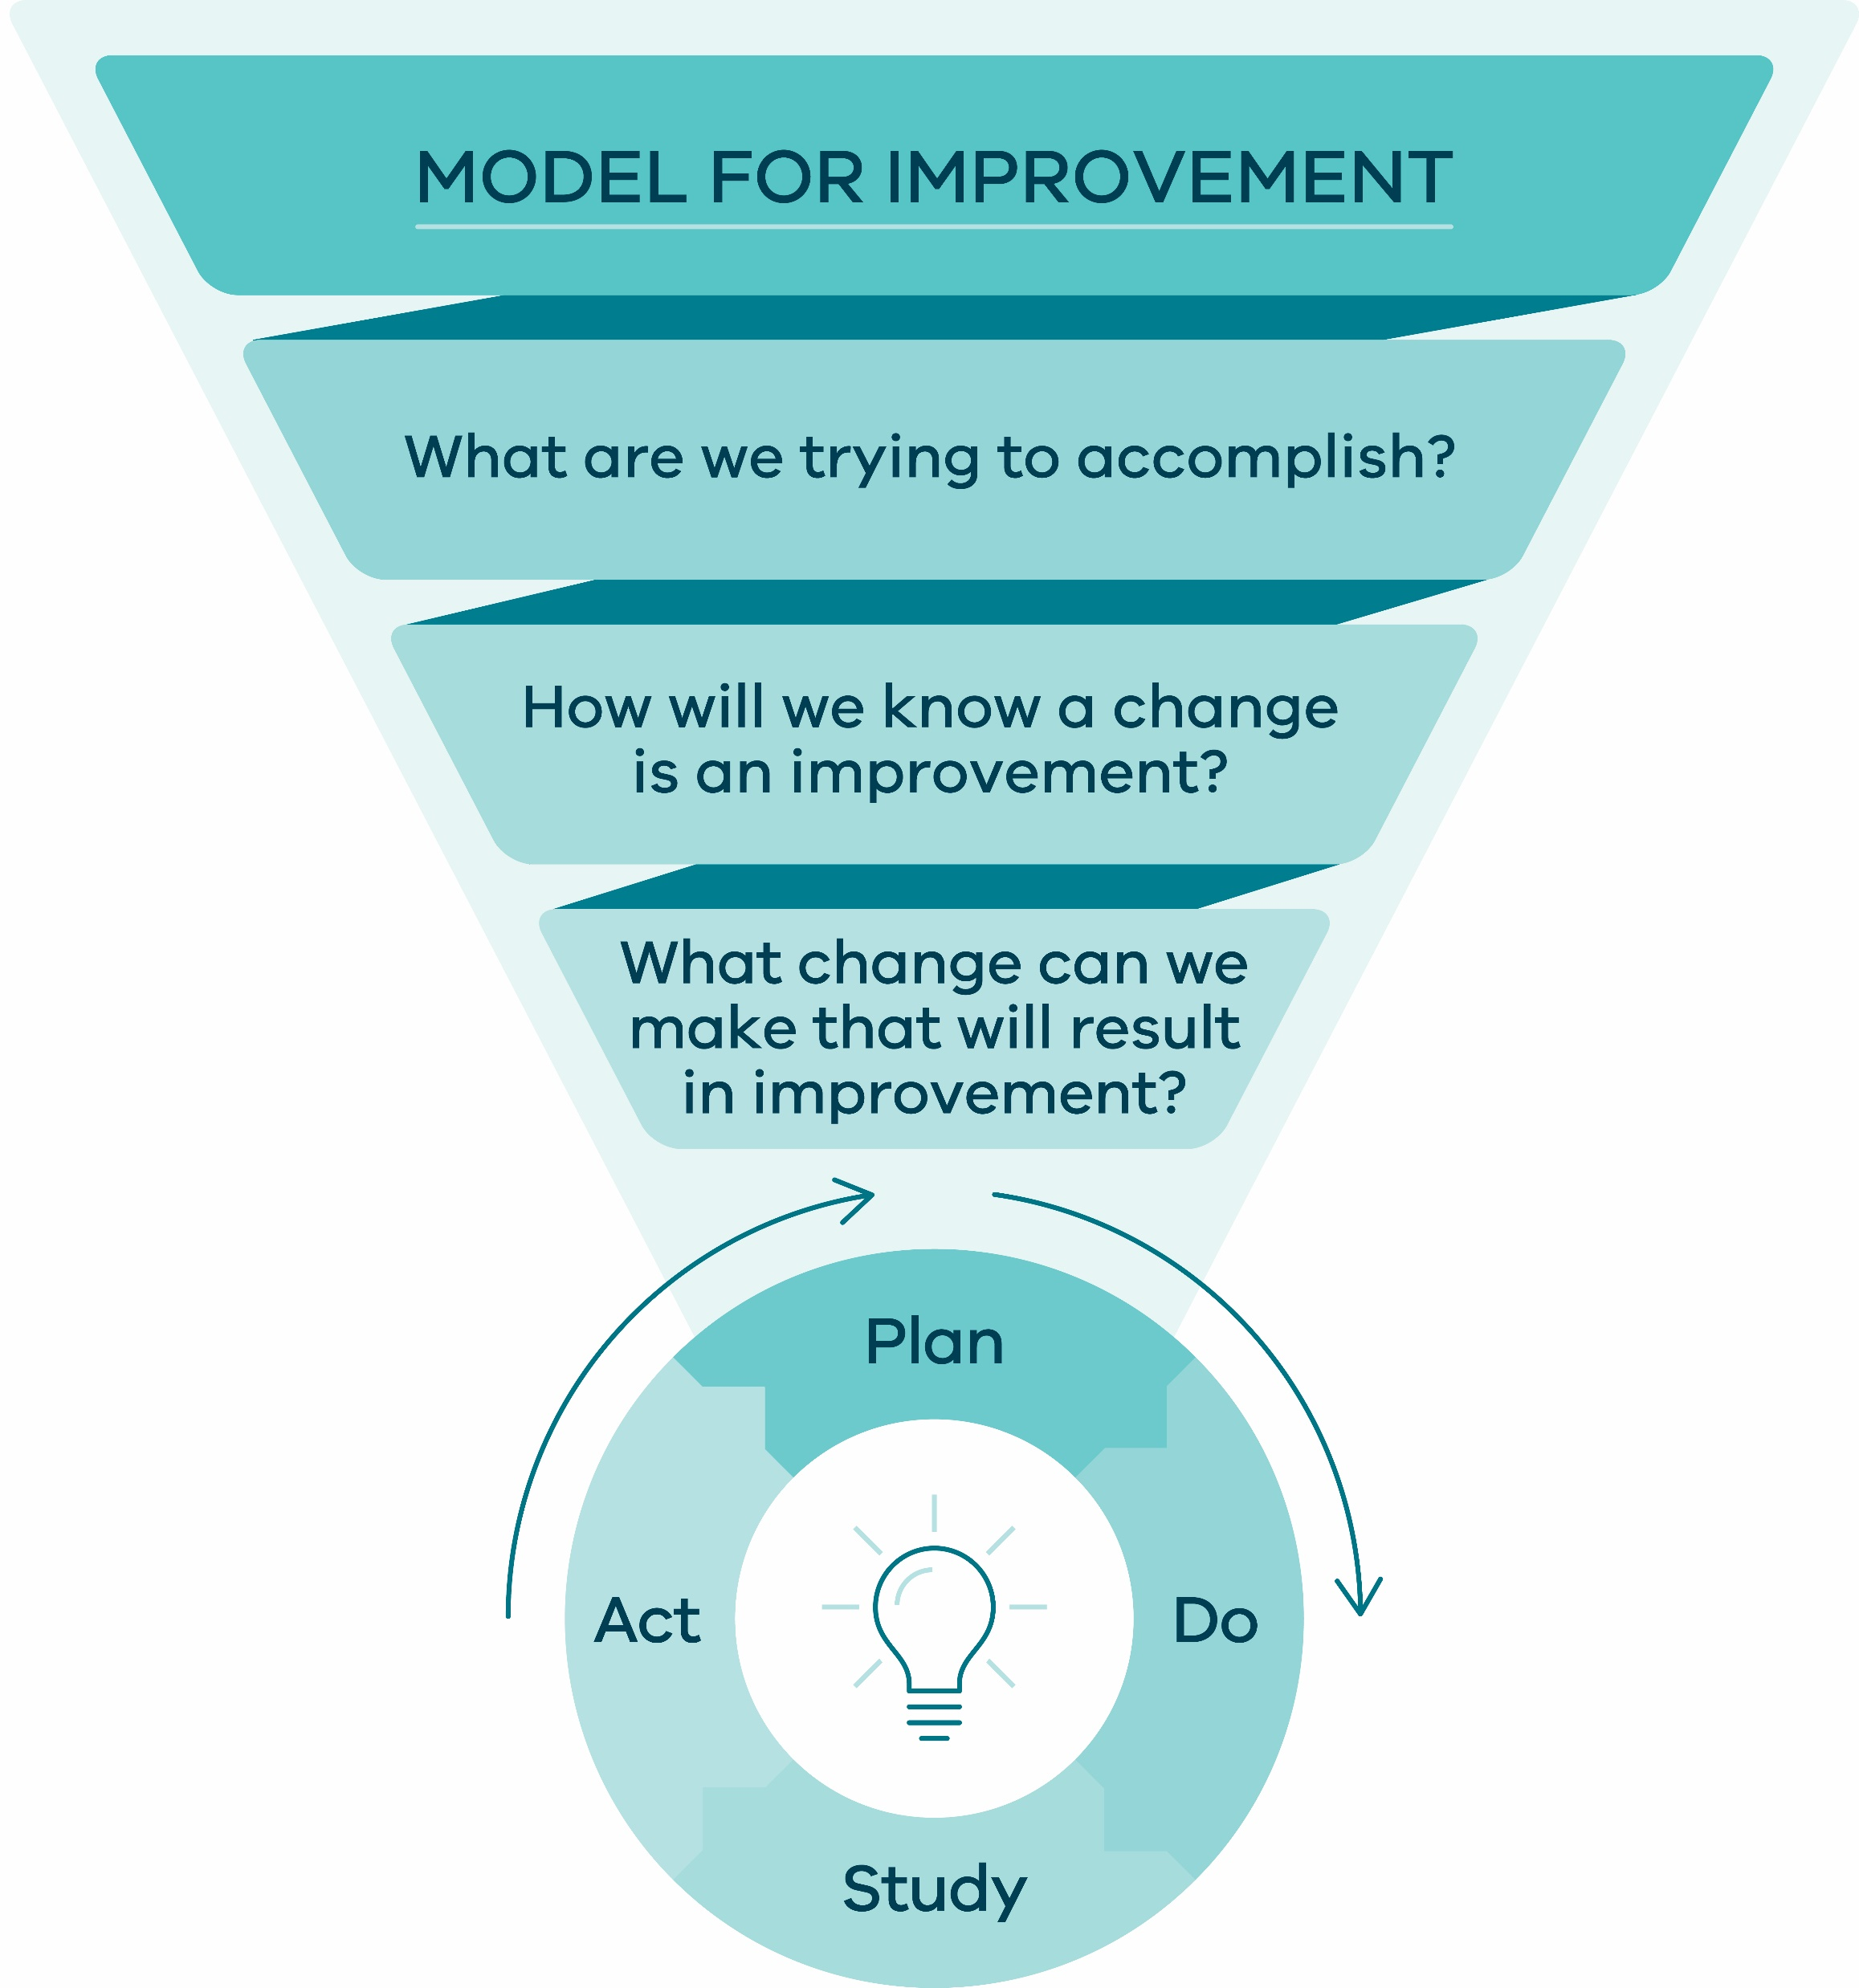
Establishing measures
Notes:
Slide 4:
Linking back to the Model for Improvement, we measure to answer the questions ‘how will we know that a change is an improvement?’
Source: Safer Care Victoria (2024) SCV Quality Improvement Tool

Slide 5
Goal of family of measures
Project measures / family of measures
Assess overall performance and success of a project
Align with the project’s aim
Provide a high-level view of whether the project is meeting its intended outcomes and objectives
Notes:
Slide 5:
We have discussed measuring effectiveness of PDSAs in Session 3, let’s now focus on the family of measures and how they are different.
Project measures (our family of measures) and measures used for a PDSA cycle are both related to the quality improvement processes, but they serve different purposes within the broader field of project management and continuous improvement.
Project measures provide an overall assessment of a project's success.
In most quality improvement projects, there will be several change ideas/PDSA measures feeding up into the family of measures to make an impact to the system at large.
Your project measures help you to understand the effectiveness and impact of multiple change ideas and how their implementation is helping to achieve your aim.

Slide 6
Data collection and measurement
Aspect | Improvement | Judgement for accountability | Clinical research
Aim | Improvement of care process, system and outcomes | Judgement, choice , reassurance, spur for change | New generalisable knowledge
Testing strategy | Sequential tests, observable tests | No test, evaluate current performance | One large test, blinded test
Bias | Accept consistent bias | Measures and adjusts to reduce bias | Design to eliminate bias
Sample size | 'Just enough’ data, small sequential samples | Obtain 100% of available and relevant data | ‘Just in case’ data
Hypothesis | Hypothesis flexible; changes as learning takes place | No hypothesis | Fixed hypothesis
Determining if change is an improvement | Run charts; Shewhart Charts | No focus on change | Hypothesis tests (T-tests, F-tests, Chi-square), p-value
Confidentiality of data | Data used only by those involved in Improvement | Data available for public consumption | Research subject's identities protected
Reference: Lief Solberg, Gordon Mosser and Sharon McDonald. The Three Faces of Performance Measurement: Improvement, Accountability and Research. Journal on Quality Improvement vol. 23, no. 3, (March 1997), 135-147
Notes:
Slide 6:
Not all measurement is the same but all approaches to measurement are valuable if used in the right context. This table looks at three of the main reasons we might collect data in healthcare.
Measurement for improvement
Measurement for judgement/accountability
Measurement for clinical research
In health care, people are often more familiar with measurement for performance (accountability) or research.
Some of the important distinctions between data collection and measurement for improvement and the other two categories include:
Improvement work is more accepting of bias. Improvement work seeks to test, learn and apply changes in the real world. The real world is messy and we need to embrace and work with the reality of messiness in our improvement work.
Data for improvement projects need to stay practical and try to reduce the burden of data. ​We don’t want the balance of work to be weighted in collecting the data and not actually focused on testing changes and improving the system.​
Improvement involves lots of little sequential tests that we adjust as we learn​. Things change – but we need to systematic and structured in documenting what we learn and how that learning influences decisions to adapt or adopt changes.
In improvement work our hypothesis is flexible based on what we learn along the way​.
Our sample size is ‘just enough’ rather than seeking a large data set​.
Improvement work involves real time analysis during change​.
The focus is on preventing an identified problem from occurring, rather than more structured research to explore and explain why the problem occurred​.
Ethics requirements for improvement work: You should always be guided by the ethics requirements of your organisation. Often ethics for improvement work are less complex as clinical trials/research, but it is important to ensure your work complies with local ethics requirements.
​
Reference: Lief Solberg, Gordon Mosser and Sharon McDonald. The Three Faces of Performance Measurement: Improvement, Accountability and Research. Journal on Quality Improvement vol. 23, no. 3, (March 1997), 135-147

Slide 7
How will we know change is an improvement?
‘All improvement requires change, but not all change leads to improvement’
Source: Fishbowl jump by Flickr under license: https://creativecommons.org/licenses/by/2.0/
Notes:
Slide 7:
Key points:
Measurement is critical to generate learning.
Good measurement will help prevent ineffective ‘busy work’.
Measurement will help us determine:
Is this change making a positive impact?
What is the best next action to take?
Are we on track to meet the aim of our project?
Are we making a difference?
Source: Fishbowl jump by Flickr under license: https://creativecommons.org/licenses/by/2.0

Slide 8
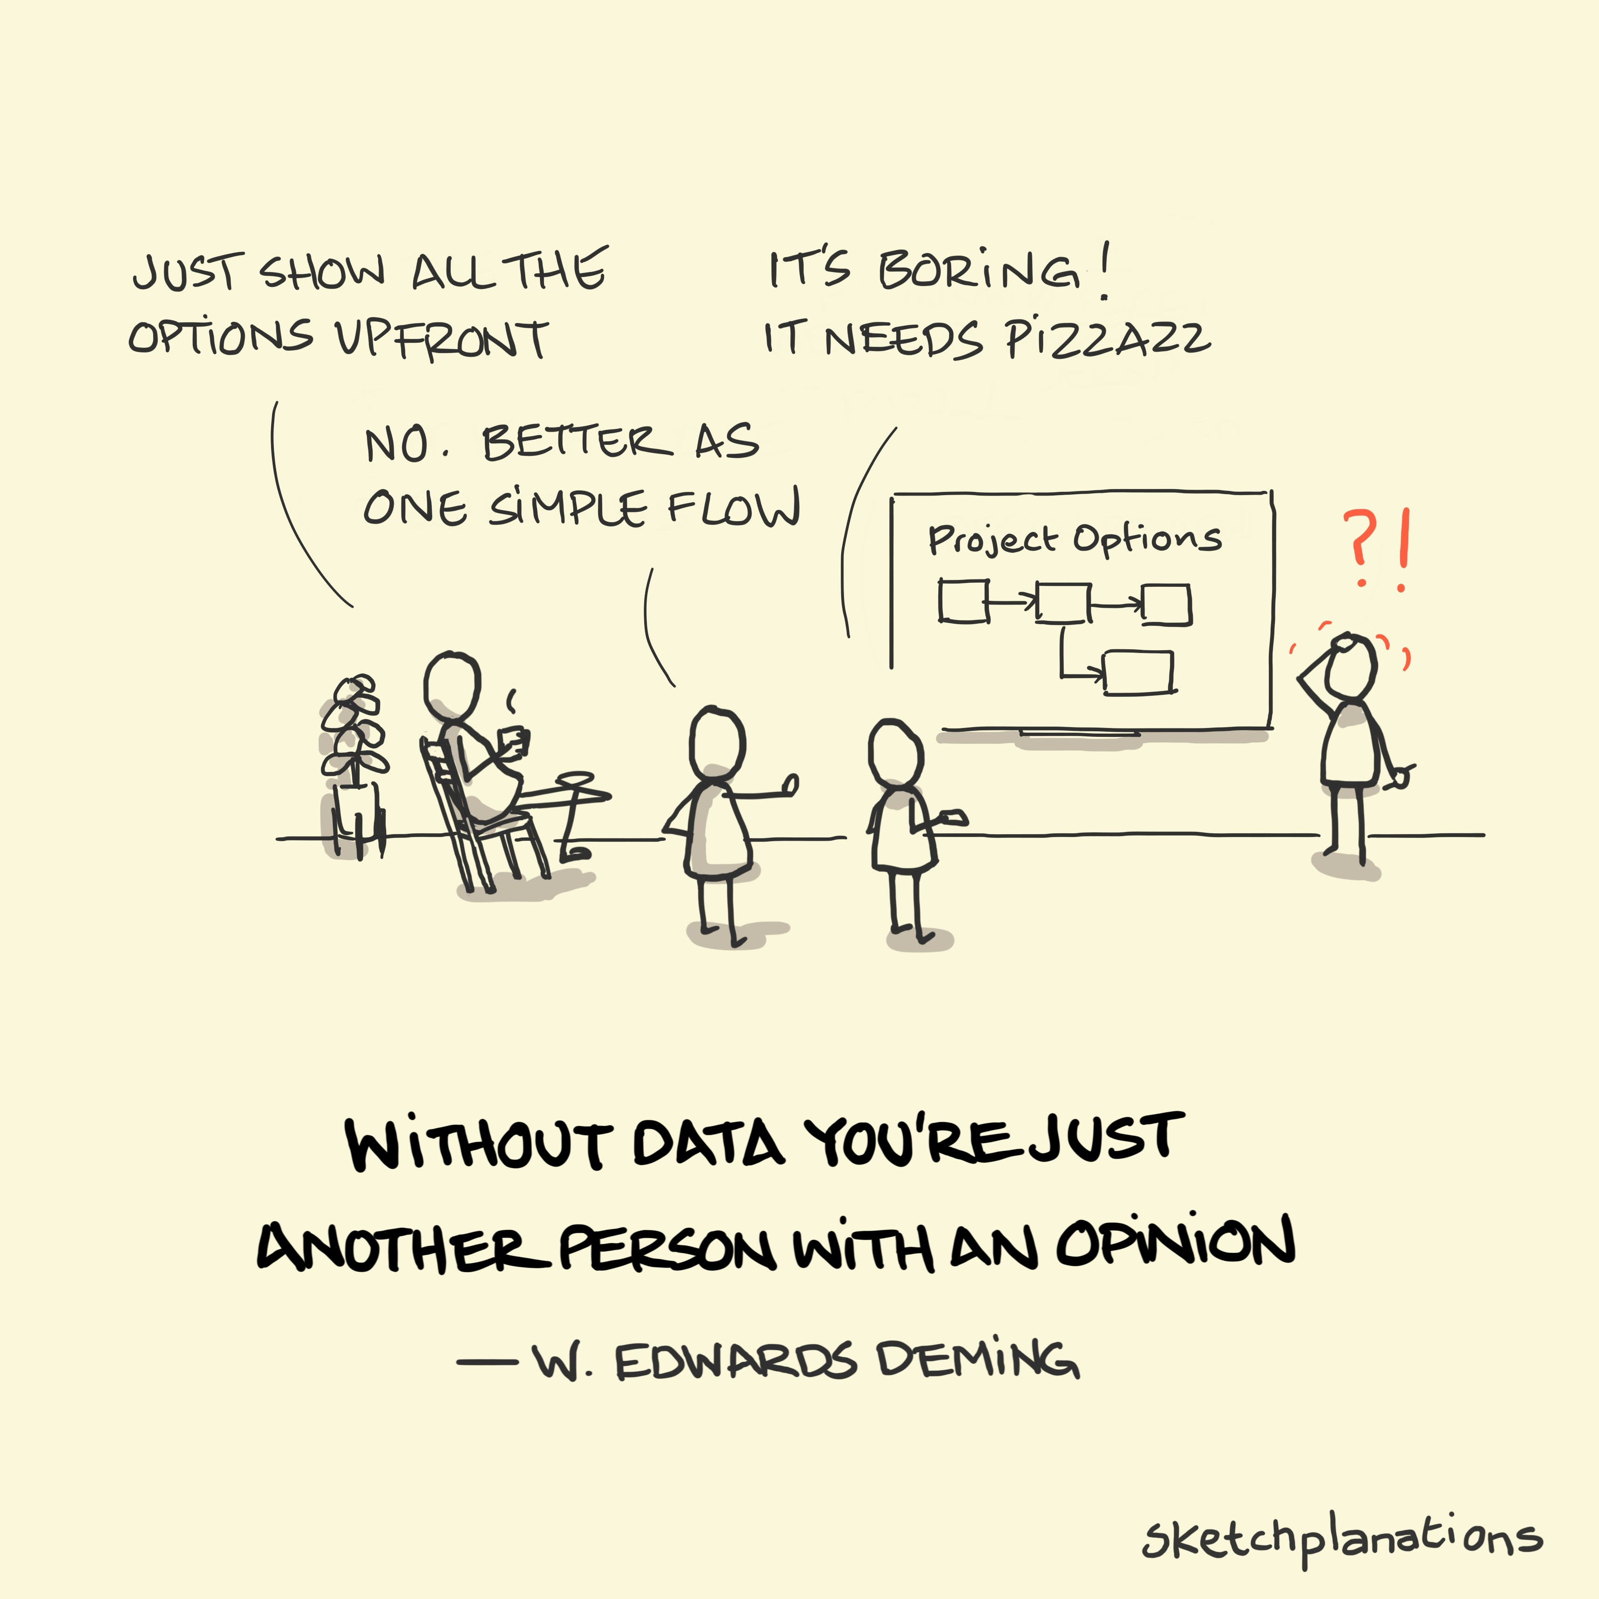
Data
Source: Without data you're just another person with an opinion by Sketchplanations under licence: https://sketchplanations.com/without-data Licensed under a Creative
Commons 4.0
Notes:
Slide 8:
Key points:
Without data you are just another person with an opinion.
Perception of what is occurring in a system is impacted by recency, bias and emotion. For example, there can be assumptions made about frequency and impact of a perceived problem where data might show the opposite.
Measurement is critical for an objective view of complex systems.
Importance of both qualitative and quantitative data to inform you measurement.
Source: Without data you're just another person with an opinion by Sketchplanations under licence: https://sketchplanations.com/without-data Licensed under a Creative Commons 4.0

Slide 9
Family of measures
Outcome measures
Process measures
Balancing measures
Notes:
Slide 9:
When thinking about measurement in improvement, there are a Family of Measures that we are interested in.
Outcome measure
Process measure and
Balancing measure
We will talk about the definitions on the next slide.

Slide 10
Family of measures: Three levels of measurement
What data will we collect? How will it be collected? How will we record and share it? How will we act on it?
Outcome
Process
Balancing
Voice of the consumer
Voice (pulse check) of the workings of the system
Looks at the impact the change may have on other parts of the system
Link directly to the aim
Unintended positive or negative consequence of your change
Determine if you are on track
Notes:
Slide 10:
Key points:
Improvement work involves developing and collecting outcome, process and balancing measures.
Outcome measures: Typically represent the voice of the consumer, relate directly to your aim and help determine if you are achieving your intended outcome (e.g. percentage of patients experiencing diabetic foot ulcers).
You would normally have 1 or 2 outcome measures for a project.
Process measures: Help you determine if you are doing the right thing to achieve your outcome measures. Like a pulse check on the inner workings of your system, they help you understand the voice of the system and determine if you are on track (percentage of patients with completed risk assessments).
You would normally have 3-5 process measures.
Balancing measures: Help determine if changes in one part of the system are impacting another part. They are defined at the start of the project and measured throughout the life of the project. They identify the unintended positive or negative consequences to the system (e.g. staff workload).
You would normally have 1-2 balancing measures.
Measurement also requires a clear data collection strategy. Make sure you plan for the data collection and analysis of your family of measures from the outset.
What data will we collect?
How will it be collected?
How will we record and share it?
How will we analyse it?
How will we act on the analysis?
Reference: IHI Professional Improvement Coach Program (2023)

Slide 11
Aim: Reduce number pressure injuries resulting in harm of high-risk patients over 65 on ward W by 20% within 12 months
OUTCOME MEASURE
PROCESS MEASURE
BALANCING MEASURE
Example:
No. pressure injuries
% pressure injuries
Rate of injuries
Example:
% of patients properly assessed
% of patients reassessed within 24 hours
No. times a patients is monitored or checked
Example:
Nursing staff time
Budget
Patient mobility after initiative
Ward average L.O.S
Reference: IHI Professional Improvement Coach Program (2023)
Notes:
Slide 11:
In this health-related scenario we can see how the outcome measures, process measures and balancing measures link back to the aim of the improvement project.
The aim is to reduce the number of pressure injuries. The outcome measure could therefore be the number of pressure injuries or the percentage of pressure injuries or the rate of injuries.
A process measure can see if we are on track with our improvement. In this example, a process measure could be the number of patients monitored or checked, or the percentage of patients reassessed in 24 hours.
A balancing measure looks at the impact to the system, including the impact on budget or time spent by nursing staff undertaking the assessments.
Reference: IHI Professional Improvement Coach Program (2023)

Slide 12
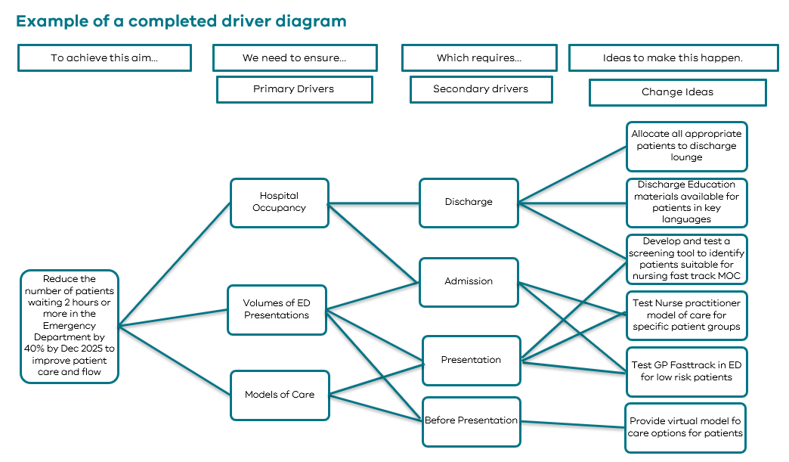
Family of measures example
Outcome measure:
Median number of minutes from triage to consultation
Process measure:
% patients referred to other services
% patients seen by different models of care
% clinicians using clinical plans
Balancing Measure:
Staff satisfaction/patient satisfaction
Number of representations in 72 hours
Source: Safer Care Victoria (Canto), 2024
Notes:
Slide 12:
NOTE: Animations in slide
In our example from the driver diagram from session 3, in our theory of change we have:
Outcome measure: median numbers of minutes from time of triage to consult.
Process measures:
% patients referred to other services
% patients seen by the different models of care with the department
% clinicians using clinical care plans
Balancing measures:
Patient and staff satisfaction
Numbers of representations within 72 hours
PDSA measure:
Would be related to your specific change ideas
Note: what you are testing in your PDSA – when you get to a certain point, then it will feed into process measures and your large project. E.g % of pts participating in the change.
Source: Safer Care Victoria (Canto), 2024

Slide 13
Activity 9: Family of measures
Continue with your assigned scenario.
Using the Family of Measures list, as a group, allocate each measure to its appropriate category.
Outcome measure
Process measure
Balancing measure
If you have time, consider what other measures you could come up or whether you would change any.
Pages 39-40 of workbook
10 Mins
Notes:
Faculty name:
Slide 12-13
Time: 10mins (activity)+ 5mins (discussion/debrief)
Allocate each measure to either an outcome, process or balancing measure.
Activity instructions
Continuing with your case scenario, we have provided you with a list of scenario specific measures. As a group, allocate each measure to its appropriate category:
Outcome measure
Process Measure
Balancing Measure
If you have time, consider what other measures you might want to include or whether you would change any of the ones provided.
Faculty notes:
Bring group back together to go through answers on slide 14.
Note: This activity can be made more interactive if the measures are printed out on cut-out cards and participants can move them to the correct category.

Slide 14
Activity 9: Family of measures
 | Scenario 1 – Reducing/ preventing falls | Scenario 2 – Improving attendance/ reducing wait times | Scenario 3 – Reducing theatre delay | Scenario 4 – Improving care
Outcome measure | Number of falls by months in ward X | % of appointments attended per week | % of patients that have surgery on the day booked | Weekly % of patients that report on discharge that care is consistent with that they said mattered most to them
Process measure | % of patients who have documented falls management plan in EMR/Medical file % of patients with falls assessment completed | Number of follow up calls made per week Time in waiting room from arrival to seeing the doctor | % of patients that received fasting information % of cancelled surgeries | % of patients with documented care plan that included what matters to them % of patients/families being asked ‘what matters to me’
Balancing measure | Number of pressure injuries | Staff satisfaction | Surgery waitlist time | Time (min) spent doing handover at bedside
Notes:
Slide 14:
NOTE: This is the solution for measure category activity (slide 13)
Run through the correct answers for each scenario.
Faculty discussion prompt: Ask if any of their answers were different or whether they added any measures? Ask for explanations about why they added/changed or chose a different category.
(A summary of the case scenario provided measures is also provided in the Faculty Guide section for this slide)
Key point:
- The solutions provided are not set in stone. It is important that a discussion is had about the differences, and reasons why people chose categories to embed learning about what each of the measure categories means (outcome, process and balancing).

Slide 15
Sustainability
Notes:
Faculty name:
Slide 15-18
Time: 10mins
In our final section, we will discuss what mechanisms and processes are needed to make change stick.
If we are working hard to test and learn how to improve our systems and the outcomes we can achieve, we also need to be thinking about we can prevent our achievements from slipping back into the way things were.
For example, often people are exposed to improvement work as part of a professional development program or on a rotation and then move on and the learning may be lost.
- But there are ways we can ensure that the hard work of the team can be sustained.

Slide 16
A new sustainable level of performance?
Change implemented
Change implemented
Previous level of performance
Previous level of performance
Current level of performance!
Current level of performance!
Notes:
Slide 16:
Post-implementation of our theory of change, we would hopefully be able to distinguish our previous level of performance from our new, current level of performance.
Sustainability is all about maintaining that new level of performance after the change has been implemented.
We need to continue to monitor performance over time to determine if a change has been sustained.
As with any system, there will be fluctuations in performance due to random variation and as mentioned earlier we don’t want to react to at any slight uptick or deterioration in performance after our change.
It is important to not celebrate too early. We want to avoid drawing conclusions from a ‘sugar hit’ a short-term spike in improved performance before it returns to the previous level of performance.

Slide 17
The bigger picture
Iterative learning
Risk mitigation
Engagement and collaboration
Data-driven decision making
Culture
Source: Arrows showing up by Flickr under license: https://creativecommons.org/licenses/by/2.0/ Source: This is the real red button by Flickr under licenese: https://creativecommons.org/licenses/by-nc/2.0/
Source: Hands grouped together in a huddle by Freerange under license: https://creativecommons.org/publicdomain/zero/1.0/ Source: Dashboard Week Day 1 – Analysing Stock Performance on ASX by the data school under license: https://creativecommons.org/licenses/by-nd/4.0/
Source: Colorful people png holding hands by raxpixel under license: https://creativecommons.org/publicdomain/zero/1.0/
Notes:
Slide 17:
This program is focused on building your foundations level skills for quality improvement.
At this foundations level you will be conducting you PDSAs and testing your change ideas at a small scale. This can often feel very removed from the lofty goals or changes you want to see happen in your system.
Let’s look at some ways to starting small contributes to the bigger picture:
Iterative Learning
Small Scale: By implementing incremental changes and running small PDSA cycles, teams can observe the immediate impact of these changes and learn from the results. It is important to remember – “from little things big things grow”, chances of integrated sustained change is enhanced by testing small and building a degree of belief in our change ideas.
Bigger Picture: The iterative learning process allows organizations to accumulate knowledge and insights over time. This knowledge can then be applied to larger-scale improvements and strategic initiatives.
Risk Mitigation
Small Scale: Testing changes on a small scale helps identify potential risks and unintended consequences in a controlled environment.
Bigger Picture: Mitigating risks at a small scale minimizes the chances of major disruptions when implementing changes organization-wide. It enhances the likelihood of successful and sustainable improvements
Engagement and Collaboration
Small Scale: Involving frontline staff and consumers in small-scale testing fosters engagement and collaboration, as they become active participants in the improvement process.
Bigger Picture: A culture of continuous improvement is cultivated throughout the organization. Employees at all levels and consumers can feel empowered to contribute ideas and solutions, creating a collaborative and innovative environment
Data-Driven Decision Making
Small Scale: Running small PDSA cycles involves collecting and analysing data to inform decision-making.
Bigger Picture: The data generated from small-scale tests provide a foundation for evidence-based
Culture
Small Scale: Involving frontline staff and consumers in small-scale testing fosters a culture of continuous improvement at a local level.
Bigger Picture: Builds organisational culture for continuous improvement.
Source: Arrows showing up by Flickr under license: https://creativecommons.org/licenses/by/2.0/ Source: This is the real red button by Flickr under licenese: https://creativecommons.org/licenses/by-nc/2.0/
Source: Hands grouped together in a huddle by Freerange under license: https://creativecommons.org/publicdomain/zero/1.0/ Source: Dashboard Week Day 1 – Analysing Stock Performance on ASX by the data school under license: https://creativecommons.org/licenses/by-nd/4.0/
Source: Colorful people png holding hands by raxpixel under license: https://creativecommons.org/publicdomain/zero/1.0/

Slide 18
Sustainability
Collaboration
Integration
Risk mitigation
Celebrate the wins
Governance and reporting
Identify champions and those that will continually reinforce and provide communication about the improvement.
Partner with people who reflect the diversity of the system or process you are trying to improve​
Bring a systems thinking mindset.
How does this change impact the wider system?
Are there other processes or goals that may impact or can join forces for a wider project?
Small scale helps identify potential risks and unintended consequences in a controlled environment. ​
​
It enhances the likelihood of successful and sustainable improvements
Share stories about the wins and the learning that have occurred to your team and a wider audience.
The level of oversight may change depending the scale or complexity of a project.
Who do you go to for approvals?
Who has final say?
Reference: Adapted from Future Proof Policymaking by Wild Thinking Studio (2024)
Notes:
Slide 18:
To ensure your quality improvement lasts, it's important to think about these key areas at the beginning and throughout your QI journey.
These five principles can be applied to sustaining a change idea but also to your overall project goal.
Collaboration: We spoke about this a lot today. Quality improvement cannot be done alone. We need to collaborate with those most affected by and who have control over what we are trying to improve. Having people on your team that can champion your quality improvement efforts is also very important.
Integration: How does this change fit into the wider system? Knowing your role and the role your project sits may lead to wider spread of the improvement work or linkages with other work.
Involvement: Ensuring you have the people most affected by the improvement on your team means you will have diversity of ideas and greater understanding of the process you are trying to improve.
Celebrate the wins: Improvement is also about sharing the wins and telling stories to the wider community about your progress. Don’t get too focused on the tasks that you don’t celebrate the big and small success you have along the way!
Governance and reporting: Ensuring you are keeping the right people in the loop is integral to the success of any quality improvement project. For example, have you considered who your executive sponsor is? How is your work connected to your organisation’s Quality Improvement and Clinical Governance team? And what kind of reporting is required, or that you need to help share the improvements you are working on and the lessons you are learning?
Reference: Adapted from Future Proof Policymaking by Wild Thinking Studio (2024).

Slide 19
Summary, questions and feedback
QI in Action has covered:
Evaluation of this program
Create conditions of change to enable quality improvement.
Understand how your system works to help identify where and when change can occur.
Use the Model for Improvement as a framework for improvement projects.
Use quality improvement tools and methods to understand the problem, set a goal, design, and implement the solution, evaluate the outcome, and sustain improvement.
And finally, we touched on how to sustain our change.
Add QR code to evaluation form here.
Notes:
Slide 19
Thank you for participating in QI in Action. We have covered a lot of content across the 4 sessions including:
How to set the conditions for change and support our improvement effort.
How to identify who is needed to make the improvement work and to ensure we have a wide range of perspectives and views, including from consumers, at each step of our improvement process.
We learnt about our system and how to look at data to find common and special cause variation and how to display data to tell a story.
We then worked through the Model for Improvement to learn how to set an aim, come up with change ideas, and document and undertake PDSA cycles to test our ideas in the real world, under a variety of conditions.
QI in Action Session 4: Measuring and sustaining success we learnt about an improvement project’s family of measures that help measure the impact our theory of change is having in the system.
And finally, we touched on how to sustain our change.
Evaluation
As any QI practitioners we like to use data to help refine and improve our work. Please take a minute to complete the course evaluation using the QR code on the screen.
Faculty prompt: Introduce your evaluation here. Add QR code for your evaluation questionnaire/form to the slide. An example has been provided in Attachment 1 with the QI in Action package.

Slide 20
Continue your learning: Quality and safety tools and training | Safer Care Victoria
Thank you
Notes:
Slide 19:
Thank you
Continue your learning: Quality and safety tools and training | Safer Care Victoria
(https://www.safercare.vic.gov.au/improvement/tools-frameworks-training/quality-improvement)
Faculty prompt: Add in details for any internal training or learning resources here

