Slide 1
Using this slide deck
Purpose
This slide deck is one of the supporting resources for health services using the Clinical Governance Maturity Matrix (CGMM). The slide deck has been designed to be used to guide communication about implementing the CGMM.
This includes supporting health services to prepare presentations for executives, staff and consumers to:
Introduce the CGMM self-assessment
Provide an overview of the CGMM self-assessment process
Explain why the health service is using the CGMM self-assessment
SCV encourages adaption of the slides to meet the needs of your health service
Additional communication resources
Information in this slide deck, as well as the CGMM Factsheet can also be used to develop other formal communication materials (e.g., emails to all staff, leaders and those completing the assessment)
Please see Communication Guidance for further information on sharing CGMM results, which can be found in Appendix 1 of Part 2: Self-assessment Guide – Outcomes and Improvement.

Slide 2
Using this slide deck
Disclaimer: This document was accurate at the time of distribution from Safer Care Victoria.
Health services are welcome to adapt the content for use within their own organisations to suit local context. However, any edited versions must not be redistributed externally or presented as official Safer Care Victoria material.
Safer Care Victoria cannot guarantee the integrity, accuracy, or currency of this content if it has been obtained from external or unofficial sources.

Slide 3

Clinical Governance Maturity Matrix
[Introduction template - editable]

Slide 4


Acknowledgement of Country
SCV acknowledges the strength, power, and resilience of Aboriginal people as members of the world’s oldest living culture. We recognise Aboriginal people as Australia’s First People and honour the richness and diversity of all Traditional Owners across Victoria.
We respect the lore, customs, and languages practiced by Aboriginal people in Victoria, and their deep spiritual and cultural connections to land and water. We are committed to a future based on equality, truth, and justice, and recognise the ongoing systemic injustices faced by Aboriginal people. Victoria’s treaty and truth-telling processes offer a chance to address these wrongs, empowering Aboriginal people to make decisions for their communities.
We pay our deepest respects to ancestors, Elders, and leaders, past and present, whose strength and fortitude have paved the way for future generations.
Kevyn Morris | Creek colours

Slide 5
Contents
01 | Clinical governance and why we are assessing our maturity
02 | How we will assess our clinical governance maturity
03 | The CGMM self-assessment process
04 | Questions and discussion

Slide 6
Clinical Governance and why we are assessing our maturity
01

Slide 7
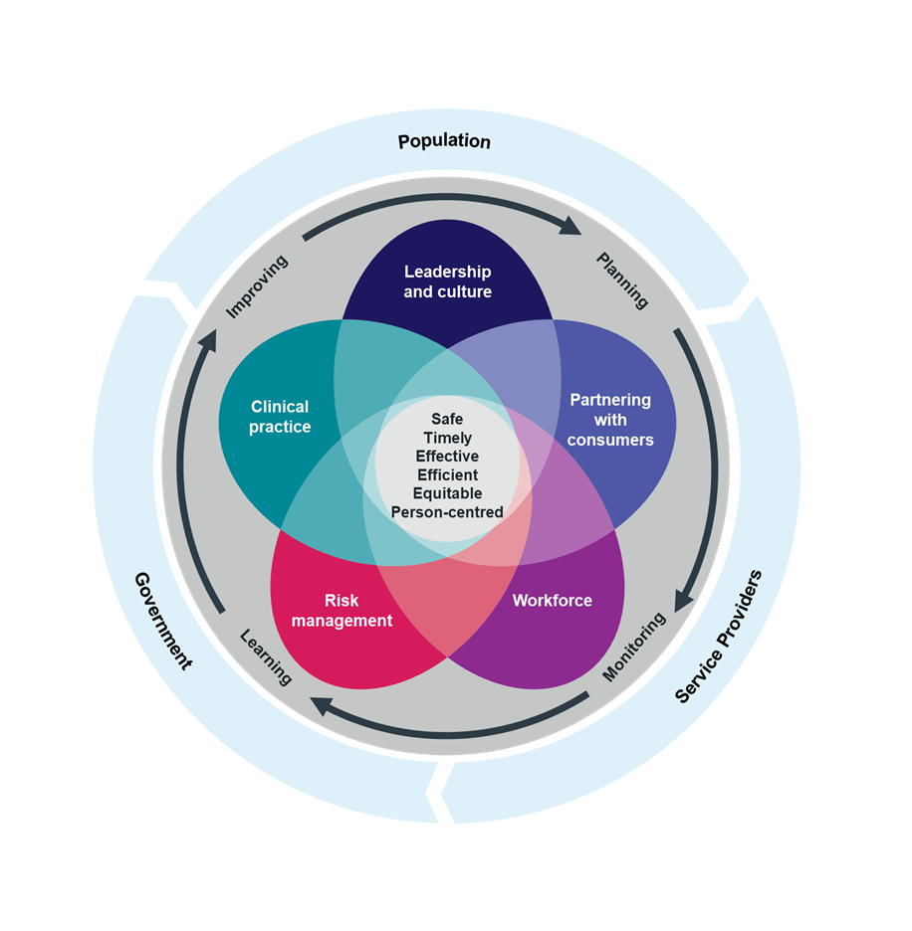
Clinical Governance
What is Clinical Governance?
A system of accountability within health services
Focused on continuous improvement of care quality
Ensures high standards of care are maintained
Clinical Governance:
Is defined by five interrelated domains
Supports high-quality care for every consumer, every time
Must be integrated into broader governance arrangements

Slide 8




Why assess clinical governance maturity?
Clinical governance maturity describes how well our health services has embedded the systems, culture and leadership required to deliver safe, high-quality care.
Assessing clinical governance maturity helps us to:
    Understand our current state
    Recognise our clinical governance strengths
    Identify opportunities for clinical governance improvement
Maturity is not a static state – it evolves as we improve capability, engage meaningfully with consumers, and build a culture of safety and learning

Slide 9



Our objectives
Undertaking a clinical governance maturity assessment enables us to:
Identify and celebrate our clinical governance strengths
Identify our clinical governance gaps (improvement opportunities)
Prioritise clinical governance improvements
Plan to improve our clinical governance arrangements
What is working well?
How do we make sure we continue to do those things well?
Monitor improvements over time
What areas are letting us down?
Where can we improve?
Where should we start?
What is most important / urgent to address?
What can we change to improve?
How will we know we are getting better?

Slide 10
How we will assess our clinical governance maturity
02

Slide 11

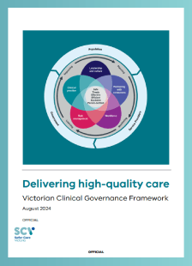
The SCV Clinical Governance Maturity Matrix
We will use the Clinical Governance Maturity Matrix (CGMM) workbook to complete our assessment. The CGMM workbook is a practical tool that will help us to understand how well our clinical governance systems and processes support safe, high-quality, person-centred care.
The CGMM is:
Grounded in the Victorian Clinical Governance Framework (VCGF)
Aligns with national clinical governance standards
The CGMM will:
Provide a structured approach to assess our clinical governance maturity
Provide insights into our strengths and improvement areas
Helps us move beyond baseline compliance
Supports us to build robust systems that empower our staff and promote shared accountability
Notes:
We will use the SCV Clinical Governance Maturity Matrix to assess our current maturity. The CGMM consists of a collection of resources that will guide us through an organisational self-assessment of our clinical governance systems, processes and culture to identify strengths and growth opportunities. We will use the results to plan and implement clinical governance improvements.

Slide 12



CGMM Resources
Part 1: Self-assessment guide - Preparation and completion
Introduces the CGMM and outlines practical steps for planning and conducting the self-assessment.
The CGMM workbook is supported by a collection of additional resources, including for example two resource guides and an improvement plan template, built into the workbook.
Preparing for the CGMM
CGMM EXCEL WORKBOOK
This excel workbook is the clinical governance self-assessment model.
The workbook provides tabs with auto generated visual results and clinical governance improvement planning, to allow documentation and tracking of improvement activities and monitor progress.
The Clinical Governance Improvement Plan template tab is designed help plan key activities, responsibilities and timelines for each improvement goal
Completing the CGMM
Part 2: Self-assessment guide - Outcomes and improvement plan
Supports interpretation of results, identification of improvement priorities and development of targeted actions.
Results and improvement planning
Together these resources will guide us through an organisational self-assessment of our clinical governance systems, processes and culture to identify strengths and growth opportunities.

Slide 13
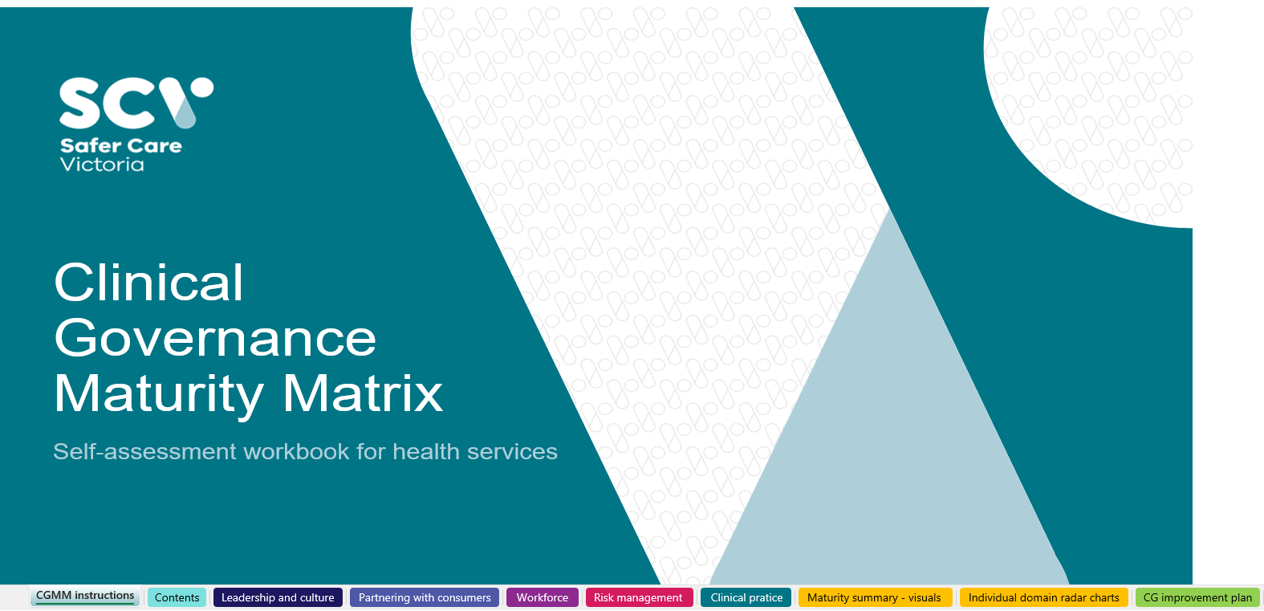


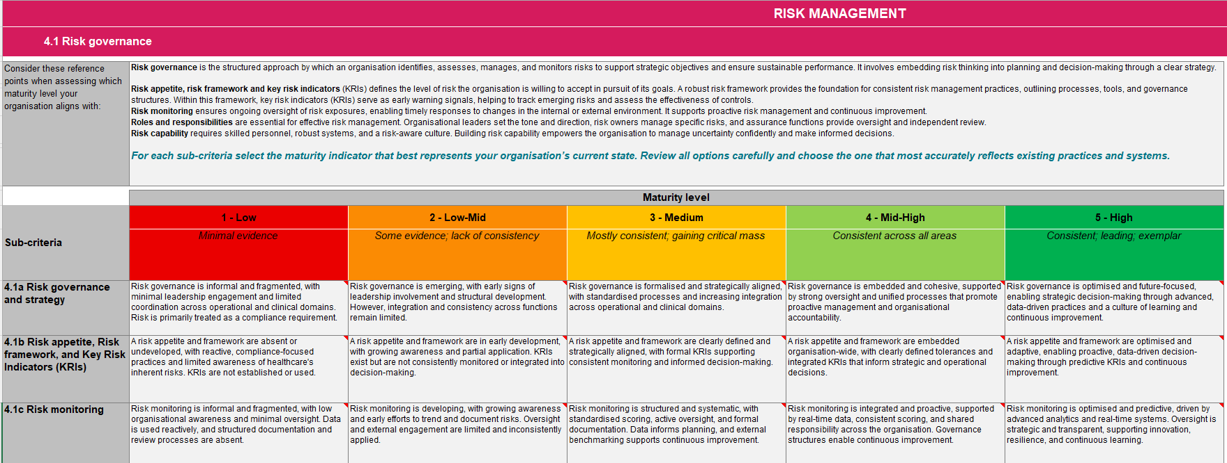




The CGMM self-assessment workbook
This is the key CGMM resource, it includes:
Clear step-by-step instructions to guide you through the process
Domain-based maturity self-assessment for all clinical governance areas
Automated visual outputs, including radar charts and a heatmap for easy interpretation
A structured improvement plan template to priorities and track actions
Each clinical governance domain tab includes:
Clinical governance domain title
Domain criteria
Criteria information
Sub-criteria
Maturity statements
Key attributes of each maturity level
Key attributes of this maturity level:

Slide 14
Understanding maturity levels and scoring
Each clinical governance domain sub-criterion is assessed on a five-level scale from Level 1 (low) to Level 5 (high), level 3 generally reflects expected standards
Ratings reflect the maturity of clinical governance practices at a point in time
Maturity ratings are used to:
  Highlight strengths
  Identify opportunities for improvement
  Encourage reflection on how clinical governance is embedded
Lower scores may highlight gaps, but can also reflect transparency and a learning culture
Importantly, when assessing our clinical governance maturity, we must be aware of our context, and set goals that align with our capability, size and context.

Slide 15
The CGMM self-assessment process
03

Slide 16
Self-assessment cycle overview
The CGMM self-assessment process aligns with the improvement cycle outlined in the VCGF: Plan, Monitor, Learn, Improve (Victorian Government, 2023). This cycle provides us with a structured approach to adopt the ideal clinical governance mindset to translate maturity findings into meaningful action
Prepare the organisation and key stakeholders to undertake the SCV CGMM self-assessment
Plan
Monitor
Improve
Learn
Use the findings to inform actions and drive clinical governance improvement
Analyse and reflect on findings to understand current maturity, gaps and strengths
Complete the self-assessment using the SCV CGMM tool

Slide 17
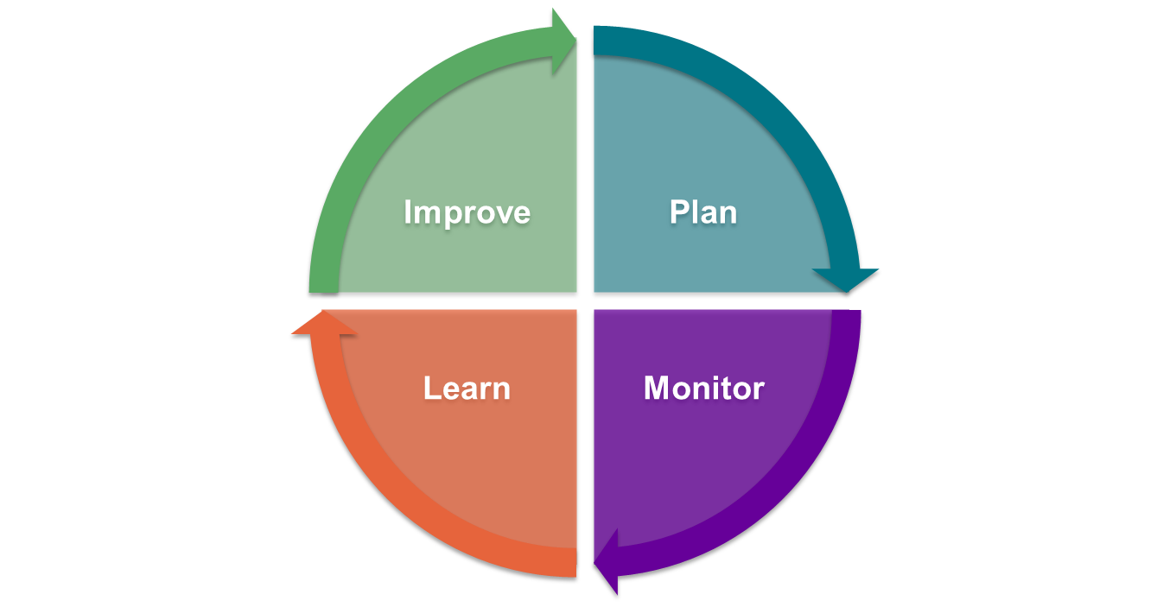
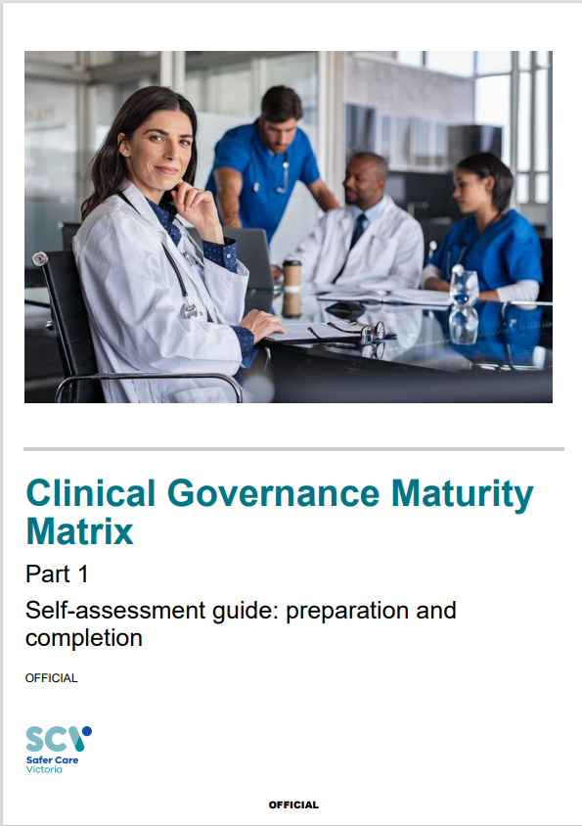

Plan
A well-structured plan is essential to ensure we are ready to undertake the SCV CGMM self-assessment.
This step involves setting up our team, establishing our approach and aligning resources and timelines for the assessment.
Key considerations:
    Who is best placed to contribute and inform the self-assessment?
    What systems and processes will support completion of the self-assessment?
    What data will we need and who will collect it?
    What approach will work best for our context
Use the CGMM Part 1 self-assessment guide: preparation and completion during the planning phase

Slide 18
Who will be involved?
Role | Key responsibilities | Suggested organisational roles
CGMM assessment coordinator/s | Prepare the health service for the assessment Advocate for the CGMM assessment Co-ordinate administration of the CGMM assessment | Director Clinical Governance Director Quality and Safety
CGMM assessment participants | Actively participate in the CGMM assessment process by invitation of the coordinator Champion the assessment outcomes and improvement activities | Members of the Executive team, Heads of departments, managers and general workforce including nurses, medical and allied health professionals, diversity and Inclusion leaders’, administrative staff and consumer advisors
Clinical governance improvement | Participate in the CGMM assessment Promote and support participation in the CGMM assessment Remove barriers for broad participation across the health service Take accountability for the CGMM results Take accountability to improve clinical governance Report the CGMM results and improvement plan to the health service board | Health service Executives and Directors Senior leaders
 | Take accountability to improve clinical governance Report the CGMM results and improvement plan to LHSN clinical governance leaders | Board members Executive team

Slide 19

What data can we use to inform maturity?
We will use existing data
We will draw on quantitative and qualitative evidence from across the five domains
Data will help us validate maturity ratings and supports robust discussions
The CGMM Part 1 self-assessment – preparation and completion guidebook provides examples of data, including:
Leadership and culture
Partnering with consumers
Workforce
Risk management
Clinical practice
People matter survey
Safety culture tools
Staff forums
Clinical governance framework
Leadership walk around schedules
Use of VHES results in service design
Consumer feedback mechanisms
Consumers on committees
Consumer resource development
Workforce turnover data use
Capability development programs
Training uptake
OVA incidents
Demographic data collection
Risk framework
Risk appetite statements
Risk registers
SAPSE reporting
Clinical risk committee
Incident classification
Clinical audits schedules
M&M meetings
Clinical communication aids
Models of care
MDT meetings
Escalation pathways

Slide 20

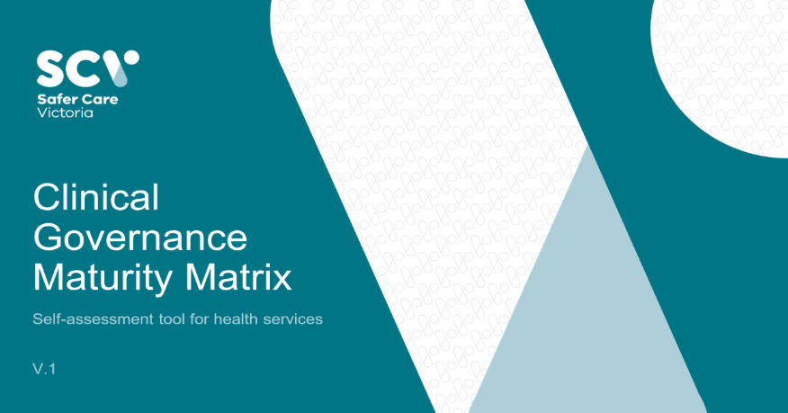
Monitor
Completing the self-assessment is a collaborative process that benefits from:
  open discussion and reflection
  shared understanding
  accurate documentation
Key considerations:
    How will we ensure shared understanding of the maturity levels?
    What facilitation methods will support open and inclusive discussion?
    How will we document insights and decisions during the assessment?
    Do we need tailored sessions for specific domains or teams?
Use the CGMM Part 1 self-assessment guide: preparation and completion and CGMM Workbook during the monitoring phase

Slide 21
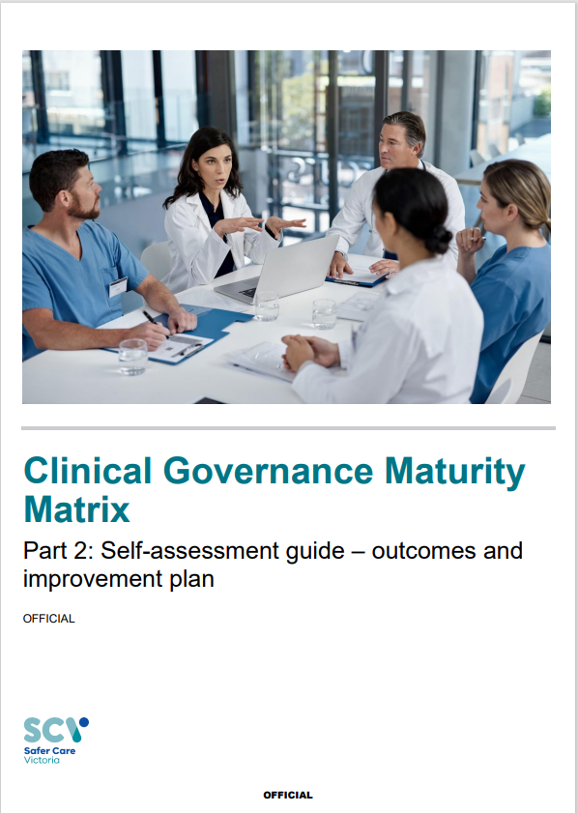
Learn
The learn stage is an opportunity to:
  Validate insights
  Align with strategic priorities
  Prepare for action.
Key considerations:
  What do the results tell us about our current governance maturity?
  Which areas show excellence and how can we celebrate them?
  What gaps have emerged across domains?
  Where are the quick wins that can build momentum?
  How do these findings align with our strategic goals?
Use the CGMM Part 2 self-assessment guide: outcomes and improvement plan and the Improvement Tab in the CGMM workbook

Slide 22
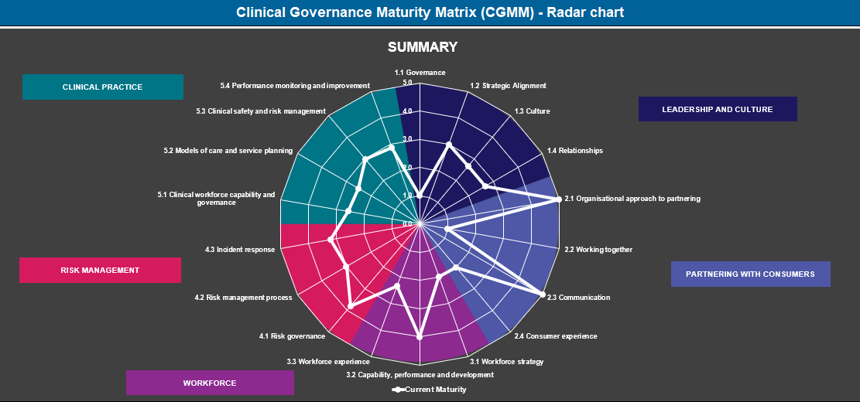
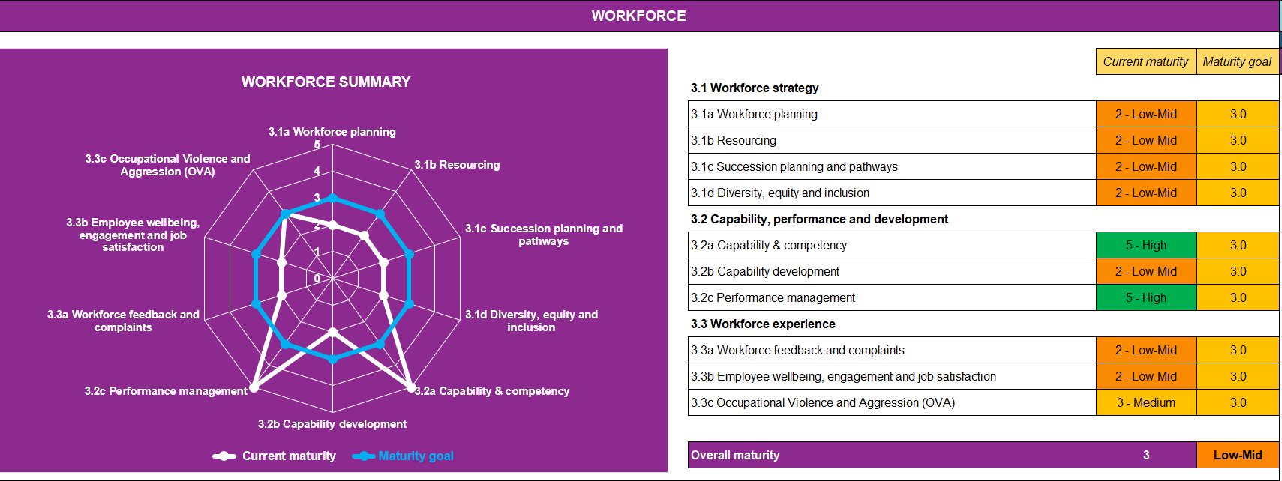
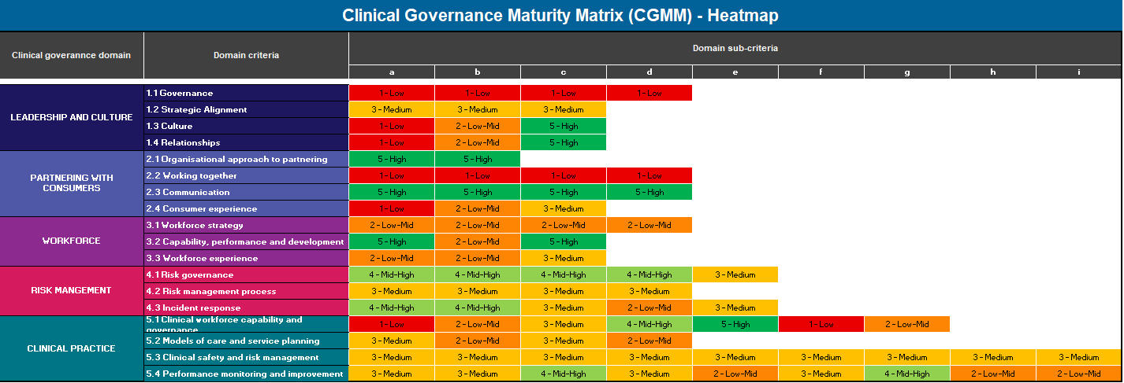
Maturity Summary - radar charts and heatmap
The CGMM workbook provides several visual summaries of maturity assessment outcomes:
Radar Charts: displays maturity across clinical governance domains and criteria, highlighting strengths & opportunities.
  Maturity Summary radar chart: Summarises clinical governance maturity across all domains
  Individual clinical governance domain radar Charts: Provides a more in-depth visual of maturity by domain sub-criteria, and includes our maturity goal
Heatmap: provide a colour-coded overview of maturity by sub-criteria and enables quick identification of strengths and gaps

Slide 23




Identifying strengths and gaps
Engage key participants and leaders to interpret self-assessment results, fostering shared ownership and transparency.
Highlight areas of strong maturity to recognise successful practices and sustain what’s working well.
Use lower maturity scores to investigate root causes, barriers, and enablers for improvement
Ensure findings are meaningful and actionable by reflecting the organisation’s unique context
Use the Clinical governance improvement plan to document, prioritise, and track clinical governance improvements, including key steps towards improvement

Slide 24
Improve
This stage is about translating insights into meaningful action by:
  Celebrating strengths
  Addressing gaps
  Embedding governance improvement into ongoing organisational work
Key considerations:
  What are our top 3-5 priorities emerging from the results?
  Who is best placed to lead each action, and how will we support them?
  What timelines and milestones will help us stay on track?
  How will we monitor progress and adjust our approach if needed?
  When and how will we reassess our clinical governance maturity?
Use the CGMM Part 2 self-assessment guide: outcomes and improvement plan and the Improvement Tab in the CGMM workbook

Slide 25



Embedding a cycle of continuous improvement
The CGMM self-assessment is most valuable when embedded into our annual planning and improvement
    We will conduct the self- assessment annually to allow:
    Progress tracking
    Plan updates
    Ongoing capability building
    Continuously improve
The CGMM is not a one-off task – it’s a tool for supporting sustainable, continuous clinical governance improvement

Slide 26

Questions and discussion

Slide 27
Need help?
If you require support during your clinical governance maturity assessment, please reach out via email to:
Culture.capability@safercare.vic.gov.au

